Slide 1
Pastoral Care in Pluralistic Contexts moving beyond fear to focus on the individual Part One
Rev Dr. Phil Kuehnert
Lutheran Pastoral Care in Pluralistic Contexts
Mercy Conference and Retreat Center, St. Louis,
October 28, 2014

Slide 3
Where we are Going
First, Some introductory comments that places these two presentations in the context of my life and in the world of Specialized Pastoral Care.
Second, I will focus my topic, Lutheran Pastoral Care in Pluralistic Contexts, with the question, “Does Lutheran Pastoral care demand confessing Christ?” I will attempt to respect The challenges provided by "Pluralism" reflecting the latest permutation of New Age thinking on the one hand and "Pluralistic Contexts" reflecting the inter faith settings that some SPM work is done in on the other hand.

Slide 4
Where we are Going
Third, By reviewing Luther’s/Lutheran “theology of the Cross” and by introducing a simple matrix for incorporating the Law-Gospel dialectic in pastoral care, I will describe what I feel is the uniqueness of LUTHERAN pastoral care.
Fourth, With this “Lutheran Uniqueness” in mind, I will struggle with the question: What serves as a normative pattern for being a “Christ Confessor?”

Slide 5
Where we are Going:
Fifth, I ask the critical question, “Can specialized forms of pastoral care, including chaplaincy, CPE, and pastoral counseling be expected, as a norm, to be a part of the Church’s evangelization.
Sixth, I will give you the opportunity to grapple with two examples from clinical settings: 1. First a Pastoral Counselor trainee reflecting on her calling. 2. A verbatim. I will ask you to analyze the verbatim using the Law Gospel Matrix.
Finally, I make a proposal on how Pastoral Care specialists, who seek to be Christ Confessors working in pluralistic contexts might, through small group peer supervision, focus their witnessing/ confessing Christ.

Slide 6
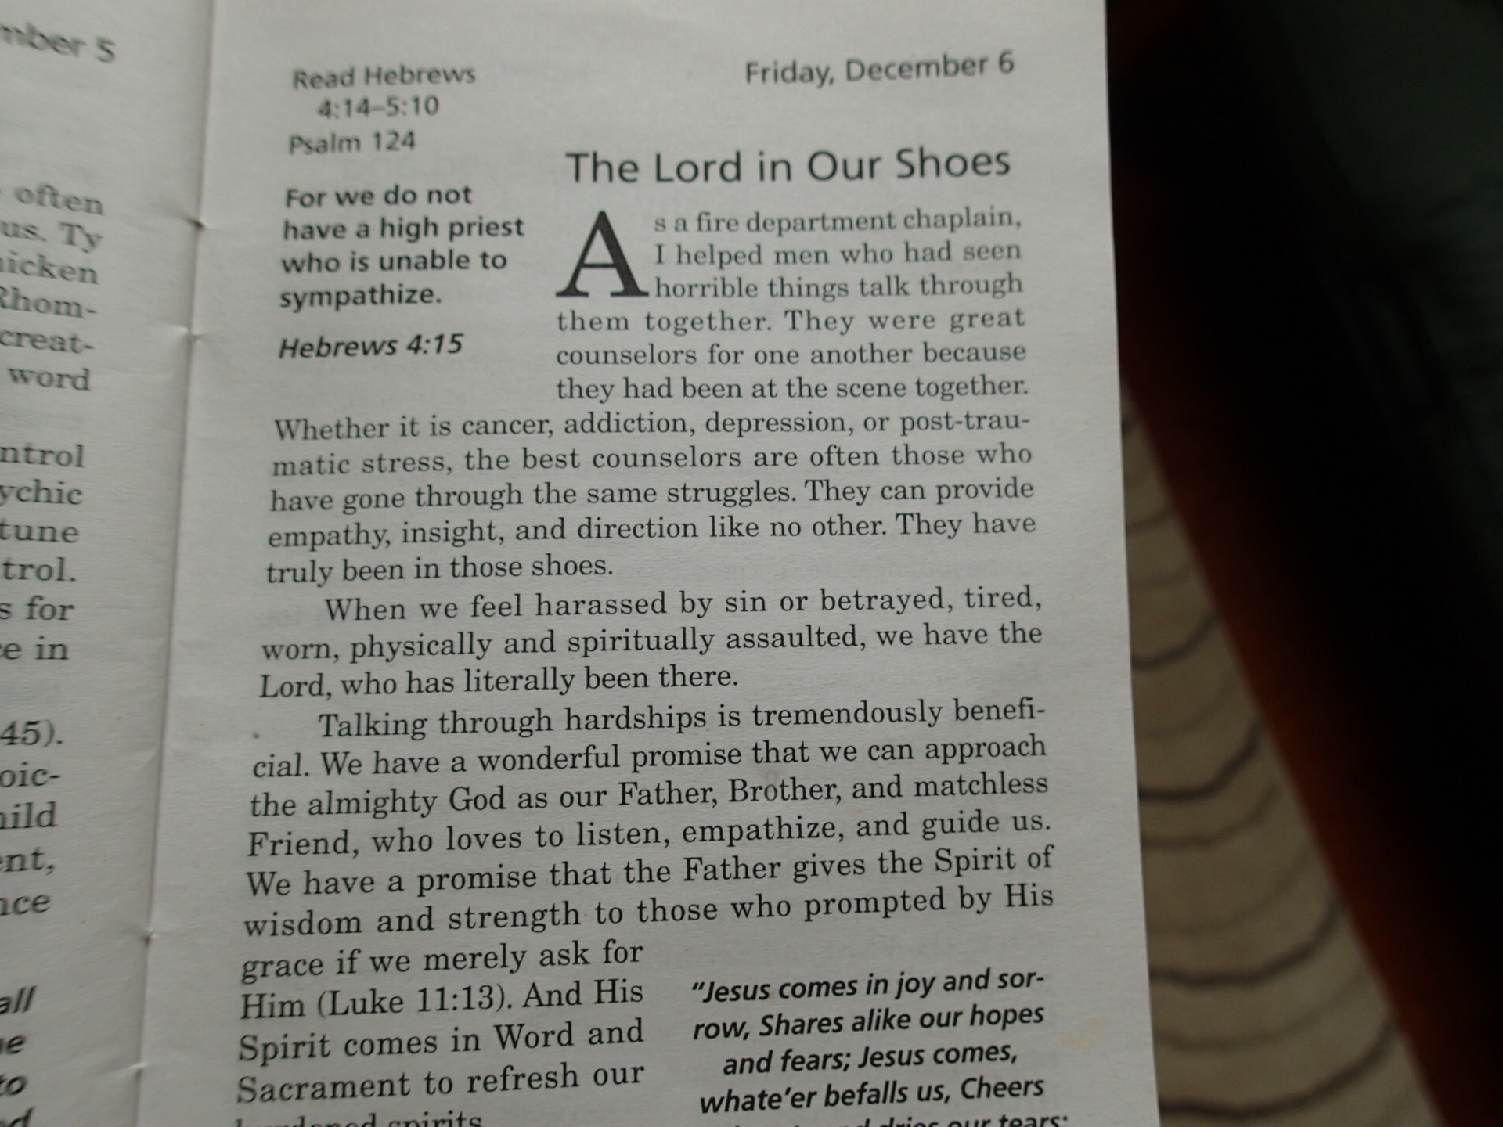
Portals of Prayer, Dec 6th 2013

Slide 7
Chaplain Henry Gerecke

Slide 9
Chaplaincy is Everywhere!

Slide 10
OTHER SPMs are almost INVISIBLE
Where is CPE…. Where is Pastoral Counseling?
Pastoral Care and pastoral care.
In spite of the fact that we are all unique “living human documents” is there a base line of practice for Christian Pastoral Care?
…..for Lutheran Pastoral Care?

Slide 11
A Nod to Stephen Ministry

Slide 12
The Challenge
Specialized Pastoral Ministries (CPE, Chaplains, Pastoral Counselors) have a bye when it comes to being evangelists (Christ Confessors) in inter faith settings.
Specialized Pastoral Ministries (CPE, Chaplains, Pastoral Counselors) DO NOT have a bye when it comes to being evangelists (Christ Confessors) in inter faith settings.

Slide 13
Pluralism – A definition
a recent, distinct and flexible theological outlook that seeks to interpret and manage the plurality of religious traditions by way of a reductionism that homogenizes their distinctive message of salvation, minimizes their substantial differences with regard to the relationship of God to the world, and relativizes their shared concern for deep truth.”

Slide 15
Pluralistic Contexts
Interfaith settings – where Christians are peers with Muslims, Jews, and other faith traditions. Most University Medical Centers.
Government and many Corporations which are consciously a-religious.
The Military
College Campuses
The shock of the Real World of Chaplaincy

Slide 16
Chaplaincy in the Age of Pluralism
The Free Range Ministry of the Church
Where SPMs serve.
Emma Churchman
Cage and Sigalow
Neutralizing
Code Switching

Slide 17
The Critical Issue for the Christian Chaplain
Can a chaplain/SPM utilize “neutralizing” or “code-switching” without compromising their ability to “confess Christ?”
St Paul on Mars Hill? Neutralizing? Code Switching?
The ease with which a SPM can forget the imperative to “confess Christ.”
Unless there is a someone who has the courage to name it! To whom are SPMs accountable? Who holds the SPM accountable?

Slide 18
Denominational Endorsement Professional Credentialing
Chaplaincy credentialing agencies required denominational/religious organization endorsement.
ELCA and LCMS in their respective manuals (very similar because of their shared DNA) use similar language.
“….seek to extend the love of God in Jesus Christ to persons – any and all persons… Those involved in these ministries declare and demonstrate Christ’s love by providing spiritual and pastoral care, advocacy, and the opportunities for service.”

Slide 19
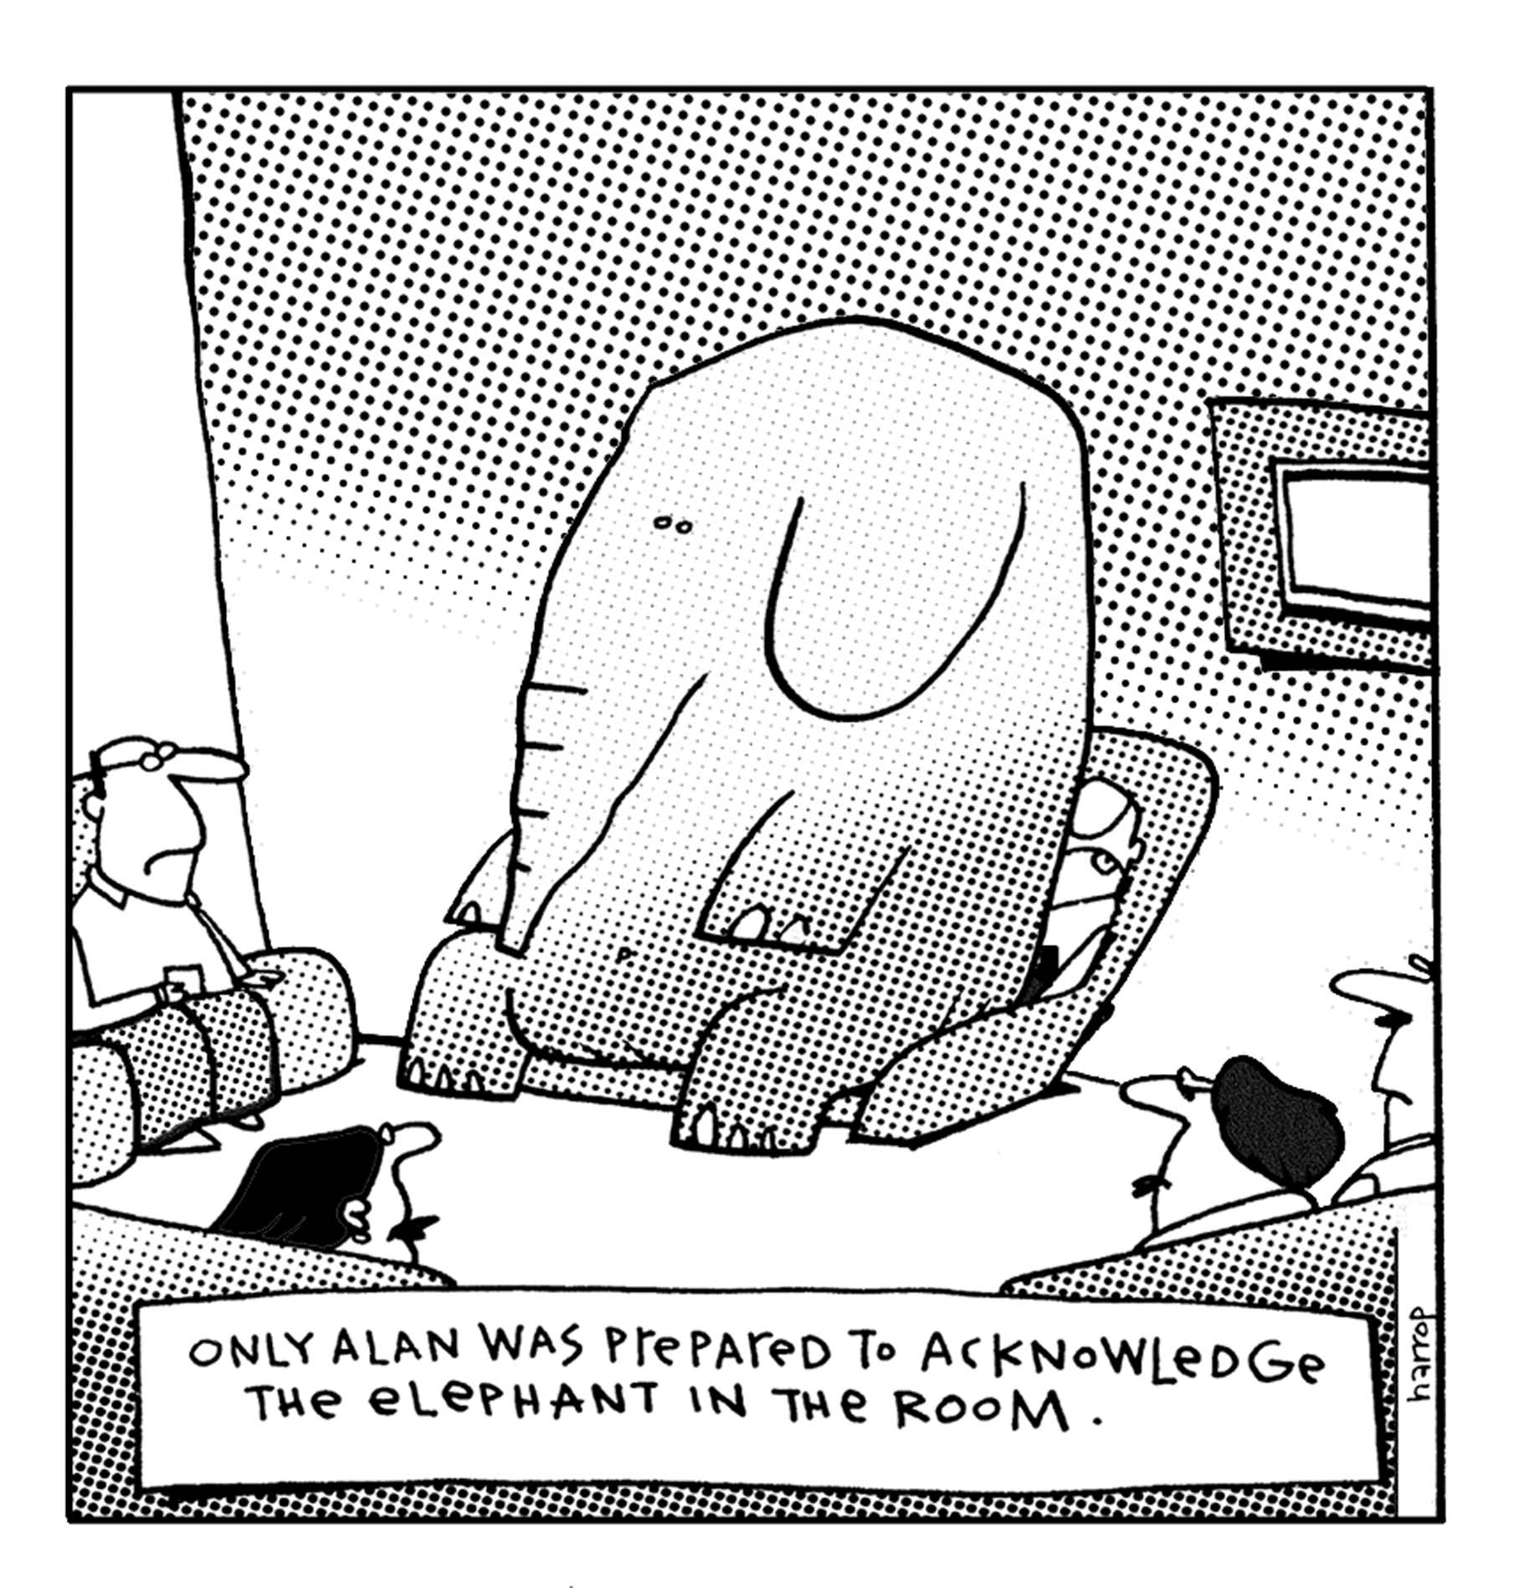
The Critical Issue (again!)
The Elephant in the the Room….?
Evangelism?
The reality of working for and being paid by secular organizations.

Slide 20
The Theology of the Cross
First, the Theology of the Cross encourages us to be honest: “A theology of glory calls evil good and good evil. A theology of the cross calls a thing what it actually is.” Thesis 21, Heidelberg Disputation
Mortal Life: Medicine and What Matters in the End Atul Gawande, Doctored – The Disillusionment of an American Physician Sandeep Jauhar
Second, The Theology of the Cross becomes the place where the caregiver comes along side the care receiver as a fellow sufferer.

Slide 21
Theology of the Cross
Third, The Theology of the Cross forces sufferers to acknowledge humbly and penitently deus absconditus.
Finally, the Theology of the Cross provides seminal language for both the “Cry” and the “Response.” The “Cry” is the guttural, even silent, scream under the curse/pressure of the Law. The “Response” is the dynamic of the Gospel lived out in relationship and in Sacrament.

Slide 22
Law Gospel Distinction The Matrix – Step One External Diagnosis
1. The client comes motivated to seek help with pain/anxiety, or in less than optimal situations, to please someone who has encouraged them "to seek counseling."
2. The Pastoral Counselor...following protocol, has the authority of the profession to do a thorough history ( at GAPC, we were encouraged to take up to three sessions just on history!)
Chaplains/SPMs – it depends on setting

Slide 23
The Matrix – Step Two Internal Diagnosis
1. Counter transference becomes a key resource for the Christ confessor
2. Do chaplains/pastoral counselors feel secure enough in their collegial relationships to seek consultation when they know their counter transference issues are blinding them.? And can they apply it theologically for themselves and their patients/clients.
3. "Out of the depths" - for the patient/client this is where God's criminate activity is being felt. The "cry" in whatever form - anger, despair, depression, revenge, etc.

Slide 24
The Matrix – Step Two Internal Diagnosis – cont’d
4. At this stage, the covenantal relationship is being established and a common vocabulary is formed. The Christian chaplain at this point can already, stealthily, begin to seed the common vocabulary of the relationship with words that have the potential to set the stage for confessing Christ.
5. The chaplain/pastoral counselor sees herself/himself already bound in a covenantal relationship with the care receiver, aware also that care receiver is, or has the potential to be in a covenantal relation with God.
6. Now the cry, using the new vocabulary, becomes vivid. In humility and with great patience, the Christian chaplain, pastoral counselor joins her/his voice in the cry.

Slide 25
The Matrix – Step Three Eternal Diagnosis
1. How does the cry (of the client/patient) become an echo of THE CRY of dereliction from the cross? Is that necessary before Christ becomes a response?
2. Are some psalms benign enough for our plural society to accept them as a universal expression of the cry? This raises the whole issue of the use of Scripture. Depending on the theological/spiritual background (Level 1 stuff) of the patient/client, the reading of scripture maybe a bridge.

Slide 26
The Matrix – Step Three Eternal Diagnosis
3. If the person and presence and words of the chaplain/pastoral counselor is the embodiment of The Word, can there be such a thing as guidelines, encouragements, protocols for "confessing Christ" with words?
4. There is a profound difference between proclaiming and witnessing, but each is dependent on the ability to connect/engage with congregation/parishioner /client/prisoner/patient.
5. Is there secular language that can be used to acknowledge God's judgment?

Slide 27
The Matrix – Step Four Eternal Prognosis
The response to “the Cry.” God does respond and God responds in a way that is structured, personal and universal.
The “sweet swap”. How is that Spoken? What language/words need to be proclaimed
Confession and Absolution.
The place of the Sacraments (yikes!)

Slide 28
The Matrix – Step Five Internal Prognosis
The proclamation of the Gospel, becomes specific to the needs of the care receiver. (Level two: the intra psychic anxiety and the care provider’s issues)
Parity is achieved?
The use of media resources – printed and other.
e. g., Walter Wangerin’s As for Me and My House, C. S. Lewis’s Mere Christianity, Bonhoeffer’s Life Together, and Richard Rohr’s Breathing Underwater – Spirituality and the Twelve Steps.

Slide 29
The Matrix – Step Six EXternal Prognosis
For the chaplain/pastoral counselor, the challenge is to honor “the holy Christian church, the communion of Saints.”
Sustainability of care is provided by the worshipping community gathered around Word and Sacrament.

Slide 30
SO FAR….
In the pluralistic world that we live in, the confessing Christian, understandably, is filled with fear, or at least hesitancy – and the SPM may want to take a bye on the imperative to “confess Christ.”
I have introduced two Lutheran tools – the Theology of the Cross, and a Law Gospel Matrix that is designed to function in Specialized Pastoral Ministry.

Slide 31
And on Thursday
Covenantal (or synonyms) Language becomes a frame for “Cry” and “Response.”
I will take steps three and four of the L G Matrix and explore theologically and practically how those two steps can be important for confessing Christ.
A Brief look at Campus and Military Ministry
Finally, a modest proposal for encouraging one another (accountability) to confess Christ.

