Slide 1
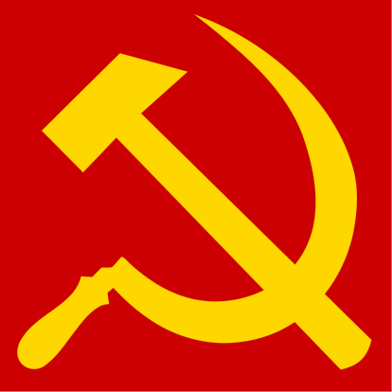
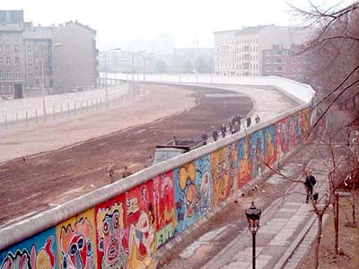


The Cold War
For Students of European History

Slide 2
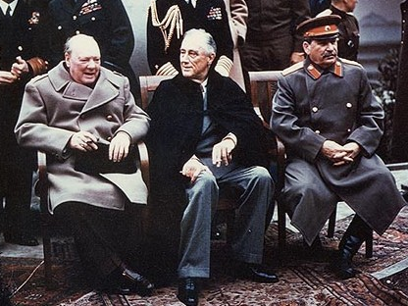
Yalta Conference
February, 1945
The “Big Three”
  FDR (US)
  Churchill (UK)
  Stalin (USSR)
Partition of Germany
“Sphere of Influence”
    Poland/Security

Slide 3
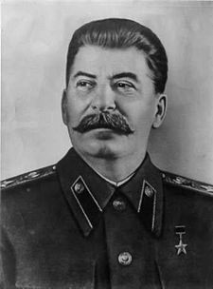
Joseph Stalin
General Secretary of Communist Party
    1922-1953
“One death is a tragedy. A million deaths is a statistic.”

Slide 4
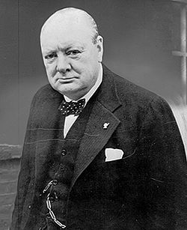
Sir Winston Churchill
British Prime Minister
    1940-45, 1951-55
Defeated in 1945 elections
Leader of Opposition in the late 1940s – still active in foreign policy
“Iron Curtain”

Slide 5
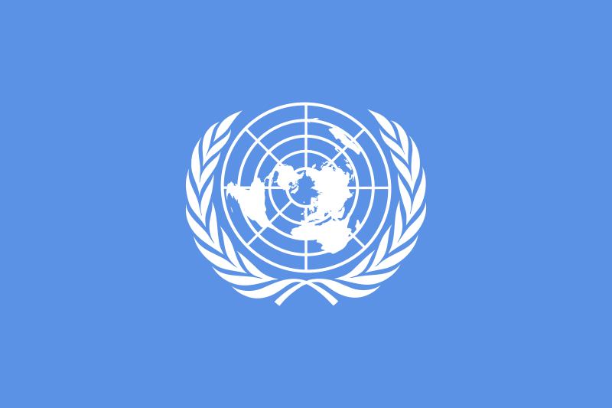
United Nations
Founded 1945 to replace League of Nations
Security Council
  Allies get permanent seats
    United States
    Great Britain
    Soviet Union
    France
    China

Slide 6
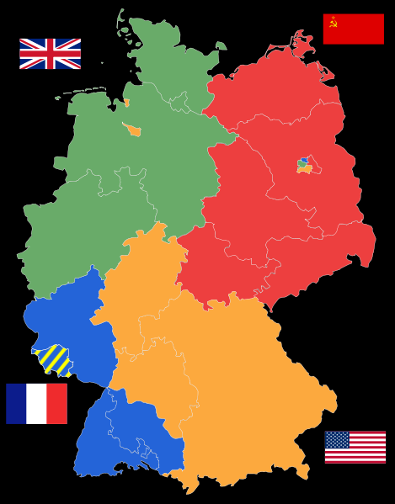
Allied Occupation
1945
Germany split into four zones of occupation
Berlin (inside Soviet Zone) was also split into four zones.
“Trizone”

Slide 7
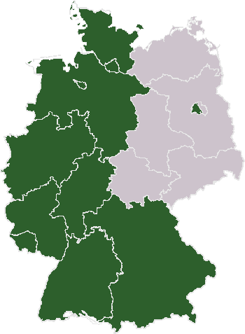
East and West Germany
1949
Federal Republic of Germany (West Germany) Established
  Trizone and W. Berlin
Soviets establish a communist government in East Germany.

Slide 8
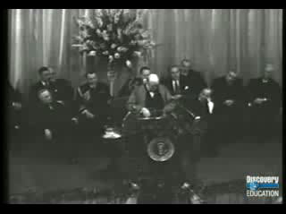
Churchill’s “Iron Curtain” Speech
March 5, 1946
Westminster College
Fulton, Missouri

Slide 9
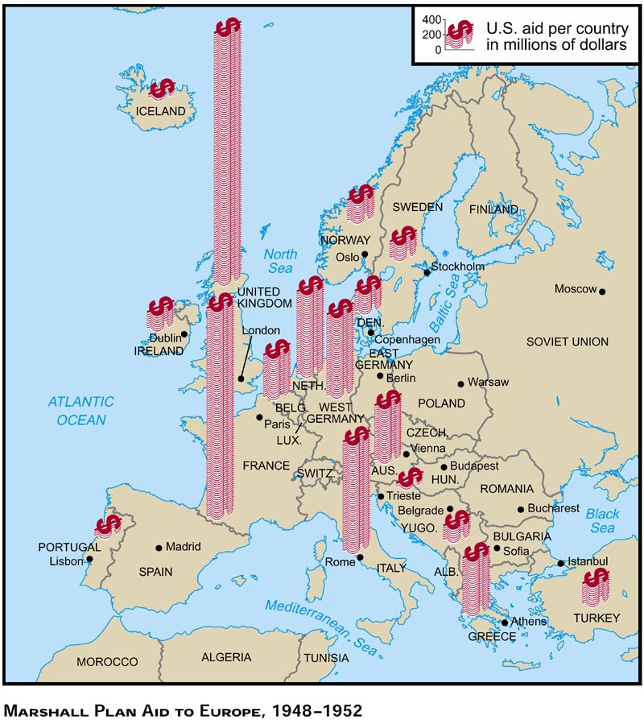

Slide 10

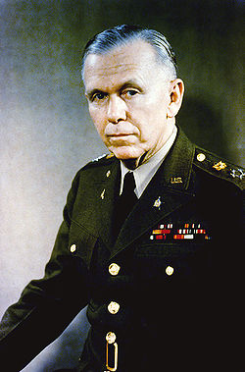
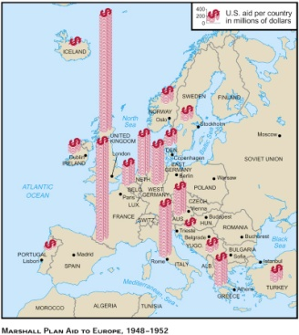
The Marshall Plan
MAP
Gen. George C. Marshall
US Secretary of State

Slide 11
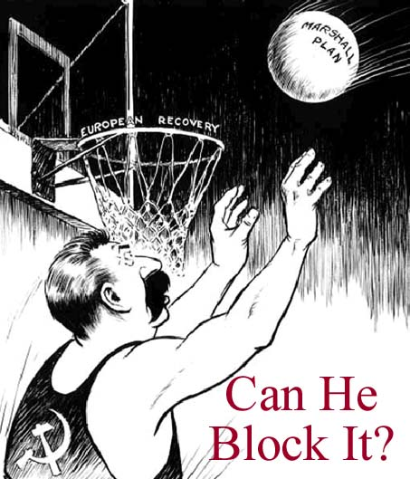

Slide 12
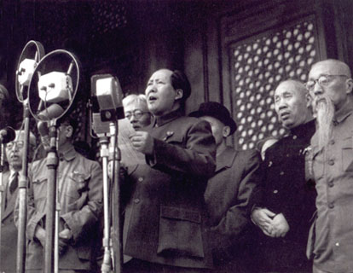
Chinese Revolution
1949
Communists defeat Nationalists in Civil War
  Communists now have two seats on Security Council
Taiwan – Nationalists establish government here
  Sovereignty Controversy
Chairman Mao proclaims the People’s Republic of China

Slide 13
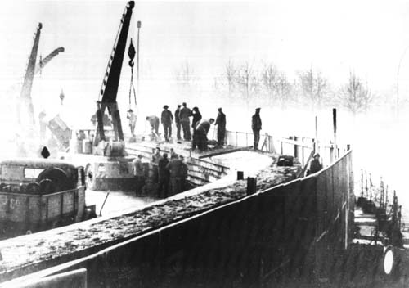
Berlin Wall
1961
East Germans begin construction of the Berlin Wall
  Separated East and West Berlin
  Encircled West Berlin
Symbolic Significance

Slide 14
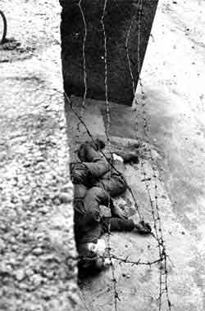
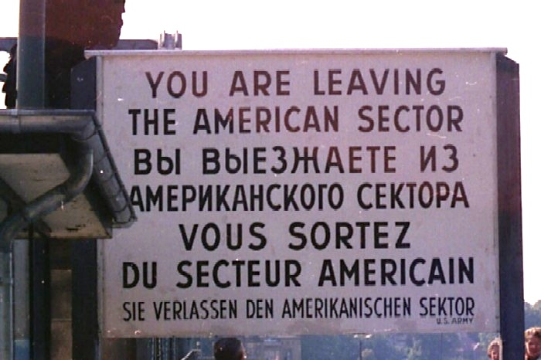
Berlin Wall
Access to Trizone restricted
Peter Fechter
Shot 1962

Slide 15
Return of the
Alliance System

Slide 16
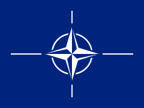
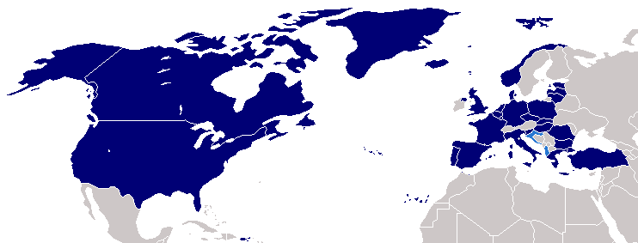
North Atlantic Treaty Organization
(NATO)
Established 1949
Collective Defense Pact
  Western Europe
  North America
Attack on any member nation treated as an attack on all member nations

Slide 17
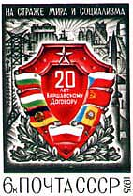
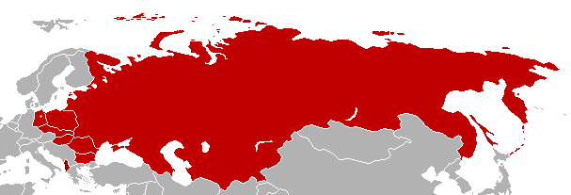
Warsaw Pact
Established 1955
Collective Defense Pact
  Soviet Union
  Eastern Europe
Response to NATO
“On Guard for Peace and Socialism”

Slide 18
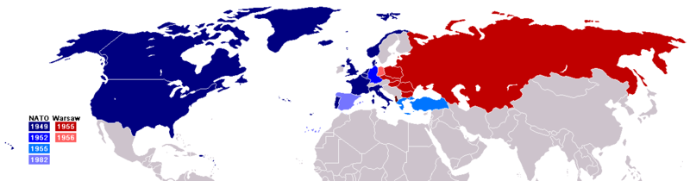
Cold War Alliances

Slide 19
Weapons Technologies

Slide 20
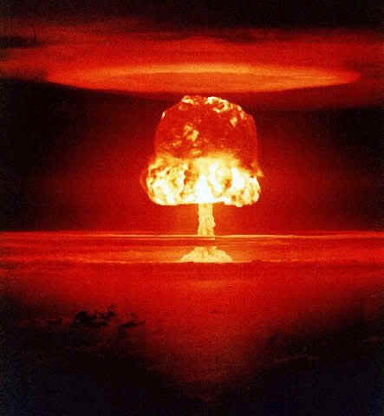
M.A.D.
Mutually Assured Destruction
1949
USSR tests its first nuclear weapon
  Espionage

Slide 21
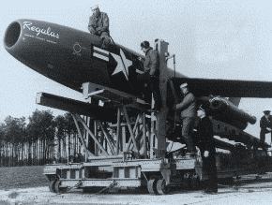
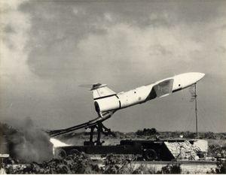
Cruise Missiles
1950s
Regulus and Matador

Slide 22
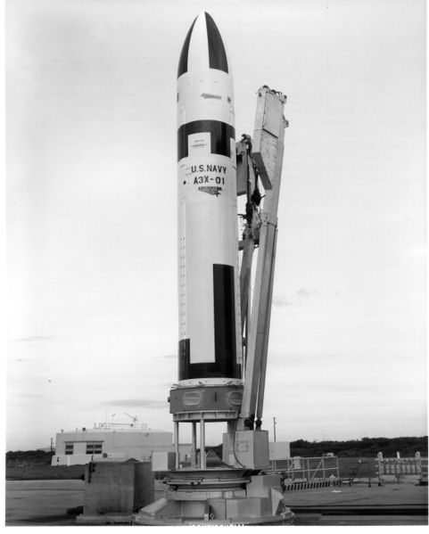
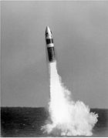
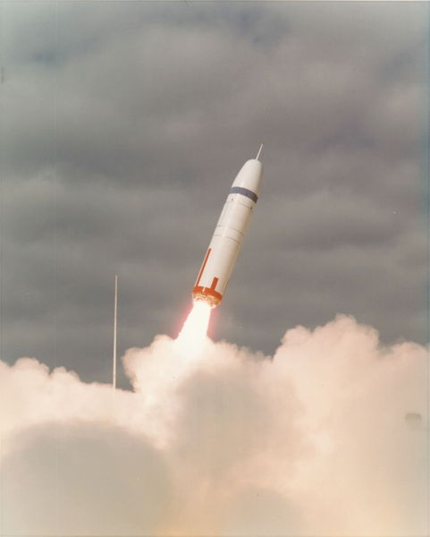
Nuclear Missiles
SLBMs
(Submarine-Launched Ballistic Missiles)
Polaris
1960s
Poseidon
1970s
Trident
1980s

Slide 23
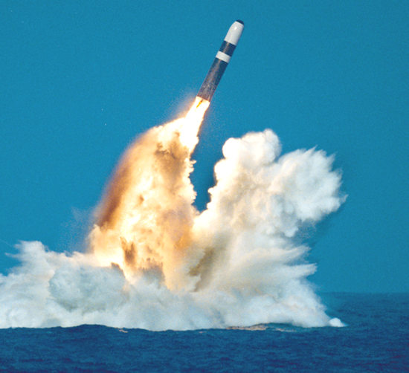
Royal Navy Trident II Test

Slide 24
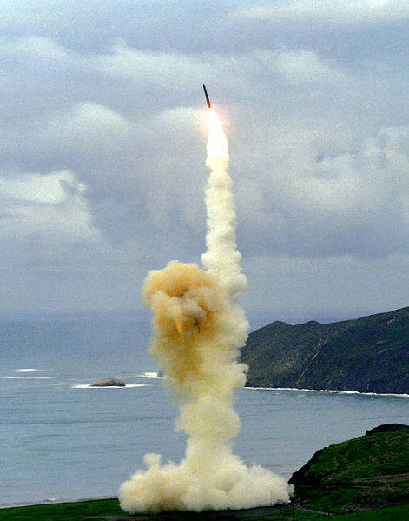
Nuclear Missiles
ICBMs
(Inter-Continental Ballistic Missiles)
Minuteman III

Slide 25
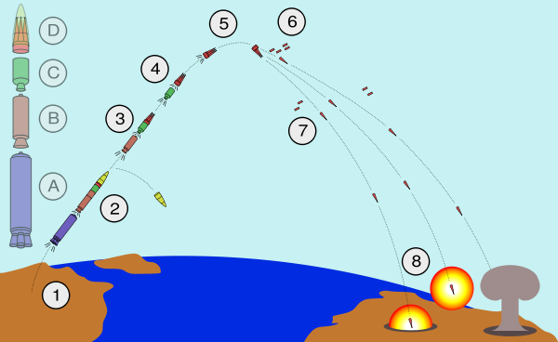
ICBM Launch Pattern
Note Multiple Warheads

Slide 26
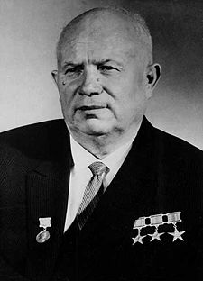
Nikita Khrushchev
1958-64
Premier of the Soviet Union
“Peaceful Coexistence”
"Whether you like it or not, history is on our side. We will bury you.” -- to Western ambassadors in 1956

Slide 27
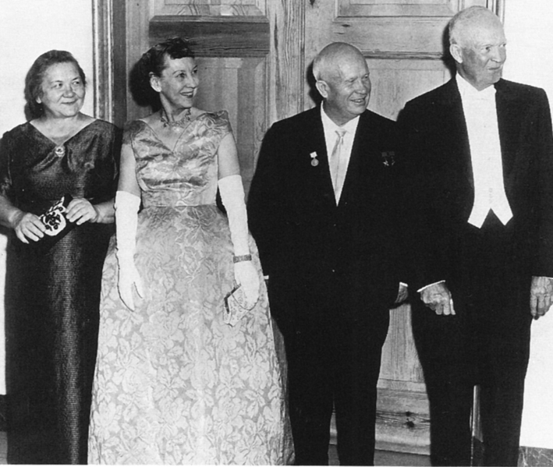
Peaceful Coexistence

Slide 28
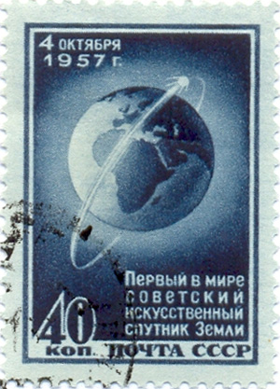
Who’s Winning???
1957
Sputnik launched by USSR
First satellite to be placed into orbit
PANIC IN US
Emphasis on math and science education

Slide 29
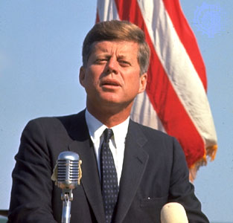
“Missile Gap”
Sen. John F. Kennedy
“Missile Gap” between USA and USSR
Elected President in 1960

Slide 30
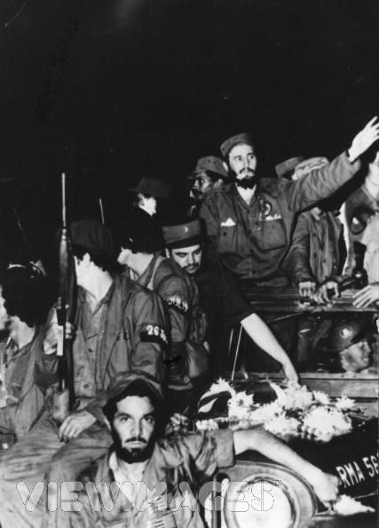
Cuban Revolution
1959
Fidel Castro’s rebels take control of the Cuban government, creating a communist state 90 miles off the coast of the U.S.

Slide 31
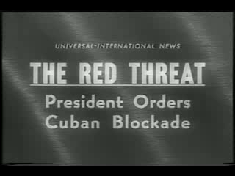
Cuban Missile Crisis
1962

Slide 32
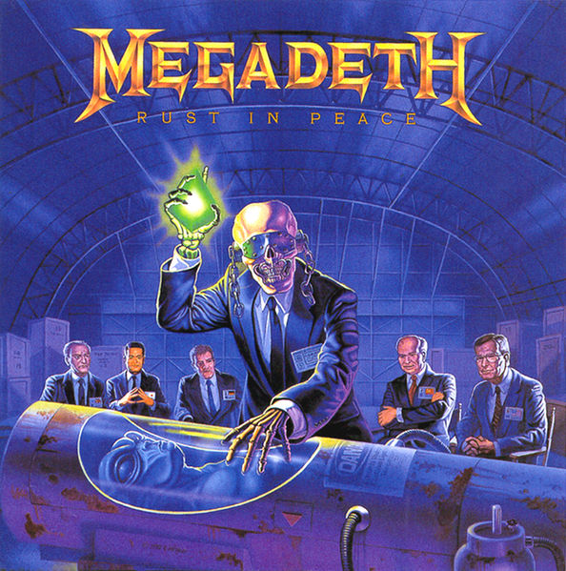
No Harm Done…
Missiles removed from Cuba and Turkey
  Turkey kept secret
JFK gets PR victory, but promises not to invade Cuba.
Nuclear war avoided, but fear of nuclear war remains, almost to the point of obsession with some folks…

Slide 33
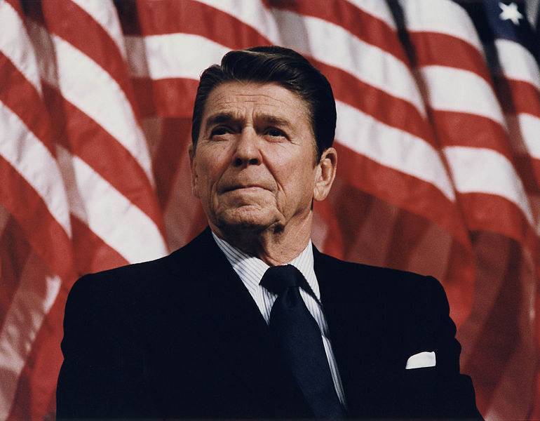
Ronald Reagan
1980
Ronald Reagan elected President
Return of a hard-line foreign policy toward the Soviet Union

Slide 34

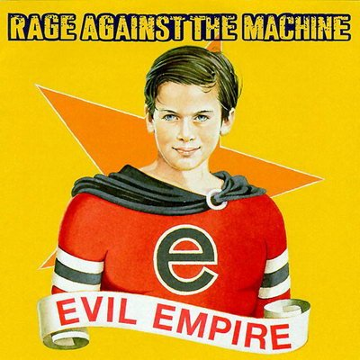

“Evil Empire” Speech
March 8, 1983

Slide 35
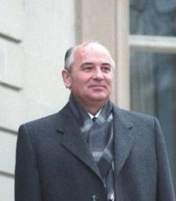
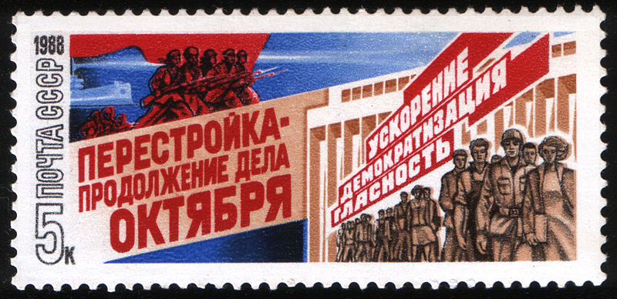
Mikhail Gorbechev
1985-1991
Glasnost – openness
  Censorship relaxed
  Easy to see how messed up everything was
Perestroika – restructuring
  combat corruption

Slide 36
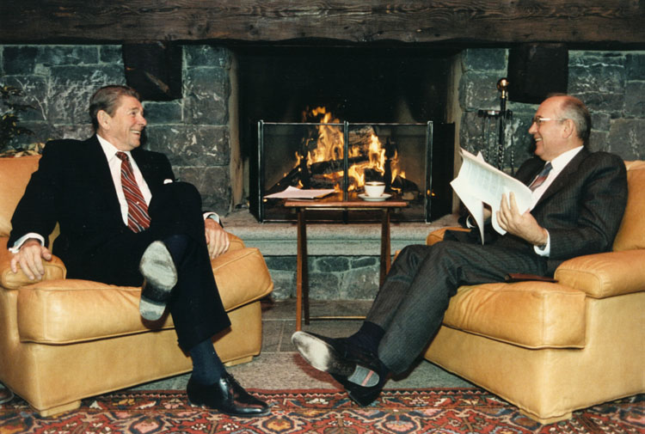
Reagan and Gorbachev in 1985

Slide 37

Berlin Wall in 1986

Slide 38
Brandenburg Gate (Berlin Wall) Speech
June 12, 1987

Slide 39
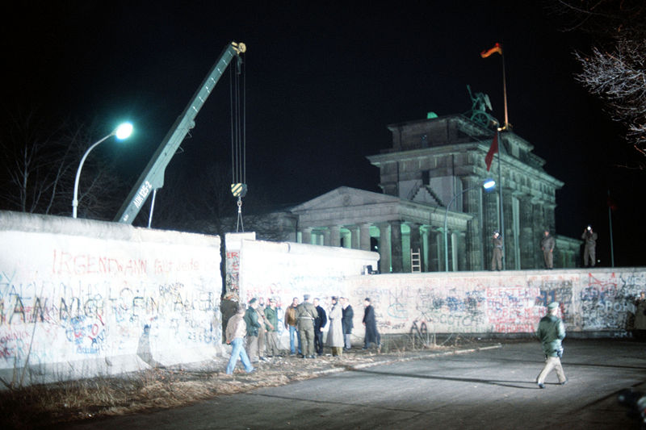
Fall of Berlin Fall
1989
“Peaceful Revolution”
Nationalist governments elected across Eastern Europe

Slide 40
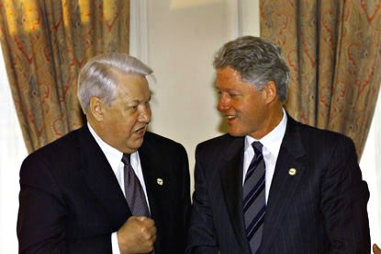
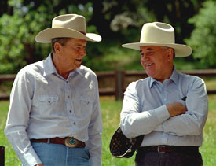
Fall of Soviet Union
1991
Boris Yeltsin elected President of the Russian Federation

Slide 41
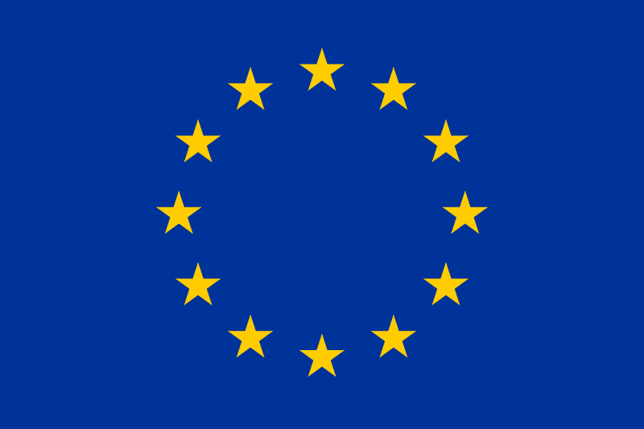
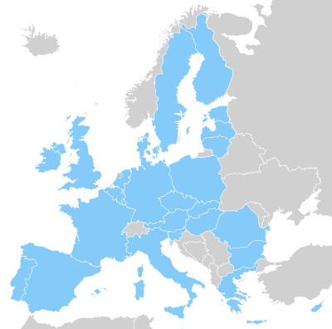
Maastricht Treaty
1992
Established the European Union

