Slide 1
THE ARTICLES of Confederation
America’s First Constitution
© Ocean/Corbis

Slide 2
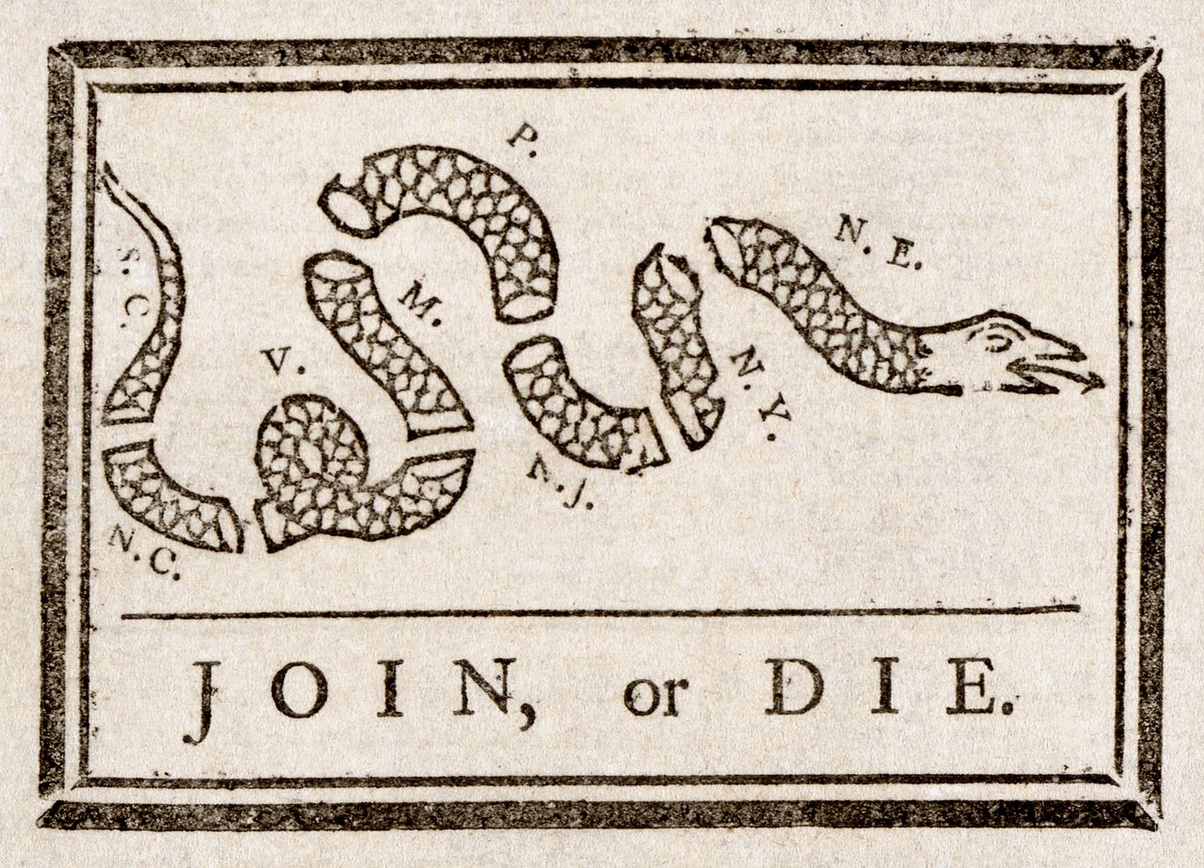

Slide 4
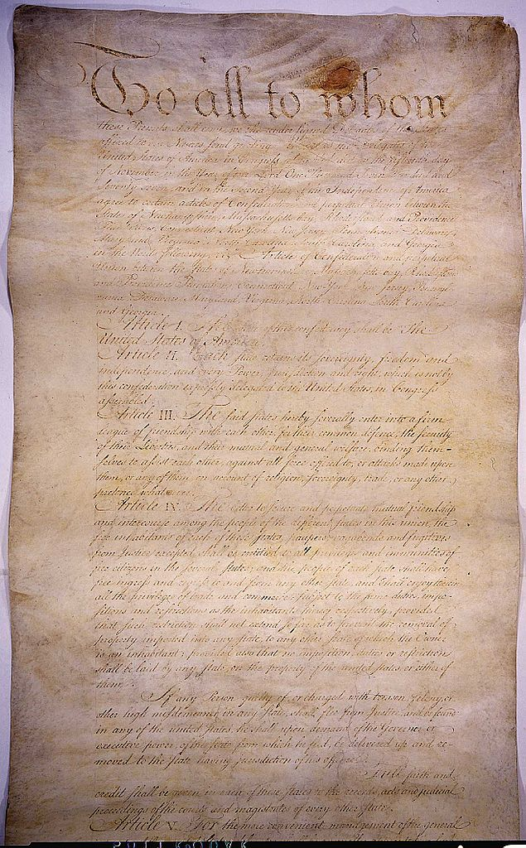
The Articles of Confederation
First plan of government
WEAK

Slide 5
REPLACED by the Constitution

Slide 6
Treaty of Paris
(1783)
“His Brittanic Majesty acknowledges the said United States, viz., New Hampshire, Massachusetts Bay, Rhode Island and Providence Plantations, Connecticut, New York, New Jersey, Pennsylvania, Maryland, Virginia, North Carolina, South Carolina and Georgia, to be free sovereign and independent states…”
Source: ourdocuments.gov

Slide 7
SOVEREIGNTY
Where Ultimate Power Resides

Slide 8
From Article II
Each state retains its sovereignty, freedom, and independence, and every power, jurisdiction, and right, which is not by this Confederation expressly delegated to the United States, in Congress assembled.
http://www.constitution.org/cons/usa-conf.htm

Slide 9
Federalism
Two Levels of Government:
Federal Government
State Governments

Slide 10
Federalism
According to the Articles
Federal Government
State Governments
Delegated
Foreign Relations

Slide 11
CONFEDERATION
A Military Alliance

Slide 12
From Article III
The said States hereby severally enter into a firm league of friendship with each other, for their common defense, the security of their liberties, and their mutual and general welfare, binding themselves to assist each other, against… attacks made upon them…
http://www.constitution.org/cons/usa-conf.htm

Slide 13
A firm league of friendship

Slide 14
EQUAL Representation

Slide 15
9 / 13
To Legislate

Slide 16
13 / 13
To Amend

Slide 17
NOPE
There was no presidency or federal court system under the Articles.

Slide 18
 | Articles | Constitution
Federalism |  | A More Perfect UNION
Sovereignty |  | Shared
Representation of States |  | Proportional (House) Equal (Senate)
Taxation |  | State & Federal
Powers of Congress |  | In Addition: Taxation Interstate Commerce Currency Crush Rebellions
Legislation |  | Senate + House + President
Amendments |  | 2/3 Congress + 3/4 States
A Firm League of Friendship
States (Except for Foreign Policy)
EQUAL
States ONLY
Foreign Relations
Army and Navy
Declare War
Ambassadors
Treaties
2/3
UNANIMOUS

Slide 19
SUCCESSES
of the Articles

Slide 20
We Won the War
Photo by sskennel

Slide 21
Northwest Territory
What we call “Midwest” today used to be the “Northwest Territory” of the United States.

Slide 22
Map Credit: Kmusser

Slide 23
Northwest Ordinance
1787
States cede “Northwestern” land claims
Goal:
Create New States

Slide 24
Northwest Ordinance
1787
SLAVERY OUTLAWED
in Northwest Territories
Some rights reserved by National Museum of American History

Slide 25
SUCCESS
The Northwest Ordinance is widely regarded as the most successful piece of legislation passed by the Confederation Congress.

Slide 26
PROBLEMS
with the Articles

Slide 27
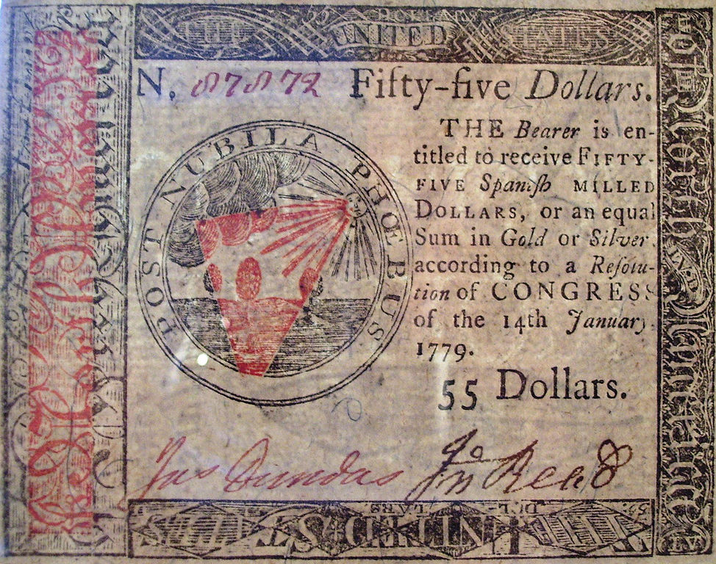
Bad Economy
Image by Beyond My Ken

Slide 28
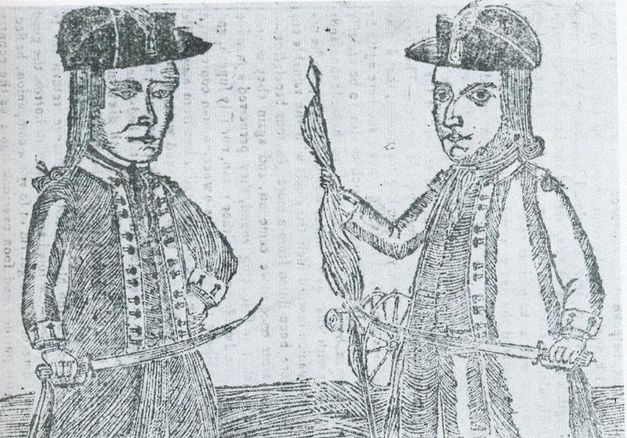
Shays’ Rebellion
Aug., 1786 – Feb., 1787

Slide 29
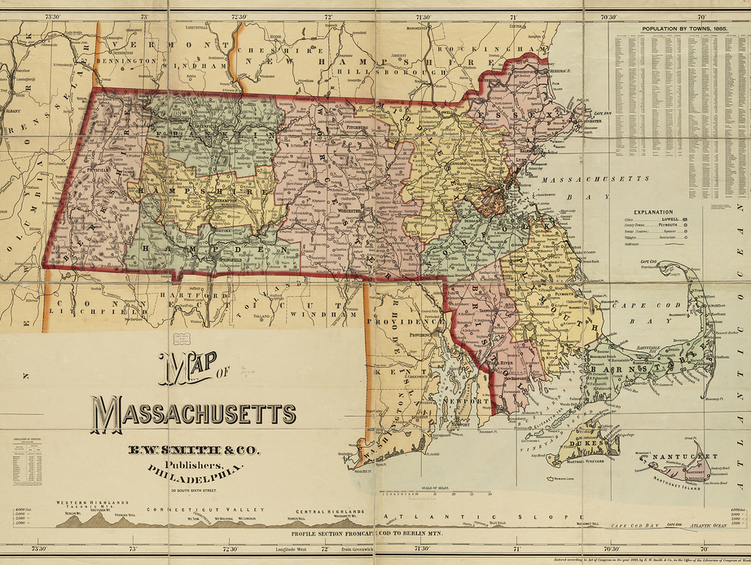
Photo Credit: Norman B. Leventhal Map Center at the BPL

Slide 30
Shortage
Some rights reserved by matthileo

Slide 31
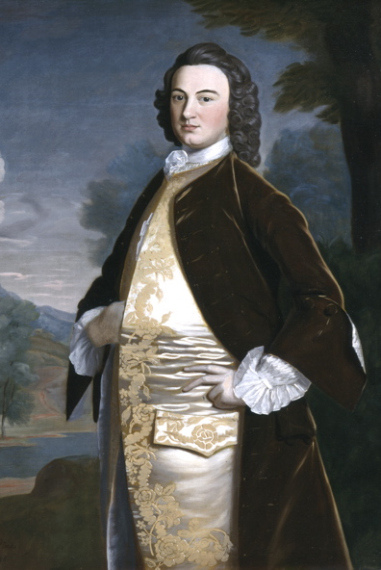
Debtors vs. Creditors
Western Mass. Farmers
Boston Merchants

Slide 32
Some rights reserved by Steve Rhodes

Slide 33
Debtors Want
Debt Relief
Paper Money
Foreclosures

Slide 34
Creditors Want
Their Money
Payable in Hard Currency

Slide 35
Legislature dominated by Creditors
Photo Credit:
Corey Templeton

Slide 36
Creditors Crack Down
Some rights reserved by taberandrew

Slide 37
Rebellion
Some rights reserved by Mr. T in DC

Slide 38
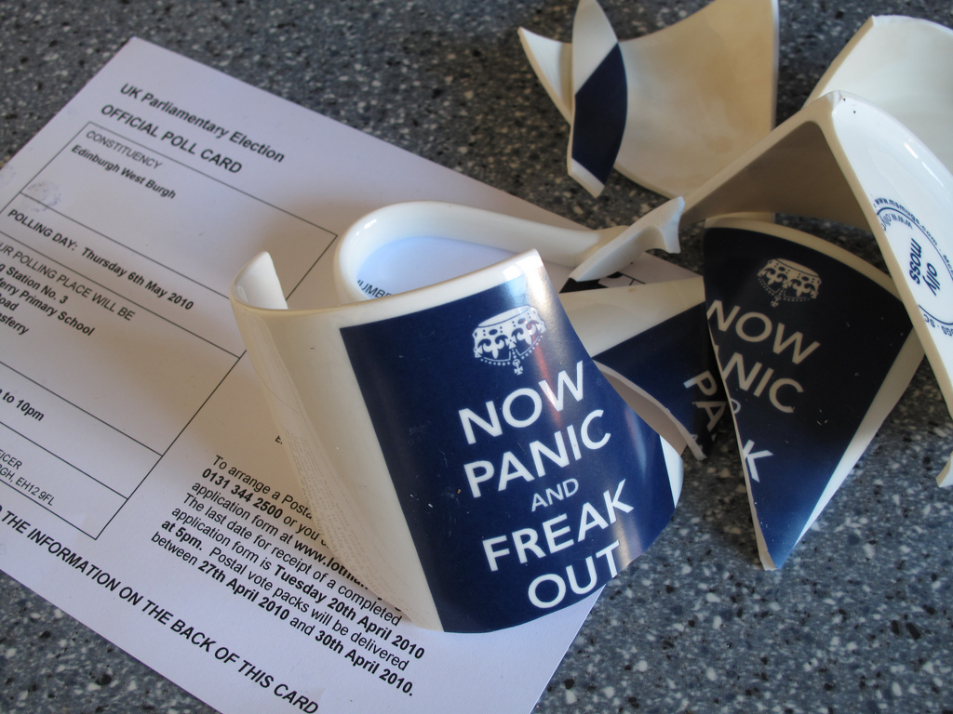
Some rights reserved by hockadilly

Slide 39
ELITE CONSENSUS
WE NEED MORE GOVERNMENT

Slide 40
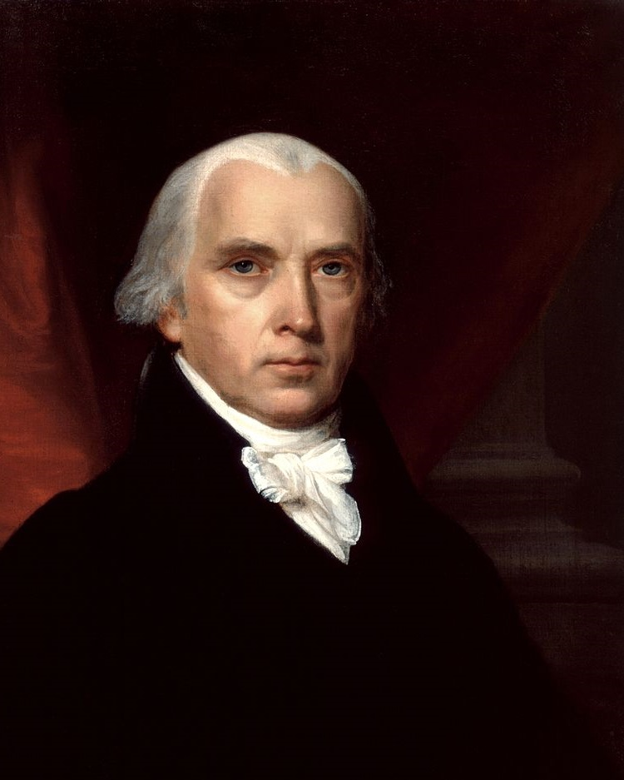
“Our situation is becoming every day more and more critical. No money comes into the Federal Treasury; no respect is paid to the Federal authority… the existing confederacy is tottering to its foundation…”
-- James Madison to Edmund Pendleton, February 25, 1787, Madison Papers.
Madison
http://www.shaysrebellion.stcc.edu/shaysapp/person.do?shortName=james_madison

Slide 41
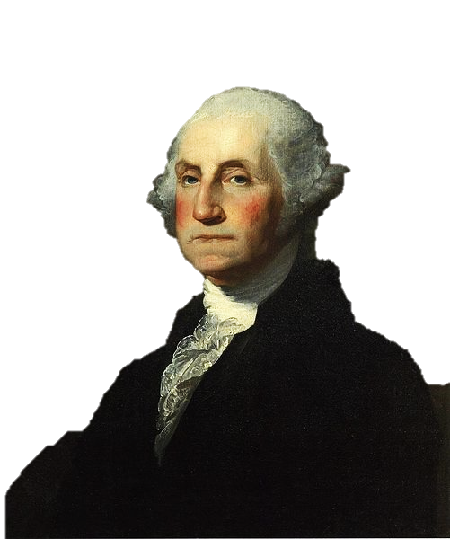
“The moment is, indeed, important! – If government shrinks, or is unable to enforce its laws; fresh maneuvers will be displayed by the insurgents – anarchy & confusion must prevail – and every thing will be turned topsy turvey.”
George Washington to Henry Knox, February 3, 1787
Washington
http://www.gilderlehrman.org/history-by-era/creating-new-government/resources/george-washington

Slide 42
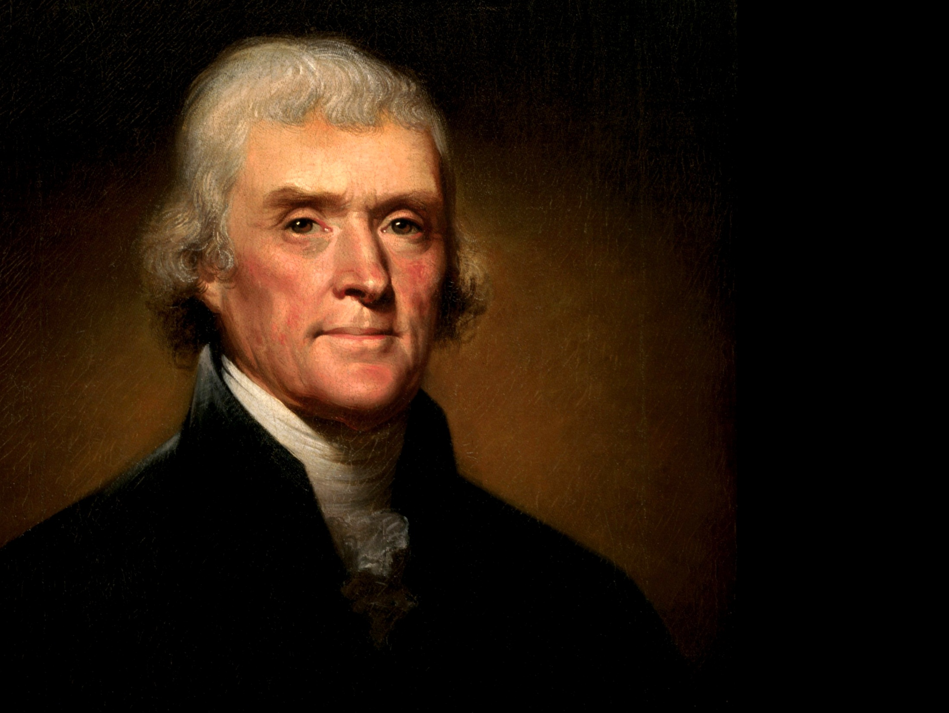
The Voice of Reason

Slide 43
“God forbid we should ever be twenty years without such a rebellion... We have had thirteen States independent for eleven years. There has been one rebellion. That comes to one rebellion in a century and a half, for each State. What country before ever existed a century and a half without a rebellion?"
-- Jefferson to William S. Smith, 1787
http://www.earlyamerica.com/review/summer/letter.html

Slide 47
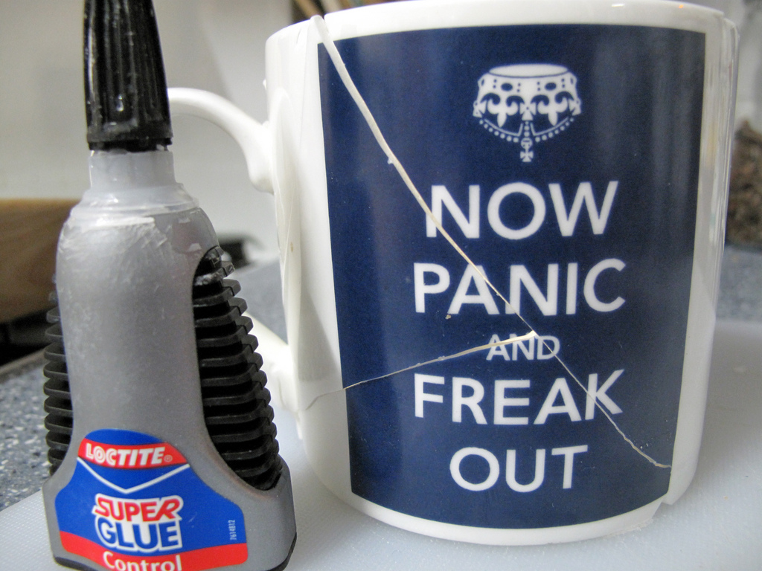
Some rights reserved by hockadilly

Slide 48
“Malo periculosam libertatem quam quietam servitutem.”
-- Jefferson to Madison,
January 30, 1787
http://www.earlyamerica.com/review/summer/letter.html

Slide 49
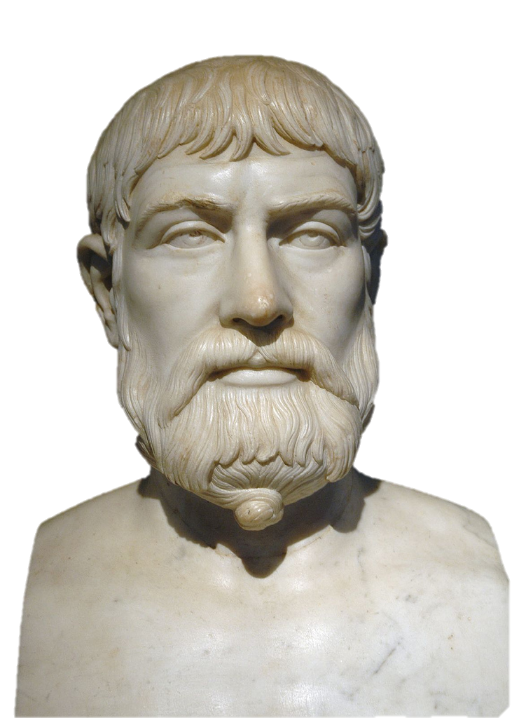
Say What?
Some rights reserved by Mr G's Travels

Slide 50
“I prefer the tumult of liberty to the quiet of servitude.”
-- Jefferson to Madison,
January 30, 1787
http://www.earlyamerica.com/review/summer/letter.html

Slide 51
THE SOLUTION

Slide 52
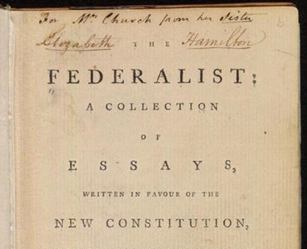
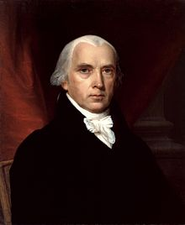
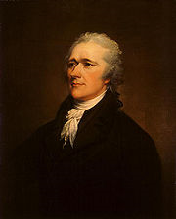
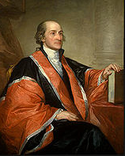
The Federalist
(aka, The Federalist Papers)
Madison
Hamilton
Jay
A New Constitution is Necessary

Slide 53
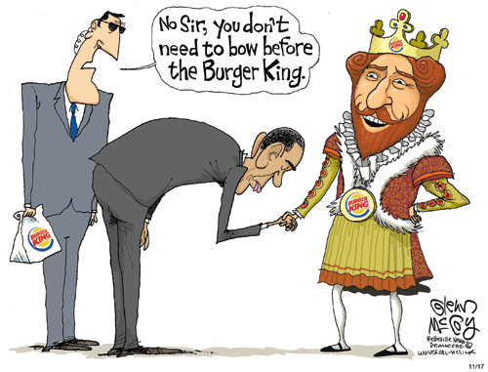

Slide 54
The last stage of national humiliation… (Federalist 15)
Hamilton
British Forts
Map Credit: Golbez

Slide 55
The last stage of national humiliation… (Federalist 15)
Hamilton
Map Credit: Golbez

Slide 56
 | Articles | Constitution
Federalism | A Firm League of Friendship
Sovereignty | States
Representation of States | EQUAL
Taxation | States ONLY
Powers of Congress | Foreign Relations Army and Navy Declare War Ambassadors Treaties
Legislation | 2/3
Amendments | UNANIMOUS
A More Perfect UNION
Shared
Proportional (House)
Equal (Senate)
State & Federal
In Addition:
Taxation
Interstate Commerce
Currency
Crush Rebellions
Senate + House + President
2/3 Congress + 3/4 States

