Slide 1
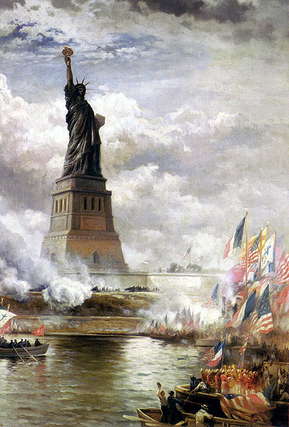
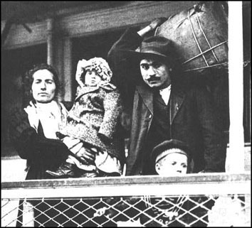

The New Immigrants
Contributing Author:
Jenna White (Student Teacher, 2010)
Notes:
http://freundeskreis-dah.de/images/FotoWilkom1.jpg, http://www.emigrantletters.com/img/emigrant32.JPG

Slide 2
SC ACADEMIC STANDARDS
USHC-4.5 Explain the causes and effects of urbanization in late nineteenth-century America, including the movement from farm to city, the changing immigration patterns, the rise of ethnic neighborhoods, the role of political machines, and the migration of African Americans to the North, Midwest, and West.
USHC-4.6 Compare the accomplishments and limitations of the women’s suffrage movement and the Progressive Movement in affecting social and political reforms in America, including the roles of the media and of reformers such as Carrie Chapman Catt, Alice Paul, Jane Addams, and presidents Theodore Roosevelt and Woodrow Wilson.

Slide 3
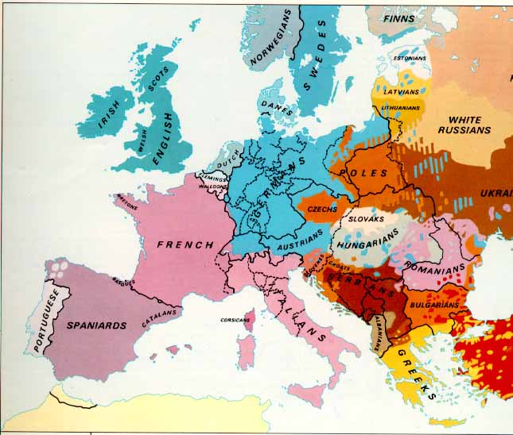
New Immigrants (1890-1920)
Southern Europe
  Italy
  Greece
Eastern Europe
  Russia
  Poland

Slide 4
New Immigrants (1890-1920)
  DEMOGRAPHICS:
Catholic, Orthodox, Jewish
Non-English-speaking countries
Republican Traditions

Slide 5
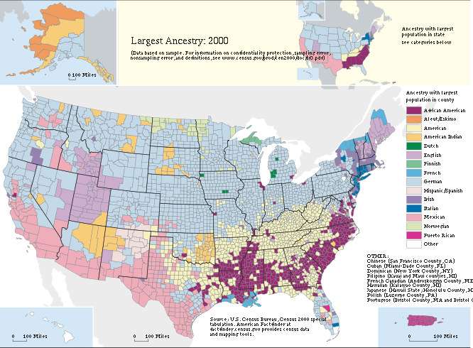

Slide 6
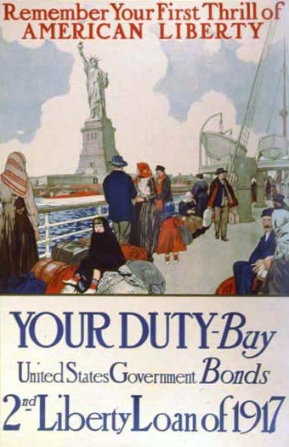
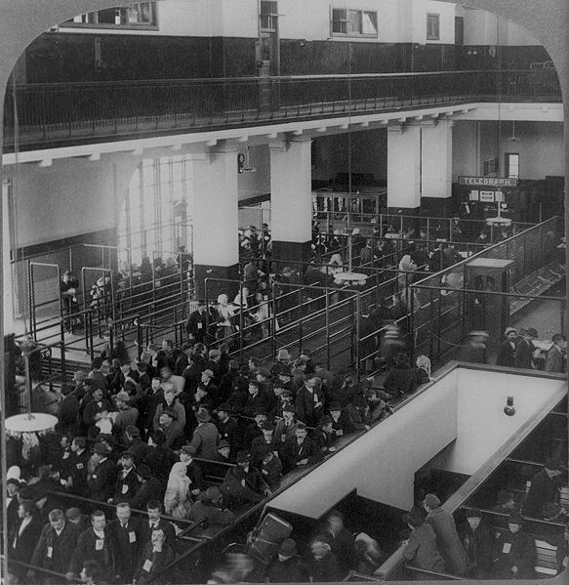
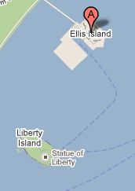
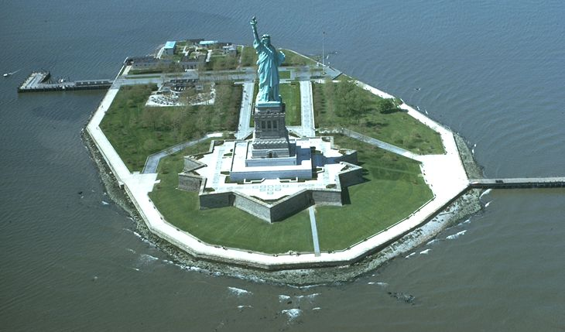
Ellis Island
New York City
The Statue of Liberty on nearby Liberty Island
Immigrants being processed, 1904

Slide 7
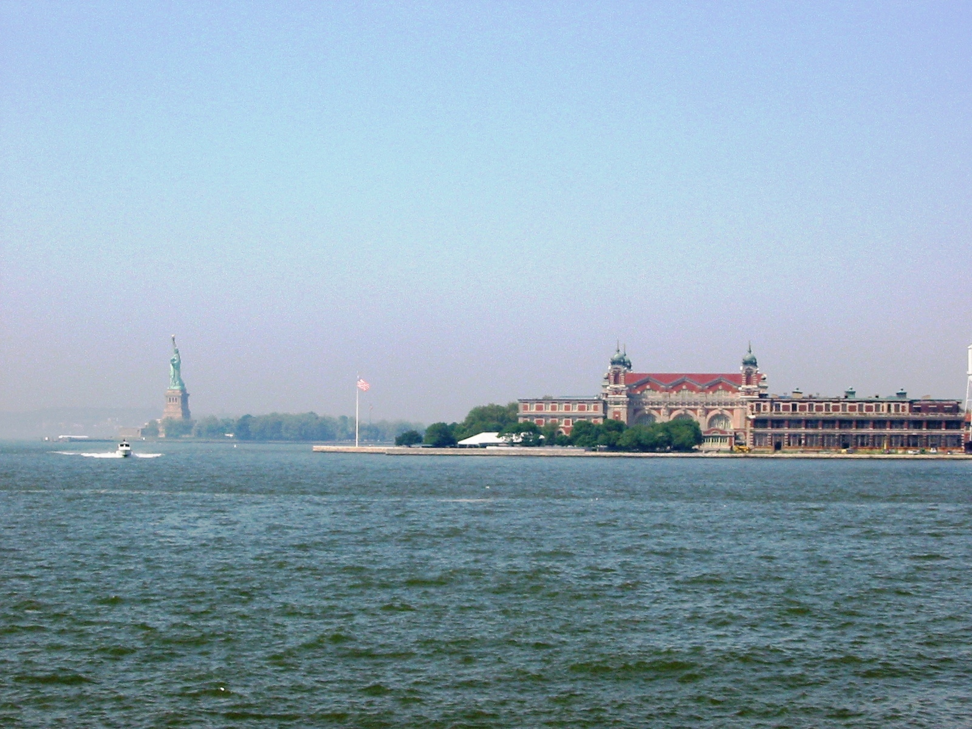
A View from the Ferry
Photo Credit: Jason Jennings (Class of 2012)

Slide 8
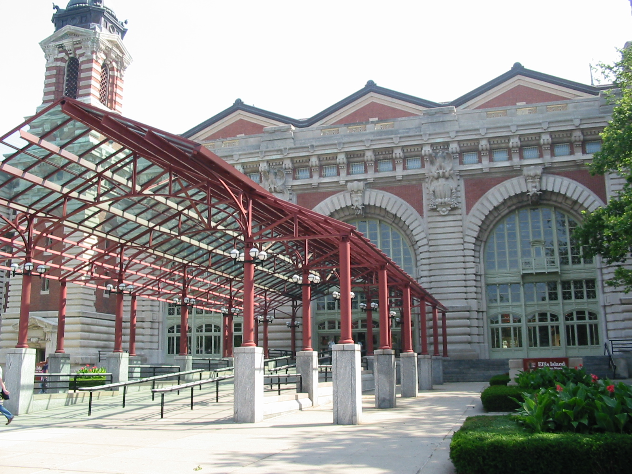
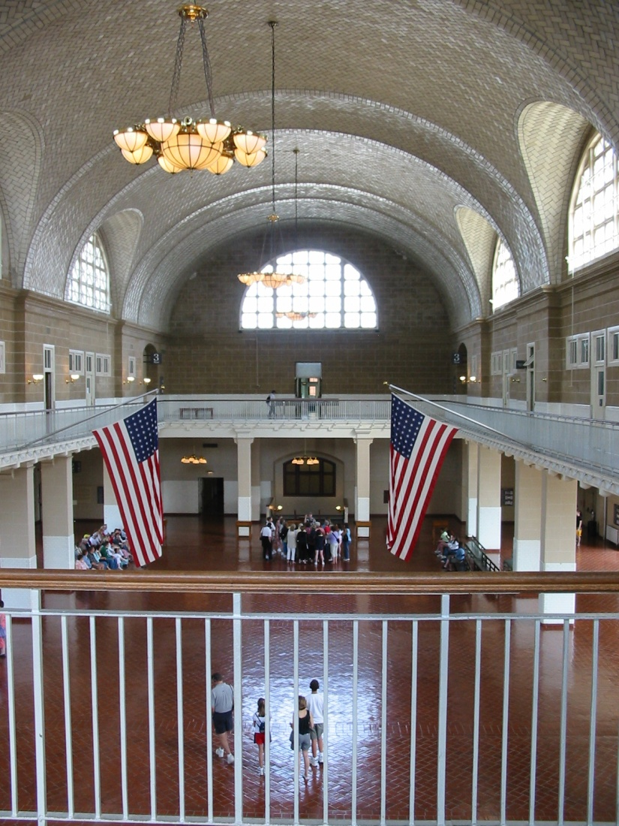
Photo Credit:
Jason Jennings
(Class of 2012)

Slide 9
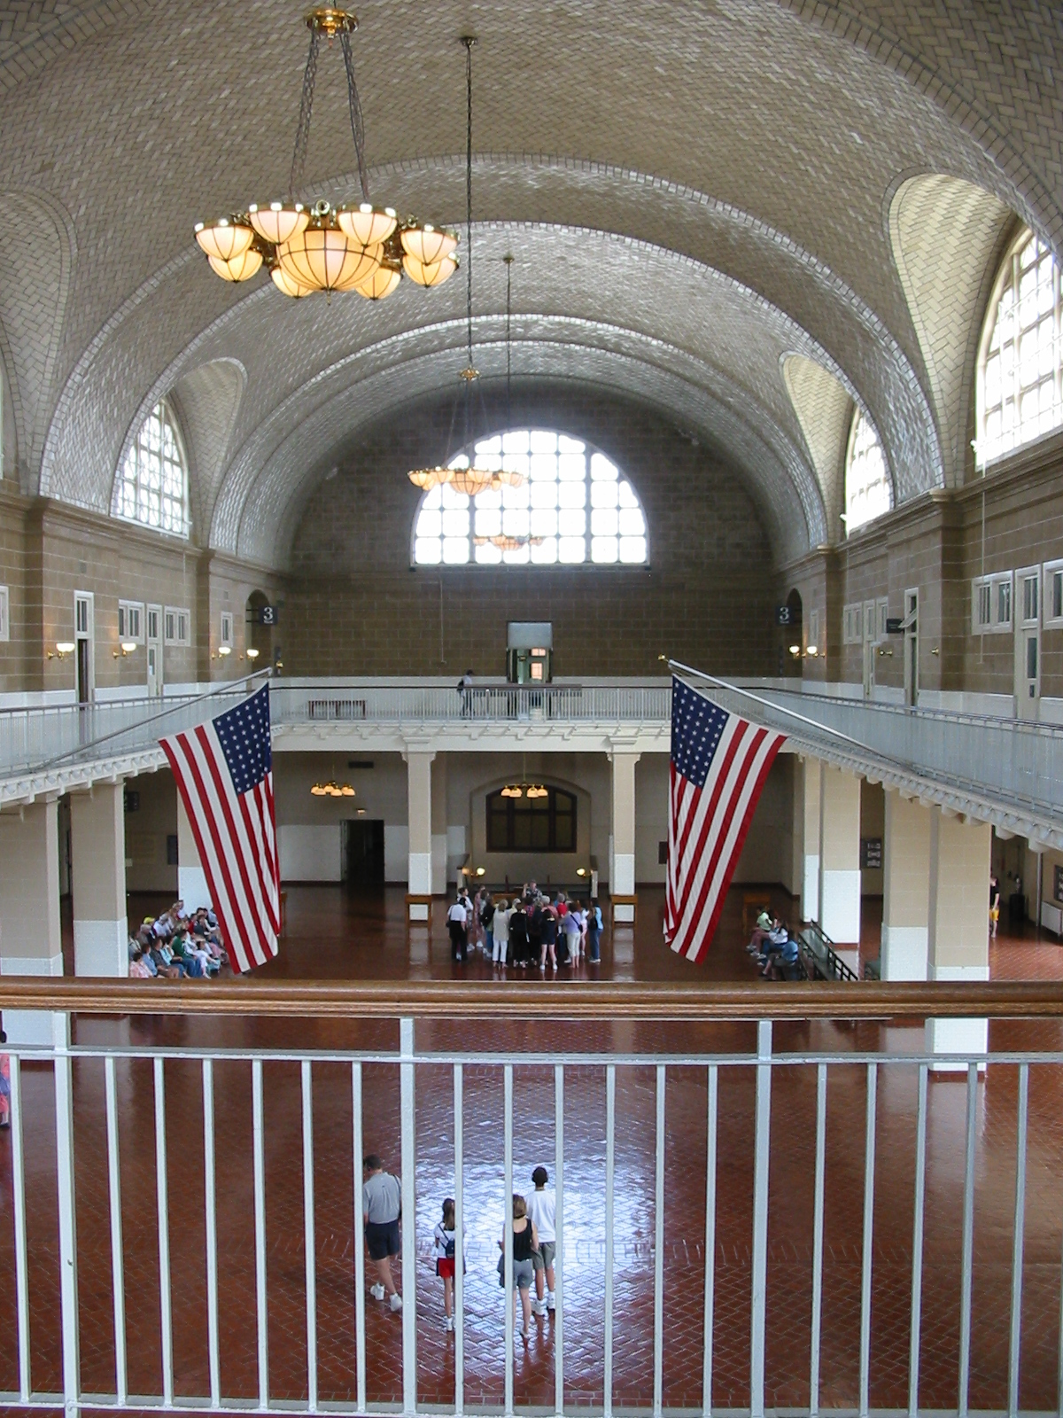
Photo Credit:
Jason Jennings
(Class of 2012)

Slide 10
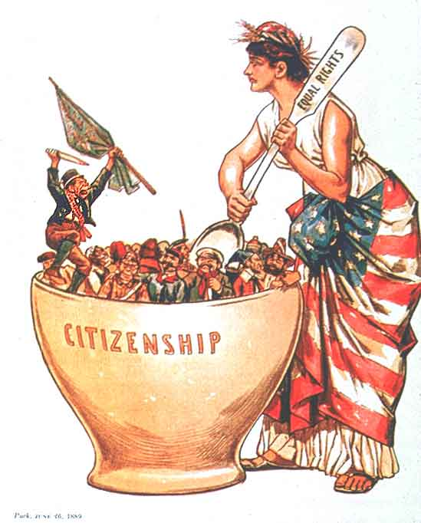

A Melting Pot?
Assimilation
Notes:
http://legalworldonline.com/OSCommerce/images/melting%20pot.jpg, http://regentsprep.org/regents/ushisgov/themes/immigration/melting_pot.gif, http://jackiemontgomery.files.wordpress.com/2009/05/meltingpot.jpg

Slide 11
A Melting Pot?
Immigrants should not be pressured, at all, to give up their language or their cultural values in order to live in the United States.
Immigrants should be assimilated (or socialized) into American culture by learning English, receiving an education in a public school, and absorbing American cultural values.
Notes:
http://legalworldonline.com/OSCommerce/images/melting%20pot.jpg, http://regentsprep.org/regents/ushisgov/themes/immigration/melting_pot.gif, http://jackiemontgomery.files.wordpress.com/2009/05/meltingpot.jpg

Slide 12
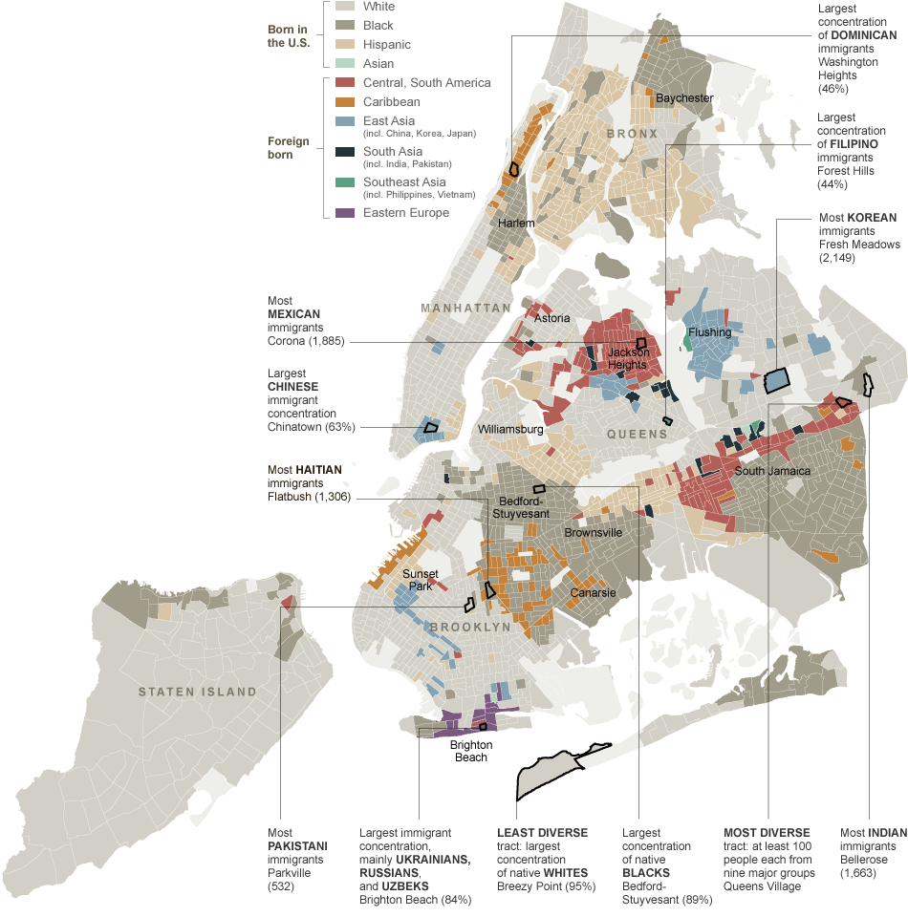
NYC Today
Ethnic Neighborhoods
Source:
New York Times

Slide 13
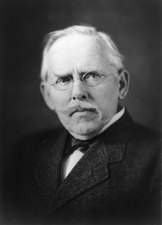
Jacob Riis
Photographer
How the Other Half Lives
  Documented living conditions in New York City’s tenements.
  Sweatshops
LINK:
http://www.authentichistory.com/1898-1913/2-progressivism/2-riis/index.html

Slide 14
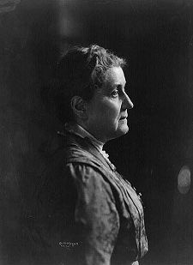
Jane Addams
“Settlement House” Movement
Hull House
  Chicago, IL
Education, Job Training, Child Care, etc.
Social and economic opportunities for the working class
Addams

Slide 15
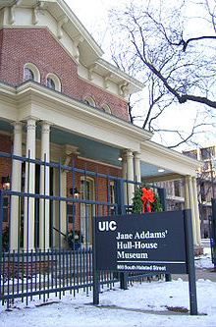
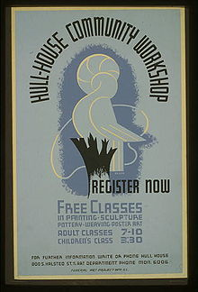

Slide 16
NATIVISM
Group | Good | Bad ^{[166]}
English | 66% | 6%
Irish | 62% | 7%
Jews | 59% | 9%
Germans | 57% | 11%
Italians | 56% | 10%
Poles | 53% | 12%
Japanese | 47% | 18%
Blacks | 46% | 16%
Chinese | 44% | 19%
Mexicans | 25% | 34%
Koreans | 24% | 30%
Vietnamese | 20% | 38%
Puerto Ricans | 17% | 43%
Haitians | 10% | 39%
Cubans | 9% | 59%
1982 Opinion Poll:
"Thinking both of what they have contributed to this country and have gotten from this country, for each one tell me whether you think, on balance, they've been a good or a bad thing for this country."
See Wikipedia for more public opinion figures on immigration in the United States.

Slide 17
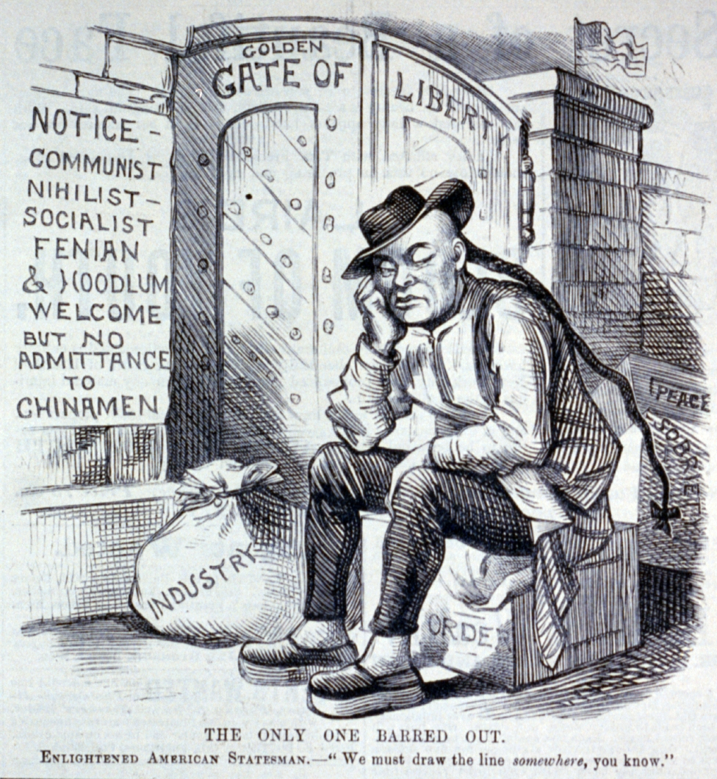

Slide 18

Chinese Exclusion Act (1882)
First US Law to restrict immigration based on nationality or race
Remained on the books in various forms until 1943

Slide 19
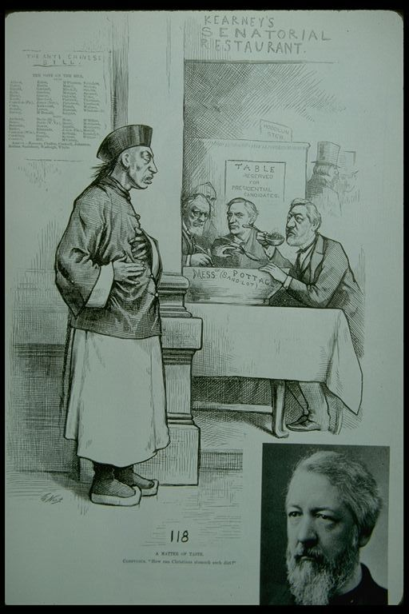
No Soup For You!
"A Matter of Taste." (c. 1883). Thomas Nast. (John Chinaman refuses Soup in Kearney's Senatorial Restaurant--refers to legislation pertaining to Chinese Exclusion Act)
“How can Christians stomach such diet?”

Slide 20
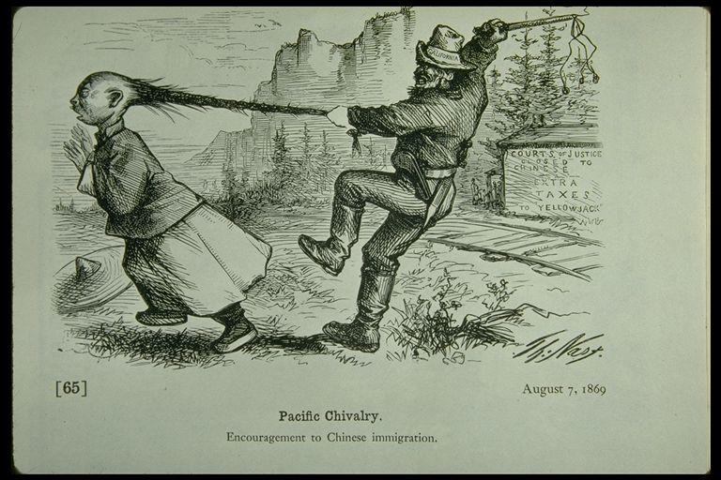
"Pacific Chivalry." (August 7, 1869). Thomas Nast. (California ruffian whips John Chinaman)
http://www.csub.edu/~gsantos/img0048.html

Slide 21
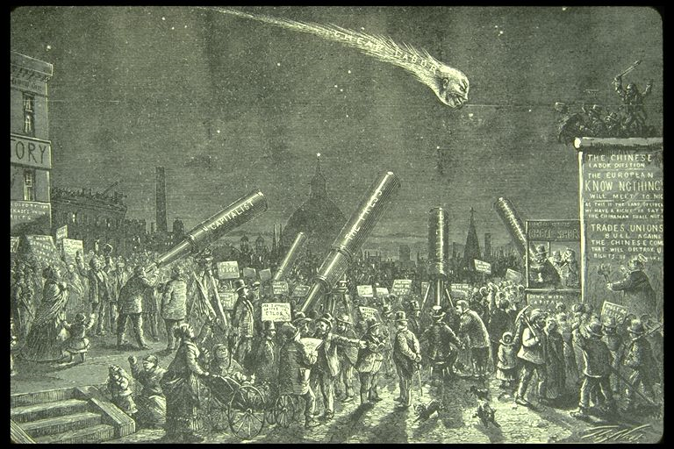
Thomas Nast, cartoon - "The Comet of Chinese Labor" (1870)
http://www.csub.edu/~gsantos/img0049.html

Slide 22
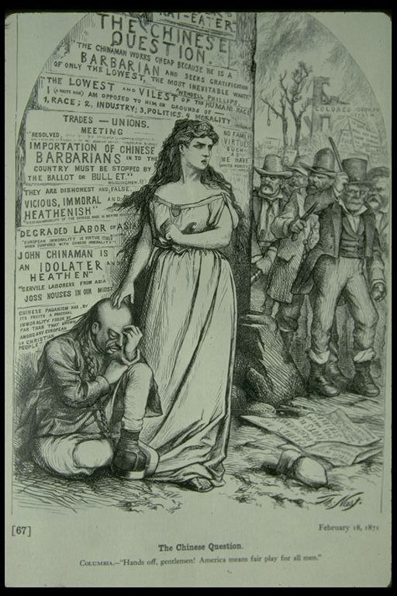
"The Chinese Question." (February 18, 1871). Thomas Nast. (Columbia defends disconsolae John Chinaman from nativist Attacks)
http://www.csub.edu/~gsantos/img0050.html

Slide 23


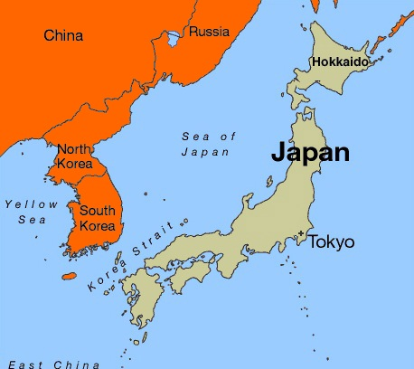

Gentleman’s Agreement (1907)
EXCLUSION BY LAW
EXCLUSION BY AGREEMENT
Japan agrees to control emigration if U.S. does not pass a law and treats existing Japanese immigrants fairly.

Slide 24





LEARNING.
DELIVERED.

