Slide 1
Aerial Device Operator Training
The Institute for Safety in Powerline Construction
© Copyright by the Institute for Safety in Powerline Construction 3504 Parliament Ct. Alexandria, LA 71303 All rights reserved. This material or any part thereof may not be reproduced in any form without the written permission of the Institute for Safety in Powerline Construction

Slide 2
Introduction
In this training program, we will cover:
Importance of aerial device operator training
Consequences of failure to train
Minimum training requirements
How an aerial device works
Safety rules for aerial lifts
Safety inspections
Operating the aerial device
Hazards of aerial devices
How to rescue injured employees
Escaping from disabled equipment

Slide 3
How an Aerial Device Works
The power unit
How to transmit hydraulic power
Engine driven
Auxiliary driven
Electric motors

Slide 4
Aerial Device One Line Diagram

Slide 5
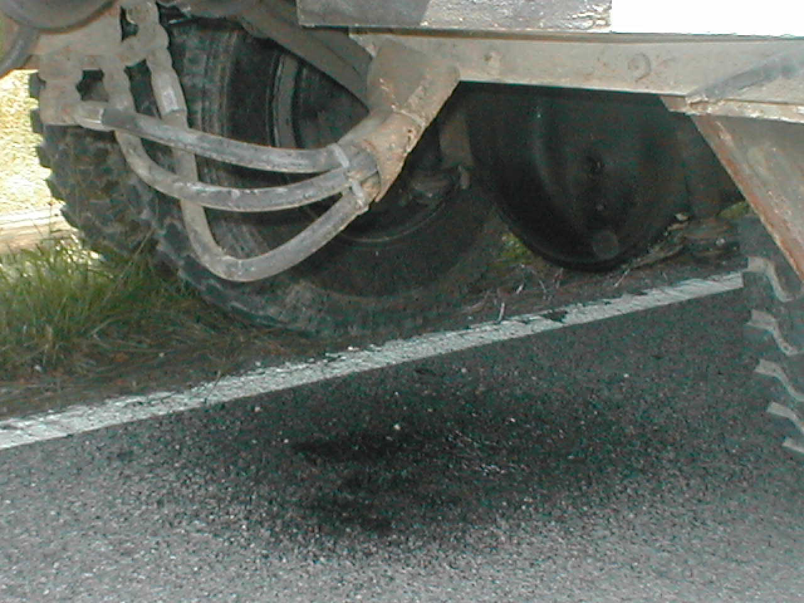
How an Aerial Device Works
Hydraulic oil under pressure
Hydraulic hoses
Motors & cylinders
Hydraulic valves
Electrical wiring

Slide 6
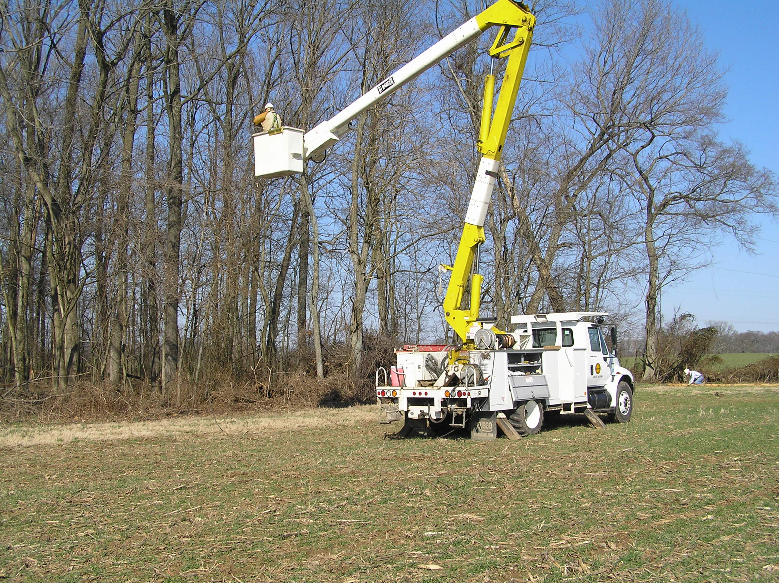
How an Aerial Device Works
Fiberglass booms
Bucket liners
Lower insulated sleeve
Hydraulic jacks
Material handlers

Slide 7
Safety Rules for Aerial Lifts
OSHA 1910.67
OSHA 1910.333
OSHA 1926.453
OSHA 1926.601
OSHA 1926.959
Best Practices

Slide 8
OSHA 1910.67(c)(2)
Aerial device shall be stowed in the cradle before driving
Lift controls tested each day before shift
Only trained operators use equipment
Proper fall restraints used aloft
Notes:
1910.67(c)(2)(i)Lift controls shall be tested each day prior to use to determine that such controls are in safe working condition.
1910.67(c)(2)(ii)Only trained persons shall operate an aerial lift.
1910.67(c)(2)(iii)Belting off to an adjacent pole, structure, or equipment while working from an aerial lift shall not be permitted.
1910.67(c)(2)(iv)Employees shall always stand firmly on the floor of the basket, and shall not sit or climb on the edge of the basket or use planks, ladders, or other devices for a work position.
1910.67(c)(2)(v)A personal fall arrest or travel restraint system that meets the requirements in subpart I of this part shall be worn and attached to the boom or basket when working from an aerial lift.
1910.67(c)(2)(vi)Boom and basket load limits specified by the manufacturer shall not be exceeded.
1910.67(c)(2)(vii)The brakes shall be set and outriggers, when used, shall be positioned on pads or a solid surface. Wheel chocks shall be installed before using an aerial lift on an incline.
1910.67(c)(2)(viii)An aerial lift truck may not be moved when the boom is elevated in a working position with men in the basket, except for equipment which is specifically designed for this type of operation in accordance with the provisions of paragraphs (b)(1) and (b)(2) of this section.

Slide 9
OSHA 1910.67(c)(2)
Boom and basket weights
Brakes, chocks and outriggers
Lower controls tested before use
Electrical testing of unit (c)(3)
Notes:
1910.67(c)(2)(ix)Articulating boom and extensible boom platforms, primarily designed as personnel carriers, shall have both platform (upper) and lower controls. Upper controls shall be in or beside the platform within easy reach of the operator. Lower controls shall provide for overriding the upper controls. Controls shall be plainly marked as to their function. Lower level controls shall not be operated unless permission has been obtained from the employee in the lift, except in case of emergency.
1910.67(c)(2)(x)Climbers shall not be worn while performing work from an aerial lift.
1910.67(c)(2)(xi)The insulated portion of an aerial lift shall not be altered in any manner that might reduce its insulating value.
1910.67(c)(2)(xii)Before moving an aerial lift for travel, the boom(s) shall be inspected to see that it is properly cradled and outriggers are in stowed position, except as provided in paragraph (c)(2)(viii) of this section.
1910.67(c)(3)Electrical tests. Electrical tests shall be made in conformance with the requirements of ANSI A92.2—1969, Section 5. However, equivalent DC voltage tests may be used in lieu of the AC voltage test specified in A92.2—1969. DC voltage tests which are approved by the equipment manufacturer or equivalent entity shall be considered an equivalent test for the purpose of this paragraph (c)(3)

Slide 10
OSHA 1910.333(a)
Safety related work practices shall be employed to prevent electric shock;
Only qualified persons shall work on energized parts;
Unqualified persons shall not get any closer than 10 feet; (c)(3)(i)(A)(1)
Notes:
1910.333(a)"General." Safety-related work practices shall be employed to prevent electric shock or other injuries resulting from either direct or indirect electrical contacts, when work is performed near or on equipment or circuits which are or may be energized. The specific safety-related work practices shall be consistent with the nature and extent of the associated electrical hazards.
1910.333(a)(1)"Deenergized parts." Live parts to which an employee may be exposed shall be deenergized before the employee works on or near them, unless the employer can demonstrate that deenergizing introduces additional or increased hazards or is infeasible due to equipment design or operational limitations. Live parts that operate at less than 50 volts to ground need not be deenergized if there will be no increased exposure to electrical burns or to explosion due to electric arcs.
Note 1: Examples of increased or additional hazards include interruption of life support equipment, deactivation of emergency alarm systems, shutdown of hazardous location ventilation equipment, or removal of illumination for an area.
Note 2: Examples of work that may be performed on or near energized circuit parts because of infeasibility due to equipment design or operational limitations include testing of electric circuits that can only be performed with the circuit energized and work on circuits that form an integral part of a continuous industrial process in a chemical plant that would otherwise need to be completely shut down in order to permit work on one circuit or piece of equipment.
Note 3: Work on or near deenergized parts is covered by paragraph (b) of this section.
1910.333(a)(2)"Energized parts." If the exposed live parts are not deenergized (i.e., for reasons of increased or additional hazards or infeasibility), other safety-related work practices shall be used to protect employees who may be exposed to the electrical hazards involved. Such work practices shall protect employees against contact with energized circuit parts directly with any part of their body or indirectly through some other conductive object. The work practices that are used shall be suitable for the conditions under which the work is to be performed and for the voltage level of the exposed electric conductors or circuit parts. Specific work practice requirements are detailed in paragraph (c) of this section.
1910.333(c)(3)(i)(A)When an unqualified person is working in an elevated position near overhead lines, the location shall be such that the person and the longest conductive object he or she may contact cannot come closer to any unguarded, energized overhead line than the following distances:
1910.333(c)(3)(i)(A)(1)For voltages to ground 50kV or below - 10 feet (305 cm);
1910.333(c)(3)(i)(A)(2)For voltages to ground over 50kV - 10 feet (305 cm) plus 4 inches (10 cm) for every 10kV over 50kV.
1910.333(c)(3)(i)(B)When an unqualified person is working on the ground in the vicinity of overhead lines, the person may not bring any conductive object closer to unguarded, energized overhead lines than the distances given in paragraph (c)(3)(i)(A) of this section.

Slide 11
OSHA 1910.333(c)(3)(ii)
Only qualified persons may work on energized lines and equipment from an aerial lift
Insulated Aerial devices shall maintain a distance following Table S-5 working energized overhead lines.
Employees on the ground may not contact vehicle unless the employee is protected.
Notes:
1910.333(c)(3)(ii)"Qualified persons." When a qualified person is working in the vicinity of overhead lines, whether in an elevated position or on the ground, the person may not approach or take any conductive object without an approved insulating handle closer to exposed energized parts than shown in Table S-5 unless:
1910.333(c)(3)(ii)(A)The person is insulated from the energized part (gloves, with sleeves if necessary, rated for the voltage involved are considered to be insulation of the person from the energized part on which work is performed), or
1910.333(c)(3)(ii)(B)The energized part is insulated both from all other conductive objects at a different potential and from the person, or
1910.333(c)(3)(ii)(C)The person is insulated from all conductive objects at a potential different from that of the energized part
1910.333(c)(3)(iii)(A)(2)If insulating barriers are installed to prevent contact with the lines, and if the barriers are rated for the voltage of the line being guarded and are not a part of or an attachment to the vehicle or its raised structure, the clearance may be reduced to a distance within the designed working dimensions of the insulating barrier.
1910.333(c)(3)(iii)(A)(3)If the equipment is an aerial lift insulated for the voltage involved, and if the work is performed by a qualified person, the clearance (between the uninsulated portion of the aerial lift and the power line) may be reduced to the distance given in Table S-5.
1910.333(c)(3)(iii)(B)Employees standing on the ground may not contact the vehicle or mechanical equipment or any of its attachments, unless:
1910.333(c)(3)(iii)(B)(1)The employee is using protective equipment rated for the voltage; or
1910.333(c)(3)(iii)(B)(2)The equipment is located so that no uninsulated part of its structure (that portion of the structure that provides a conductive path to employees on the ground) can come closer to the line than permitted in paragraph (c)(3)(iii) of this section.
1910.333(c)(3)(iii)(C)If any vehicle or mechanical equipment capable of having parts of its structure elevated near energized overhead lines is intentionally grounded, employees working on the ground near the point of grounding may not stand at the grounding location whenever there is a possibility of overhead line contact. Additional precautions, such as the use of barricades or insulation, shall be taken to protect employees from hazardous ground potentials, depending on earth resistivity and fault currents, which can develop within the first few feet or more outward from the grounding point.

Slide 12
OSHA 1926.453(b)(2)
Lift controls shall be tested daily
Only authorized employees can operate aerial devices
Fall arrest shall be worn in aerial device
Brakes, outrigger pads, chocks
Aerial device shall not be moved while elevated
Controls shall be plainly marked
Electrical test shall meet ANSI A92.2-1969
Notes:
1926.453(b)(2)(viii)An aerial lift truck shall not be moved when the boom is elevated in a working position with men in the basket, except for equipment which is specifically designed for this type of operation in accordance with the provisions of paragraphs (a)(1) and (2) of this section.
1926.453(b)(2)(ix)Articulating boom and extensible boom platforms, primarily designed as personnel carriers, shall have both platform (upper) and lower controls. Upper controls shall be in or beside the platform within easy reach of the operator. Lower controls shall provide for overriding the upper controls. Controls shall be plainly marked as to their function. Lower level controls shall not be operated unless permission has been obtained from the employee in the lift, except in case of emergency.
1926.453(b)(2)(x)Climbers shall not be worn while performing work from an aerial lift.
1926.453(b)(2)(xi)The insulated portion of an aerial lift shall not be altered in any manner that might reduce its insulating value.
1926.453(b)(2)(xii)Before moving an aerial lift for travel, the boom(s) shall be inspected to see that it is properly cradled and outriggers are in stowed position except as provided in paragraph (b)(2)(viii) of this section.
1926.453(b)(3)Electrical tests. All electrical tests shall conform to the requirements of ANSI A92.2-1969 section 5. However equivalent d.c.; voltage tests may be used in lieu of the a.c. voltage specified in A92.2-1969; d.c. voltage tests which are approved by the equipment manufacturer or equivalent entity shall be considered an equivalent test for the purpose of this paragraph (b)(3).

Slide 13
OSHA 1926.601
Motor Vehicles
All vehicles must have adequate brakes;
All vehicles shall be checked at the beginning of each shift for operating condition and defects;
All defects corrected before vehicle is placed in service;
Notes:
1926.601(b)(1)All vehicles shall have a service brake system, an emergency brake system, and a parking brake system. These systems may use common components, and shall be maintained in operable condition.
1926.601(b)(14)All vehicles in use shall be checked at the beginning of each shift to assure that the following parts, equipment, and accessories are in safe operating condition and free of apparent damage that could cause failure while in use: service brakes, including trailer brake connections; parking system (hand brake); emergency stopping system (brakes); tires; horn; steering mechanism; coupling devices; seat belts; operating controls; and safety devices. All defects shall be corrected before the vehicle is placed in service. These requirements also apply to equipment such as lights, reflectors, windshield wipers, defrosters, fire extinguishers, etc., where such equipment is necessary.

Slide 14
OSHA 1926.959
Vehicle inspections
Equipment test at beginning of each shift
Use observer for backup and MAD
Protect employees with barricades to guard against hazardous electrical potentials
Notes:
1926.959(a)(1)Other applicable requirements. Mechanical equipment shall be operated in accordance with applicable requirements in this part, including Subparts N, O, and CC of this part, except that § 1926.600(a)(6) does not apply to operations performed by qualified employees.
1926.959(a)(2)Inspection before use. The critical safety components of mechanical elevating and rotating equipment shall receive a thorough visual inspection before use on each shift. Note to paragraph (a)(2): Critical safety components of mechanical elevating and rotating equipment are components for which failure would result in free fall or free rotation of the boom.
1926.959(a)(3)Operator. The operator of an electric line truck may not leave his or her position at the controls while a load is suspended, unless the employer can demonstrate that no employee (including the operator) is endangered.
1926.959(b)(1)Extend outriggers. Mobile equipment, if provided with outriggers, shall be operated with the outriggers extended and firmly set, except as provided in paragraph (b)(3) of this section.
1926.959(b)(2)Clear view. Outriggers may not be extended or retracted outside of the clear view of the operator unless all employees are outside the range of possible equipment motion.
1926.959(b)(3)Operation without outriggers. If the work area or the terrain precludes the use of outriggers, the equipment may be operated only within its maximum load ratings specified by the equipment manufacturer for the particular configuration of the equipment without outriggers.
1926.959(c)Applied loads. Mechanical equipment used to lift or move lines or other material shall be used within its maximum load rating and other design limitations for the conditions under which the mechanical equipment is being used.
1926.959(d)Operations near energized lines or equipment.
1926.959(d)(1)Minimum approach distance. Mechanical equipment shall be operated so that the minimum approach distances, established by the employer under § 1926.960(c)(1)(i), are maintained from exposed energized lines and equipment. However, the insulated portion of an aerial lift operated by a qualified employee in the lift is exempt from this requirement if the applicable minimum approach distance is maintained between the uninsulated portions of the aerial lift and exposed objects having a different electrical potential.
1926.959(d)(2)Observer. A designated employee other than the equipment operator shall observe the approach distance to exposed lines and equipment and provide timely warnings before the minimum approach distance required by paragraph (d)(1) of this section is reached, unless the employer can demonstrate that the operator can accurately determine that the minimum approach distance is being maintained.
1926.959(d)(3)Extra precautions. If, during operation of the mechanical equipment, that equipment could become energized, the operation also shall comply with at least one of paragraphs (d)(3)(i) through (d)(3)(iii) of this section.
1926.959(d)(3)(i)The energized lines or equipment exposed to contact shall be covered with insulating protective material that will withstand the type of contact that could be made during the operation.
1926.959(d)(3)(ii)The mechanical equipment shall be insulated for the voltage involved. The mechanical equipment shall be positioned so that its uninsulated portions cannot approach the energized lines or equipment any closer than the minimum approach distances, established by the employer under § 1926.960(c)(1)(i).

Slide 15
OSHA 1926.959
Working near energized lines;
Ground truck, barricade and consider as energized
Passing of material from aerial device thru energized pole equipment is prohibited
Maintain proper clearances
Notes:
1926.959(d)(3)(iii)Each employee shall be protected from hazards that could arise from mechanical equipment contact with energized lines or equipment. The measures used shall ensure that employees will not be exposed to hazardous differences in electric potential. Unless the employer can demonstrate that the methods in use protect each employee from the hazards that could arise if the mechanical equipment contacts the energized line or equipment, the measures used shall include all of the following techniques:
1926.959(d)(3)(iii)(A)Using the best available ground to minimize the time the lines or electric equipment remain energized,
1926.959(d)(3)(iii)(B)Bonding mechanical equipment together to minimize potential differences,
1926.959(d)(3)(iii)(C)Providing ground mats to extend areas of equipotential, and
1926.959(d)(3)(iii)(D)Employing insulating protective equipment or barricades to guard against any remaining hazardous electrical potential differences

Slide 16
Safety Inspections
Why inspect
When to inspect
What to inspect
Needed safety equipment
When you can’t use aerial device
Recording your inspection

Slide 17
Safety Inspections
Why Inspect
It’s OSHA law
Safety Manual rules
Manufacturer’s recommendation
It’s the right thing to do

Slide 18
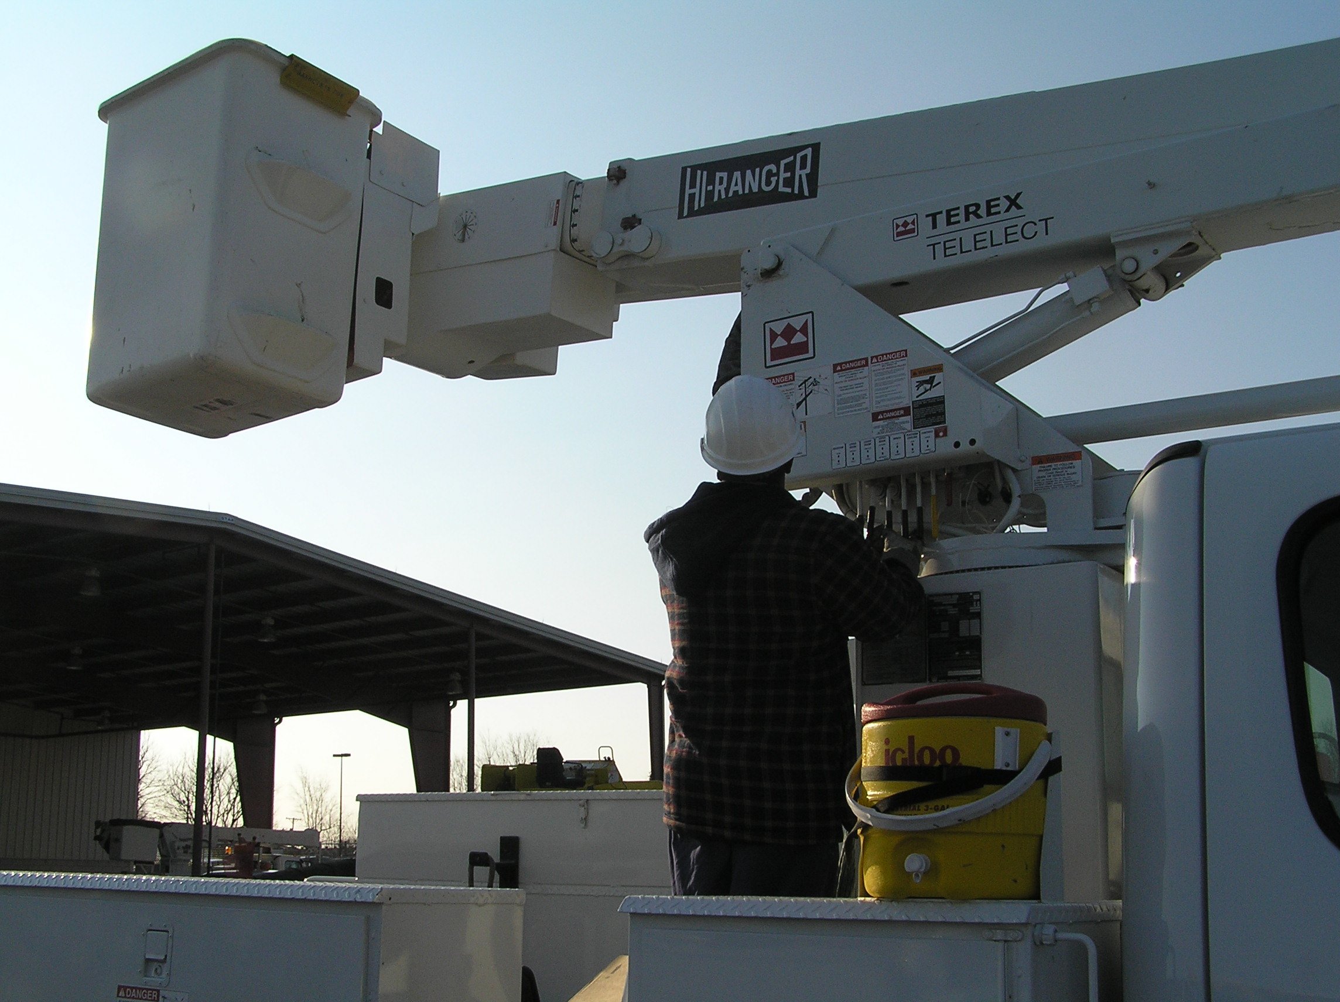
Safety Inspections
When to Inspect
Daily inspections
Quarterly inspections
Annual inspections
Whenever something changes, looks or feels wrong

Slide 19
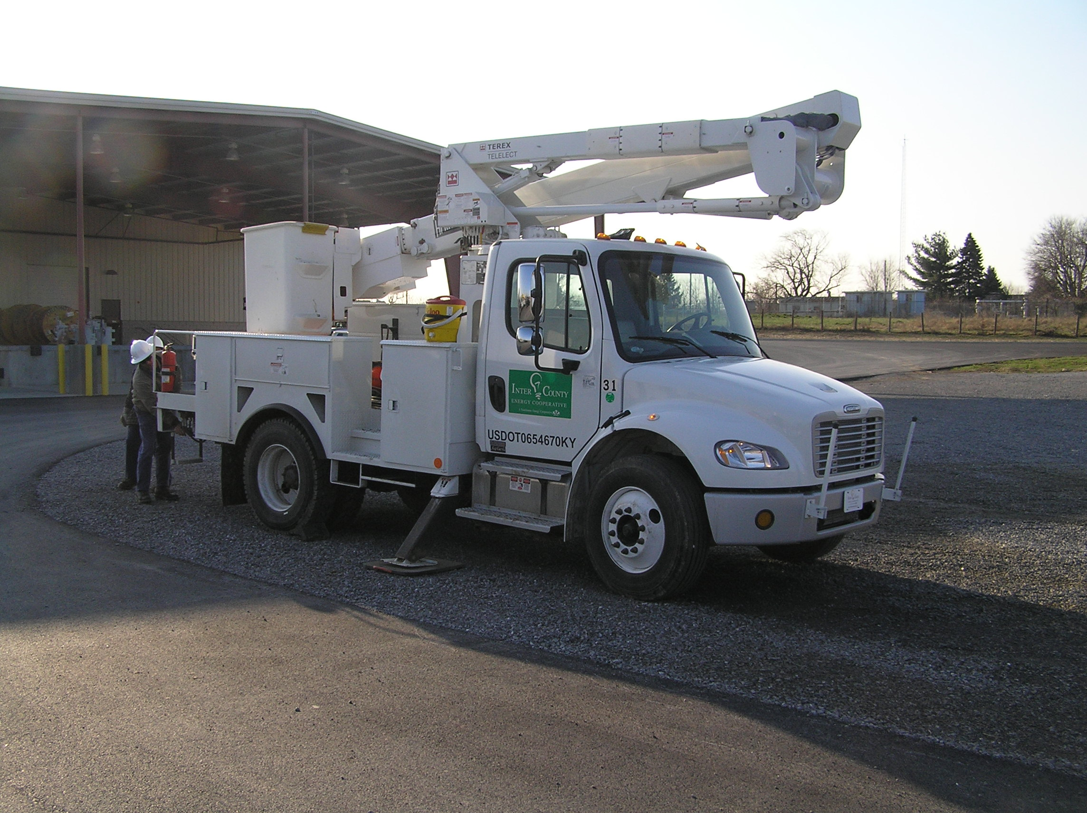
Safety Inspections
What to Inspect
General condition
Tires, fluid levels
Appearance
Test operation
Housekeeping

Slide 20
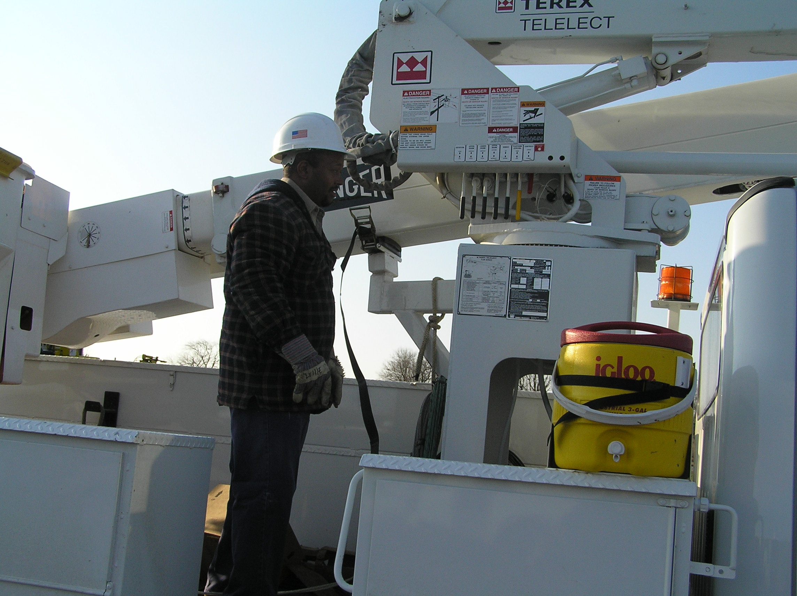
Safety Inspections
What to Inspect
Look for leaks
Worn hoses and parts
Unusual noise from unit
Erratic operation
Read last inspection report

Slide 21
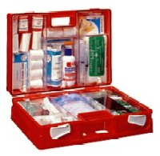
Safety Inspections
Needed Safety Equipment
First aid kit
Fire extinguishers
PPE required by equipment
PPE for job
Safety manual
Understand Operators manual

Slide 22
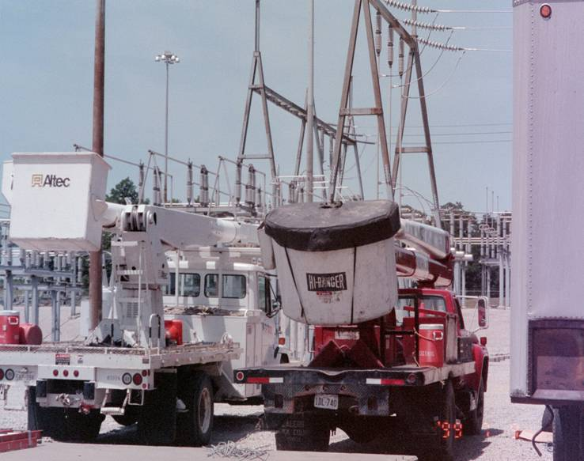
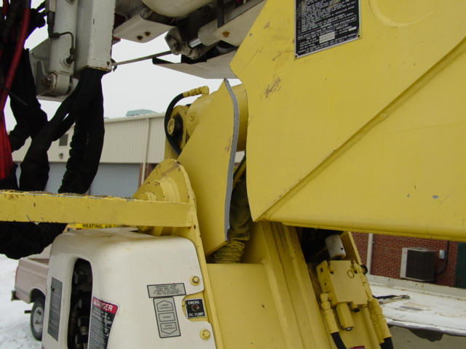
Safety Inspections
When NOT to use the aerial lift
Aerial device doesn’t look OK
Aerial device doesn’t pass daily inspection
Power unit fails inspection
Aerial device is inadequate
Company mandates different procedure and equipment

Slide 23
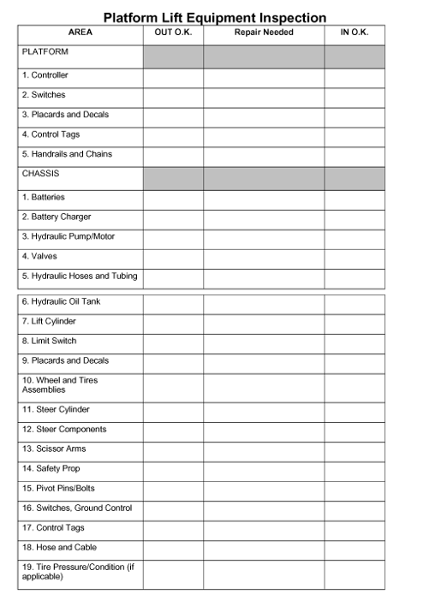
Safety Inspections
Record your inspection
Check all items
Add items if needed
Do the inspection
Serious problems, notify supervisor
Sign and date document

Slide 24
Operating the Aerial Device
Work location
Operating controls
Maintaining adequate line clearance
Doing the work
Finishing the job
End of day inspection

Slide 25
Operating the Aerial Device
Work Location
Convenient to most work
Out of traffic flow
Safe location for assistants
Minimize movement

Slide 26
Operating the Aerial Device
Work Location
Notify dispatcher of location
Set brakes
Use wheel chocks
Traffic warnings
Ground trucks
Pedestrian warnings

Slide 27
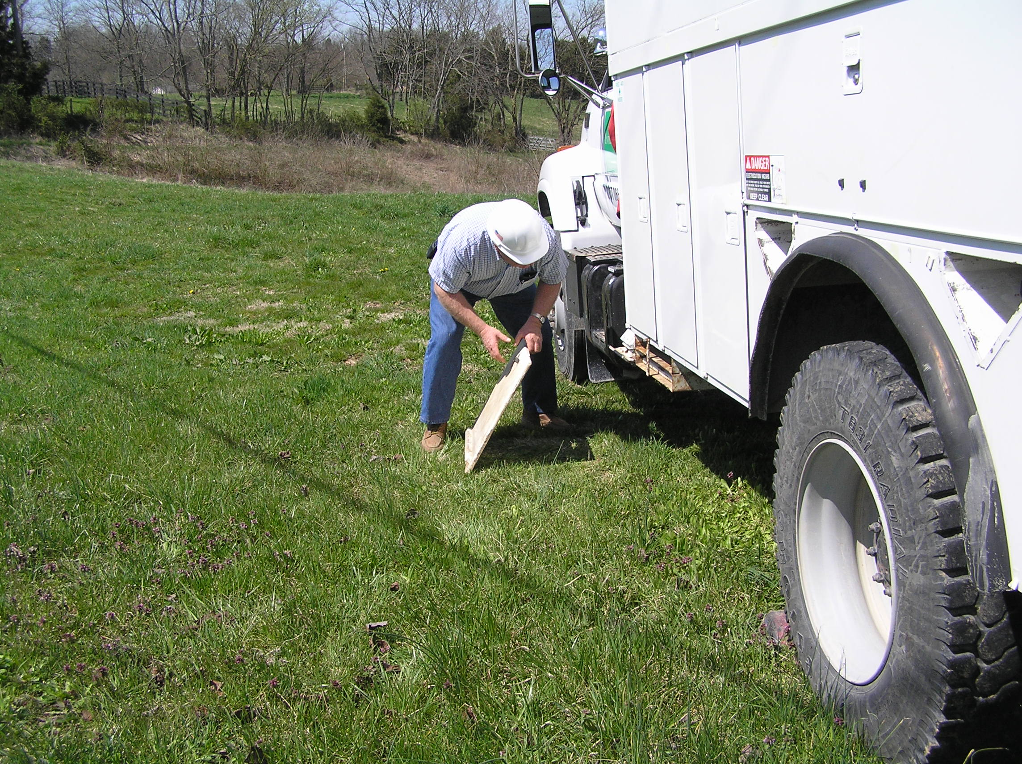
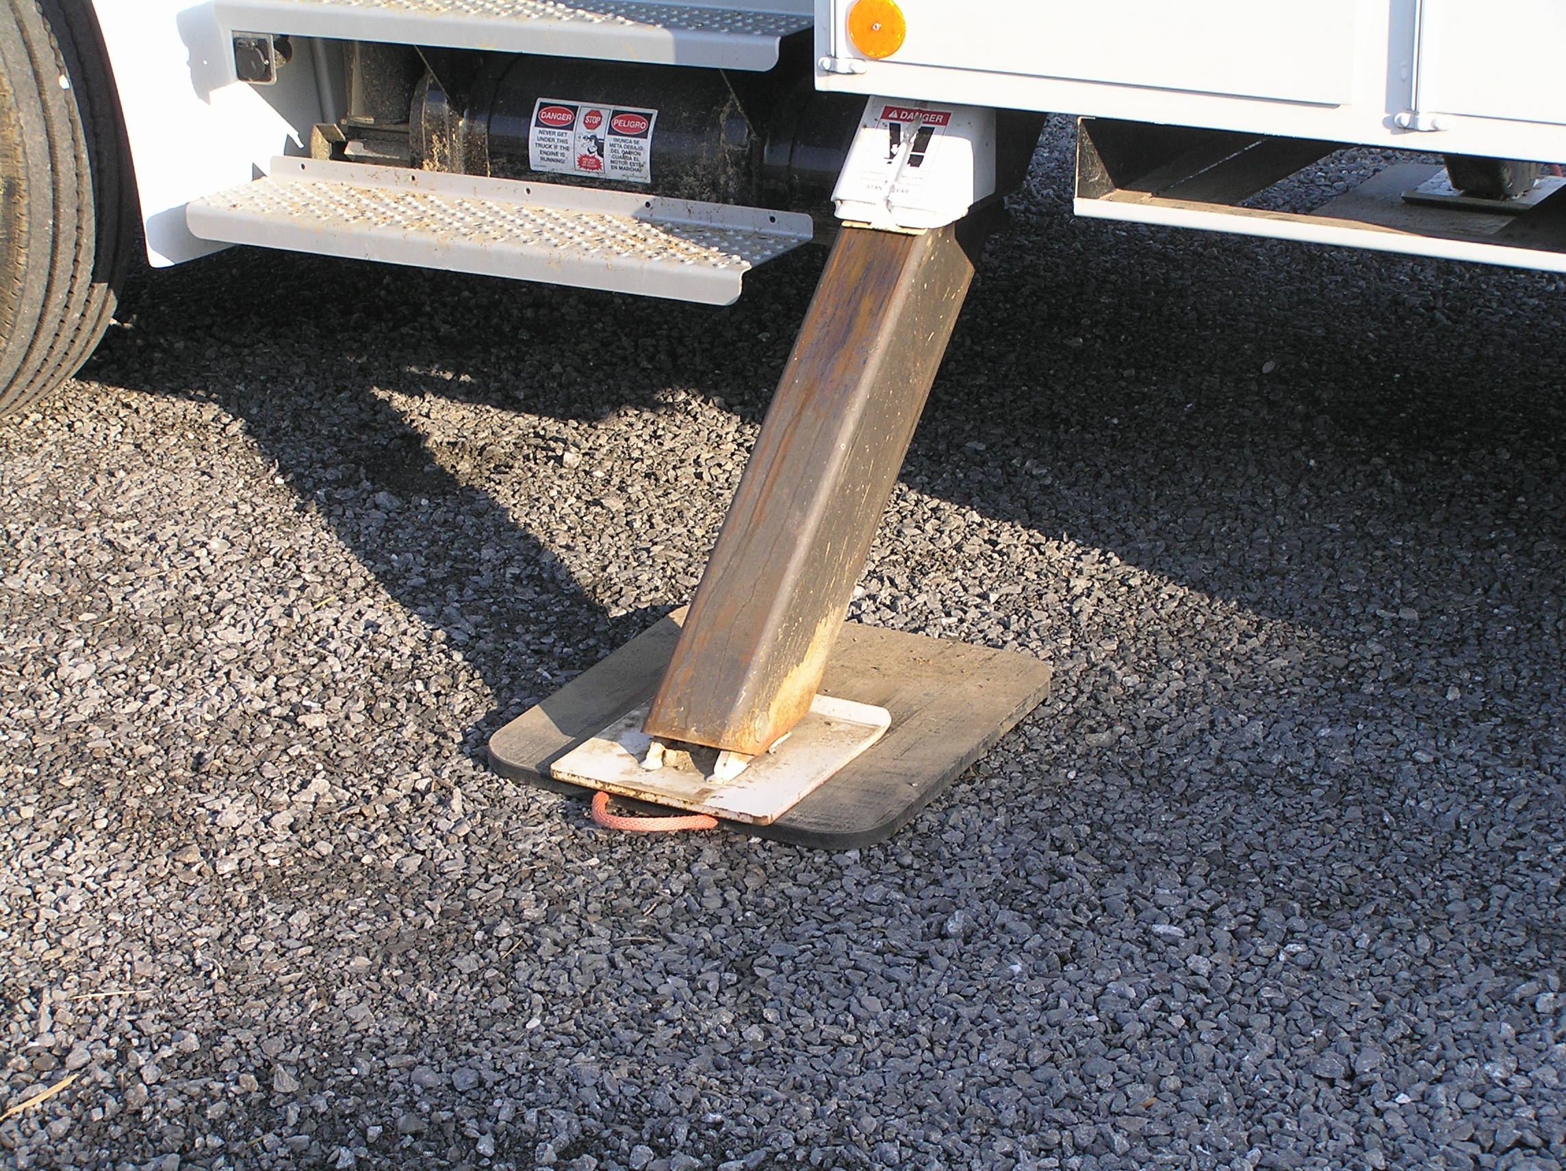
Operating the Aerial Device
Work Location
Use outrigger pads on solid surface
Use recommended equipment
Vehicle level
Unobstructed view to work location

Slide 28
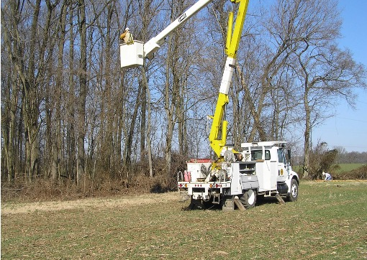
Operating the Aerial Device
Operating Controls
Know your device
Know your area
Feather controls
Watch all directions
Use PPE
Maintain conductor clearances
Ground equipment

Slide 29
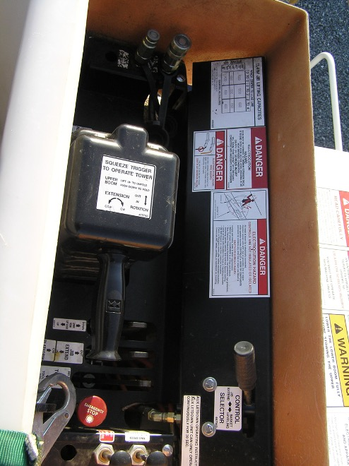
Operating the Aerial Device
Operating Controls
Deadman controls
Move control smoothly
Avoid sudden stops
Watch out for obstacles

Slide 30
Operating the Aerial Device
Doing the Work
Qualified person for work
Mind on your business
Use proper PPE
Stay alert
Use proper work practices
Maintain electrical clearances
Inspect job before leaving

Slide 31
Operating the Aerial Device
Finishing the Job
Work area has changed
Back out slowly
Watch for wires and poles
Watch out for employees
Secure aerial device

Slide 32
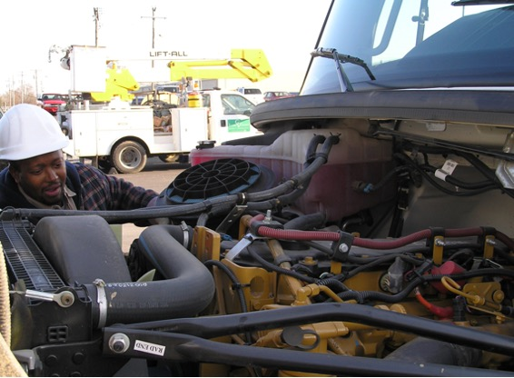
Operating the Aerial Device
End of Day Inspection
Inspect unit for broken parts
Look for leaks
Listen for unusual sounds
Do your housekeeping
Fill out report

Slide 33
Hazards Around Aerial Lift Devices
Pinch points
Hot parts
Fiberglass breaking down
Falling off unit
Hot oil under pressure
Spraying oil
Unit failure
Tip overs
Electrifying aerial device
Equipment fires
Falling out of unit
Personal electrocution
Oil injection into body parts
Falling material
Traffic and public hazards
Control handle continuity
Electrocution of ground workers

Slide 34
Hazards Around Aerial Lift Devices
Examples of hazards in the next few slides

Slide 35
Operator Control Continuity
Second point of contact

Slide 36
Ground Level Continuity
Electrocution to ground workers thru bucket outriggers and truck body
Step and touch potentials

Slide 37
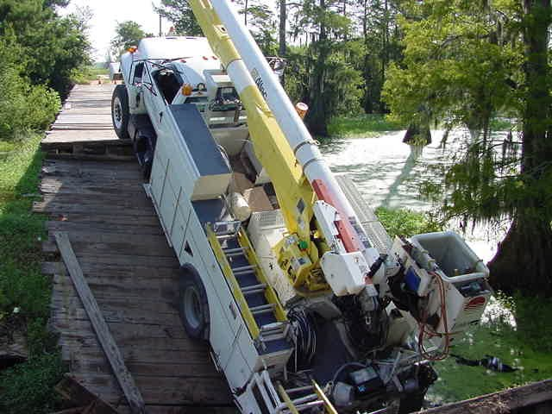
Hazards Around Aerial Lift Devices
Roadway failures
Culvert cave ins
Narrow roads

Slide 38
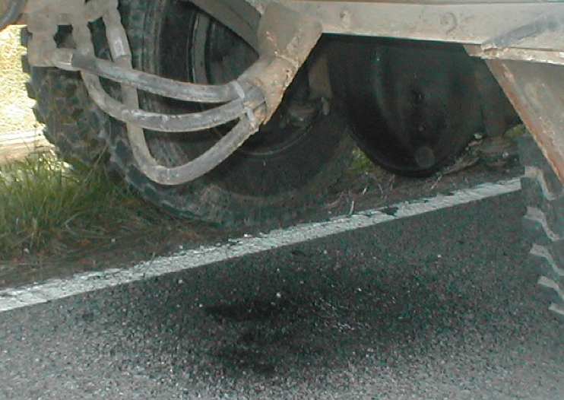
Hazards Around Aerial Lift Devices
Oil leaks
Oil contamination
Environmental

Slide 39
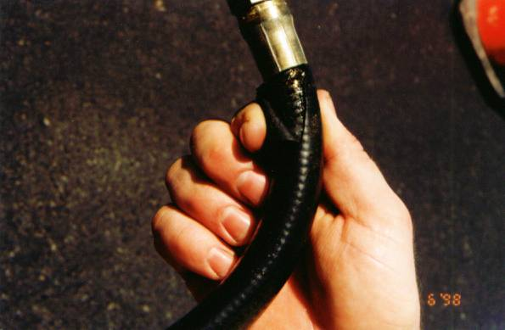
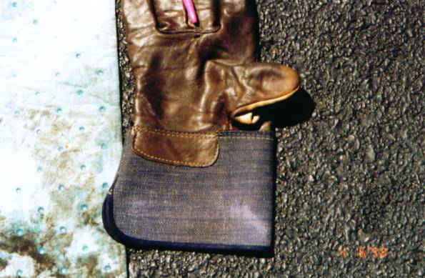
Hazards Around Aerial Lift Devices
Oil Injection
Oil hose failures
Rags and gloves are no match for high pressure oil lines

Slide 40
WARNING: Next slide is graphic

Slide 41
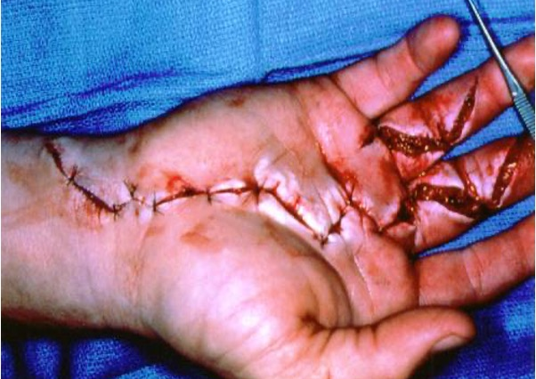
Hazards Around Aerial Lift Devices
Oil injection into hands and body parts can cause severe tissue damage and even death

Slide 42
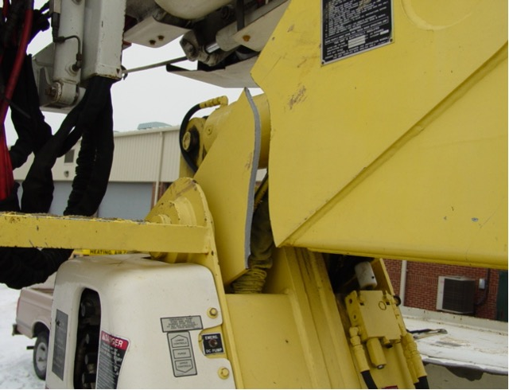
Hazards Around Aerial Lift Devices
Mechanical breakdown found at inspection or;
Mechanical breakdown in the air

Slide 43
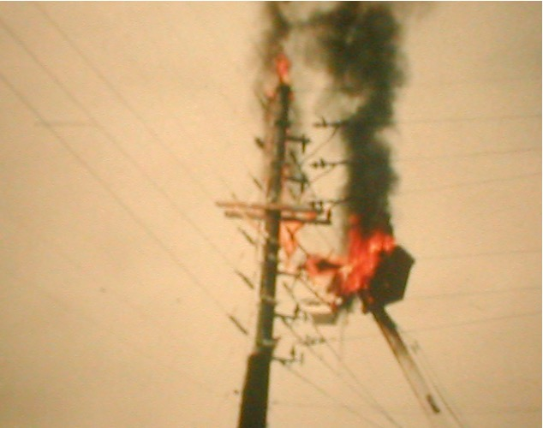
Hazards Around Aerial Lift Devices
Electrical fire
Electrical fire, oil fed
Fall danger
Electrocution
Toxic fumes

Slide 44
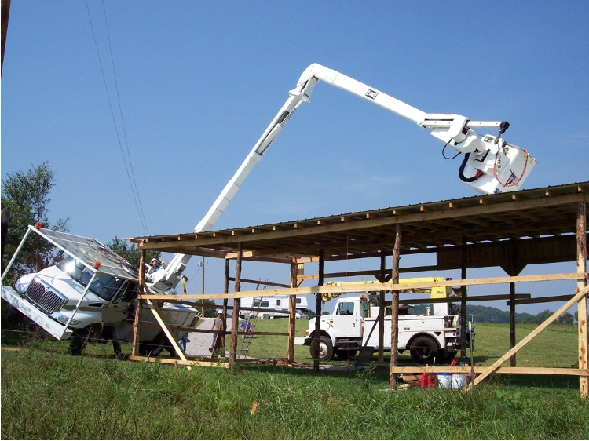
Hazards Around Aerial Lift Devices
Tip overs
Thrown out
Thrown into power
Struck by equipment

Slide 45
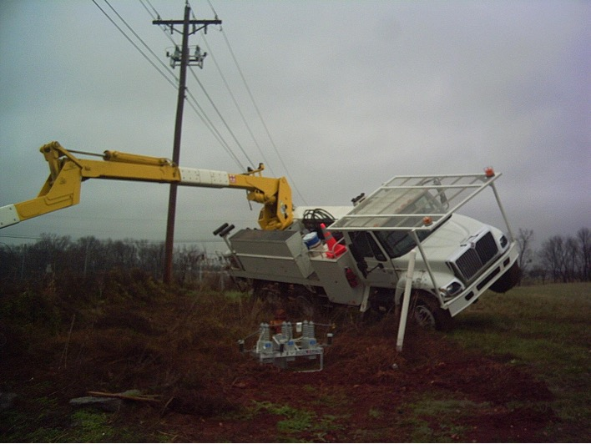
Hazards Around Aerial Lift Devices
Ground failure
Jack failures
Low tires
Unlevel terrain

Slide 46
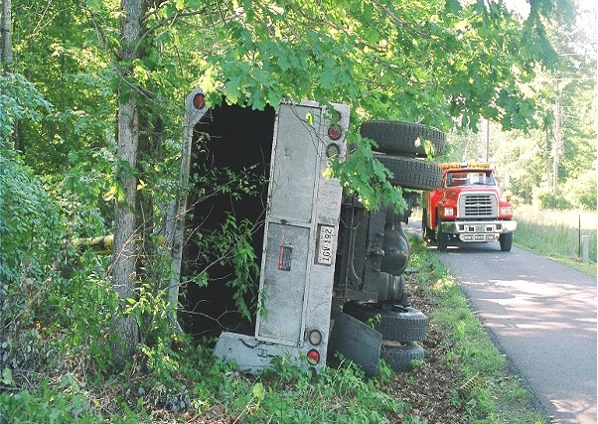
Hazards Around Aerial Lift Devices
Roll overs
Traffic crowding
High center of gravity

Slide 47
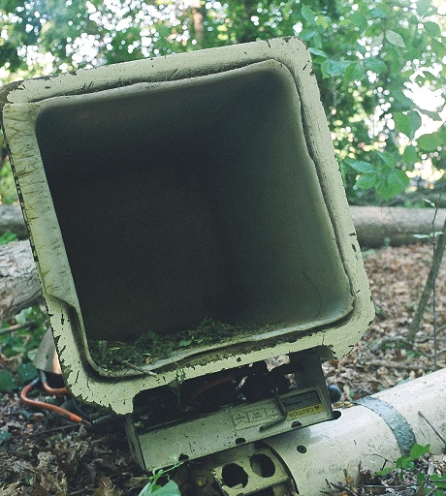
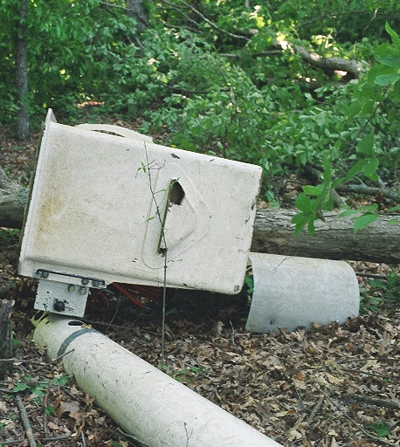
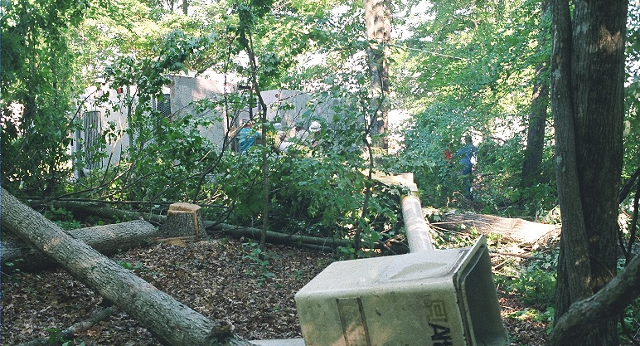
Hazards Around Aerial Lift Devices
Boom failures
Basket failures

Slide 48
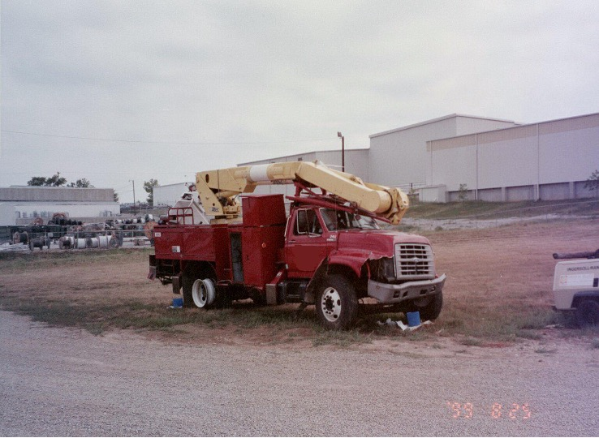
Hazards Around Aerial Lift Devices
Wide roads, narrow bridges
Rollovers
Bad suspension and tires

Slide 49
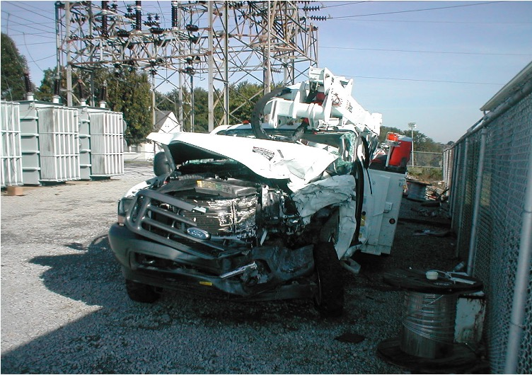
Hazards Around Aerial Lift Devices
Head-on crashes
Mystery crashes
Adverse working conditions
No brakes
Roll overs

Slide 50
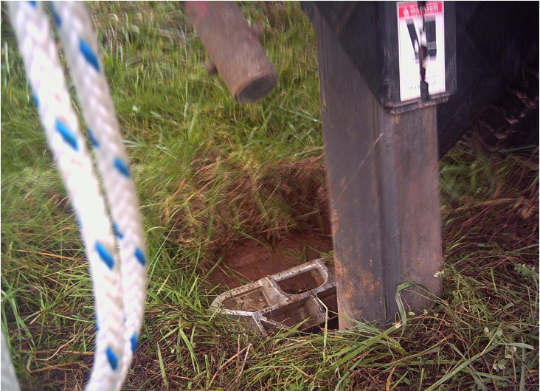
Hazards Around Aerial Lift Devices
Cave ins
Water meters
Septic tanks
Cemeteries

Slide 51
Bucket Rescue
Recognize problem with operator
Protect yourself
Call for help
Remove injured quickly
Don’t make situation worse
Follow up with written report

Slide 52
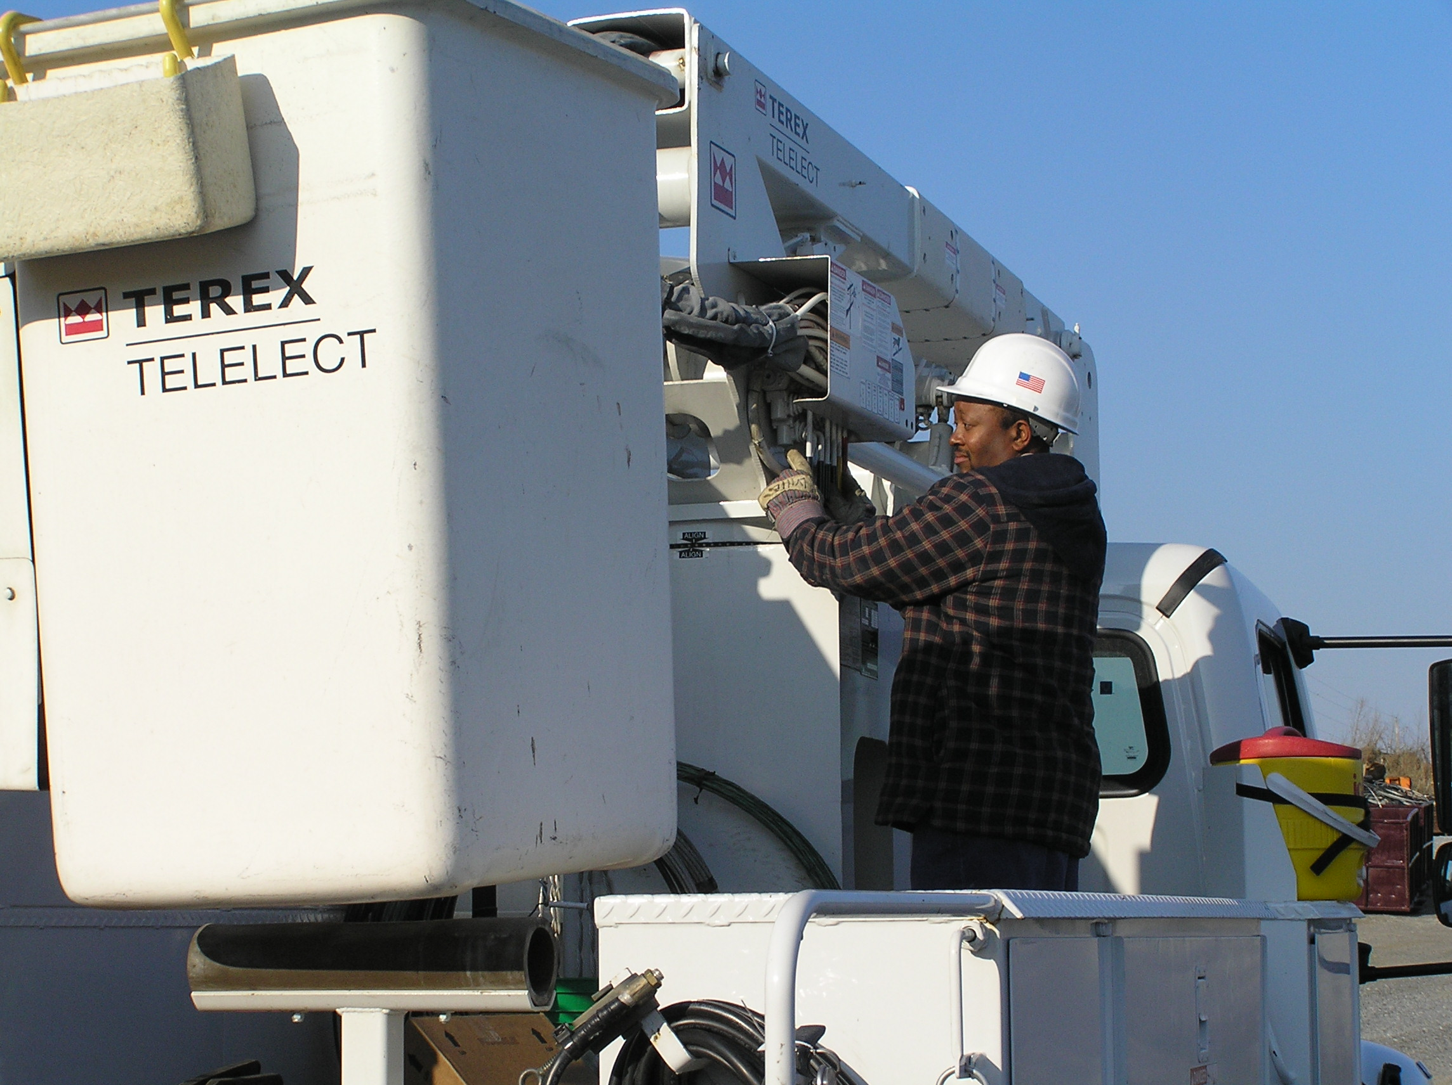
Bucket Rescue
Recognize a problem with operator
Over center travel units
Ask operator if they are OK
No response
Protect yourself
Call for assistance
Lower bucket by lower controls

Slide 53
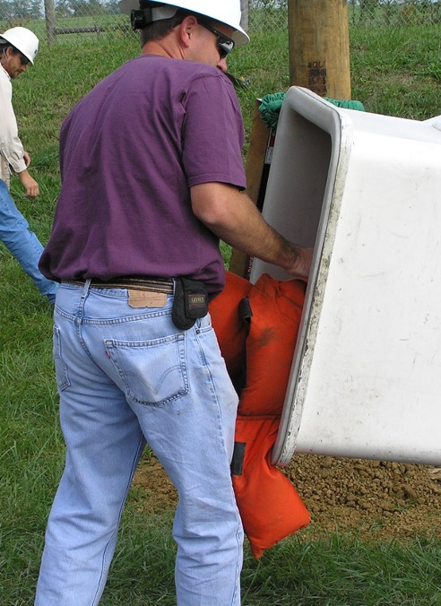
Bucket Rescue
Recognize a problem with operator
Over center travel units
Lower bucket to ground
Check operator’s condition
Remove from bucket
Perform first aid

Slide 54
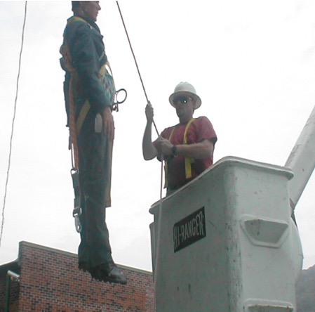
Bucket Rescue
Recognize a problem with operator
Non-over center units
Ask operator if they are OK
No response
Protect yourself
Call for assistance
Lower bucket by lower controls
Use boom/blocks to remove operator from bucket

Slide 55
Bucket Rescue
Recognize problem with operator
Non-over center units
Check operator's condition
Begin first aid

Slide 56
Escape from Disabled Aerial Lift
Have a plan
Know your emergency equipment
Work in pairs
Be able to utilize existing supplies for escape

Slide 57
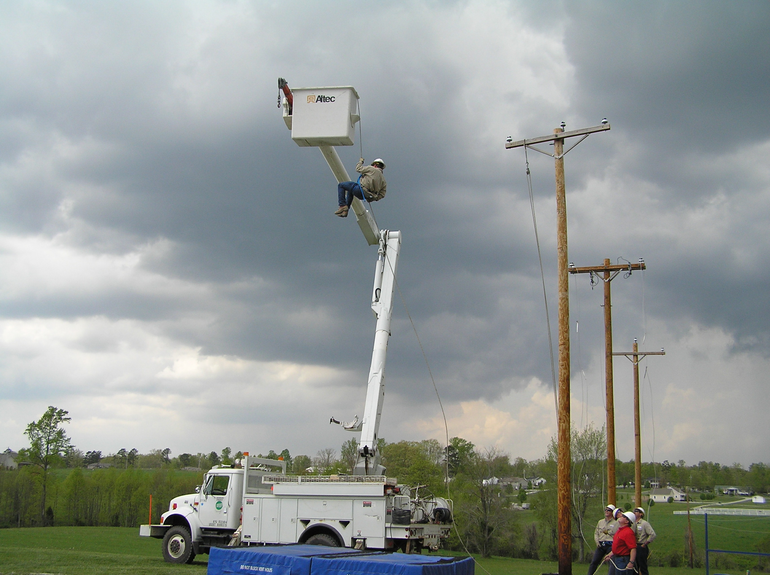
Escape from Disabled Aerial Lift
Escape by another device
Escape by power pack
Escape by pole
Escape by rope
Escape plan, plan ahead

Slide 58
Summary
Learn your equipment
Follow rules and policies
Operate slowly and cautiously
Feather controls
Watch out for changing conditions
Have an emergency plan in mind

Slide 59
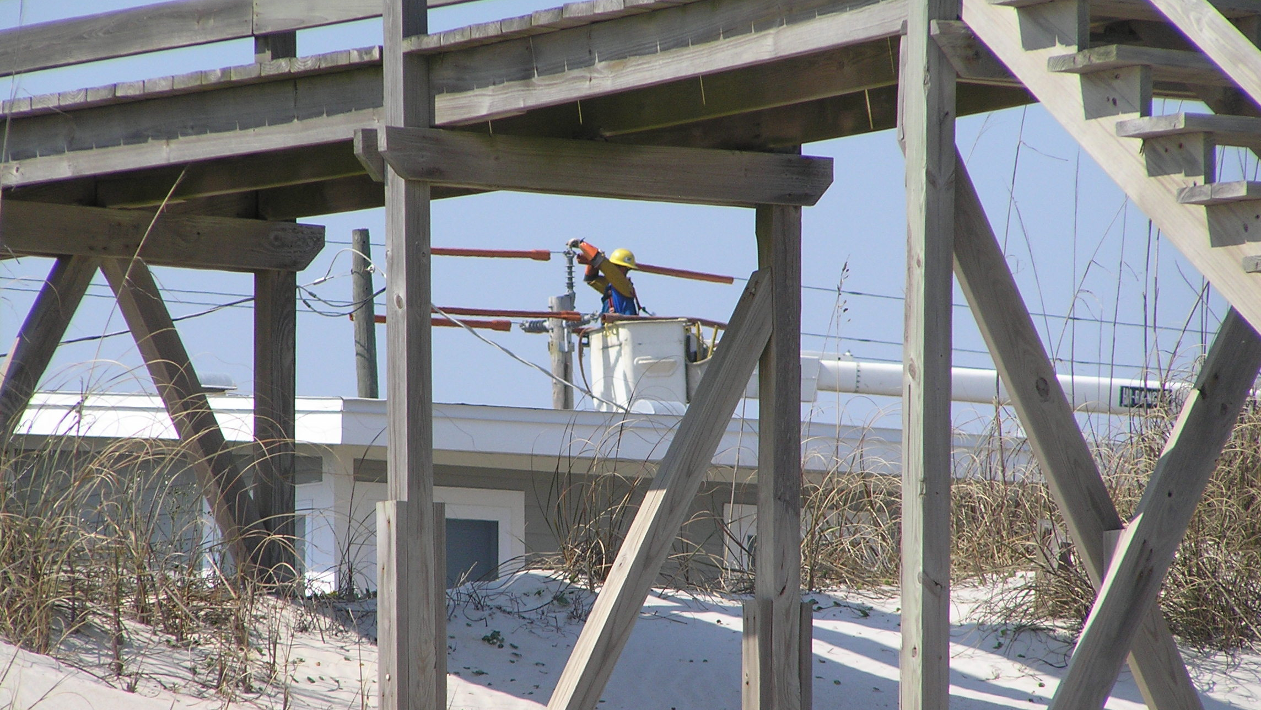
Questions?

Slide 60
Thank you
ISPC
info@ispconline.com
430.201.3201

