Slide 1
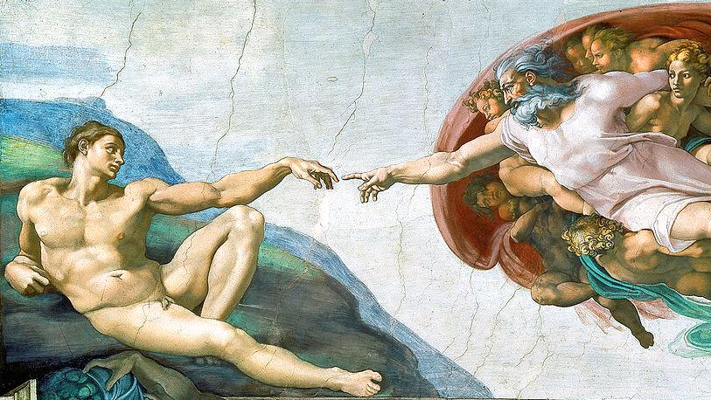
Humanity
and Human Rights

Slide 2
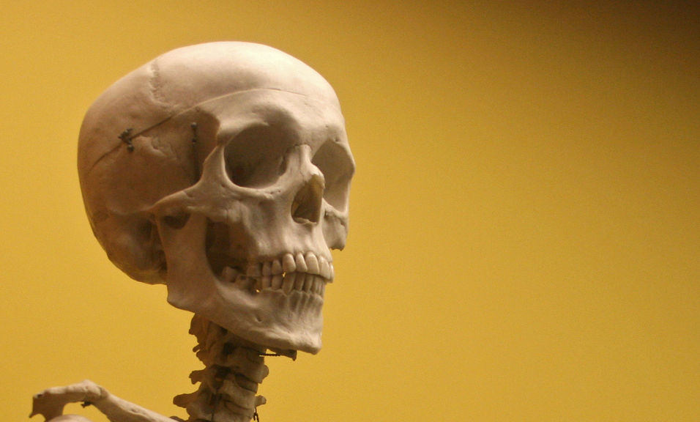
What does it mean to be human?
Photo by woodleywonderworks

Slide 3
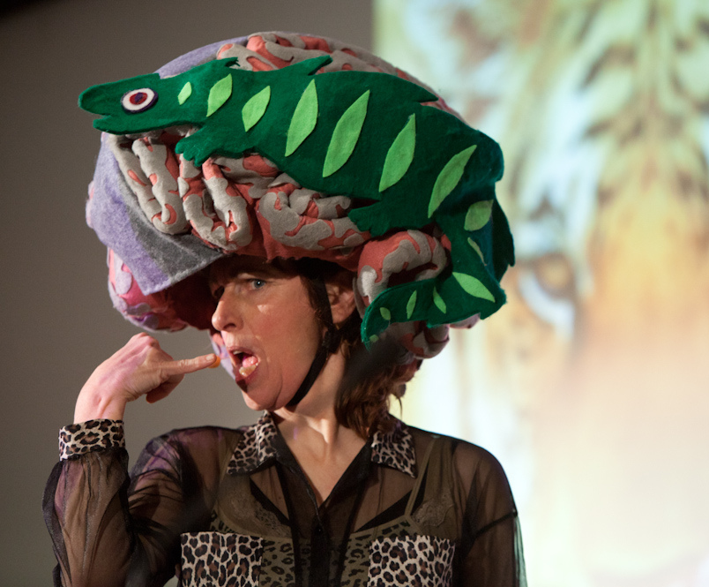
1
The Human BRAIN
Some rights reserved by TEDxPioneerValley2012

Slide 4
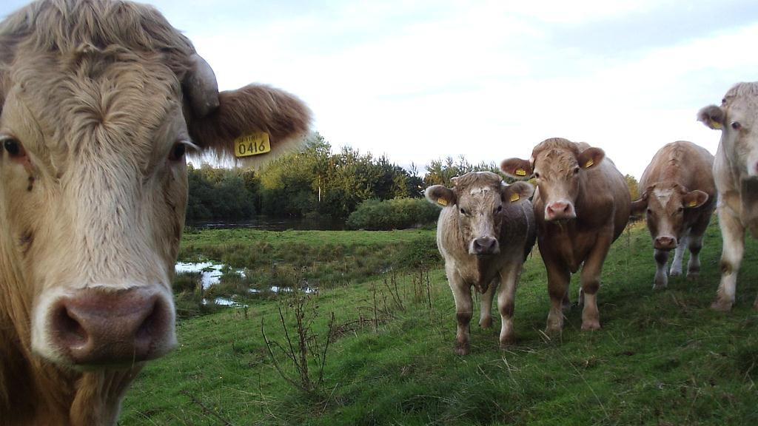
The brain is not enough.
Some rights reserved by I-Man--10N

Slide 5
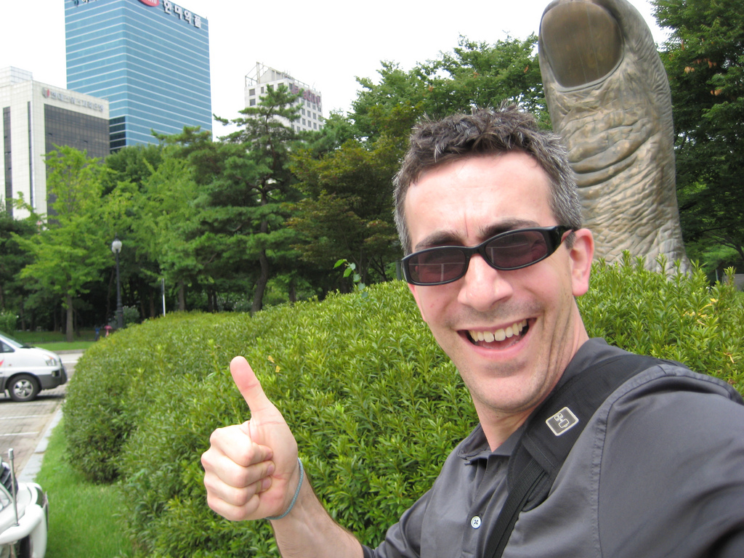
2
Opposable THUMBS
Some rights reserved by TPapi

Slide 6
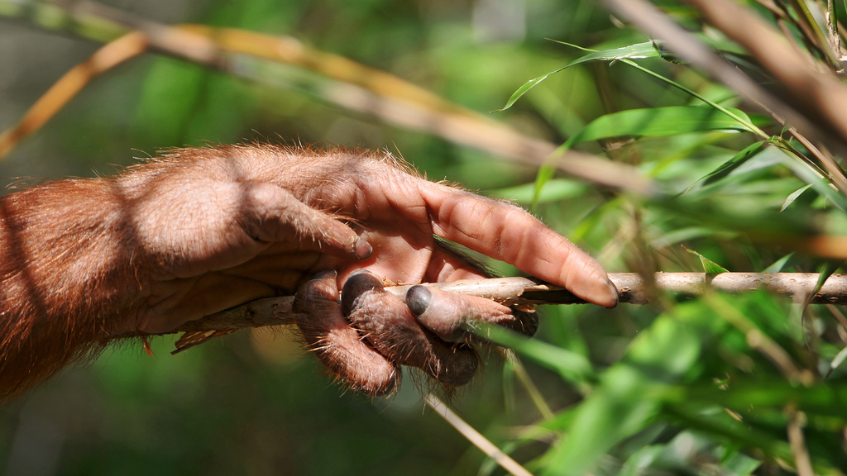
Tools
Photo by Tambako The Jaguar
http://youtu.be/c1DYgc0GF3k

Slide 7
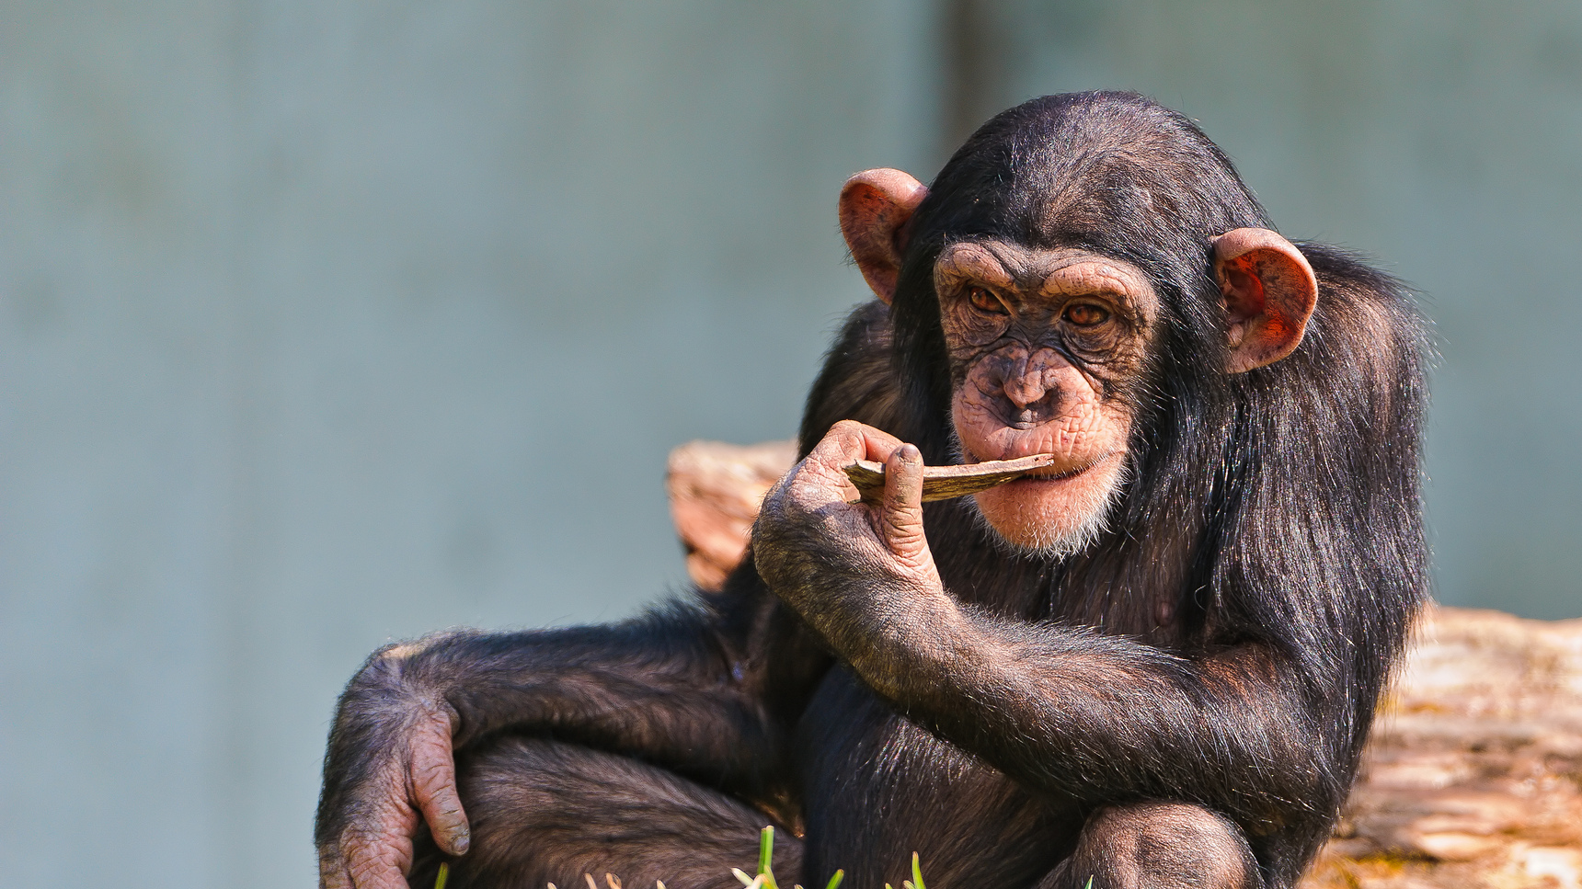
Tool Use vs. Technology Use

Slide 8
Monkeys can pick up things and use them.
Photo by Tambako The Jaguar

Slide 9
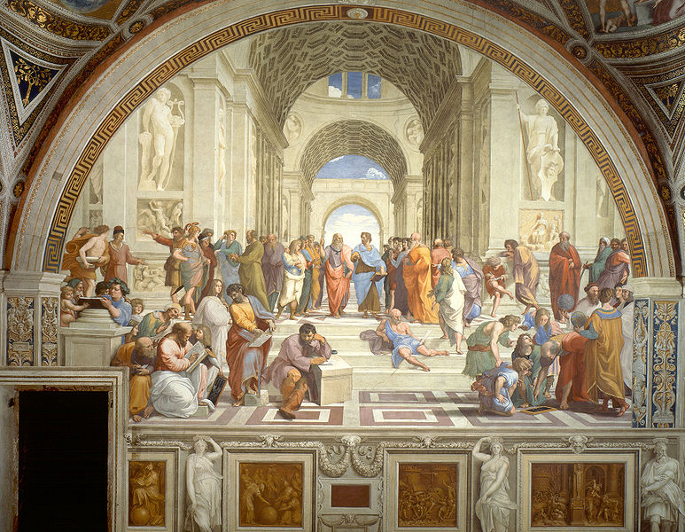
But only humans can create something entirely new.

Slide 10
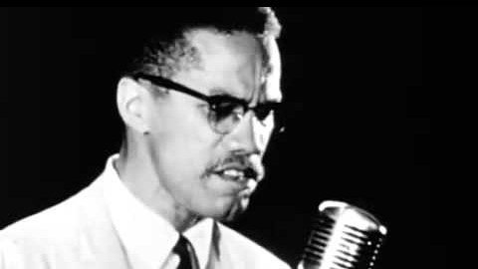
http://www.youtube.com/watch?v=mnJWQb0PjVM

Slide 11
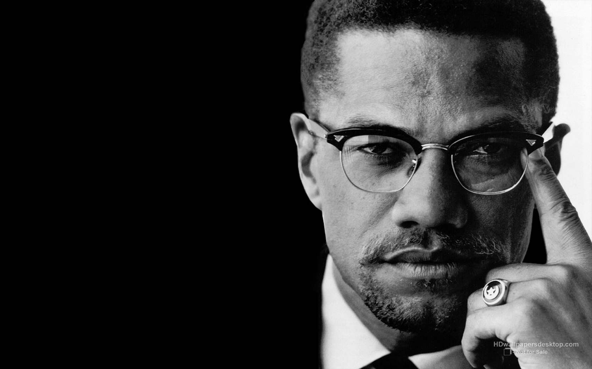
“We declare our right on this earth to be a man, to be a human being, to be respected as a human being, to be given the rights of a human being in this society, on this earth, in this day, which we intend to bring into existence by any means necessary.”
-- Malcolm X

Slide 12
What does it mean
to be a HUMAN BEING?

Slide 13
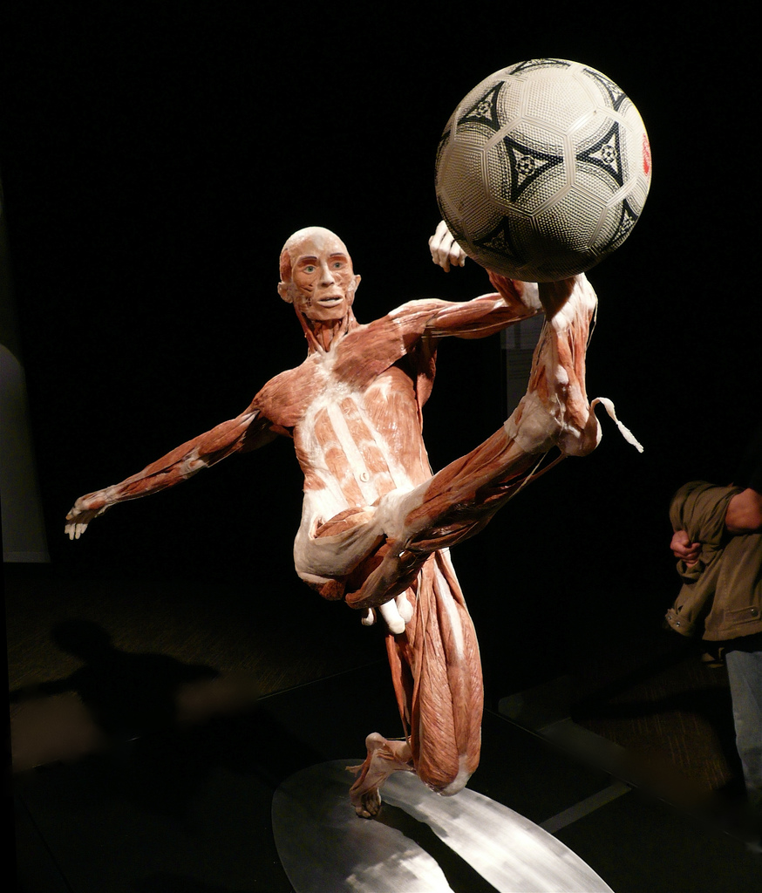
It’s more than just biology.
Photo by Steve Jurvetson

Slide 14
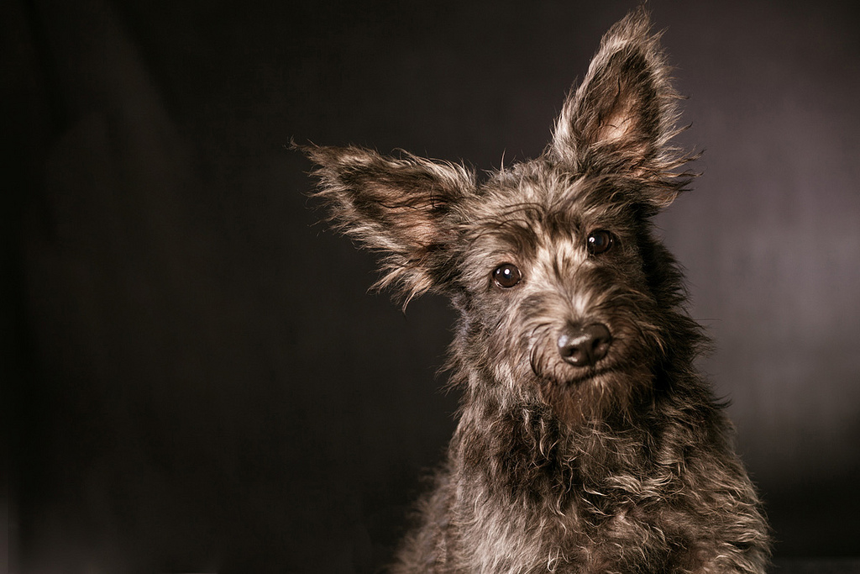
Humane
Photo by Mustafa Sayed

Slide 15
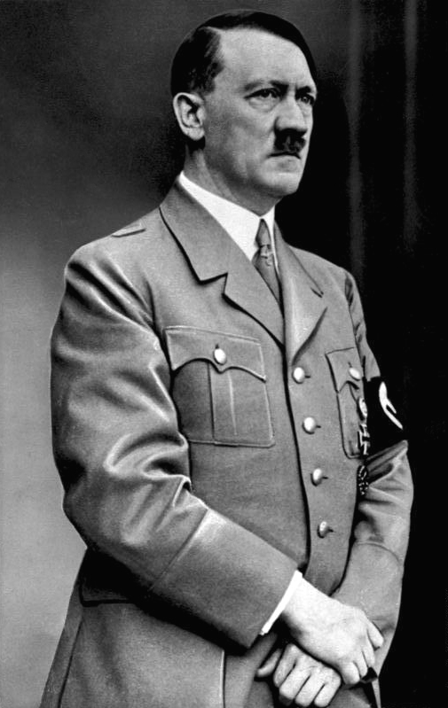
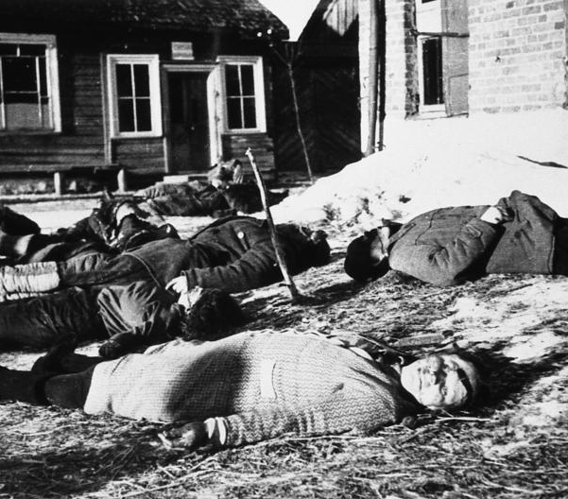
INHUMAN
German Federal Archive

Slide 16
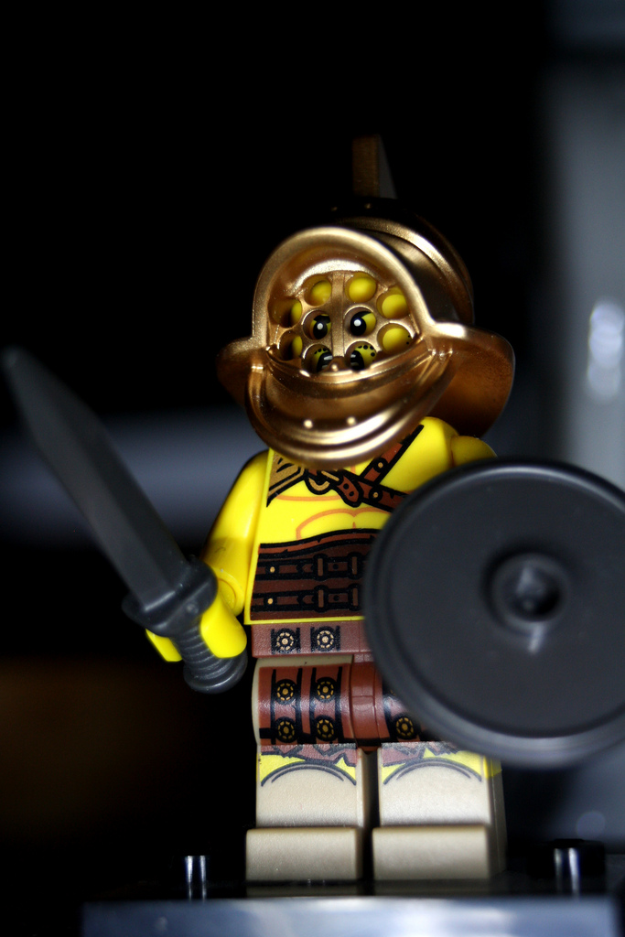
Barbarian
Photo by Chris Isherwood

Slide 17
Bar bar bar bar bar bar bar bar bar bar
Photo by Chris Isherwood

Slide 18
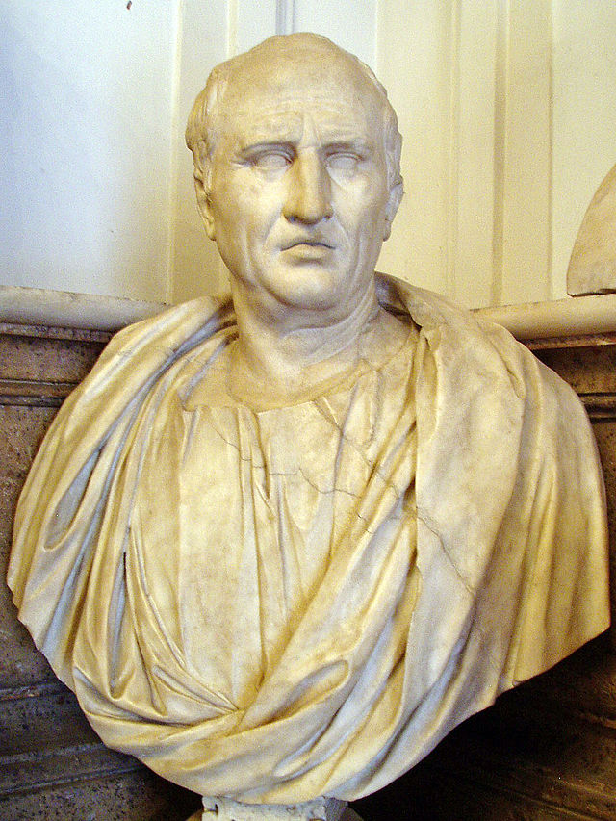
“Humanities”
From humanitas, coined by Cicero to describe the education of a cultivated human being
Photo by Glauco92

Slide 19
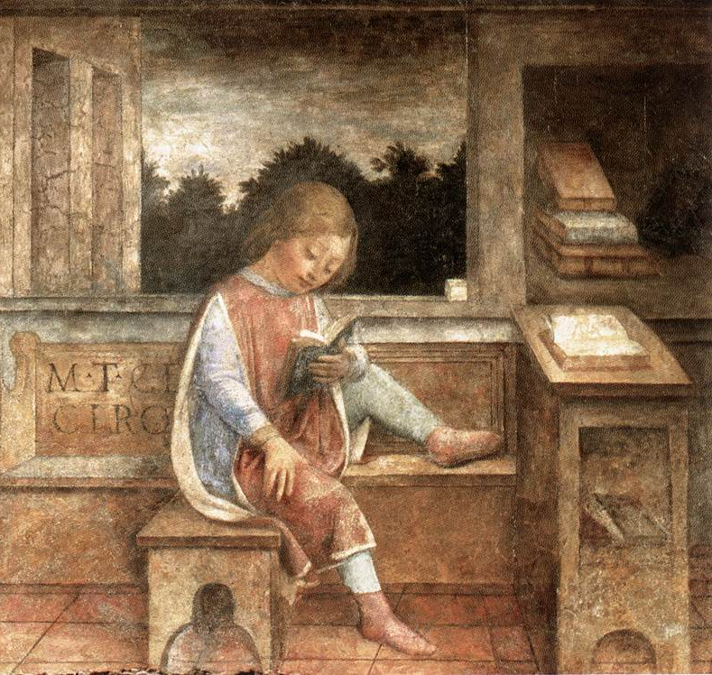
Humanities
History
Literature
Art
Music
Philosophy
Vincenzo Foppa, The Young Cicero Reading (1464)

Slide 20
WHODUNIT?

Slide 21
CHIMP!
Photo by Michele W

Slide 22
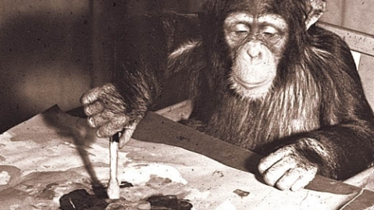
Congo the Chimp
WATCH ON YOUTUBE

Slide 23
“What a great miracle is man…”

Slide 24
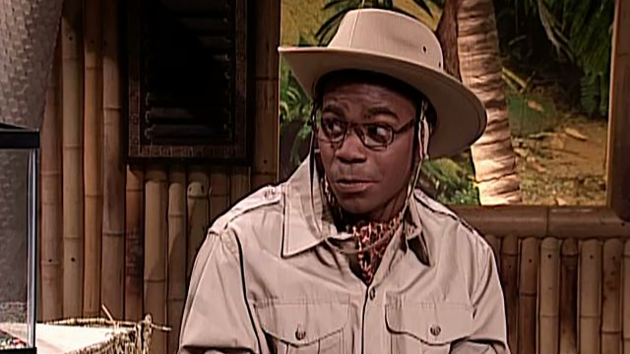
A rabbit can’t cut its own hair…
A Rabbit and a Donkey
(Brian Fellow’s Safari Planet)

Slide 25
ONLY A HUMAN COULD DO THIS.

Slide 26
BELL RINGER
What traits make humans different from other animals? Be sure to note which differences are fundamental and which differences are by degree.

Slide 27
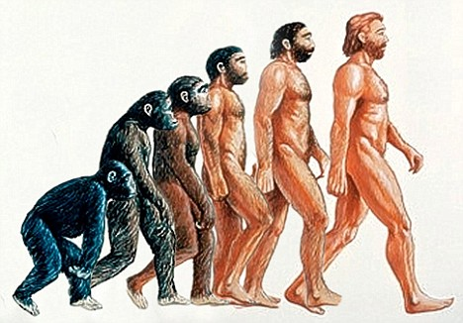
Ideas Concerning Human Origins
Special Creation
Human Evolution
Faith and modern science have both put forward explanations of human origins that everyone who seeks to be human must grapple with at some point.

Slide 28
Michelangelo, The Creation of Adam
Special
Creation

Slide 29
Darwinian Evolution
Humans evolved through a process of natural selection.
Notes:
Image Source: http://wikimotive.com/wikiblog/content-marketing-syndication-for-seo/

Slide 30
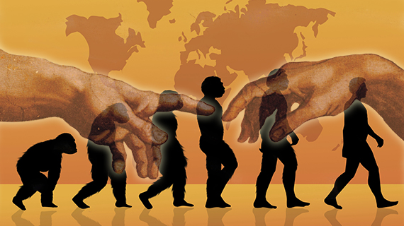
“Theistic” Evolution
Belief in a God-directed evolutionary process
Notes:
Photo Source: http://www.equip.org/articles/neither-human-evolution-nor-theistic-evolution-1/

Slide 31
What are the RIGHTS…
of a HUMAN BEING?

Slide 32
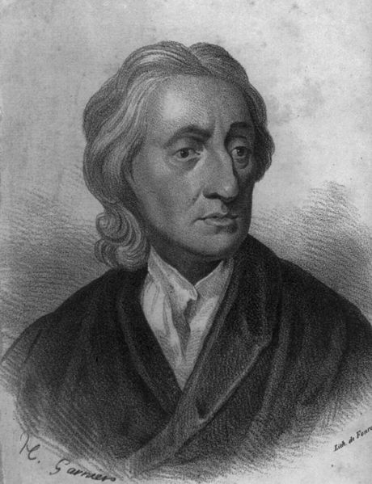
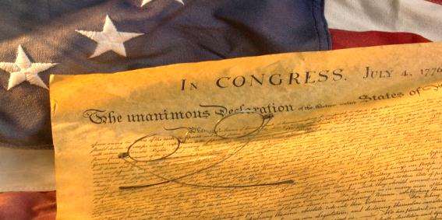
Natural Rights
L
L
P
ife
iberty
roperty
God-given
The U.S. Declaration of Independence employs the language of Locke’s natural rights theory.
John Locke
(Philosopher)

Slide 33
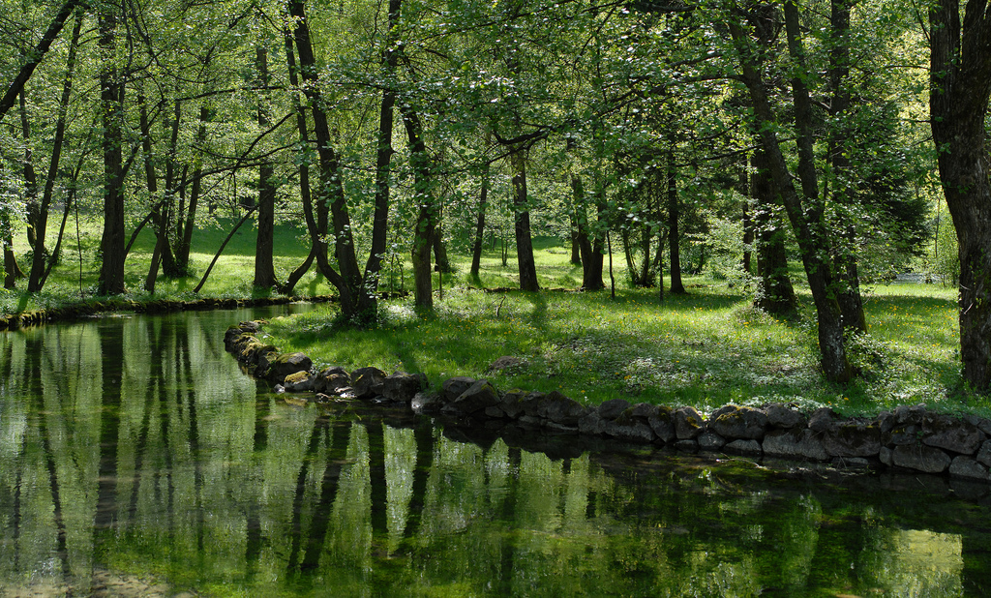
State of Nature
Some rights reserved by Rudolf Getel

Slide 34
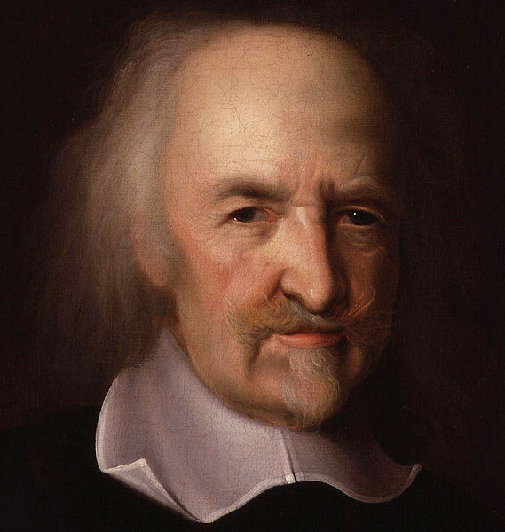
Thomas Hobbes
Leviathan

Slide 35
State of War
Photo by PEOSoldier

Slide 36
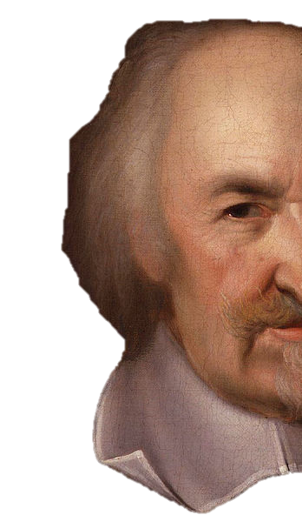
Bellum Omnium Contra Omnes

Slide 37
War of ALL against ALL.

Slide 38
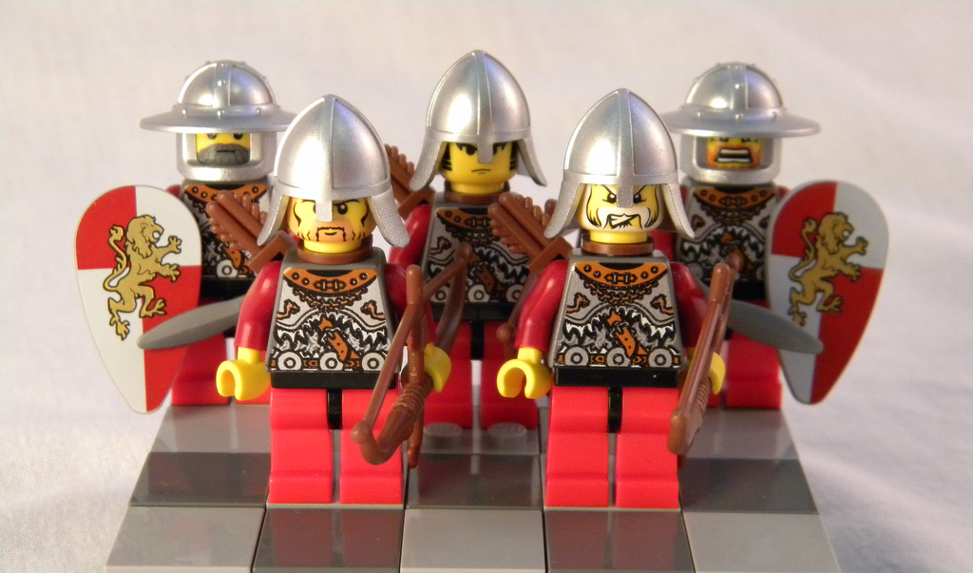
We have only those rights we can DEFEND.
Photo by minivan1411

Slide 39
Social Darwinism
The application of Darwinian biological theory to social relations
Some rights reserved by kate.gardiner

Slide 40
Survival of the Fittest
Some rights reserved by kate.gardiner

Slide 41
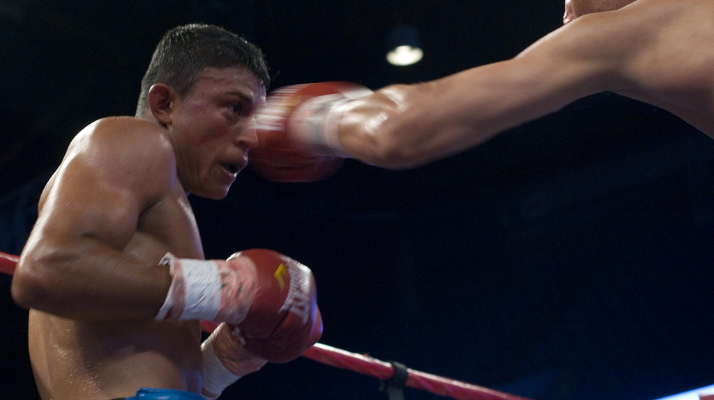
COMPETITION
The ONLY natural right
Some rights reserved by kate.gardiner

Slide 42
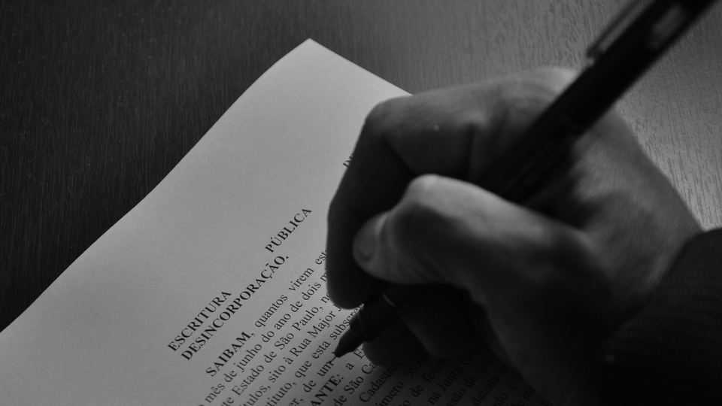
SOCIAL CONTRACT
Photo by .v1ctor Casale.

Slide 43
We give up some natural rights…
Man by Alan Berkowitz via the Noun Project
Photo by .v1ctor Casale.

Slide 44
We give up some natural rights…
So that we can KEEP the rest.
Man by Alan Berkowitz via the Noun Project
Photo by .v1ctor Casale.

