Slide 1
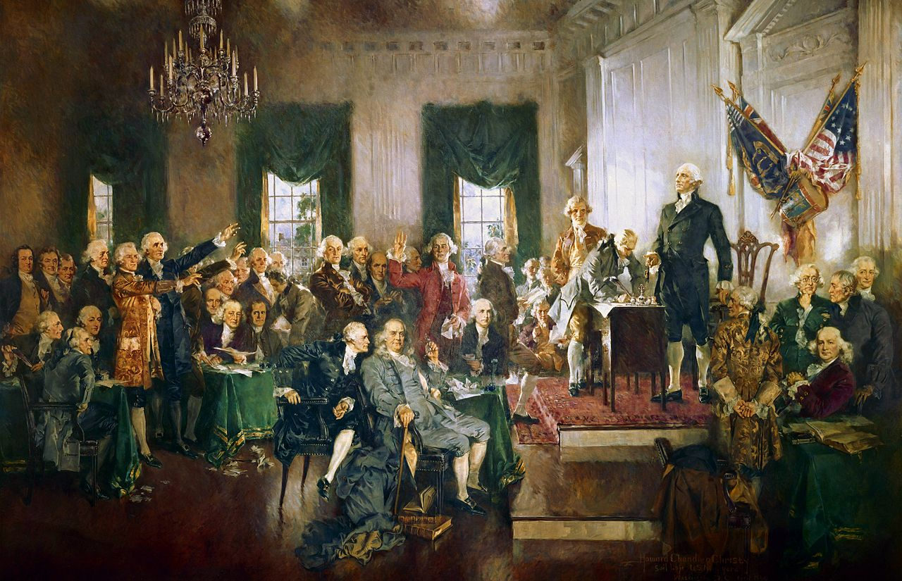
The Constitutional Convention
Howard Chandler Christy, Scene at the Signing of the Constitution of the United States (1940)

Slide 2
USHC 1.4
Analyze how dissatisfactions with the government under the Articles of Confederation were addressed with the writing of the Constitution of 1787, including the debates and compromises reached at the Philadelphia Convention and the ratification of the Constitution.

Slide 3
Elite Consensus:
The Articles aren’t working.
Photo by Nesster

Slide 4
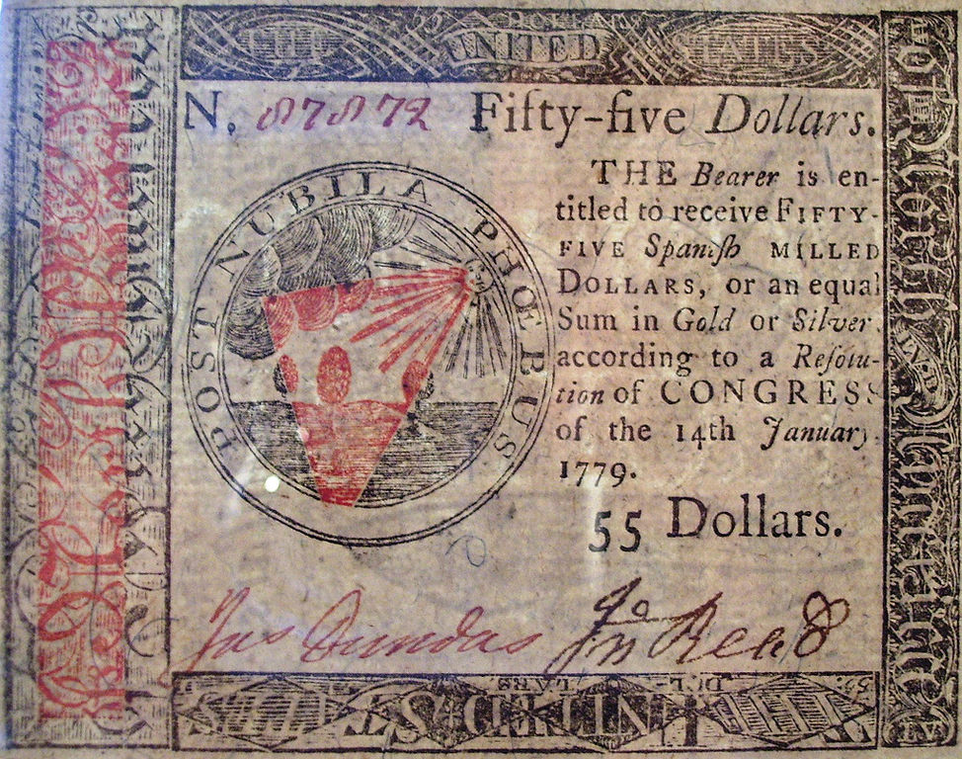
Bad Economy
Image by Beyond My Ken

Slide 5
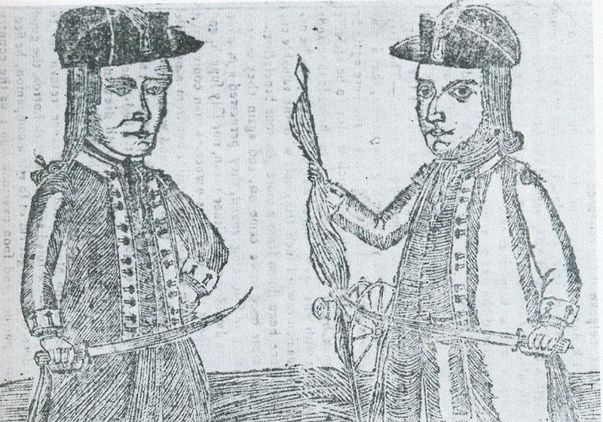
Shays’ Rebellion

Slide 6
TRADE BARRIERS
Photo by Eddy Van 3000

Slide 7
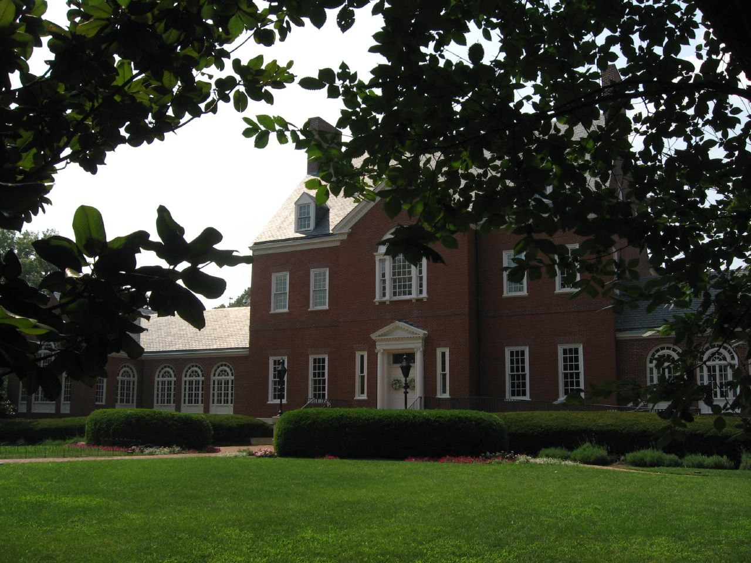
The Annapolis Convention 1786
Photo by Ken Lund

Slide 8
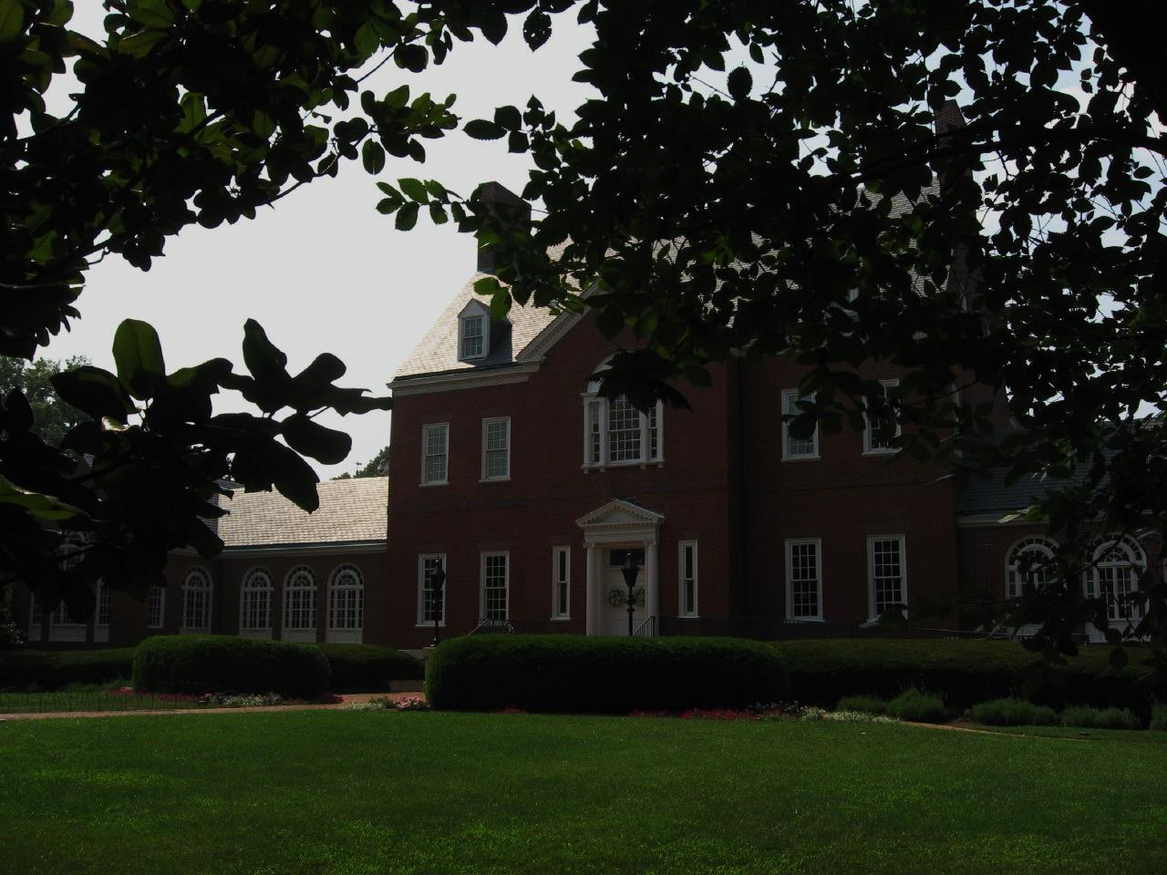
Let’s meet again.
Photo by Ken Lund

Slide 9
Let’s meet again. Next year.
Photo by Ken Lund

Slide 10
Let’s meet again. Next year. With more people.
Photo by Ken Lund

Slide 11
The Philadelphia Convention 1787

Slide 12
The Philadelphia Convention 1787
STATED PURPOSE:
Amend the Articles

Slide 13
LOL
They have no idea.

Slide 14
FROM SCRATCH
Photo by photochem_PA

Slide 15
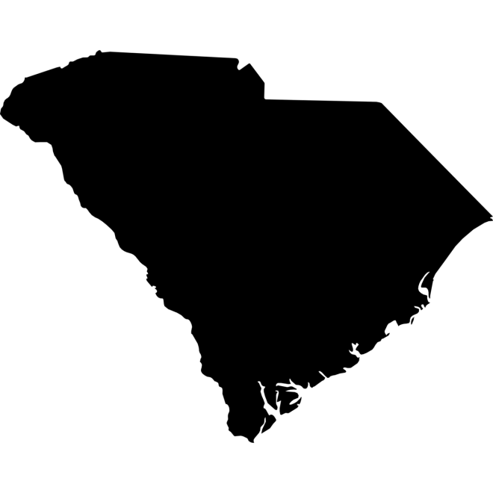
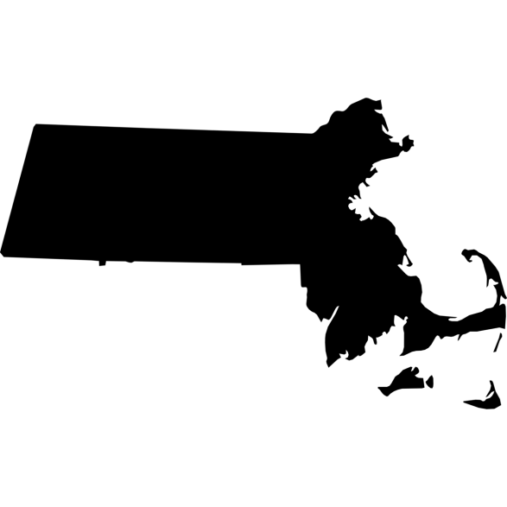
LARGE STATE
small state
Slave State
Free State
State icons designed by Ted Grajeda from the Noun Project

Slide 16
Statistics From the 1790 Census
 | State Population | Percentage of Total | Regional Population |  |  | Number of Slaves | Percentage of Population
New Hampshire | 141,885 | 4% |  |  |  | 158 | 0%
Massachusetts | 378,787 | 10% |  |  |  | 0 | 0%
Connecticut | 237,946 | 7% |  |  |  | 2,759 | 1%
Rhode Island | 68,825 | 2% |  |  |  | 152 | 0%
NEW ENGLAND |  | 23% | 827,443
New Jersey | 184,139 | 5% |  |  |  | 11,423 | 6%
New York | 340,120 | 9% |  |  |  | 21,324 | 6%
Pennsylvania | 434,373 | 12% |  |  |  | 3,737 | 1%
MIDDLE STATES |  | 26% | 958,632
NORTH OF MASON/DIXON |  | 49% | 1,786,075 |  | Slaves (North) | 39,853 | 6%
Delaware | 59,096 | 2% |  |  |  | 8,887 | 15%
Maryland | 319,728 | 9% |  |  |  | 103,036 | 32%
Virginia | 747,610 | 20% |  |  |  | 293,427 | 39%
North Carolina | 393,751 | 11% |  |  |  | 100,572 | 26%
South Carolina | 249,073 | 7% |  |  |  | 107,094 | 43%
Georgia | 82,548 | 2% |  |  |  | 29,264 | 35%
SOUTHERN STATES |  | 51% | 1,851,806 |  | Slaves (South) | 642,280 | 94%
TOTAL POPULATION |  |  | 3,637,881 |  | SLAVE POPULATION | 681,833 | 15%
Sources: http://www.infoplease.com/ipa/A0004986.html http://manyeyes.alphaworks.ibm.com/manyeyes/visualizations/slave-population-of-us-states-and-te

Slide 17
LEGISLATIVE BRANCH

Slide 18
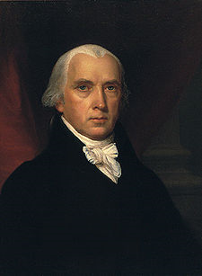
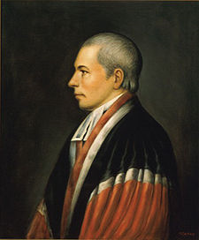
VIRGINIA PLAN
new jersey plan
JAMES MADISON
william paterson
BICAMERAL Legislature
unicameral legislature
Based on POPULATION
one vote
per state
View Census Data

Slide 19
How do we share?
Photo by Vegan Feast Catering

Slide 20
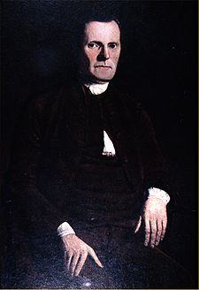
“GREAT COMPROMISE”
Roger Sherman (CT)
View Census Data
House of Representatives
Lower House
Senate
Upper House
Based on POPULATION
Two Votes Per State
Elected by Voters
(DIRECT)
Appointed by
State Legislatures (INDIRECT)

Slide 21
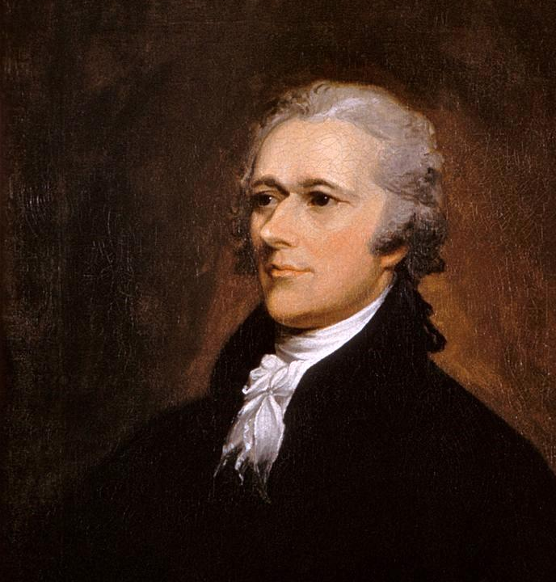
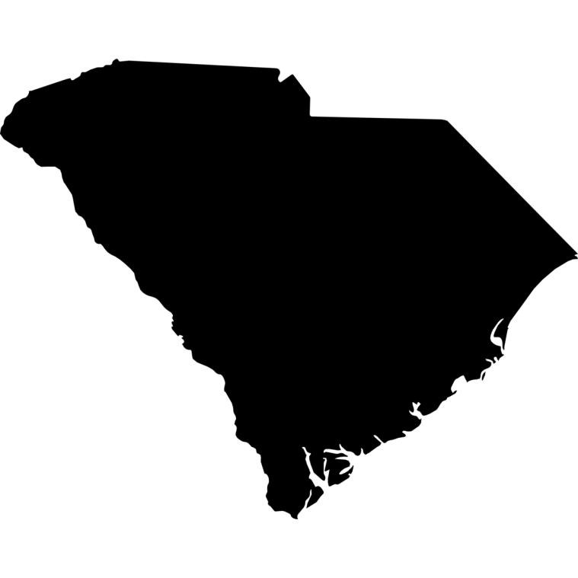
Hamilton’s Plan
for a national government
State Sovereignty

Slide 22
The convention heard Hamilton’s plan, but did not debate it.

Slide 23
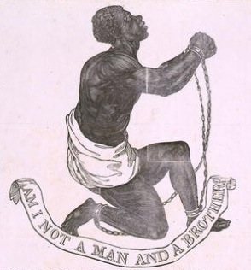
QUESTION:
Should slaves be counted for purposes of representation in the lower house of Congress?
Consider the interests of your assigned state when answering.
View Census Data

Slide 24
The “Three-Fifths” Compromise
FOR THE SOUTH | FOR THE NORTH
For representation in Congress, slaves counted as 3/5 of a person. | After 20 years, Congress has the power to regulate (or outlaw) the international slave trade.
3/5

Slide 25
The “Three-Fifths” Compromise
FOR THE SOUTH | FOR THE NORTH
For representation in Congress, slaves counted as 3/5 of a person. | After 20 years, Congress has the power to regulate (or outlaw) the international slave trade.
3/5

Slide 26
EXECUTIVE BRANCH

Slide 28
ELECTORAL

Slide 29
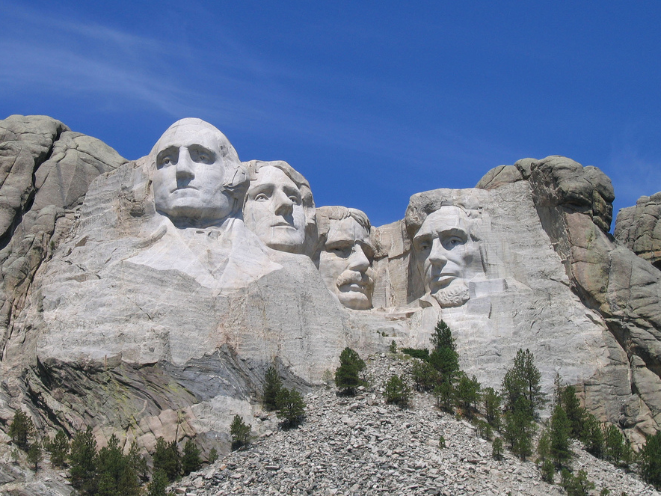
ELECTORAL COLLEGE
Photo by Liz Lawley

Slide 30
ELECTORAL COLLEGE
Each state will send electors to cast votes for President.
Photo by Liz Lawley

Slide 31
ELECTORAL COLLEGE
# of ELECTORS =
# of Senators + Reps
Photo by Liz Lawley

Slide 32
The LARGE STATES get more electoral votes.
Photo by DaPuglet

Slide 33
The small states get a head start.
Photo by greg westfall

Slide 34
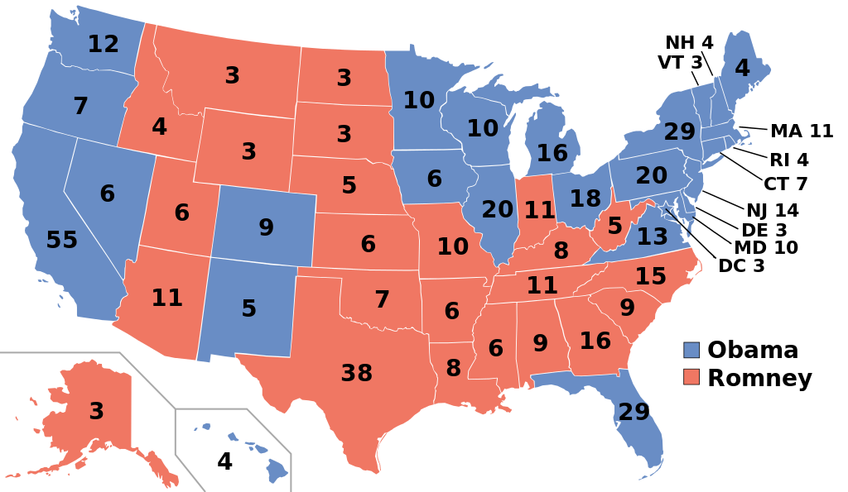
2012 Presidential Election

Slide 35
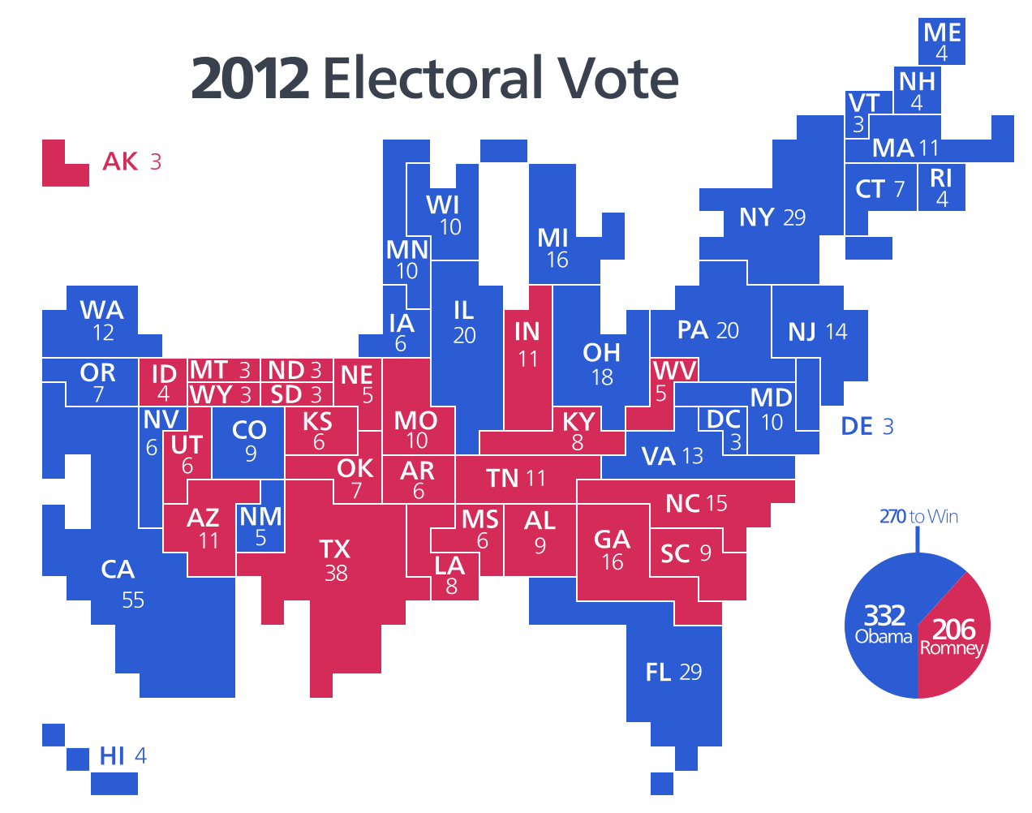
2012 Electoral Vote
Map Credit: Kelvinsong

Slide 36
JUDICIAL BRANCH

Slide 38
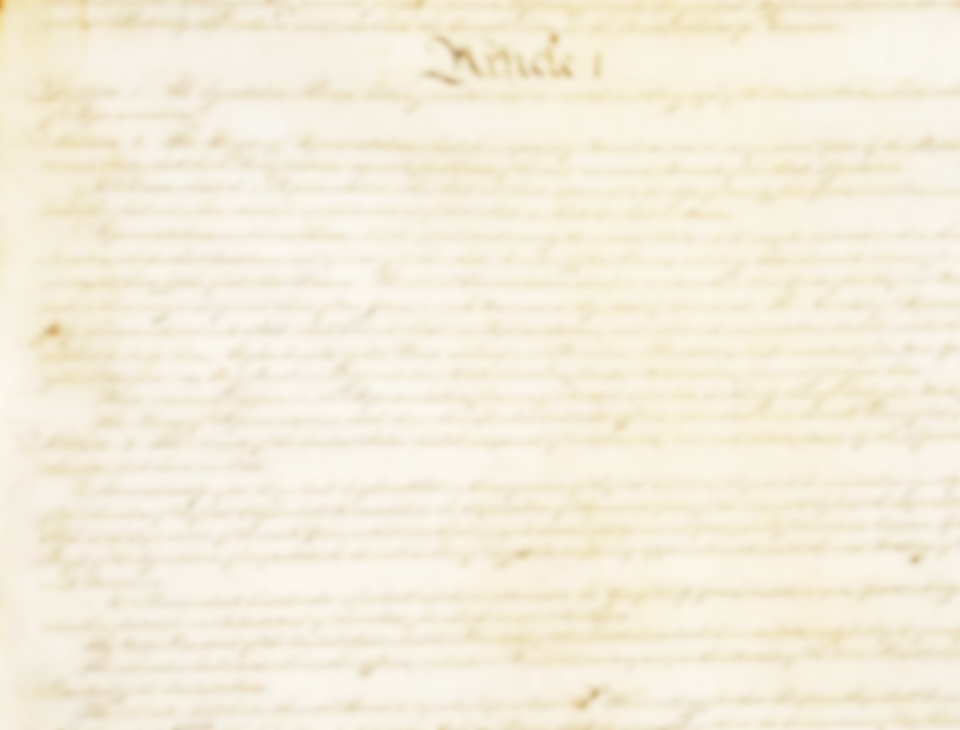
ARTICLE III
The judicial Power of the United States, shall be vested in one supreme Court, and in such inferior Courts as the Congress may from time to time ordain and establish. The Judges, both of the supreme and inferior Courts, shall hold their Offices during good Behavior, and shall, at stated Times, receive for their Services a Compensation which shall not be diminished during their Continuance in Office.

Slide 39
Commerce Clause
Photo by Randy Heinitz

Slide 40
COMMERCE CLAUSE
[The Congress shall have Power] To regulate Commerce with foreign Nations, and among the several States, and with the Indian Tribes;

Slide 41
COMMERCE CLAUSE
Congress will control
INTERSTATE
commerce.

Slide 42
COMMERCE CLAUSE
The states will continue to control commerce within their states.
(intrastate commerce)

Slide 43
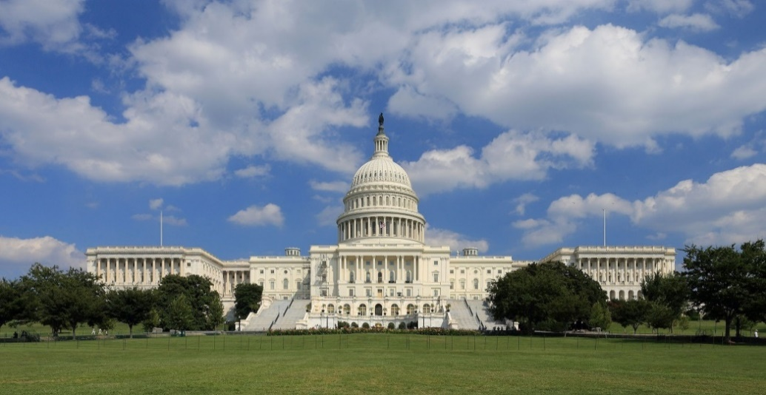
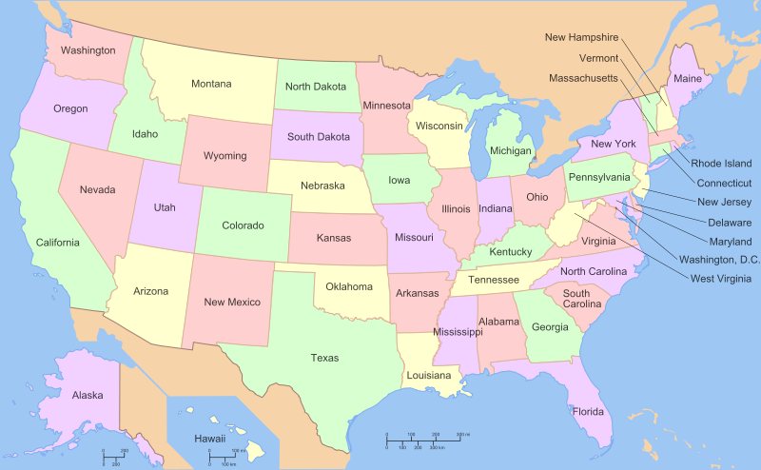
AMENDING THE CONSTITUTION
Photo by Martin Falbisoner
Map by ZooFari
2 3

Slide 44
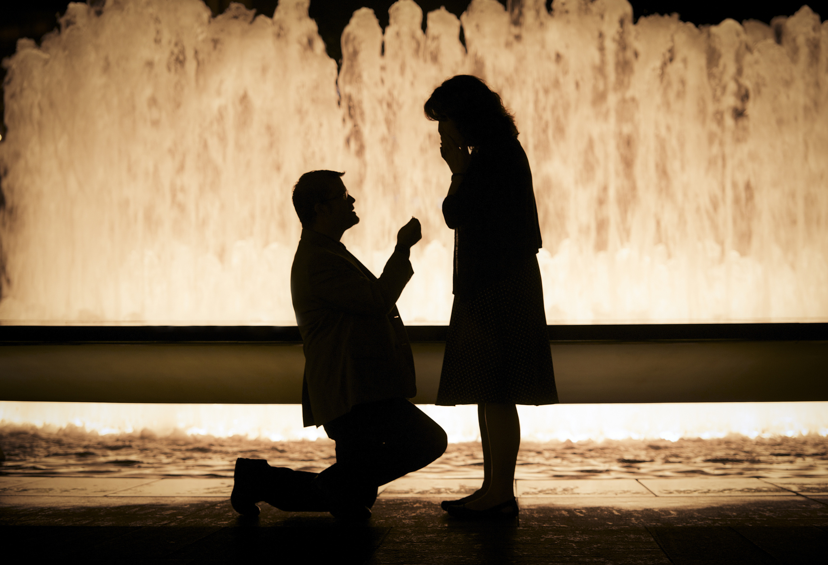
CONGRESS PROPOSES
Photo by Andrew Higgins

Slide 45
AMENDING THE CONSTITUTION
Photo by Martin Falbisoner
Map by ZooFari
2 3
3 4

Slide 46
THE STATES RATIFY
OR REJECT
Photo by Andrew Higgins

Slide 47
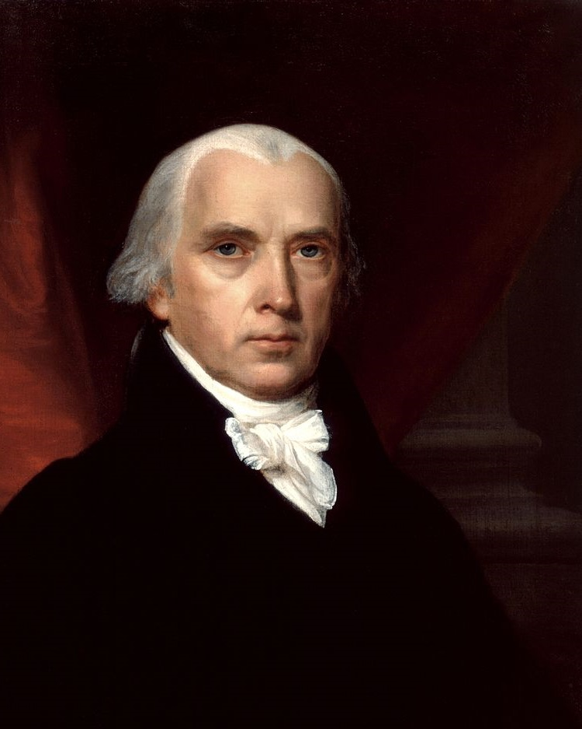
“[The amendment process] guards equally against that extreme facility which would render the Constitution too mutable; and that extreme difficulty which might perpetuate its discovered faults.”
-- James Madison
Federalist No. 43
Source: http://www.constitution.org/fed/federa43.htm

Slide 48
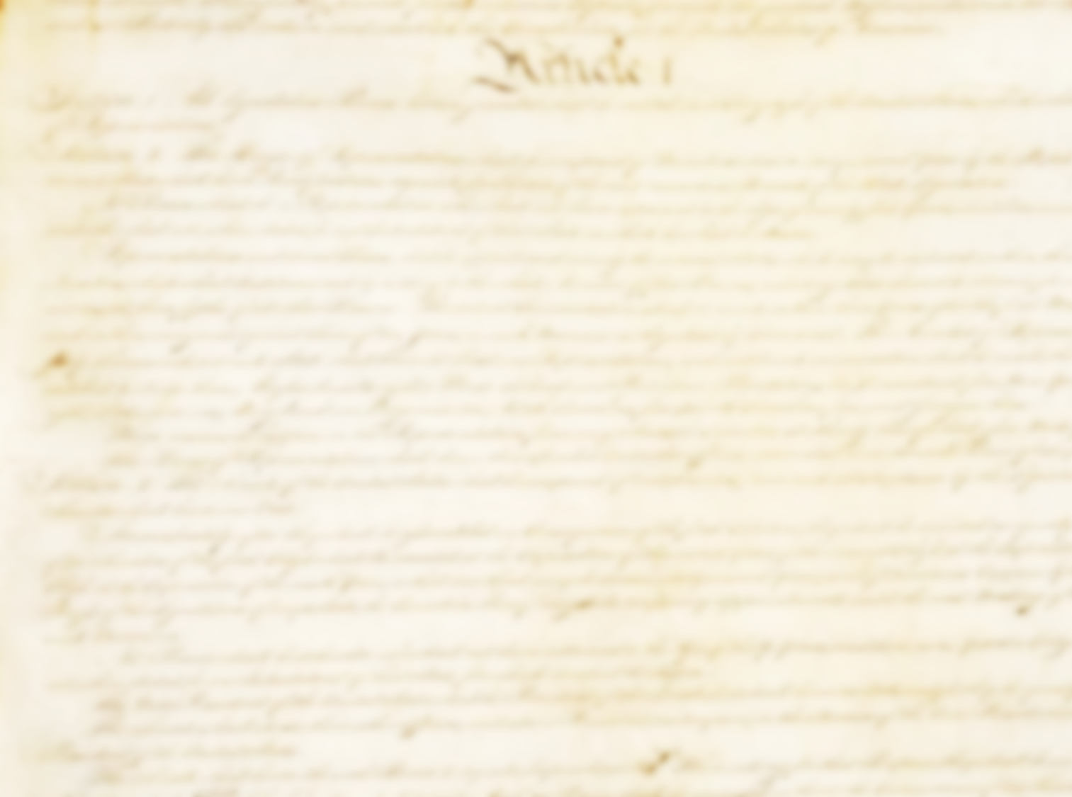
Convention of States
The Congress, whenever two thirds of both Houses shall deem it necessary, shall propose Amendments to this Constitution, or, on the Application of the Legislatures of two thirds of the several States, shall call a Convention for proposing Amendments, which, in either Case, shall be valid to all Intents and Purposes, as part of this Constitution, when ratified by… three fourths of the several States.

Slide 49
“[The amendment process] … equally enables the General and the State Governments to originate the amendment of errors, as they may be pointed out by the experience on one side, or on the other.”
-- James Madison
Federalist No. 43
Source: http://www.constitution.org/fed/federa43.htm

Slide 50
Convention of States
A Convention of states has NEVER been called… but maybe it’s about time?

Slide 51
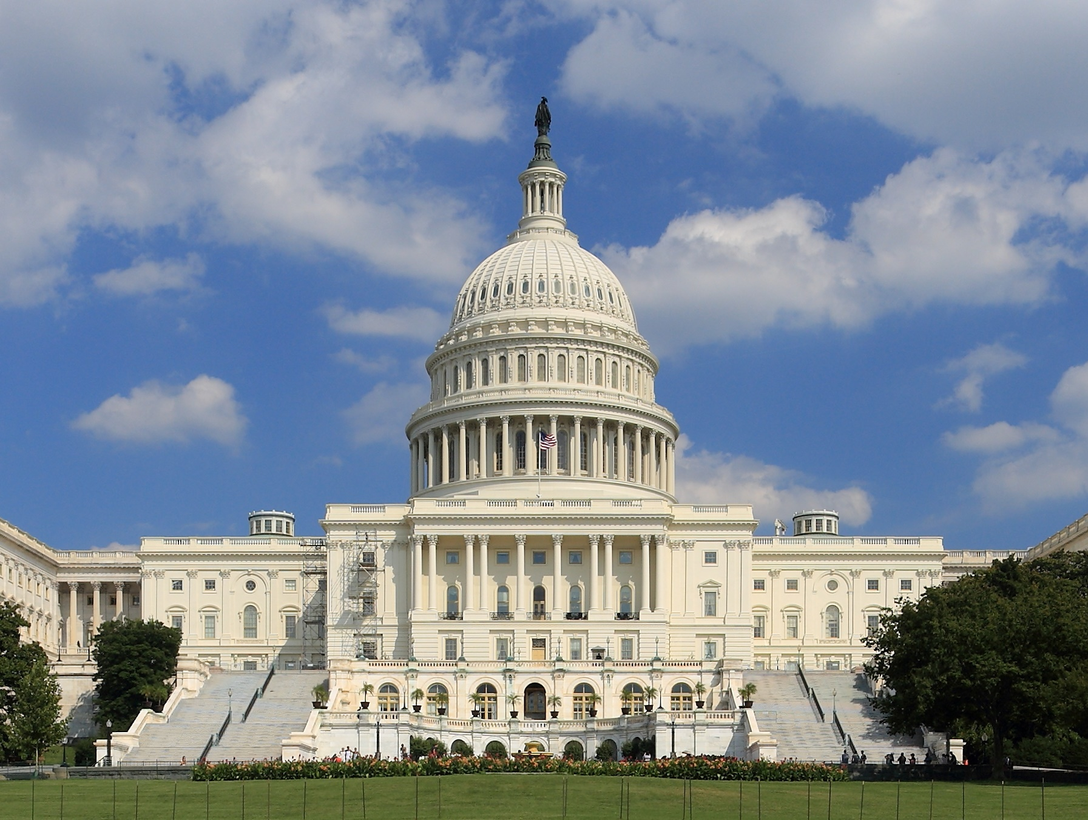
Congressional Term Limits?
Photo by Martin Falbisoner

Slide 52
Articles
A COMPARISON
Sovereignty?
Foreign Relations?
Taxation?
Commerce & Trade?
Representation?
To Legislate?
To Amend?
Constitution
States
SHARED
Federal
Federal
States
Federal & State
Federal (Interstate) State (Intrastate)
States
Proportional (House)
Two Each (Senate)
1 Vote Per State
2/3
Concurrent Majority + President’s Signature
UNANIMOUS
2/3 + 3/4

