Slide 1

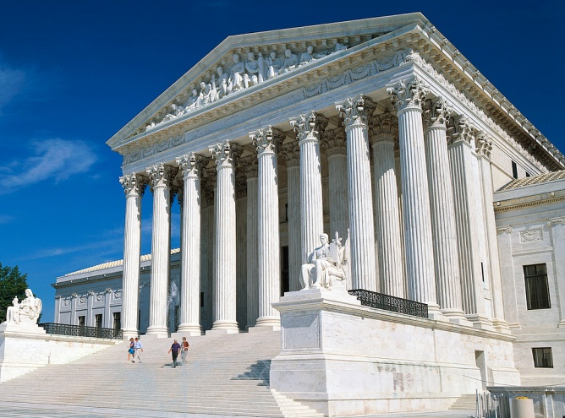
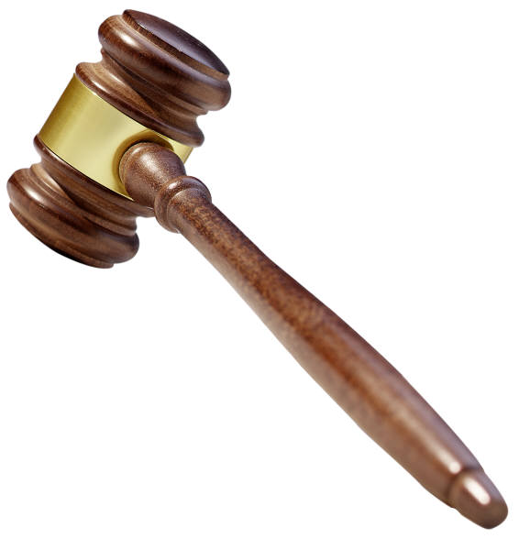
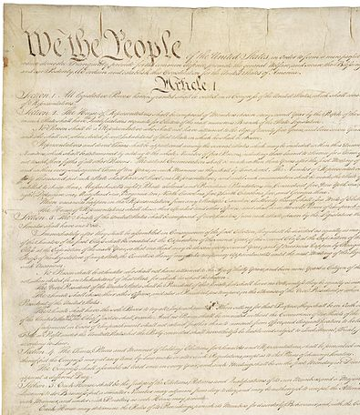

Landmark
Supreme Court
Cases

Slide 2
TIER ONE
Tier One cases have appeared on multiple released AP exams, making them “must know” material for anyone even having a shot at passing the exam in May.
JUMP TO TIER:
Marbury v. Madison (1803)
McCulloch v. Maryland (1819)
Gibbons v. Ogden (1824)
Dred Scott v. Sandford (1857)
Plessy v. Ferguson (1896)
Brown v. Board (1954)
Miranda v. Arizona (1966)
Roe v. Wade (1973)
1
2
3
Legal Concepts Link

Slide 3
TIER TWO
Tier Two cases have appeared on a released AP exam, meaning that there is a very good chance that they may appear again on this year’s exam.
JUMP TO TIER:
Baker v. Carr
Gideon v. Wainwright
Gitlow v. New York [Link]
Griswold v. Connecticut [Link]
Korematsu v. United States [Link]
Mapp v. Ohio [Link]
New York Times v. Sullivan [Link]
Shaw v. Reno [Link]
Sweatt v. Painter [Link]
1
2
3
Legal Concepts Link

Slide 4
TIER THREE
While Tier Three cases have not appeared in multiple choice items released by AP, it does not mean they have not appeared or will not appear on this year’s exam.
JUMP TO TIER:
Schechter Poultry Corp. v. U.S. [Link]
Heart of Atlanta Motel v. U.S. [Link]
Tinker v. Des Moines
Miller v. California [Link]
Hustler Magazine v. Falwell [Link]
Schenck v. United States [Link]
Texas v. Johnson [Link]
Engel v. Vitale
Lemon v. Kurtzman
Regents v. Bakke [Link]
1
2
3
Legal Concepts Link

Slide 5

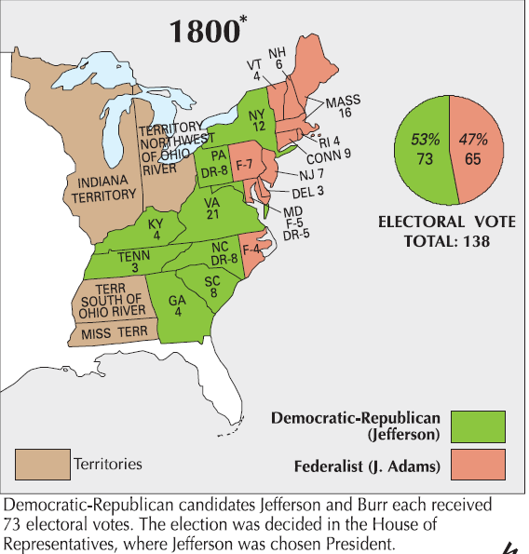
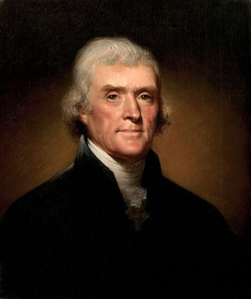
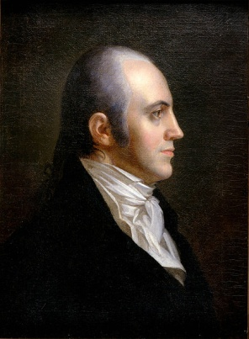
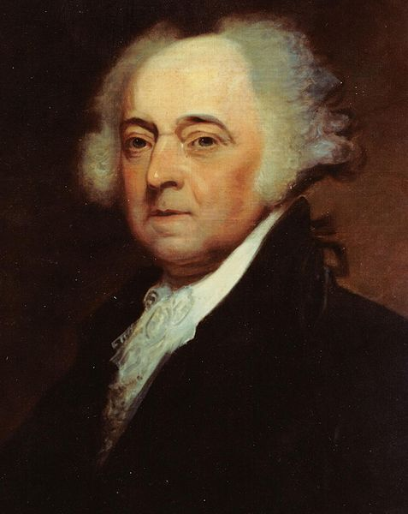
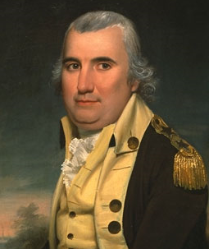
Jefferson (R)
73
Burr (R)
73
The
“Revolution of 1800”
Adams (F)
65
Pinckney (F)
64
TIEBREAKER:
House of Representatives
1 vote per state

Slide 6
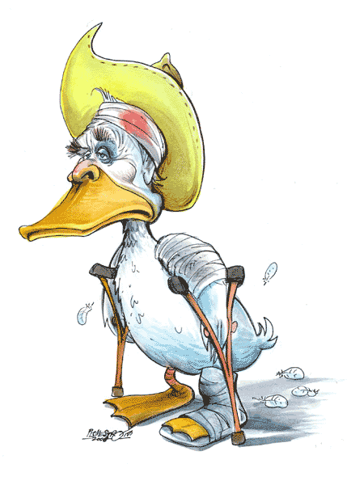
“Lame Duck” Session
ELECTION
SUCCESSOR’S TERM

Slide 7

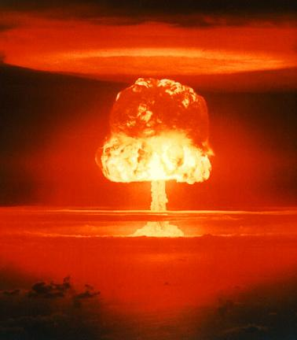
The Doomsday Clock

Slide 8
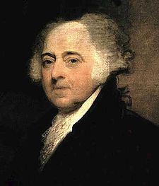
The Judiciary Act of 1801
The
“Midnight Judges”
Act
16
new federal circuit judges

Slide 9
The Judiciary Act of 1801 aka, the “Midnight Judges” Act
Supreme Court
-1

Slide 10
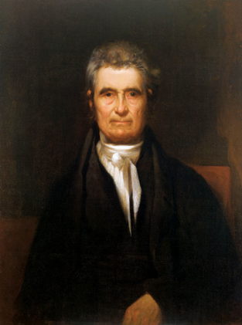
John Marshall
Federalist
Secretary of State (Adams Administration)
Chief Justice
of the Supreme Court
“Midnight” Appointment
John Marshall
Chief Justice

Slide 11
Marbury v. Madison
William Marbury
(Midnight Judge)
vs.
James Madison
(Secretary of State)
Judiciary Act of 1791
  Writ of Mandamus
Judicial Review
John Marshall
Chief Justice

Slide 12
Marbury v. Madison
Judicial Review
Marshall:
The Supreme Court can declare laws to be unconstitutional.
  (in this case, a federal law passed by Congress)
John Marshall
Chief Justice

Slide 13

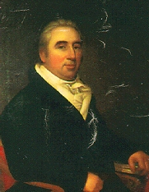
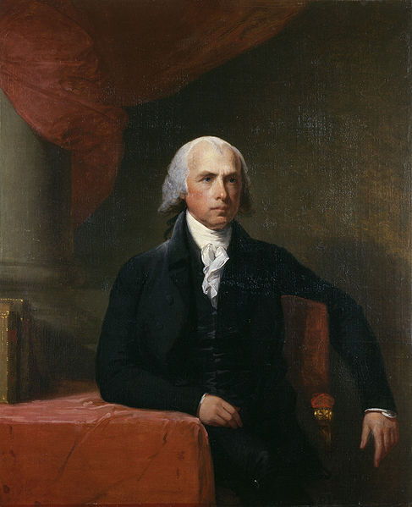
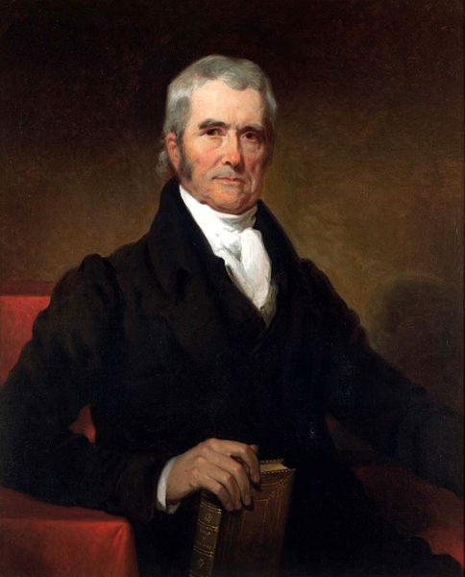

Marbury v. Madison
(1803)
William Marbury
Midnight Judge
James Madison
Secretary of State
JUDICIAL REVIEW
BACKGROUND
John Marshall
Chief Justice
MORE INFO
Wikipedia
Street Law
Cornell LII
Rehnquist, Chapter 1

Slide 14
McCulloch v. Maryland
Second BUS v. Maryland
Maryland had placed a tax on the Bank of the United States. The B.U.S. sued Maryland in protest.
John Marshall
Chief Justice

Slide 15

McCulloch v. Maryland
DECISION:
  Bank GOOD
  Supremacy Clause
    Fed Gov SUPREME when acting within the scope of its delegated powers
  Elastic Clause
    With the “Elastic Clause” liberally applied, this can be just about anything!
John Marshall
Chief Justice

Slide 16

McCulloch v. Maryland
(1819)
FEDERALISM
SUPREMACY CLAUSE
The National Bank
BACKGROUND
ELASTIC CLAUSE
The McCulloch v. Maryland decision typifies the loose construction of the Marshall Court.
John Marshall
Chief Justice
IMPLIED POWERS
MORE INFO
Wikipedia
Street Law
Cornell LII

Slide 17
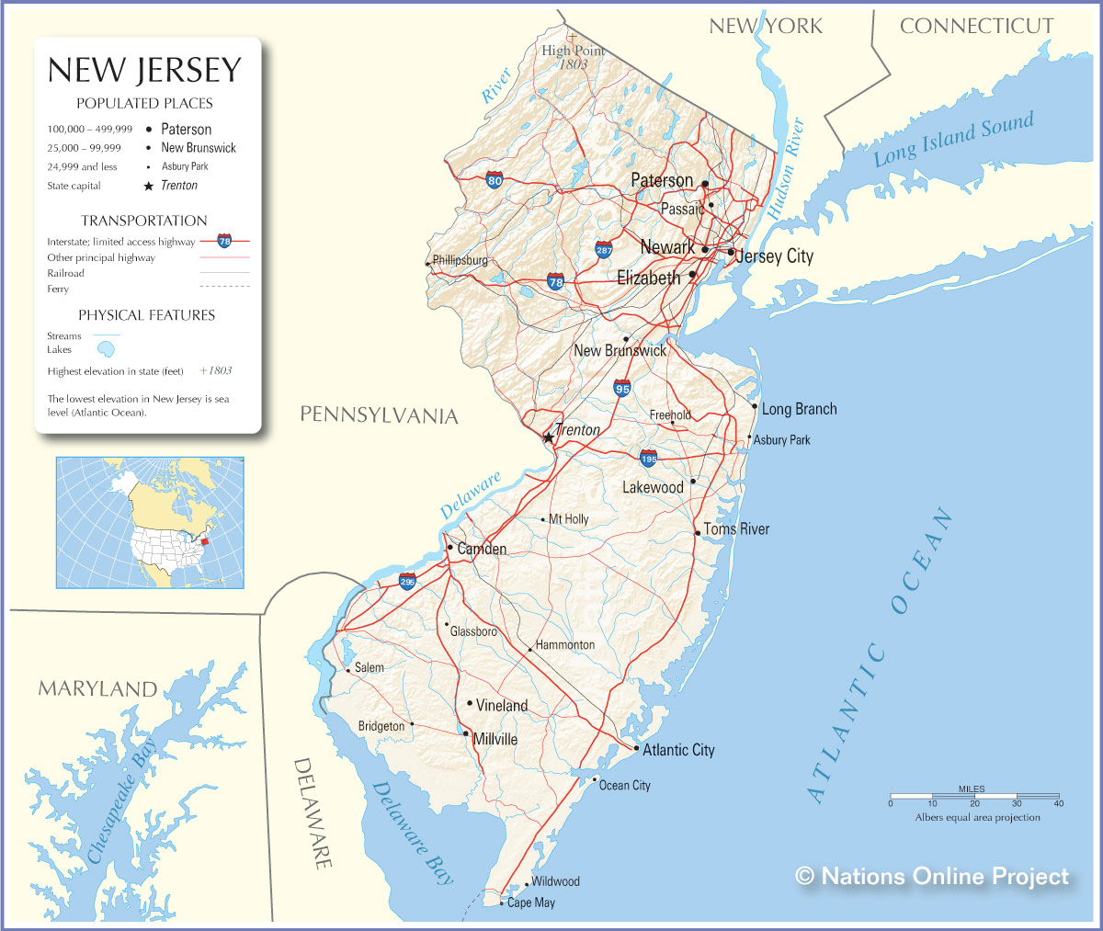
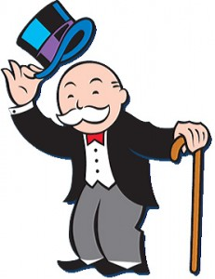
FEDERALISM
COMMERCE CLAUSE
Gibbons
(& Vanderbilt)

Slide 18
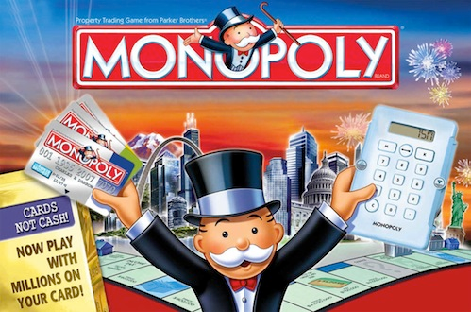
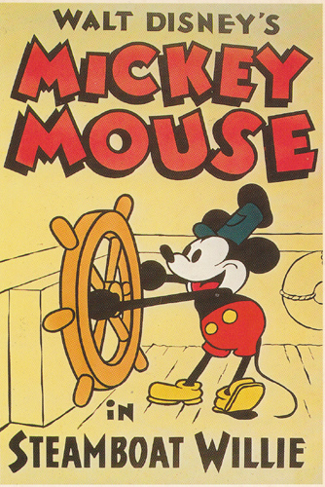
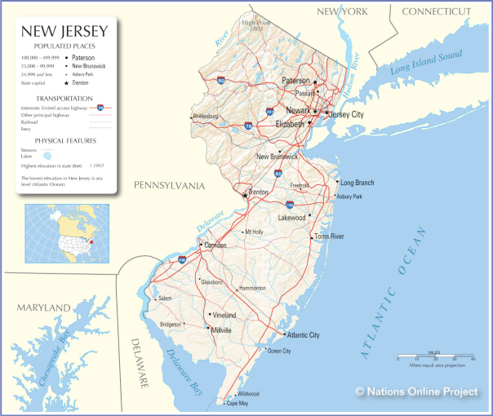
Gibbons v. Ogden
(1824)
FEDERALISM
COMMERCE CLAUSE
John Marshall
Chief Justice
MORE INFO
Wikipedia
Street Law
Cornell LII

Slide 19

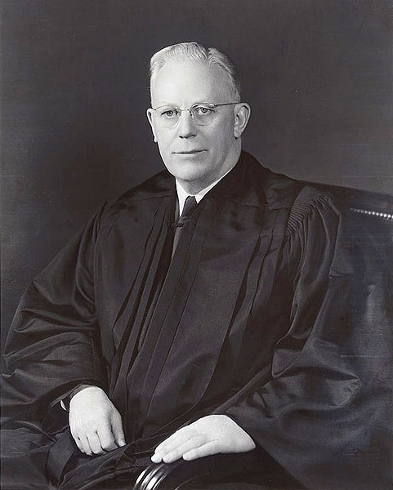
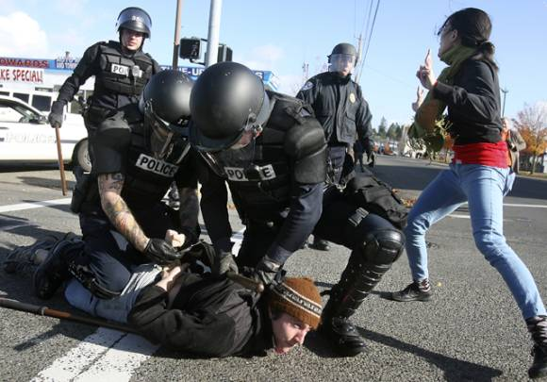
Miranda v. Arizona
(1966)
5-4
5TH
SELF-INCRIMINATION
6TH
The “Miranda Warning”
You have the right to remain silent. Anything you say or do can and will be held against you in a court of law. You have the right to speak to an attorney. If you cannot afford an attorney, one will be appointed for you. Do you understand these rights as they have been read to you?
RIGHT TO COUNSEL
Earl Warren
Chief Justice
MORE INFO
Wikipedia
Street Law
Cornell LII

Slide 20
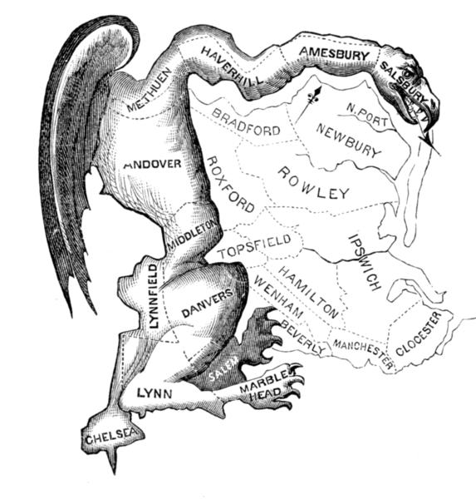
GERRYMANDER

Slide 21
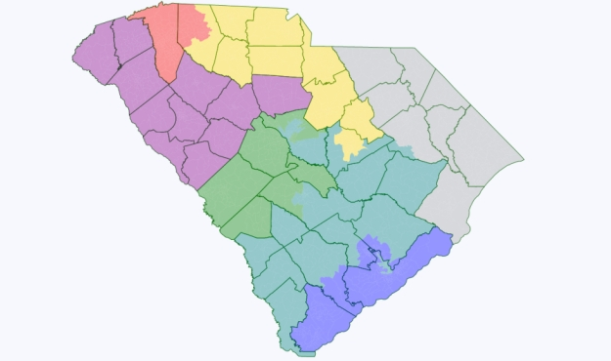
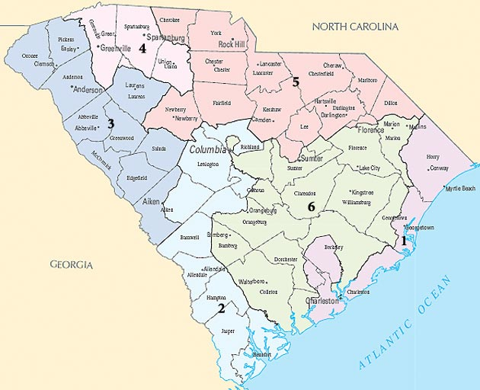
South Carolina Congressional Districts
NEW DISTRICTS

Slide 22
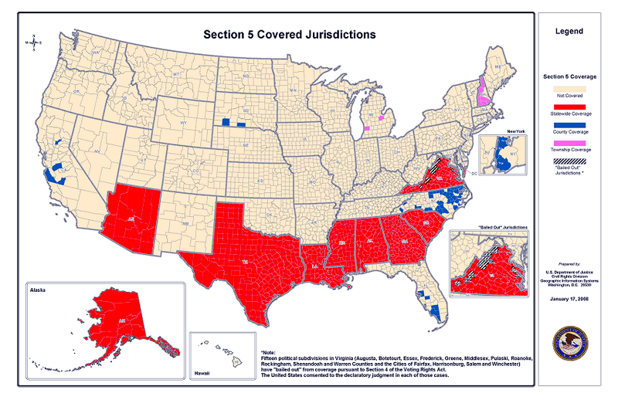
Voting Rights Act of 1965
PRECLEARANCE
Further Reading

Slide 23


Baker v. Carr
(1962)
6-2
QUESTION:
Should the Supreme Court involve itself in questions of political redistricting?
Gerrymandering
Earl Warren
Chief Justice
MORE INFO
Wikipedia
Cornell LII
Oyez Project

Slide 24

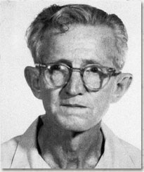

Gideon v. Wainwright
(1963)
9-0
A video project by Jacob B., Cory C., and Jensen P. (2011-2012)
DECISION:
Individuals have the right to an attorney in ALL criminal cases (previously only capital cases), whether they can afford one or not.
Earl Warren
Chief Justice
Clarence Earl Gideon
MORE INFO
Wikipedia
Street Law
Cornell LII
Oyez Project

Slide 25
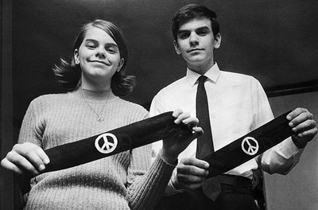

Tinker v. Des Moines
(1969)
7-2
In favor of Tinkers
1st
John and Mary Beth Tinker show off the armbands they wore to school to protest the Vietnam War.
SCHOOL SPEECH
SYMBOLIC SPEECH
Earl Warren
Chief Justice
MORE INFO
Wikipedia
Street Law
Cornell LII
Oyez Project

Slide 26

Engel v. Vitale
(1962)
6-1
In opposition to mandatory school prayer
1st
ESTABLISHMENT
CLAUSE
A video project by Kara M., Elizabeth E., & Jonathan R. (2011-2012)
14th
SELECTIVE INCORPORATION
Earl Warren
Chief Justice
MORE INFO
Wikipedia
Cornell LII
Oyez Project

Slide 27

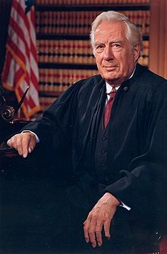


Lemon v. Kurtzman
(1970)
7-?
Warren Burger
Chief Justice
The “Lemon Test”
MORE INFO
Wikipedia
Cornell LII
Oyez Project

