Slide 1
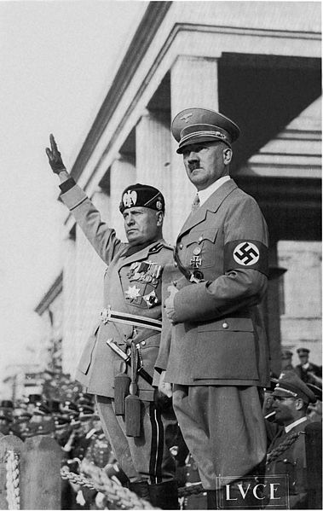
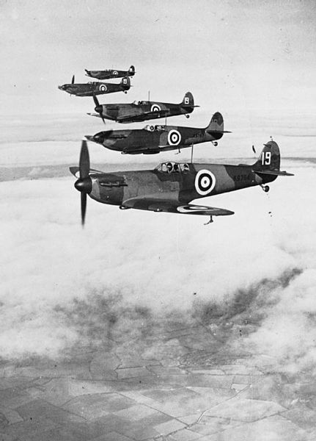
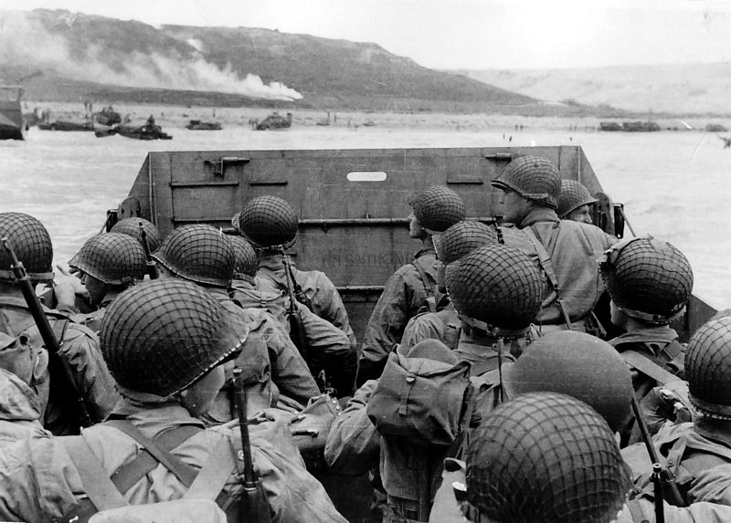
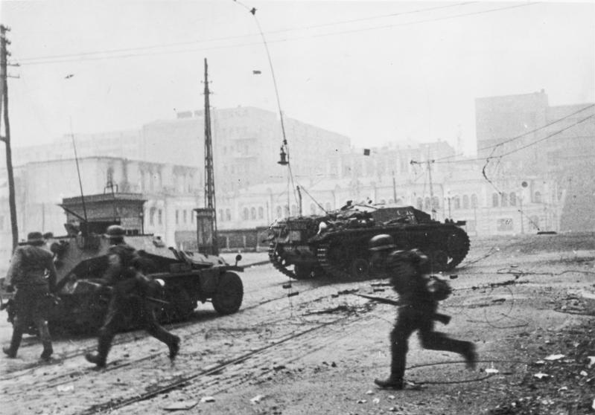

World War II

Slide 2
Pre-War
1933
Hitler appointed Chancellor of Germany
Reichstag fire – Communists blamed
Reichstag Fire Decree
  Suspends Civil Liberties
  Outlaws Communist Party
Enabling Act (2/3 to pass)
  Hitler gets dictatorial power for four years
  Rule by decree
  Communists unable to vote (arrested)

Slide 3
Pre-War
1935
Mussolini invades Ethiopia
Hitler announces German rearmament
1936
Rhineland (Versailles DMZ) Re-Militarized

Slide 4
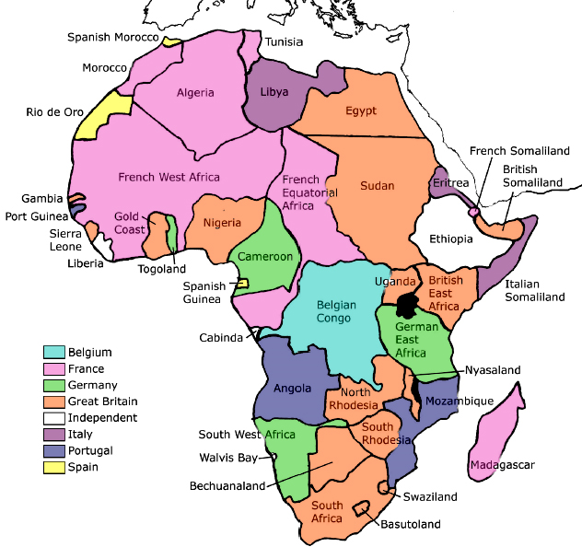
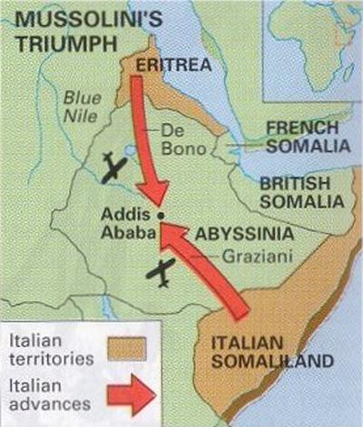
Mussolini’s Conquest of Ethiopia
1935-1936

Slide 5
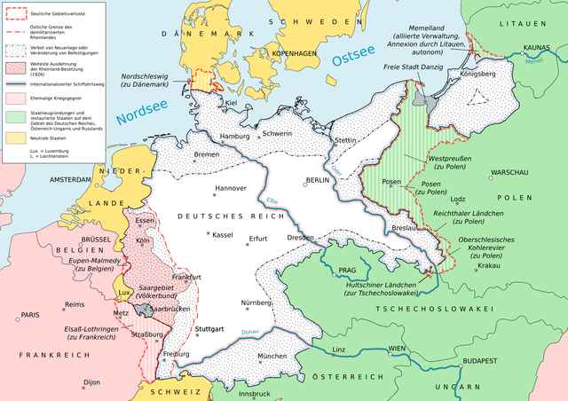
Rhineland (DMZ)
Map by Matthias Küch

Slide 6
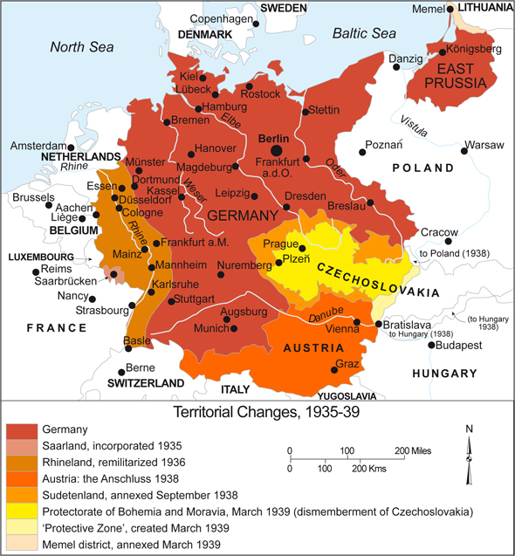
German Expansion
to 1939
Rhineland (DMZ)
Austria
Sudetenland

Slide 7
appeasement

Slide 8
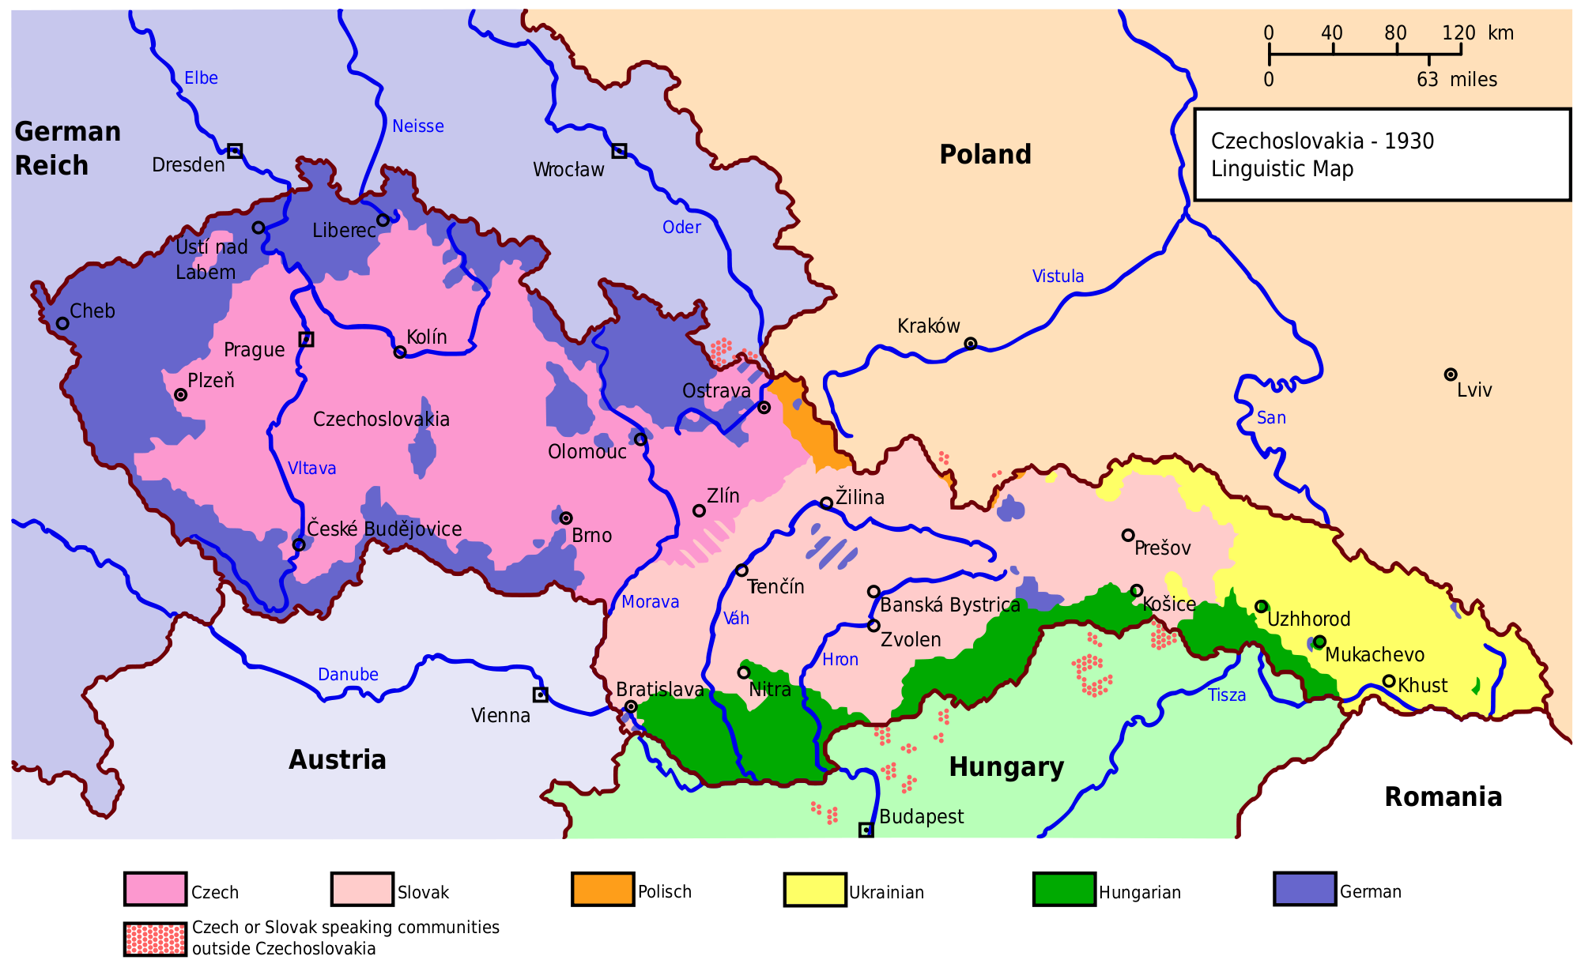
Czechoslovakia
Self-determination of Peoples?

Slide 9
Pre-War
1938
Germany annexes Austria
Munich Conference
  Appeasement
  Sudetenland (predominantly German area of Czechoslovakia)
  Czechoslovakia had a treaty with France, which had treaties with Britain and Soviet Union
  Cartoon p. 965

Slide 10
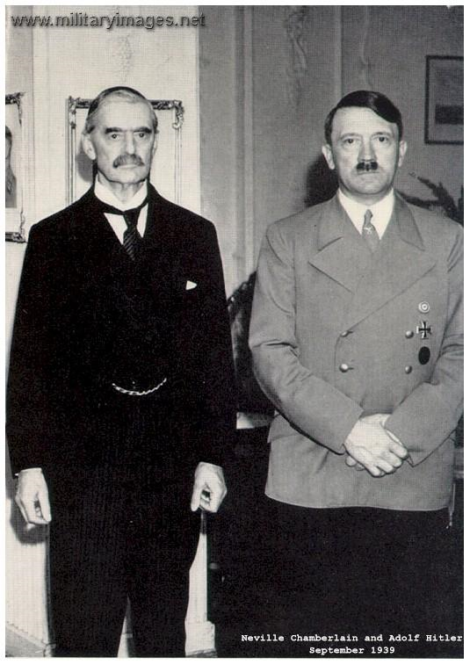
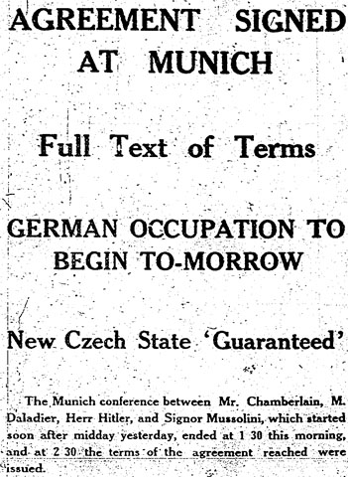
The Munich Agreement
(Britain and France sell Czechoslovakia downriver)
An Odd Couple
Neville Chamberlain
(British PM)
Adolf
Hitler
Not Pictured: Deladier (France)

Slide 11
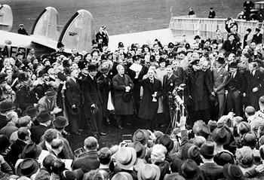
“Peace for our time…”

Slide 12
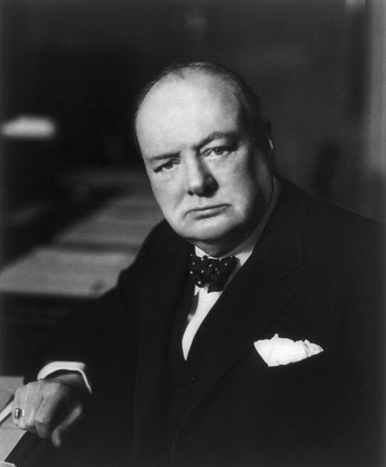
Sir Winston Churchill on Munich
The Western democracies “are weighed in the balance and found wanting.”
“And do not suppose that this is the end. This is only the beginning of the reckoning.”
Churchill’s Speech: http://www.churchill-society-london.org.uk/Munich.html

Slide 13
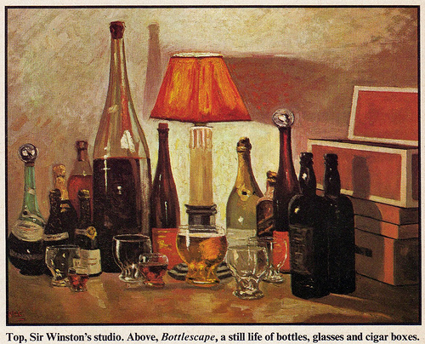

Slide 14
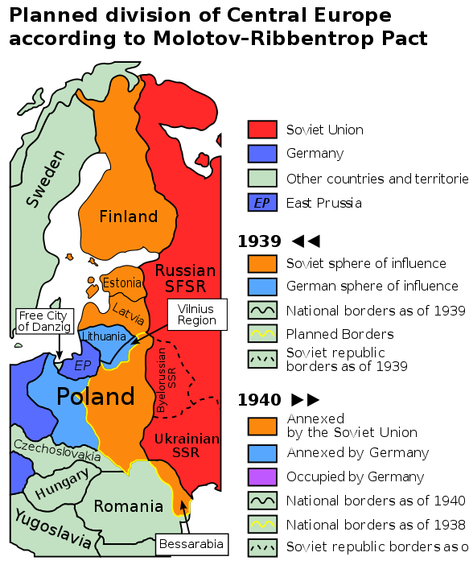

Slide 15
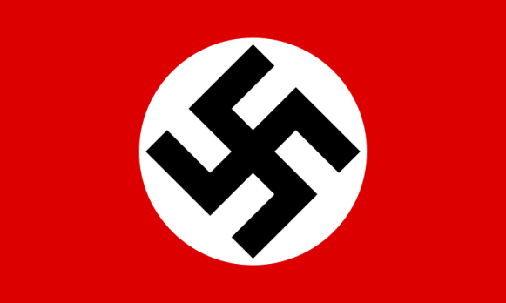

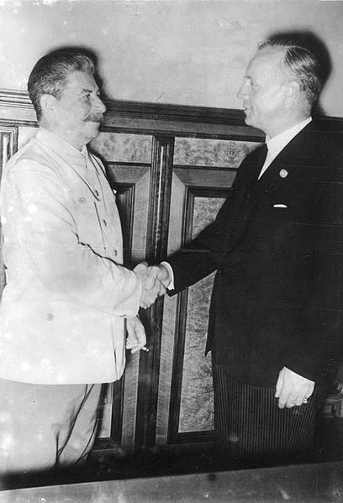

Molotov-Ribbentrop
Pact
Non-aggression Pact
  Germany and Soviet Union
Secret Provision:
  Divide Poland

Slide 16
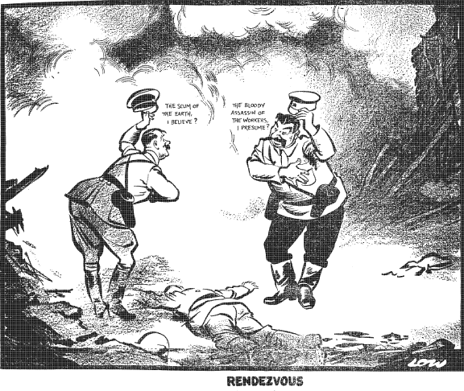

Slide 17
German Aggression
1939
March, Germany Occupies Czechoslovakia (entire country – not just Sudetenland)
Sep., Germany invades Poland
  Britain, France declare war
  Soviet Union occupies Baltic States and half of Poland

Slide 18
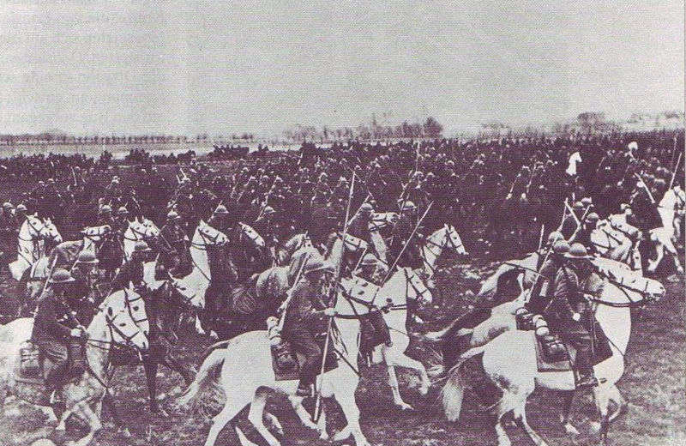
The Wrong War?
Polish Cavalry

Slide 19
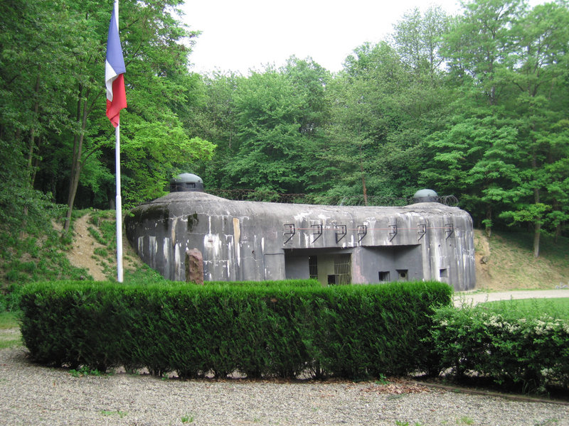
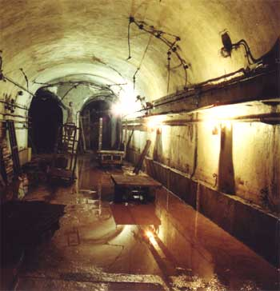
Maginot Line
French system of fortifications for WWI-type war

Slide 20
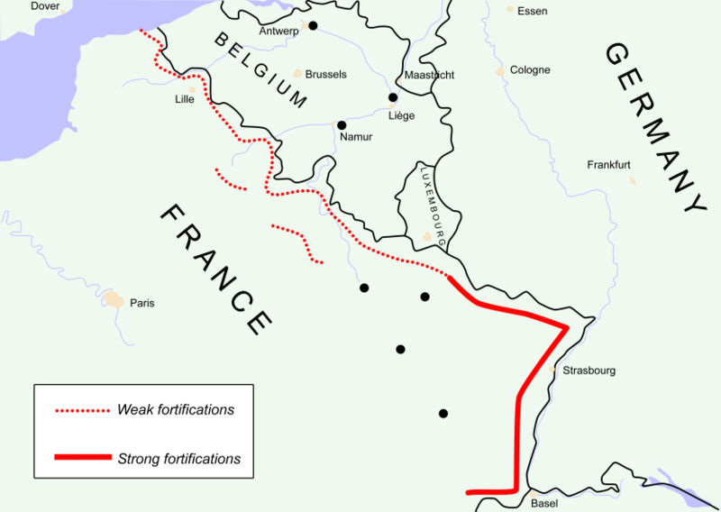

Slide 21
Maginot Line
The Maginot Line was strongest at the German border – fortifications were much weaker on the Belgian border, where the Germans attacked (again).

Slide 22

Blitzkrieg
(Lightning War)
Panzer

Slide 23
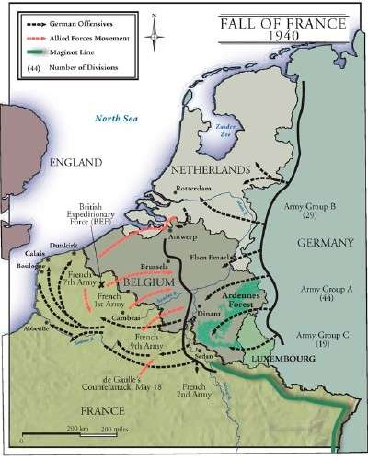
Fall of France
Blitzkrieg (Lightning War)
Tank Warfare
France fell in less than a month
British Expeditionary Force evacuated from Dunkirk

Slide 24
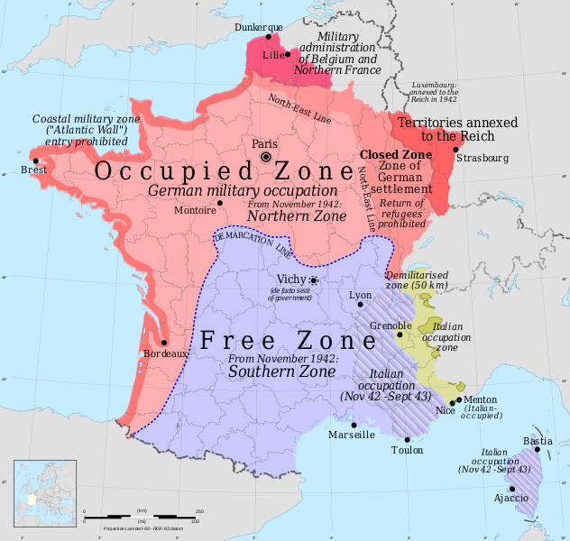

Slide 25
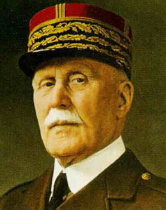
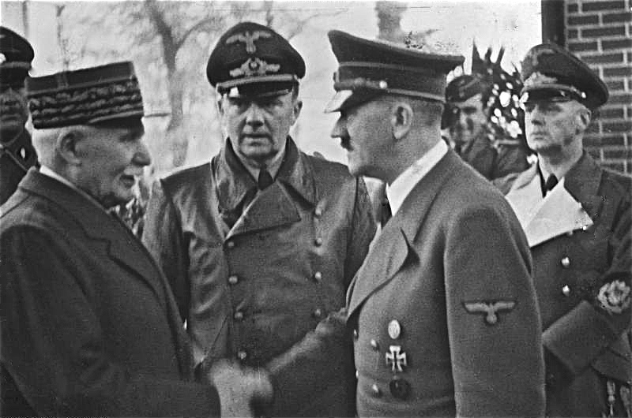
Vichy France
1940-1944
Southern France was governed by a Nazi-supported government based in Vichy.
Marshal Philippe Pétain
Head of Government
WWI Hero
Pétain and Hitler shake hands

Slide 26
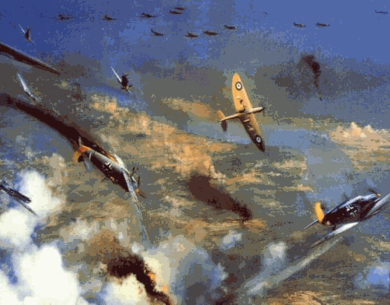

Battle of Britain
1940 Air Battles
RAF vs. Luftwaffe
Military Targets
Cities/Civilians
Hitler thought bombing cities would lower morale; instead, it increased British defiance.
Churchill’s
“Finest Hour” Speech
[BEST VERSION]

Slide 27
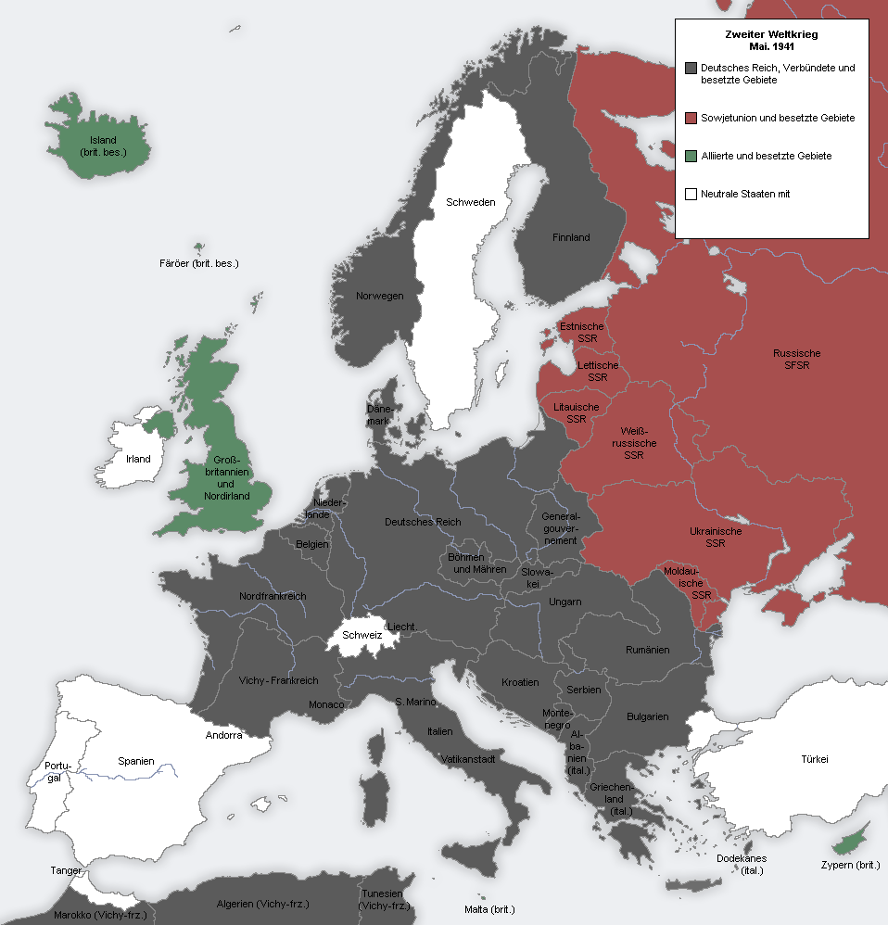
1941
Map Credit: MaGioZal

Slide 28
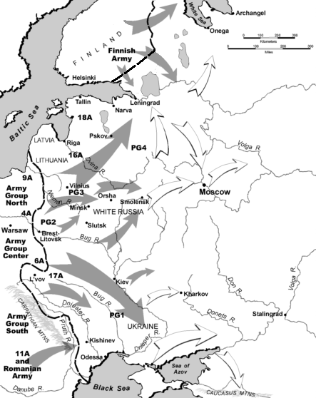
Operation Barbarossa
1941 – Hitler invades Russia, opening a two-front war.
Russian dead far outnumber the dead from any other European country (see chart on next slide).

Slide 29
Operation Barbarossa
Major Battles/Sieges:
Stalingrad
Leningrad
Millions of casualties each
“Great Patriotic War”
Russian Nationalism revived

Slide 30
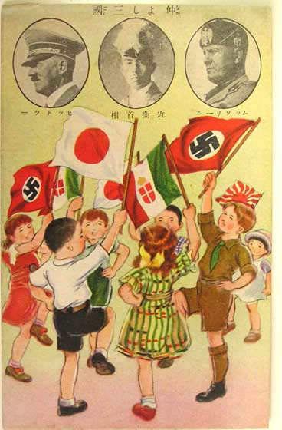
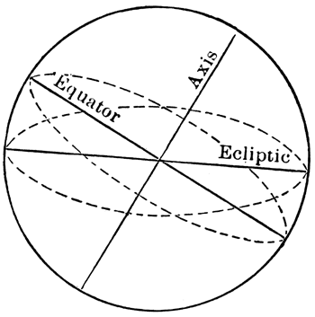
Axis Pact
Japan, Germany, and Italy agree to cooperate in their efforts… They further undertake to assist one another with all political, economic and military means if one of the Contracting Powers is attacked by a Power at present not involved in the European War or in the Japanese-Chinese conflict.

Slide 31
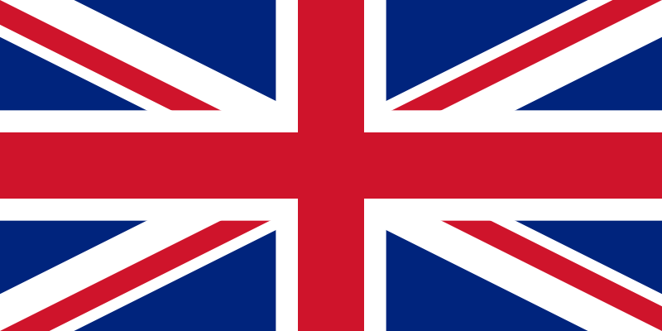

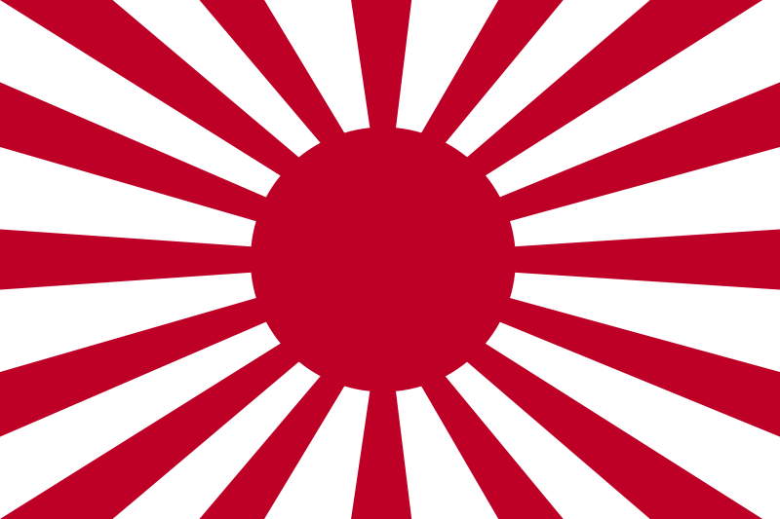
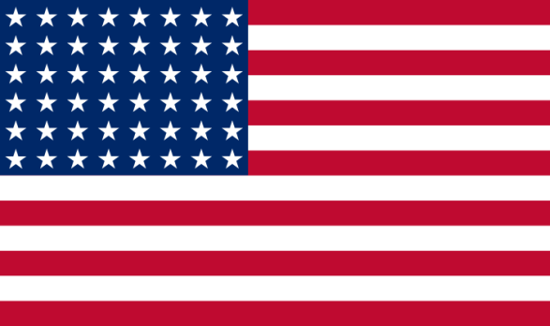

The Situation: 1940
The Allies
The Axis
Neutral

Slide 32

The Situation: 1941
The Allies
The Axis
Neutral
Occupied

Slide 33
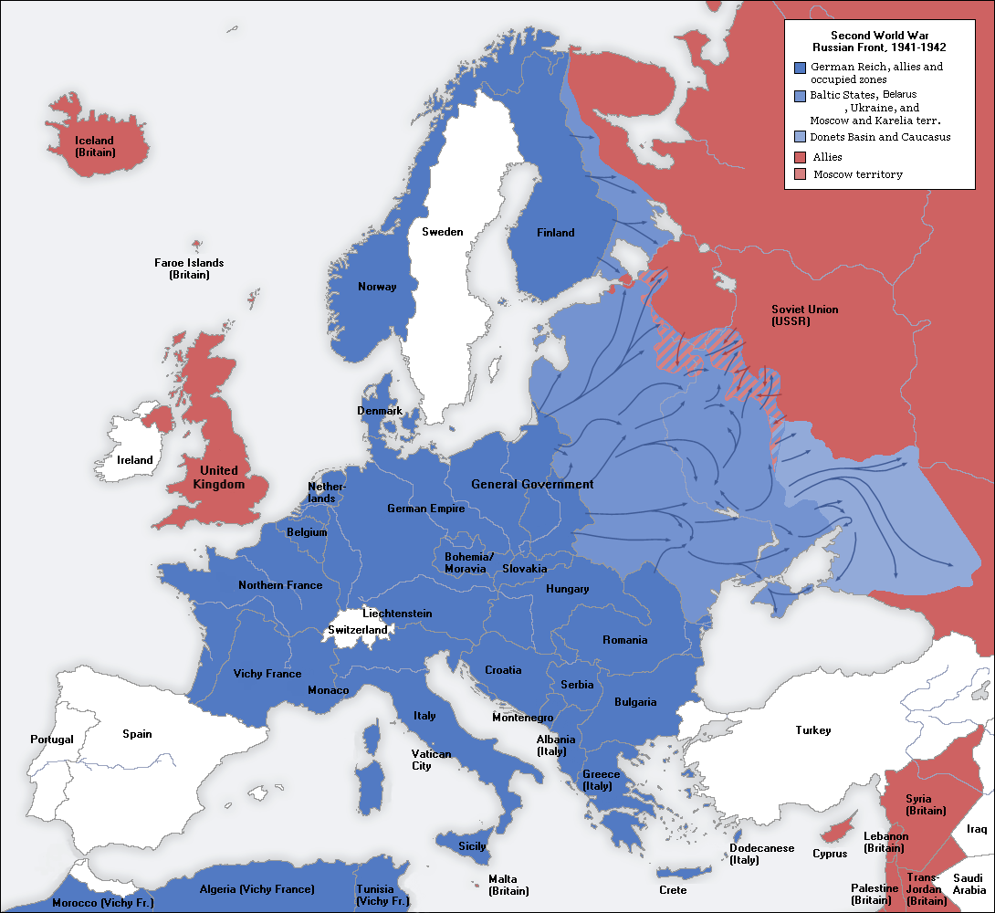
Europe (1941)

Slide 34
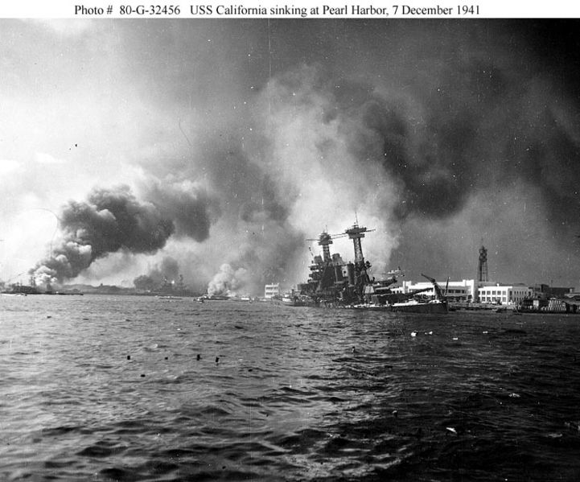
Pearl Harbor
December 7, 1941
Japan attacks U.S. Pacific Fleet at Pearl Harbor
FDR “A date which will live in infamy.”
U.S declares war on Japan

Slide 35
More Declarations
December 11, 1941
Hitler declares war on the United States, followed by Fascist Italy
Tri-Partite (Axis) Pact – Alliance System
The fact that the Japanese Government, which has been negotiating for years with this man [ Franklin D. Roosevelt ], has at last become tired of being mocked by him in such an unworthy way, fills us all, the German people, and all other decent people in the world, with deep satisfaction...”
– Adolf Hitler

Slide 36
The Situation: 1941
The Allies
The Axis
Neutral
WAR
WAR
WAR
Occupied

Slide 37
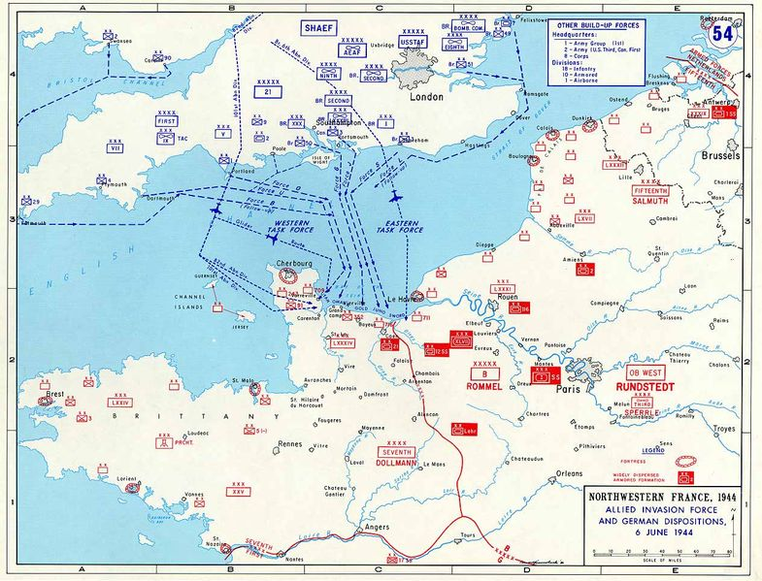

Slide 38
D-Day
June 6, 1944
Allied invasion of Normandy (France)

Slide 39
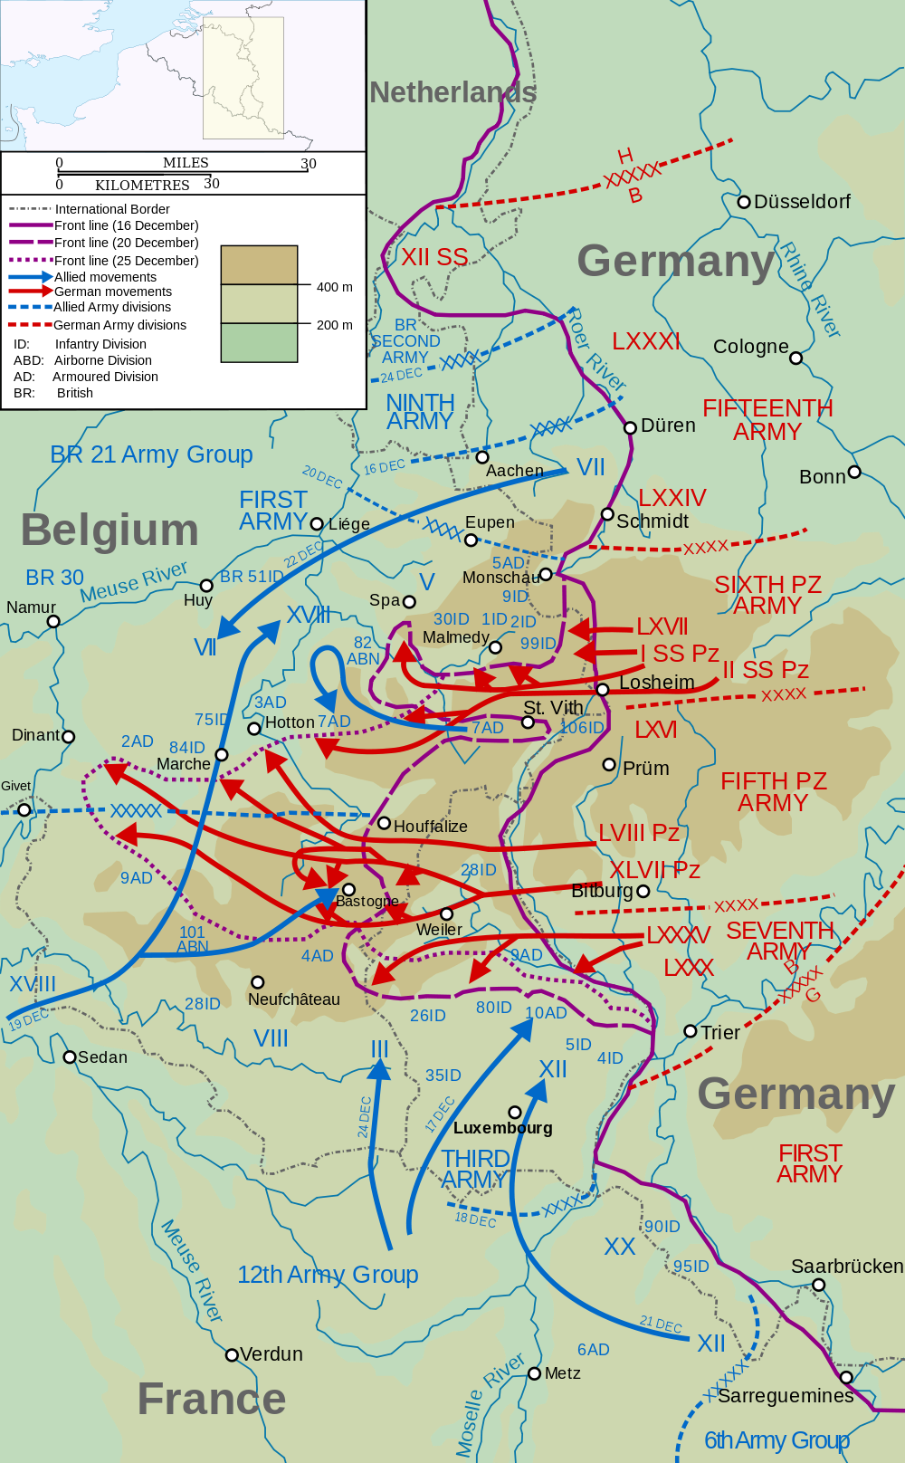

Slide 40
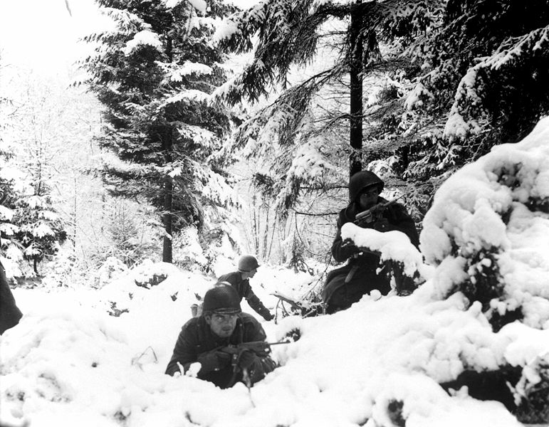
The Battle of the Bulge
German counter-offensive
Initial Success (Bulge)
REPULSED
American soldiers of the 290th Infantry Regiment 75th Division photographed in the Ardennes during the Battle of the Bulge.

Slide 41
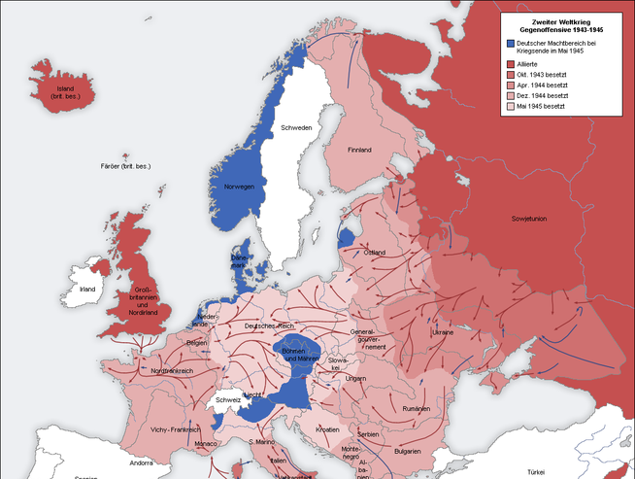
Troop Movements
1944-45

Slide 42
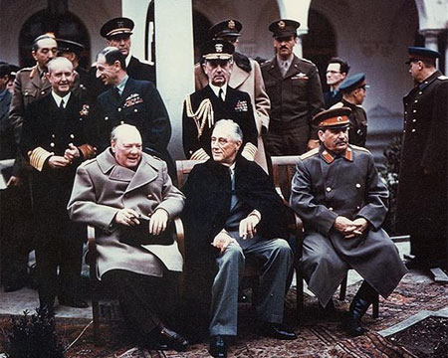
Yalta Conference
February, 1945
DECISIONS:
Divide Germany
United Nations
The
“Big Three”
Stalin
FDR
Churchill

Slide 43
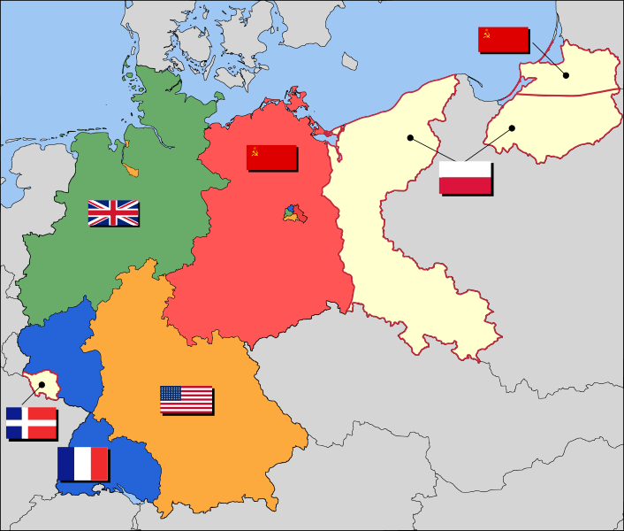
Allied Occupation Zones

Slide 44
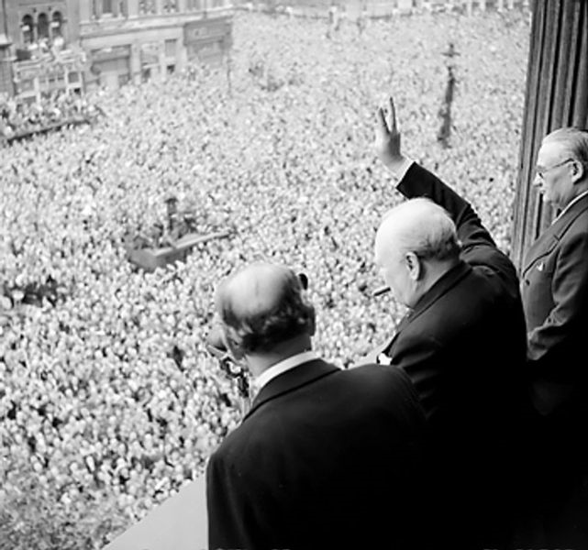
V-E Day
May 8, 1945

Slide 45
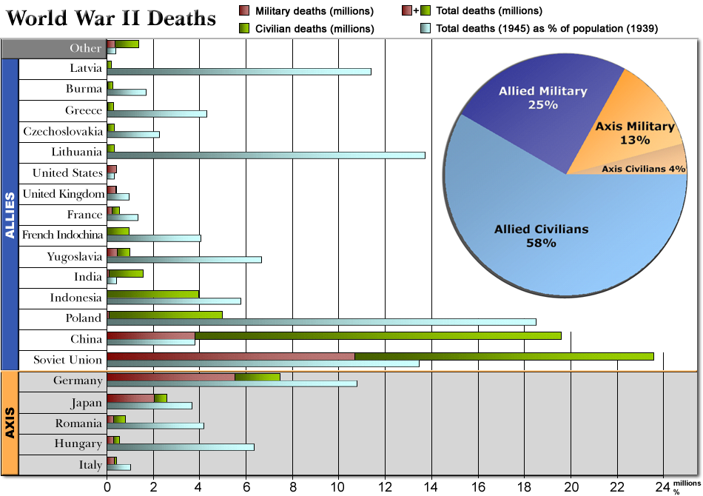

Slide 46
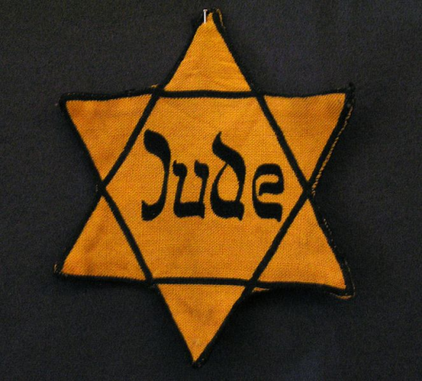
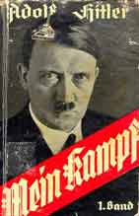
Anti-Semitism in Nazi Germany
“Hence today I believe that I am acting in accordance with the will of the Almighty Creator: 'by defending myself against the Jew, I am fighting for the work of the Lord.‘”
-- Adolf Hitler
Mein Kampf
http://www.mosaisk.com/auschwitz/Adolf-Hitler-about-the-Jews.php

Slide 47
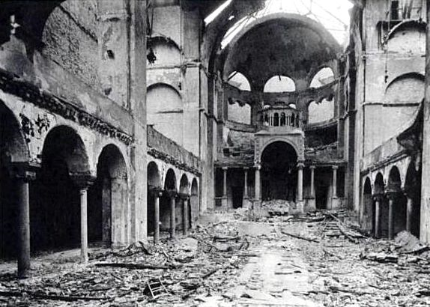

Kristallnacht (1938)

Slide 48
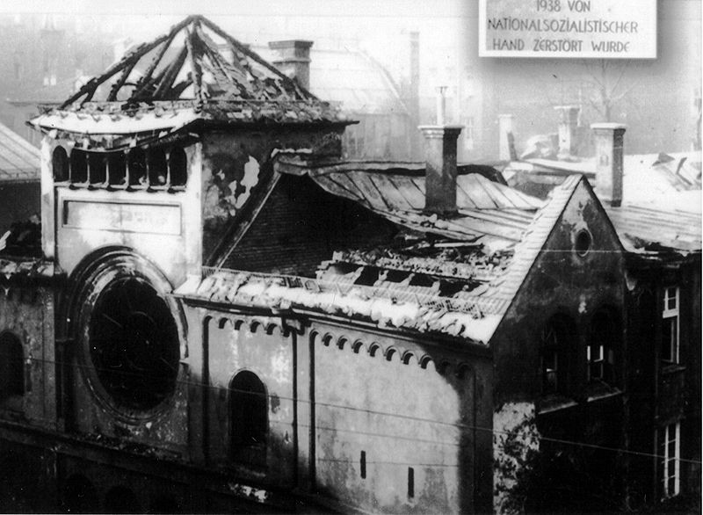
Kristallnacht (1938)

Slide 49
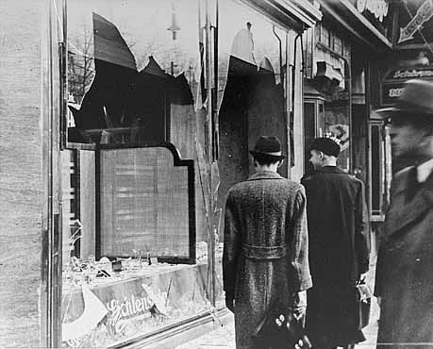
Kristallnacht (1938)

Slide 50
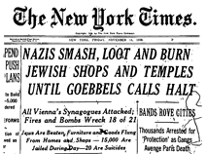
The front page of The New York Times November 11, 1938
How much did the outside world know?

Slide 51


“Crimes Against Humanity”
Holocaust
Concentration Camps
Genocide
“Final Solution”
Auschwitz Extermination Camp (Poland)
Mass Grave

Slide 52

Hitler’s “Final Solution” to the “Jewish Problem”

Slide 53


Maps of the Holocaust

Slide 54




Nuremburg Trials
1945-1946
INDICTMENTS:
Participation in a…
crime against peace
Planning, initiating and
waging wars of aggression…
War crimes
Crimes against humanity

Slide 55


The State of Israel
(1948)
Zionism had been around since the late nineteenth century, but it took the Holocaust to get the Western powers to actively involve themselves in the creation of a Jewish state.

