Slide 1
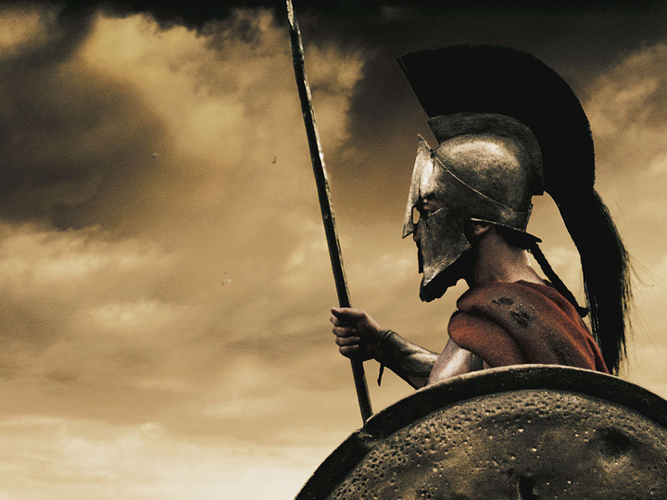

This
is
The History of
Sparta
Image Credit: Σταύρος

Slide 2
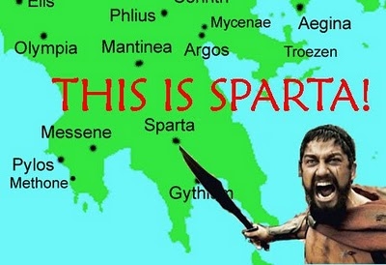


Slide 3
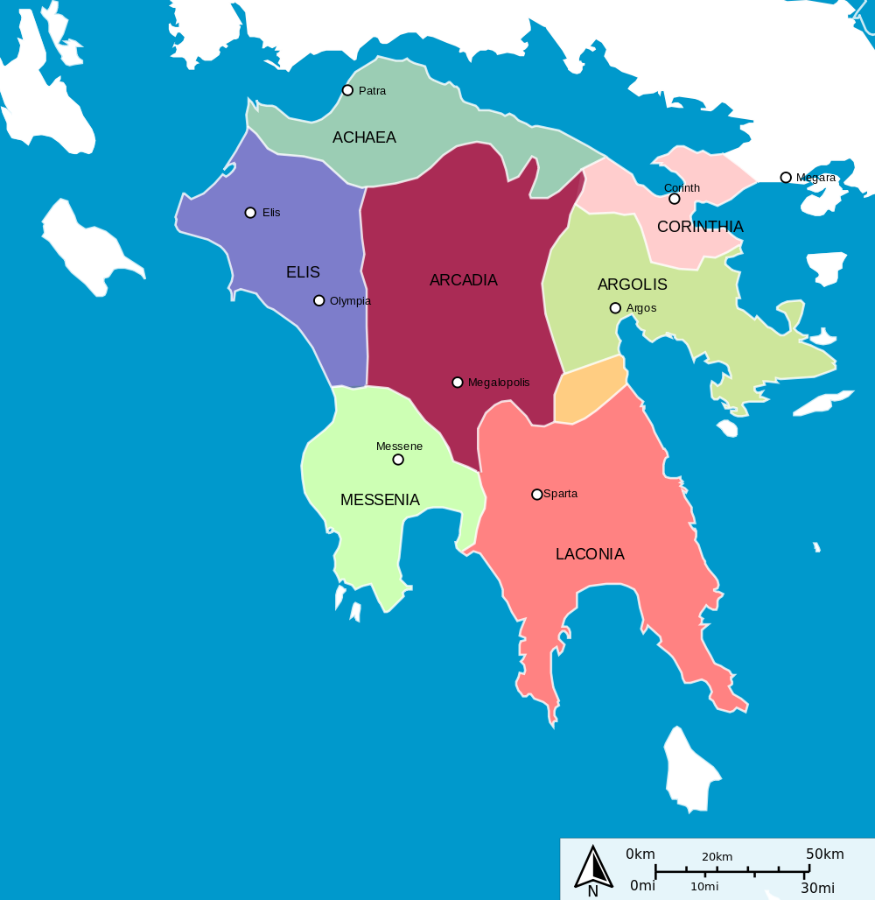
Geography
FIND THE FOLLOWING:
Peloponnesus
Sparta
Eurotas R.
Laconia
Messenia
Map Credit: Jkan997

Slide 4
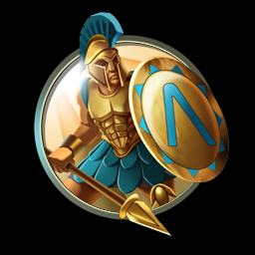

SPARTAN SOCIAL PYRAMID
Citizens
Perioikoi
“Dwellers Around”
Free Non-Citizens
Helots

Slide 5
HELOTS
Slaves (from Messenia)
  10 : 1
“Most Spartan institutions have always been designed with a view to security against the Helots.”
  Thucydides
Map Credit: Jkan997

Slide 6
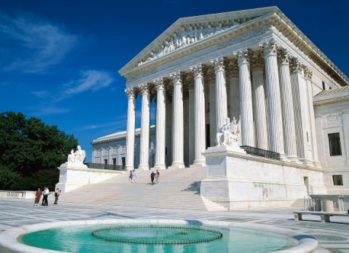



INSTITUTIONS
Units of Social Organization
GOVERNMENT
EDUCATION
FAMILY

Slide 7

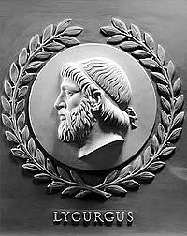
LYCURGUS
Legendary Lawgiver
Credited with the development of Spartan institutions.
Bas-relief of Lycurgus, one of 23 great lawgivers depicted in the chamber of the U.S. House of Representatives

Slide 8
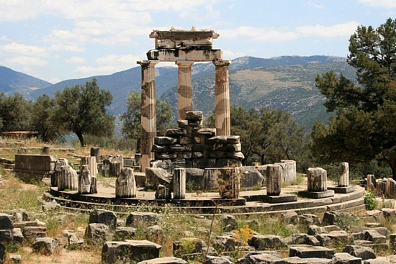
The Oracle
  Until I return…

Slide 9
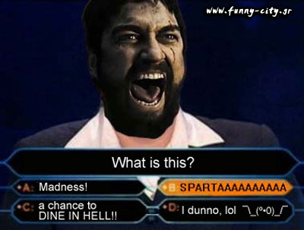

Slide 10
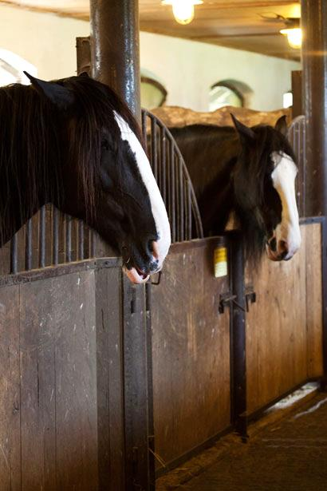


PRINCIPLES
of Spartan Government
STABLE
Government
MIXED
Government
CHECKS
& Balances

Slide 11
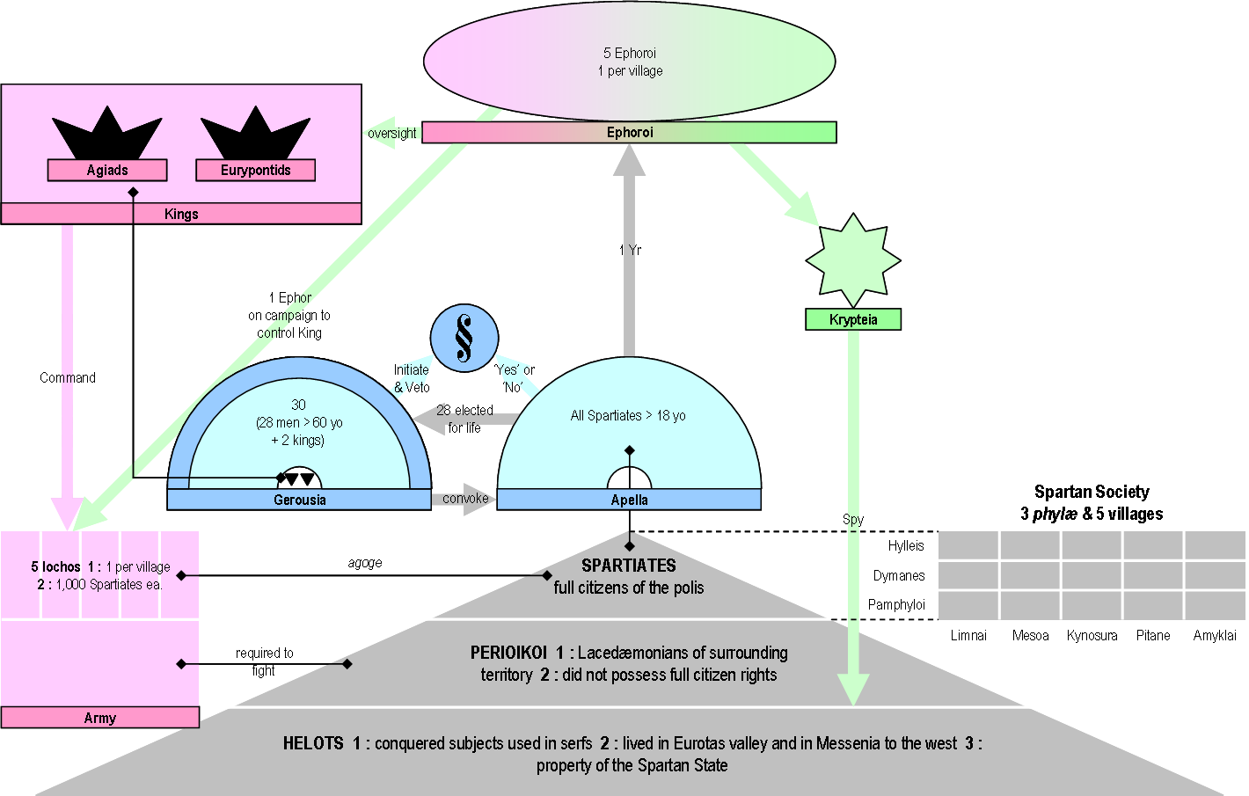
The Spartan Constitution
LEGISLATIVE
Gerousia (28)
Apella (All)
EXECUTIVE
Kings (2)
Ephors (5)
JUDICIAL
Gerousia (28)
Source: http://upload.wikimedia.org/wikipedia/commons/6/6d/SpartaGreatRhetra.png

Slide 12
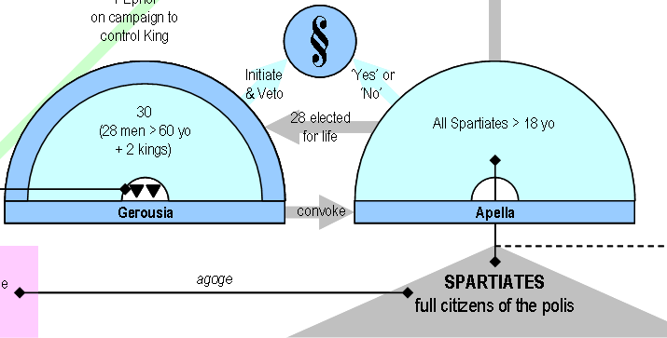
Legislative Branch
BICAMERAL
BACK

Slide 13
Legislative Branch
Gerousia
(Upper House)
28 Members (Age 60+)
Plus 2 Kings = 30
Aristocracy
Gerontocracy
BACK

Slide 14
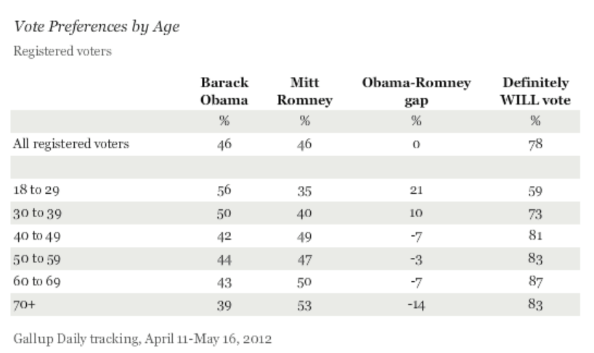
Gerontocracy

Slide 15


Slide 16

Legislative Branch
Apella
(Lower House)
All Spartan Citizens
Debate
BACK

Slide 17
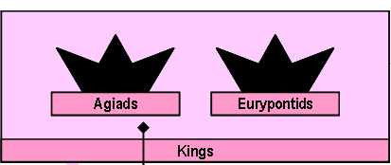

EXECUTIVE Branch
Kings (2)
1
Diarchy
Commanders-in-Chief
Ephors (5)
One Year Terms
ARMY
BACK

Slide 18
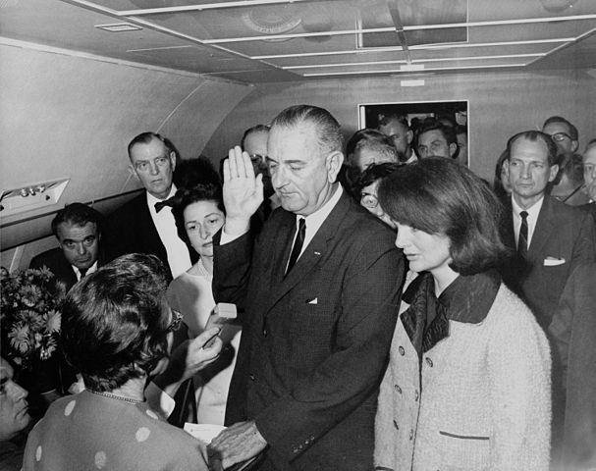
OATH OF OFFICE
President Lyndon Johnson takes the presidential oath of office after the death of President John F. Kennedy.
“I do solemnly swear (or affirm) that I will faithfully execute the Office of President of the United States, and will to the best of my ability, preserve, protect and defend the Constitution of the United States.”

Slide 19
SPARTAN Oaths of office
Kings (2)
“We swear to uphold the laws…”
“We swear to
support the kings…
as long as they
uphold the laws.”
BACK

Slide 20

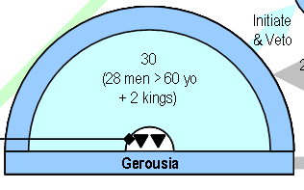
JUDICIAL Branch
Gerousia
(Supreme Court)
28 Members (Age 60+)
Plus 2 Kings = 30
Aristocracy
Gerontocracy
BACK

Slide 21
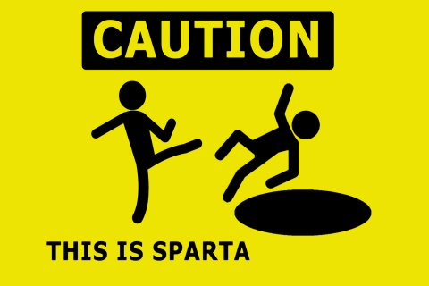

Slide 22
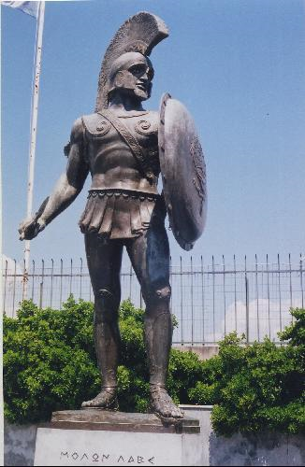
The Spartan Citizen
ALL Spartan citizens were professional soldiers.
The lives of Spartan men were highly regimented from birth.

Slide 23
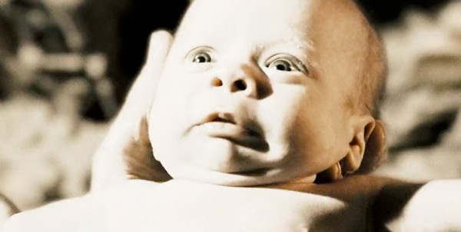
BIRTH INSPECTION
Screenshot from the movie, 300, accessed here

Slide 24


Slide 25
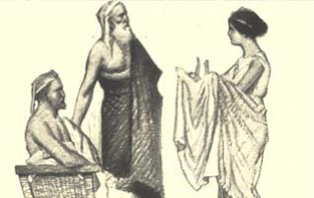
Eugenics
Birth
A Spartan mother presents her child to the elders for a birth inspection.

Slide 26
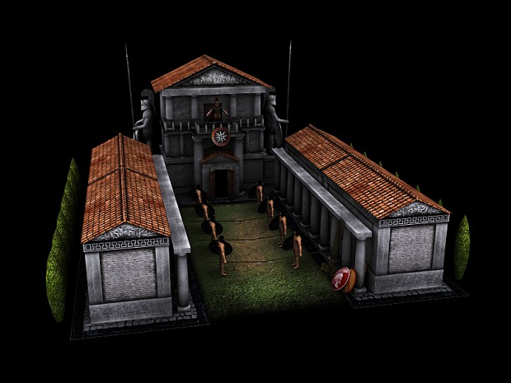
agoge
Age 7-20
“Raising”
Academics
Discipline
Combat
Stealth
Brotherhood
All Spartan males were required to go through the agoge (raising), where they received 13 years of military training.
Image Credit: http://www.moddb.com/mods/the-peloponnesian-wars/images/the-new-and-final-agoge

Slide 27


Krypteia
Age 18-20
The most talented Spartan youths were selected for service in the Krypteia, a secret, elite band charged with terrorizing the Helot population.
SEDITION
Image Credit: http://vixstar1314.wordpress.com/2011/05/18/and-so-night-falls/

Slide 28


Slide 29
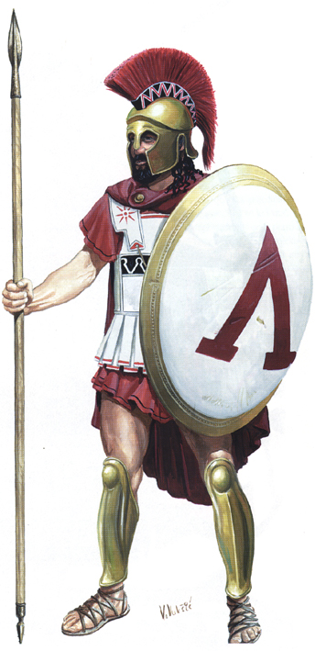
Adulthood
Finally!
At 21, the young Spartan male could take his place among the citizen hoplites...
Spartan Shield
(hoplon)
Note the Lambda for Laconia, the Spartan homeland
Notes:
Picture accessed at: http://philbancients.blogspot.com/2012/10/whats-one-of-them-hoplite.html

Slide 30

…and get married.

Slide 31

NOT UNTIL YOU’RE 30!
Although they got married at 21, Spartan men lived in the barracks until age 30.

Slide 32
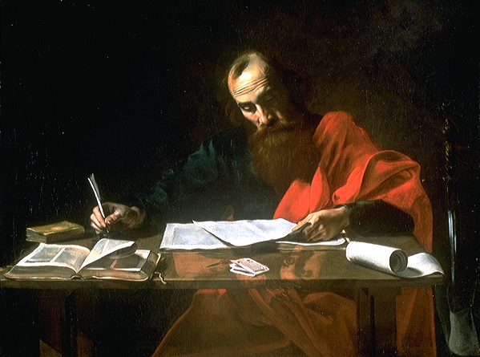
Passionate Marriage
“It is better to marry than to
BURN WITH PASSION.”
-- St. Paul
Notes:
Paul Writing His Epistles, painting probably by Valentin de Boulogne, 17th century (Blaffer Foundation Collection, Houston, Texas)

Slide 33
Are passion and marriage
mutually
exclusive?
Notes:
Paul Writing His Epistles, painting probably by Valentin de Boulogne, 17th century (Blaffer Foundation Collection, Houston, Texas)

Slide 34
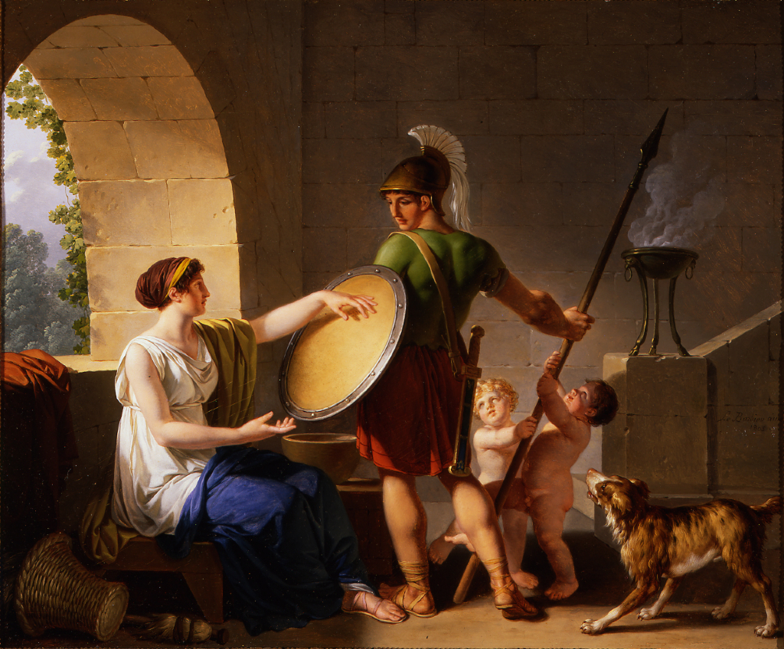
The Spartan Woman

Slide 35
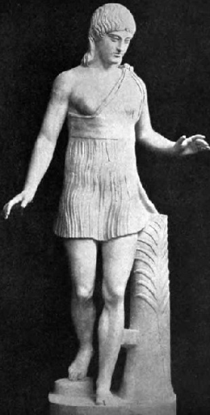
The Spartan Woman
On being quizzed by an Athenian woman, ‘Why is it that you Spartan women are the only ones who rule your men?’, she replied ‘Because we are the only women too who give birth to men.’
  -- From Plutarch, Sayings of Spartan Women,
  quoted in Cartledge, The Spartans (125)
Statue of a winner of the Heraia (footrace every four years to honor Hera)

Slide 36
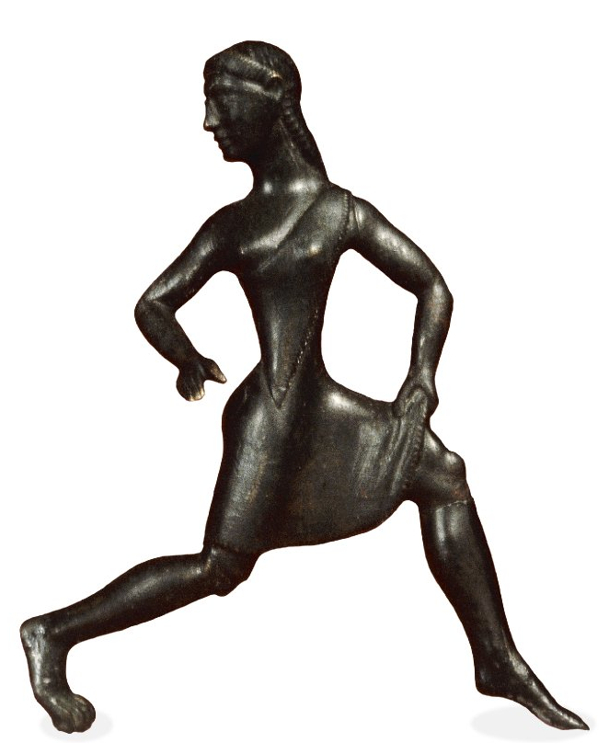
Athletics
Unlike women in other city states, Spartan women were expected to participate in athletic training.

Slide 37
Athletics
“For it was not by imitating other states, but by devising a system utterly different from that of most others, that [Lycurgus] made his country prosperous…he insisted on physical training for the female no less than for the male sex: moreover, he instituted races and trials of strength for women competitors as for men, believing that if both parents are strong they produce more vigorous offspring…”
  Xenophon (4th century B.C.)
  Constitution of the Lacedaemonians
http://people.uncw.edu/deagona/amazons/spartanwomen2.htm#Education

Slide 38
“There are no adulterers in Sparta.”
-- ancient saying

Slide 39
With it or on it
A Spartan Woman Giving a Shield to Her Son, 1805
Jean-Jacques-François Le Barbier

Slide 40
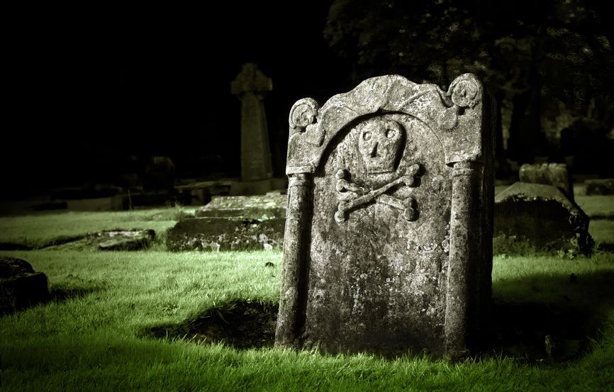
CHILDBIRTH
A Spartan Woman’s Glory
A Spartan woman would be buried with a gravestone if she died in childbirth (men had to die in battle).

Slide 41
Greek Women Compared
 | Athenian | Spartan
EDUCATED?
GYMNASTICS?
HOUSEWORK?
Own Property in their own right?
Short Skirts?
NO
YES
NO
YES
YES
NO
(Helots did this)
NO
YES
NO
YES

Slide 42








