Slide 1
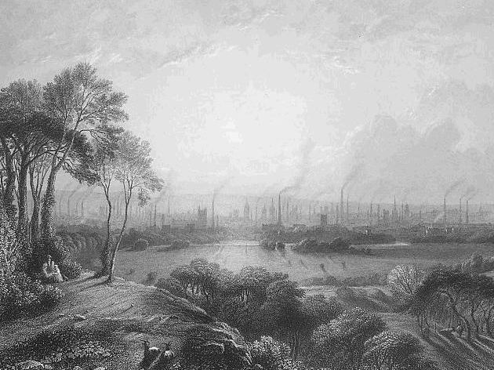

The Industrial
Revolution

Slide 2
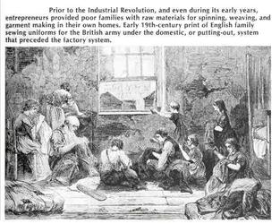
Cottage Industry
“Putting Out” System
Fun for the
whole family!

Slide 3

Problems
Difficult to supervise
rural workers
“Holy Monday”
SOLUTION:
Factory Production
Photo by thedz_

Slide 4
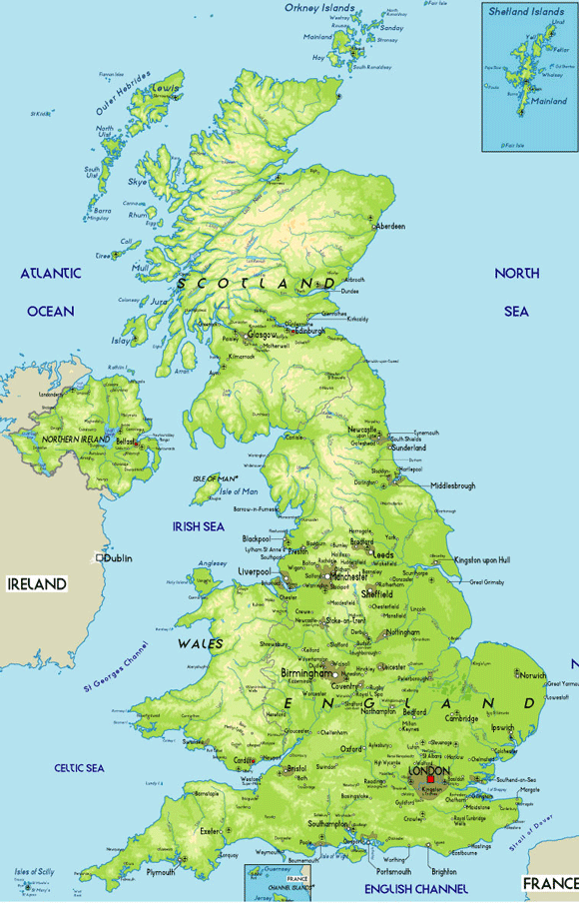
beginnings
Britain c. 1760
Historians:
Was there an Industrial “Revolution”?

Slide 5
Why Britain?
Natural Advantages
Lots of Rivers
  Cheap, easy transportation
  Water power
Coal
Iron
Sheep
(imported in 16th century)

Slide 6
Why Britain?
Human Advantages
National Bank
  Chartered 1694
  No NB in France
  Source of capital
Private Property Rights
Aristocrats invested in commerce/industry
  Not so in France
Canals
Invention

Slide 7
Why Britain???
Natural Advantages | Human Advantages
Rivers | Canals
Coal | Free Market Economy
Iron | Capital
Sheep | National Bank
 | Private Property Rights
 | Enclosures

Slide 8
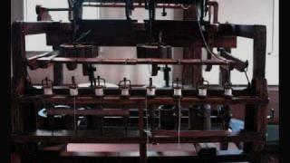

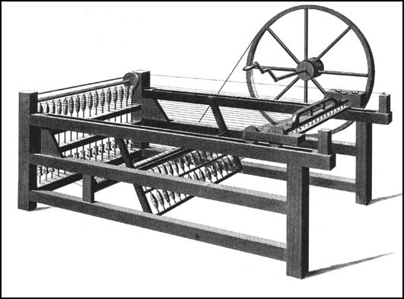
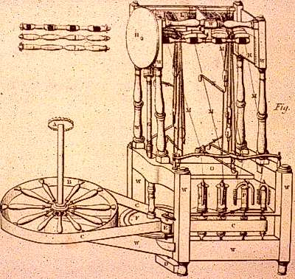
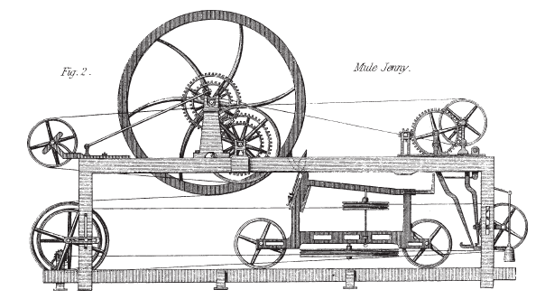
Inventions
of the Industrial Revolution
Inventions of the Industrial Revolution
Spinning Jenny
Water Frame
Spinning
Mule
James Hargreaves
1764
Richard Arkwright 1768
Samuel Crompton
1779

Slide 9

Water Frame
Richard Arkwright - 1768
Held several hundred spindles and required water power to operate

Slide 10
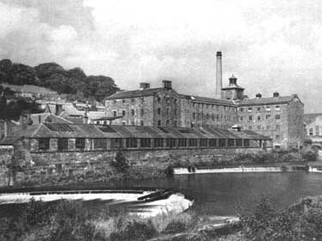
MILLS
The Water Frame could not be operated from home.
Mills, housing thousands dozens of water frames, were built near rivers.

Slide 11

Water Power
Water power is finite – only so many water frames could be built, and only by major rivers.
Goods still produced on a small scale in the countryside.

Slide 12
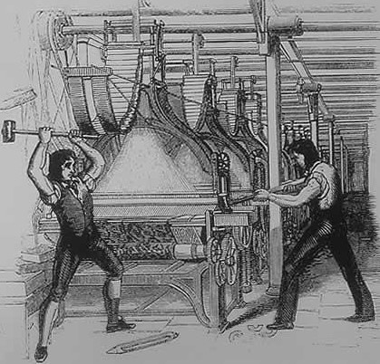
Luddites
Ned Ludd
Mythical forest dweller
Luddites smashed frames that made automated weaving possible.
Modern Usage:
Anti-technology

Slide 13

Smashing
is what Luddites do best!

Slide 14
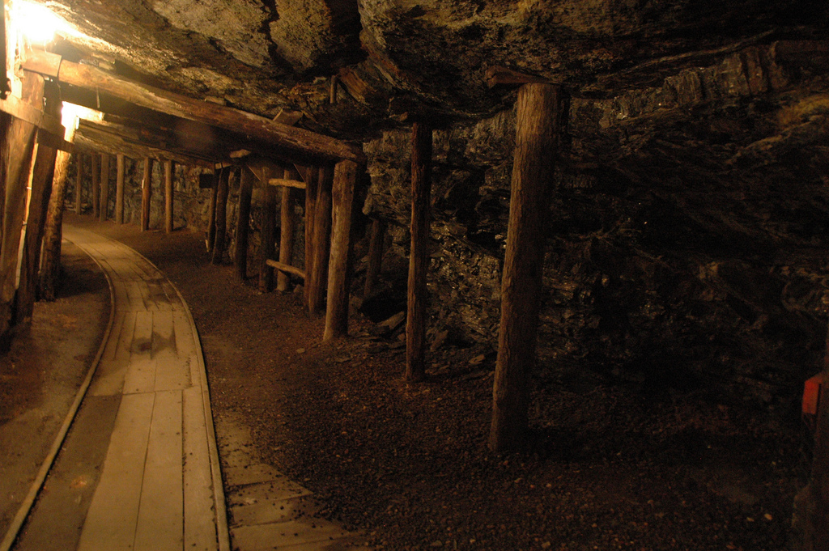
Coal
The British had access to coal, which provided massive amounts of energy in comparison to water, but it was still finite.
Photo by peterp

Slide 15
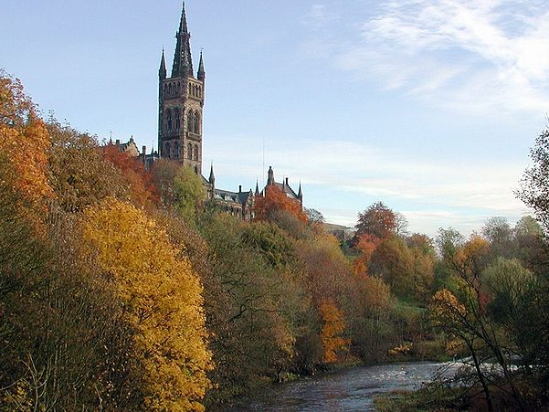

University of Glasgow
Scottish universities emphasized science and the mechanical arts.
Oxford and Cambridge emphasized theology and the humanities.

Slide 16
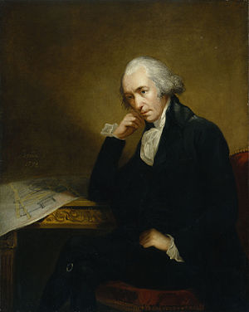
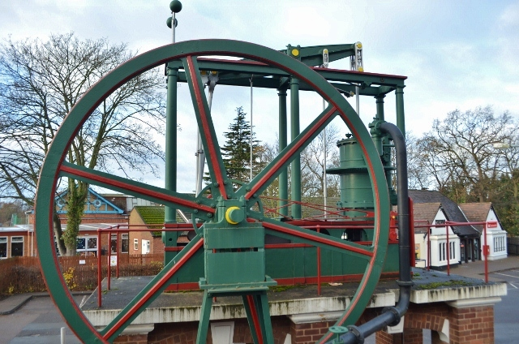
Steam Engine
E=mc²
1705 | First experimental steam engine invented
1769 | James Watt (U. of Glasgow) made the existing steam engine (which was being used at Scottish universities for experiments) more efficient.
1770s | Steam engine becomes a major producer of power.
Watt
A preserved Watt engine at Loughborough University

Slide 18
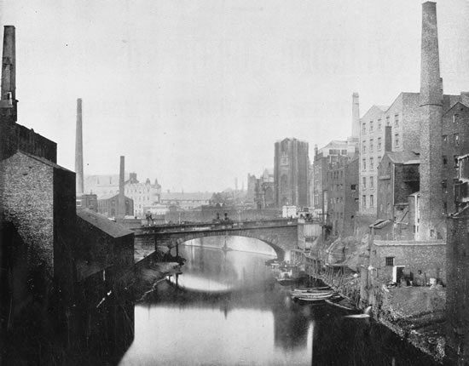
Cities
The development of the steam engine allowed people to build factories anywhere.
Many factories popped up in cities, such as Manchester and Liverpool.

Slide 19
“Cottonopolis”

Slide 20
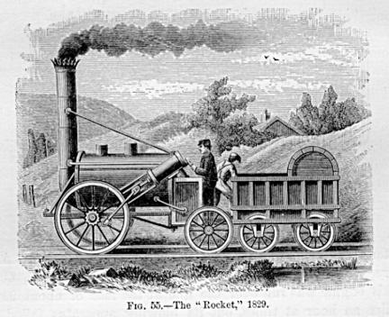
Railroads
Transportation of goods was still a problem until railroads were developed.
1825 – Liverpool to Manchester Railway
1830 – The Rocket clocked a record 16 MPH.

Slide 21
Railroads
Goods can now be produced and transported in mass quantities.

Slide 22
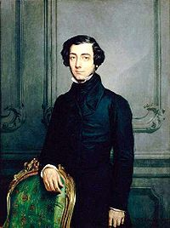
A Foreign Traveler’s Perspective
Alexis de Tocqueville
  Journeys to England and Ireland
  Visiting Manchester

Slide 23
WILL THINGS GET BETTER?

Slide 24
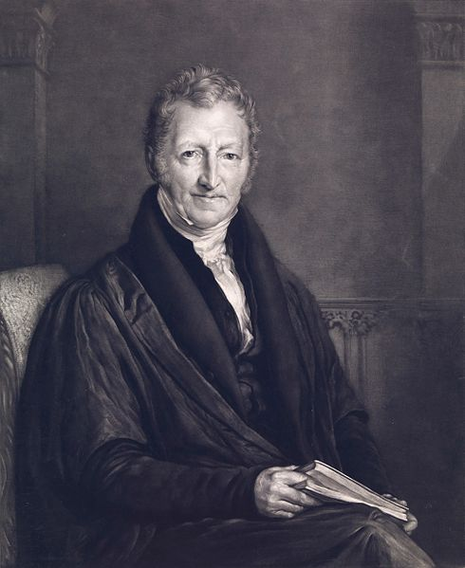
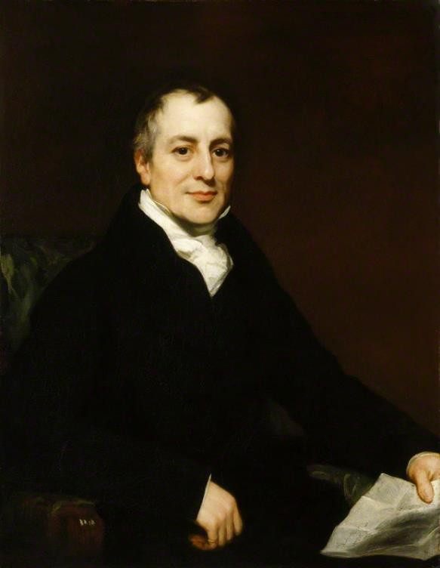
The Dismal Science
Economic Pessimism
Thomas Malthus
1766-1834
David Ricardo
1772-1823

Slide 25
The Malthusian Dilemma
Thomas Malthus,
Essay on the Principle of Population (1798)
Food supply growth is arithmetic, but population growth is geometric.
Thomas Malthus
1766-1834

Slide 26
The Malthusian Dilemma

Slide 27
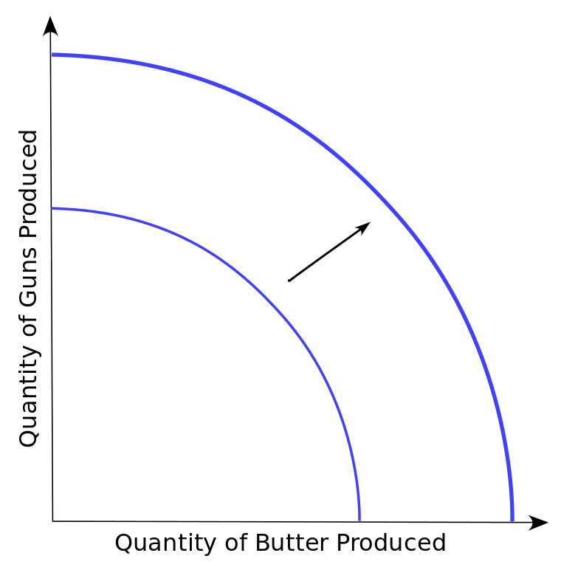
Production Possibilities frontier
As technology advances, so does our capacity to produce.
Graph Credit: Everlong

Slide 28
Iron Law of Wages
Wages (in the long-term) will always tend toward the subsistence* level.
*what is needed to survive
David Ricardo
1772-1823

Slide 29
Iron Law of Wages
Things are NOT
going to get better.
David Ricardo
1772-1823

Slide 30
correct
SHORT-TERM
Thomas Malthus
1766-1834
David Ricardo
1772-1823

Slide 31
incorrect
LONG-TERM
Thomas Malthus
1766-1834
David Ricardo
1772-1823

Slide 32

Things DID get better.
Photo by André Zahn

Slide 33
Standard of Living
Depends on Time Period
  1820’s, 1830’s, 1850’s…
Momentary shock, but conditions improved

Slide 34








