Slide 1
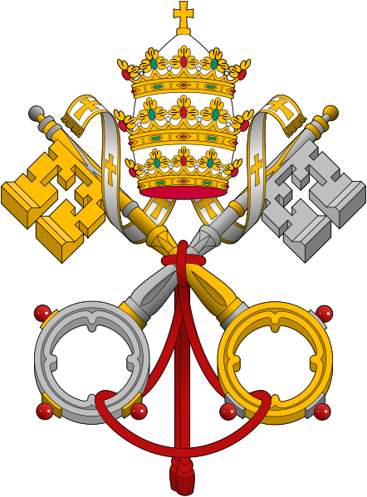
CAUSES of the
REFORMATION

Slide 2
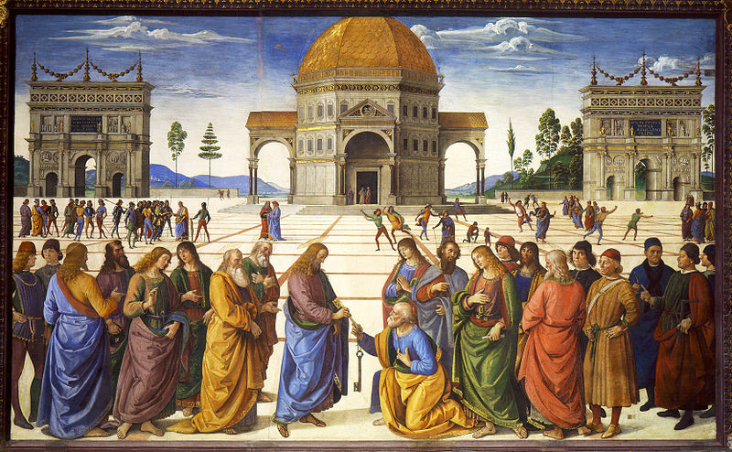
Perugino, Delivery of the Keys (1482)

Slide 3
Blessed art thou, Simon Barjona: for flesh and blood hath not revealed it unto thee, but my Father which is in heaven.
¹⁸ And I say also unto thee, That thou art Peter, and upon this rock I will build my church; and the gates of hell shall not prevail against it.
¹⁹ And I will give unto thee the keys of the kingdom of heaven: and whatsoever thou shalt bind on earth shall be bound in heaven: and whatsoever thou shalt loose on earth shall be loosed in heaven.
-- Matthew 16 (KJV)

Slide 4
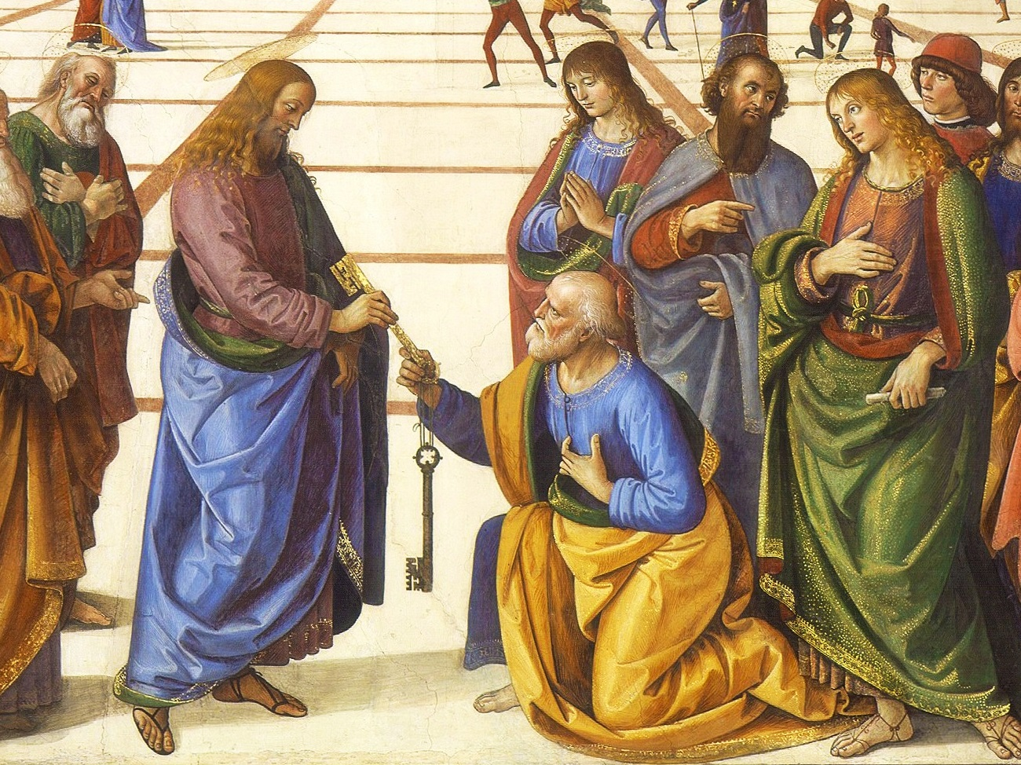
What you shall bind on earth...
Notes:
What makes Perugino’s Delivery of the Keys a work of classical art? *** READ SCRIPTURE PASSAGE *** According to Catholic tradition, Peter was the first Bishop of Rome and the Keys to the Kingdom were his to pass on to the next bishop of Rome and, by extension, to all future bishops of Rome. There’s a reason that the pope commissioned this work of art: the passage of Scripture that Perugino brings to life here provides scriptural basis for the Pope’s claim to be Christ’s Vicar on earth.

Slide 5
Christ’s Representative on Earth
Vicar

Slide 6
Papal Insignia
Note the
Keys!

Slide 7
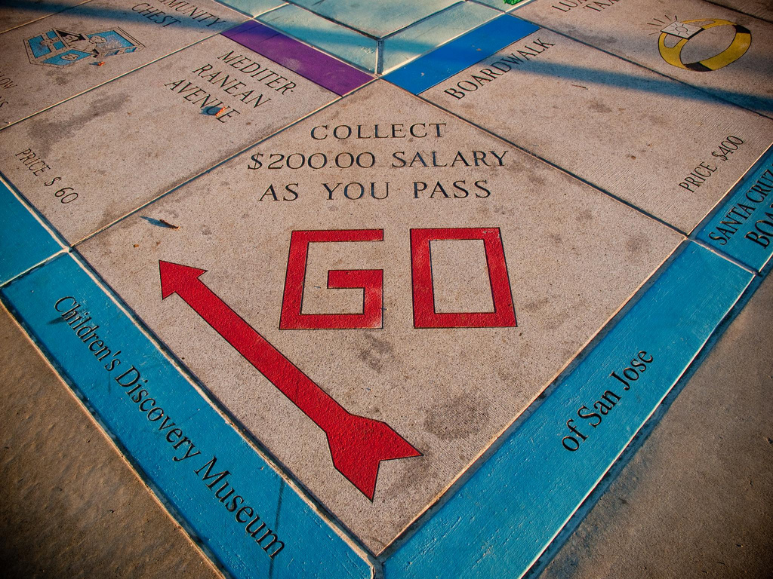
A Religious Monopoly
Some rights reserved by HarshLight
Notes:
By the fifteenth century, the Pope’s monopoly on salvation was accepted by nearly everyone in Western Europe.

Slide 8
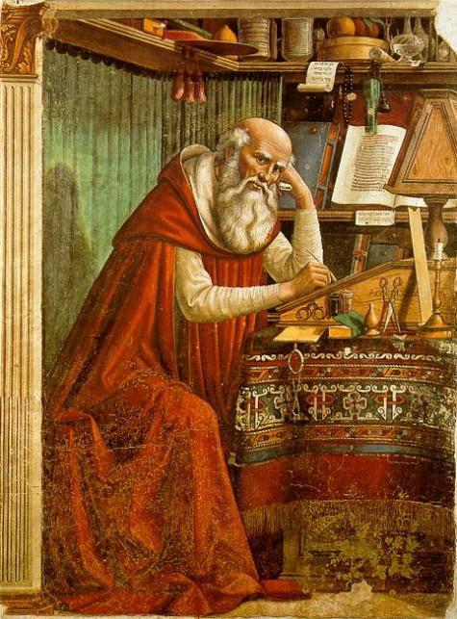
The Vulgate
(5th century)
The Bible in VULGAR language
St. Jerome Domenico Ghirlandaio (1480)
Notes:
In the fifth century, St. Jerome translated the Scriptures from the original Greek and Hebrew into vulgar Latin. I know what you’re thinking. VULGAR??? THE BIBLE??? NO WAY!!! This is not the same “vulgar” that we use today to mean “bad language.” It just means, “the language of the people,” Latin that everyday people spoke – not Cicero Latin that students would learn in schools.
So, maybe it makes sense now, if you think about it. When your mother tells you to stop using vulgar language, she’s telling you not to use the crowd’s language – to speak with a little more class. So, when Jerome translated the Vulgate, he wasn’t trying to write an EXPLICIT LYRICS Bible – he was just trying to make the Bible accessible to the common reader.

Slide 9
1,000 Years
Notes:
A lot can change in a thousand years. In the intervening millennium, Latin became the language of scholarship and the common people didn’t understand it, anymore.

Slide 10
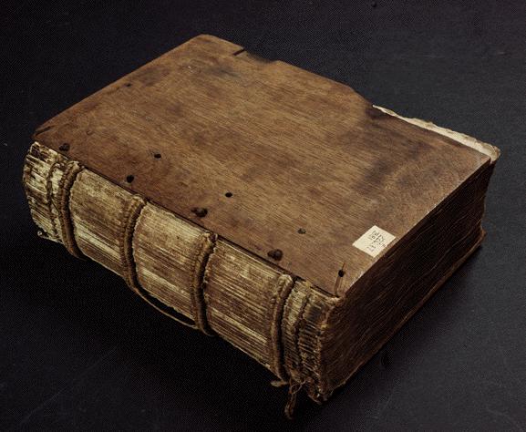
OFFICIAL
Bible. Latin. Vulgate. 1487 Nuremberg: Anton Koberger, 1487
Notes:
During the Middle Ages, the Vulgate became the official Bible of the Roman Catholic Church.
Photo Credit: http://specialcollections.vassar.edu/Incunabula/image2.html

Slide 11
Can YOU READ THIS?
Notes:
Any Latin scholars in the audience want to volunteer to read this? Keep in mind that if you’re watching this, you’ve completed at least ten years of formal schooling, so if you can’t read this, how about this guy? The average medieval peasant had no formal education. How much of this could our peasant friend here read or even understand?

Slide 12
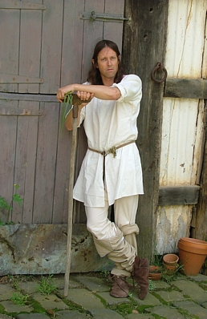
Can YOU read THIS?
Can he?
Notes:
Any Latin scholars in the audience want to volunteer to read this? Keep in mind that if you’re watching this, you’ve completed at least ten years of formal schooling, so if you can’t read this, how about this guy? The average medieval peasant had no formal education. How much of this could our peasant friend here read or even understand?

Slide 13
Notes:
An inaccessible Bible was only one of many ways that the Church was disconnected from the average person in Europe at that time.
Photo Credit: http://googleplus-update.blogspot.com/2011/12/google-disconnect-block-google-from.html

Slide 14
CORRUPTION
in the Church

Slide 15
SIMONY
Church offices
Some rights reserved by 401(K) 2013

Slide 16
NEPOTISM
Some rights reserved by camknows
From Greek, Nepos (Nephew)

Slide 17
ABSENTEEISM
Some rights reserved by derekbruff

Slide 18
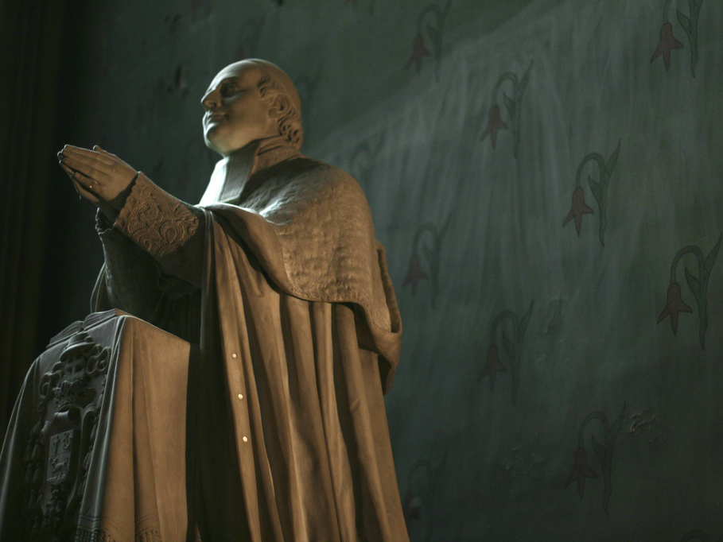
Uneducated Priests
Some rights reserved by firstworldchild

Slide 19
2 + 2 = ?
Some rights reserved by firstworldchild

Slide 20
SALE
OF INDULGENCES
Some rights reserved by 401(K) 2013

Slide 21
DON’T
Challenge
the Church

Slide 22
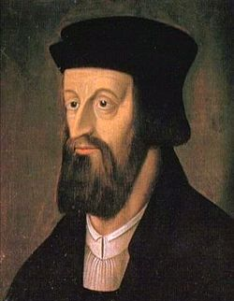
Jan Hus
Bohemia (15th c.)
Challenged Practices & Doctrines

Slide 23
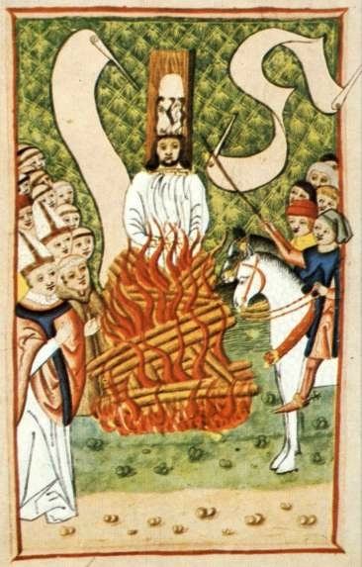
In the Middle Ages...
HERESY = DEATH

Slide 24
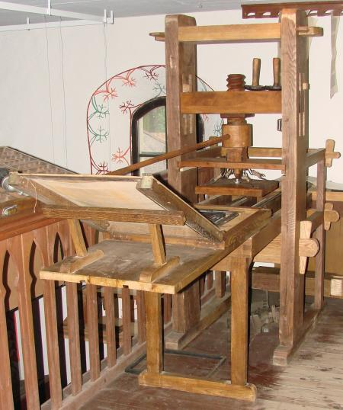
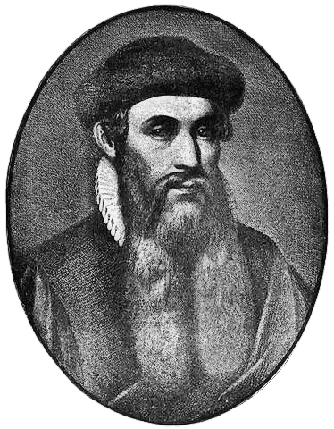
Game Changer
Gutenberg
Notes:
The Printing Press: The Internet of early Modern Europe
Johannes Gutenberg pioneered movable type in the mid-fifteenth century.

Slide 25
The Gutenberg Bible
c. 1456
Notes:
The Gutenberg Bible was the first major work to be printed on Gutenberg’s press. Around 180 copies were printed. The artwork surrounding the text was done by hand.

Slide 26
About 180 copies were printed, making the Bible more available.
c. 1456
Notes:
The Gutenberg Bible was the first major work to be printed on Gutenberg’s press. Around 180 copies were printed. The artwork surrounding the text was done by hand.

Slide 27
...but it was in Latin, so most people couldn’t read it.
Notes:
The Gutenberg Bible was the first major work to be printed on Gutenberg’s press. Around 180 copies were printed. The artwork surrounding the text was done by hand.

Slide 28
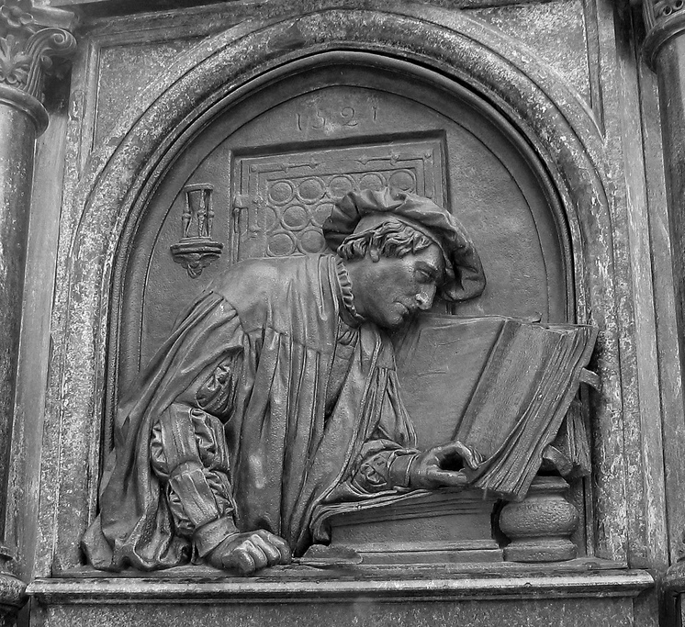
But Some Could
Martin Luther searches the Scriptures (from the Luther Monument, Eisleben)
Notes:
The average person in Europe couldn’t read the Gutenberg Bible, but the Printing Press made copies of the Scriptures more available to people, like Martin Luther, who could read them. The wide availability of the Scriptures would be a catalyst for the Reformation. *** Look at the picture ***
Photo Source: http://www.sacred-destinations.com/germany/eisleben-pictures/slides/lutherdenkmal-scriptures-c-photomaven.htm
Photo © photomaven

Slide 29
Luther’s Reformation
NEXT UP…

