Slide 1
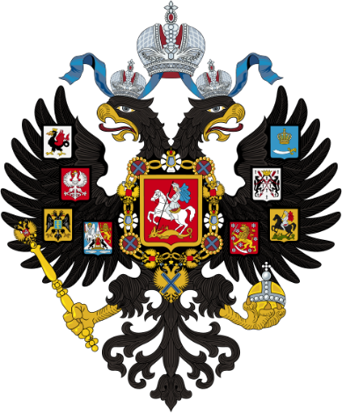
The Rise of Russia

Slide 2
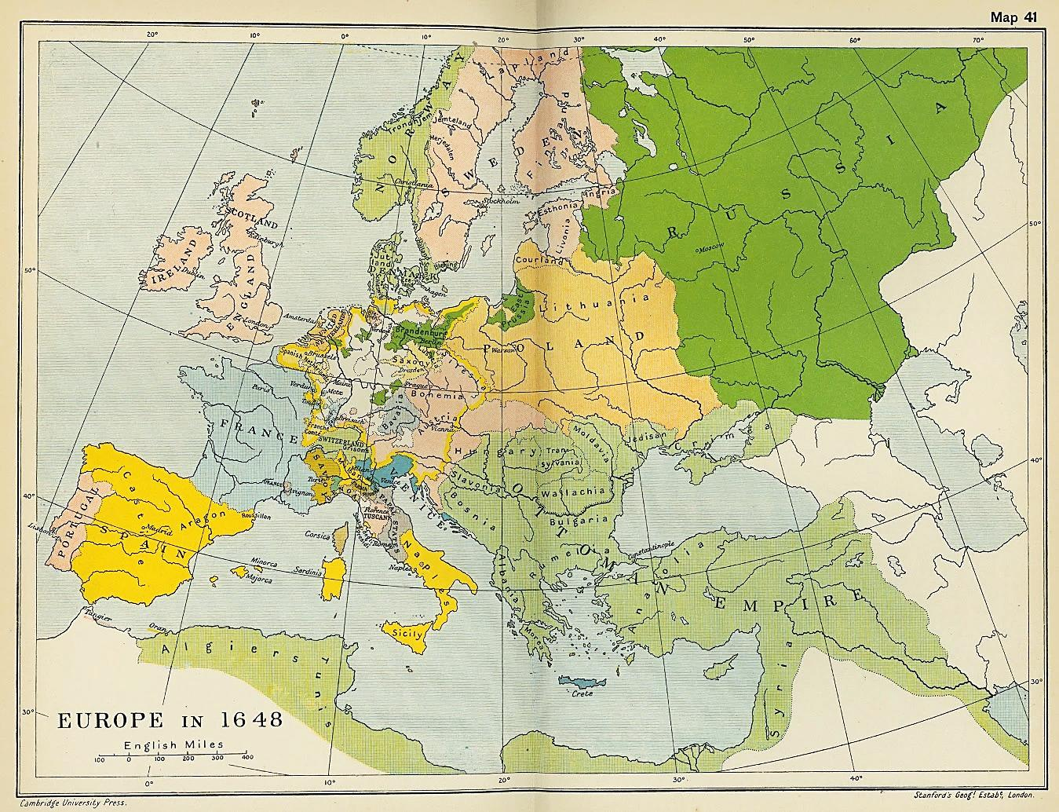
Political Entities of Eastern Europe
Russia
(Muscovy)
Prussia
Poland
Habsburg Monarchy
Ottoman Empire

Slide 3
BACKGROUND

Slide 4
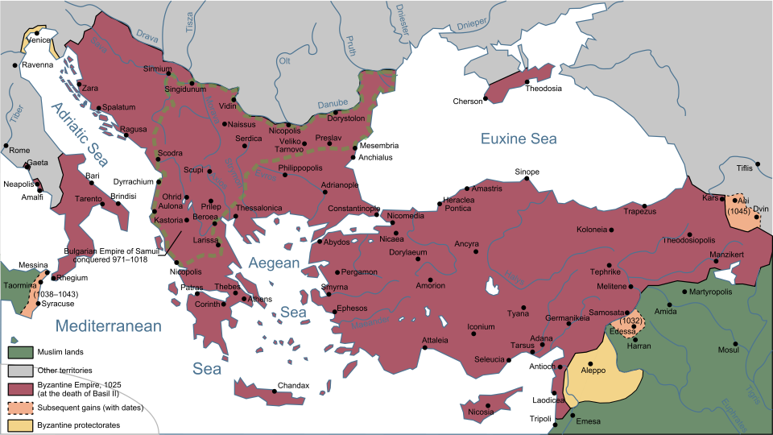
The Byzantine Empire
11th Century
“Buffer State”
Between Islamic empires and Christian Europe
Map Credit: Nécropotame and Cplakidas

Slide 5
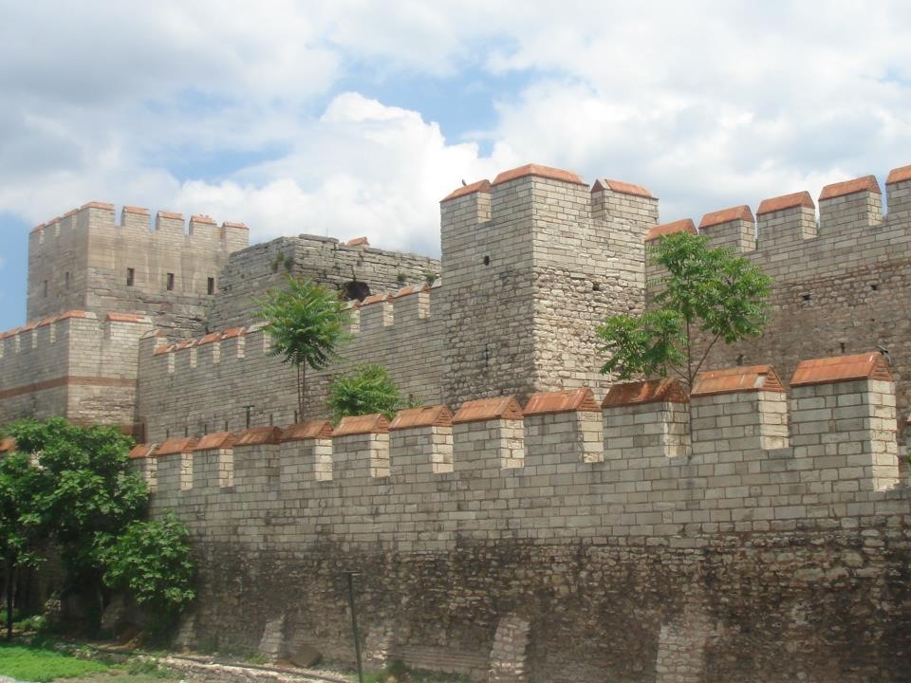
The Walls of Constantinople
Photo by Bigdaddy1204

Slide 6
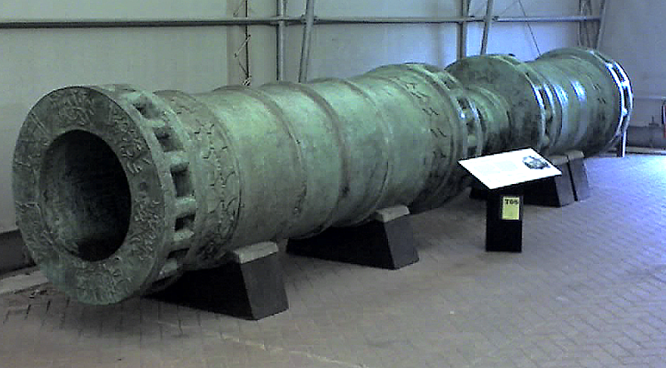
Game Changer

Slide 7
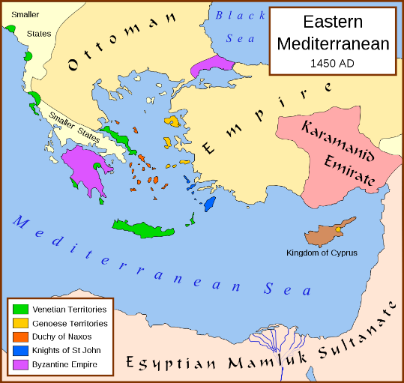
The Fall of Constantinople
1453
Map Credit: MapMaster

Slide 8
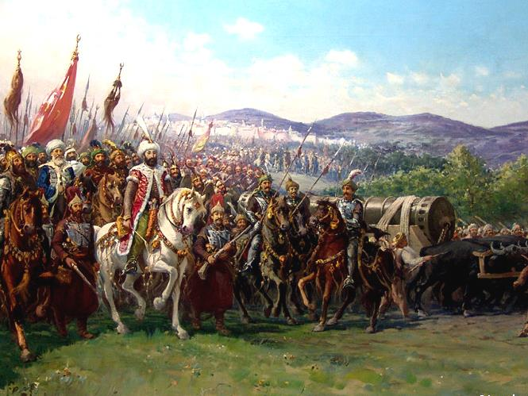
Mehmet II Marches on Constantinople

Slide 9
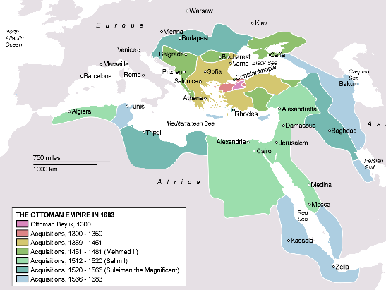
The Ottoman Empire
At its peak in 1683, the Ottoman Empire spanned from North Africa to the Middle East to Southeastern Europe.
Map Credit: Atilim Gunes Baydin

Slide 10
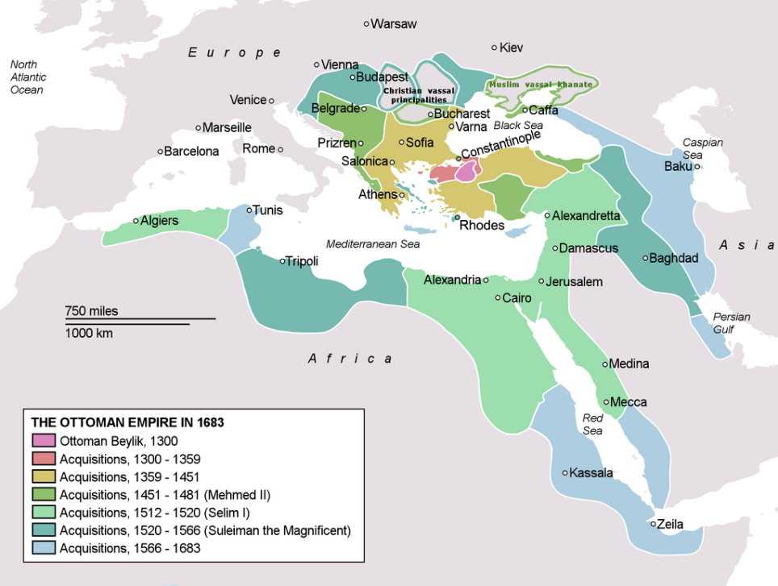
Map Credit: Atilim Gunes Baydin

Slide 11
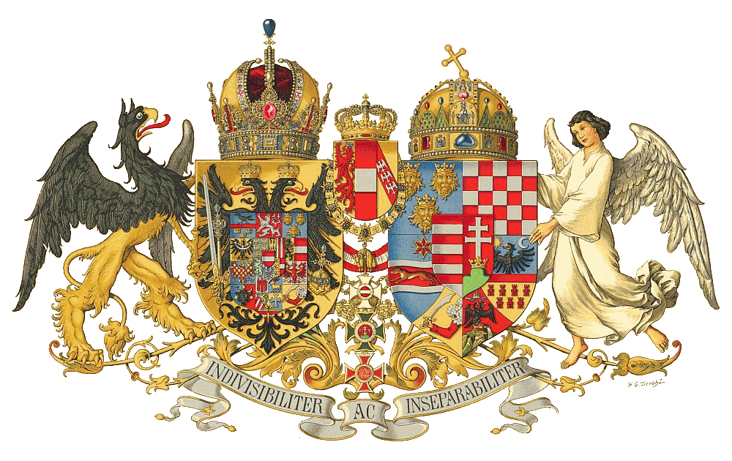
The Habsburg Monarchy Austria-Hungary

Slide 12
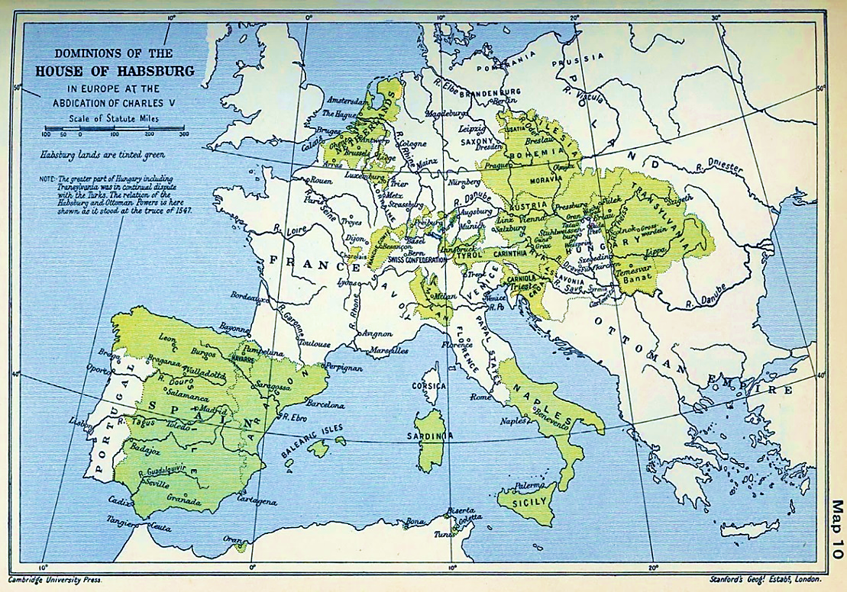
Ottoman-Habsburg Wars 1526-1791
The Hapsburg monarchs of Austria-Hungary fought the Ottomans for control of the Balkan Peninsula for over two centuries.

Slide 13
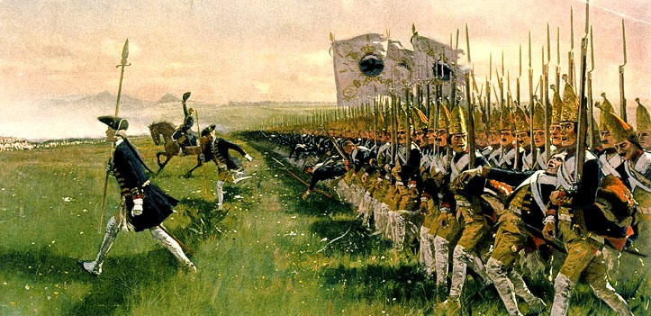
PRUSSIA
A modest, but modern, militaristic state
Carl Röchling (d. 1920), Attack of the Prussian Infantry

Slide 14
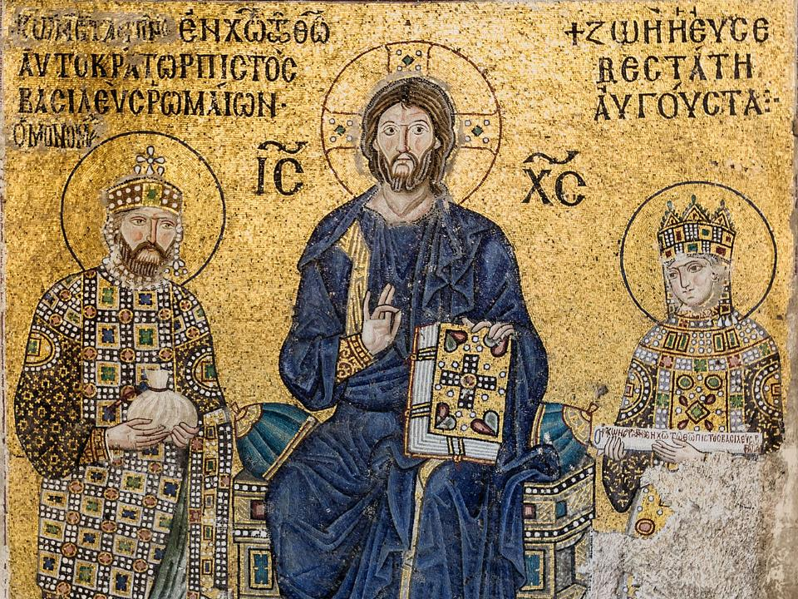
Who will inherit the Empire?

Slide 15
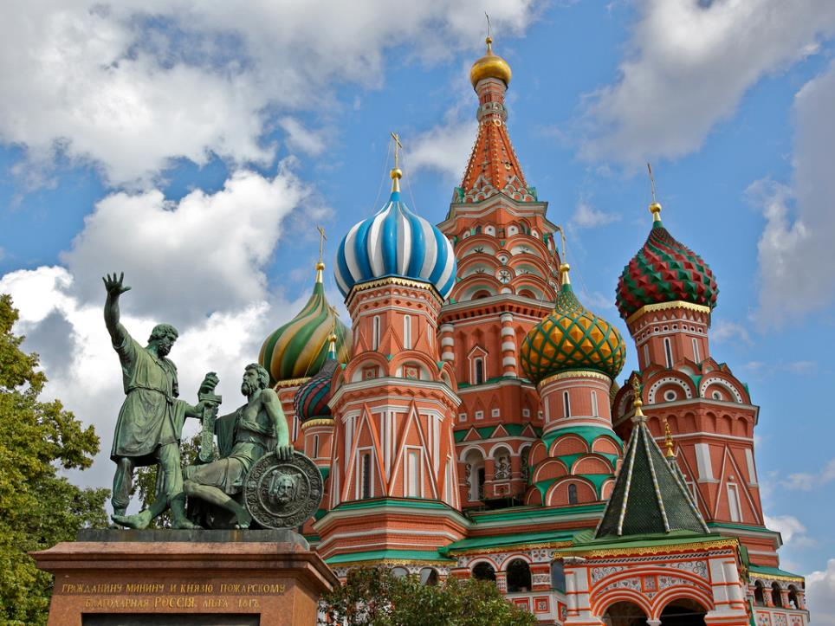
Russia
Photo by Steve Jurvetson

Slide 16
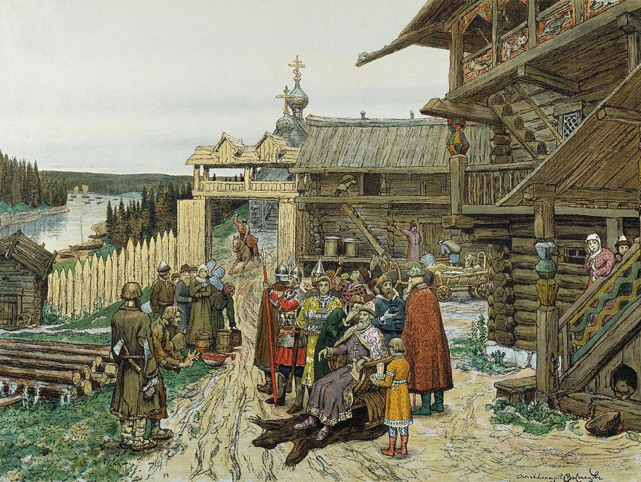
Muscovy
Grand Duchy of
1283-1547

Slide 17
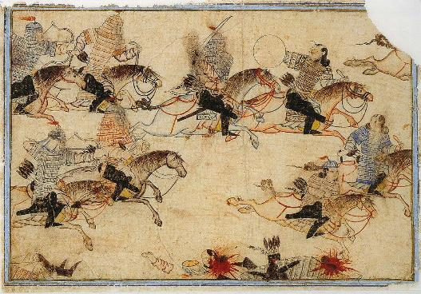
Tributary State
Muscovite princes paid tribute to the Mongol Empire until 1480.

Slide 18
1480
The Mongols retreated, leaving Muscovy to be an independent kingdom.

Slide 19
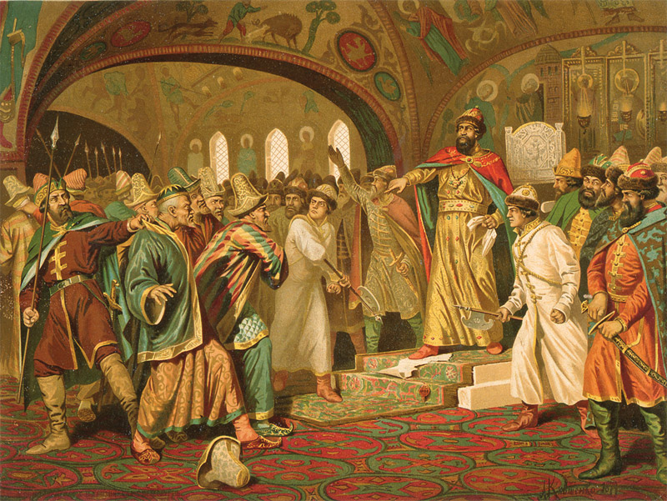
Ivan III
Ivan III proclaimed Muscovy to be independent in 1480

Slide 20
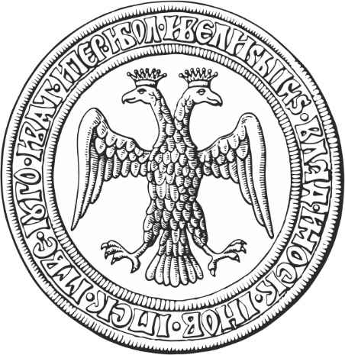
The Third Rome
Ivan married a Byzantine princess and began to use the Byzantine double-headed Eagle on official correspondence.

Slide 21
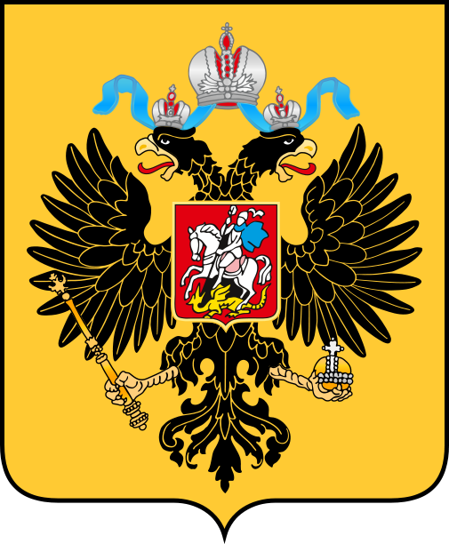
Coat of Arms
of the Russian Empire

Slide 22
TSAR
Variant of Caesar

Slide 23
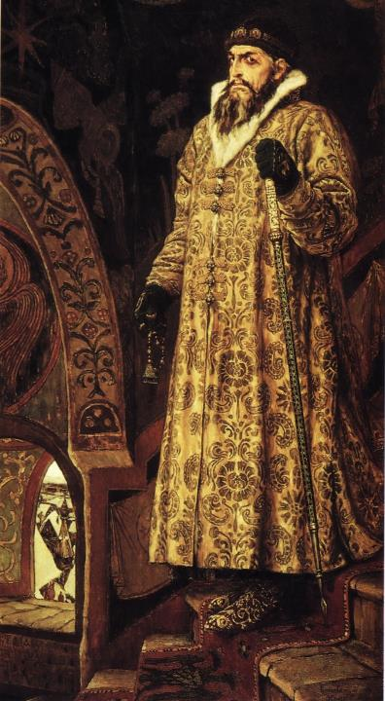
AUTOCRACY
Russian tsars were absolutists before absolutism was even cool.

Slide 24
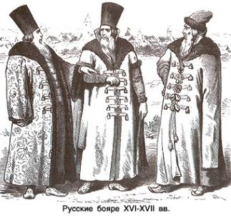
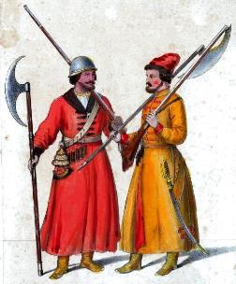
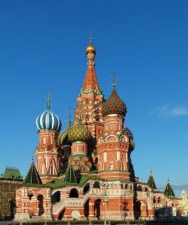
Entrenched Classes
Photo by Alvesgaspar
Boyars
(Nobility)
Streltsy
(Musketeers)
Russian Orthodox Church

Slide 25
Ivan IV “the Terrible”
(1533-1584)
Tsar vs Boyars

Slide 26
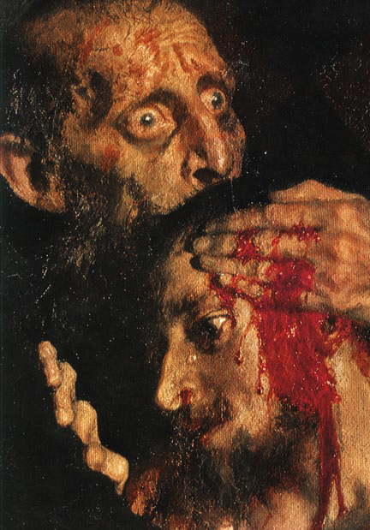
OOPS
Ivan killed his son in an argument after he struck his son’s wife for wearing immodest clothing.
Ilya Repin, Ivan the Terrible and His Son (1885)

