Slide 1
Nepean Sailing Club : Club-owned vessels with an engine 2021
Name | Make | Driving position | Shelter | Sides | Weather capability | Primary role | Color / Identifiers | Registration | Engine HP | Special equipment
Andy Haydon | Sportcraft 252 25’ | Side console | Half-cabin | Hard | < storm | Fleet | White | C24047ON | 250 inboard | Head. Signal gun. VHF. Powered anchor. Swim platform. 12V outlet
Bill Levesque | Bayliner Trophy 2503 25’ | Side console | Canopy | Hard | < storm | Fleet | White, blue stripe, blue canopy | ON4388193 | 225 outboard | Head. VHF Swim platform. 12V outlet
The Vice | Islamorada 21’ | Center-console | Canopy | Hard | < storm | Fleet | White, green stripe | C24048ON | 175 outboard | 12V outlet
The Hoff | Triumph 17’ | Side console | None | Hard | < storm | Fleet / Sail Training | Off-white or cream. Grey seats | ? | 60 outboard | 12V outlet
BMO Boat | Highfield | Center-console | None | Rib | < storm | Able Sail | Grey, blue BMO sticker | C24994ON ? | 40 outboard
Sesiya | C&C 27-3 yacht | Cockpit | Full cabin, bimini | Fibreglass | < storm | Able Sail | Keelboat, white hull, blue and red trim | 18E0279 | inboard | Sails
Red Highfield | Highfield | Center-console | None | Rib | < storm | Sail training | Red, black highlights | ? | 50 outboard
Caribe | Caribe | Center-console | None | Rib | < storm | Sail training | Very light grey | C24051ON | 60 outboard
Zodiac C24050ON | Zodiac Pro | Center-console | None | Rib | < storm | Sail training | Dark grey, youth racing sticker | C24050ON | outboard | Pulpit, side bench seats
Zodiac ON1905291 | Zodiac Pro | Center-console | None | Rib | < storm | Sail training | ON1905291 | ON1905291 | 90 outboard | No pulpit. No side bench seats
Small rib J | Triumph | Tiller | None | Rib | Moderate | Sail training | White | C24035ON | 15 outboard
Small rib H | Triumph | Tiller | None | Rib | Moderate | Sail training | White | C24036ON | 15 outboard
Small rib I | Triumph | Tiller | None | Rib | Moderate | Sail training | White | C24037ON | 15 outboard
Small rib N | Triumph | Tiller | None | Rib | Moderate | Sail training | White | C24038ON | 15 outboard
Small rib G | Triumph | Tiller | None | Rib | Moderate | Sail training | White | C24041ON | 15 outboard
Small rib letter ? | Triumph | Tiller | None | Rib | Moderate | Sail training | White | C24042ON | 15 outboard
Green Legend 043 | Legend V-1468 Widebody | Tiller | None | Hard | Moderate | Harbor / Sail training | Green hull, aluminum interior | C24043ON | 15 outboard
Green Legend 044 | Legend V-1468 Widebody | Tiller | None | Hard | Moderate | Harbor / Sail training | Green hull, aluminum interior | C24044ON | 15 outboard
Blue Whaly | Whaly | Tiller | None | Semi-rigid | Light | Harbor / Sail training | Blue hull, blue interior | C24039ON | 15 outboard
Red Whaly | Whaly | Tiller | None | Semi-rigid | Light | Harbor / Sail training | Red hull, red interior | C24040ON | 15 outboard
Barge | Home-made | Tiller | None | Hard | In-harbour | Harbor | Wood deck, green superstructure | none | 15 outboard | Crane

Slide 2
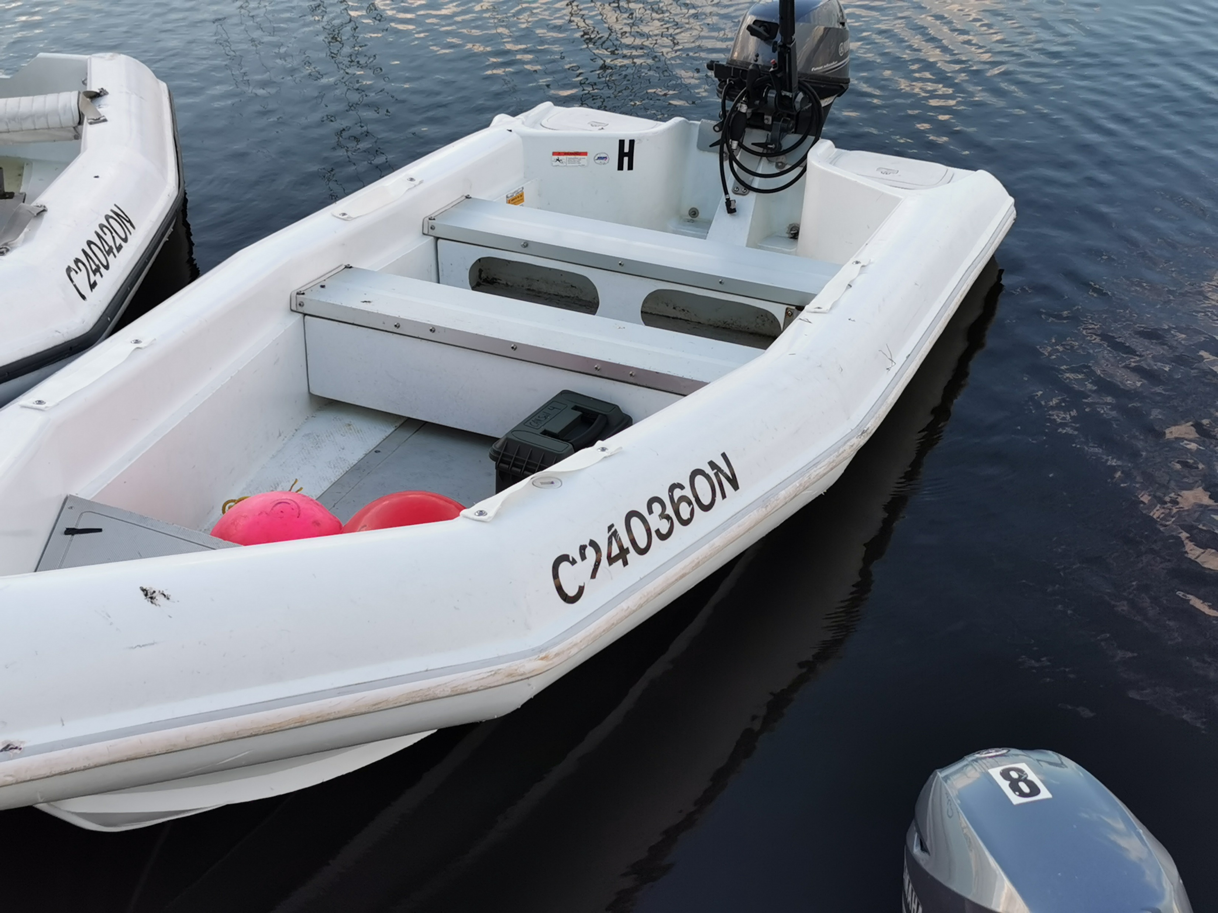
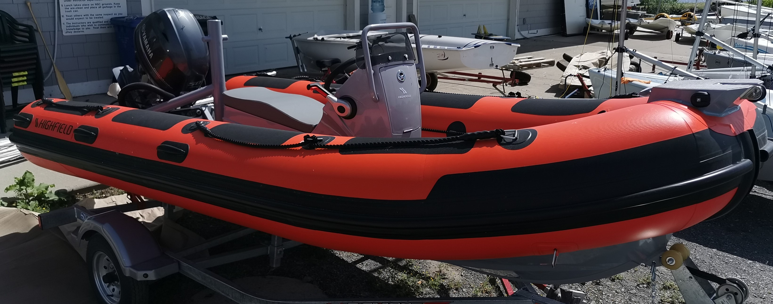
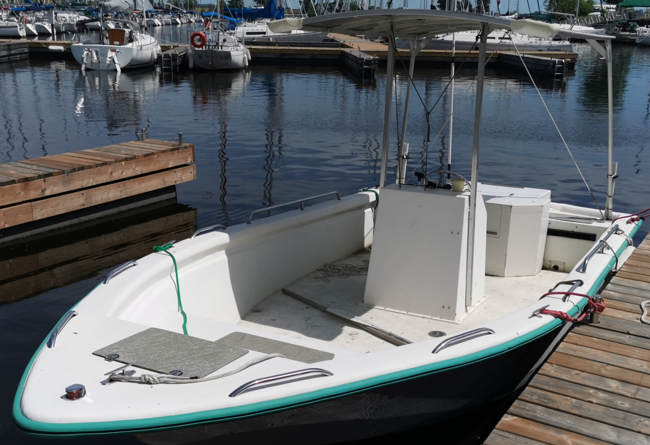
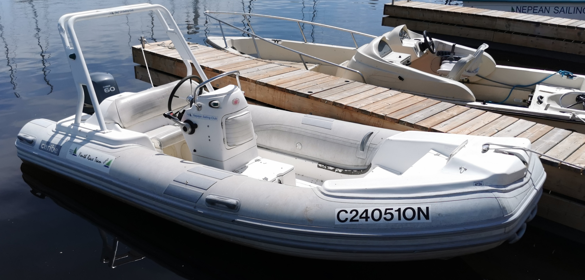
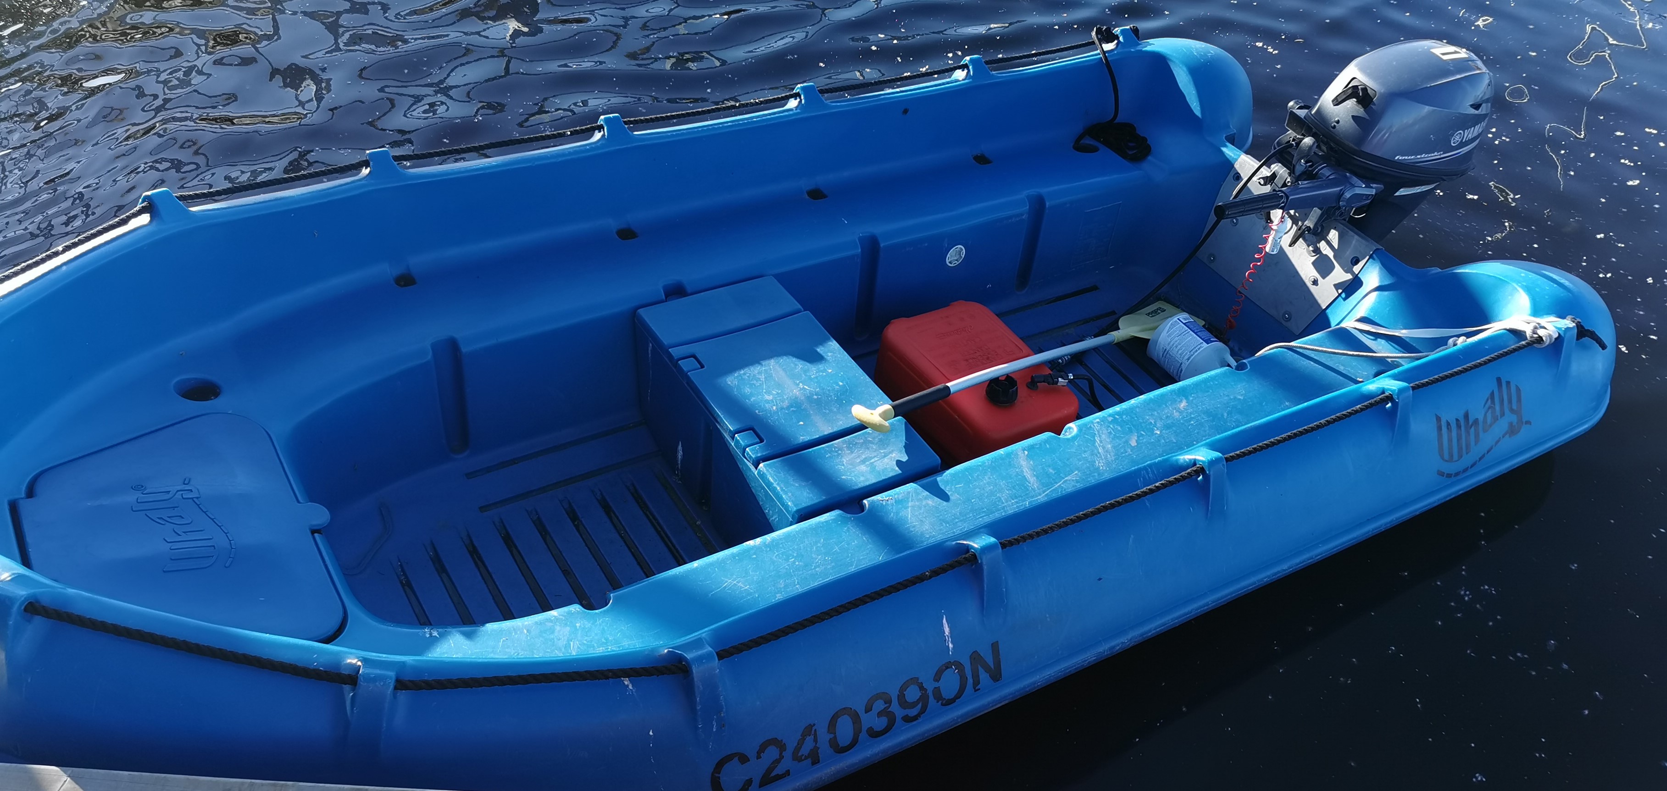
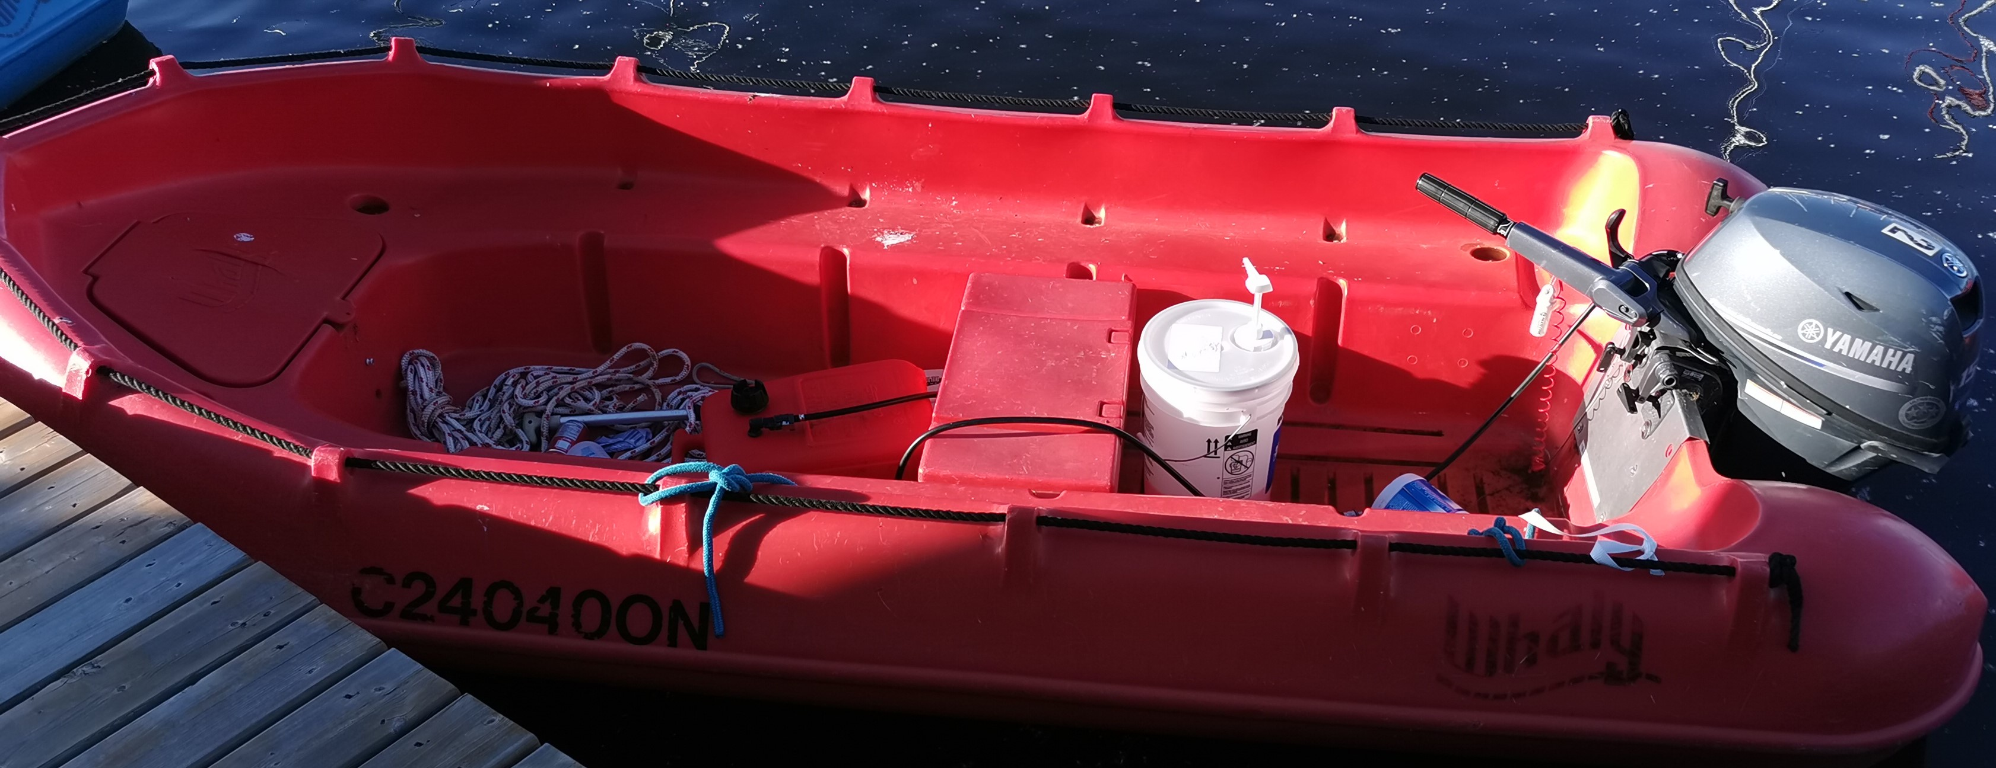
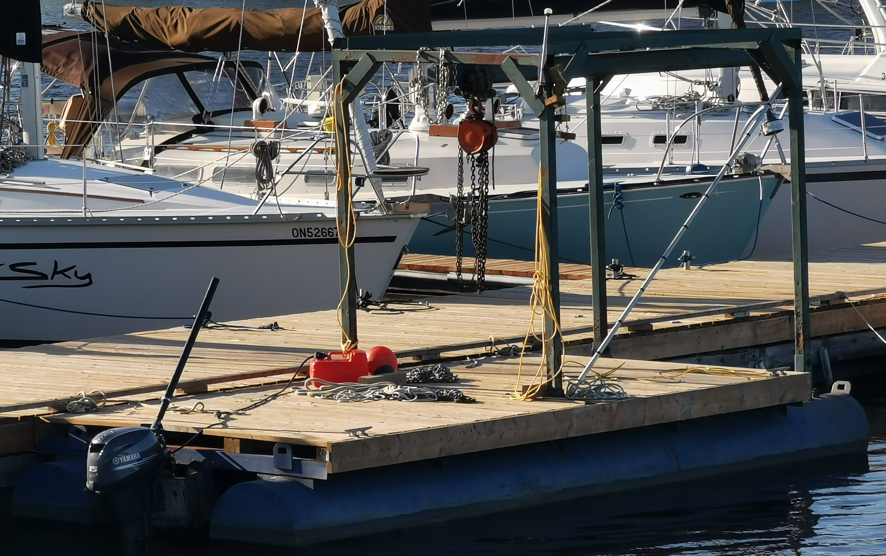
Andy Haydon
Sesiya
Small rib
Bill Levesque
Red Highfield
Green Legend
The Vice - Islamorada 21
Caribe
Blue Whaly
The Hoff - Triumph 17
Zodiac C24050ON
Red Whaly
BMO Boat
Zodiac ON1905291
Barge

