Slide 1
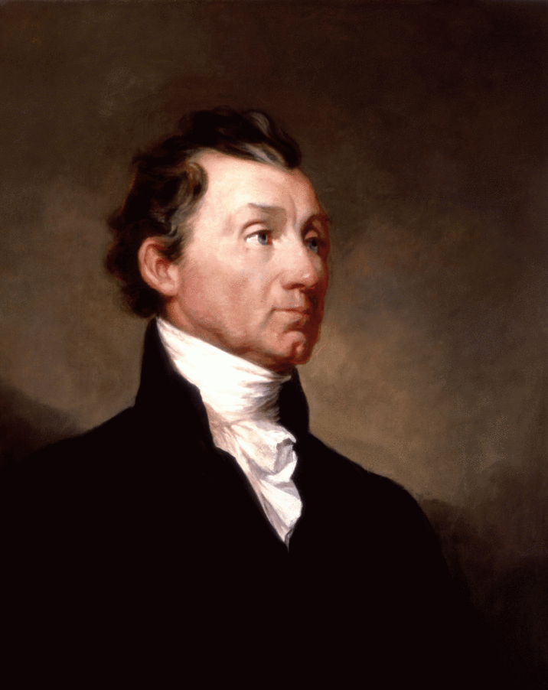
Nationalism and Sectionalism
In the Era of
Good Feeling

Slide 2
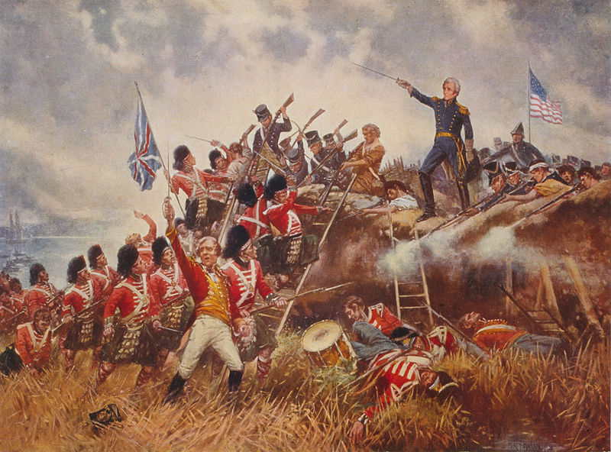

Slide 3
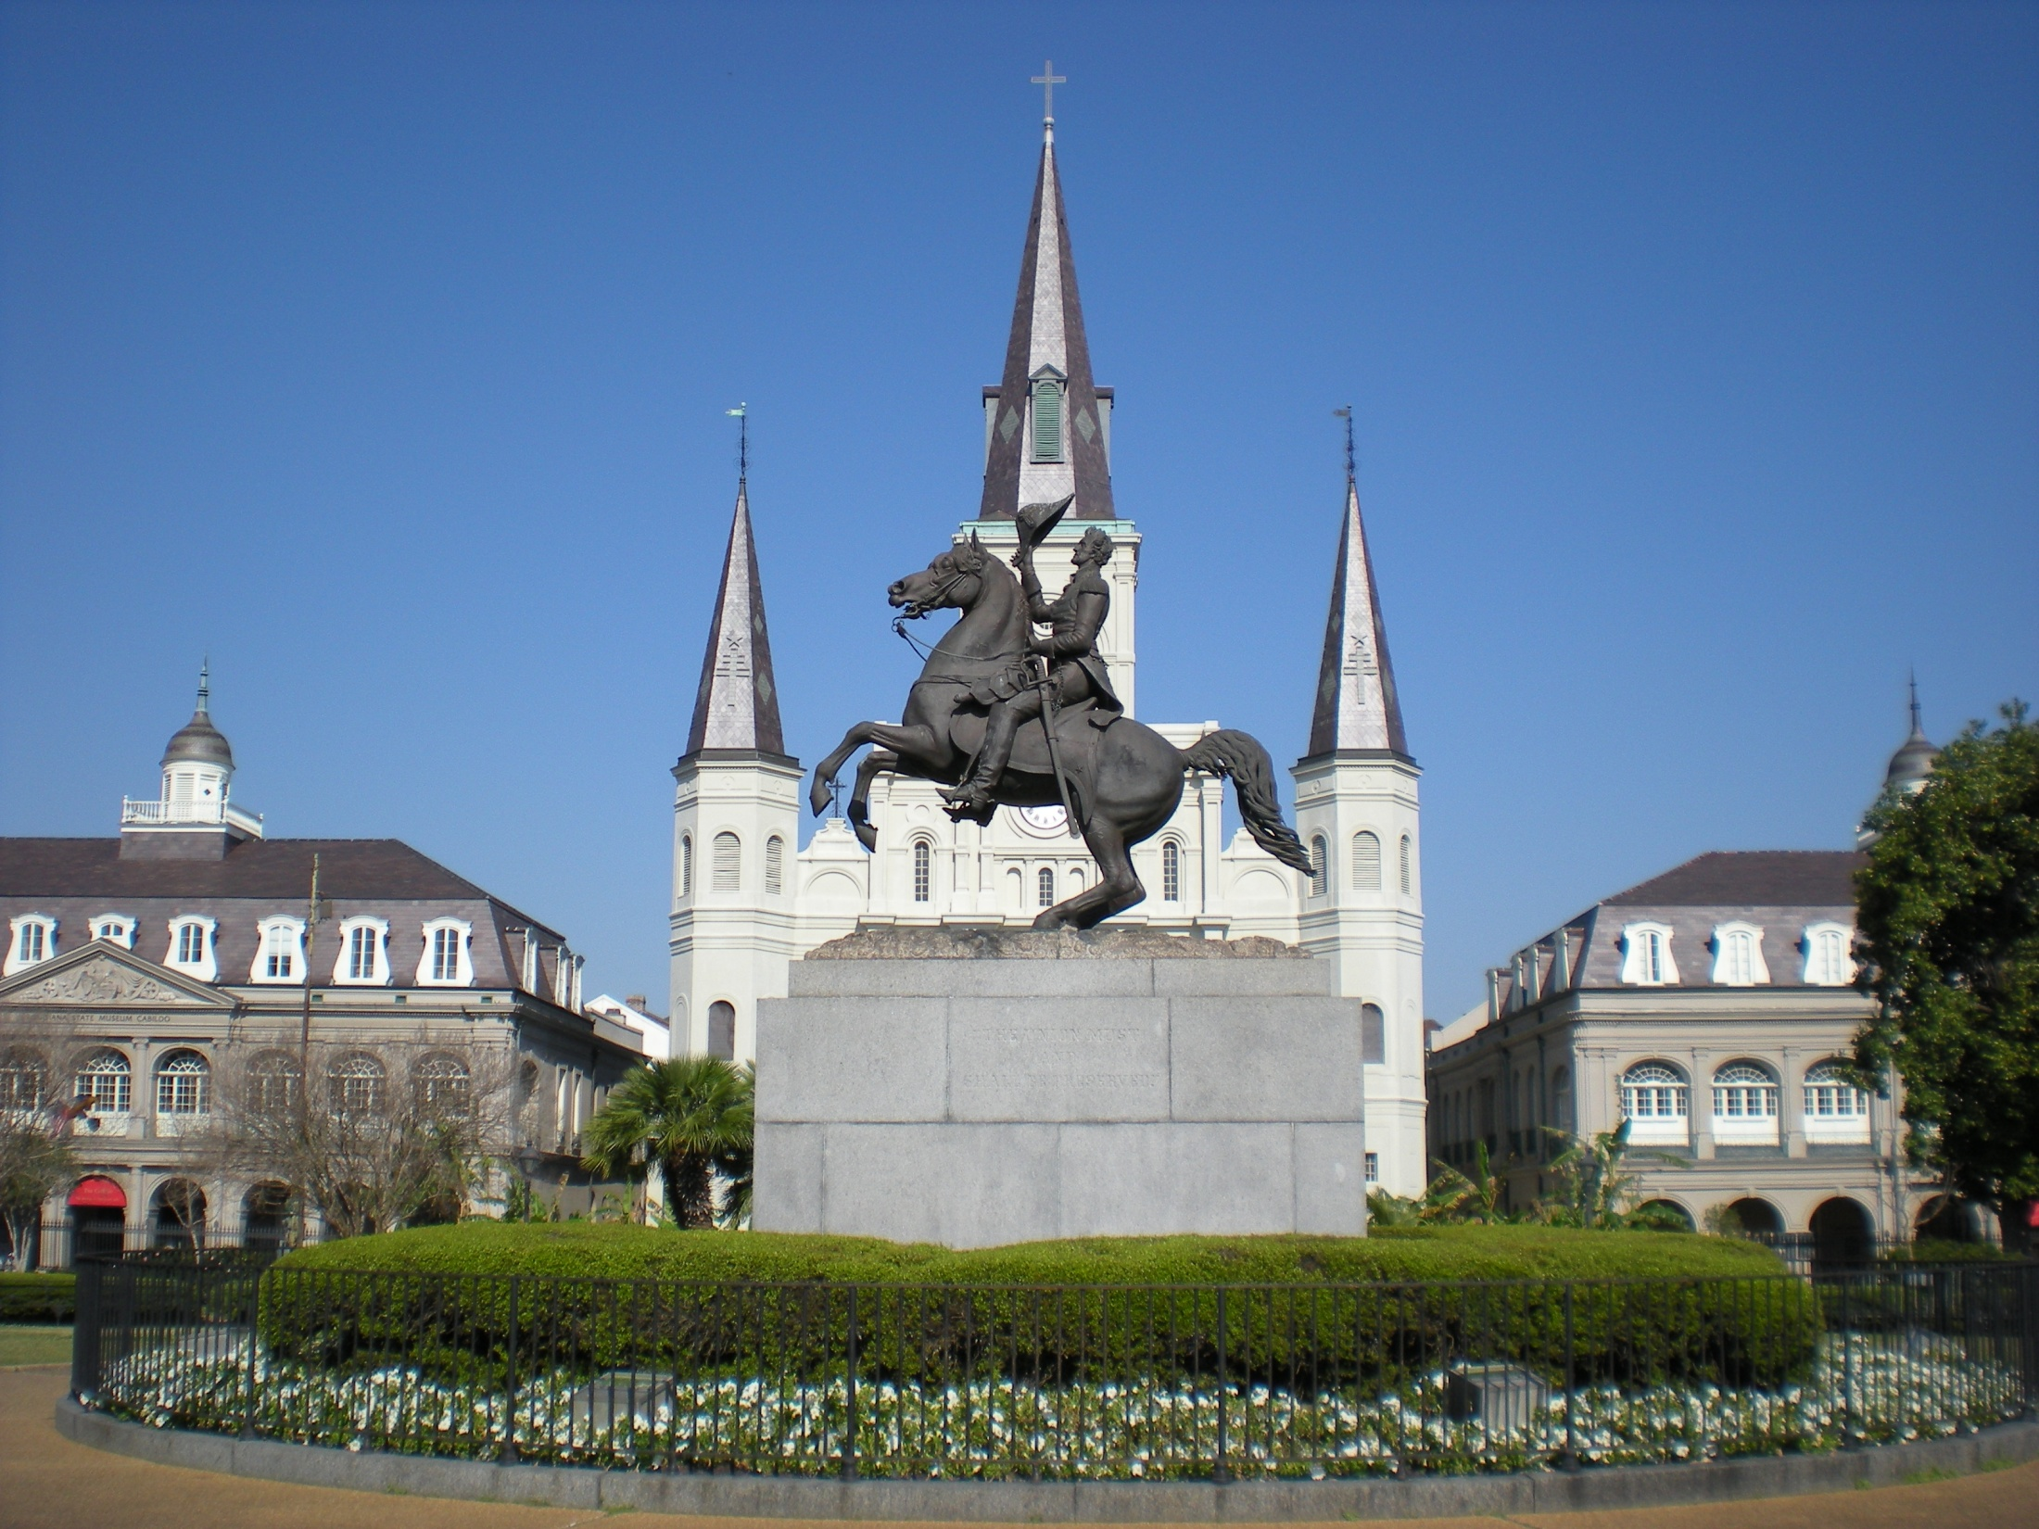
Jackson Square
New Orleans

Slide 4

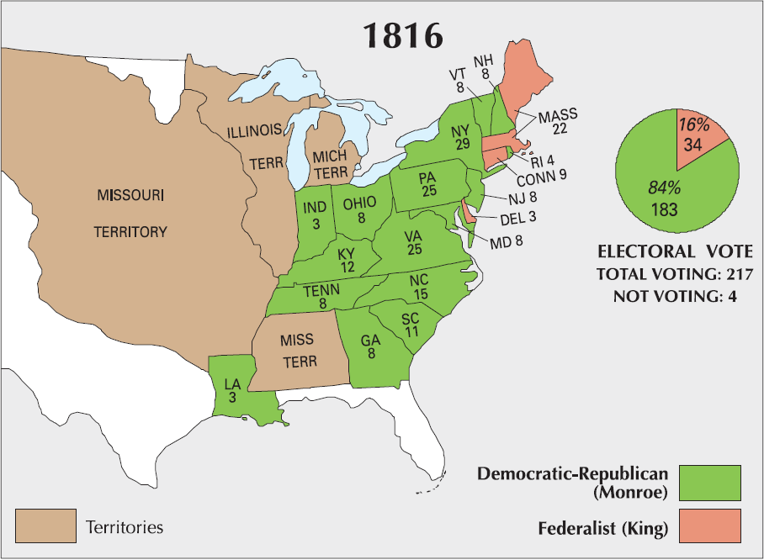
NOTE:
This is the last election in which the Federalist Party participated in a national election.
1800
1804
1808
1812
1816
1820

Slide 5
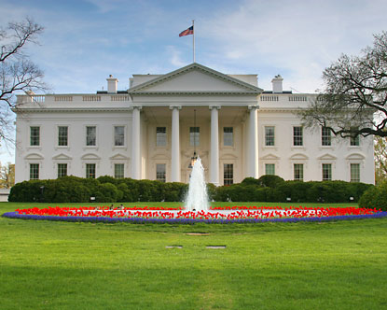

James Monroe (R-VA)
Fifth President of the U.S.
1817-1825
Last of the “Virginia Dynasty”
Continental Army Veteran
Former Antifederalist
“Era of Good Feeling”
Re-election nearly unanimous
http://www.whitehouse.gov/about/presidents/jamesmonroe

Slide 6
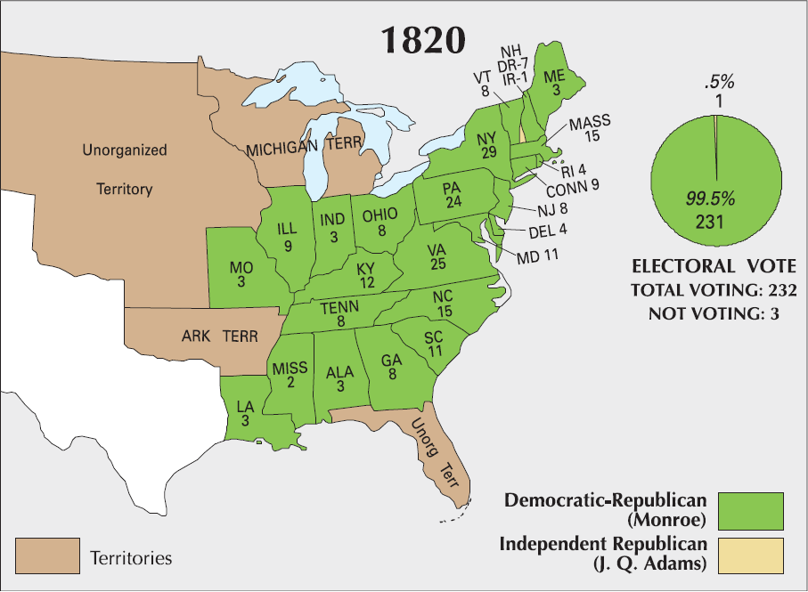
NATIONALISM
1800
1804
1808
1824
1812
1816
1820

Slide 7
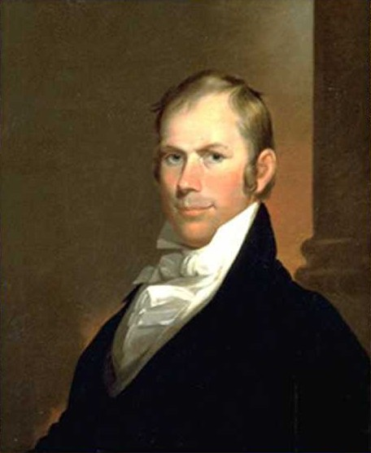
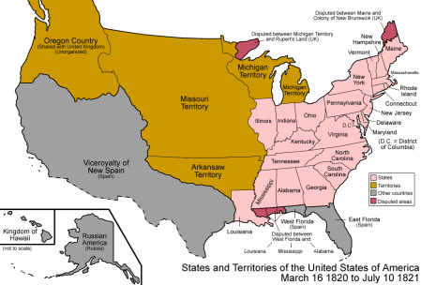

Henry Clay’s “American System”
The Economics of Nationalism
National Bank
  First B.U.S. had expired in 1811
Internal Improvements
  Infrastructure (roads, bridges, canals)
Protective Tariff
  Build and protect domestic manufacturing
Jeffersonian or Hamiltonian?

Slide 8

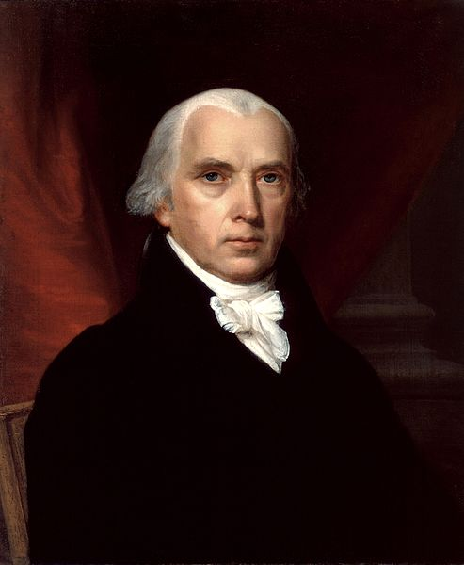
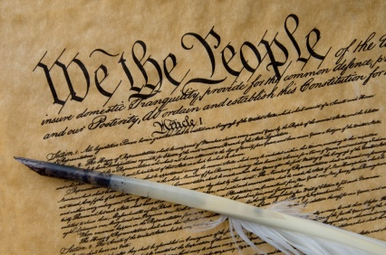
Henry Clay’s “American System”
The Economics of Nationalism
National Bank
  Second B.U.S. chartered in 1816
Internal Improvements
Protective Tariff
  Tariff of 1816
Strict or Loose Construction?

Slide 9


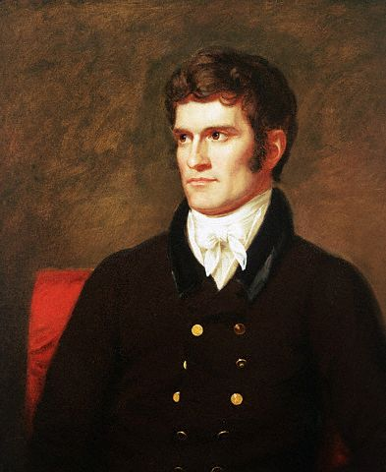
Calhoun’s “Bonus Bill”
“for constructing roads and canals, and improving the navigation of water courses, in order to facilitate… internal commerce among the several States, and to render more easy and less expensive the means and provisions for the common defense…”
VETO
Calhoun

Slide 10
QUESTION:
Is an election map always an accurate measure of the national political climate?

Slide 11
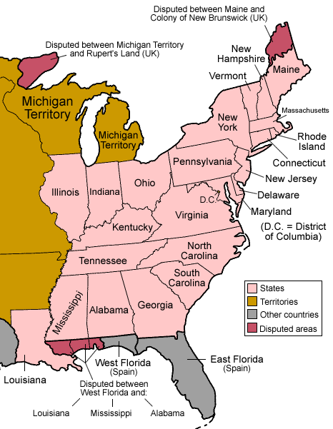

Slide 12
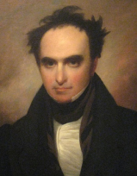

SECTIONALISM
 | NORTH | SOUTH | WEST
Economy
Political Leaders
Political Issues
Commerce
Manufacturing
Agriculture
Developing
Agriculture
Daniel
Webster
John C.
Calhoun
Henry
Clay
Tariff (+)
Slavery (-)
Tariff (-)
Slavery (+)
Internal Improvements

Slide 13
Henry Clay’s “American System”
The Economics of Nationalism
National Bank
  First B.U.S. had expired in 1811
Internal Improvements
  Infrastructure (roads, bridges, canals)
Protective Tariff
  Build and protect domestic manufacturing
Who Benefits? Who doesn’t?

Slide 14
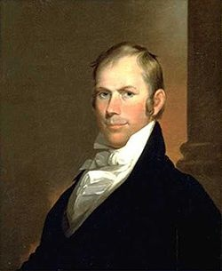

The American Colonization Society
aka: The Society for the Colonization of Free People of Color of America
Founded 1816
Liberia
  Colony established in Africa
  Capital: Monrovia
Henry Clay
Charter Member

Slide 15
Notable Members of ACS
James Madison (U.S. President)
James Monroe (U.S. President)
Daniel Webster (U.S. Senator)
Stephen Douglas (U.S. Senator)
Henry Clay (Speaker of the House)
Francis Scott Key (The Star Spangled Banner)
John Marshall (Chief Justice)

Slide 16
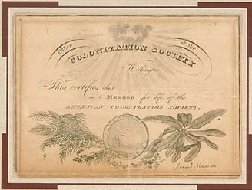
Membership Certificate signed by James Madison
Sold for $928 in 2006
Madison served as President of the ACS from 1833-1836

Slide 17
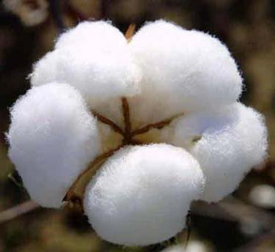
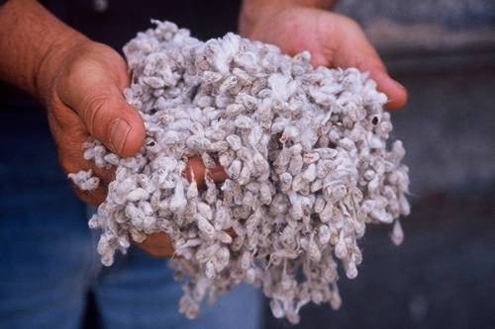
Cotton

Slide 18
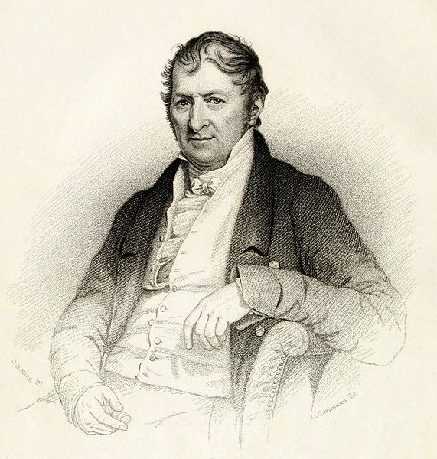
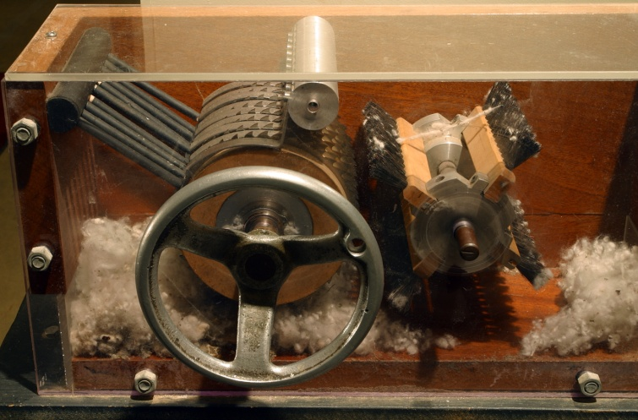
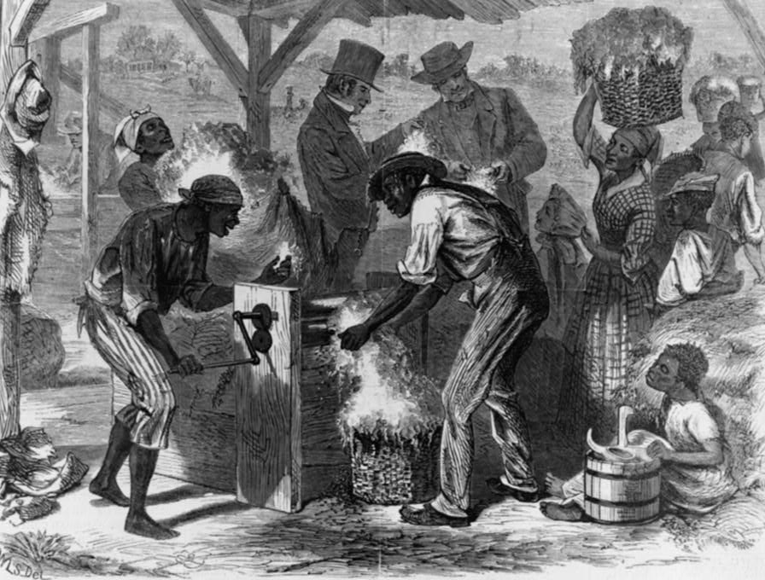
The Cotton Gin
Mechanized cotton production
Eli Whitney
Of Massachusetts

Slide 19


Slide 20
From Harper’s Weekly (1869)

Slide 21
“King Cotton”
The South’s dependence on slavery

Slide 22
The (in)Effectiveness of Colonization
2,500,000 / 12,000 = 208

Slide 23
http://www.youtube.com/watch?v=OuLWgVOLbG4

Slide 24
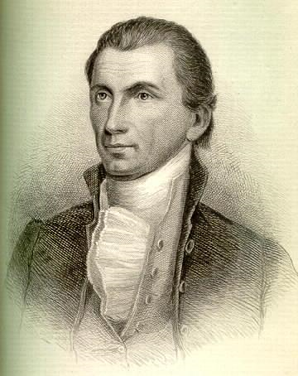

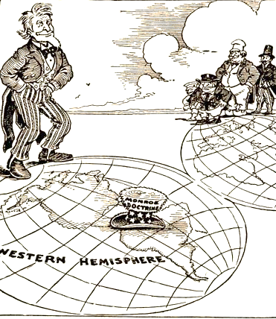
The Monroe Doctrine
“The American continents… are henceforth not to be considered as subjects for future colonization by any European powers. . .”
-- From Monroe’s
Seventh Annual Message
READ MY
LIPS
NEW
COLONIES
EUROPE: KEEP OUT!!!

Slide 25
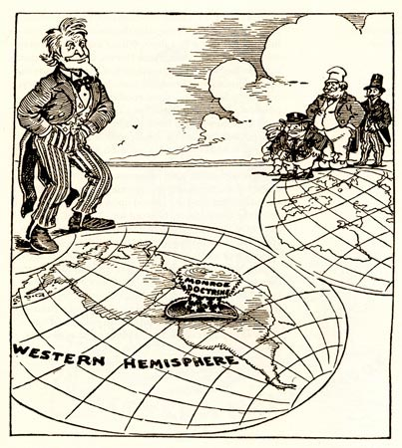

Slide 26
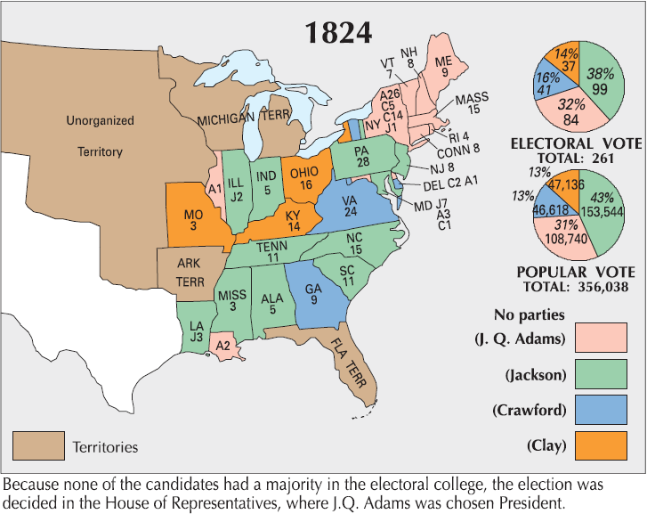
The end of an era…
1800
1804
1808
1824
1812
1816
1820

Slide 27








