Slide 1
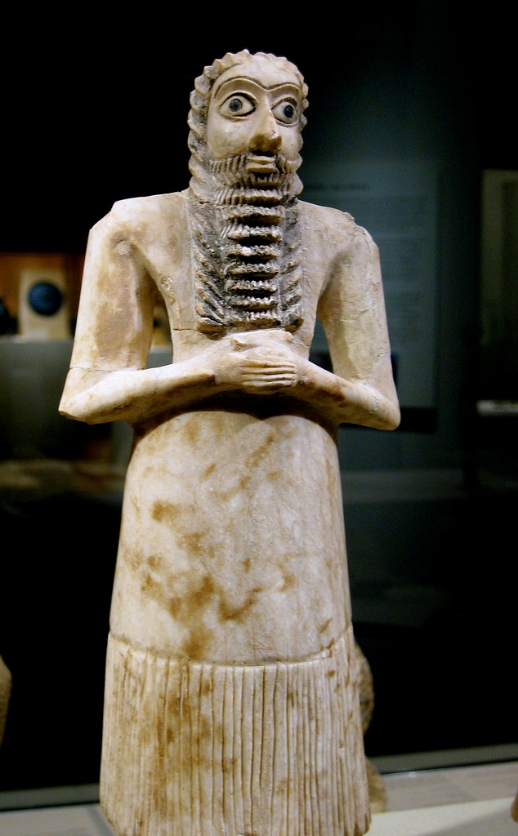
Ancient Mesopotamia
The Land Between
the Rivers
Photo by Cåsbr

Slide 2
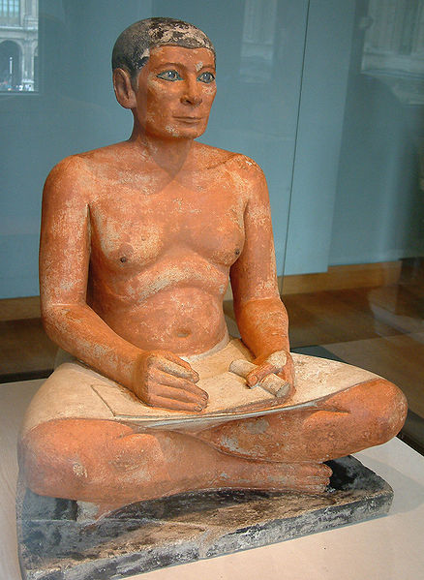
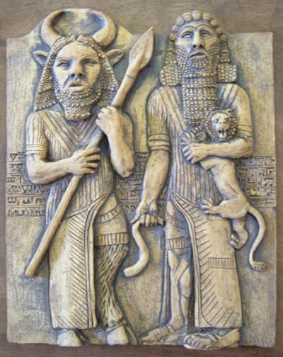
TABLE OF CONTENTS
PART I
PART II
Geography and Writing
Religion and Literature

Slide 3
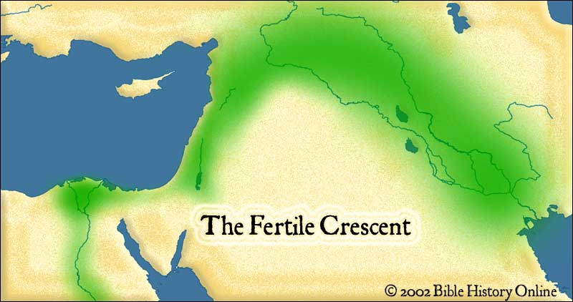
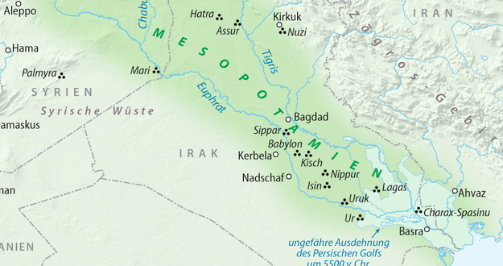

Geography & Writing
Map Credit: NordNordWest

Slide 4
Fertile Crescent

Slide 5
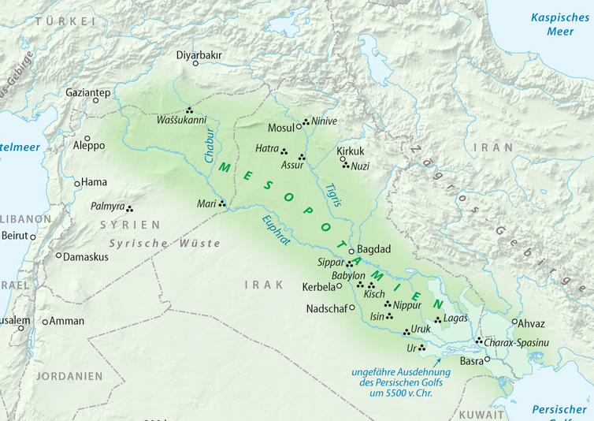
Mesopotamia
“The Land Between the Rivers”
Euphrates
Tigris
Map Credit: NordNordWest

Slide 6
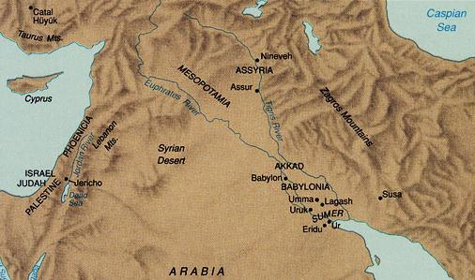
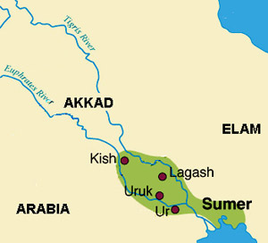
Sumer
The Sumerians established the first city-states c. 3,000 B.C.

Slide 7
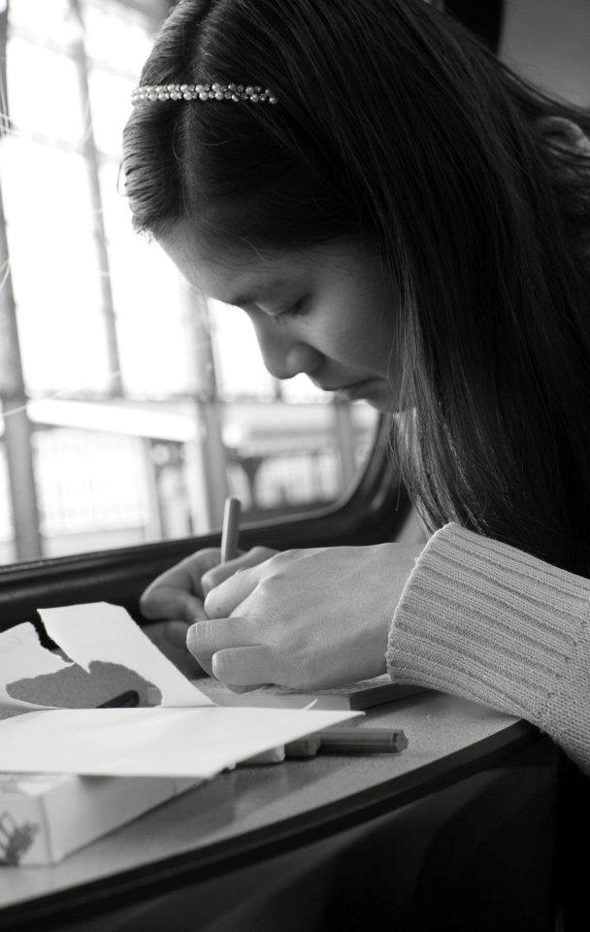
Writing
What purposes does writing serve?
Why is writing necessary and useful?
Photo by Pascal Maramis

Slide 8
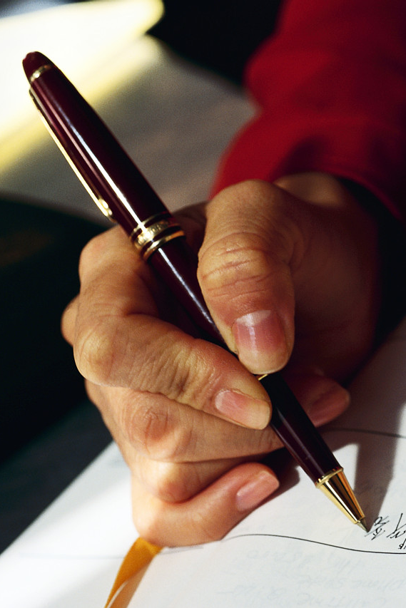
The Sumerians were the first to develop
Writing

Slide 9
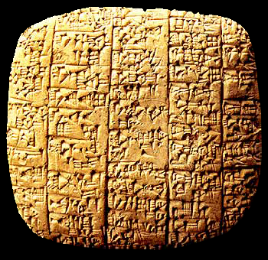
Sumerian Clay Tablet

Slide 10
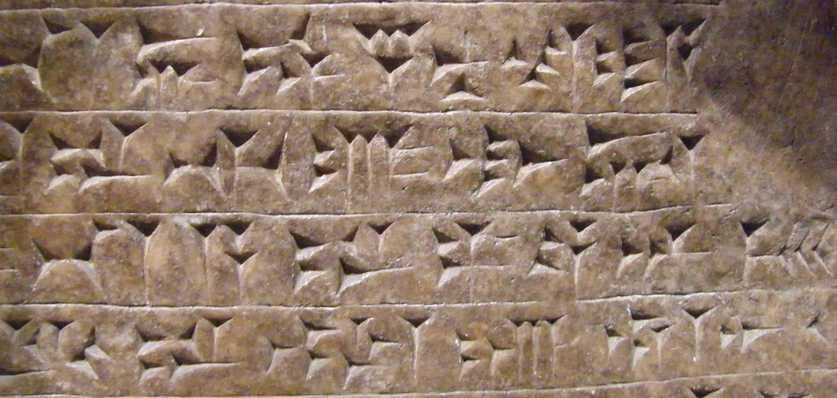
Cuneiform
(Latin: Wedge-Shaped)
Photo by tortipede
MORE on cuneiform from the British Museum.

Slide 11



Pictograms
Earliest writing form
Words represented by symbols.
Click to Purchase Dora and the Rainbow Kite Festival

Slide 12
Scribes
Professional Writers
  high social status
  rigorous education

Slide 13
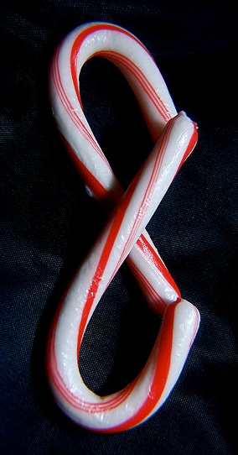

A Scribe Remembers…
My headmaster read my tablet, said:
“There is something missing,” caned me.
The fellow in charge of silence said:
“Why did you talk without permission,” caned me.
The fellow in charge of the assembly said:
“Why did you stand at ease without permission,” caned me.
Photo by JD Hancock
Full Version HERE

Slide 14
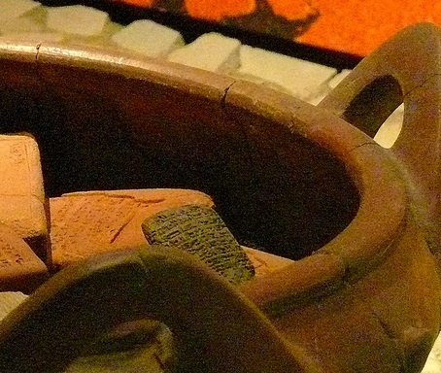
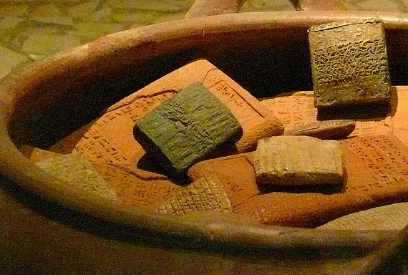
Scribes
Employed in temples and palaces, recording:
financial transactions
legal documents
Literature (for practice)
Photo by Astacus

Slide 15
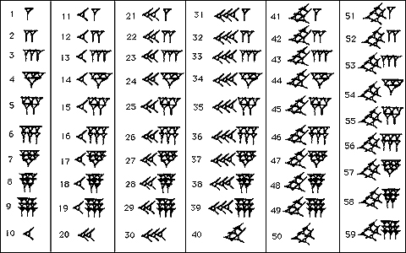
Sumerian Numbers

Slide 16
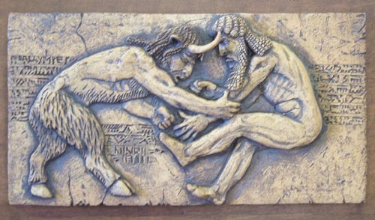
Religion & Literature

Slide 17
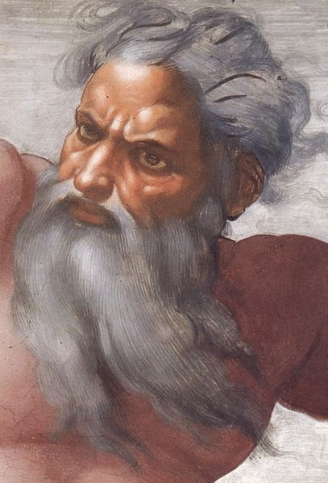


Deities and
Existence
What kind of characteristics do modern humans typically attribute to God?
What is the purpose of human existence?

Slide 18
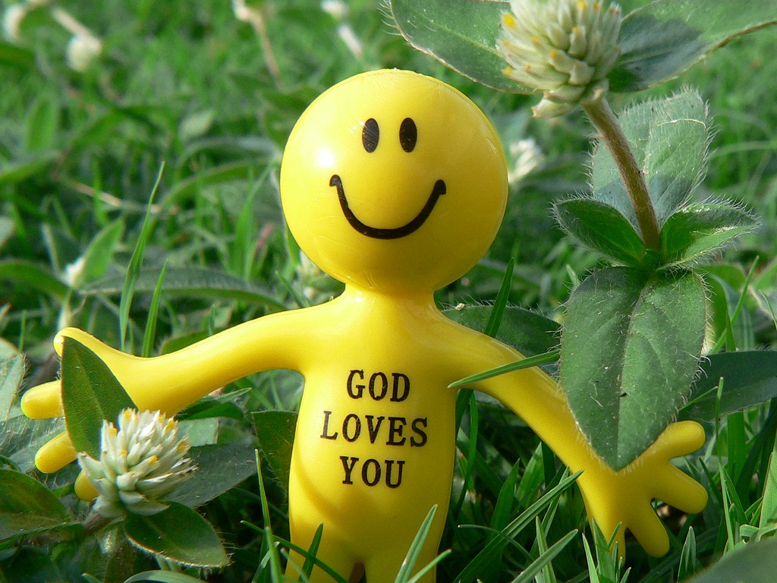
Photo by Leonard John Matthews

Slide 19
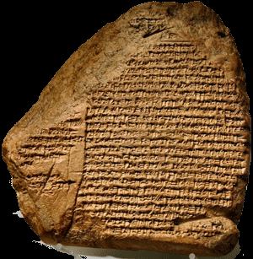
Enuma elish
“When on high…”
What does the
Enuma elish tell us about Mesopotamian ideas about their gods?
CLICK HERE
to Read

Slide 20

Benevolence / Malevolence
Deities can be described as benevolent or malevolent toward human beings.

Slide 21
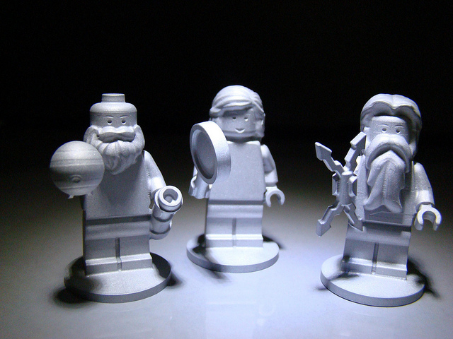

Mesopotamian Religion
Photo by TooMuchDew
Polytheism
(Many Gods)
Malevolence
(Ill-willed)
Anthropomorphism
(Human-like Gods)

Slide 22
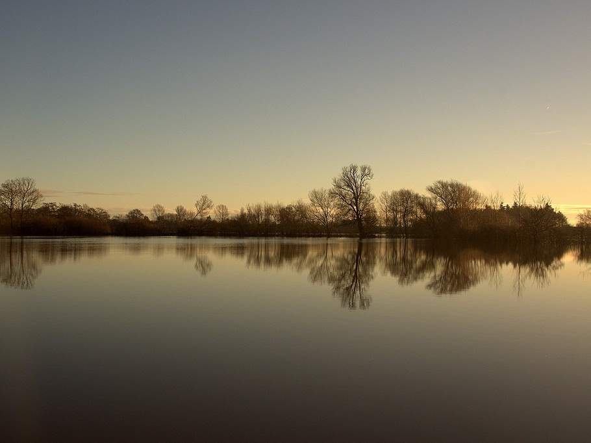
Floods
Catastrophic Floods were a regular part of life in ancient Mesopotamia.
Photo by stopherjones

Slide 23

5,000 Years

Slide 24
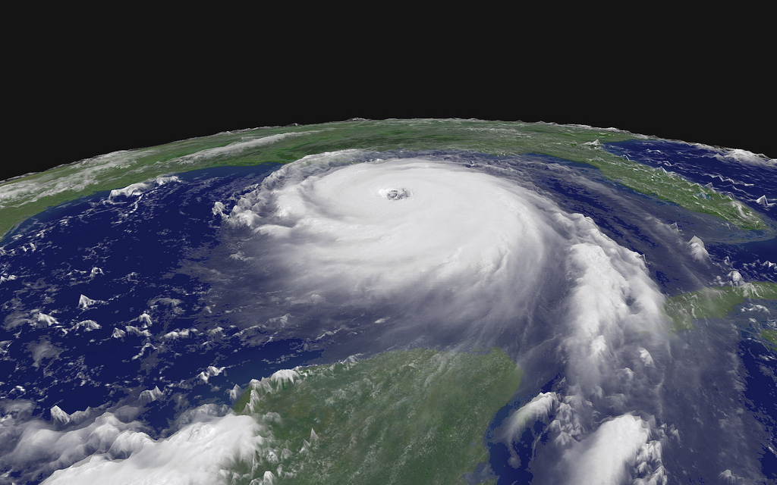
Hurricane Katrina
August,
2005
Photo by NASA

Slide 25
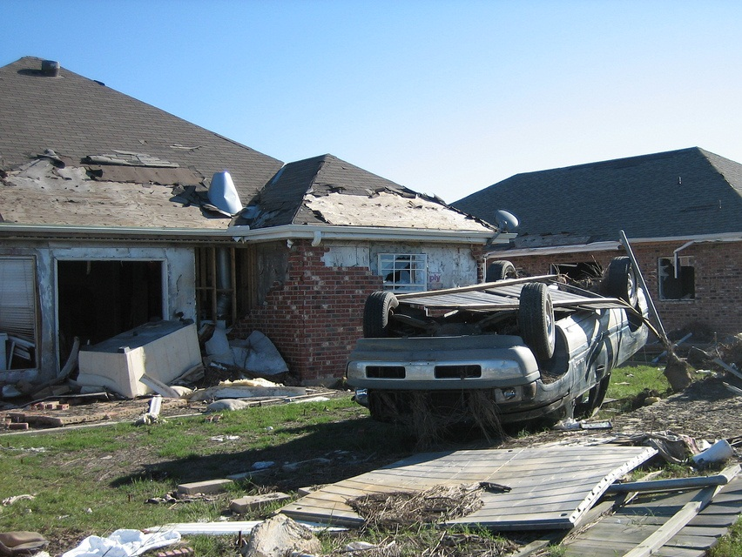
WHY?
Photo by Infrogmation

Slide 26
"Although the loss of lives is deeply saddening, this act of God destroyed a wicked city....New Orleans was a city that had its doors wide open to the public celebration of sin...
Source: religioustolerance.org

Slide 27
"May this act of God cause us all to think about what we tolerate in our city limits, and bring us trembling before the throne of Almighty God.”
-- Repent America
Source: religioustolerance.org

Slide 28
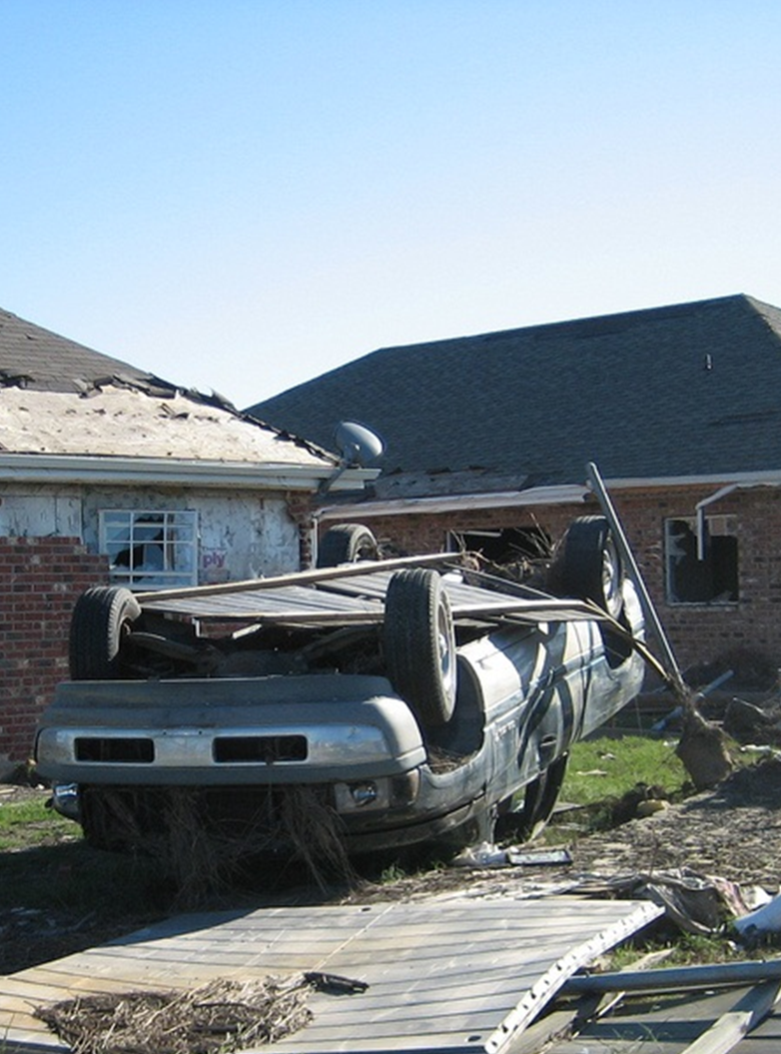
DID I DO THAT?

Slide 29
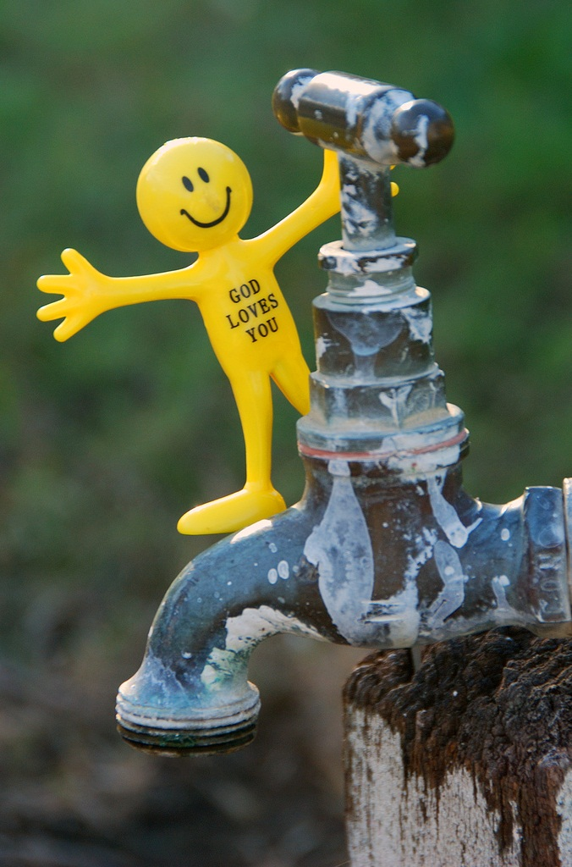
The Ancient Worldview
The gods control the tap.
Photo by Leonard John Matthews

Slide 30
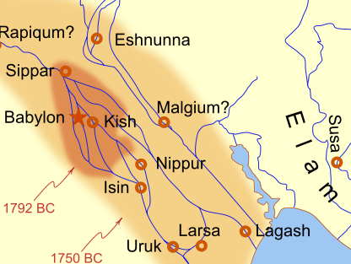
Lots of Rivers
=
Lots of Floods

Slide 31
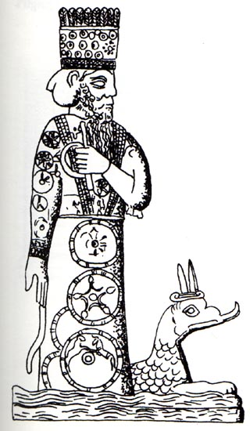
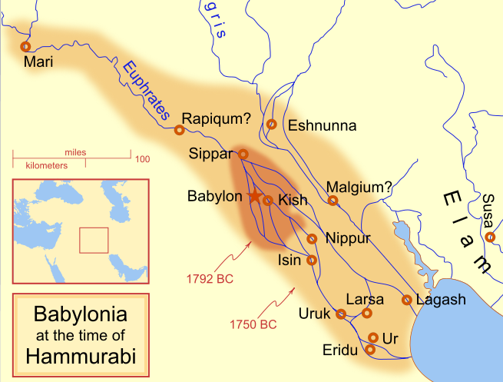
Marduk
Patron god of Babylon
Rivers / Floods

Slide 32
If Marduk were a band…

Slide 33
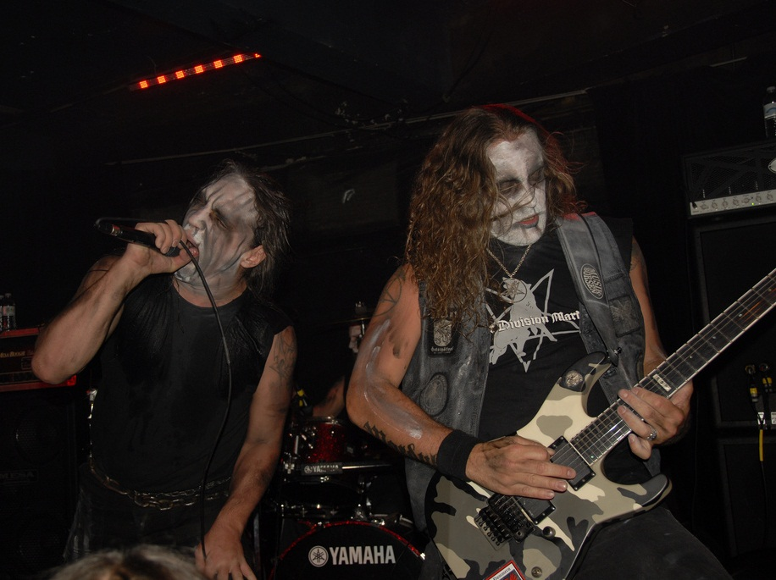
He’d Look Like this!
Yes, this is a real band called Marduk.
Photo by Metal Chris

Slide 34
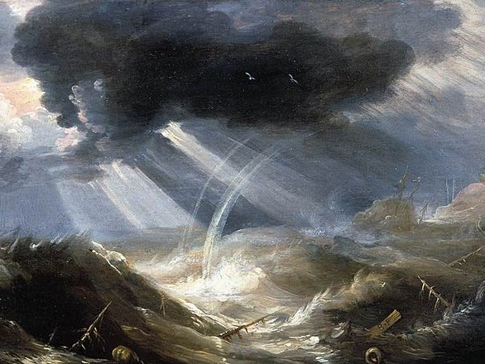
The Great Flood
CLICK HERE
to Read
Bonaventura Peeters, The Great Flood (17th c.)

Slide 35
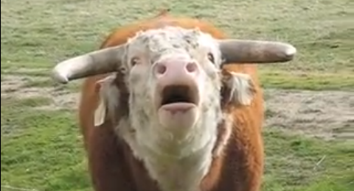
The world Bellowed like a wild bull…
http://www.youtube.com/watch?v=LFu0WZMTxr0

Slide 36
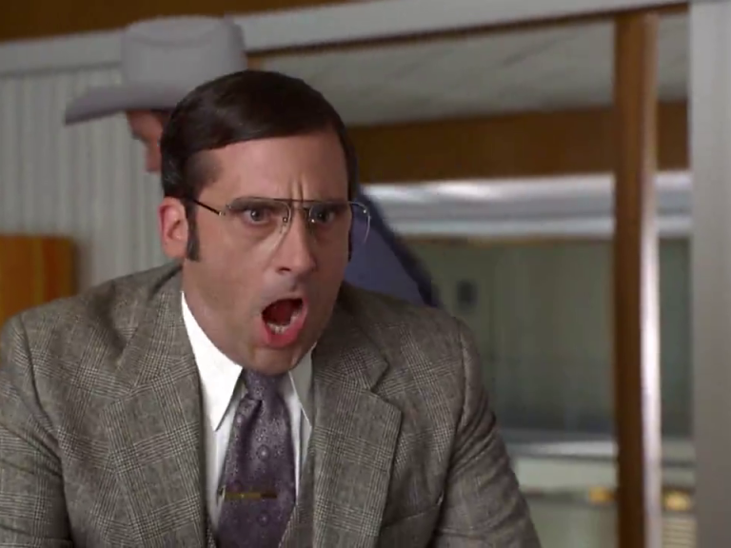
LOUD NOISES!
Screenshot from Anchorman: The Legend of Ron Burgundy (Dreamworks, 2004).
Reproduced for instructional use.

Slide 37
Ancient Mesopotamians believed their gods destroyed humans because they were
TOO NOISY!

Slide 38
The GOAL of Mesopotamian Religion?

Slide 39
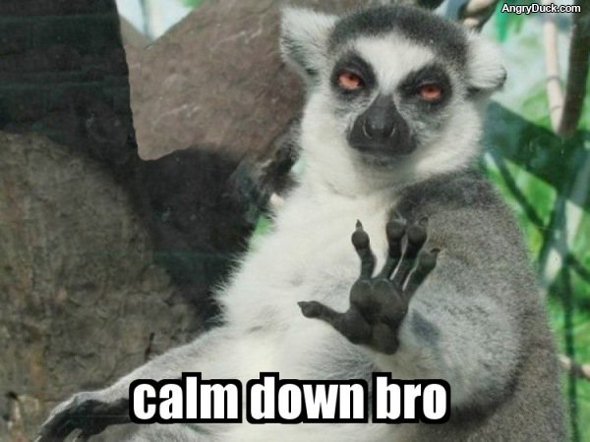

Slide 40
Propitiation
Appeasing a deity in order
to avoid divine wrath

Slide 41
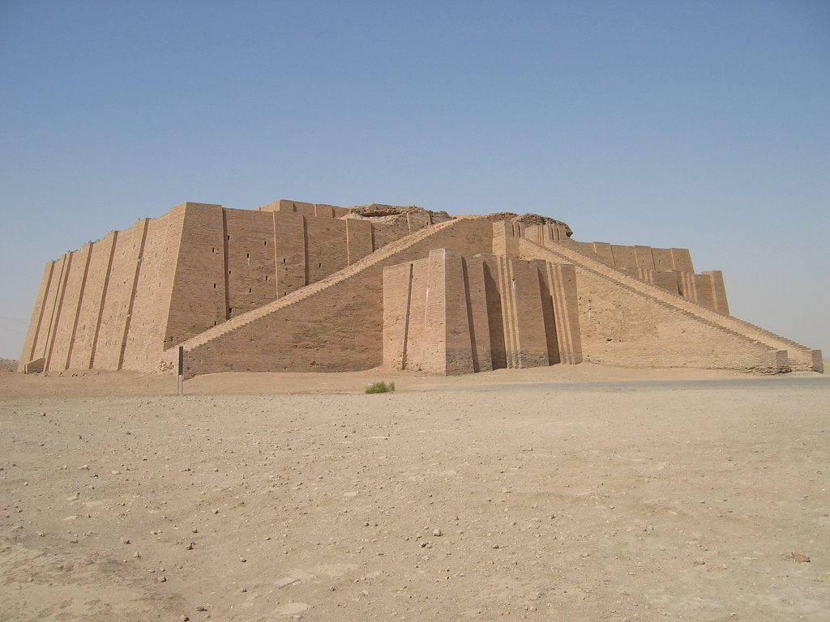
Ziggurats
Mesopotamian Temples
Largest building in city
A home for the gods
Photo by jmcfall

Slide 42
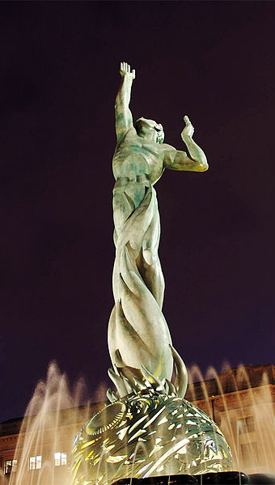
IMMORTALITY
If you could live forever, would you?
Explain why or why not.
Photo Credit: Notwist

Slide 43
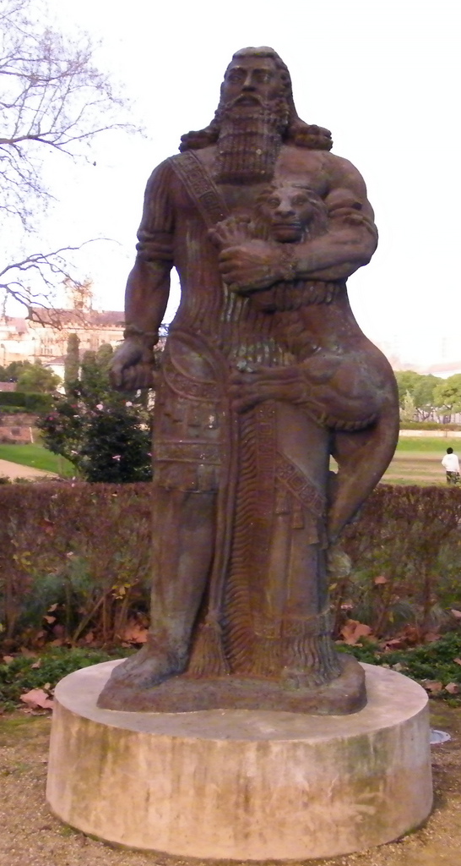
The Epic of Gilgamesh
KEY THEMES:
Immortality
Death
CLICK HERE
to Read
Photo by zayzayem

Slide 44
Gilgamesh vs. Enkidu
Pictures: http://www.mythstories.com/oldmanR.html

Slide 45
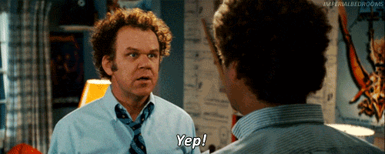
http://www.youtube.com/watch?v=QzBmQMyYDBk

Slide 46
Best Friends
After a good fight, Gilgamesh and Enkidu became best friends and went on adventures together.

Slide 47
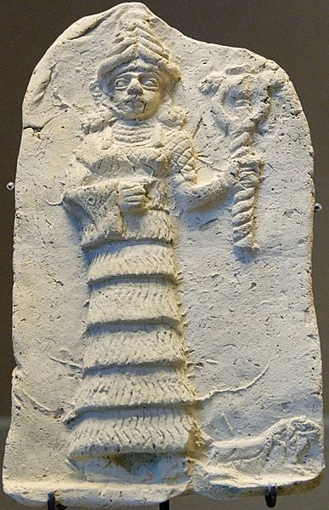
Ishtar
The Goddess as Adversary
Ishtar, a fertility goddess, fell in love with Gilgamesh and tried to have him killed after he rejected her.
She failed.

Slide 48
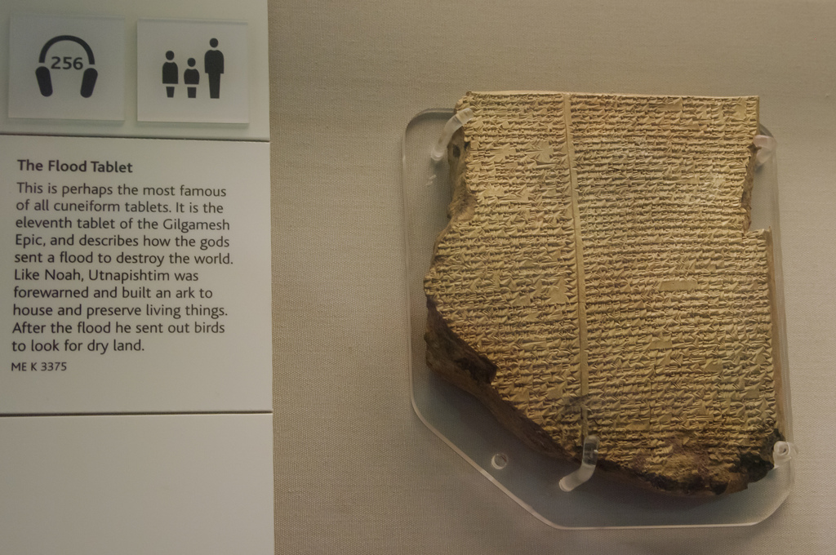
Some rights reserved by fredthechicken

Slide 49
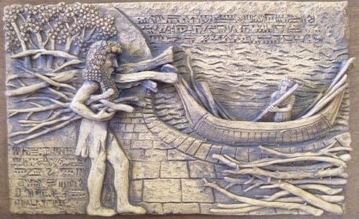
Utnapishtim
The Survivor

Slide 50
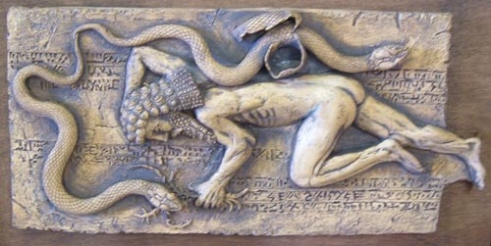
SORRY...
You’re going to die!

Slide 51
Now What?

Slide 52
The king has laid himself down and will not rise again,
The Lord of Kullah will not rise again;
He overcame evil, he will not come again;
Though he was strong of arm he will not rise again;
He had wisdom and a comely face, he will not come again;
He is gone into the mountain, he will not come again;
On the bed of fate he lies, he will not rise again,
From the couch of many colors he will not come again.

Slide 53







