Slide 1
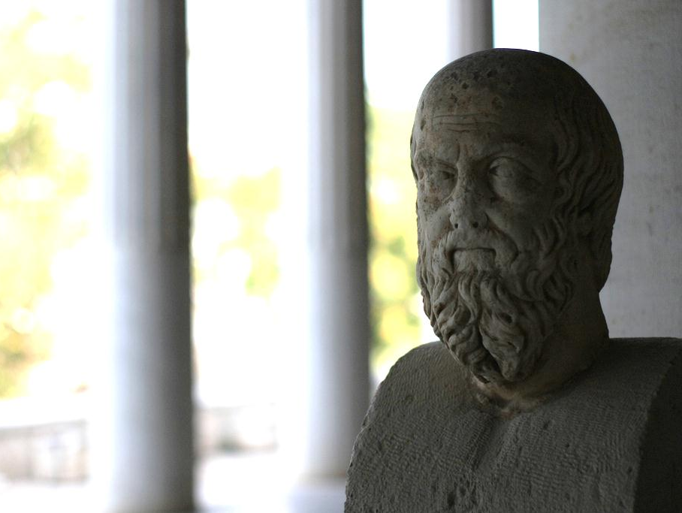
Journal Prompt
What is history?
And what makes something (or someone) historic?
NOTE: There is no right or wrong answer. Be specific and continue to write for at least a full paragraph (4-5 complete sentences).
Photo by d3l

Slide 2
What is History?
An Inquiry into the Process of History-making
Photo by d3l

Slide 3
The Past

Slide 4
“The Past”
Years following the birth of Christ are marked “A.D.”
(Anno Domini - “In the Year of Our Lord”)

Slide 5
Is everything that happens historic?
(Hint: NO)

Slide 6
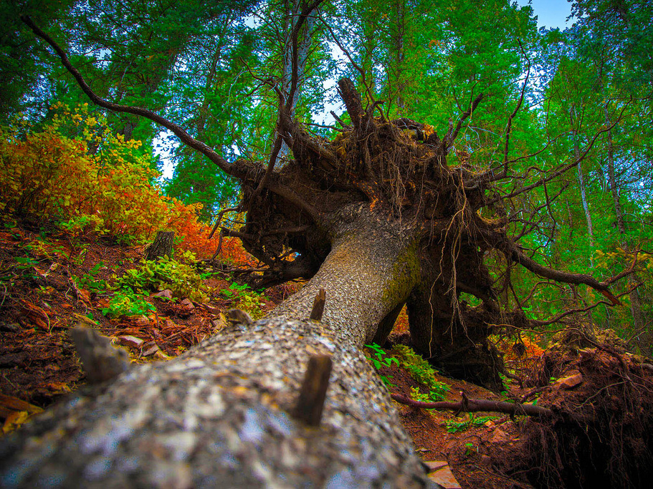
Did you HEAR that?
Photo by SingleDadLaughing

Slide 7
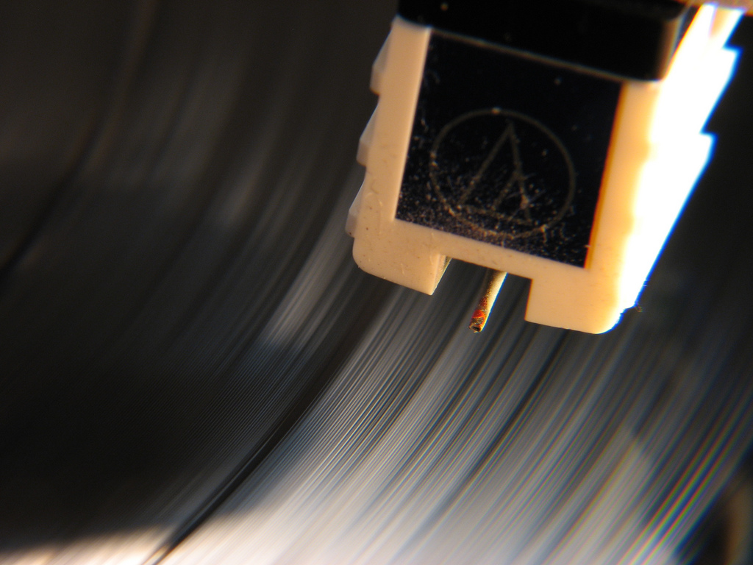
A Written RECORD
Photo by Great Beyond

Slide 8
Significance
IMPACT
IMPORTANCE

Slide 9
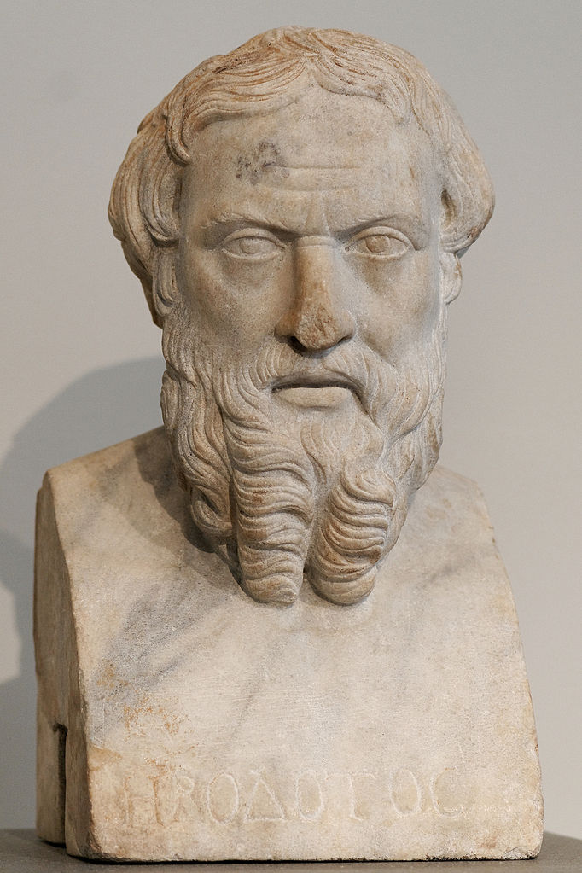
Herodotus
The “Father of History”
Herodotus
Photo Credit: Marie-Lan Nguyen

Slide 10
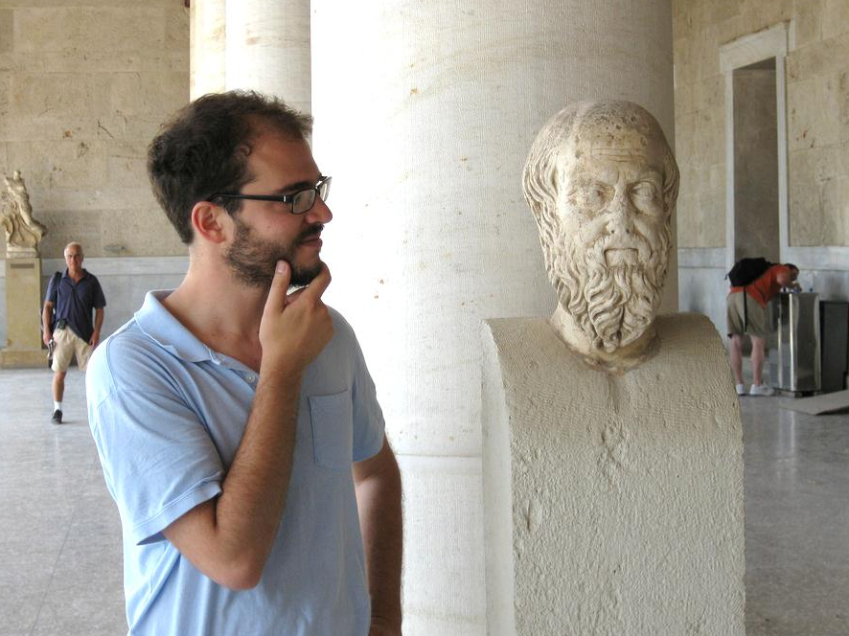
ἱστορίαι
(Historiae)
“Inquiries”
Photo by
pindarninja

Slide 11
History is as much about questions as it is about answers.
Photo by
pindarninja

Slide 12
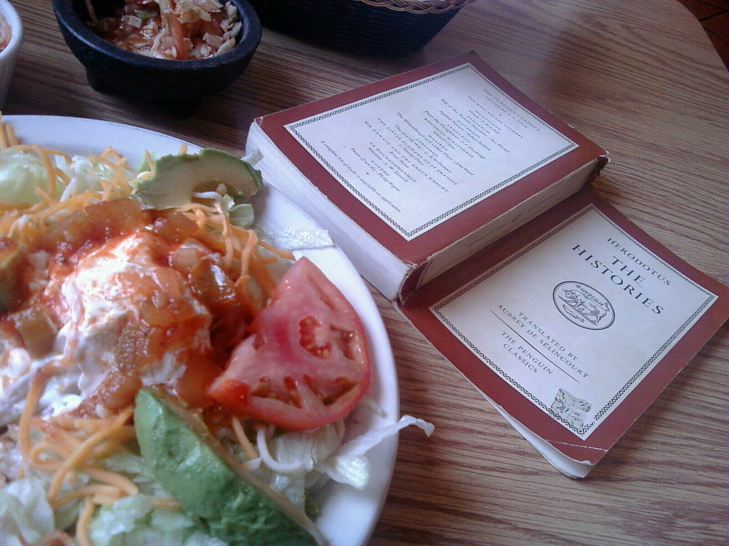
We’re still inquiring…
Photo by goblinbox

Slide 13
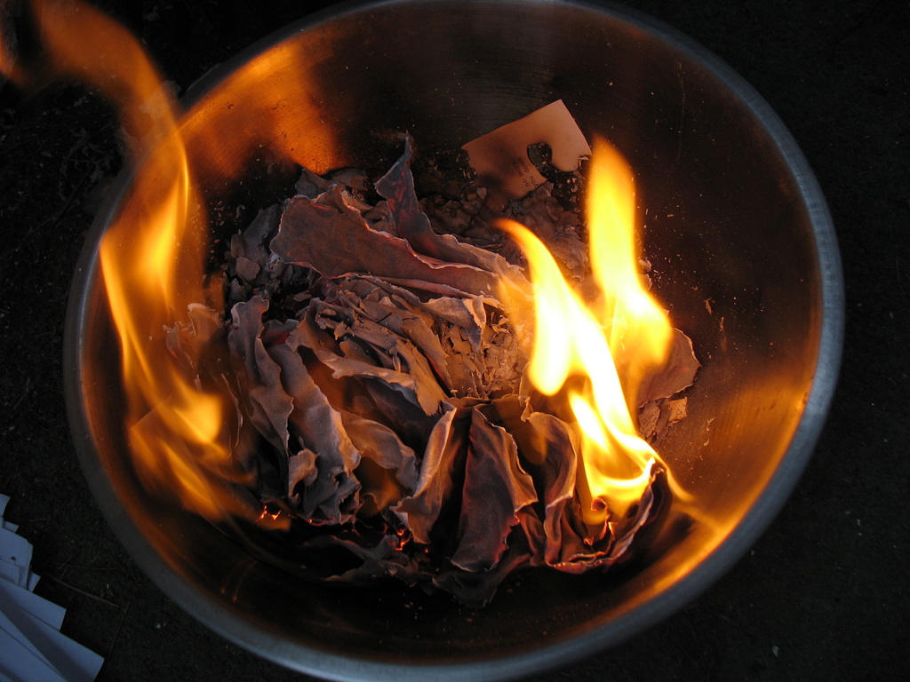
The “Ash Heap of History”
Photo by Anosmia

Slide 14
Evidence
A historian’s best friend!
LITERARY | NON-LITERARY
DOCUMENTS
Literature
Journals/Letters
Newspapers
Gov. Records
ARTIFACTS
Pottery
Architecture
Bodies/Mummies
Ruins

Slide 15
Archaeology
Historians rely on archaeologists and other scientists to make sense of non-literary evidence.
Photo by Odense Bys Museer

Slide 16
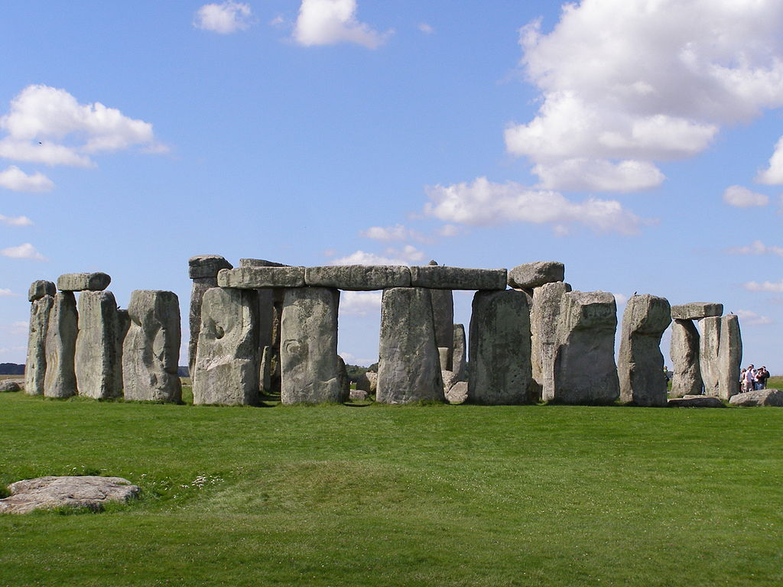
Stonehenge
Who?
What?
Where?
When?
Why?
How?
http://www.theforgottentechnology.com

Slide 17
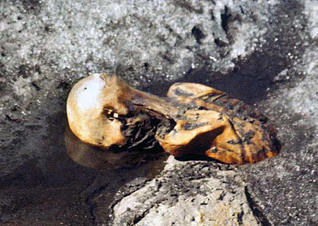
An Inquiry… The Iceman!
Discovered in 1991 in the Alps by hikers…

Slide 18
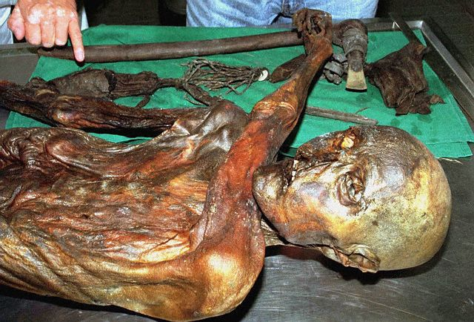
© Reuters/CORBIS
Reproduced for Educational Purposes

Slide 19
Your Assignment
You will receive some information from archaeologists and scientists on the next slides. Your job is to figure out what happened.

Slide 20
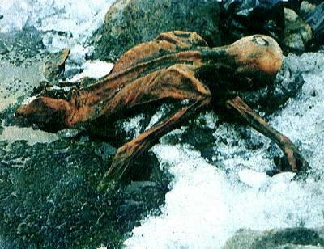
Items found on his person:
Copper Axe
Flint Knife
14 bone-tipped arrows
two finished
twelve unfinished
Unfinished Longbow
Flints
Mushrooms

Slide 21
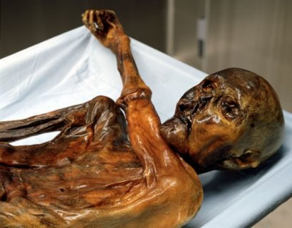
The Autopsy:
Cerebral Trauma to the head
Cuts and bruises on hands
Arrow wound in shoulder (arrow probably removed)
Blood from four people (DNA)
57 Carbon Tattoos (dots and lines on lower spine, back of knees, and right ankle)
About 5,000 years old!
frozen body, face down, left arm bent across the chest

Slide 22
Artifacts | Autopsy
Copper Axe Flint Knife 14 bone-tipped arrows (two finished / twelve unfinished) Unfinished Longbow Flints Mushrooms | Cerebral Trauma to the head Cuts and bruises on hands Arrow wound in shoulder (arrow probably removed) Blood from four people (DNA) 57 Carbon Tattoos (dots and lines on lower spine, back of knees, and right ankle) About 5,000 years old!

Slide 23
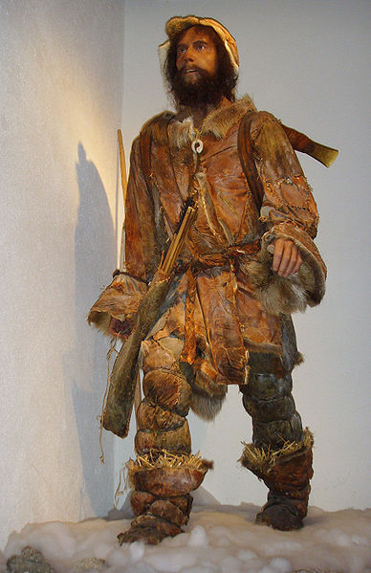
A Re-creation using evidence

Slide 24
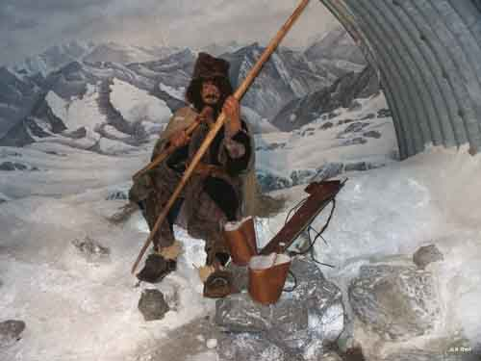
Otzi the Ice Man

