Slide 1
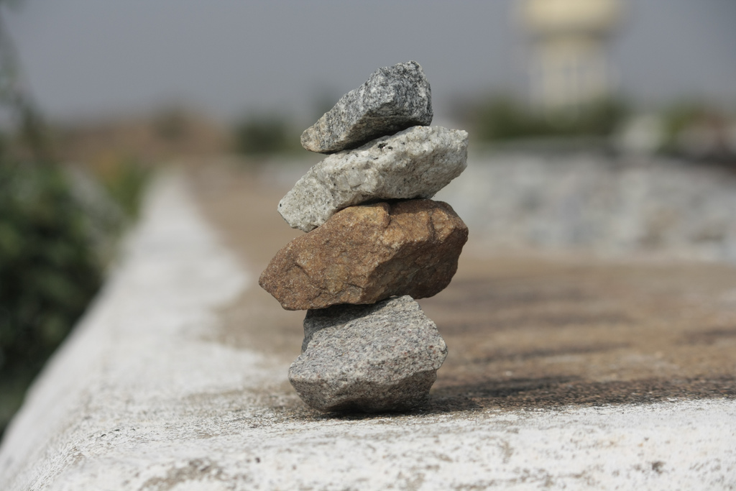
The Stone Age
Some rights reserved by moosa_khan

Slide 2
λίθος
Some rights reserved by Matt Peoples

Slide 3
Lithos
Some rights reserved by Matt Peoples

Slide 4
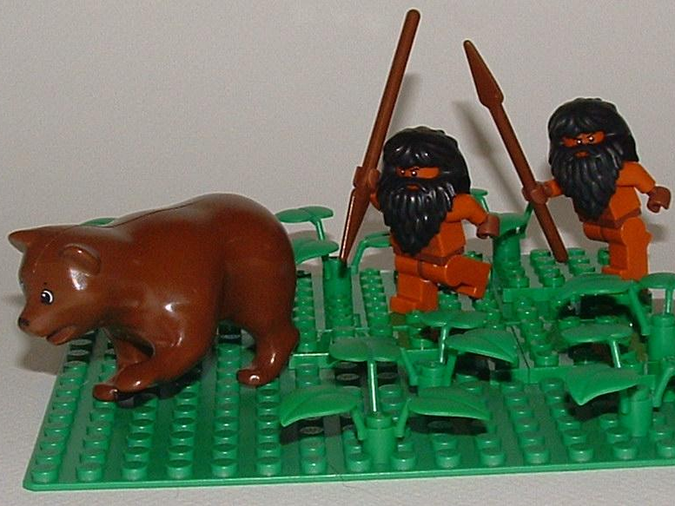
Paleolithic
Some rights reserved by floodllama

Slide 5
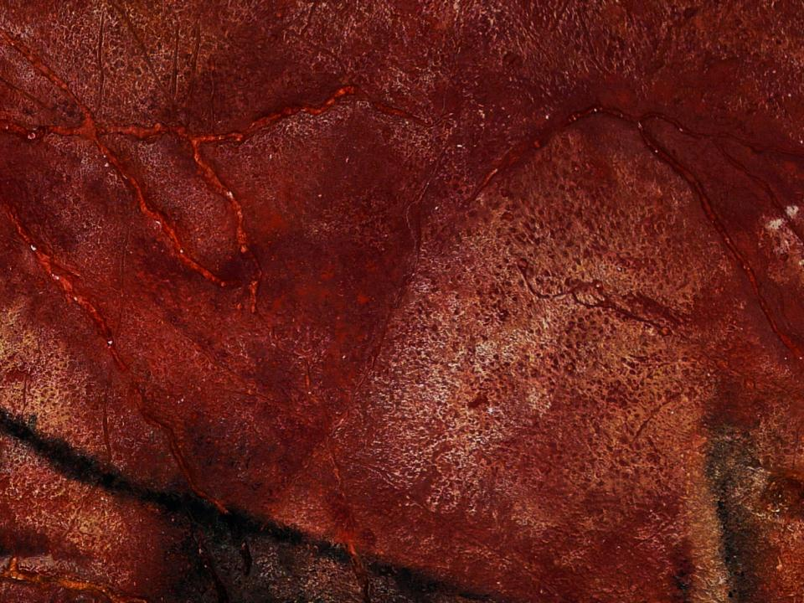
Prehistoric Humans
Paleolithic | Mesolithic | Neolithic
 | Μέσος (mesos) “middle” + λίθος (lithos) “stone” | νέος (neos) “new” + λίθος (lithos) “stone”
 | “Middle Stone Age” | “New Stone Age”
 | Around 10,000 B.C. | 10,000 B.C. - 4,000 B.C.
 | Hunting, Gathering, and Fishing | Agriculture
 | Nomadic | Settled Communities
 | Domestication of Dogs Canoes | Domestication of Livestock (cattle, sheep, goats, pigs)
“Old Stone Age”
Παλαιός (palaios) “old”
+ λίθος (lithos) “stone”
Until around 10,000 B.C.
Hunting & Gathering
Nomadic
Cave Art
Venus Figurines

Slide 6
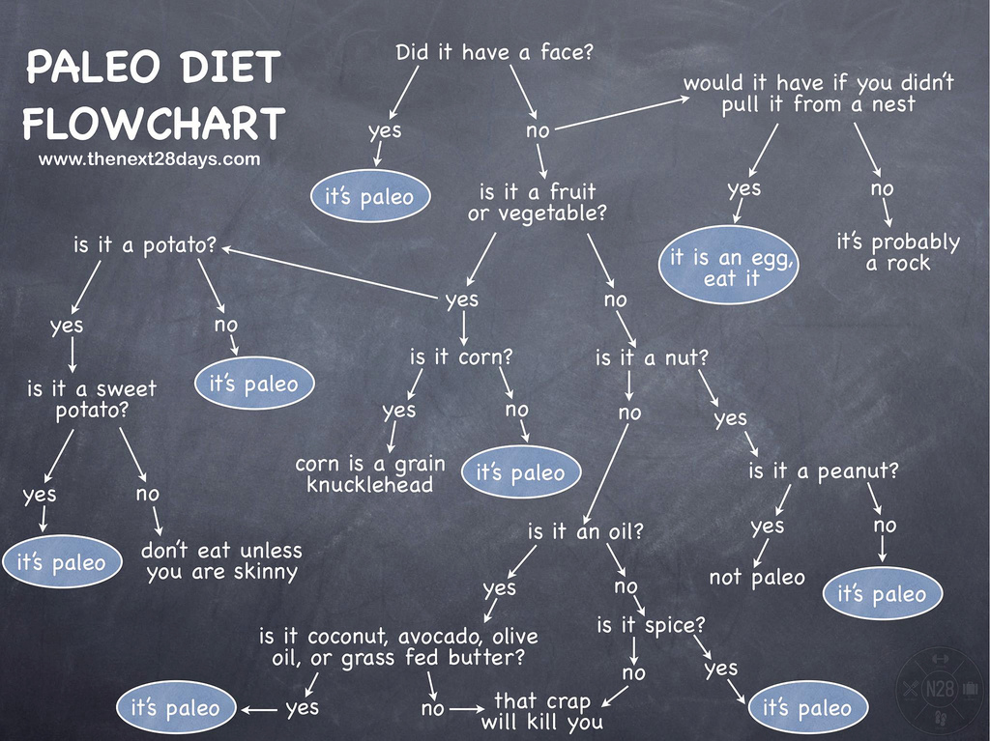
Some rights reserved by thenext28days

Slide 7
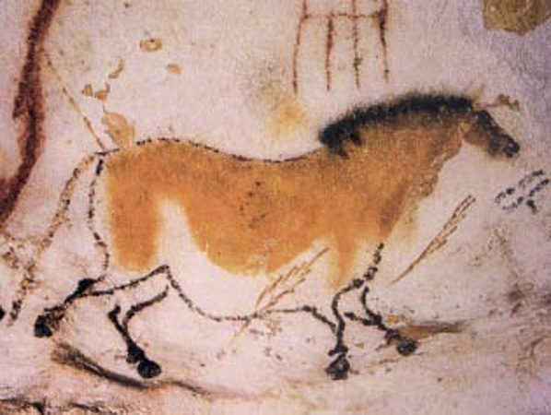
Cave Painting
Lascaux (France)
c. 15,000 B.C.

Slide 8
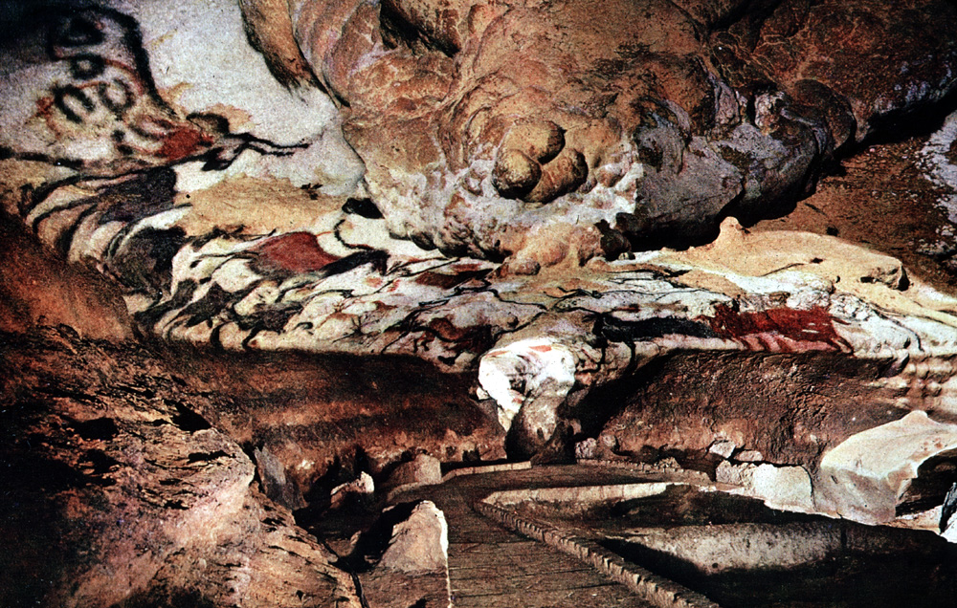
Art History PowerPoint Resource http://iris.nyit.edu/arthistory/pptshows.html
Notes:
Slide concept by William V. Ganis, PhD
FOR EDUCATIONAL USE ONLY
For publication, reproduction or transmission of images, please contact individual artists, estates, photographers and exhibiting institutions for permissions and rights.

Slide 9
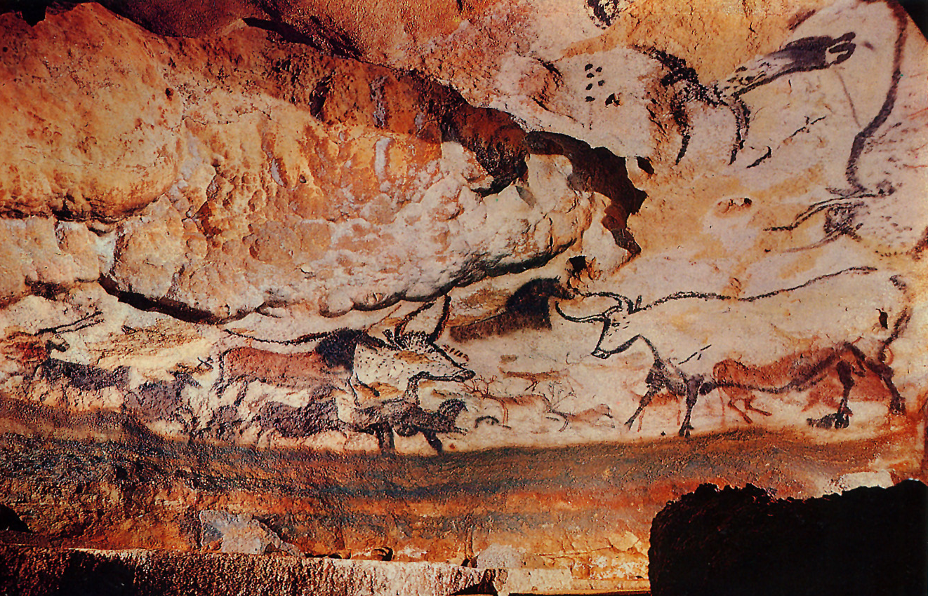
Art History PowerPoint Resource http://iris.nyit.edu/arthistory/pptshows.html
Notes:
Slide concept by William V. Ganis, PhD
FOR EDUCATIONAL USE ONLY
For publication, reproduction or transmission of images, please contact individual artists, estates, photographers and exhibiting institutions for permissions and rights.

Slide 10
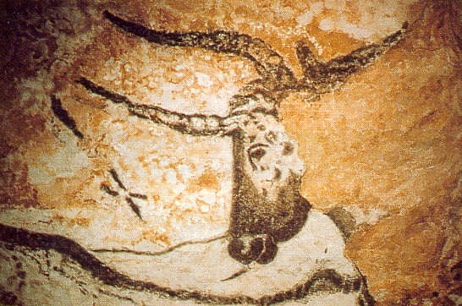
Art History PowerPoint Resource http://iris.nyit.edu/arthistory/pptshows.html
Notes:
Slide concept by William V. Ganis, PhD
FOR EDUCATIONAL USE ONLY
For publication, reproduction or transmission of images, please contact individual artists, estates, photographers and exhibiting institutions for permissions and rights.

Slide 11
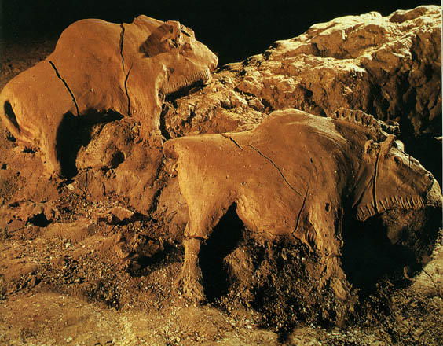
Bison reliefs
(Ariége, France)
ca. 15,000-10,000 B.C.
each approximately 2 feet long
Art History PowerPoint Resource http://iris.nyit.edu/arthistory/pptshows.html
Notes:
Slide concept by William V. Ganis, PhD
FOR EDUCATIONAL USE ONLY
For publication, reproduction or transmission of images, please contact individual artists, estates, photographers and exhibiting institutions for permissions and rights.

Slide 12
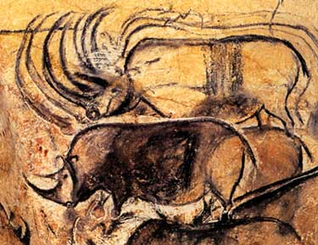
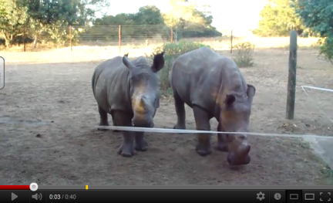
Chauvet Cave paintings
Vallon-Pont-d’Arc, Ardèche, France ca. 30,000-28,000 B.C.
Art History PowerPoint Resource http://iris.nyit.edu/arthistory/pptshows.html
Notes:
Slide concept by William V. Ganis, PhD
FOR EDUCATIONAL USE ONLY
For publication, reproduction or transmission of images, please contact individual artists, estates, photographers and exhibiting institutions for permissions and rights.

Slide 13
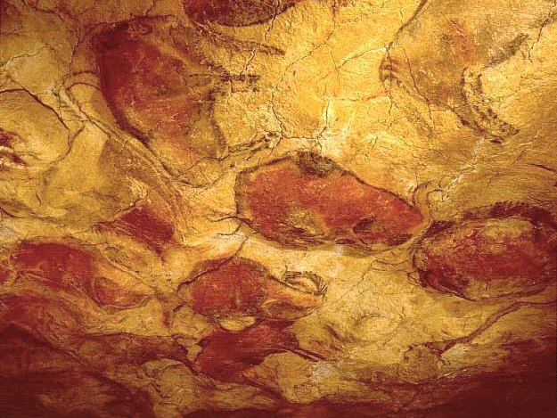
The Sistine Chapel of Cave Art
Altamira Cave paintings
Santander, Spain
ca. 12,000-11,000 B.C.E.
Art History PowerPoint Resource http://iris.nyit.edu/arthistory/pptshows.html
Notes:
Slide concept by William V. Ganis, PhD
FOR EDUCATIONAL USE ONLY
For publication, reproduction or transmission of images, please contact individual artists, estates, photographers and exhibiting institutions for permissions and rights.

Slide 14
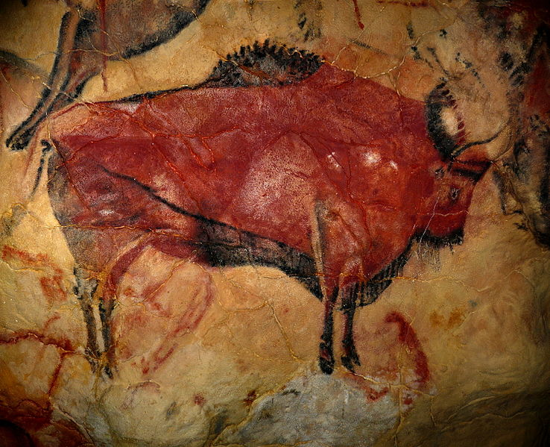

Slide 15
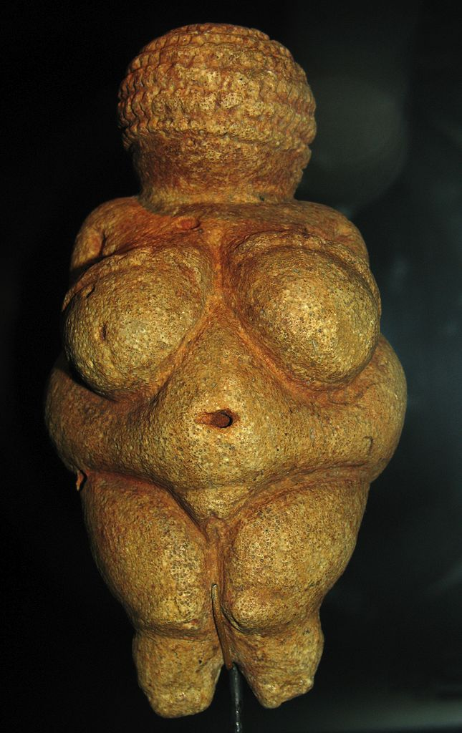
?
Photo by
Don Hitchcock

Slide 16
Venus
of Willendorf (Willendorf, Austria)
c. 25,000 B.C.
Photo by
Don Hitchcock

Slide 17
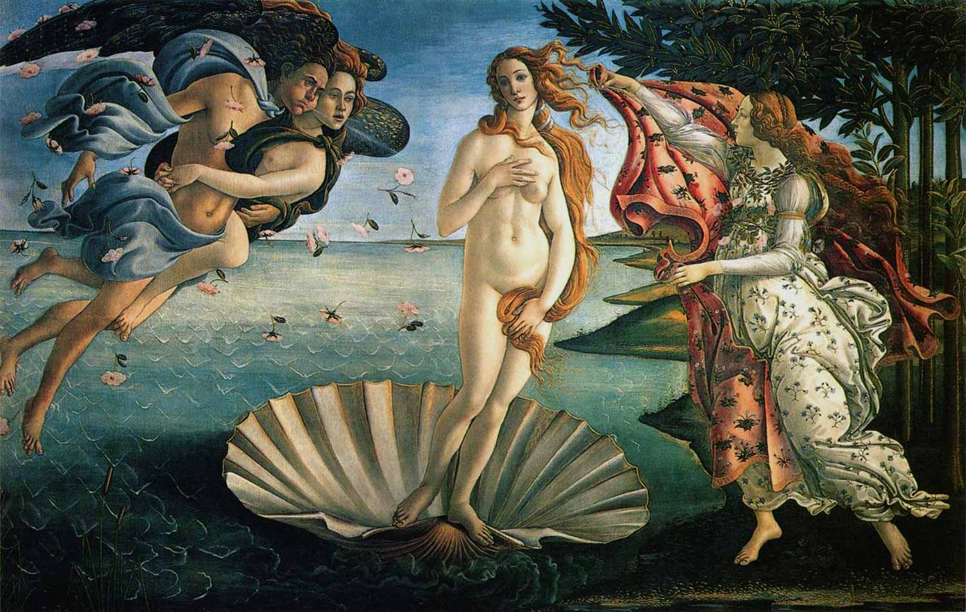
Sandro Botticelli The Birth of Venus 1486

Slide 18
You Wish!
Venus
of Willendorf (Willendorf, Austria)
c. 25,000 B.C.
Photo by
Don Hitchcock

Slide 19
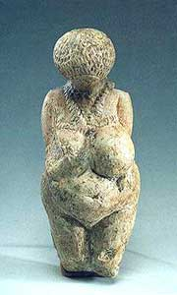
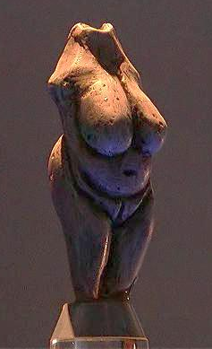
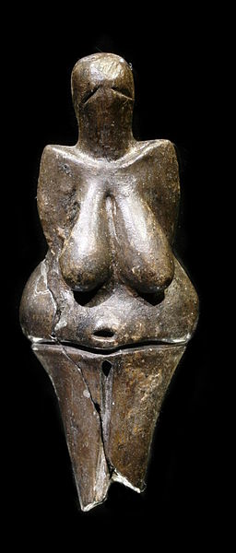
More Venus Figurines
Evidence of religion or just of free time?
Art History PowerPoint Resource
Martin Hlauka (Pescan)
Petr Novák, Wikipedia

Slide 20
Why?
Evidence of religion or just of free time?
Art History PowerPoint Resource
Martin Hlauka (Pescan)
Petr Novák, Wikipedia

Slide 21
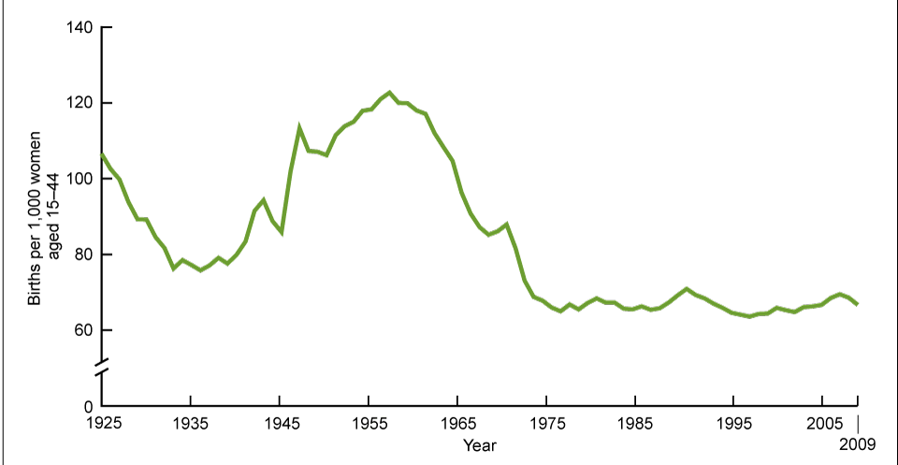
U.S. Fertility Rates (1925-2009)
Source: www.cdc.gov

Slide 22
SURVIVAL
Some rights reserved by Zuhair Ahmad

Slide 23
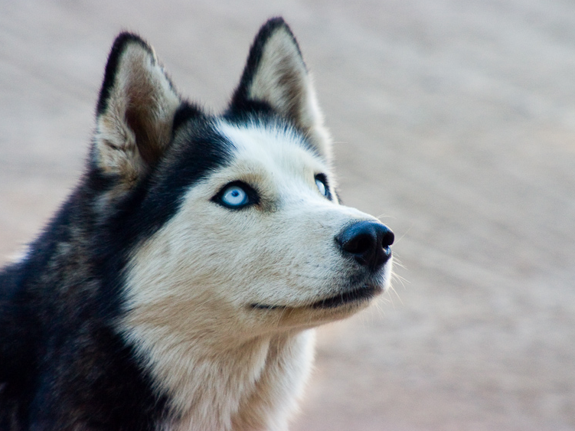
Mesolithic
Photo by rapettif

Slide 24
Prehistoric Humans
Paleolithic | Mesolithic | Neolithic
Παλαιός (palaios) “old” + λίθος (lithos) “stone” |  | νέος (neos) “new” + λίθος (lithos) “stone”
“Old Stone Age” |  | “New Stone Age”
Until around 10,000 B.C. |  | 10,000 B.C. - 4,000 B.C.
Hunting and Gathering |  | Agriculture
Nomadic |  | Settled Communities
Cave Art Venus Figurines |  | Domestication of Livestock (cattle, sheep, goats, pigs)
“Middle Stone Age”
Μέσος (mesos) “middle”
+ λίθος (lithos) “stone”
Around 10,000 B.C.
Hunting, Gathering, and Fishing
Nomadic
Domestication of Dogs
Canoes

Slide 25
Neolithic Revolution
Agriculture
Settled Communities

Slide 26
Prehistoric Humans
Paleolithic | Mesolithic | Neolithic
Παλαιός (palaios) “old” + λίθος (lithos) “stone” | Μέσος (mesos) “middle” + λίθος (lithos) “stone”
“Old Stone Age” | “Middle Stone Age”
Until around 10,000 B.C. | Around 10,000 B.C.
Hunting and Gathering | Hunting, Gathering, and Fishing
Nomadic | Nomadic
Cave Art Venus Figurines | Domestication of Dogs Canoes
“New Stone Age”
νέος (neos) “new” + λίθος (lithos) “stone”
c. 10,000 – 4,000 B.C.
Agriculture
Settled Communities
Domestication of Livestock
(cattle, sheep, goats, pigs)

Slide 27
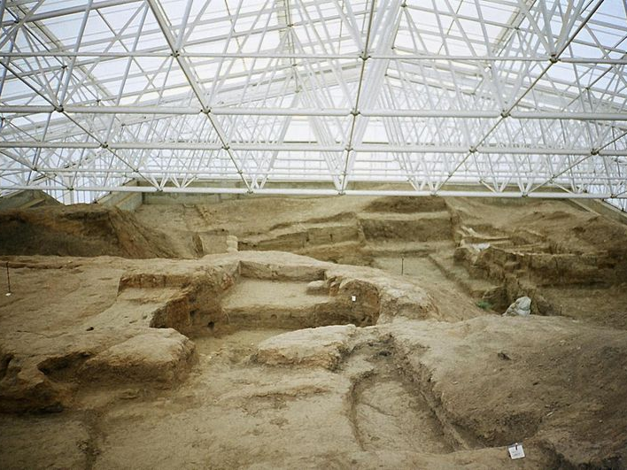
Çatalhöyük
A Neolithic City in Modern-day Turkey
Some Rights Reserved by Ziggurat

Slide 28
6,000 B.C.
Some Rights Reserved by Ziggurat

Slide 29
Archaeology
Uncovering the Past
Some rights reserved by Dr._Colleen_Morgan

Slide 30
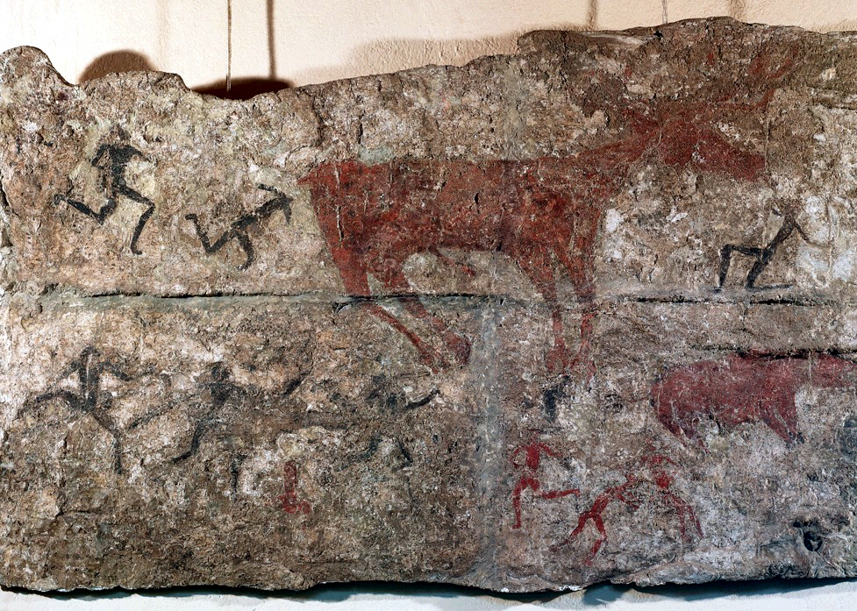
Deer Hunt detail of a wall painting from Level III
Çatal Höyük, Turkey ca. 5,750 B.C.E.
Art History PowerPoint Resource http://iris.nyit.edu/arthistory/pptshows.html
Notes:
Slide concept by William V. Ganis, PhD
FOR EDUCATIONAL USE ONLY
For publication, reproduction or transmission of images, please contact individual artists, estates, photographers and exhibiting institutions for permissions and rights.

Slide 31
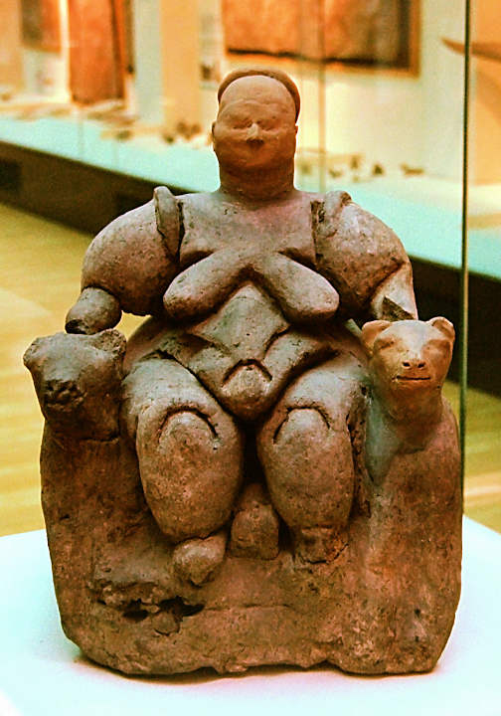
Seated Woman of Çatal Hüyük
“Mother Goddess” Style
Some Rights Reserved by Roweromaniak
Notes:
Slide concept by William V. Ganis, PhD
FOR EDUCATIONAL USE ONLY
For publication, reproduction or transmission of images, please contact individual artists, estates, photographers and exhibiting institutions for permissions and rights.

Slide 32
Seated Woman of Çatal Hüyük
“Mother Goddess” Style
What is uniquely Neolithic about this sculpture?
Some Rights Reserved by Roweromaniak
Notes:
Slide concept by William V. Ganis, PhD
FOR EDUCATIONAL USE ONLY
For publication, reproduction or transmission of images, please contact individual artists, estates, photographers and exhibiting institutions for permissions and rights.

Slide 33
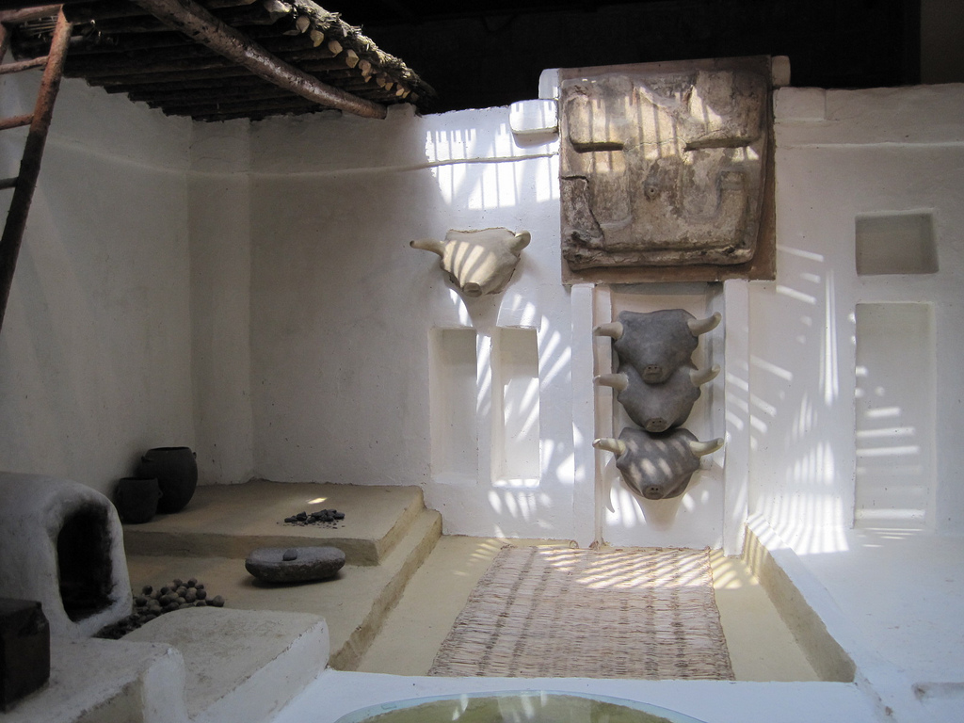
A Reconstruction
based on evidence
Some rights reserved by zamito44

Slide 34
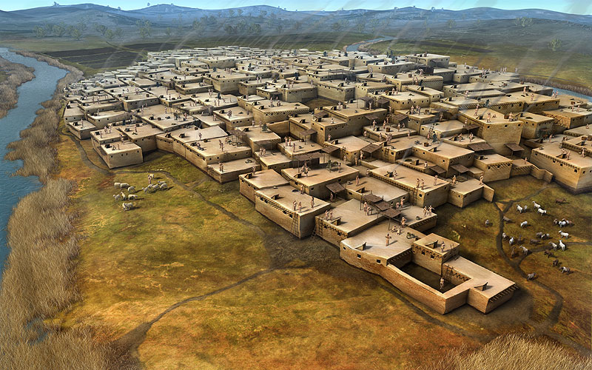
Çatalhöyük
An Aerial View
Image Source: http://alfredojunior.wordpress.com/tag/catal-huyuk/

Slide 35
Prehistoric Humans
Paleolithic | Mesolithic | Neolithic
Until around 10,000 B.C. | Around 10,000 B.C.
Hunting and Gathering | Hunting, Gathering, and Fishing
Nomadic | Nomadic
Cave Art Venus Figurines | Domestication of Dogs Canoes
“Old Stone Age”
“Middle Stone Age”
“New Stone Age”
Παλαιός (palaios) “old”
+ λίθος (lithos) “stone”
Μέσος (mesos) “middle”
+ λίθος (lithos) “stone”
νέος (neos) “new” + λίθος (lithos) “stone”
c. 10,000 – 4,000 B.C.
Agriculture
Settled Communities
Domestication of Livestock
(cattle, sheep, goats, pigs)

Slide 36
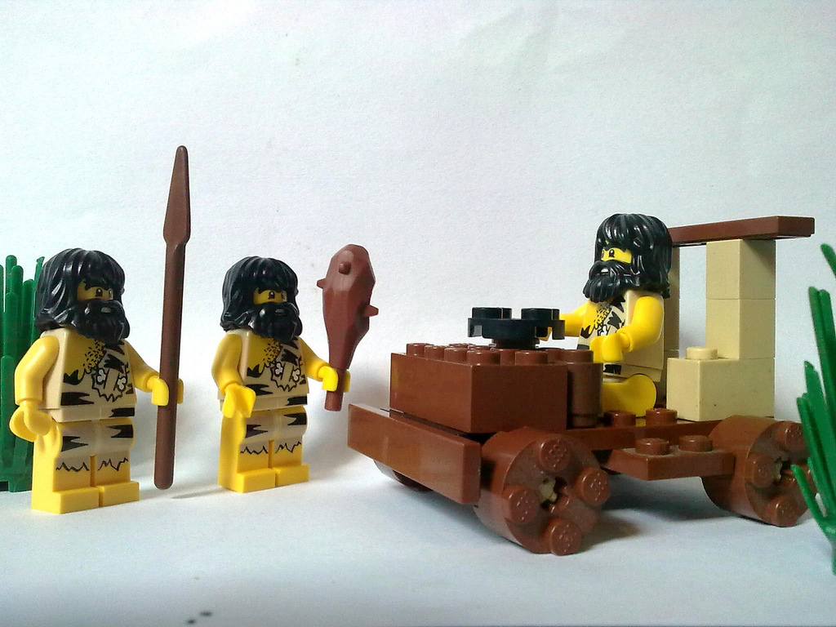
Civilization
Are we there, yet???
© Bobby-Joe Henson – Used with Permission

Slide 37
Settled Cities
Fire
Agriculture
Cities

Slide 38
What’s Missing?

Slide 39
WRITING

Slide 40
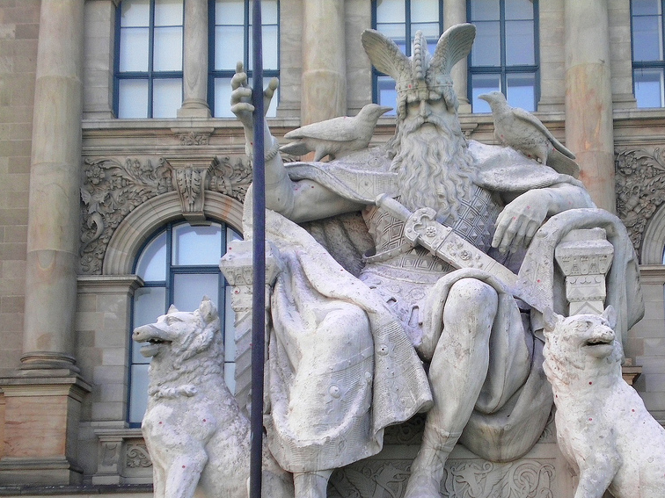
Odin
Chief Norse God
Photo by Elias Schwerdtfeger

Slide 41
Runes
Norse Writing
The Vikings believed that the runes had magical powers.
Why?

Slide 42
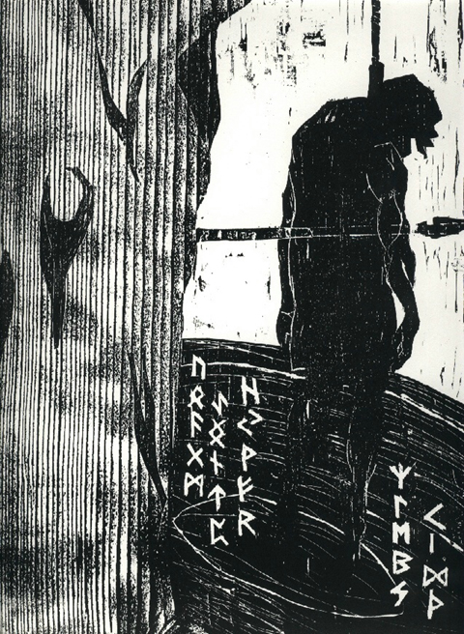
Sacrifice of Odin
I know I hung on the windswept Tree through nine days and nights I was struck with a spear and given to Odin, myself given to myself They helped me neither by meat nor drink I peered downward, I took up the runes, screaming, I took them - then I fell back.
-- Poetic Edda

