Slide 1
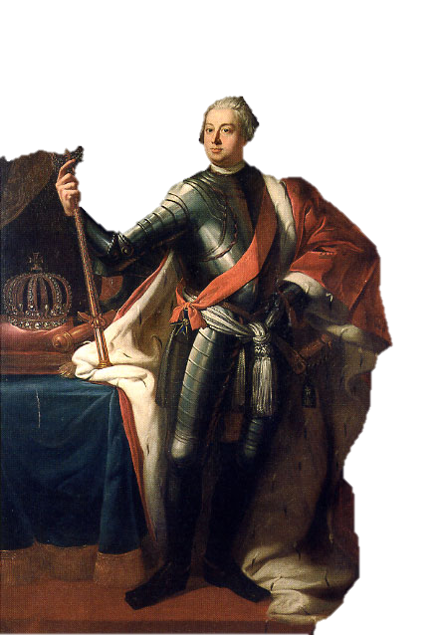
Absolutist Prussia

Slide 2
The Holy Roman Empire
Art Credit: David Liuzzo & N3MO

Slide 3
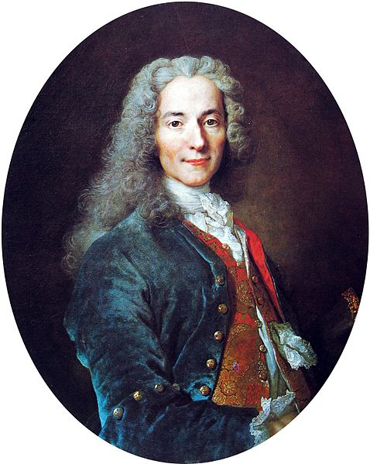
The Holy Roman Empire
“Neither Holy, nor Roman, nor an Empire!”
-- Voltaire

Slide 4
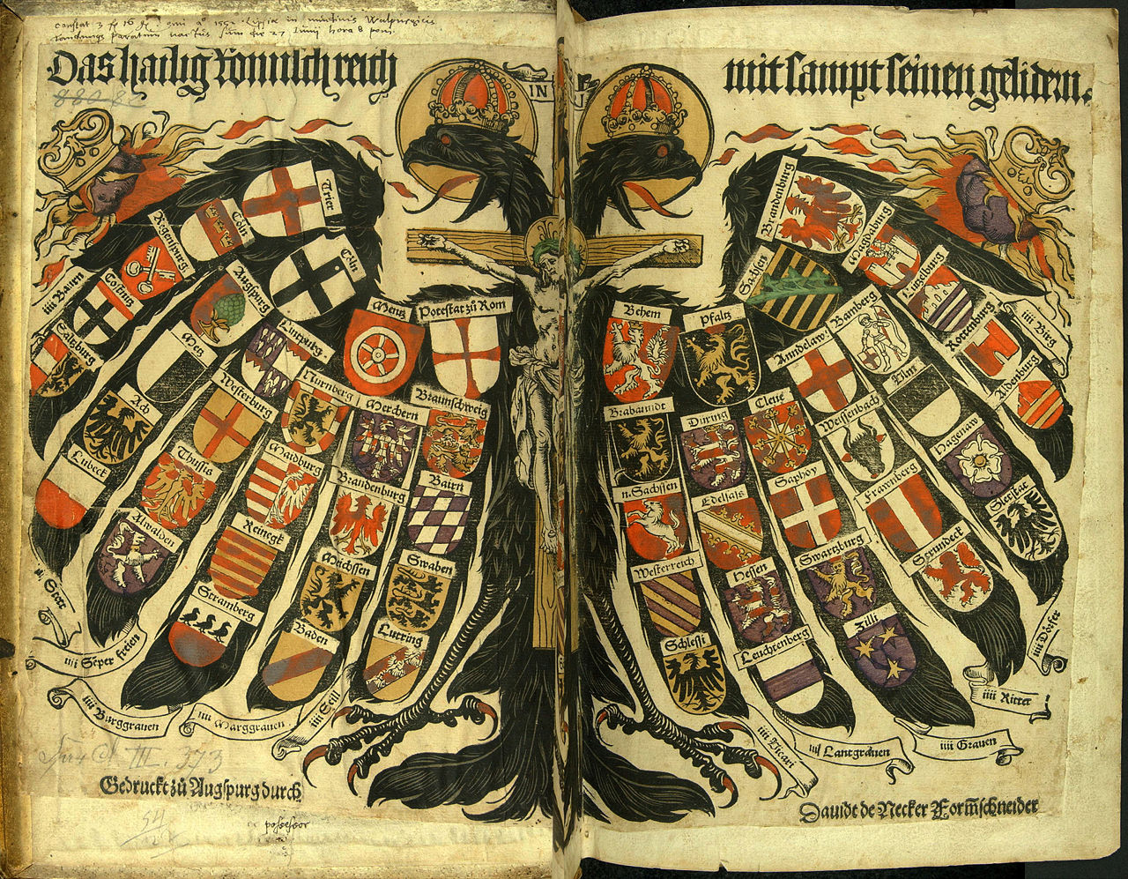
Confederation

Slide 5
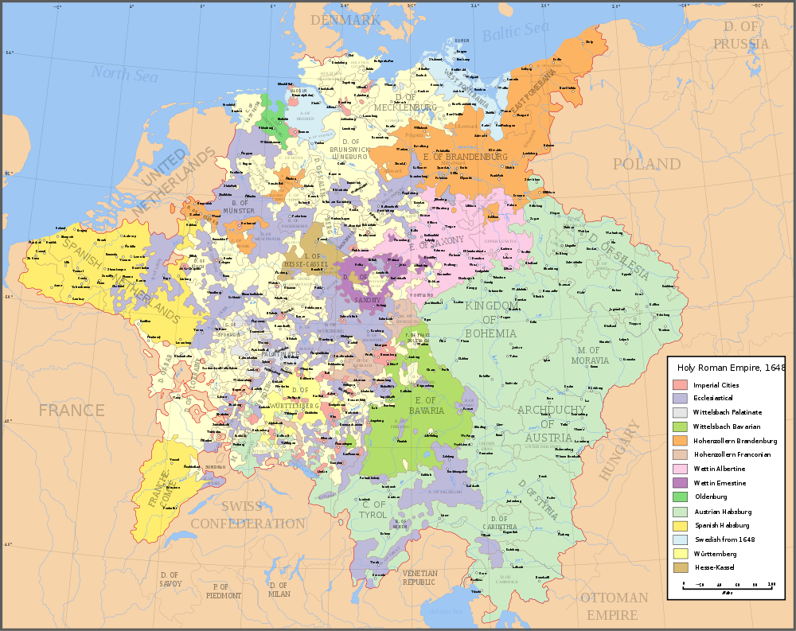
Brandenburg
Map Credit: Astrokey44

Slide 6
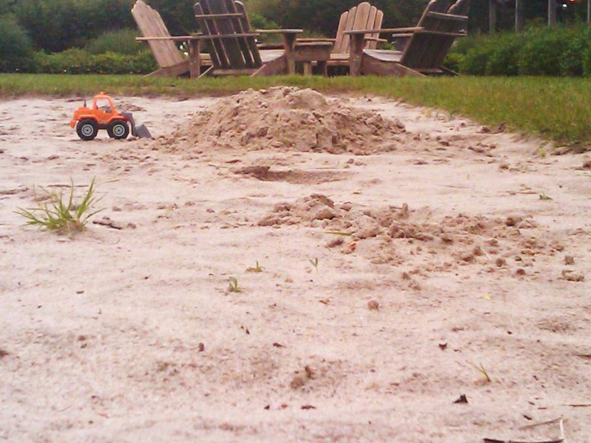
The Sandbox
of the Holy Roman Empire
Some rights reserved by lazzarello

Slide 7
Brandenburg-Prussia
Art Credit: David Liuzzo

Slide 8
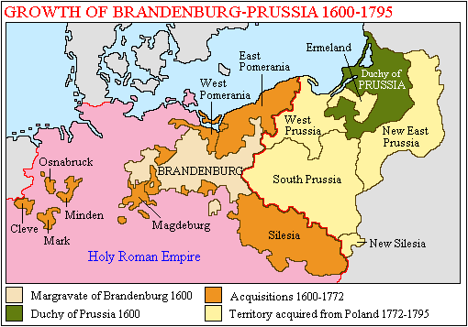

Slide 9
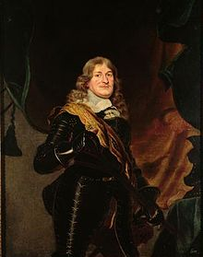
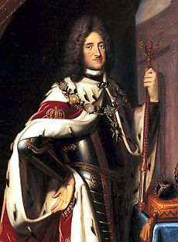
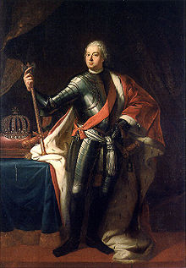
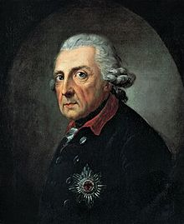
Hohenzollern Dynasty
“The Fredericks”

Slide 10
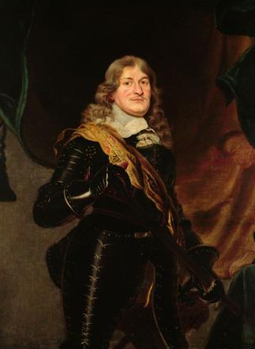
Frederick William
(r. 1640-1688)
The “Great Elector”
Father of Prussian Absolutism

Slide 11
Frederick William I
(r. 1713-1740)
The “Soldier King”
Soldatenkönig

Slide 12
Frederick II “the Great”
(r. 1740-1786)
Enlightened Absolutist
Friend of Voltaire

Slide 13
“A formidable army and a war chest large enough to make this army mobile in times of need can create great respect for you in the world, so that you can speak a word like the other powers.”
-- Frederick William I

Slide 14
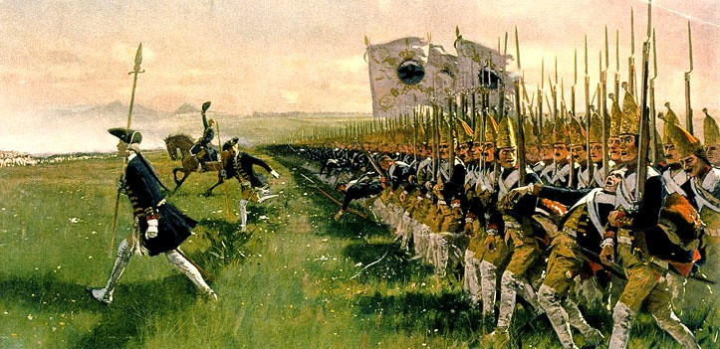
MILITARISM
Carl Röchling (d. 1920), Attack of the Prussian Infantry

Slide 15
MILITARISM
12TH
Largest Population
Carl Röchling (d. 1920), Attack of the Prussian Infantry

Slide 16
MILITARISM
12TH
Largest Population
4TH
Largest Army
Carl Röchling (d. 1920), Attack of the Prussian Infantry

Slide 17
MILITARISM
Armies from Russia to the United States adopted the Prussian drill model.
Carl Röchling (d. 1920), Attack of the Prussian Infantry

Slide 18
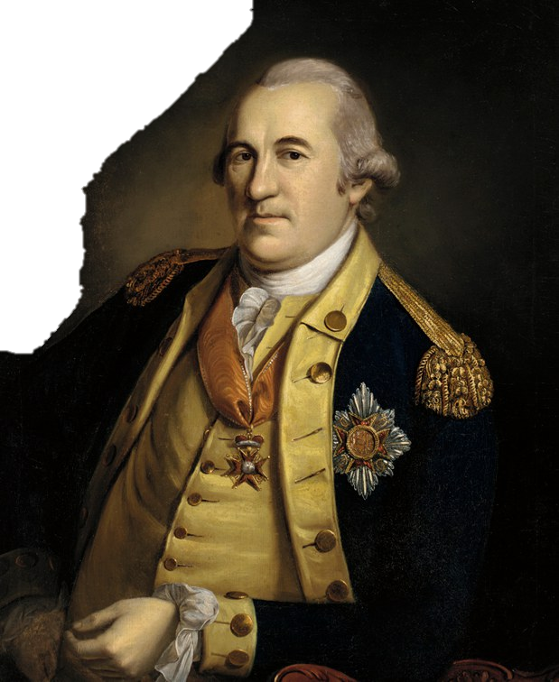
Baron von Steuben
Trained Washington’s Continental Army in Prussian-style drill

Slide 19
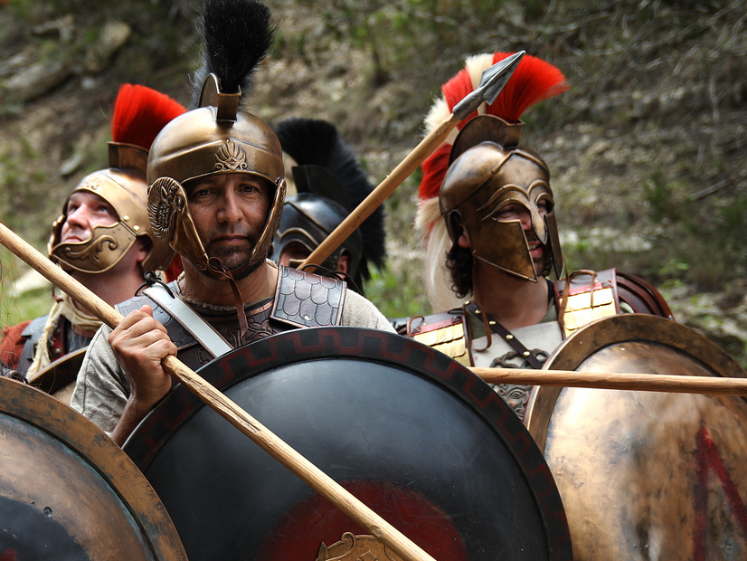
“Sparta of the North”
© mpfilmcraft
Used with Permission

Slide 20
THIS... IS... SPARTA!

Slide 21
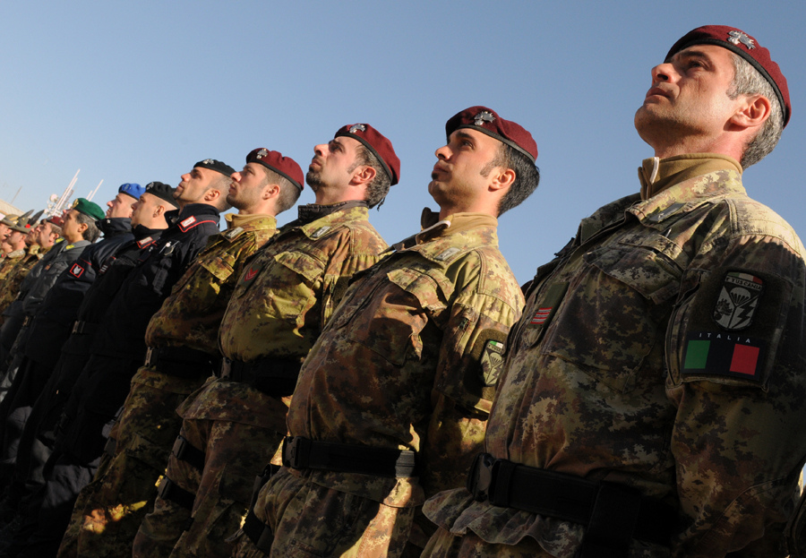
DISCIPLINE
Some rights reserved by isafmedia

Slide 22
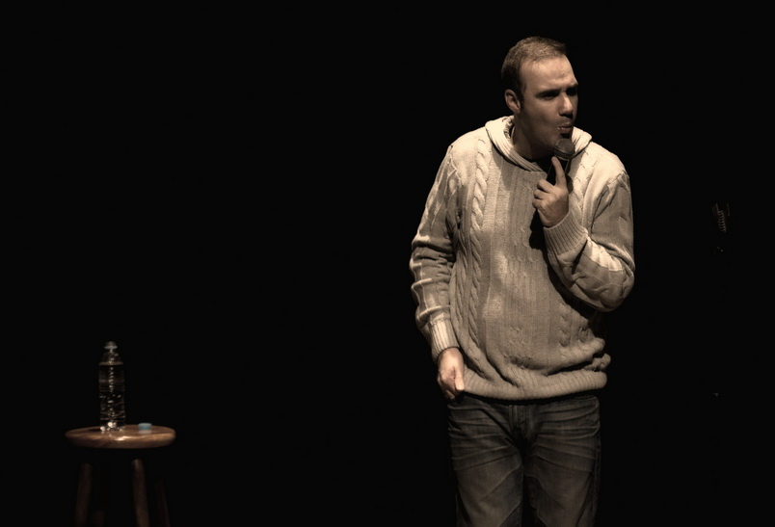
Comedies
Some rights reserved by Douglas Pimentel

Slide 23
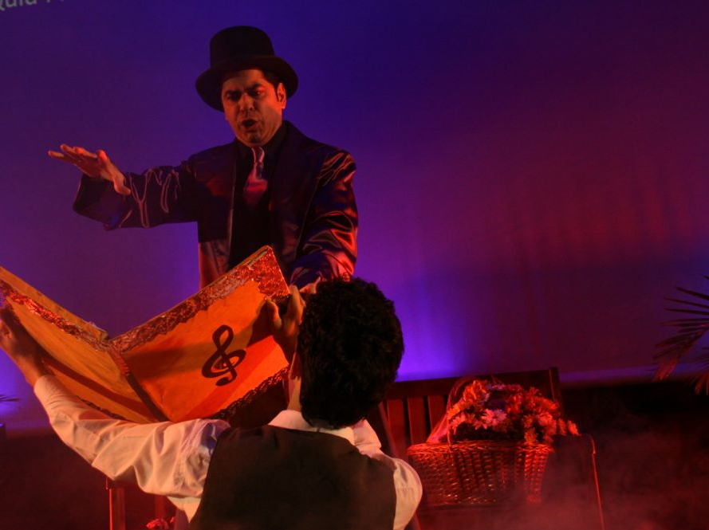
Operas
Some rights reserved by ClubTransatlântico

Slide 24
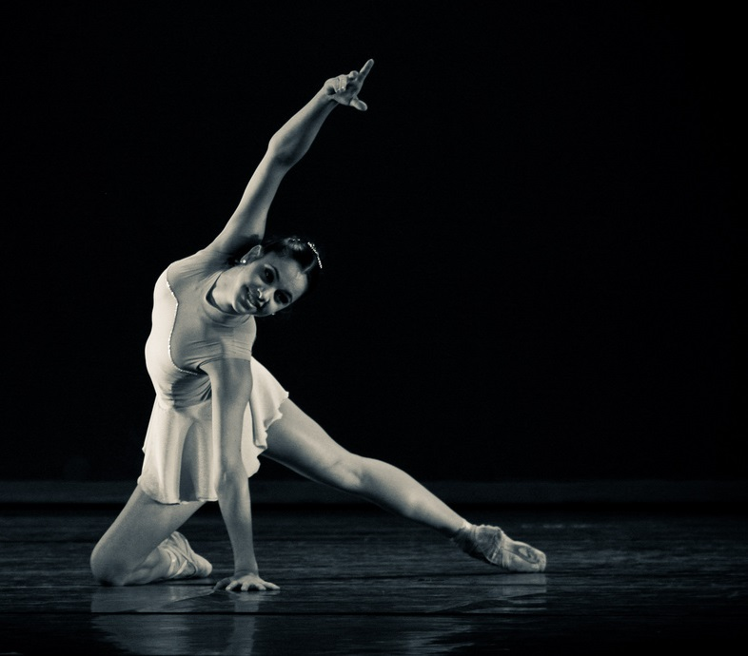
Ballets
Some rights reserved by rdenubila

Slide 25
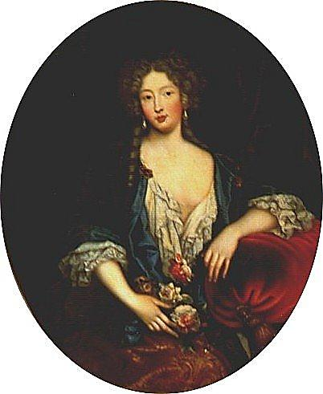
“All successful rulers keep God before their eyes and have no mistresses or, rather, whores, and lead a godly life…”
-- Frederick William I
Marie Angélique de Scorailles, one of Louis XIV’s many mistresses

Slide 26
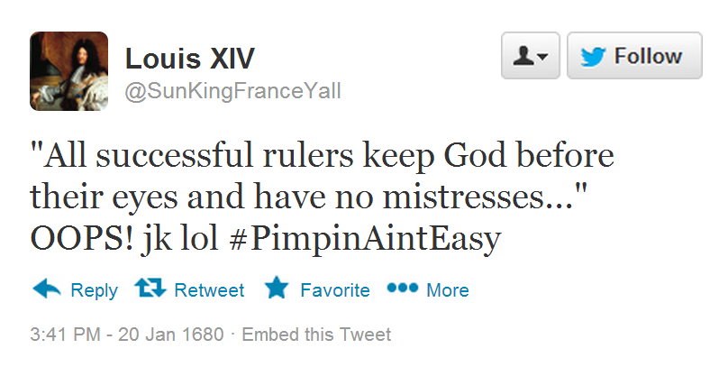
I’m going to get rid of all my mistresses so I can be more successful. jk lol #PimpinAintEasy

Slide 27
“The most beautiful girl or woman in the world would be a matter of indifference to me, but tall soldiers - they are my weakness.”
-- Frederick William I

Slide 28
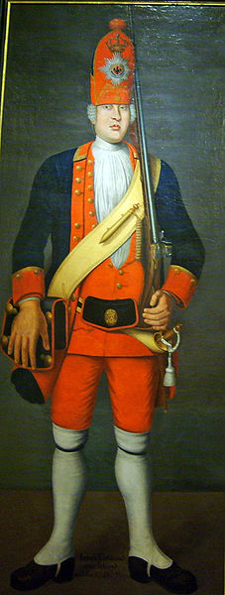
Potsdam GIANTS
Internationally-recruited regiment of tall soldiers

Slide 29
“Everything must be committed except eternal salvation – that belongs to God, but all else is mine.”
-- Frederick William I

Slide 30
Building an Absolutist State
Church
Nobility (Junkers)
Representative Bodies (Estates)
Education
Protestant
Religious Toleration
Cooperation
(Service Nobility)
Reduced Power
Taxation by Decree
Compulsory Public Education (1st system of its kind)

