Slide 1
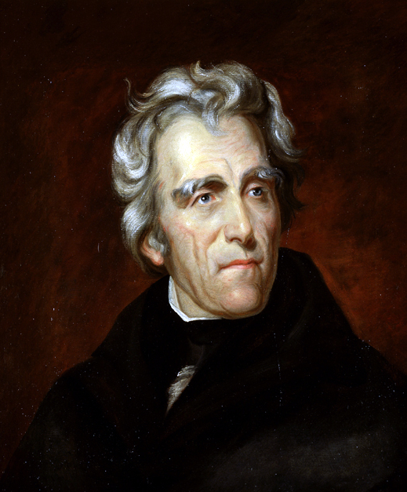

The Age of Jackson

Slide 2
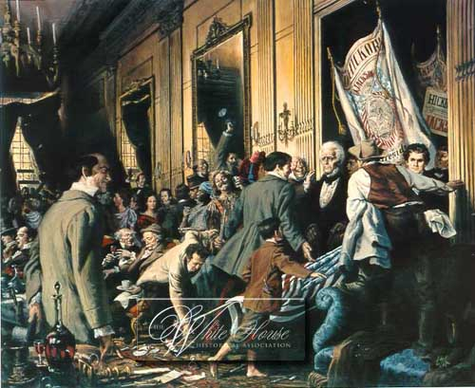
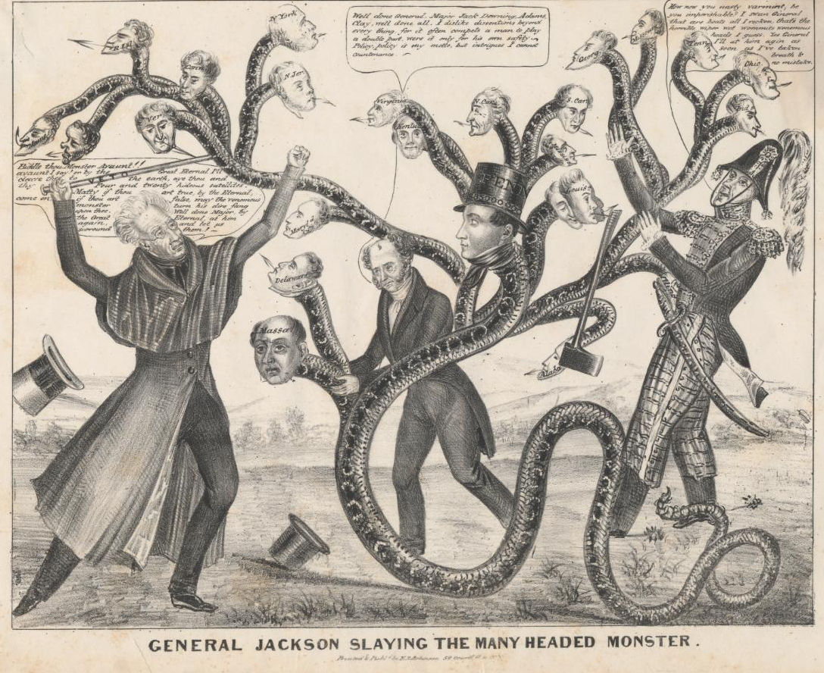
Table of Contents
Jacksonian Democracy
Jacksonian Controversies

Slide 3
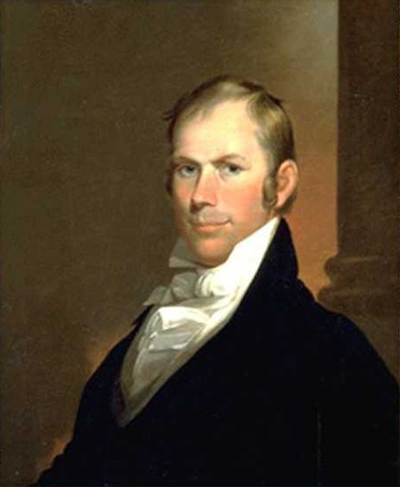
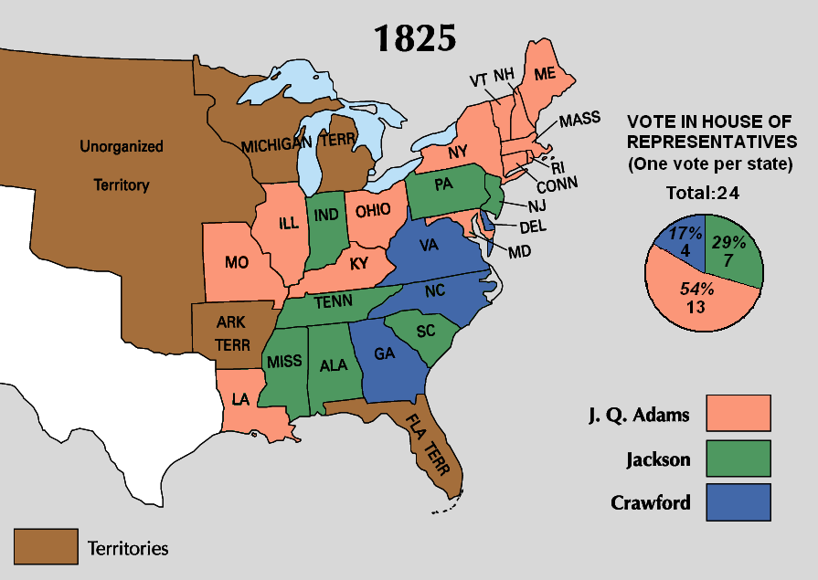

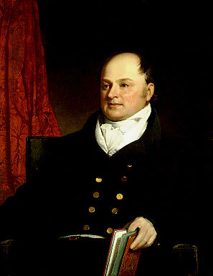
Jacksonian Democracy
USHC 2.1
Summarize the impact of the westward movement on nationalism and democracy, including the expansion of the franchise, the displacement of Native Americans from the southeast and conflicts over states’ rights and federal power during the era of Jacksonian democracy as the result of major land acquisitions such as the Louisiana Purchase, the Oregon Treaty, and the Mexican Cession.

Slide 4
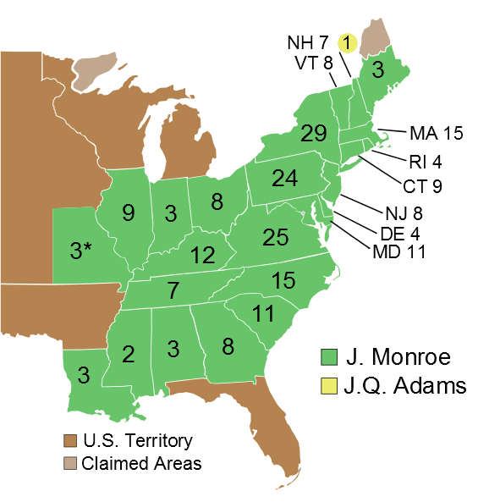

1820
99.5%
Electoral Vote
1820
1824
1828
1832
1836
1840

Slide 5
Direct Balloting for President
President
The New System
Direct Election
(Democracy)
The Old System
Indirect Election
(Aristocracy)
Presidential Electors
By 1836, voters in all states except for South
Carolina were casting
direct ballots for presidential electors.
South Carolina continued to select electors indirectly until 1860.
State Legislature
Voters
Notes:
Which arrangements

Slide 6
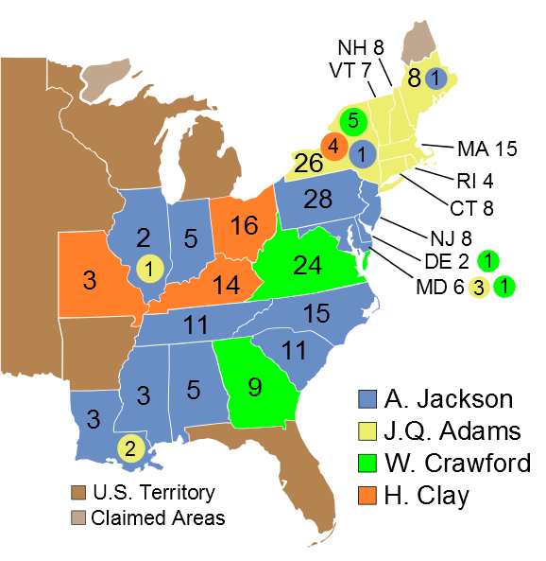


1824
13%
37
13%
99
41
43%
31%
84
Popular Vote
(356,038 Votes)
Electoral Vote
View Popular Vote
View Electoral Vote
HOUSE VOTE
1820
1824
1828
1832
1836
1840

Slide 7
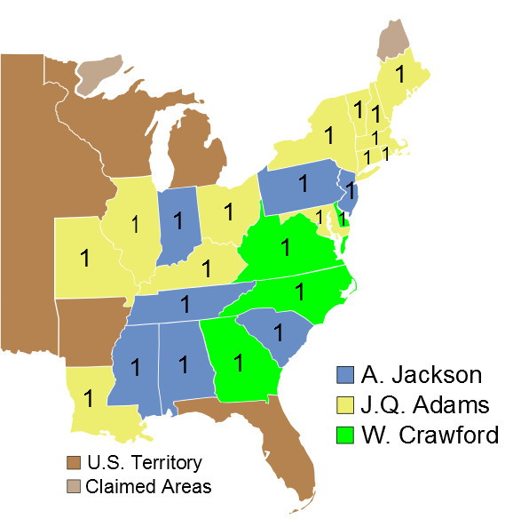

1825
4
7
13
ELECTORAL VOTE
1820
1824
1828
1832
1836
1840

Slide 8
A “Corrupt Bargain”?
The northwestern states that had supported Clay all threw their support behind John Quincy Adams.
POTUS
Sec. of State
Henry Clay
John Q. Adams

Slide 9
A “Corrupt Bargain”?
YEARS | PRESIDENT | SEC OF STATE | VICE PRESIDENT
1789-1797 | George Washington | Thomas Jefferson | John Adams
1797-1801 | John Adams |  | Thomas Jefferson
1801-1809 | Thomas Jefferson | James Madison
1809-1817 | James Madison | James Monroe
1817-1825 | James Monroe | John Quincy Adams
1825-1829 | John Quincy Adams | Henry Clay | John C. Calhoun

Slide 10
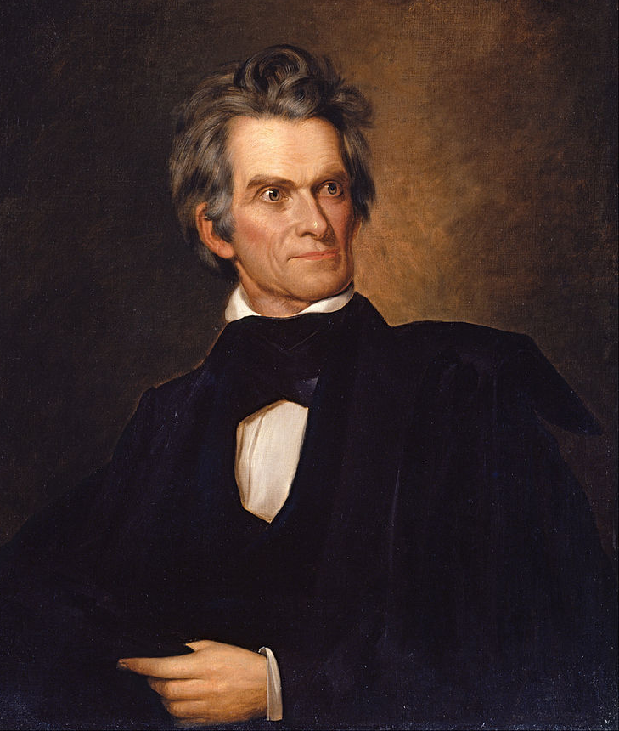
A “Corrupt Bargain”?
“I see in the fact that Mr. Clay has made the President against the voice of his constituents, and that he has been rewarded by the man elevated by him by the first office in his gift, the most dangerous stab, which the liberty of this country has ever received. I will not be on that side. I am with the people.”
John C. Calhoun
Vice President

Slide 11
Jacksonian Democracy
Belief in the
Common Man
Universal [White Male] Suffrage
Popular Campaigning

Slide 12
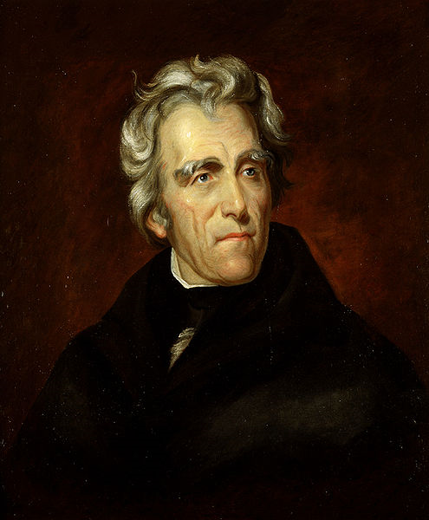
“Jacksonian” Democracy?
Which came first???

Slide 13
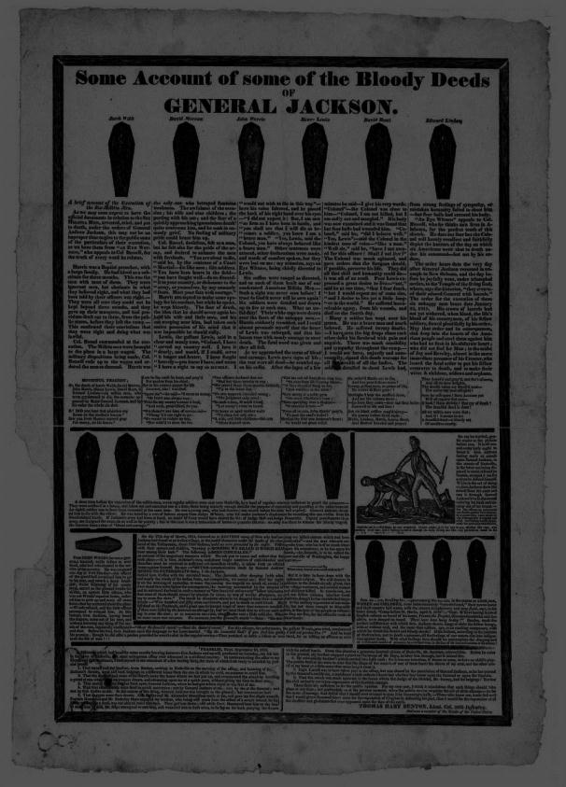
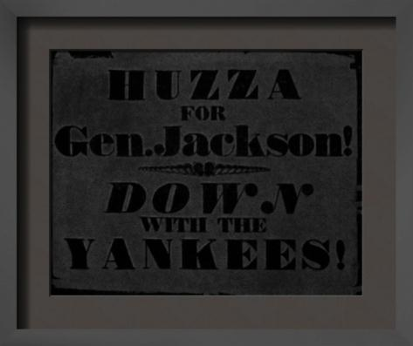
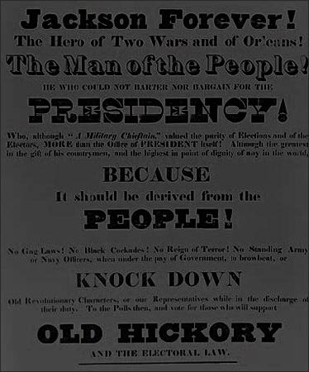
The 1828 Campaign
Candidate-centered
Negative Advertising
Just Plain Dirty
Sectionalism
Candidate
Promotion
Further Reading

Slide 14
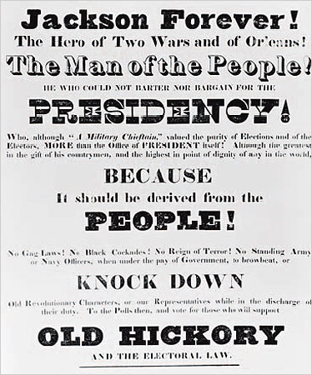
A Man of the People
Jackson campaigned as a man of the people standing against “corrupt bargainers” like Adams.
OLD

Slide 15
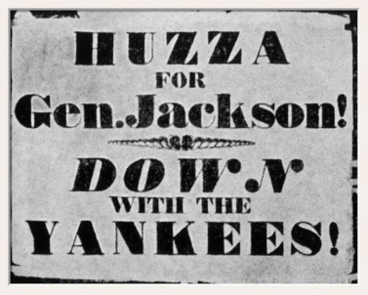

Slide 16
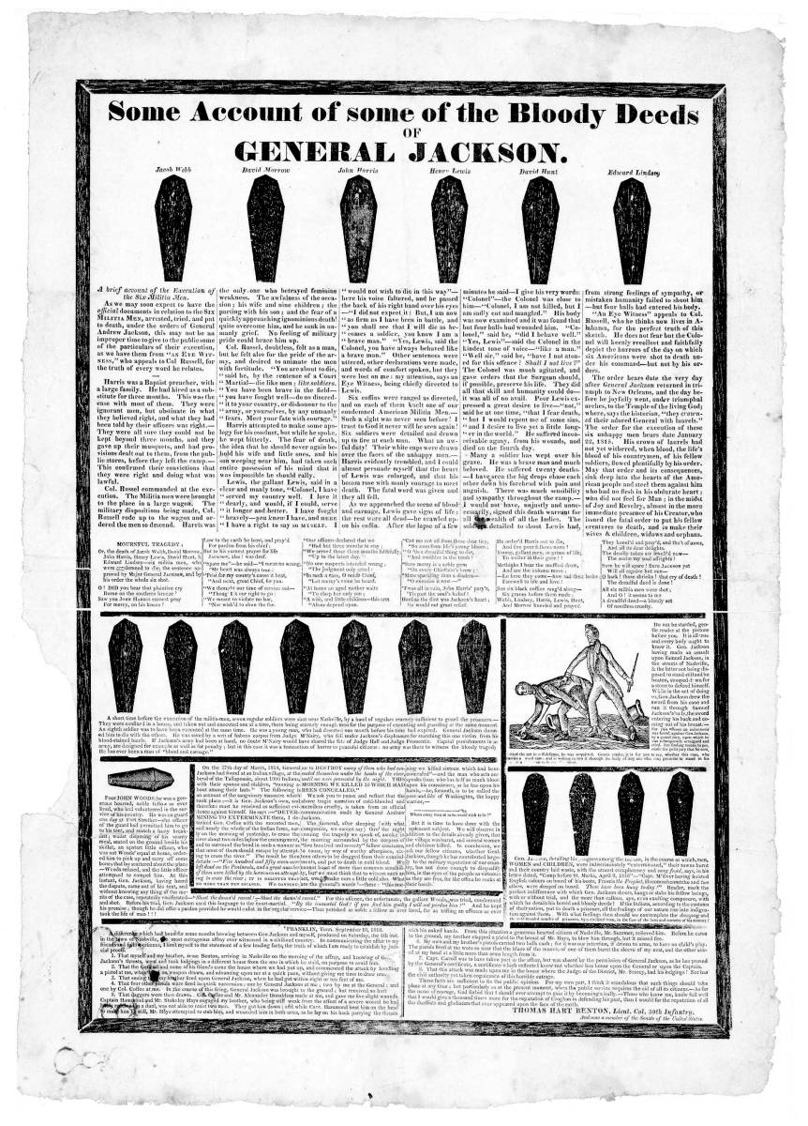
“Coffin Handbills”
Distributed by Adams supporters
Further Reading

Slide 17
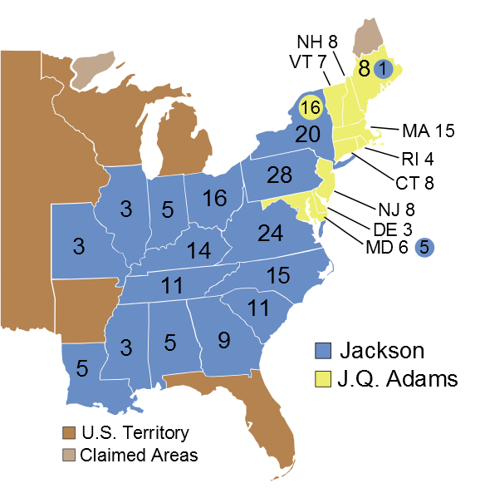


1828
83
44%
56%
178
Popular Vote
(1,155,350 Votes)
Electoral Vote
View Popular Vote
View Electoral Vote
1820
1824
1828
1832
1836
1840

Slide 18
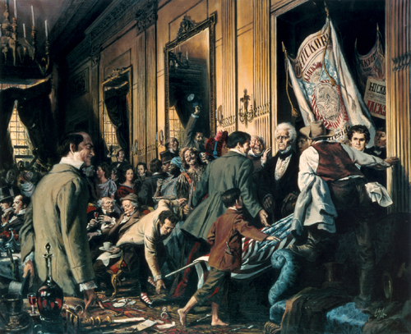
The Inauguration:
Jacksonian Democracy in Action
Source: White House Historical Association Artist: Louis S. Glanzman

Slide 19
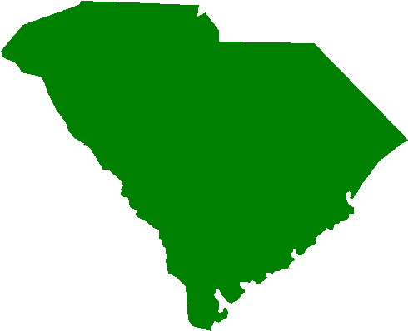
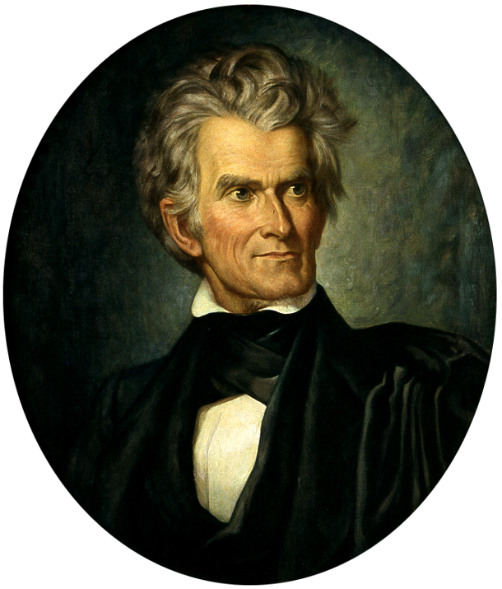
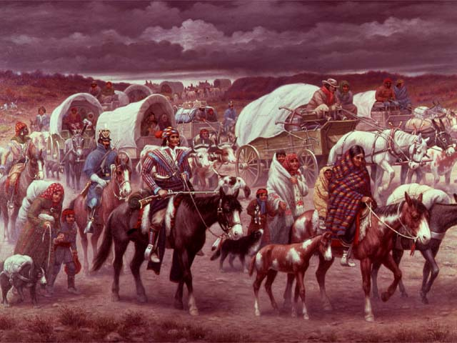

Jacksonian
Controversies
USHC 2.1
Summarize the impact of the westward movement on nationalism and democracy, including the expansion of the franchise, the displacement of Native Americans from the southeast and conflicts over states’ rights and federal power during the era of Jacksonian democracy as the result of major land acquisitions such as the Louisiana Purchase, the Oregon Treaty, and the Mexican Cession.

Slide 20
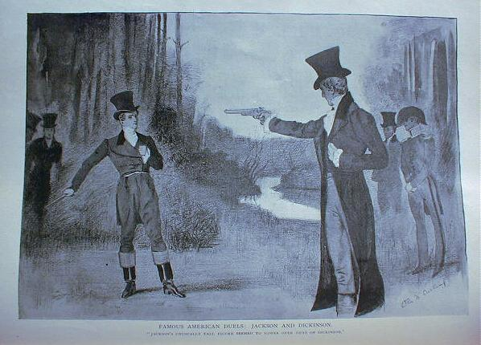
Jackson-Dickinson Duel (1806)

Slide 21
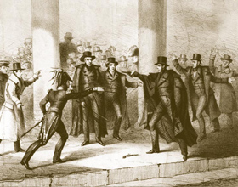
Assassination Attempt
The Story: http://www.americanheritage.com/people/articles/web

Slide 22
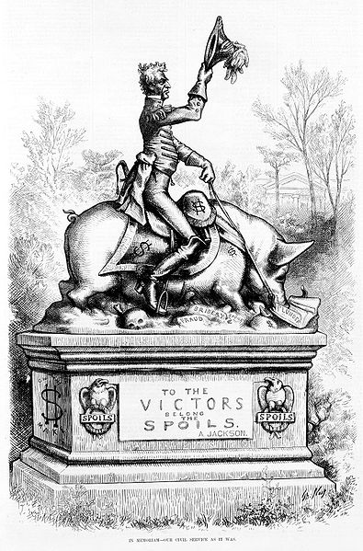
The
Spoils System
“To the victor belong the spoils…”
Political Patronage
Government offices given
to political supporters
In memoriam--our civil service as it was, A Political cartoon by Thomas Nast showing statue of Andrew Jackson on pig, which is over "fraud," "bribery," and "spoils," eating "plunder." in Harper's Weekly, 1877 April 28, p. 325.
Modern Day Spoils System

Slide 23
The Second Two Party System
1
1790-1816 | Federalists | Republicans [Jeffersonian or Democratic]
1816-1824 | “Republicans”
1828-1833
1833-1854
National Republicans
Democratic Republicans
2
“Whigs”
“Democrats”

Slide 24
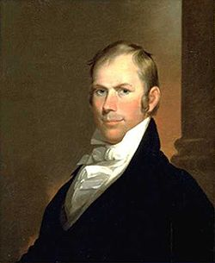

WHIGS | The 2nd Party System | DEMOCRATS
 | Leaders
 | Federalism
 | Attitude toward the “Common Man”
 | Moral Reform?
 | Constitution
 | Economy
 | Sectional Support
 | National Bank
 | Internal Improvements
 | Protective Tariff
Henry Clay
Andrew Jackson
Nationalistic
States’ Rights
Elitist
Egalitarian
YES
NO
Loose
STRICT
Gov. Involvement OK
Laissez-faire
Northeast (& West)
South / West
AMERICAN
SYSTEM
YES
NO
YES
NO
YES
Yes & No

Slide 25
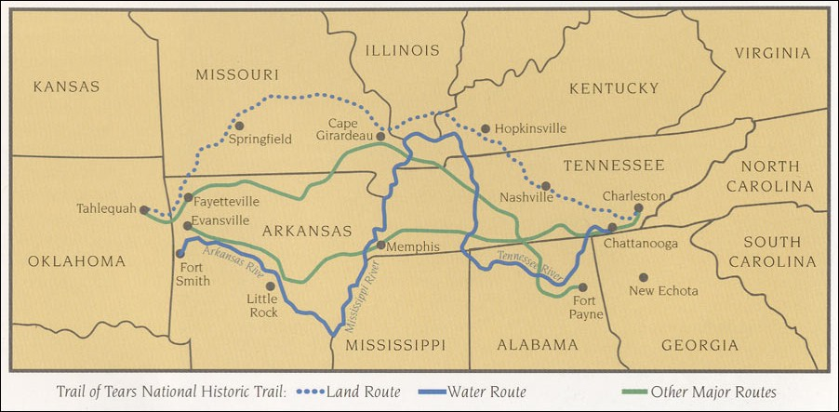
Indian Removal
Trail of Tears
Cherokee Tribe

Slide 27
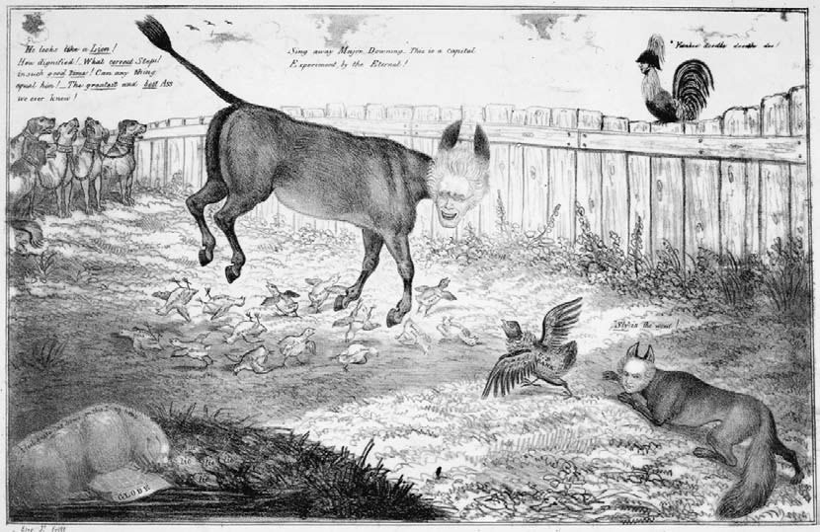
Jackson vs. the Bank
Second Bank of the United States
  Chartered 1816-1836
“Pet Banks”
A “Hydra of Corruption”

Slide 28


Slide 29
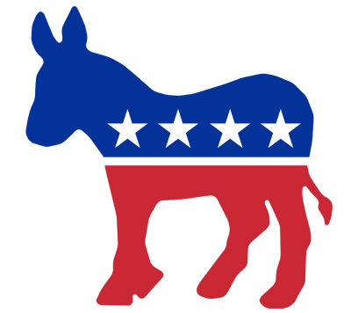

Slide 30

“The bank…
is trying to kill me…
BUT I WILL KILL IT.”
-- Andrew Jackson
Photo by Nate Steiner

Slide 31
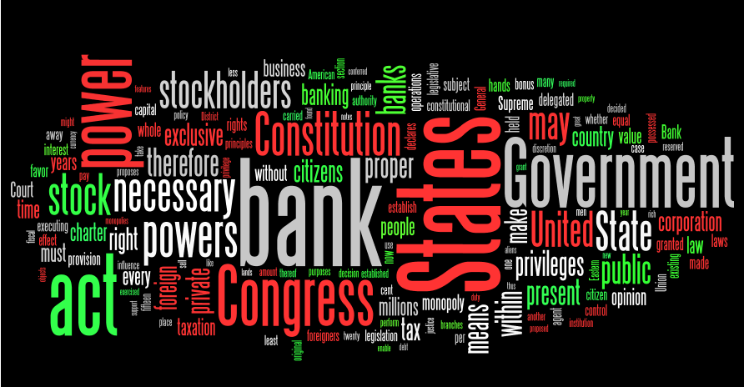
Jackson’s Veto Message
FULL TEXT

Slide 32
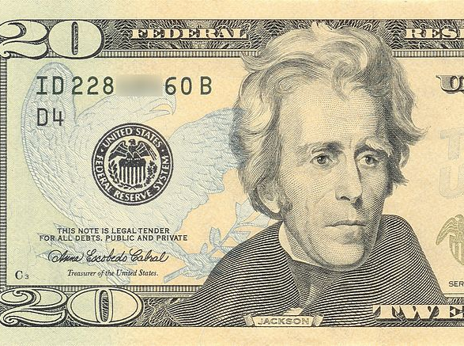
IRONY

Slide 33
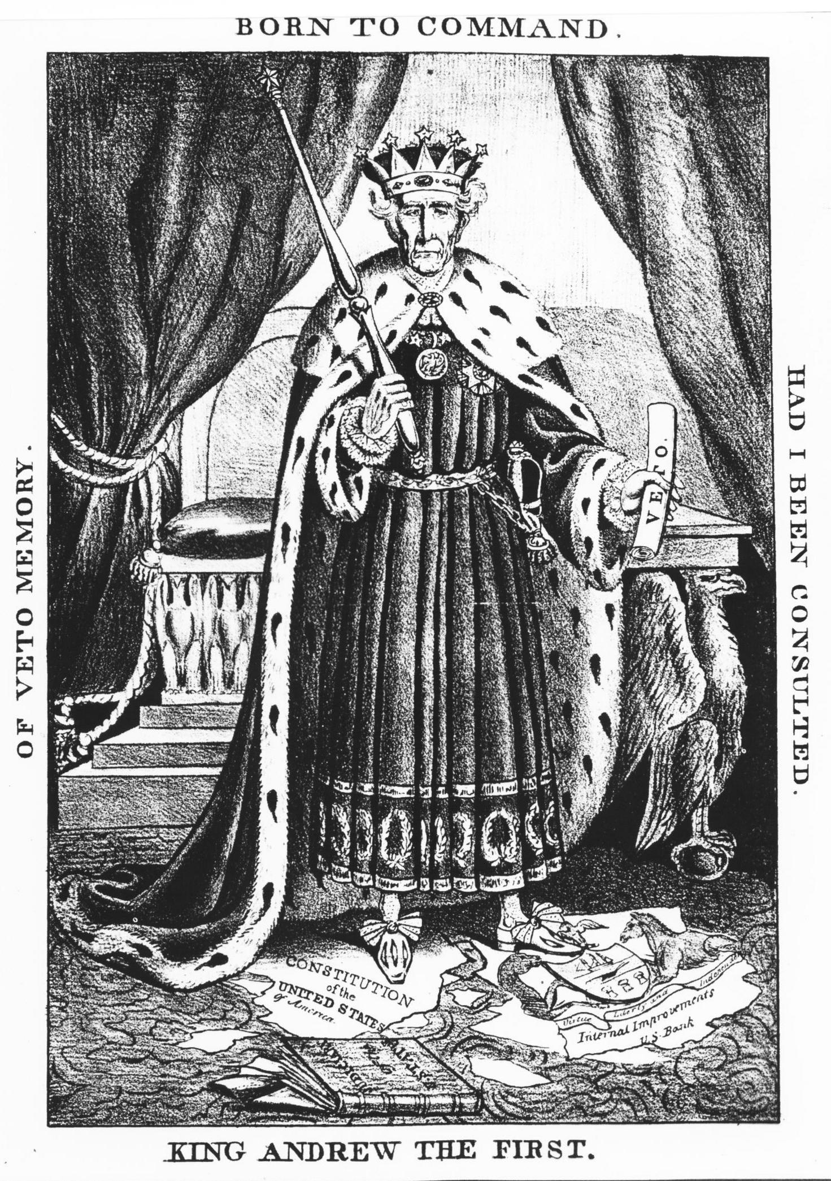
Political Cartoon
What does this cartoon say about contemporary opinions of Andrew Jackson?

Slide 34
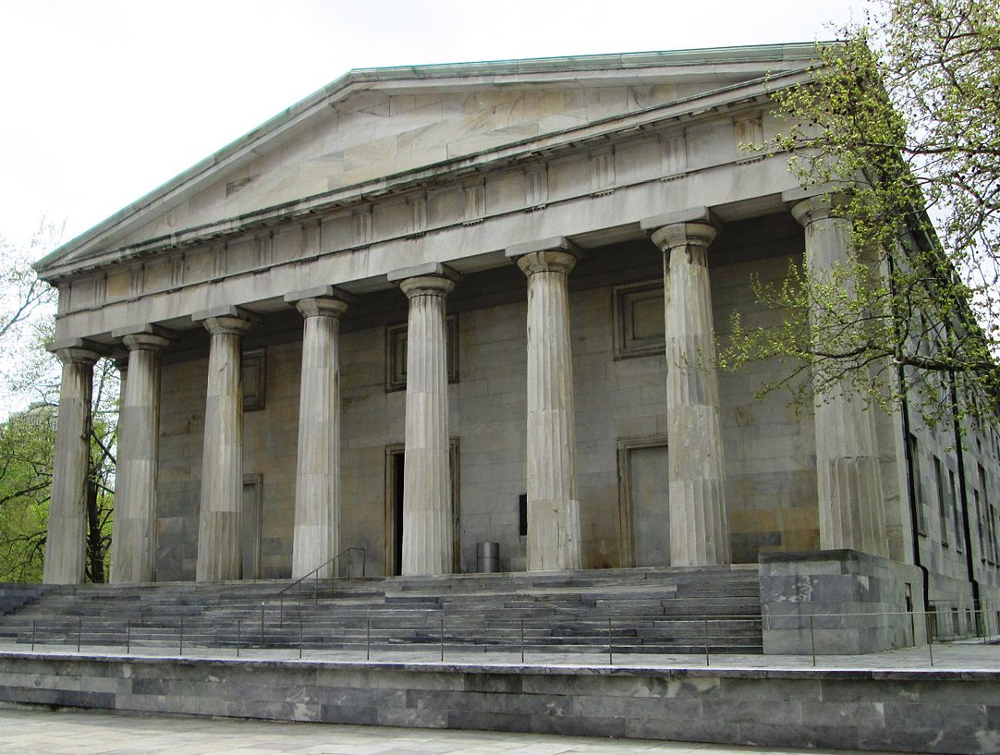
Jackson vs the Bank
The Second Bank of the United States
420 Chestnut Street
Philadelphia, PA
Photo by
Beyond My Ken

Slide 35



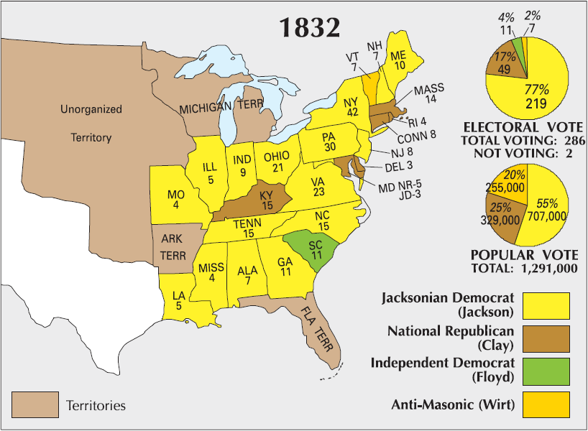
1832 Presidential Election
WINNER
LOSER
Jackson
Clay
The National Bank was the central issue of the 1832 election.

Slide 36
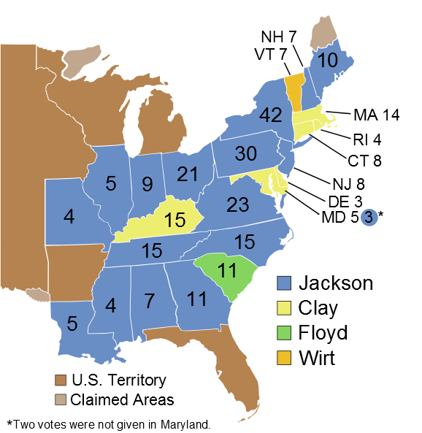

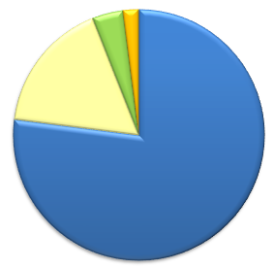
1832
20%
49
55%
25%
219
Popular Vote
(1,291,000 Votes)
Electoral Vote
View Electoral Vote
View Popular Vote
1820
1824
1828
1832
1836
1840

Slide 37
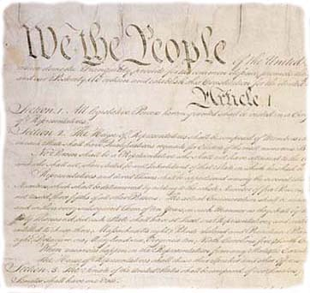
NULLIFICATION
1828-1833

Slide 38

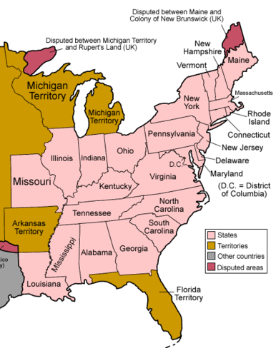
The American System
GOAL:
Economic Self-Sufficiency
Clay
THREE PARTS:
National Bank
Internal Improvements
Protective Tariff

Slide 39
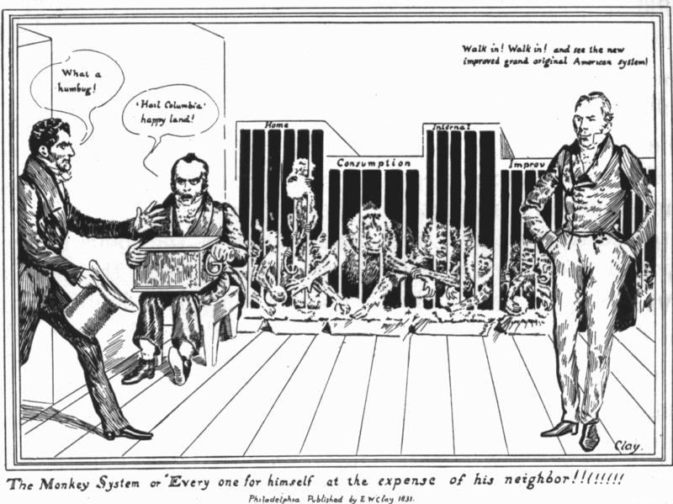

Slide 40
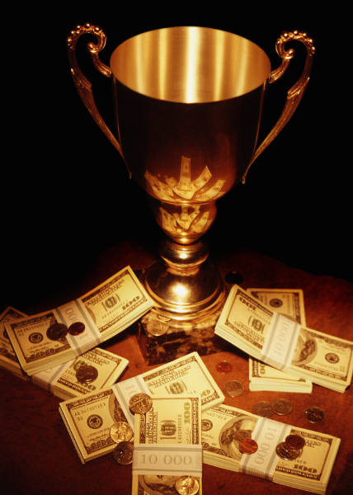
The Tariff of 1828
The “Tariff of Abominations”
Highest tariff rates
ever passed by Congress
PROTECTIVE
  In excess of $$$ necessary to finance the government

Slide 41
Three Major Industries:
Commerce
Agriculture
Which industry benefits from a protective tariff?
Manufacturing

Slide 42
The Tariff of 1828
The “Tariff of Abominations”
House Vote on Tariff of 1828 | + | -
New England | 16 | 23
Middle States (Mid-Atlantic) | 57 | 11
West | 29 | 10
South | 3 | 50
Total | 105 | 94
Did the Tariff of 1828 provide for the general welfare?

Slide 43
From Article I, Section 8
“The Congress shall have Power To lay and collect Taxes, Duties [tariffs], Imposts and Excises, to pay the Debts and provide for the common Defence and general Welfare of the United States…”
By this standard, was the
Tariff of 1828 constitutional?

Slide 44
Nullification
South Carolina threatened to nullify the Tariff of 1828
  Refused to collect the tariff within the state’s borders
The South Carolina Exposition [and Protest]
John C. Calhoun
Vice President

Slide 45
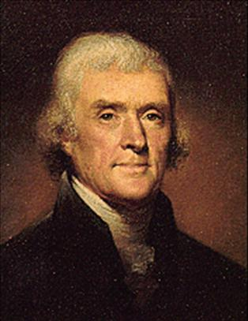
From the Kentucky Resolution of 1798
“Resolved, That the several States composing, the United States of America, are not united on the principle of unlimited submission to their general government… and that whensoever the general government assumes undelegated powers, its acts are unauthoritative, void, and of no force…”
Jefferson

Slide 46
Jackson’s Dilemma
States’
Rights
Federal Authority

Slide 47
A Toast
“The Union. Next to our liberty, the most dear.”
“Our Federal Union: It must be preserved.”

Slide 48
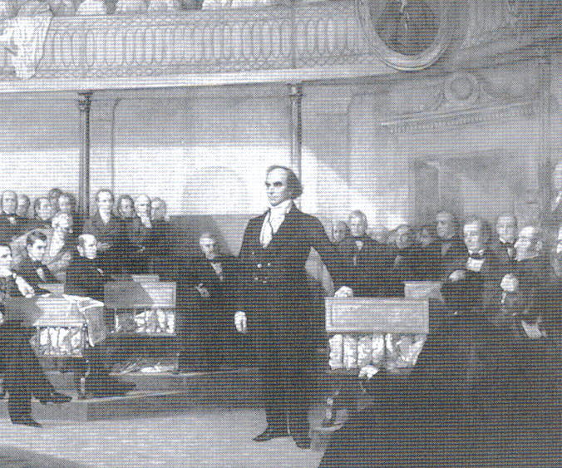
Hayne-Webster Debate
Debate in U.S. Senate concerning the constitutionality of Nullification
Daniel Webster (MA)
  (Anti-Nullification)
  “liberty and Union, now and forever, one and inseparable!”
Rhetorical victory for Webster

Slide 49

The Force Bill
1832
Congress authorizes Jackson to use force to collect the tariff in SC.
SC calls out militia

Slide 50
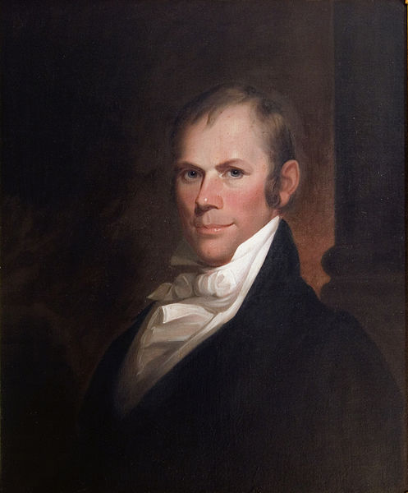

Slide 51
The Compromise Tariff
of 1833
Lowered protective rates
South Carolina accepts
  Then nullified the Force Bill
CRISIS AVERTED
  For now…
Henry Clay
“The Great Compromiser”

Slide 52
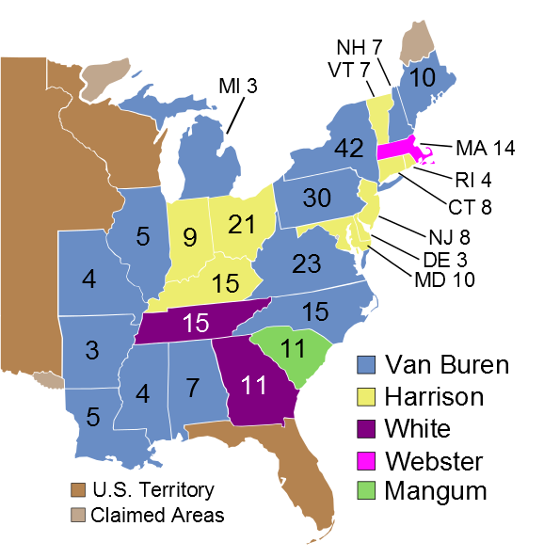
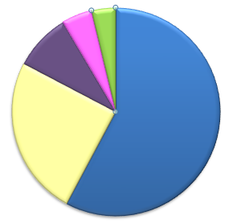

1836
2%
13
11
10%
26
73
51%
37%
170
Popular Vote
(1,498,678 Votes)
Electoral Vote
View Electoral Vote
View Popular Vote
1820
1824
1828
1832
1836
1840

Slide 53
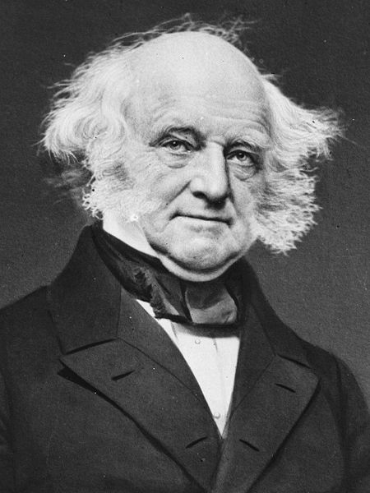
Martin Van Buren
Eighth President
(1837-1841)
DEMOCRAT
New York
The “Little Magician”
Panic of 1837
Panic of 1839
Van Buren

Slide 54
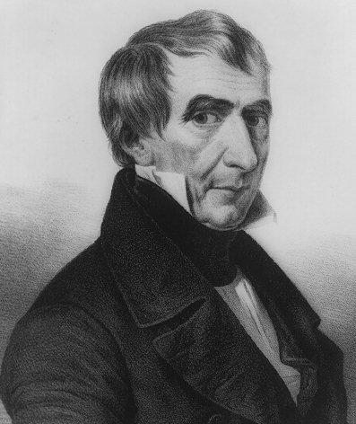
Election of 1840
Elitist Whigs Regroup
Tippecanoe and Tyler Too!
The “Log Cabin” Campaign
Whigs beat the Democrats at their own game.
William Henry
Harrison

Slide 55
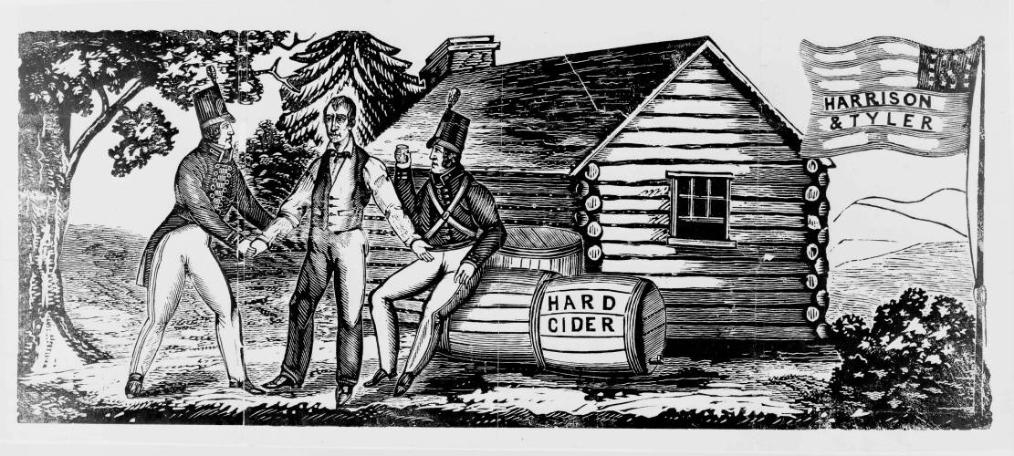
Looks like democracy…
smells like democracy…
tastes like democracy…

Slide 56
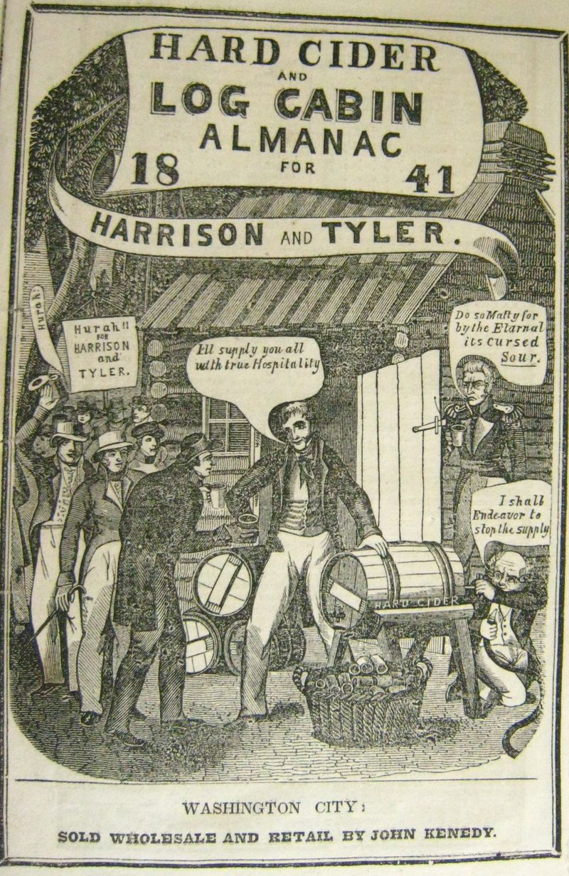
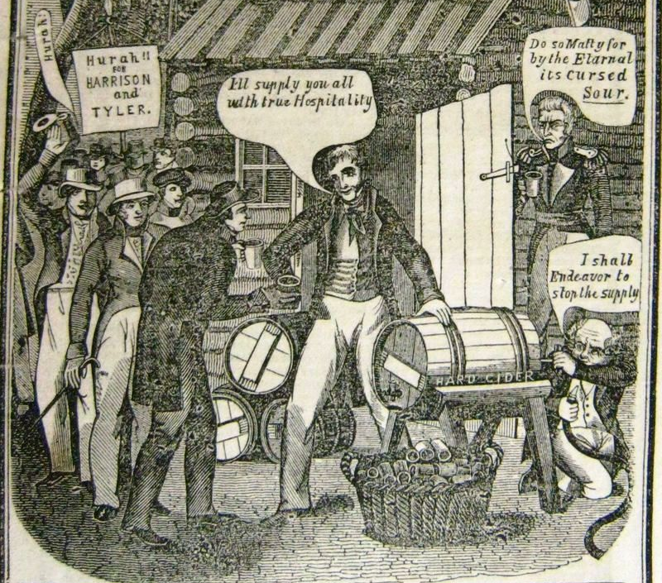

Slide 57


Slide 58



1840
73
47%
53%
234
Popular Vote
(2,411,187 Votes)
Electoral Vote
View Electoral Vote
View Popular Vote
1820
1824
1828
1832
1836
1840

Slide 59







