Slide 1
Conquest of the American West

Slide 2
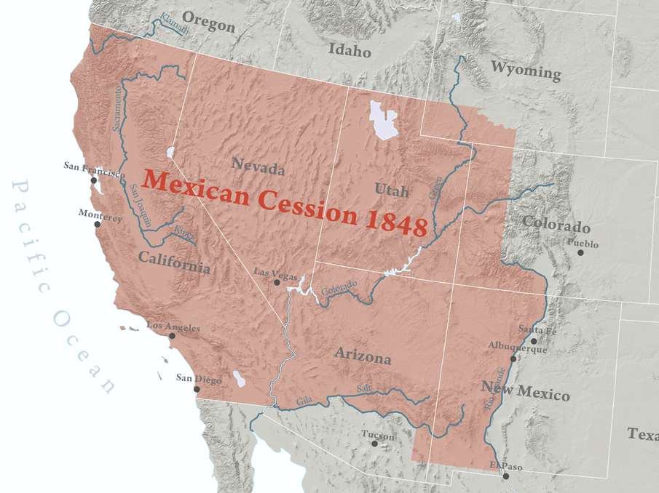
The Mexican War
Extended America’s borders to the Pacific Ocean.
Map Credit: Kballen

Slide 3
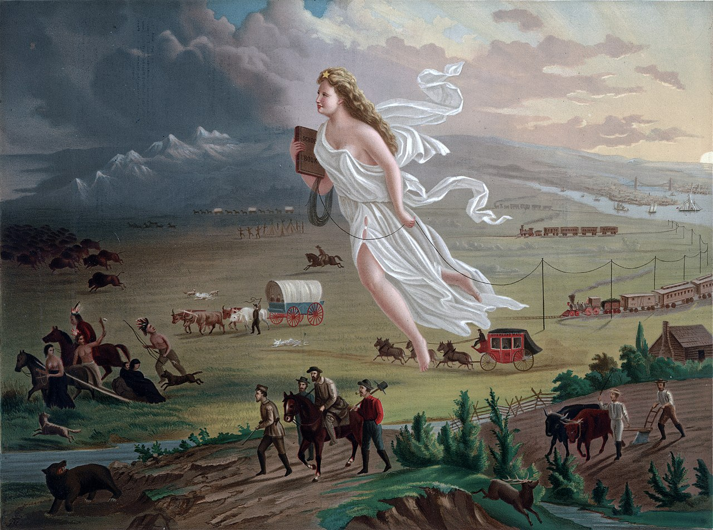
MISSION ACCOMPLISHED

Slide 4
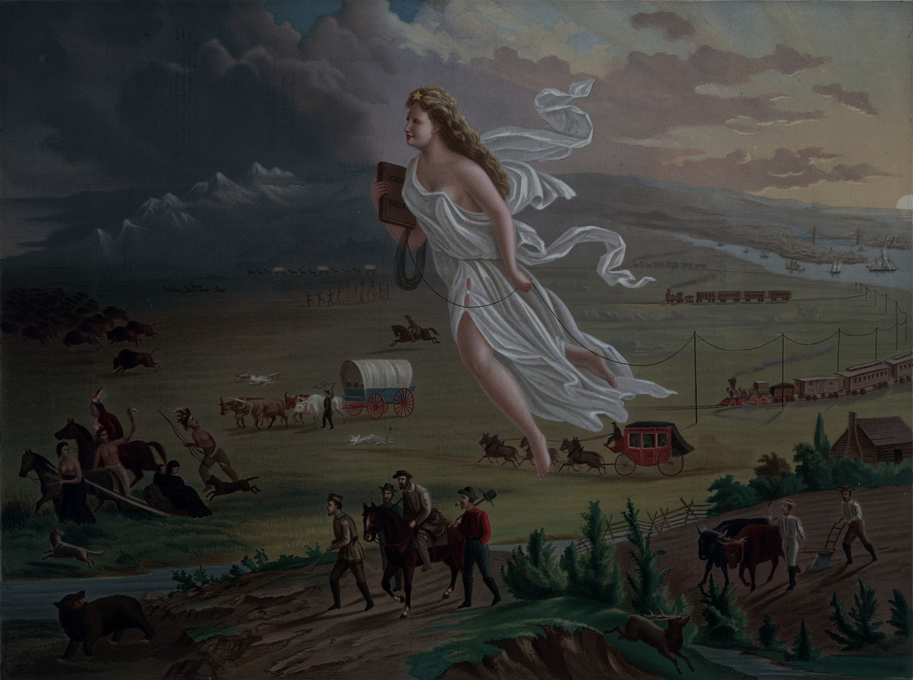
NOT QUITE

Slide 5
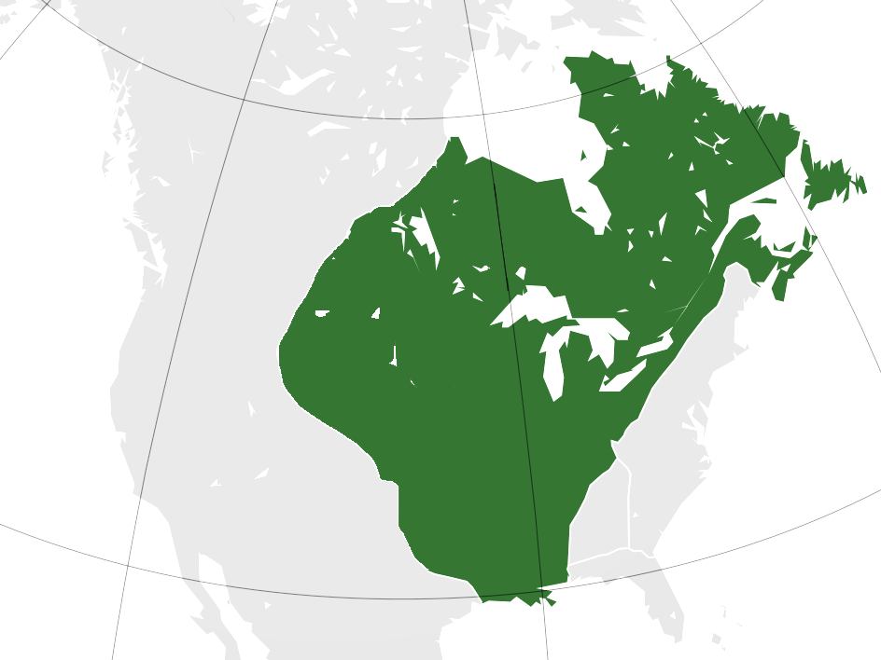
New France
1534–1760
Territory is of no use if no one lives there!

Slide 6
Conquering the West
Free Land
Railroads
Military Force

Slide 7
FREE LAND

Slide 8
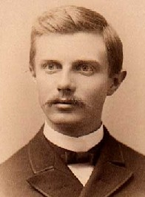
FREE LAND
“The most significant thing about the American frontier is, that it lies at the hither edge of free land.”
-- Frederick Jackson Turner
Historian

Slide 9
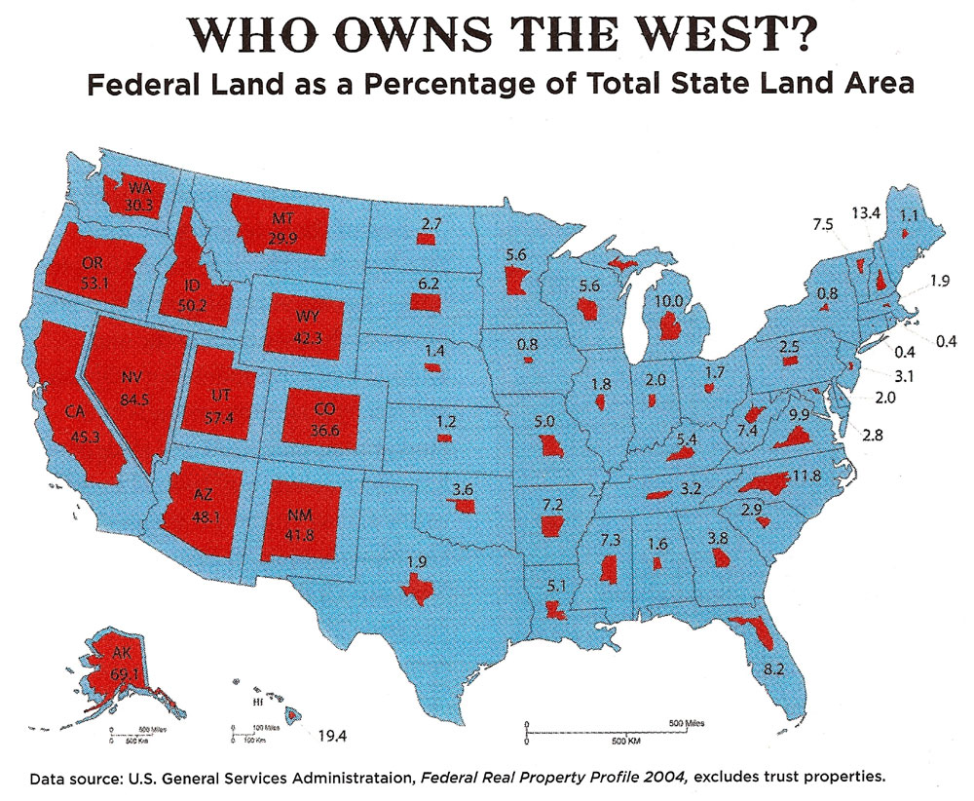

Slide 10
LOTS
of Federal Land

Slide 11
Homestead Act
Morrill Land Grant Act
Dawes Act

Slide 12
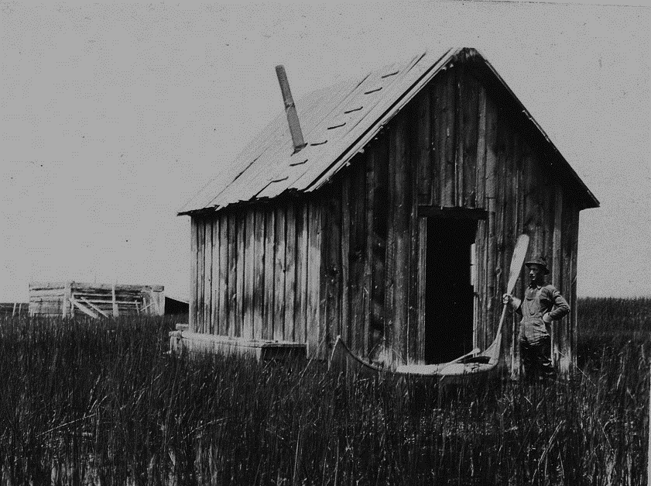
HOMESTEADS

Slide 13
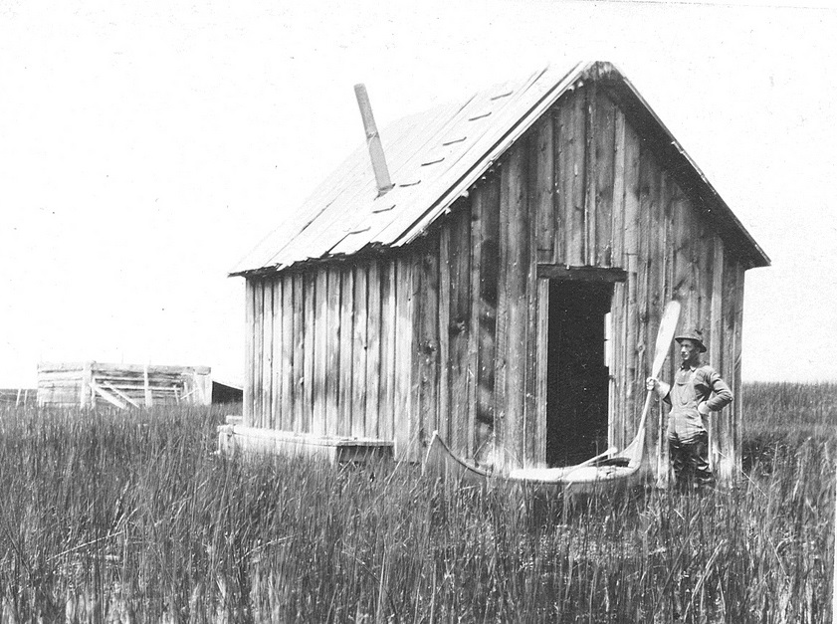
Homestead Act
(1862)
160 Acre homesteads for small farmers
Some rights reserved by USFWS Headquarters

Slide 14
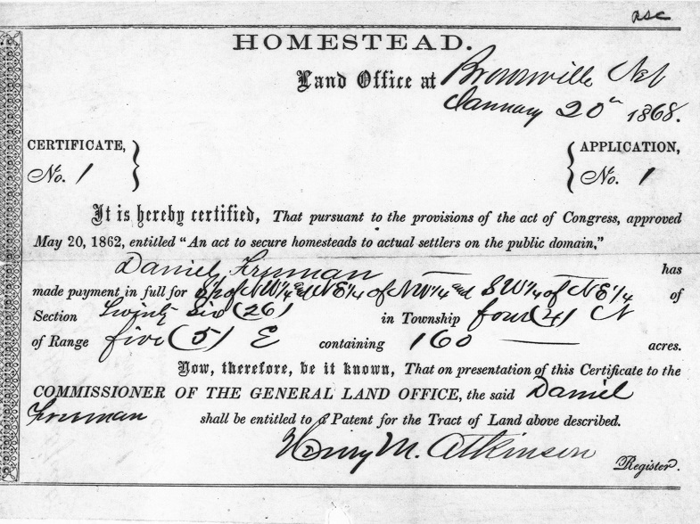

Slide 15
600,000 Families
Map Credit: Golbez

Slide 16
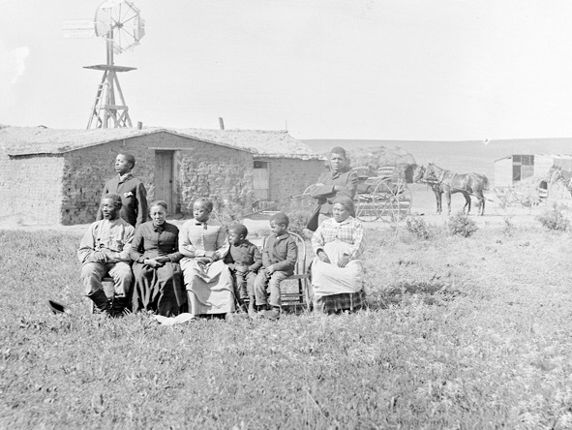
“EXODUSTERS”
Thousands of black American families left the South after the failure of Radical Reconstruction, establishing homesteads in Kansas and other Western states...

Slide 17
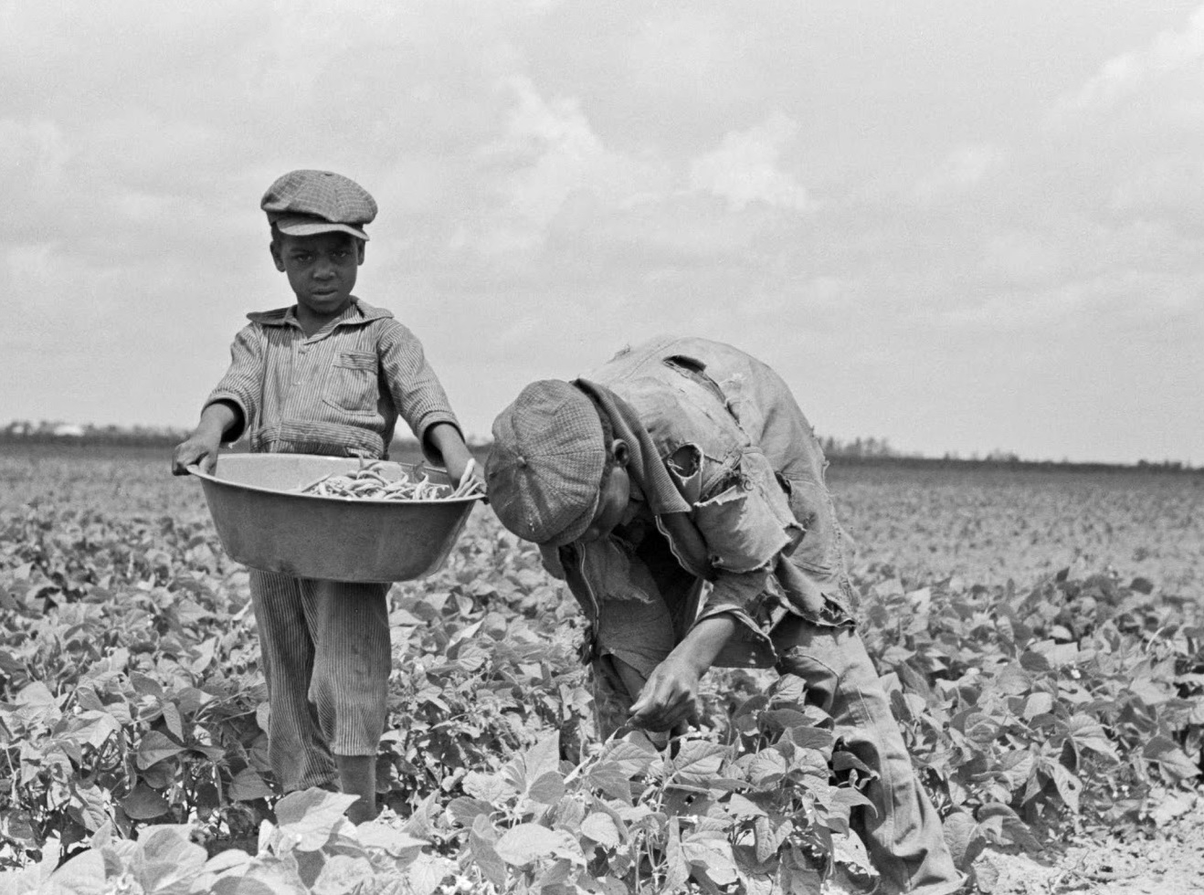
But most Black Americans stayed in the South...

Slide 18
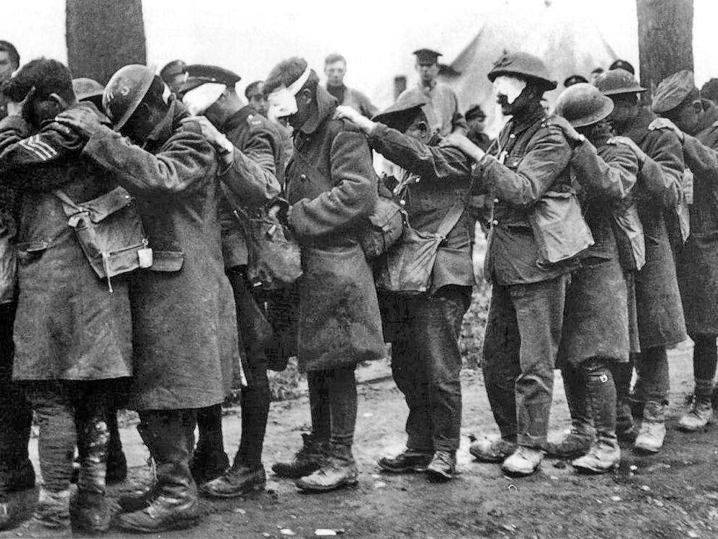
UNTIL WORLD WAR I

Slide 19
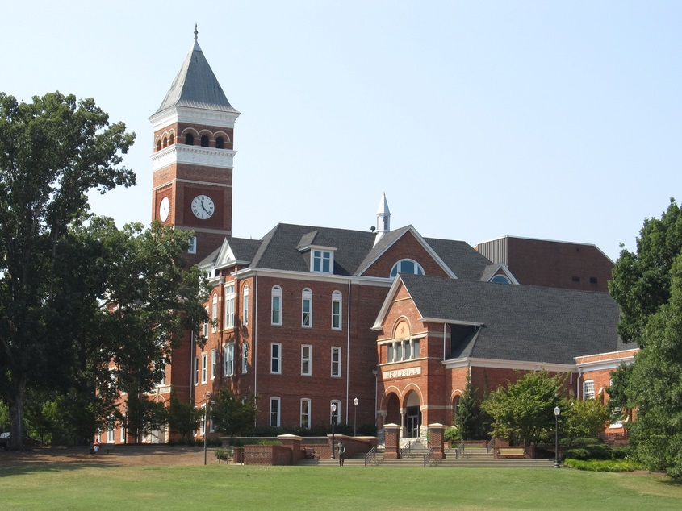
Morrill land grant act
(1862)
Some rights reserved by Ken Lund

Slide 20
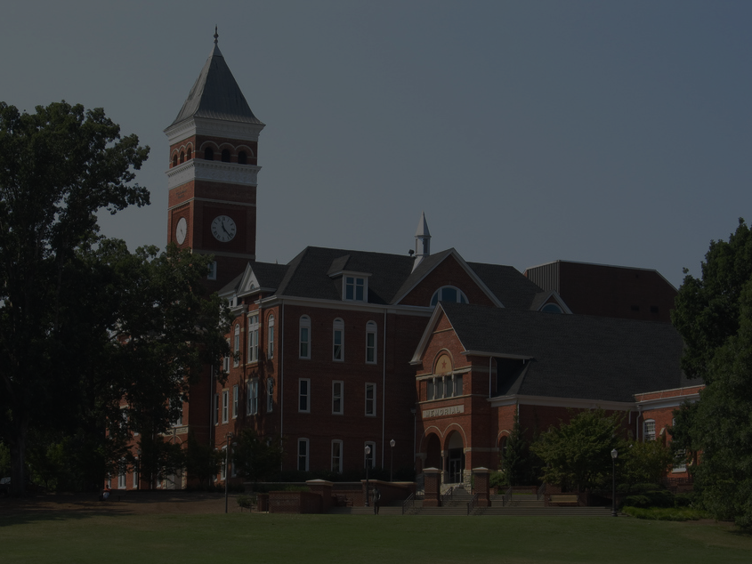
Morrill land grant act
(1862)
Federal lands sold to create colleges dedicated primarily to the study of agriculture, Mechanical arts, & Military tactics.
A&M
Agricultural & Mechanical
Some rights reserved by Ken Lund

Slide 21
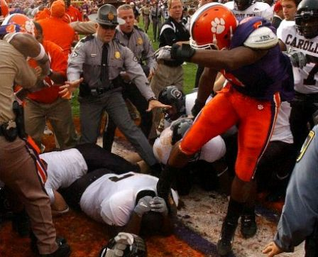
MILITARY TACTICS

Slide 22
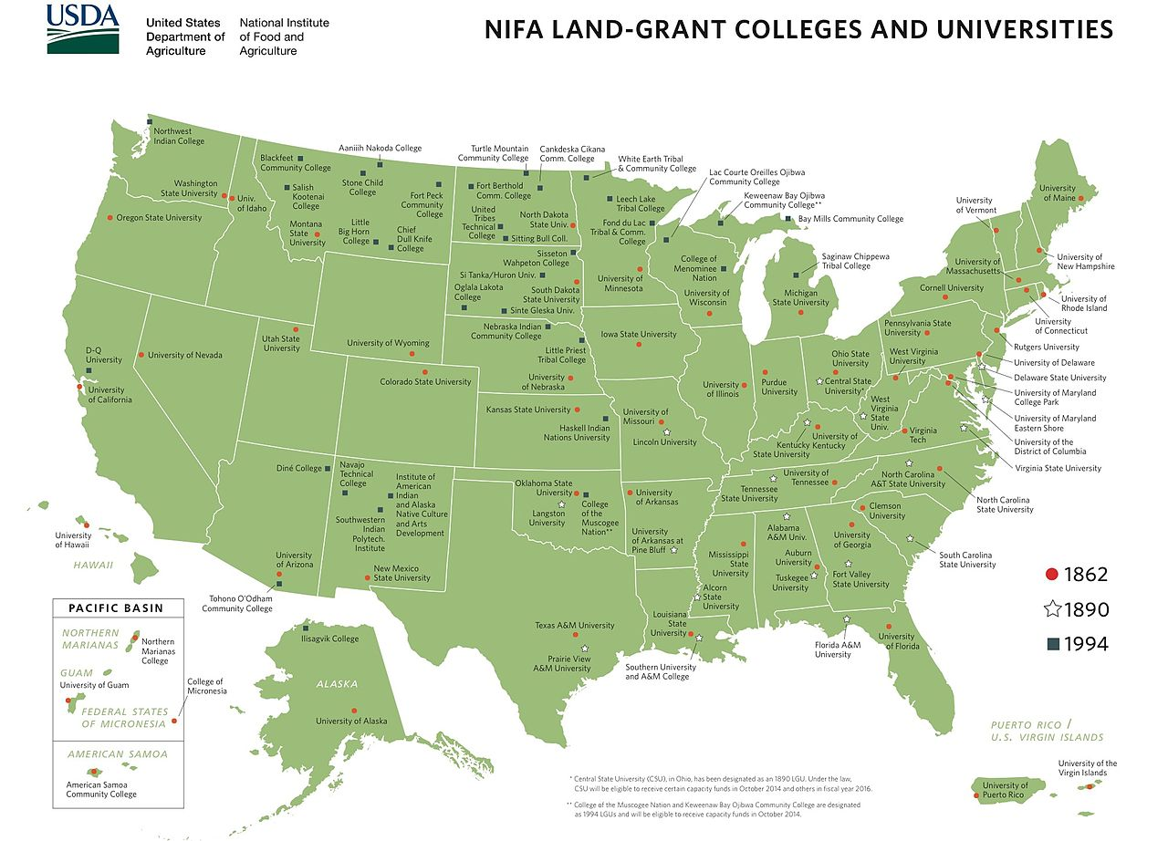

Slide 23
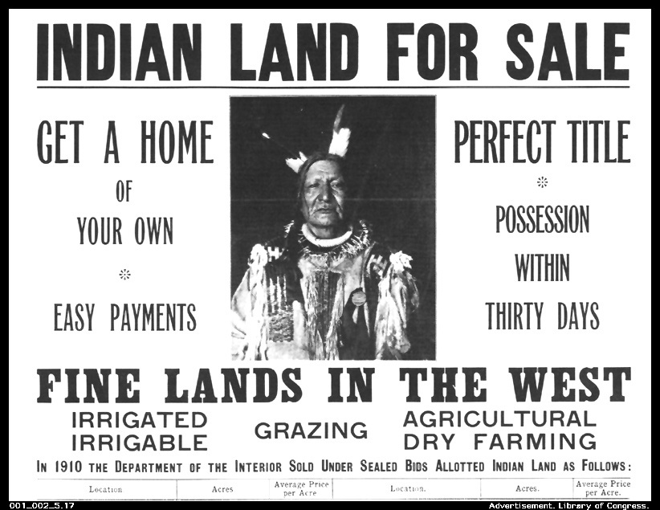

Slide 24
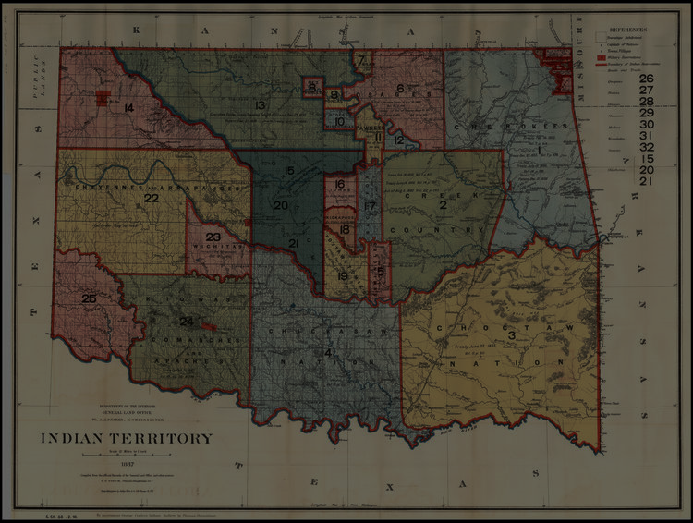
Dawes Act
(1887)
Reservations were broken up and tribal lands were distributed to individual Indian families.

Slide 25
Dawes Act
(1887)
Surplus lands in Indian Territory were opened to white settlement.

Slide 26
Oklahoma Land Rush
April 22, 1889

Slide 27
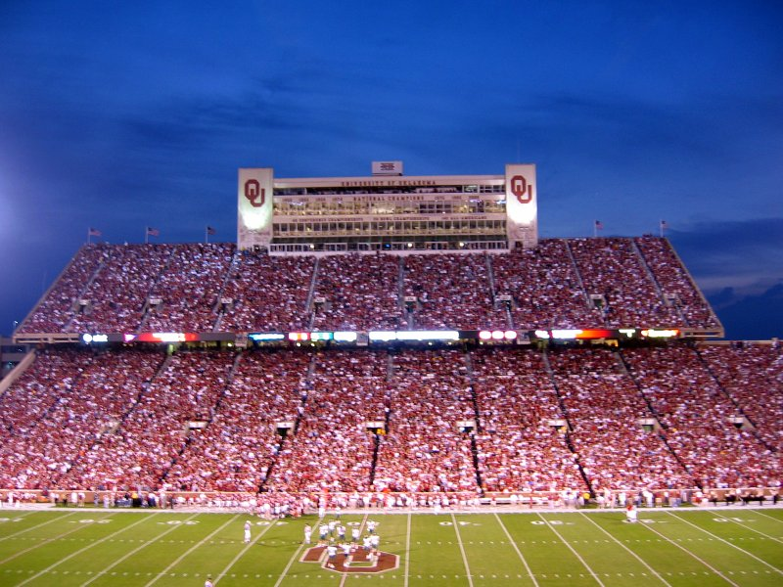
SOONERS
Some didn’t want to wait until April 22...
Some rights reserved by allisonmeier

Slide 28
THE SOONER STATE
Some rights reserved by allisonmeier

Slide 29
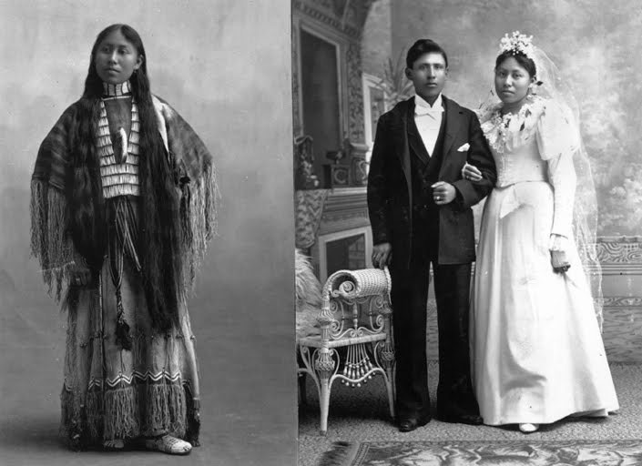
GOAL: ASSIMILATION

Slide 30
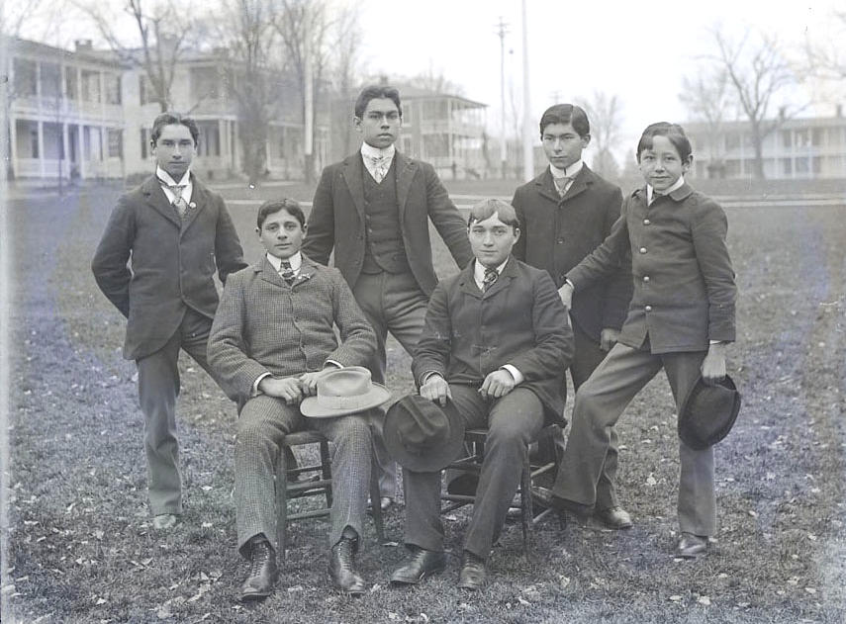
Carlisle Indian School (PA), 1879-1918

Slide 31
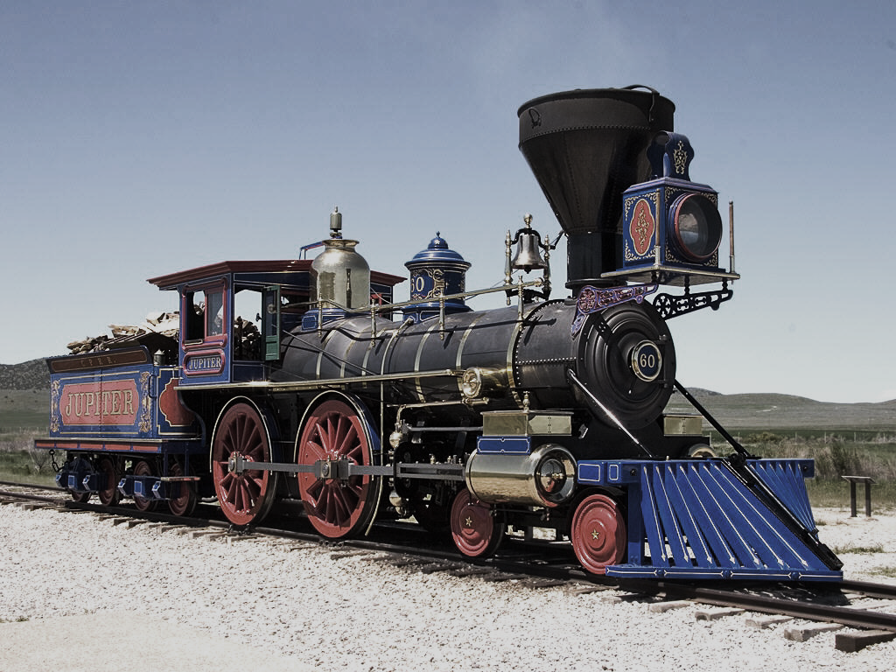
Transcontinental Railroads
Photo Credit: Mr Snrub

Slide 32
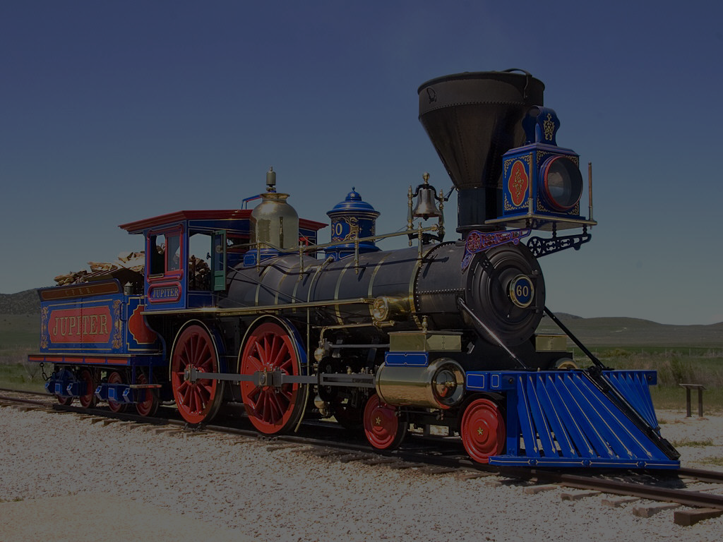
ESSENTIAL QUESTIONS
Why did the U.S. government subsidize the construction of transcontinental railroads?
What were the advantages and disadvantages of government action?
Photo Credit: Mr Snrub

Slide 33
The U.S. in 1860
Map Credit: Golbez

Slide 34
How do we create a national market?
Map Credit: Golbez

Slide 35
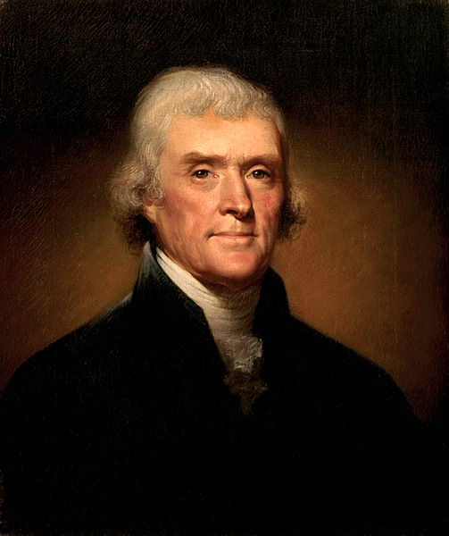
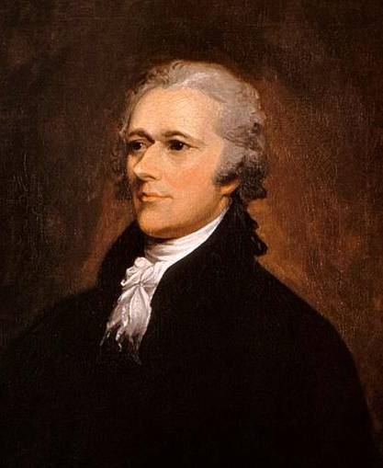
How Are Marketplaces Created?
Jefferson
Laissez-faire
The market will develop on its own.
Hamilton
Government Action
Government needs to assist.

Slide 36
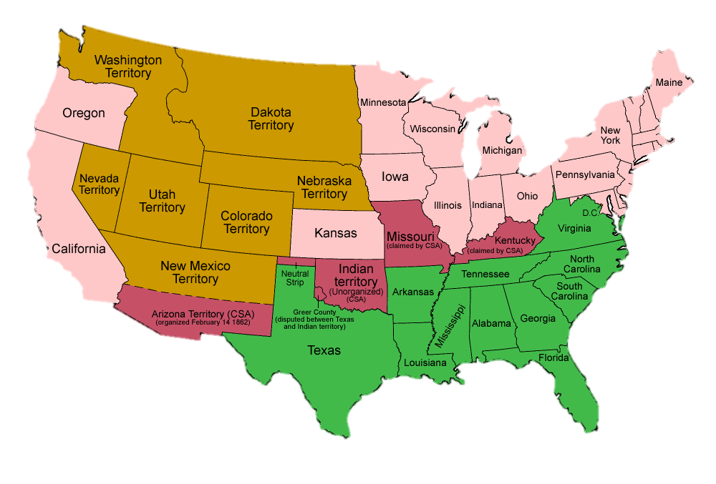
EXIT JEFFERSONIANS
1860-1861
PEACE OUT!
Map Credit: Golbez

Slide 37
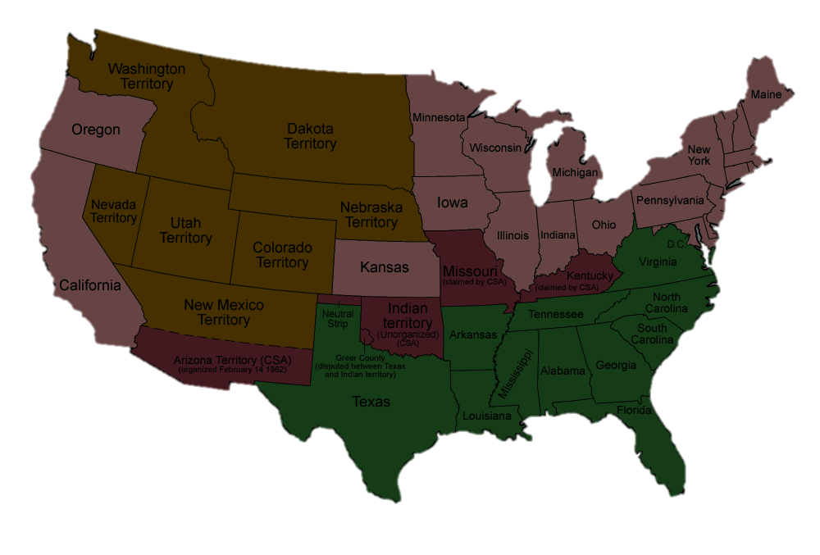
Secession A Hamiltonian Triumph
Secession created a large Republican majority in Congress that was friendly to government intervention in the economy.

Slide 38
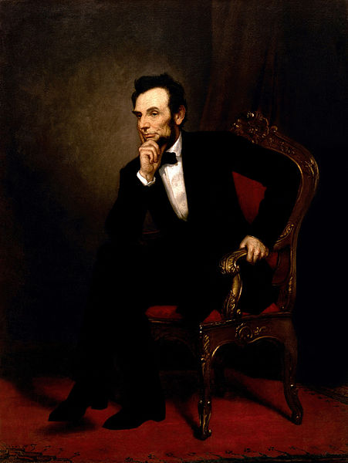
The Party of Lincoln
Free Soil
Industry
Big Business

Slide 39
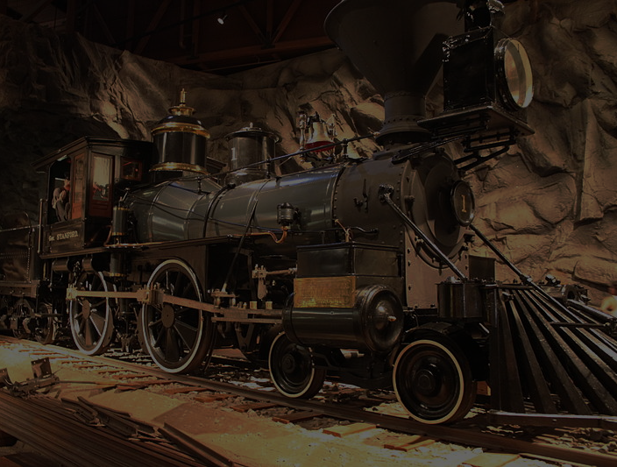
PACIFIC Railroad ACT
1862
Government subsidies for corporations constructing railroads
Photo by BenFranske

Slide 40
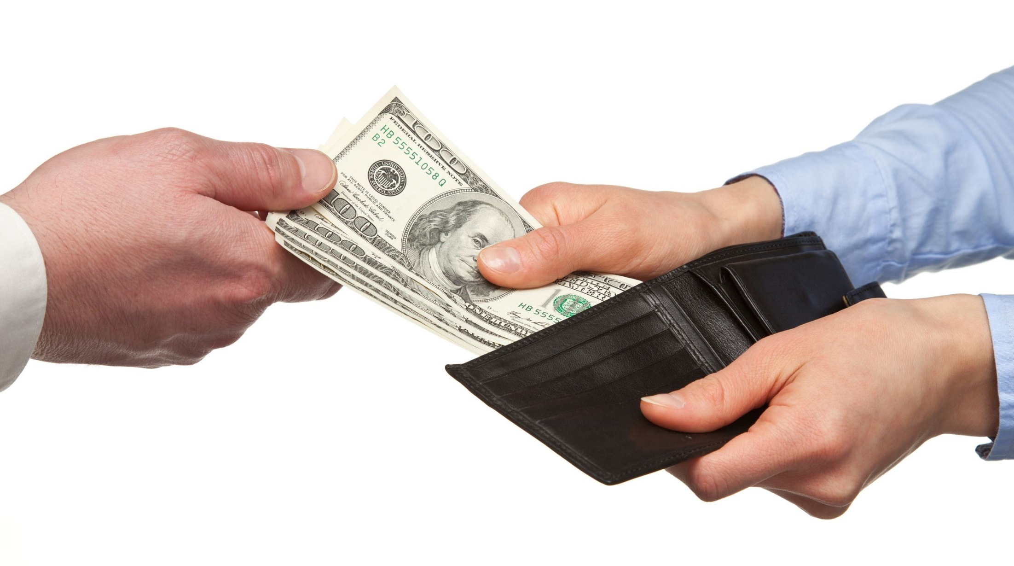
SUBSIDIES
Financial incentives from authorities intended to encourage desired outcomes

Slide 41
PACIFIC Railroad ACT
1st
1862
This marked the first time that the federal government had given money directly to corporations for internal improvements.
Photo by BenFranske

Slide 42
LOTS
of Federal Land

Slide 43
Federal Land Grants
Subsidies
Square mile held or sold by government
CHECKERBOARD PATTERN
Square mile granted to the railroad company
Some rights reserved by Brett Jordan

Slide 44
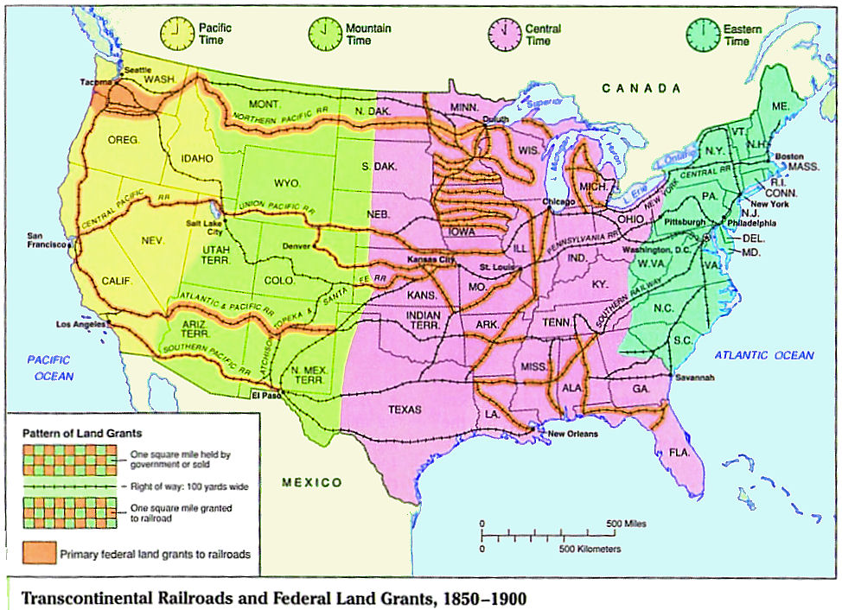
The federal government subsidized several Transcontinental railroads with Land Grants

Slide 45
The First Transcontinental Railroad
Central Pacific RR
http://1.bp.blogspot.com
Union Pacific RR

Slide 46
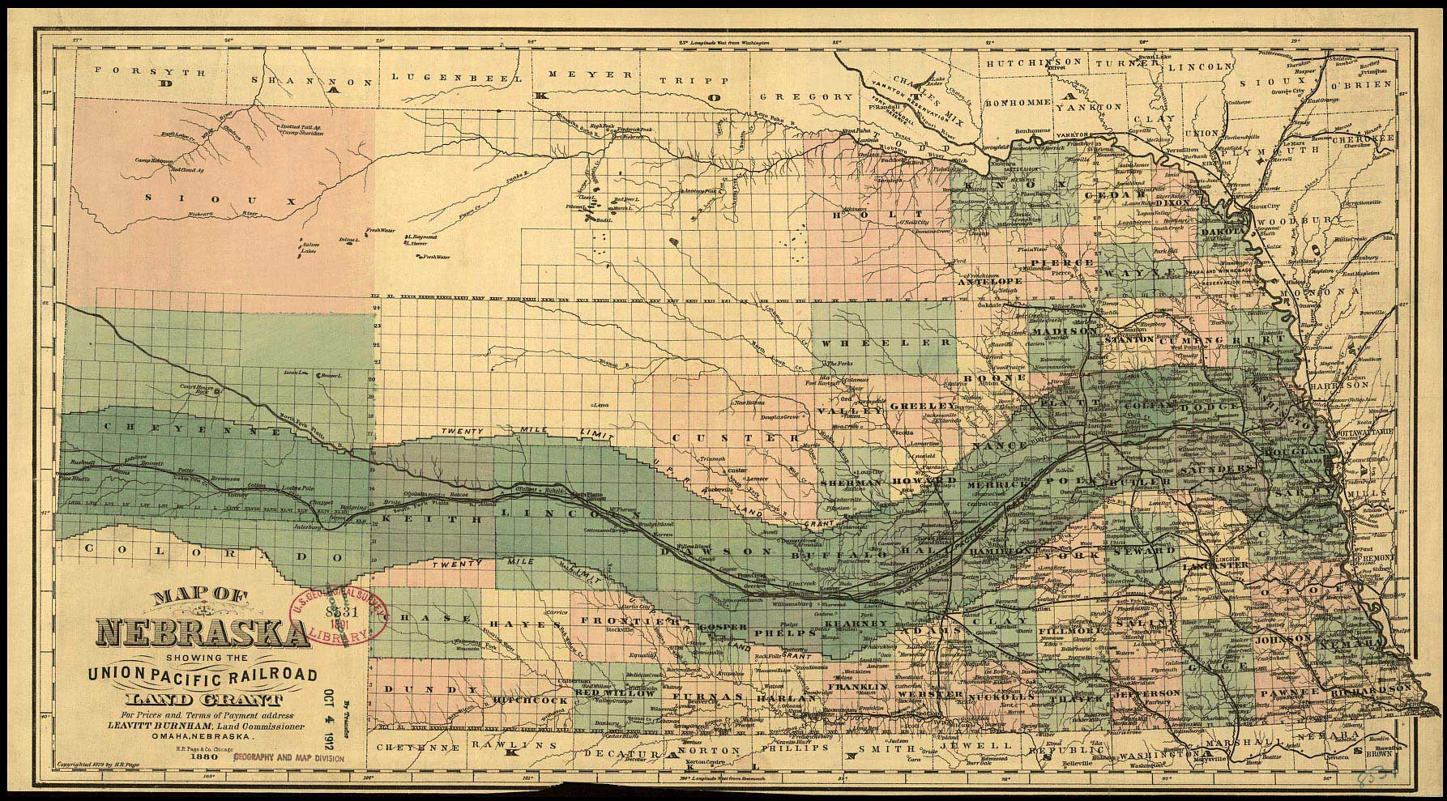
Indirect routes
More Miles = More Money

Slide 47
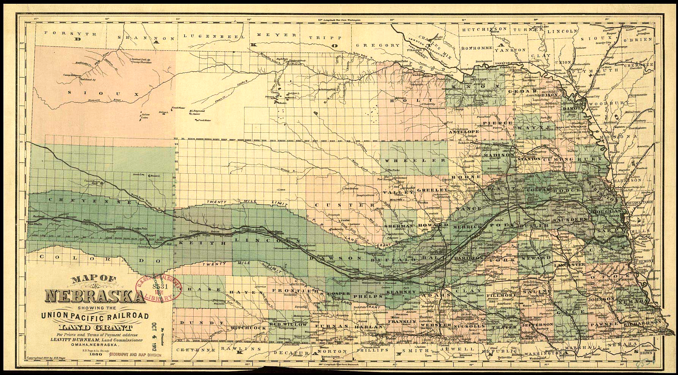
POINT a
POINT B

Slide 48
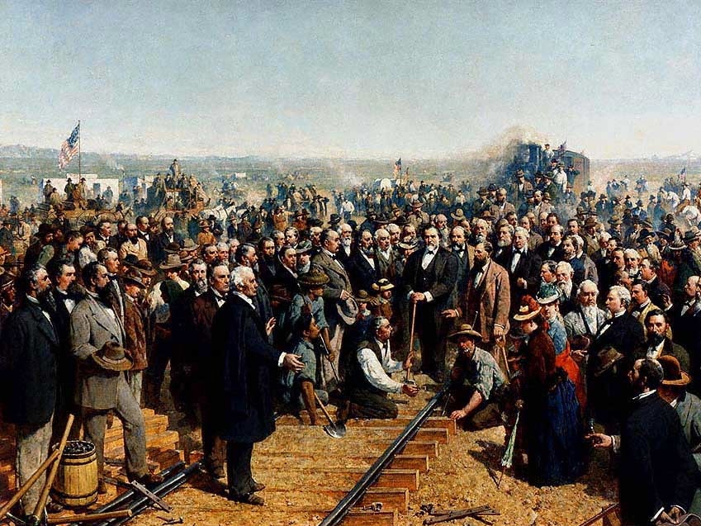
The Golden Spike
1869
Promontory Point, Utah

Slide 49
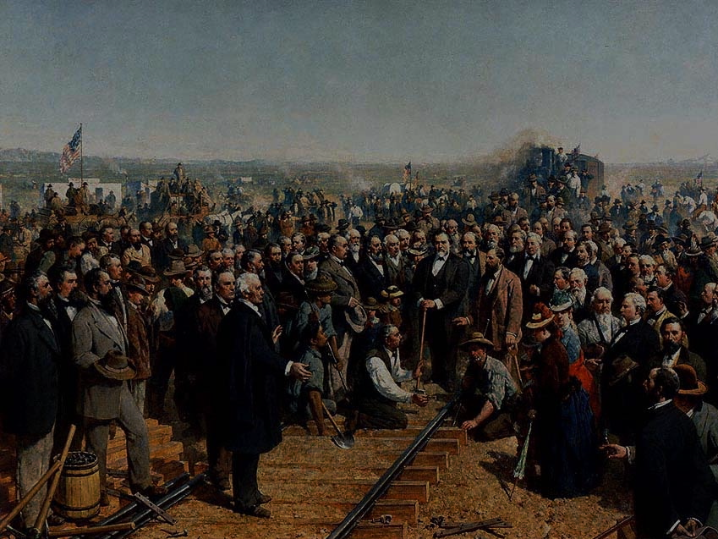
THAT WAS FAST!

Slide 50
But at what price?

Slide 51
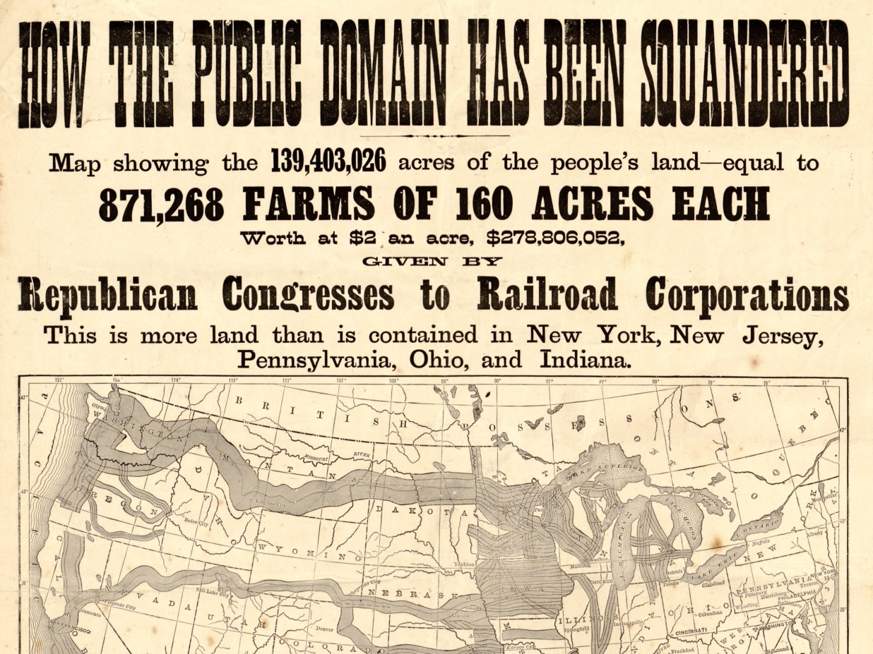

Slide 52
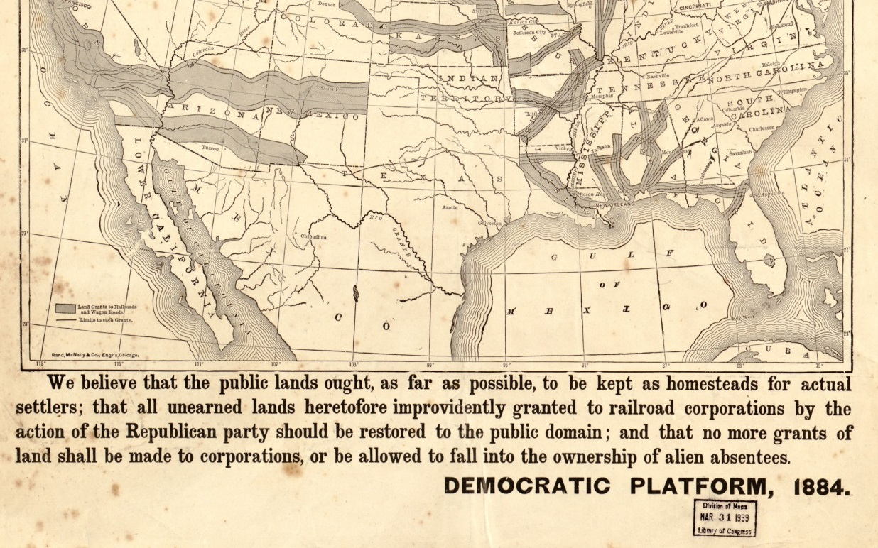
Doc Butler's US History Website

Slide 53
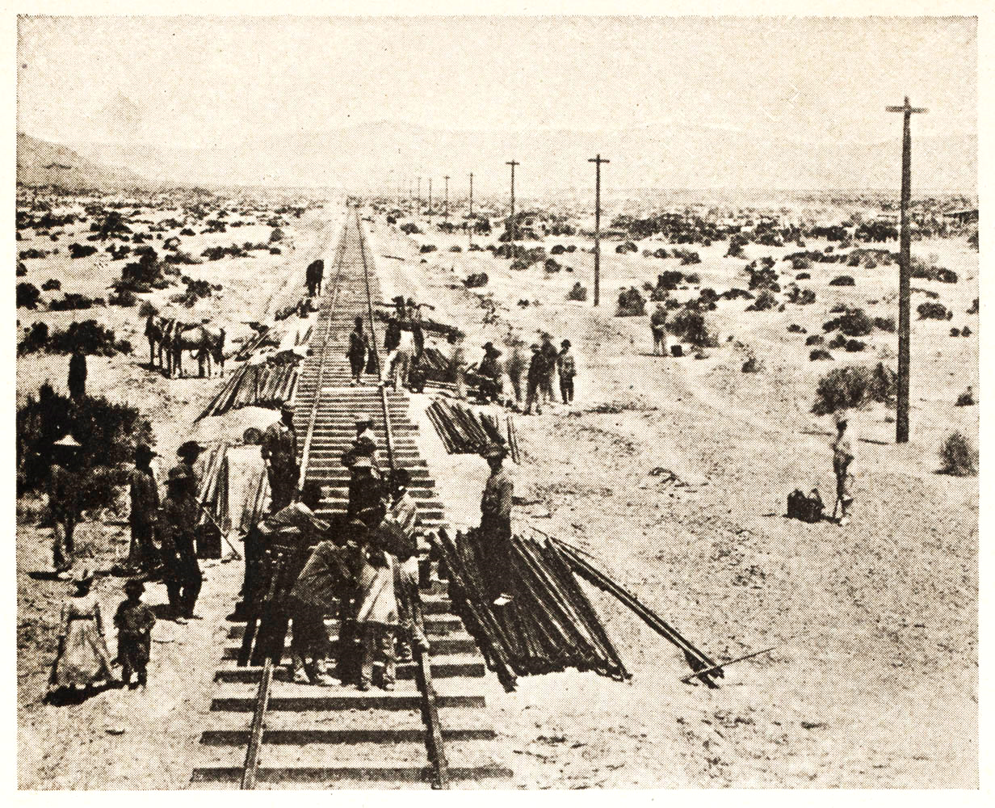
Credit Mobilier Scandal
A Union Pacific executive created a RR construction company to defraud the government.

Slide 54
Gov. Subsidies
UNION PACIFIC
Credit mobilier

Slide 55
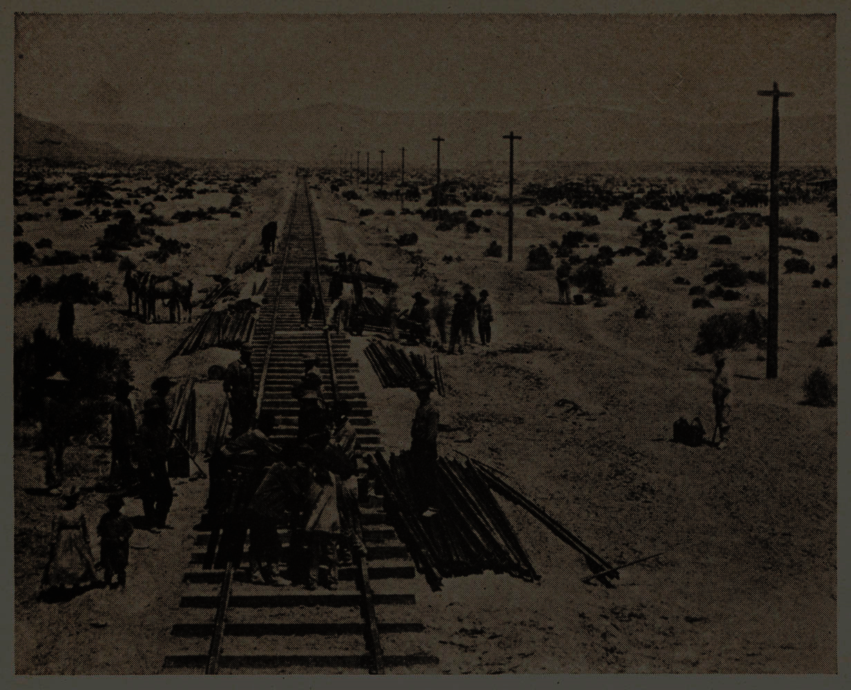
Gov. Subsidies
The Union Pacific executive used THE PEOPLE’S money to pay HIMSELF
UNION PACIFIC
Credit mobilier
More Info

Slide 56
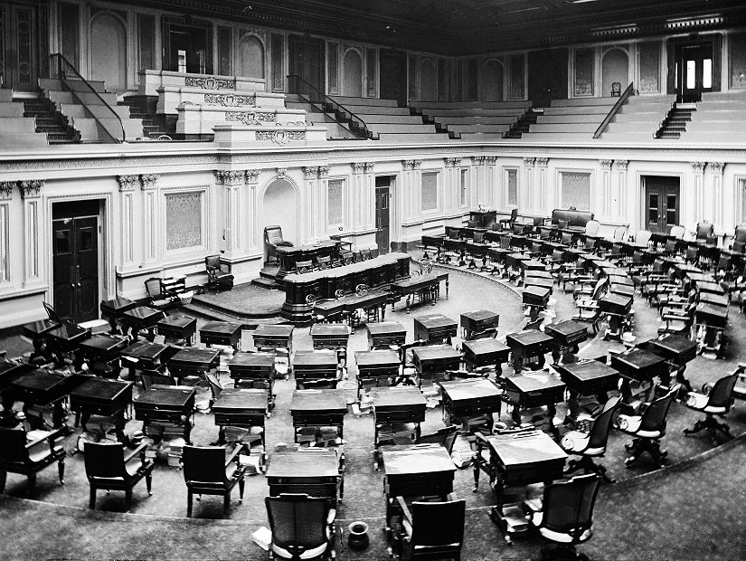
WHERE IS CONGRESS?

Slide 57
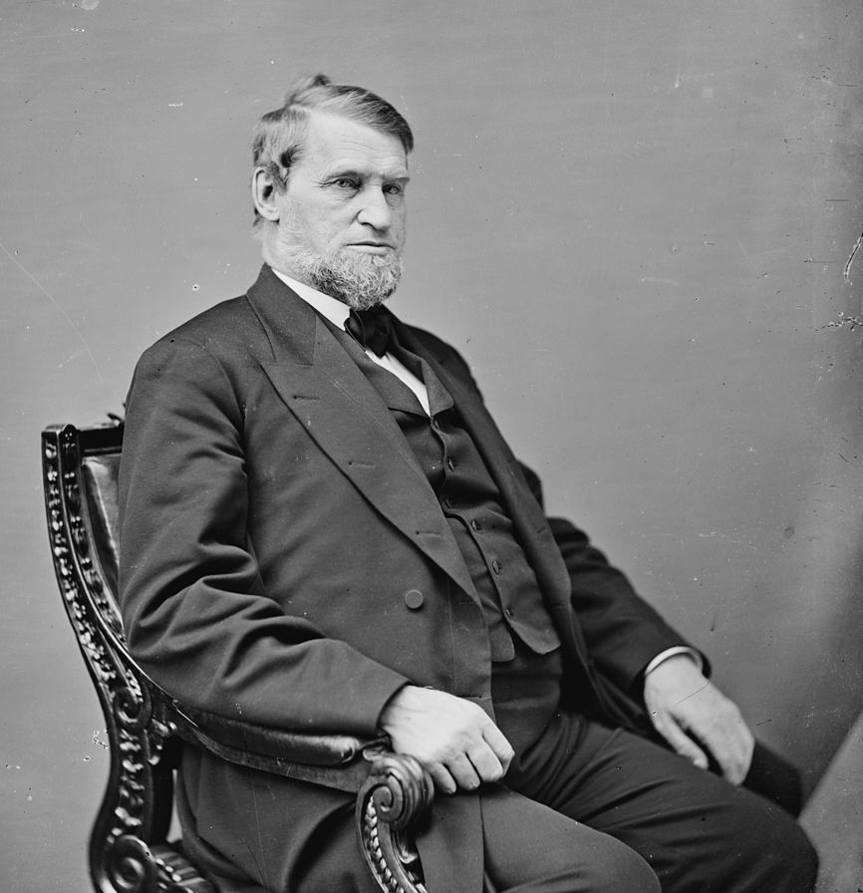
In my POCKET!
Rep. Oakes Ames (R-MA)

Slide 58
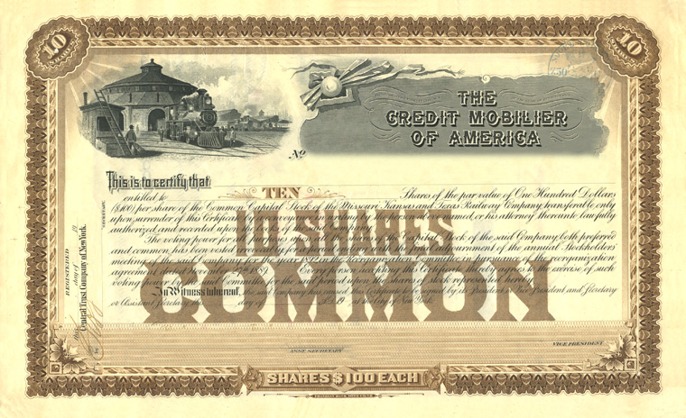
Ames gave shares of Credit Mobilier stock to several members of Congress.

Slide 59
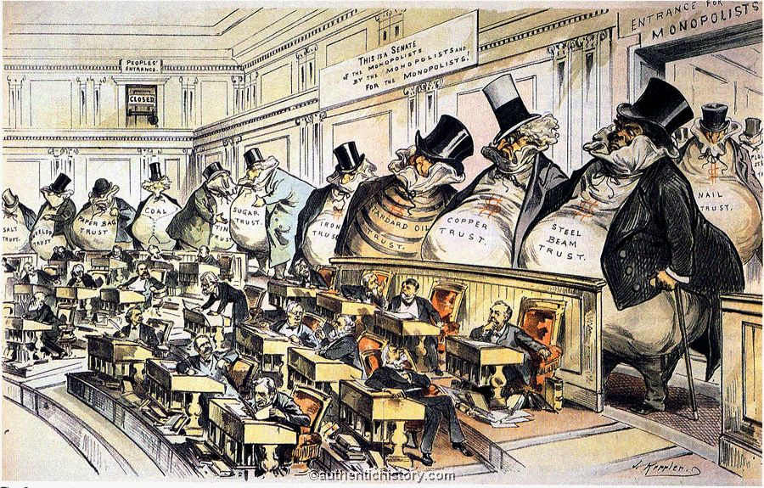
The Public Perception

Slide 60
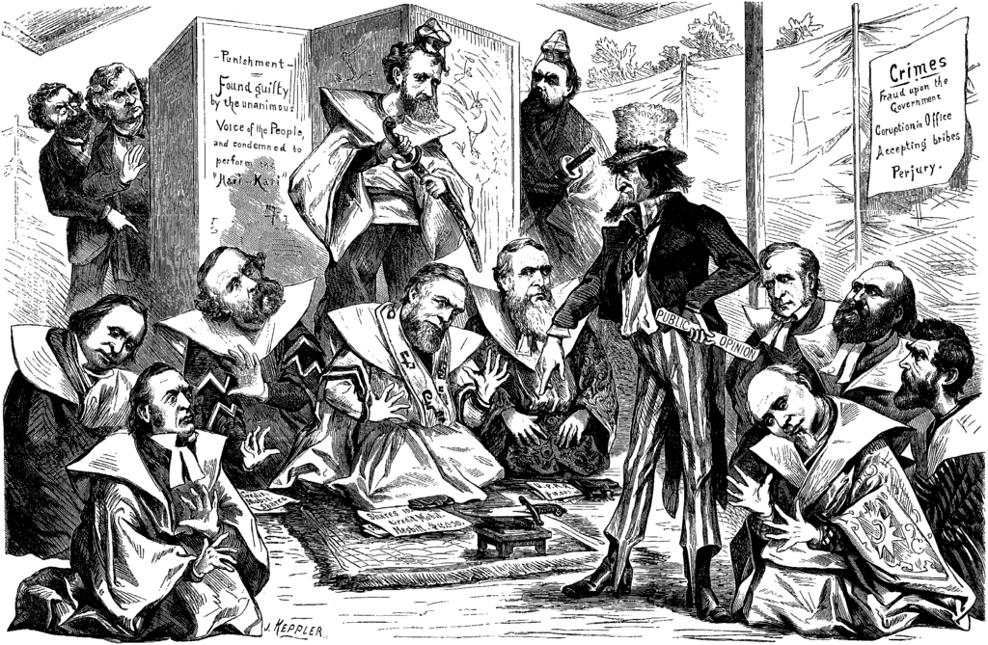

Slide 61
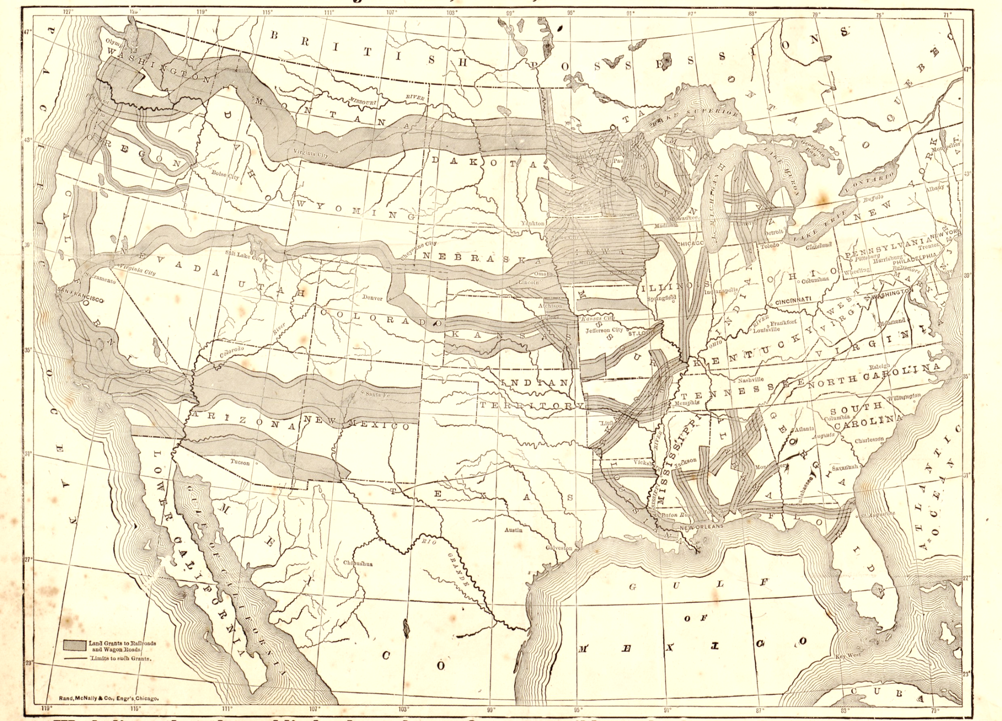
Should the Government subsidize Corporations?

Slide 62
CRONY CAPITALISM
Some rights reserved by tourist_on_earth

Slide 63
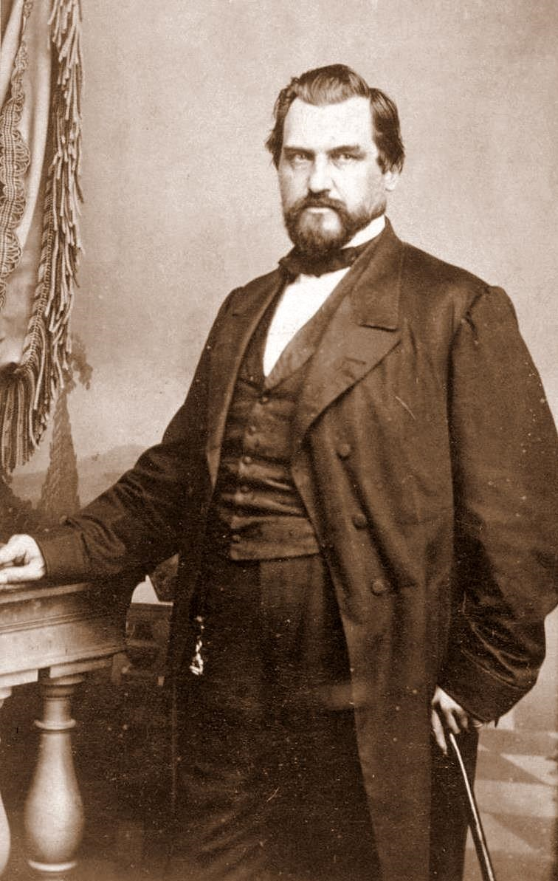
Leland Stanford
Governor of California
President
Central Pacific Railroad

Slide 64
Stanford used his political influence to gain advantages in the marketplace.

Slide 65
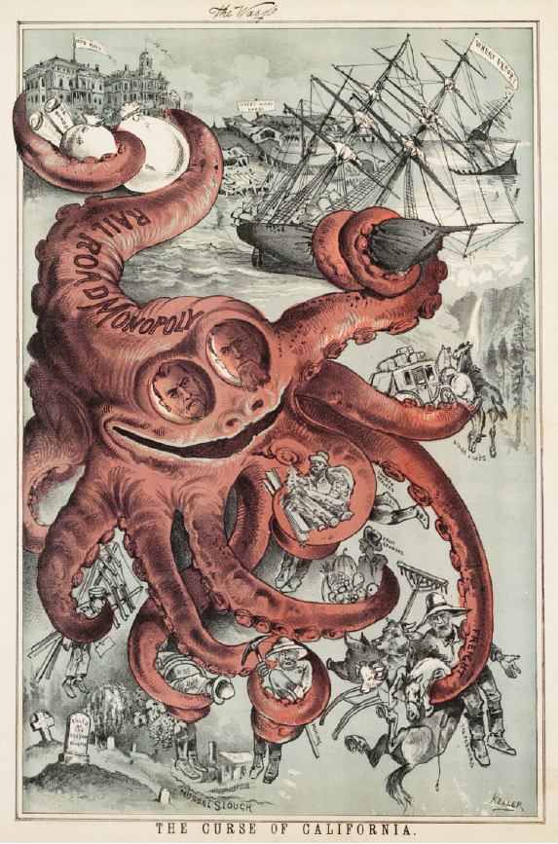
Californians chafed under the influence of the Railroad Monopolies

Slide 66
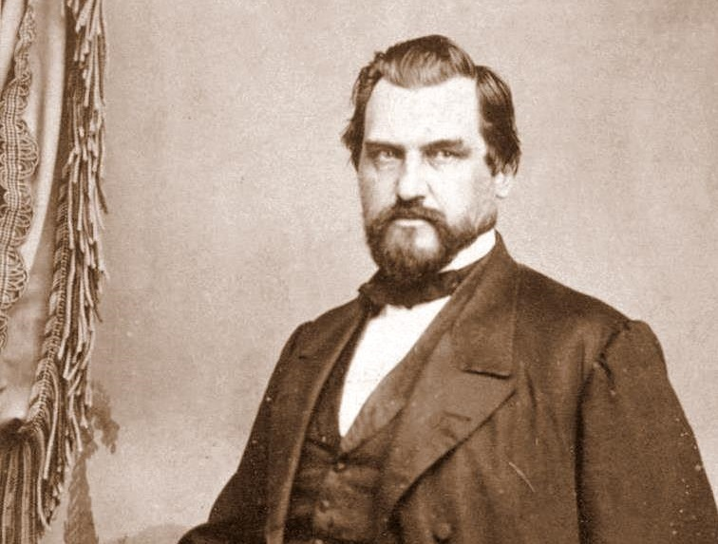
MONOPOLIST

Slide 67
But I founded an awesome university, so it’s cool.

Slide 68
There’s a BETTER way!

Slide 69
James J. HILL
Great northern railroad

Slide 70
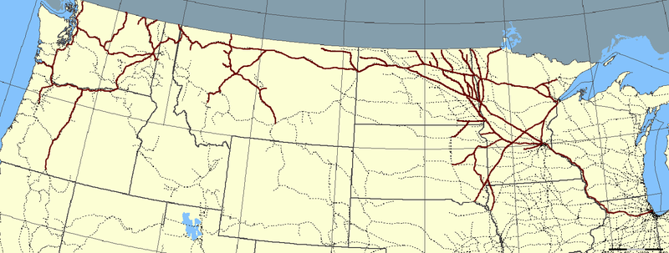
The Great Northern Railroad
Map Credit: Elkman
Hill built one of the most profitable and successful transcontinental railroads in the United States.

Slide 71
WITHOUT
http://www.trinityhistory.org/AmH/images/04.rrlandgrants.jpg
LAND GRANTS

Slide 72
James J. HILL
The “empire builder”

Slide 73
Hill built a profitable and efficient railroad exclusively through PRIVATE INVESTMENT

Slide 74
When the subsidized railroads went bankrupt in the 1890s...

Slide 75
HIS DIDN’T

Slide 76
Were Subsidies NECESSARY?

Slide 77
Were Subsidies NECESSARY?
Were they PROPER?

Slide 78
Interstate Commerce Commission
Founded in 1887 to regulate the railroad industry
First “fourth-branch” independent regulatory agency
Not directly responsible to the president

Slide 79
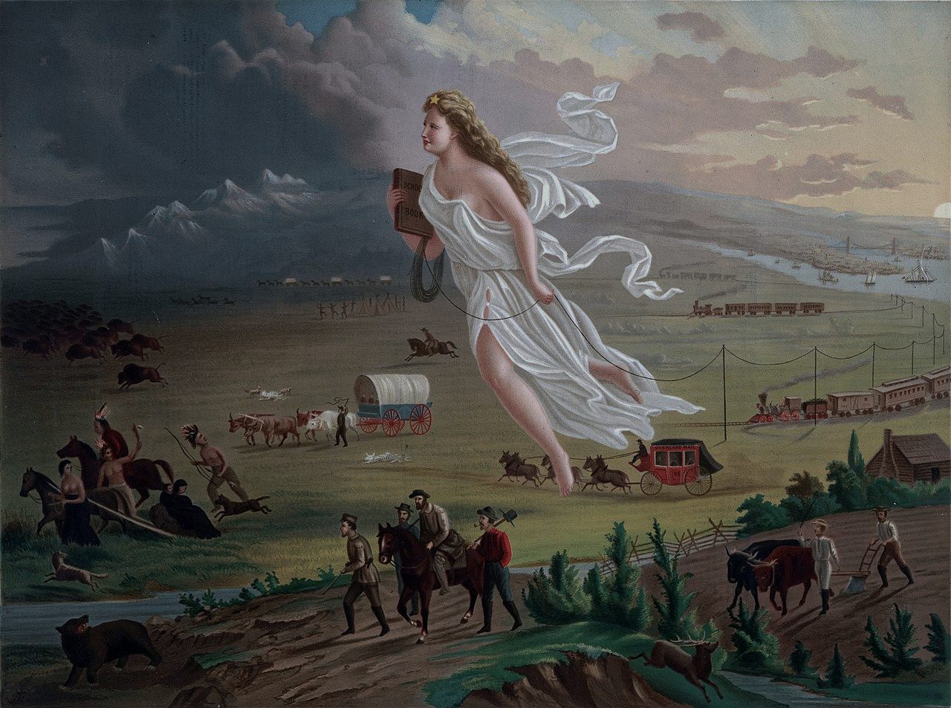
There’s still stuff in my way!

Slide 80
If this car were a train...
Some rights reserved by Seth W.

Slide 81
This just isn’t going to work...

Slide 82
BYE, SON!
Some rights reserved by viralbus

Slide 83
BUFFALO BILL CODY
As a young man, “Buffalo Bill” contracted with railroads to provide bison meat to workers.

Slide 84
Prior to 1870, MILLIONS of bison roamed the Great Plains.

Slide 85
By 1900, they were nearly EXTINCT.

Slide 86
Plains Indians
The extermination of the buffalo made it impossible for the Plains Indians to continue their way of life.

Slide 87
The Indians were also in the way

Slide 88
GOLD CLAIMS in the U.S.

Slide 89
THE INDIAN WARS

Slide 90
Final Solution
Gen. William T. Sherman used this phrase decades before Hitler.

Slide 91
“Hostilities between the races will continue till the Indians are all killed or taken to a Country where they can be watched.”
William T. Sherman
June 10, 1867

Slide 92
Custer’s “Last Stand”
Battle of the Little Bighorn (Montana - 1876)

Slide 93
Custer was celebrated by several generations as an American hero.
Some rights reserved by puuikibeach

Slide 94
U.S. ARMY Memorial
Erected 1881

Slide 95
Indian Memorial
Erected 2003
Some rights reserved by Nomadic Lass

Slide 96
Sherman rightly predicted that the transcontinental railroads would undermine the Plains Indians’ way of life in a way that the U.S. Army couldn’t.
Some rights reserved by SG_Design

Slide 97
By 1890, all tribes had been placed on reservations
Some rights reserved by SG_Design

Slide 98
Apache Wars
1849-1886
Last Tribe to offer armed resistance to the U.S.
Geronimo

Slide 99
COCHISE STRONGHOLD
Dragoon Mountains (Arizona)

Slide 100
A Century of Dishonor
(1888)
Helen Hunt Jackson’s chronicle of abuses and deprivations on Native American reservations
Jackson

Slide 101
Wounded Knee Massacre
1890
The last armed conflict between the U.S. Army and Native Americans

Slide 102
genocide

Slide 103
End of an era
“Never again will such gifts of free land offer themselves... Now, four centuries from the discovery of America... the frontier has gone, and with its going has closed the first period of American history.”
-- Frederick Jackson Turner

Slide 104
MISSION ACCOMPLISHED

Slide 105
Homesteads

Slide 106
Homesteads
RAILROADS

Slide 107
Homesteads
RAILROADS
WARFARE

Slide 108
MANIFEST DESTINY

