Slide 1
Hominids and the Stone Age
A Survey of Prehistoric Man

Slide 2
Essential Questions
?
What are the origins of humanity?
Why do humans depend on technology?
What are the elements of civilization?

Slide 3
What are the Origins of Humanity?

Slide 4
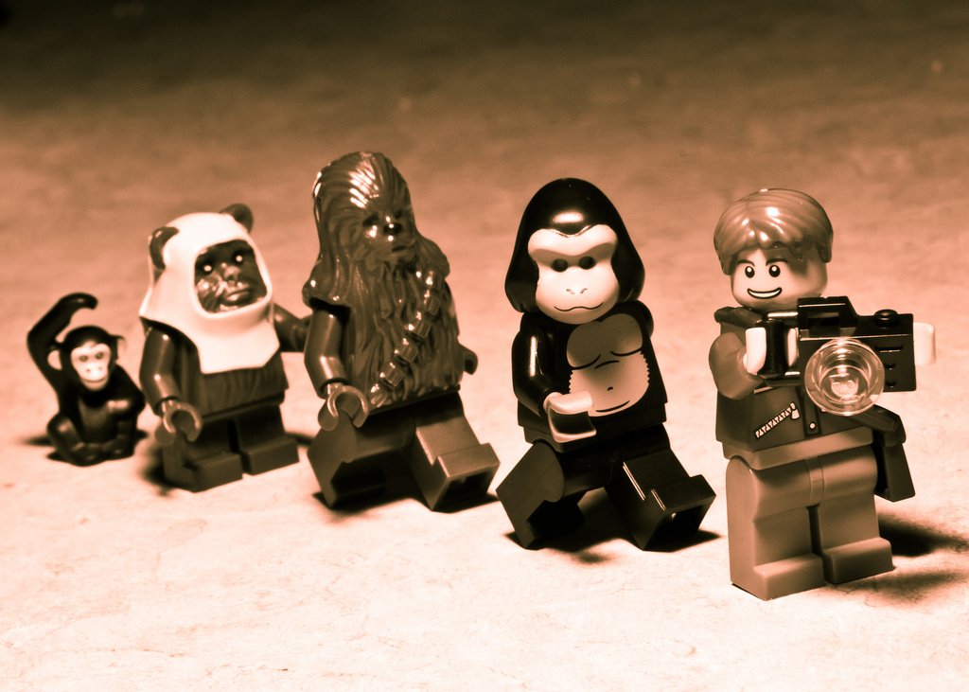
Science offers explanations...
Photo by Federico Aranda
Used with Permission

Slide 5
As does religion...

Slide 6
But do we KNOW?

Slide 7
NO

Slide 8
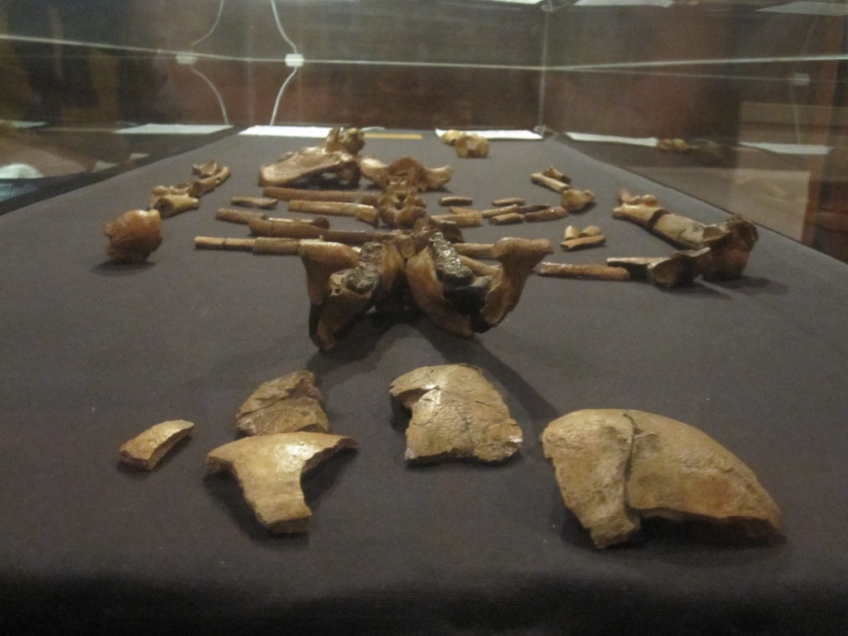
3.7 Million Years Old
Photo by Le Grand Portage

Slide 9
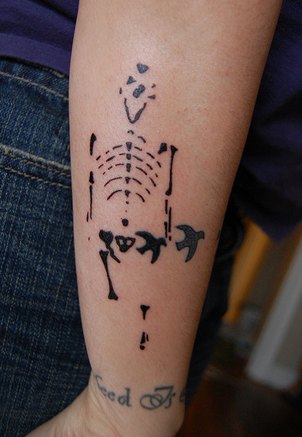
GREAT ODIN’s Raven!
Photo by arbuford24

Slide 10
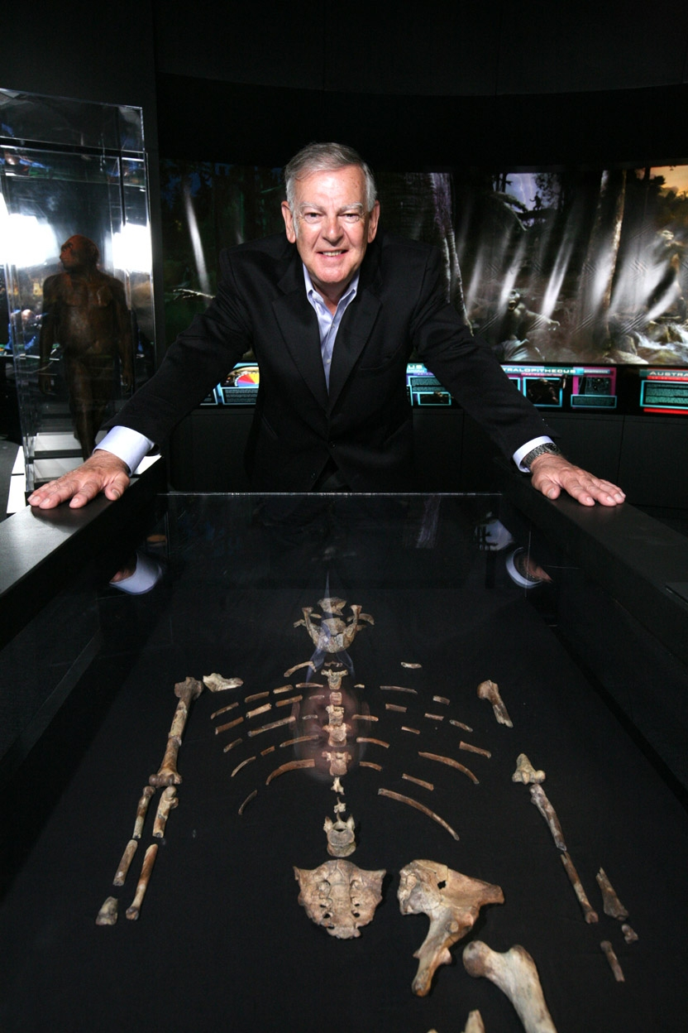
Lucy
Discovered in 1974 in Ethiopia
Named after a then-popular song by the Beatles
Photo by Tadias Magazine

Slide 11
Photo by cclark395

Slide 12
Is this the Key to our Origins?
Photo by stevendepolo

Slide 13
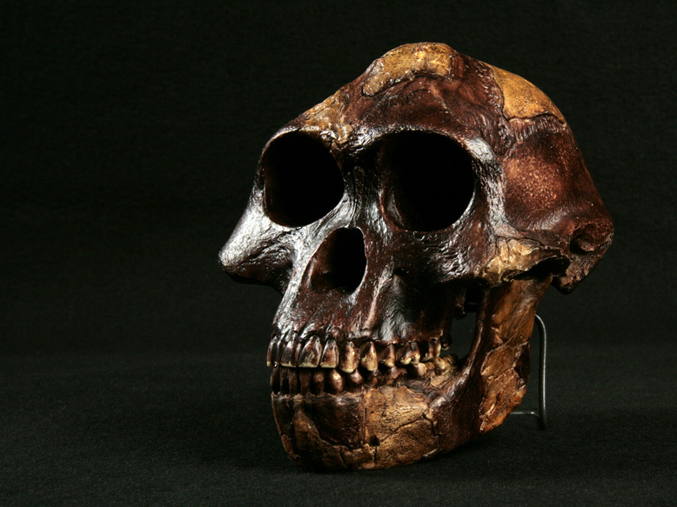
Lucy
Photo by NCSSMphotos
Notes:
Hominid_Skull-Australopithecus_afarensis -Lucy_004.jpg

Slide 14
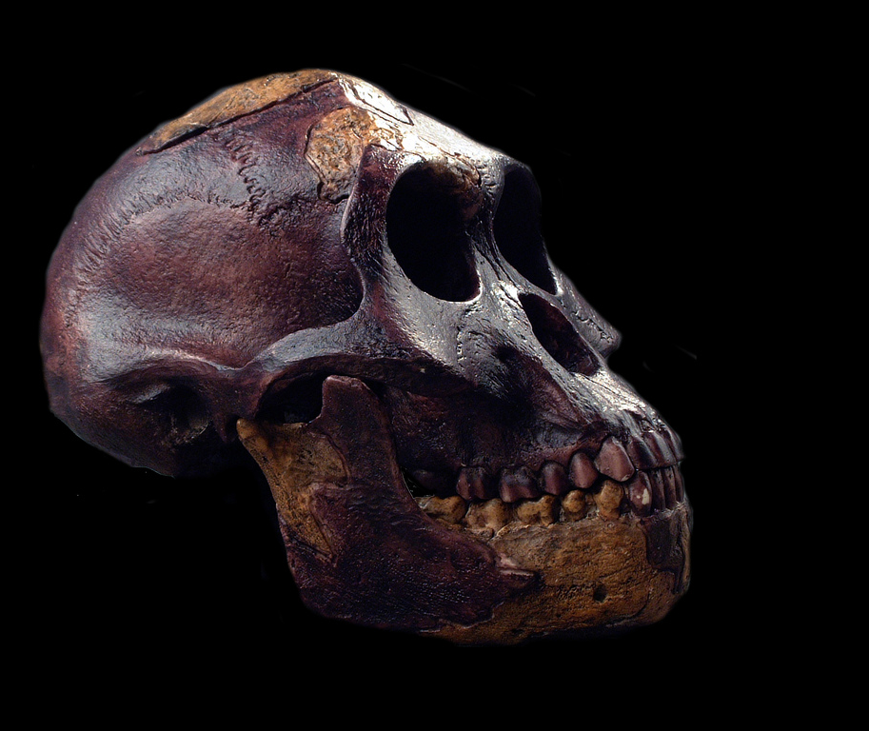
Human?
Photo by NCSSMphotos
Notes:
Hominid_Skull-Australopithecus_afarensis -Lucy_004.jpg

Slide 15
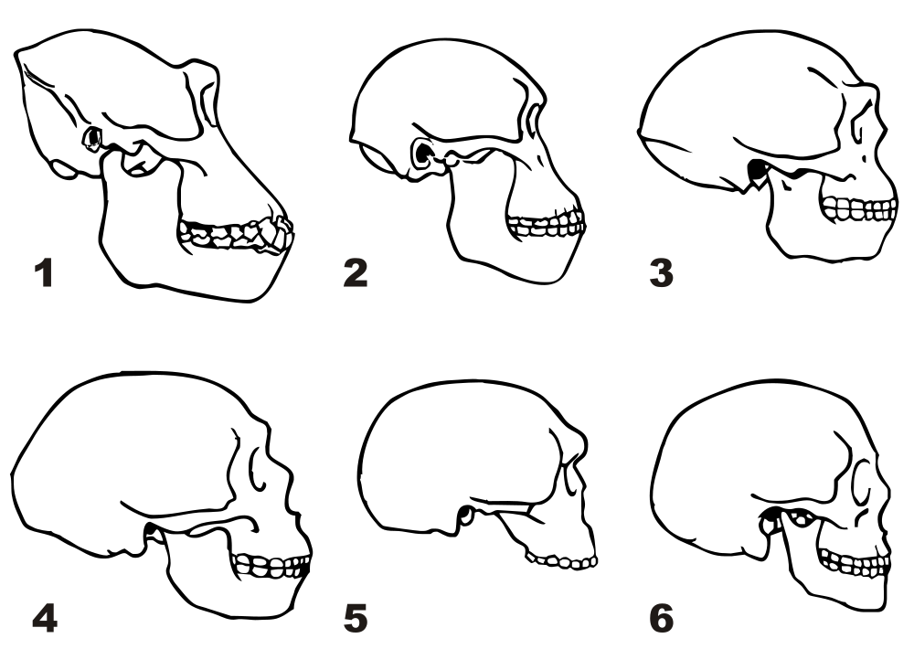
Comparing Skulls
Contrast the gorilla skull with the modern human skull.
Which hominid had the largest brain?
Gorilla
Homo erectus
Neanderthal
Modern Human

Slide 16
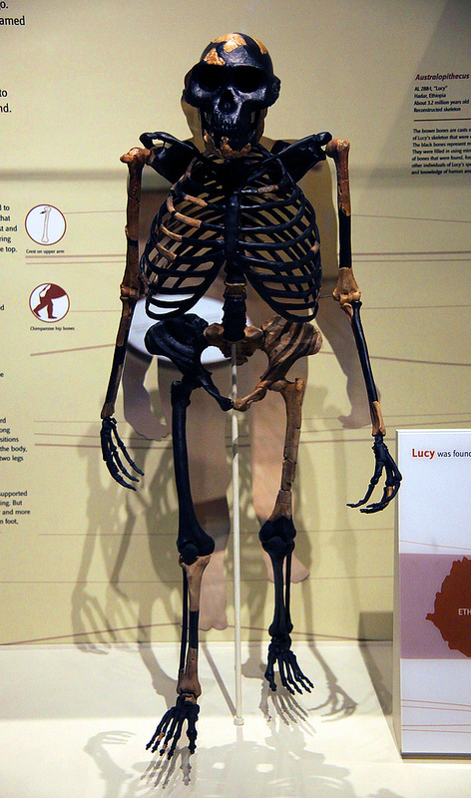
How Human?
What is human-like?
What isn’t?
Photo by Tim Evanson

Slide 18
Humerofemoral Ratios
Chimpanzee | 97.8
Lucy | 84.6
Humans | 71.8
by biologycorner

Slide 19
HOMINIDS
Human… but not quite.

Slide 20
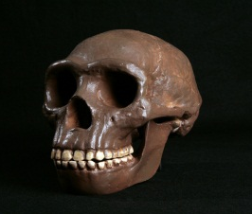
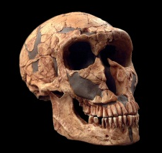
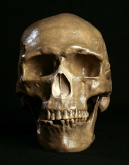
Hominids
Graphic Organizer
Scientific Name | Homo erectus |  | Homo Neanderthalensis |  | Homo sapiens
Meaning | “Upright Man” |  | “Neanderthal Man” |  | “Wise Man”
Extinction? | 400,000 years ago? |  | 24,500 yrs ago |  | Still Living
Technology And Lifestyle |  |  | Large Brains Careful Burial Speech Stone-Tipped Spears |  | Antler-tipped spears (throwing) Cave Paintings
Walk Upright
Control Fire
Cook Food
NOTE:
The information on this chart represents the hypotheses of scientists based on available fossil evidence. Whether you find the evidence credible is up to you.

Slide 21
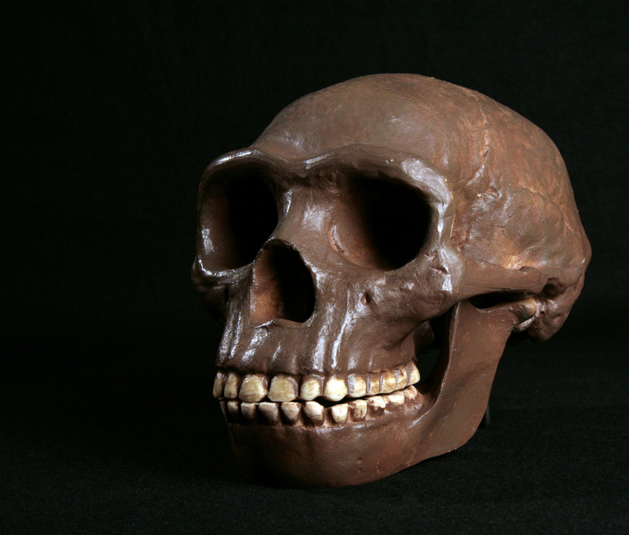
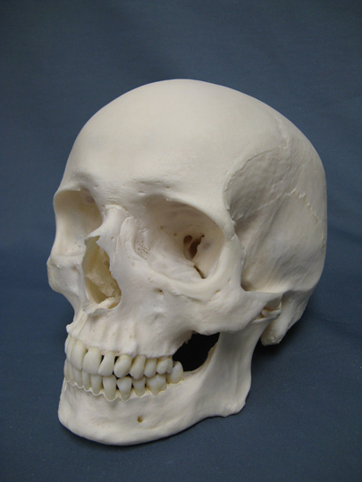
Homo erectus
Modern Human Skull
Photo by NCSSMphotos

Slide 22
Critical Thinking
Imagine humanity without the benefit of any tools or technology. What would happen to our species if we had to fend for ourselves using nothing but our hands?

Slide 23
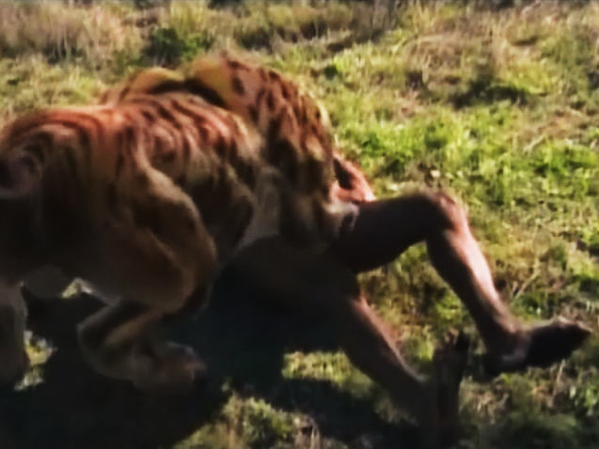
YOU
Minus Technology

Slide 24
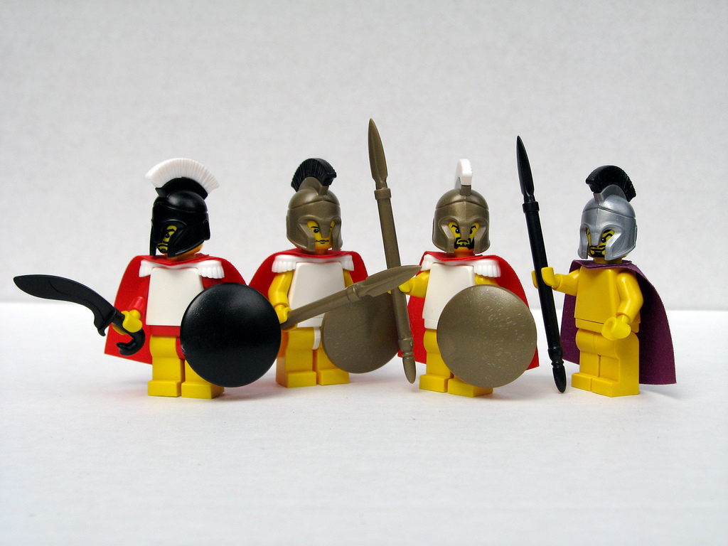
Human Creation
according to the ancient Greeks.
Some rights reserved by Dunechaser

Slide 25
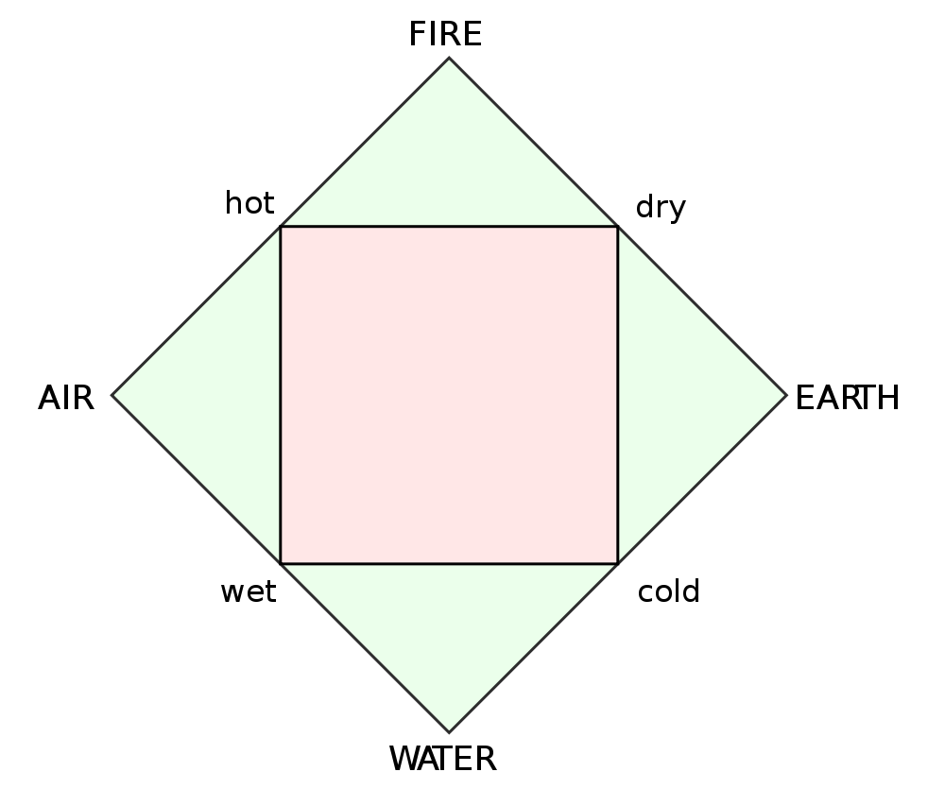
The Classical Elements

Slide 26
Prometheus
(Forethought)
Some rights reserved by Peter Fasano

Slide 27
Epimetheus
(Afterthought)
Some rights reserved by Peter Fasano

Slide 28
Fire!
The most important technology
EVER!
Photo by matthewvenn

Slide 30
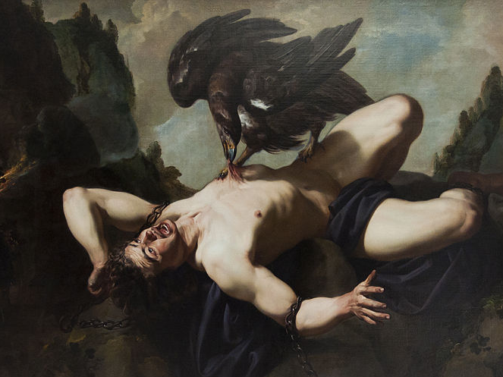
The Cost of Compassion

Slide 31
How Human?
Photo by NCSSMphotos

Slide 32
Hominids
Graphic Organizer
Scientific Name | Homo erectus |  | Homo Neanderthalensis |  | Homo sapiens
Meaning | “Upright Man” |  | “Neanderthal Man” |  | “Wise Man”
Extinction? | 400,000 years ago? |  | 24,500 yrs ago |  | Still Living
Technology And Lifestyle | Walk Upright Control Fire Predator Cook Food |  |  |  | Antler-tipped spears (throwing) Cave Paintings
Large Brains
Speech
Stone-Tipped Spears
Careful Burial
NOTE:
The information on this chart represents the hypotheses of scientists based on available fossil evidence. Whether you find the evidence credible is up to you.

Slide 33
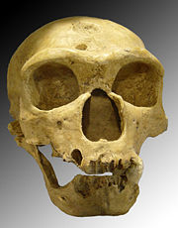
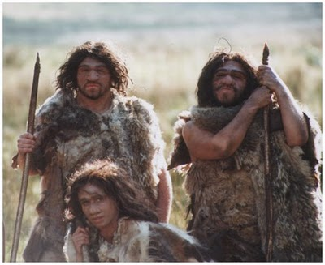
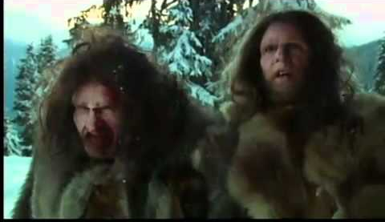
Neanderthal Man
500,000 – 30,000 years ago?
Named for fossils found in Germany’s Neander Valley
SUPERPREDATORS
Evidence of Ritual
http://www.thehindu.com/sci-tech/science/article78778.ece
?

Slide 34
Neanderthal
Modern Human
Photo by NCSSMphotos

Slide 35
Hominids
Graphic Organizer
Scientific Name | Homo erectus |  | Homo Neanderthalensis |  | Homo sapiens
Meaning | “Upright Man” |  | “Neanderthal Man” |  | “Wise Man”
Extinction? | 400,000 years ago? |  | 24,500 yrs ago |  | Still Living
Technology And Lifestyle | Walk Upright Control Fire Predator Cook Food |  | Large Brains Careful Burial Speech Stone-Tipped Spears |  | Antler-tipped spears (throwing) Cave Paintings
NOTE:
The information on this chart represents the hypotheses of scientists based on available fossil evidence. Whether you find the evidence credible is up to you.

Slide 36
Cro-Magnon man
c. 40,000 years ago - Present
Cro-Magnon Rock Shelter (France)
Early Modern Humans
(same as us)
Intelligent
Artistic
Photo by NCSSMphotos

Slide 37
The Stone Age
Some rights reserved by moosa_khan

Slide 38
Lithos
Some rights reserved by Matt Peoples

Slide 39
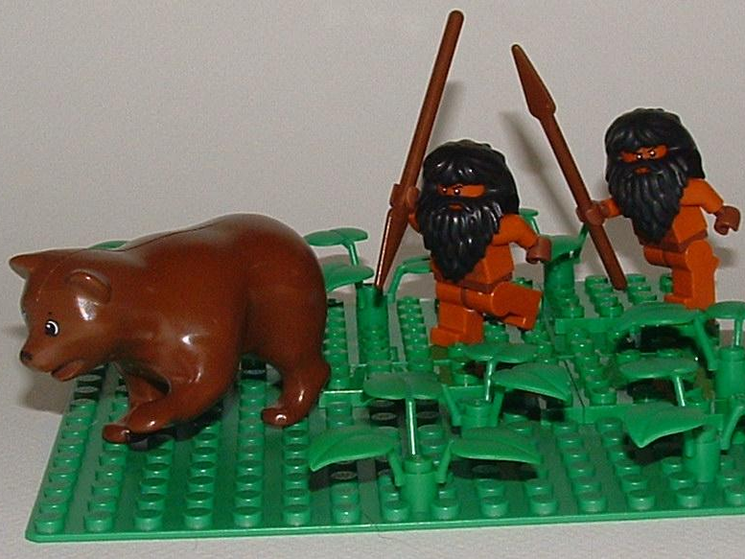
Paleolithic
Some rights reserved by floodllama

Slide 40
Prehistoric Humans
Paleolithic | Mesolithic | Neolithic
 | Μέσος (mesos) “middle” + λίθος (lithos) “stone” | νέος (neos) “new” + λίθος (lithos) “stone”
 | “Middle Stone Age” | “New Stone Age”
 | Around 10,000 B.C. | 10,000 B.C. - 4,000 B.C.
 | Hunting, Gathering, and Fishing | Agriculture
 | Nomadic | Settled Communities
 | Domestication of Dogs Canoes | Domestication of Livestock (cattle, sheep, goats, pigs)
“Old Stone Age”
Παλαιός (palaios) “old”
+ λίθος (lithos) “stone”
Until around 10,000 B.C.
Hunting & Gathering
Nomadic
Cave Art
Venus Figurines

Slide 41
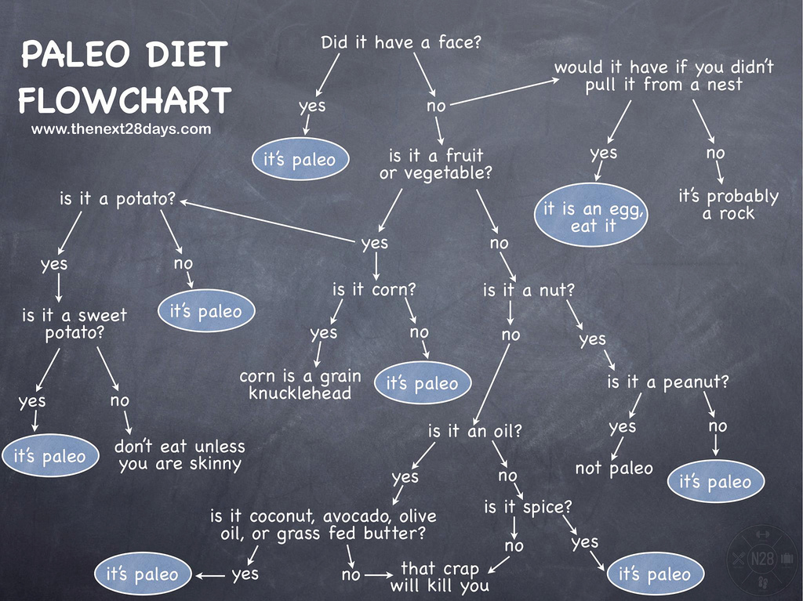
Some rights reserved by thenext28days

Slide 42
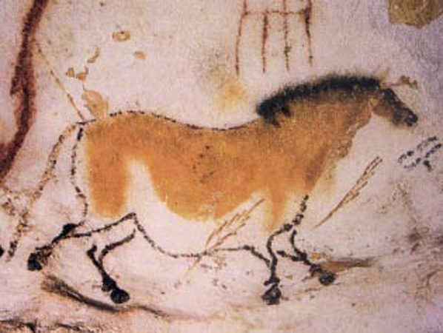
Cave Painting
Lascaux (France)
c. 15,000 B.C.

Slide 43
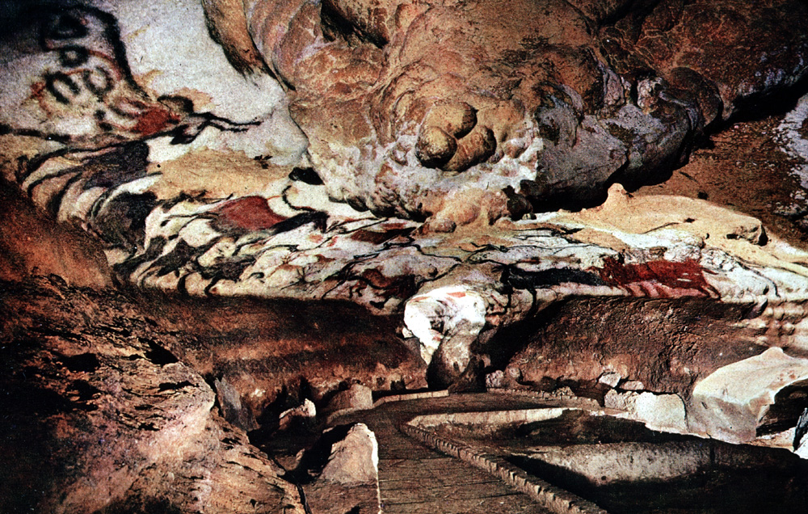
Art History PowerPoint Resource http://iris.nyit.edu/arthistory/pptshows.html
Notes:
Slide concept by William V. Ganis, PhD
FOR EDUCATIONAL USE ONLY
For publication, reproduction or transmission of images, please contact individual artists, estates, photographers and exhibiting institutions for permissions and rights.

Slide 44
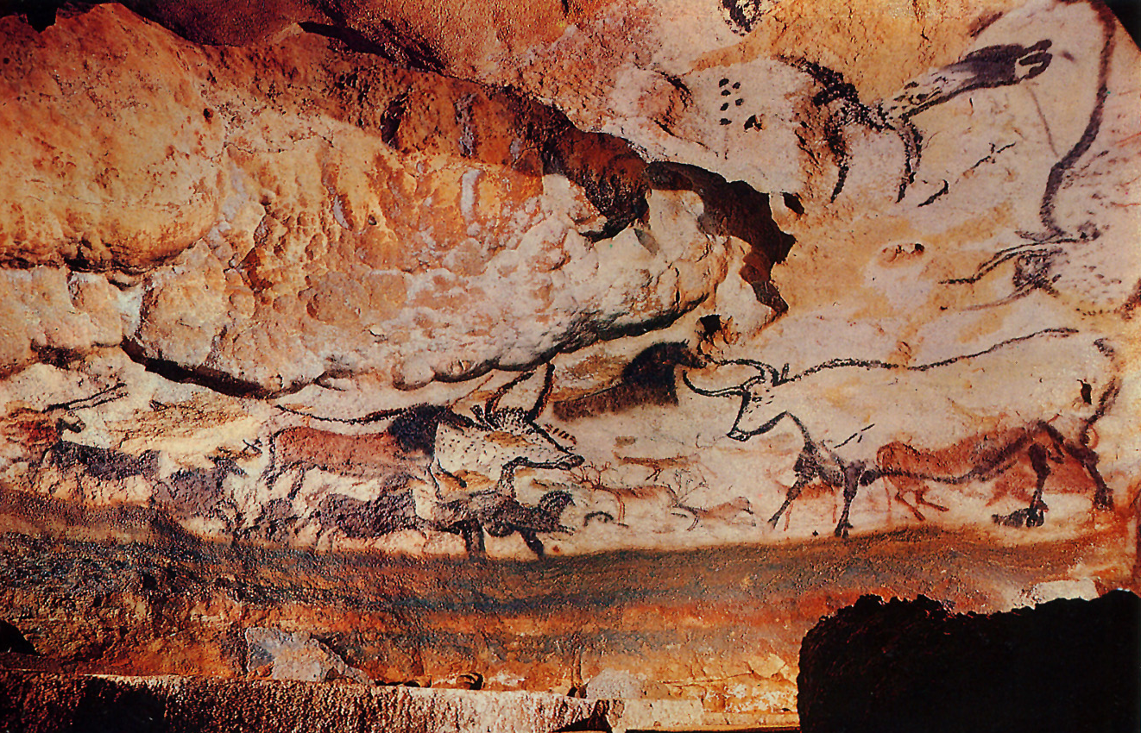
Art History PowerPoint Resource http://iris.nyit.edu/arthistory/pptshows.html
Notes:
Slide concept by William V. Ganis, PhD
FOR EDUCATIONAL USE ONLY
For publication, reproduction or transmission of images, please contact individual artists, estates, photographers and exhibiting institutions for permissions and rights.

Slide 45
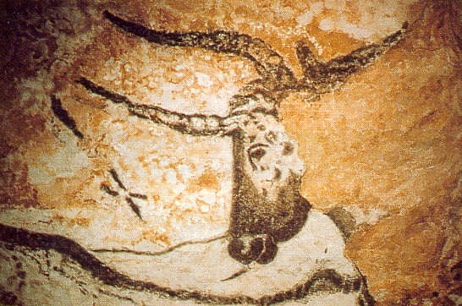
Art History PowerPoint Resource http://iris.nyit.edu/arthistory/pptshows.html
Notes:
Slide concept by William V. Ganis, PhD
FOR EDUCATIONAL USE ONLY
For publication, reproduction or transmission of images, please contact individual artists, estates, photographers and exhibiting institutions for permissions and rights.

Slide 46
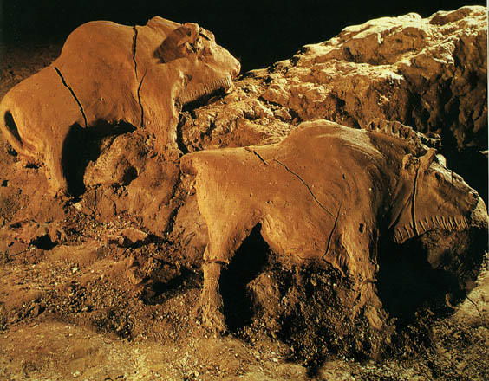
Bison reliefs
(Ariége, France)
ca. 15,000-10,000 B.C.
each approximately 2 feet long
Art History PowerPoint Resource http://iris.nyit.edu/arthistory/pptshows.html
Notes:
Slide concept by William V. Ganis, PhD
FOR EDUCATIONAL USE ONLY
For publication, reproduction or transmission of images, please contact individual artists, estates, photographers and exhibiting institutions for permissions and rights.

Slide 47
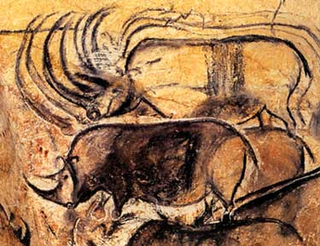
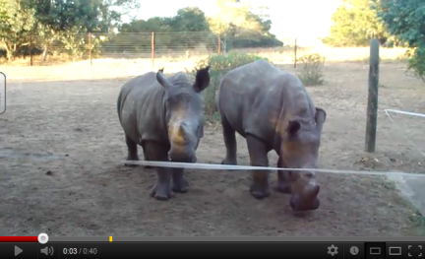
Chauvet Cave paintings
Vallon-Pont-d’Arc, Ardèche, France ca. 30,000-28,000 B.C.
Art History PowerPoint Resource http://iris.nyit.edu/arthistory/pptshows.html
Notes:
Slide concept by William V. Ganis, PhD
FOR EDUCATIONAL USE ONLY
For publication, reproduction or transmission of images, please contact individual artists, estates, photographers and exhibiting institutions for permissions and rights.

Slide 48
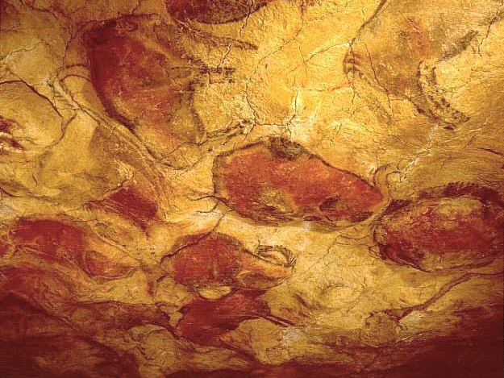
The Sistine Chapel of Cave Art
Altamira Cave paintings
Santander, Spain
ca. 12,000-11,000 B.C.E.
Art History PowerPoint Resource http://iris.nyit.edu/arthistory/pptshows.html
Notes:
Slide concept by William V. Ganis, PhD
FOR EDUCATIONAL USE ONLY
For publication, reproduction or transmission of images, please contact individual artists, estates, photographers and exhibiting institutions for permissions and rights.

Slide 49
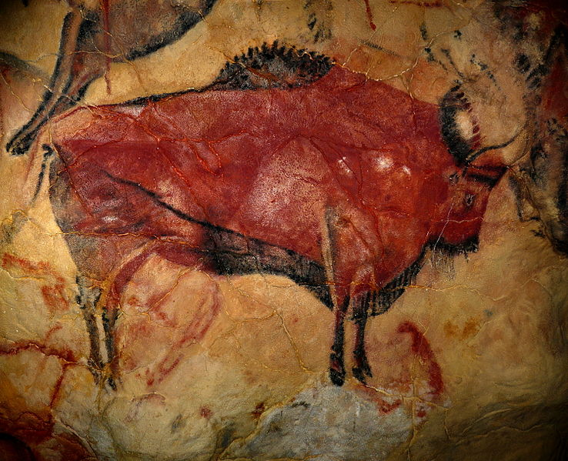

Slide 50
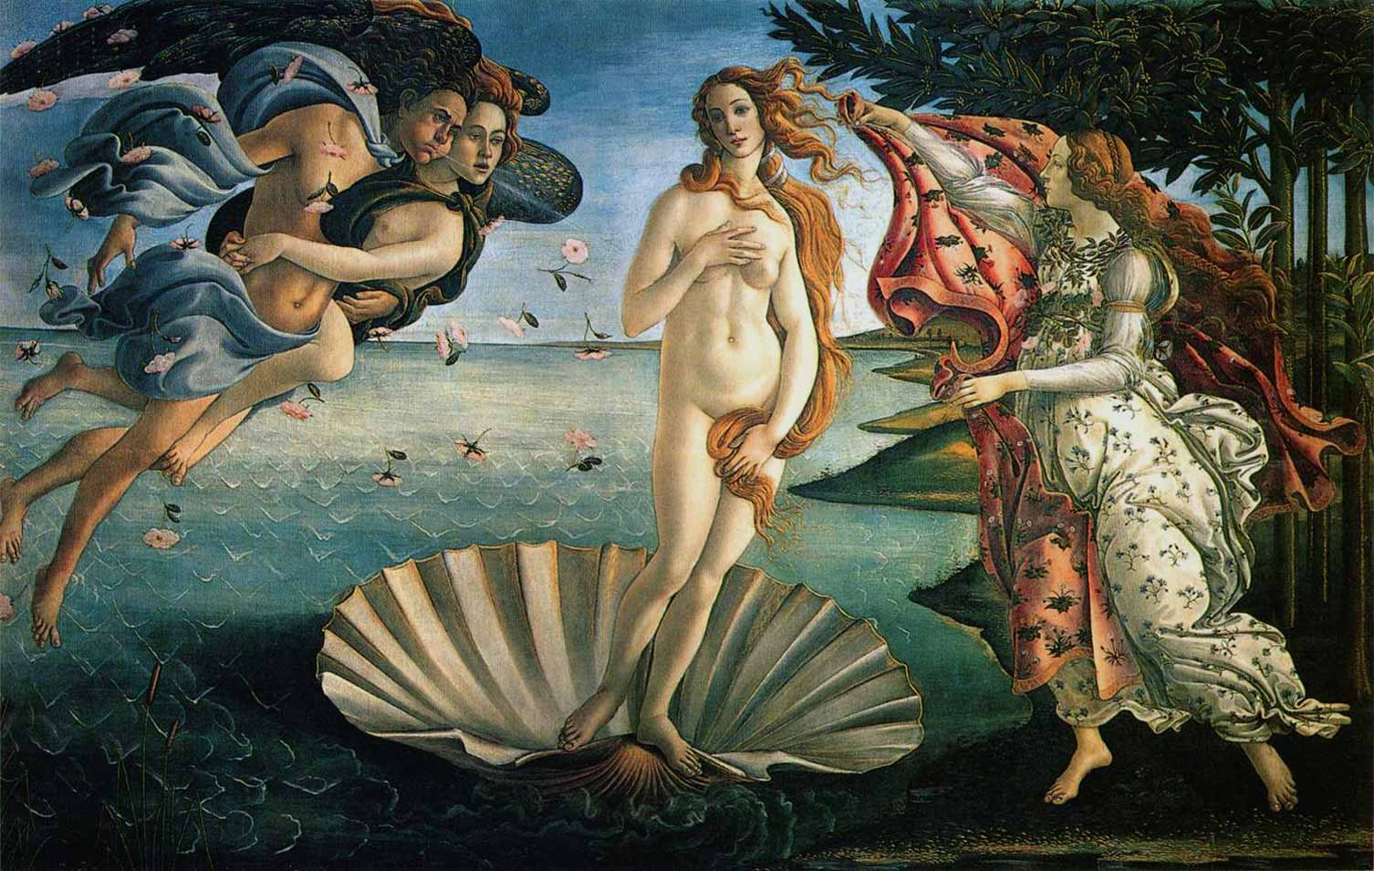
Sandro Botticelli The Birth of Venus 1486

Slide 51
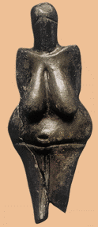
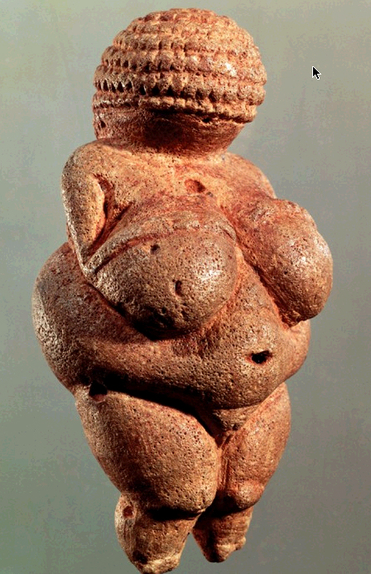
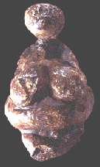
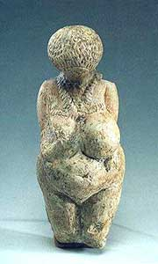
Venus Figurines
Evidence of religion or just of free time?
Venus of Willendorf (Willendorf, Austria)
c. 25,000 B.C.
Art History PowerPoint Resource: http://iris.nyit.edu/arthistory/pptshows.html

Slide 52
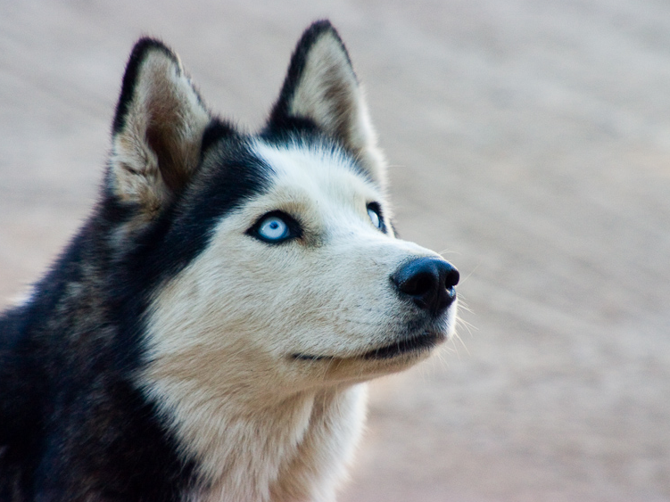
Mesolithic
Photo by rapettif

Slide 53
Prehistoric Humans
Paleolithic | Mesolithic | Neolithic
Παλαιός (palaios) “old” + λίθος (lithos) “stone” |  | νέος (neos) “new” + λίθος (lithos) “stone”
“Old Stone Age” |  | “New Stone Age”
Until around 10,000 B.C. |  | 10,000 B.C. - 4,000 B.C.
Hunting and Gathering |  | Agriculture
Nomadic |  | Settled Communities
Cave Art Venus Figurines |  | Domestication of Livestock (cattle, sheep, goats, pigs)
“Middle Stone Age”
Μέσος (mesos) “middle”
+ λίθος (lithos) “stone”
Around 10,000 B.C.
Hunting, Gathering, and Fishing
Nomadic
Domestication of Dogs
Canoes

Slide 54
Neolithic Revolution
Agriculture
Settled Communities

Slide 55
Prehistoric Humans
Paleolithic | Mesolithic | Neolithic
Παλαιός (palaios) “old” + λίθος (lithos) “stone” | Μέσος (mesos) “middle” + λίθος (lithos) “stone”
“Old Stone Age” | “Middle Stone Age”
Until around 10,000 B.C. | Around 10,000 B.C.
Hunting and Gathering | Hunting, Gathering, and Fishing
Nomadic | Nomadic
Cave Art Venus Figurines | Domestication of Dogs Canoes
“New Stone Age”
νέος (neos) “new” + λίθος (lithos) “stone”
c. 10,000 – 4,000 B.C.
Agriculture
Settled Communities
Domestication of Livestock
(cattle, sheep, goats, pigs)

Slide 56
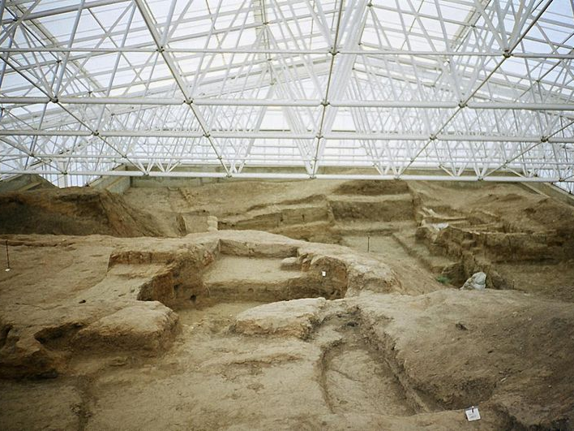
Çatalhöyük
A Neolithic City in Modern-day Turkey
Some Rights Reserved by Ziggurat

Slide 57
6,000 B.C.
Some Rights Reserved by Ziggurat

Slide 58
Archaeology
Uncovering the Past
Some rights reserved by Dr._Colleen_Morgan

Slide 59
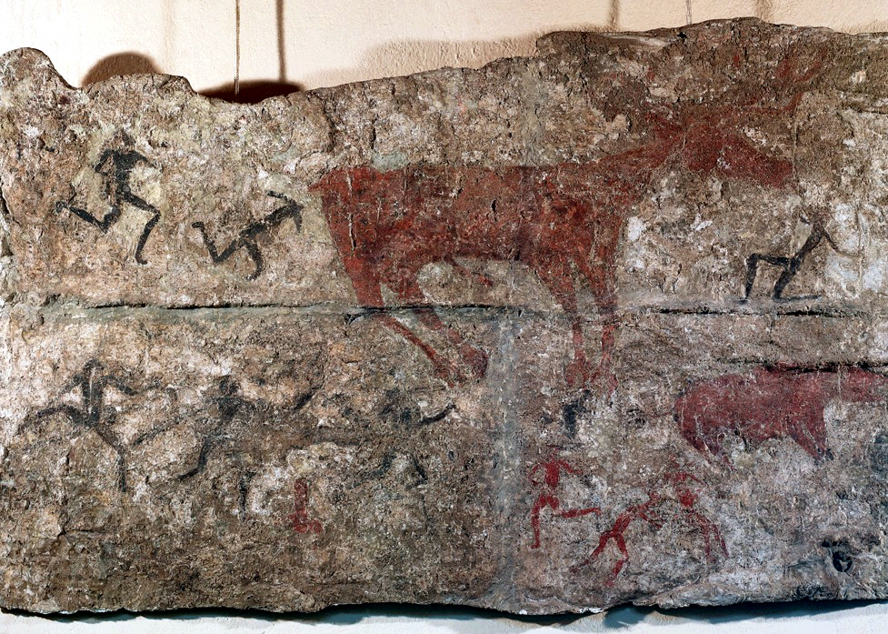
Deer Hunt detail of a wall painting from Level III
Çatal Höyük, Turkey ca. 5,750 B.C.E.
Art History PowerPoint Resource http://iris.nyit.edu/arthistory/pptshows.html
Notes:
Slide concept by William V. Ganis, PhD
FOR EDUCATIONAL USE ONLY
For publication, reproduction or transmission of images, please contact individual artists, estates, photographers and exhibiting institutions for permissions and rights.

Slide 60
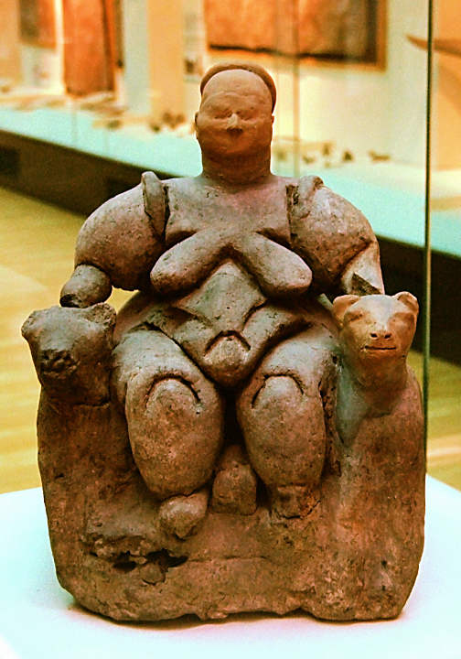
Seated Woman of Çatal Hüyük
“Mother Goddess” Style
What is uniquely Neolithic about this sculpture?
Some Rights Reserved by Roweromaniak
Notes:
Slide concept by William V. Ganis, PhD
FOR EDUCATIONAL USE ONLY
For publication, reproduction or transmission of images, please contact individual artists, estates, photographers and exhibiting institutions for permissions and rights.

Slide 61
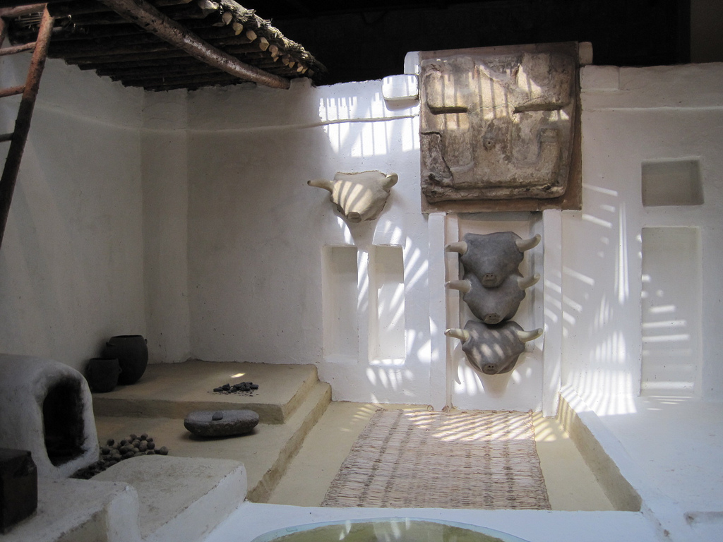
A Reconstruction
based on evidence
Some rights reserved by zamito44

Slide 62
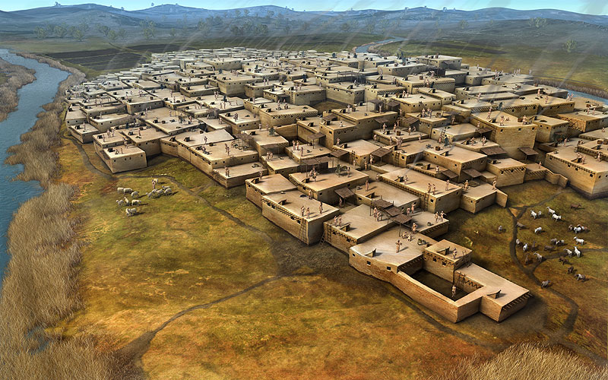
Çatalhöyük
An Aerial View
Image Source: http://alfredojunior.wordpress.com/tag/catal-huyuk/

Slide 63
Prehistoric Humans
Paleolithic | Mesolithic | Neolithic
Until around 10,000 B.C. | Around 10,000 B.C.
Hunting and Gathering | Hunting, Gathering, and Fishing
Nomadic | Nomadic
Cave Art Venus Figurines | Domestication of Dogs Canoes
“Old Stone Age”
“Middle Stone Age”
“New Stone Age”
Παλαιός (palaios) “old”
+ λίθος (lithos) “stone”
Μέσος (mesos) “middle”
+ λίθος (lithos) “stone”
νέος (neos) “new” + λίθος (lithos) “stone”
c. 10,000 – 4,000 B.C.
Agriculture
Settled Communities
Domestication of Livestock
(cattle, sheep, goats, pigs)

Slide 64
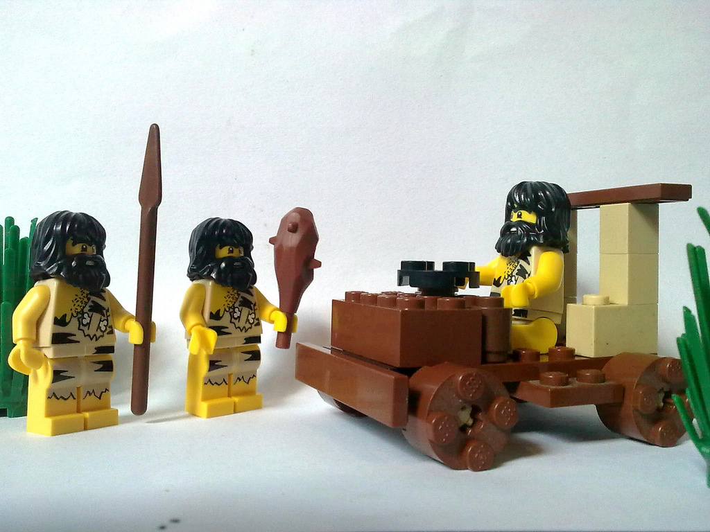
Civilization
Are we there, yet???
© Bobby-Joe Henson – Used with Permission

Slide 65
Settled Cities
Fire
Agriculture
Cities

Slide 66
What’s Missing?

Slide 67
WRITING

Slide 68
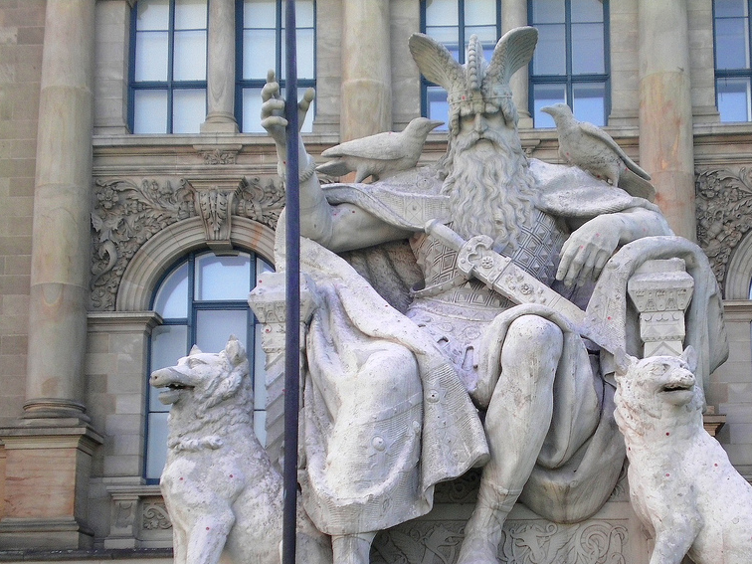
Odin
Chief Norse God
Photo by Elias Schwerdtfeger

Slide 69
Runes
Norse Writing
The Vikings believed that the runes had magical powers.
Why?

Slide 70
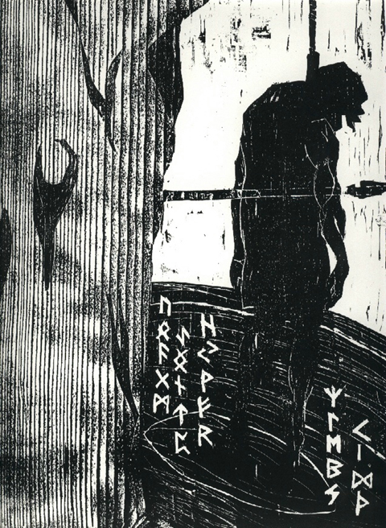
Sacrifice of Odin
I know I hung on the windswept Tree through nine days and nights I was struck with a spear and given to Odin, myself given to myself They helped me neither by meat nor drink I peered downward, I took up the runes, screaming, I took them - then I fell back.
-- Poetic Edda

