Slide 1
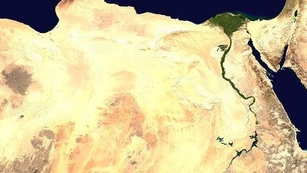
Geography of Ancient Egypt

Slide 2
Sahara Desert

Slide 3
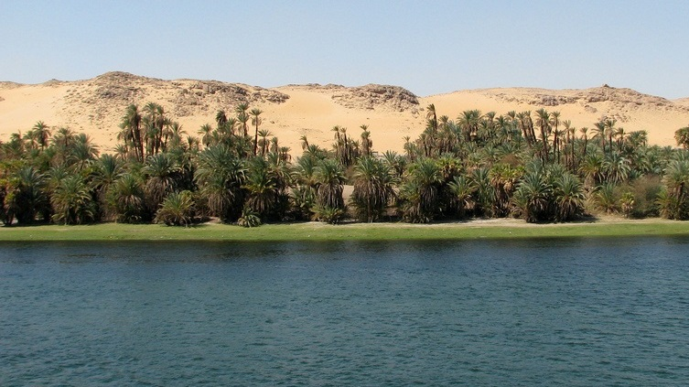
The “Gift of the Nile” – Herodotus
Some rights reserved by Dale Gillard

Slide 4
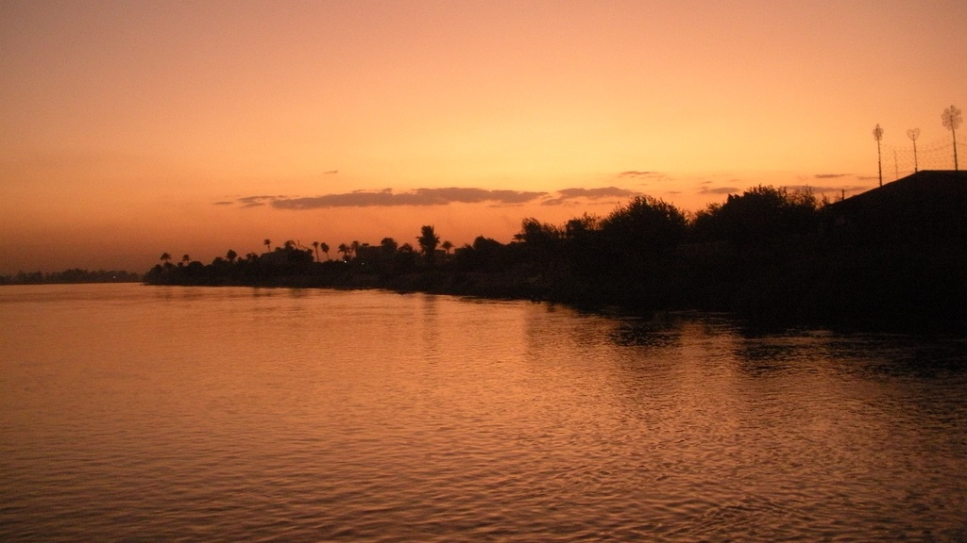
Regular Floods (Annual)
Some rights reserved by shaimaa85

Slide 5
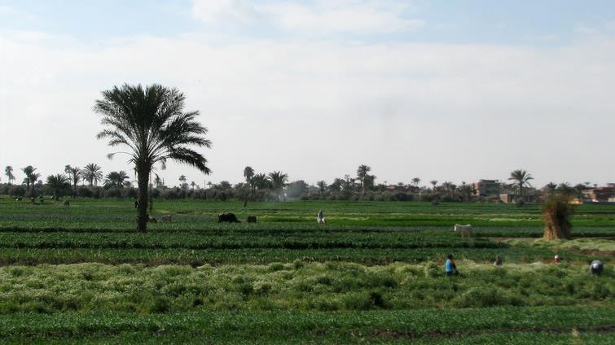
Fertile Soil
Some rights reserved by Dale Gillard

Slide 6
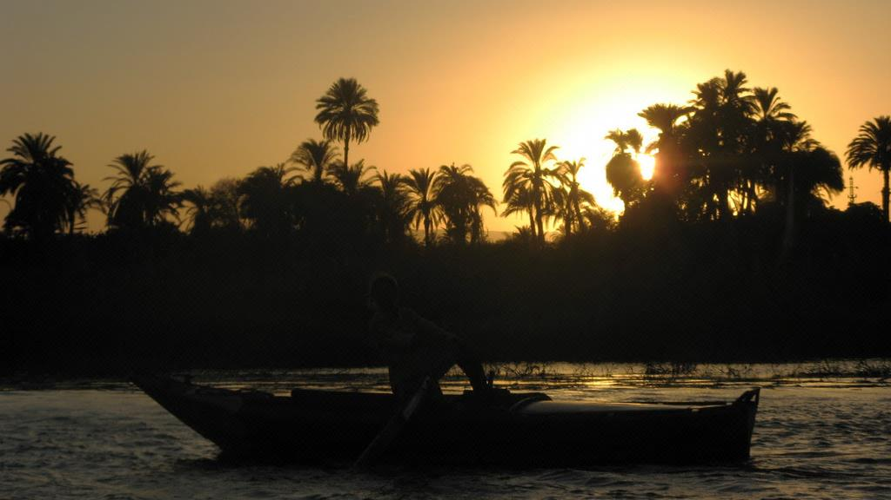
A Highway
Uniting Upper & Lower Egypt
Some rights reserved by dungodung

Slide 7
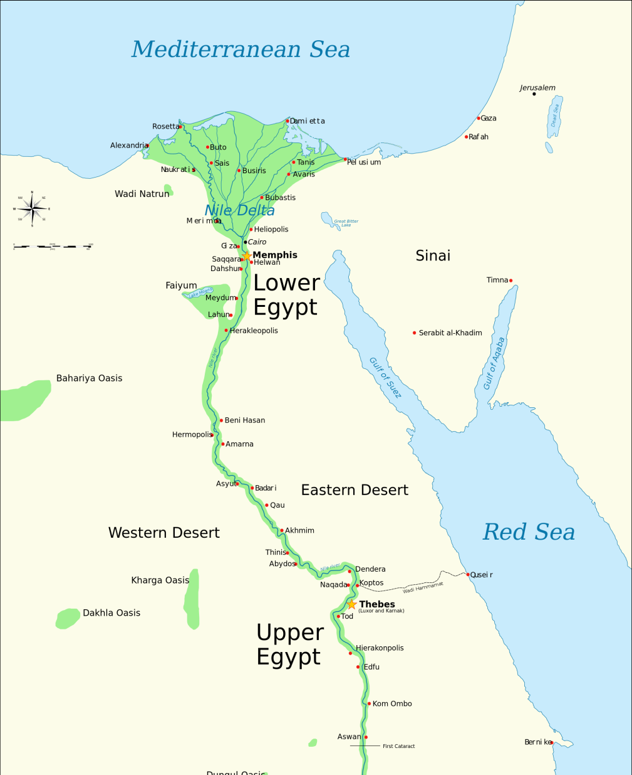
Interactive Map
CLICK a section to zoom in!
Map Credit: Jeff Dahl

Slide 8
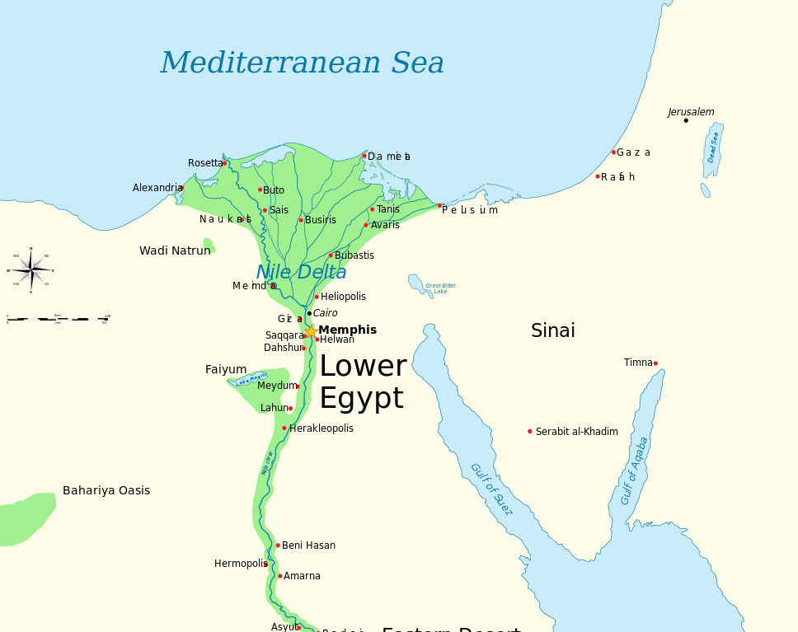
ZOOM IN
ZOOM OUT
Map Credit: Jeff Dahl

Slide 9
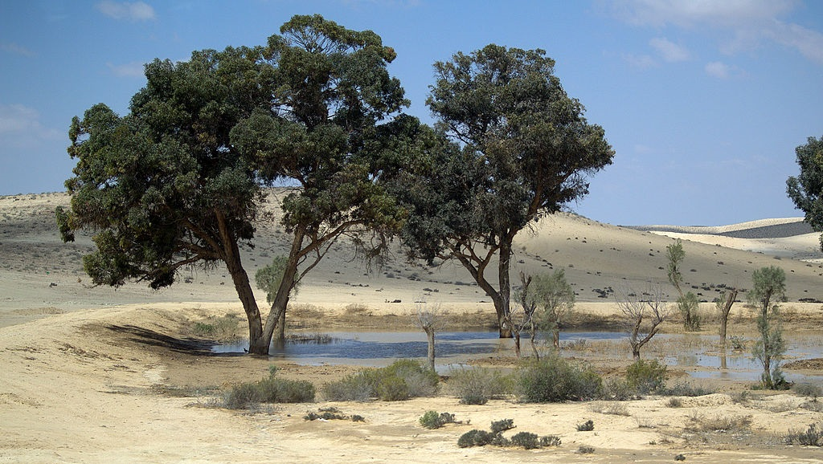
Oasis
Photo Credit: David Shankbone

Slide 10
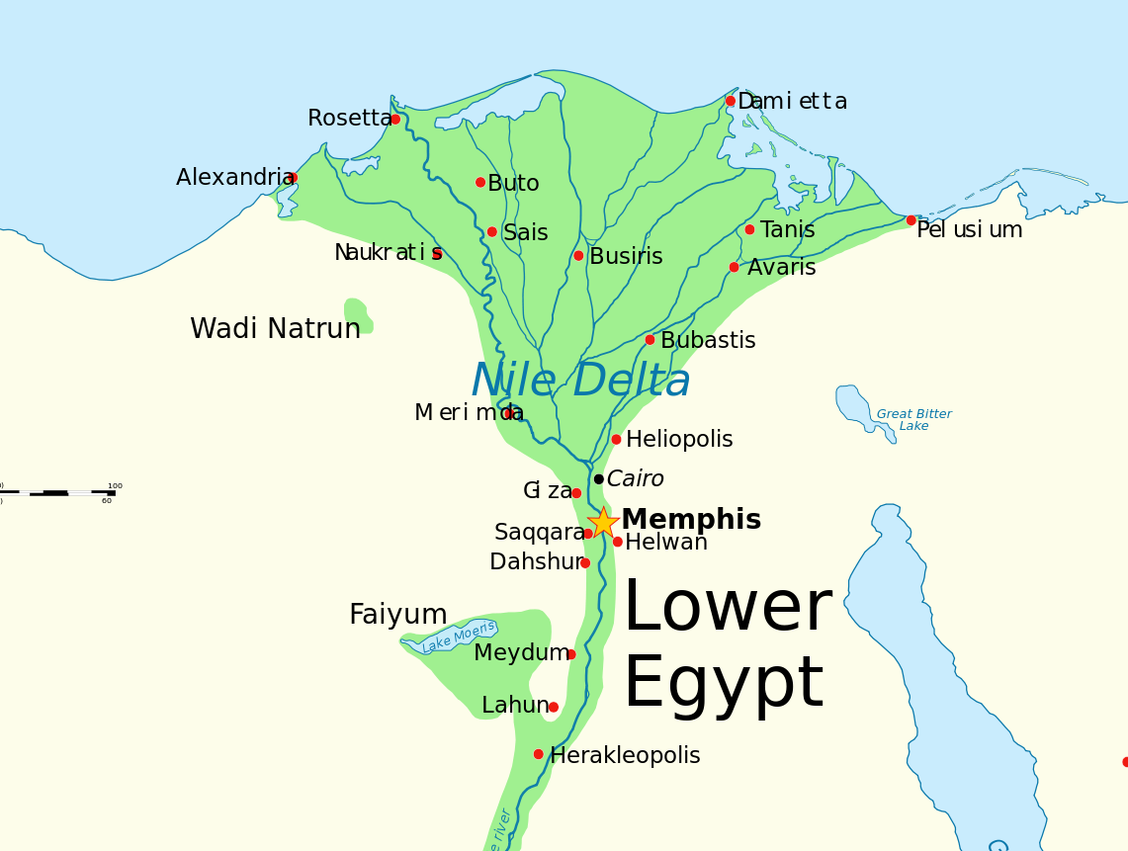
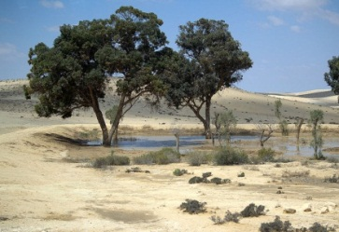
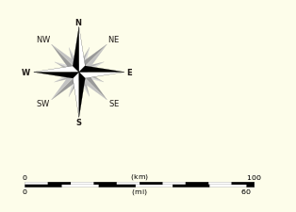
Oases
ZOOM OUT
Map Credit: Jeff Dahl

Slide 11
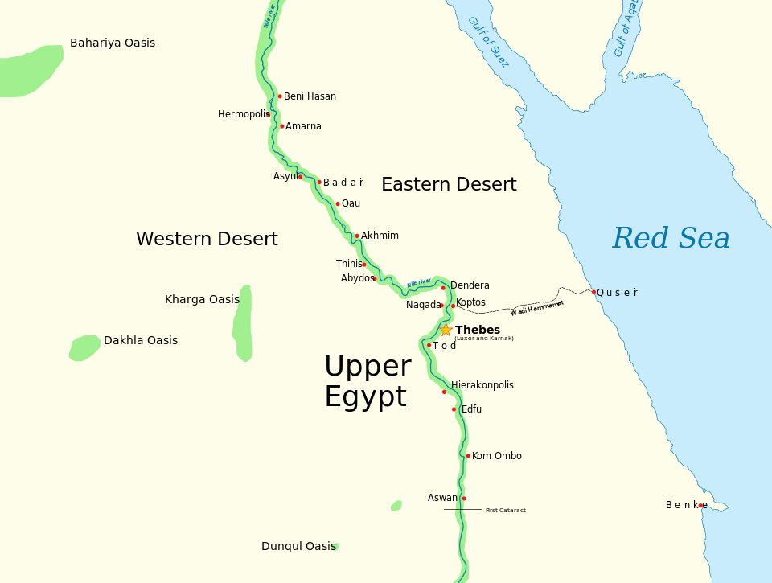
Slide 8
ZOOM IN
ZOOM OUT
Map Credit: Jeff Dahl

Slide 12
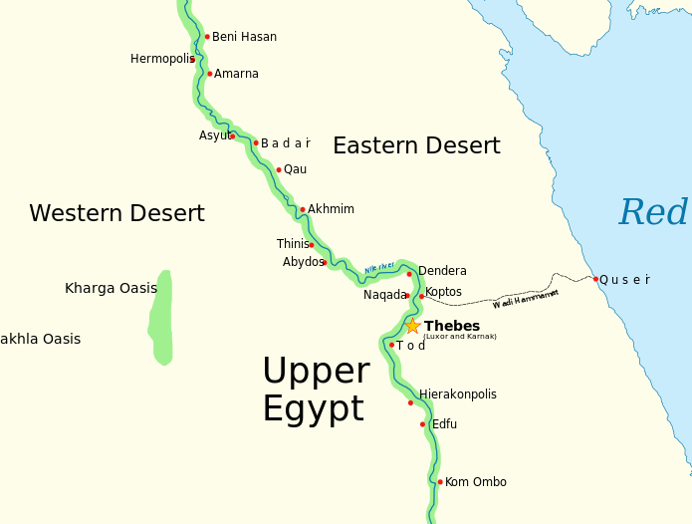
ZOOM OUT
Map Credit: Jeff Dahl

Slide 13
Click

