Slide 1
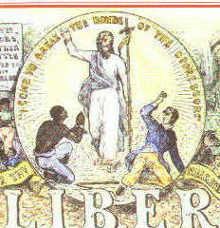
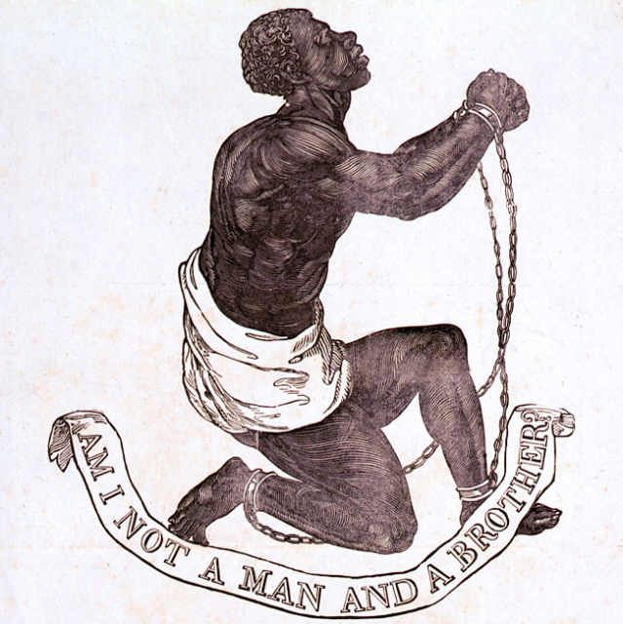
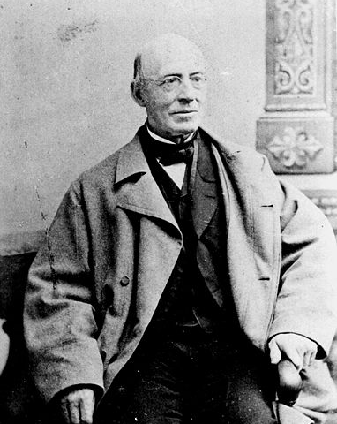
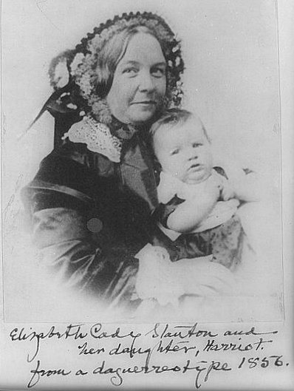


Antebellum Reform
USHC 2.4
Compare the social and cultural characteristics of the North, the South, and the West during the antebellum period, including the lives of African Americans and social reform movements such as abolition and women’s rights.

Slide 2
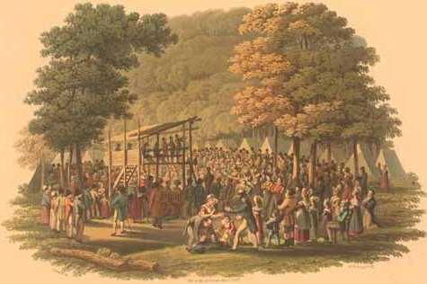
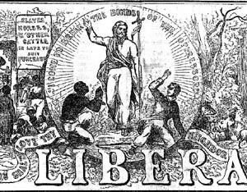
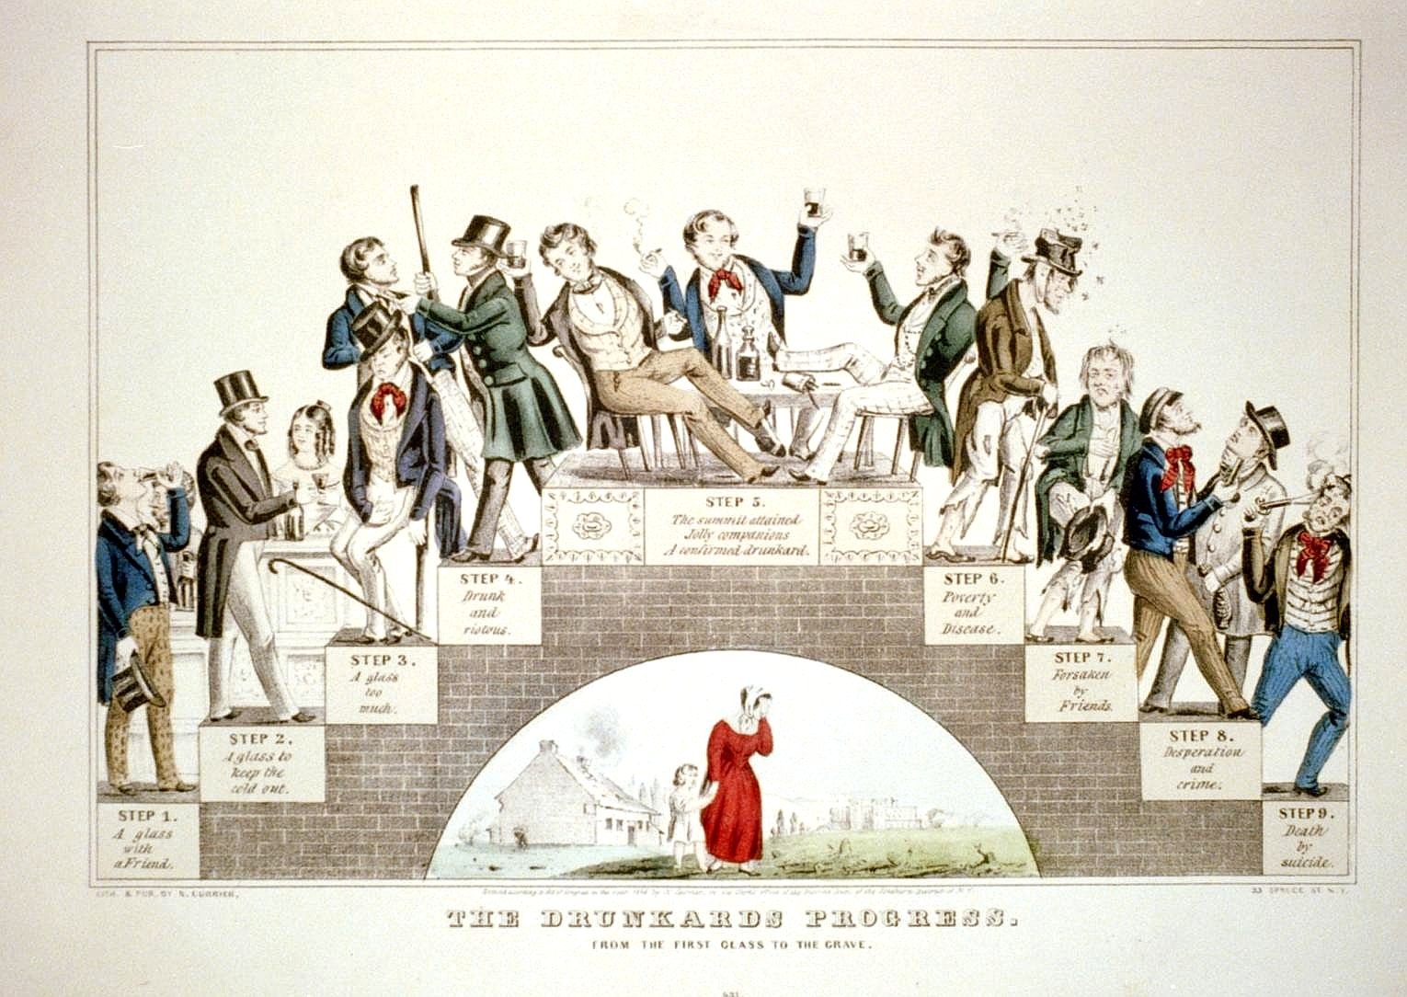
Table of Contents
The Second
Great Awakening
Abolitionist Movement
Temperance, Suffrage, etc.

Slide 3
antebellum

Slide 4
Periods of U.S. History
Colonial (1607-1750)
Revolutionary (1750-1783)
Early National (1783-1820)
Antebellum (1820-1860)
NOTE: Most dates are approximate.

Slide 5
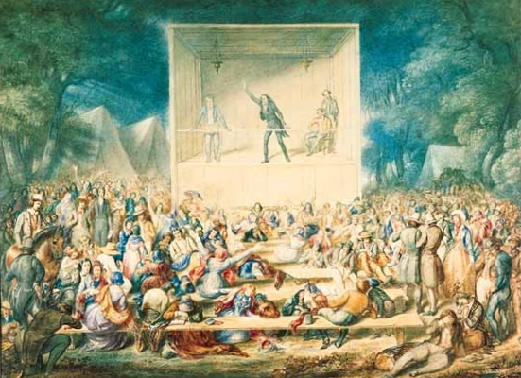

Slide 6
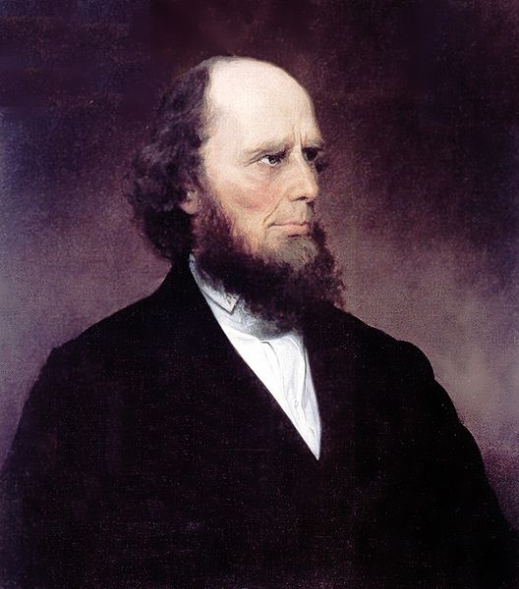
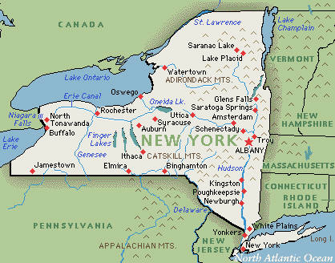

The Second
Great Awakening
Religious Revival (1820s-1830s)
Itinerant Preachers
Camp Meetings
Charles G. Finney
Revivalist
A Methodist
Camp Meeting
“Burned Over District”

Slide 7
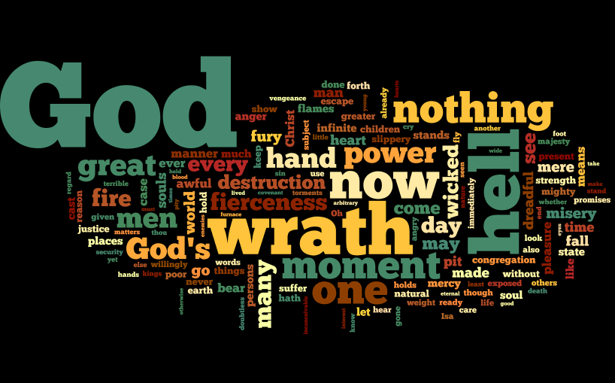
A Wordle of Jonathan Edwards’ Sinners in the Hands of an Angry God
Compare to Charles G. Finney
(Second Great Awakening)
http://www.ccel.org/ccel/edwards/sermons.sinners.html

Slide 8

A Wordle of a Charles G. Finney Sermon
Compare to Jonathan Edwards
(First Great Awakening)
http://www.charlesgfinney.com/1836SOIS/11sois_reprobation.htm

Slide 9
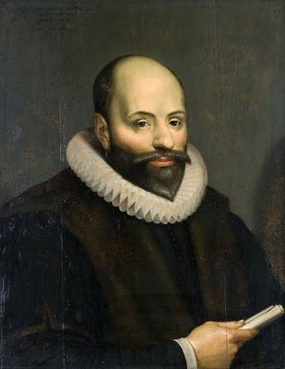

Arminianism
FREE WILL
As distinct from Predestination
SALVATION OR DAMNATION:
YOUR CHOICE
Arminius
Revivalists during the Second Great Awakening focused on a conversion experience within the heart of the listener.
WORDLE!!!

Slide 10
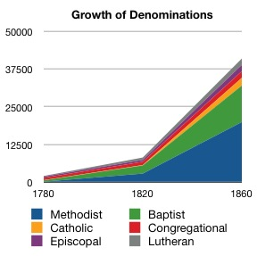
Conversion
Baptists
&
Methodists

Slide 11
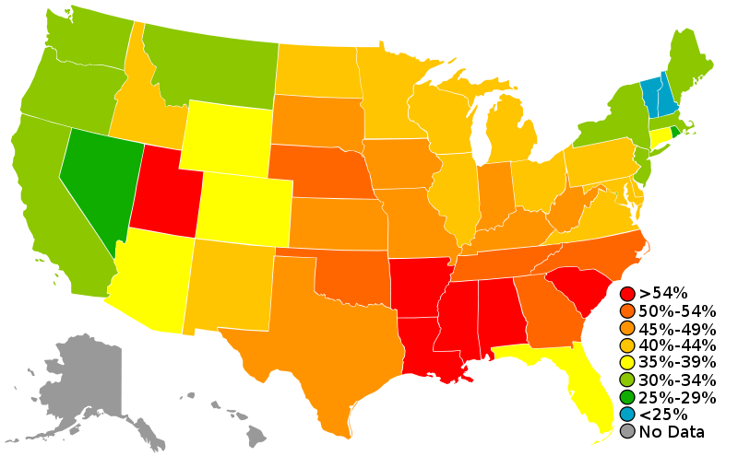
Church Attendance in the U.S.

Slide 12
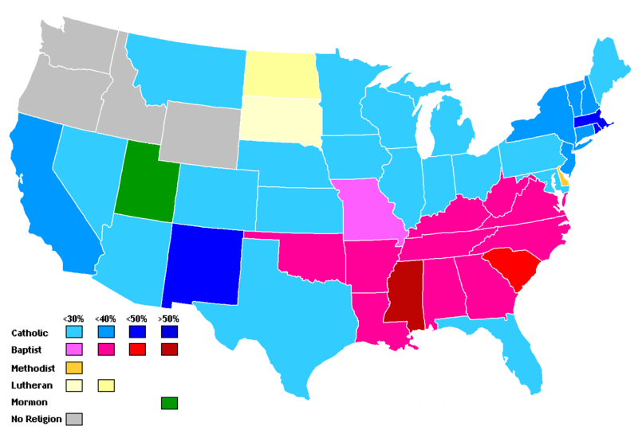
Plurality of Religious Preference

Slide 13
MISSION:
PURIFY THE WORLD

Slide 14
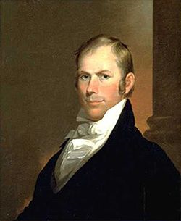
American Colonization Society
NOT ENOUGH
Founded 1816
Liberia
  Colony established in Africa
  Capital: Monrovia
Premise
Henry Clay
Charter Member

Slide 15
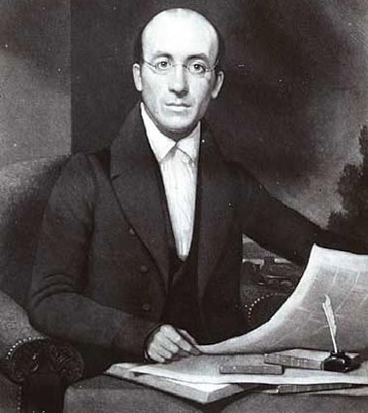
Abolitionism
William Lloyd Garrison
  American Anti-Slavery Society
    Colonization
  The Liberator (1831-1865)
      Boston, MA, Newspaper
NOTE:
Abolition was a radical movement – especially in its early years.
Garrison

Slide 16
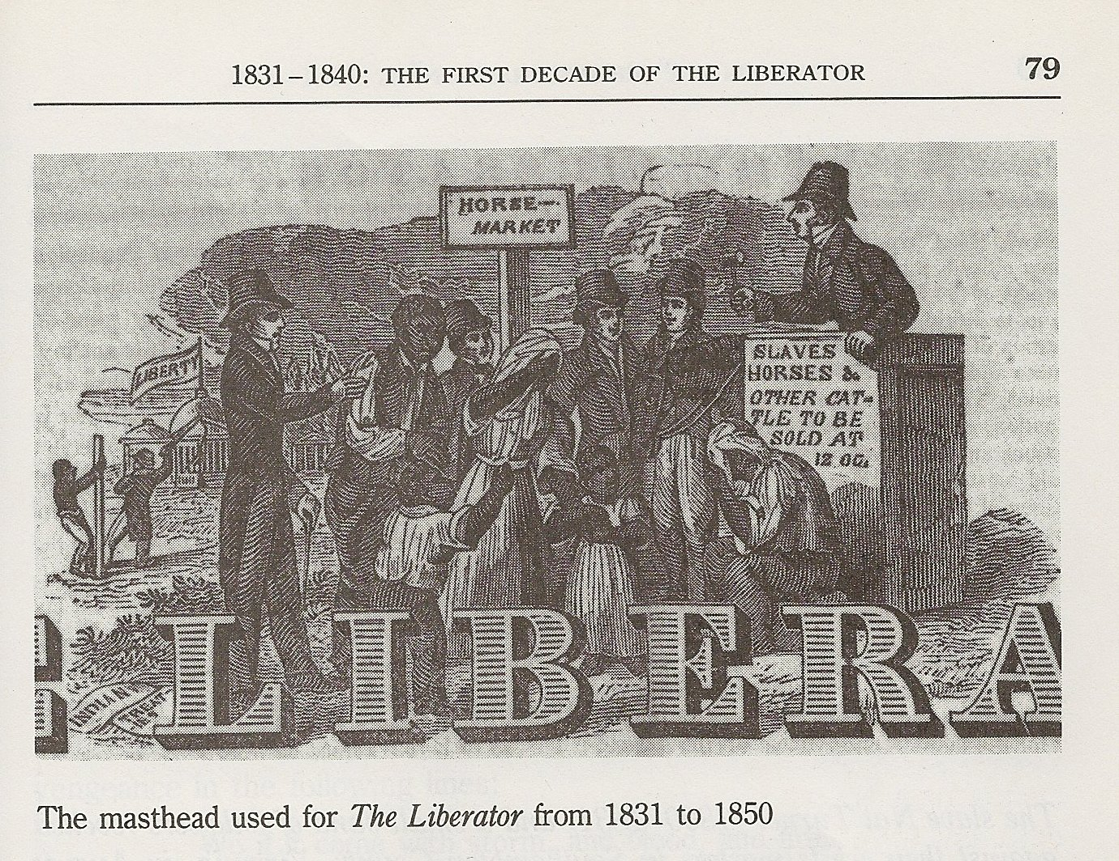

Slide 17
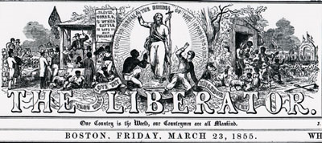

Slide 18

A “Higher Law”?
“We pronounce [the Constitution] the most bloody and heaven-daring arrangement ever made by men for the continuance and protection of a system of the most atrocious villainy ever exhibited on earth… Such a compact was, in the nature of things and according to the law of God, null and void from the beginning. No body of men ever had the right to guarantee the holding of human beings in bondage.” -- The Liberator

Slide 19
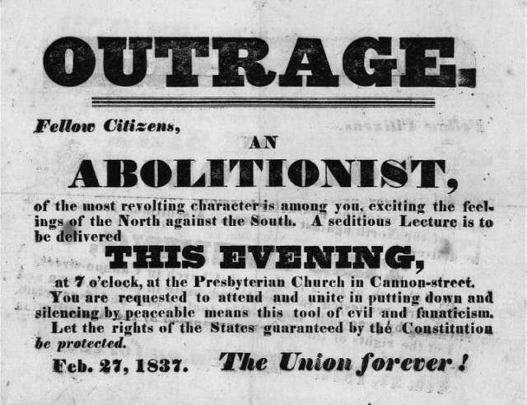

Slide 20
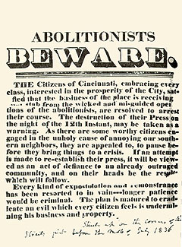
Anti-Abolitionist Advertisement
Cincinnati, OH

Slide 21

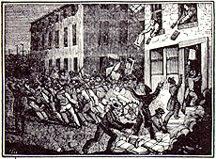
Northern Reactions to Abolitionism in the 1830s
Anti-Abolitionist Riots
New York City (1832)
New York City (1834)
Boston (1835)
Cincinnati (1836)
http://utc.iath.virginia.edu/abolitn/mobhp.html

Slide 22
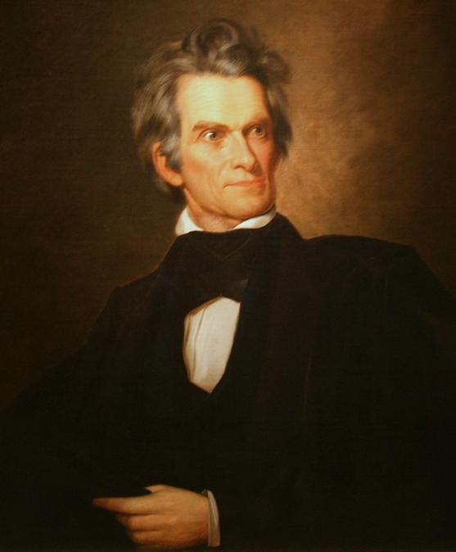
Southern Reactions to Abolitionism in the 1830s
The
“Positive Defense”
of Slavery
“I hold that in the present state of civilization, where two races of different origin, and distinguished by color, and other physical differences, as well as intellectual, are brought together, the relation now existing in the slaveholding States between the two, is, instead of an evil, a good—a positive good.”
-- John C. Calhoun (1837)
Calhoun

Slide 23




The “Gag Rule”
Antislavery Petitions
FROM THE
1ST AMENDMENT
“Congress shall make no law… abridging… the right of the people… to petition the Government for a redress of grievances.”

Slide 24
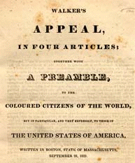
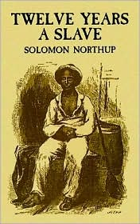
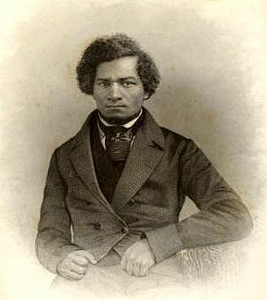
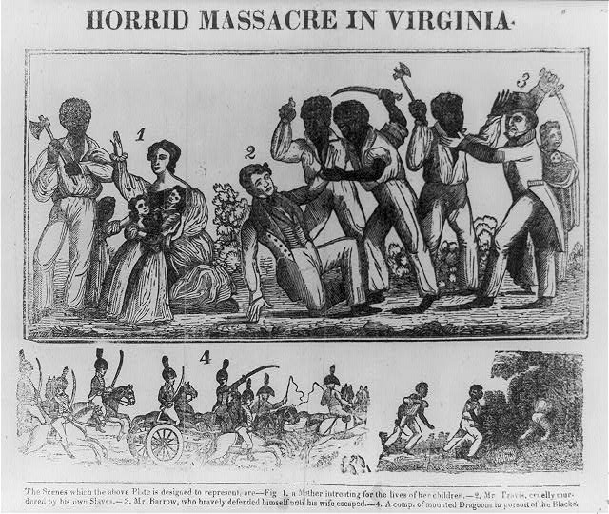
Black Abolitionists

Slide 25
David Walker’s Appeal
1829
“Now, I ask you, had you not rather be killed than to be a slave to a tyrant, who takes the life of your mother, wife, and dear little children? Look upon your mother, wife and children, and answer God Almighty; and believe this, that it is no more harm for you to kill a man, who is trying to kill you, than it is for you to take a drink of water when thirsty....”

Slide 27
Nat Turner’s Rebellion
1831
Largest slave rebellion in U.S. history
About 200 dead (total)
Put down in two days

Slide 28
Frederick Douglass
1838 – Frederick Douglass escapes from slavery in Maryland
Popular Anti-Slavery Speaker
Narrative of the Life of Frederick Douglass: An American Slave
Douglass

Slide 29
Twelve Years a Slave is a narrative of a free person of color from New York who was abducted and sold into slavery in Louisiana.

Slide 31
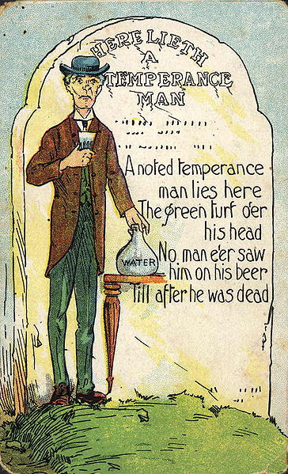
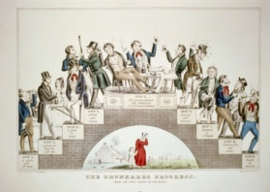
Temperance
Alcohol
15 Gallon Act
  Massachusetts, 1838
  Aimed at shutting down bars
  Whig Elitism
    The wealthy could afford their own liquor in large quantities
LINK: An insightful article about the Temperance Movement and Democracy
Document 5.10

Slide 32
The Legacy of Temperance
World Drinking Ages
16 | 18 | 19 | 20 | 21
Antigua Barbados Belgium Georgia Germany Greece Luxembourg Malta Norway Poland Portugal Spain | Algeria Argentina Australia Bahamas Barbados Belarus Belize Bolivia Botswana Brazil Bulgaria Cameroon Canada United Kingdom ETC | Nicaragua South Korea | Iceland Japan Paraguay | Fiji Pakistan Palau Sri Lanka United States
http://www2.potsdam.edu/hansondj/LegalDrinkingAge.html

Slide 33
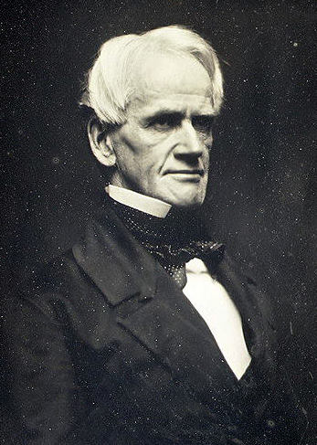
Public Education
Horace Mann
  The “father of
  public education”
  Free Elementary Education
Public ed. still a rarity in the South until after the Civil War
Horace Mann
(Massachusetts)

Slide 34
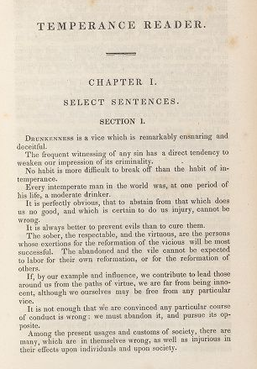
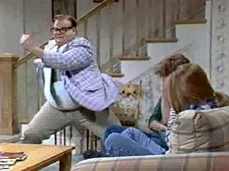
Schoolbooks as Motivational Tools
http://www.hulu.com/watch/4183/saturday-night-live-down-by-the-river
http://pds.lib.harvard.edu/pds/view/14156071?n=13

Slide 35
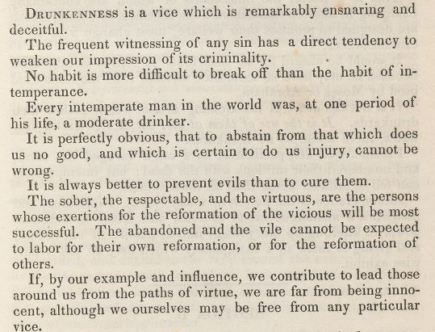

Slide 36
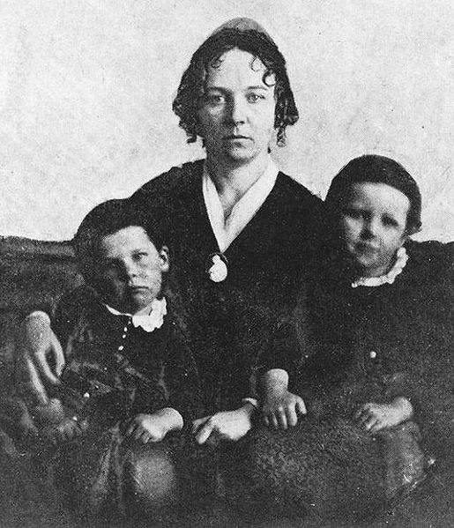
Seneca Falls Convention
1848
Women’s Rights Convention in New York
“We hold these truths to be self-evident: that all men and women are created equal…”
First American document to advocate
women’s suffrage
Elizabeth Cady Stanton
with her children
Document 5.9

Slide 37
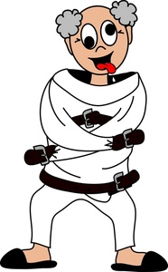
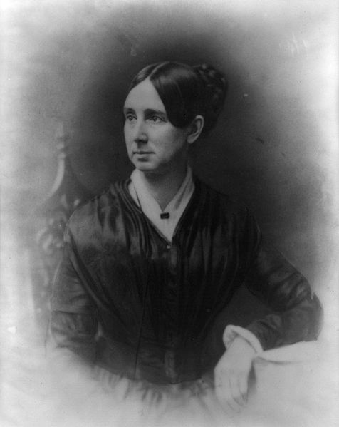
Prison & Asylum Reform
Dorothea Dix
Dorothea Dix sought to improve conditions in prisons and asylums.
Image Credit: http://www.people-clipart.com

Slide 38
Antebellum Reform
Movement | Key Figures | Info
Second Great Awakening
Abolitionism
Temperance
Public Education
Women’s Rights
Asylum Reform

Slide 39
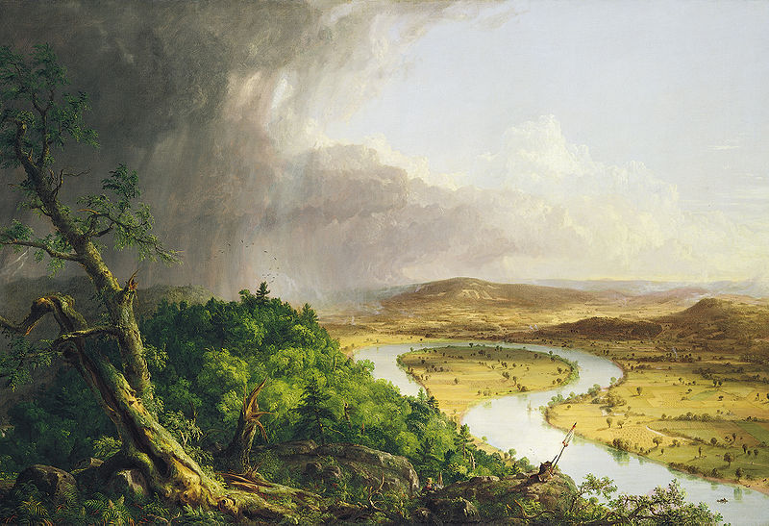

Slide 40

The Hudson River School
Romantic Art from Upstate New York
Landscapes
  Mostly in the Hudson River valley
Thomas Cole
  More Paintings by Thomas Cole
Thomas Cole (1801-1848),The Oxbow, View from Mount Holyoke, Northampton, Massachusetts, after a Thunderstorm 1836, The Metropolitan Museum of Art

