Slide 1
Bucket Rescue
The Institute for Safety in Powerline Construction
© Copyright by the Institute for Safety in Powerline Construction 3504 Parliament Ct. Alexandria, LA 71303 All rights reserved. This material or any part thereof may not be reproduced in any form without the written permission of the Institute for Safety in Powerline Construction
Notes:
There is no question about the need for bucket rescue. When we think of bucket rescue, most of us think of someone being electrocuted and being able to remove them from a bucket truck. Let’s think about some things that should be in place before we send a person up in an aerial device.
When would someone need to be rescued from a raised aerial lift?
Electrical contact injury
Heat stroke
Fainted
Heart problem
Insect bite – allergic reaction
Pulled, strained muscles

Slide 2
Please Note
This presentation is for educational purposes only. Nothing herein is to be regarded as indicating approval or disapproval of any specific product or practice.
Please check your company procedures to ensure the information we are showing complies with your company policy.
Bucket Rescue is an essential part of safety training for lineworkers.
There are several methods for removing an injured worker from a bucket truck.
Knowing how to operate the truck using the lower controls is a must.

Slide 3
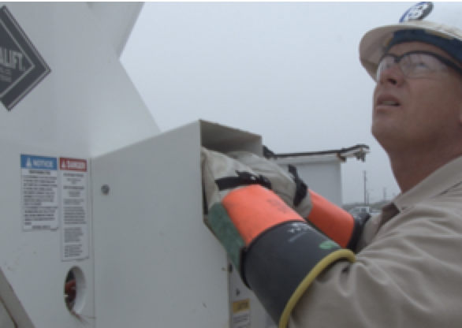
Basic Safety
Test lift controls prior to use
Stand on bucket floor
Booms will have upper and lower controls
Do not move the truck with the bucket in the working position
Notes:
Job Briefing
Make sure everyone at the job site knows what your location is
Be sure everyone at the job site knows the circuit you are working on
Be sure everyone at the job site knows how to operate the bucket from the lower control
Make sure everyone knows how to make a mayday call
Make sure everyone is current in First Aid/CPR techniques
Make sure everyone knows the hazards involved with a rescue should an accident occur

Slide 4
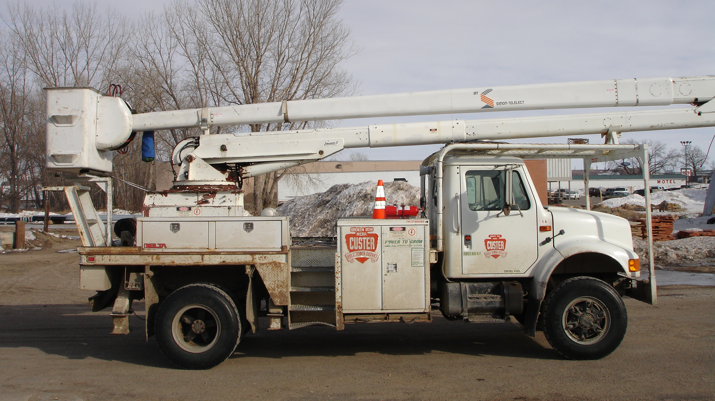
Non-over Center
Notes:
Buckets that do not reach the ground
Rescue blocks must be used
Points to be considered:
Who is the most important person at the scene of an emergency?
Discuss possible answers:
Victim
Rescuer
The RESCUER is the most important person at the scene of an emergency
Why?
Because the rescuer is vital to the victim’s survival
If the rescuer gets into trouble or is injured, then there are two victims, and possibly no one to help them

Slide 5
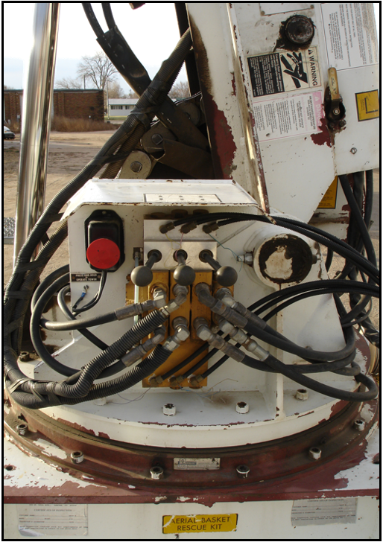
Non-over Center
Become familiar with the lower controls
Where they are located
How to operate them
Bucket will not come to the ground
Use block and tackle rescue device
Notes:
Lower controls are different on every truck
Know where the attachment point is for the rescue rope
Operation of the boom should be smooth for a successful rescue
Types of equipment (There are many different types of aerial lifts available today; Each one is different)
Hi-Ranger
Pitman
Teco
Reach-All
Versalift
Altec

Slide 6
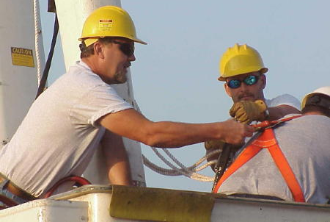
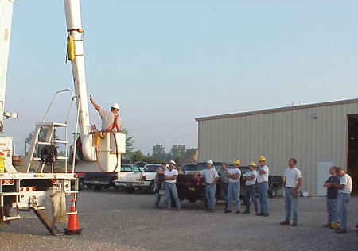
Non-over Center
Notes:
Major Area of Rescue Procedure
Look things over
Don’t rush into a situation without first making sure you won’t be injured yourself.
Check:
Is victim still in trouble?
How do you get victim out of trouble?
Is the truck energized?
How do you get on the truck?
YOU MUST PROTECT YOURSELF
Contact dispatch for help
Start rescue after dispatch is notified

Slide 7
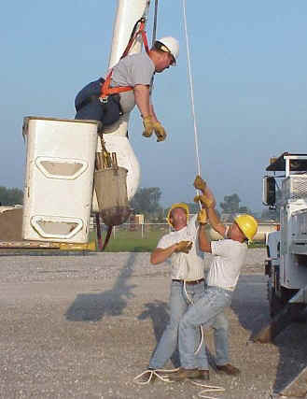
Non-over Center
Know your equipment
Discuss difference between equipment you use
Learn about the operation of that equipment
Practice often and keep practicing
Know where special rescue equipment is located on each vehicle
Notes:
Know your equipment
Discuss difference between equipment you use
Learn about the operation of that equipment
Practice often and keep practicing
New employees
Seasoned employees
New equipment
Know where special rescue equipment is located on each vehicle
Know how to use it
It should be marked
If possible, standard location and marking on each vehicle

Slide 8
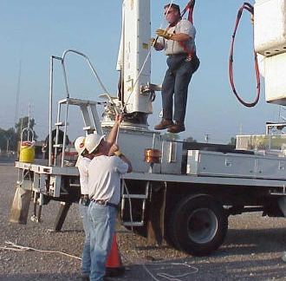
Non-over Center
Getting the victim out
Notes:
Getting victim out
Remember - seconds count
Techniques vary with equipment
Follow company procedures
Practice Practice Practice

Slide 9
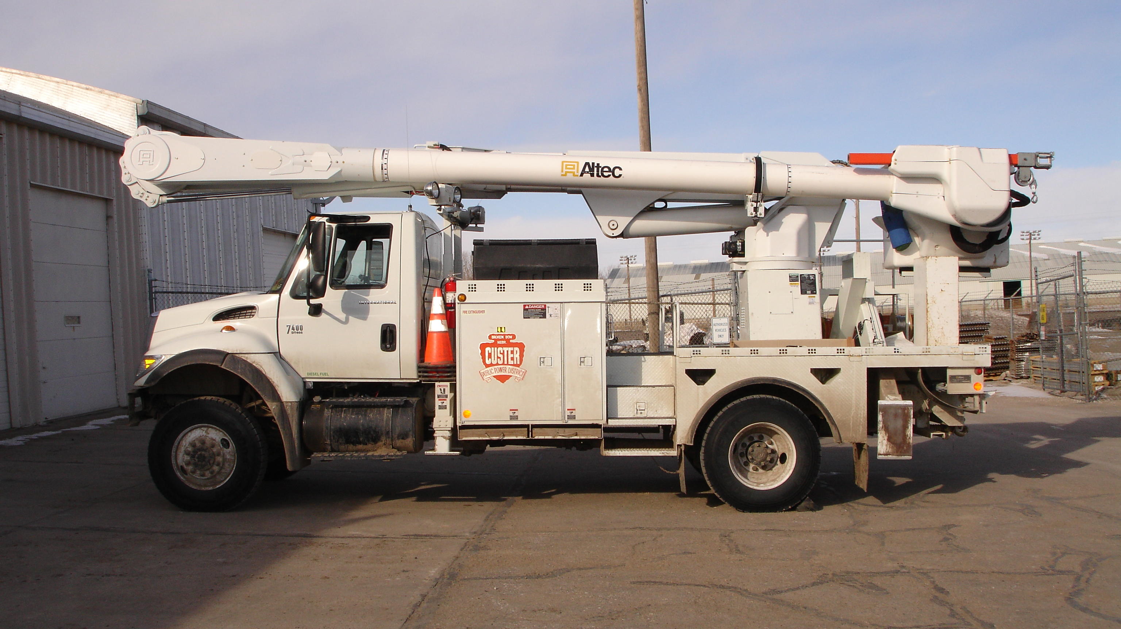
Over Center
Notes:
Know your First Aid
Two victims-which do you help first?
Determine what has happened to the victims
Heart attack
Heat stroke
Electric contact
Insect bite or allergic reaction
Pulled or strained muscles
Fainted
What aid does the victim need?
When to call for help?

Slide 10
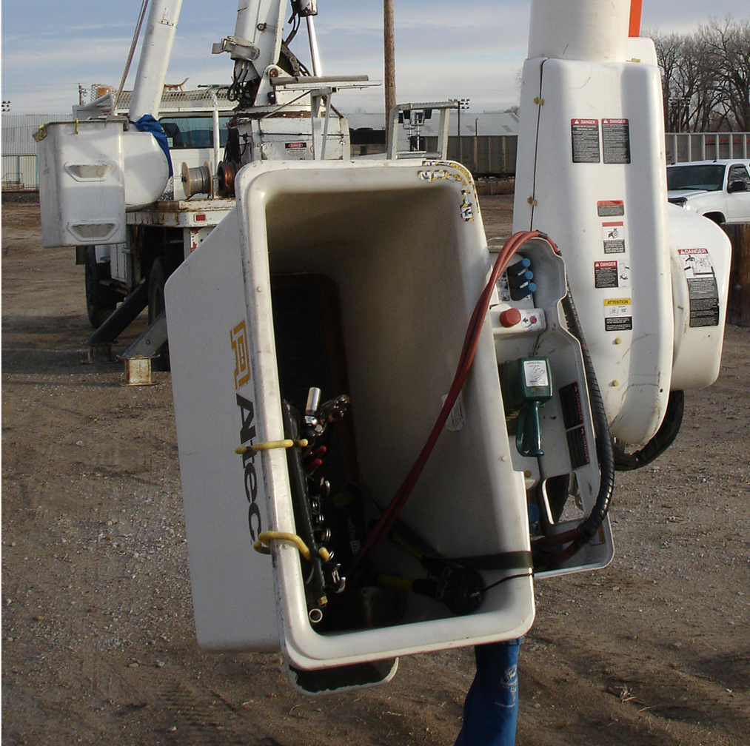
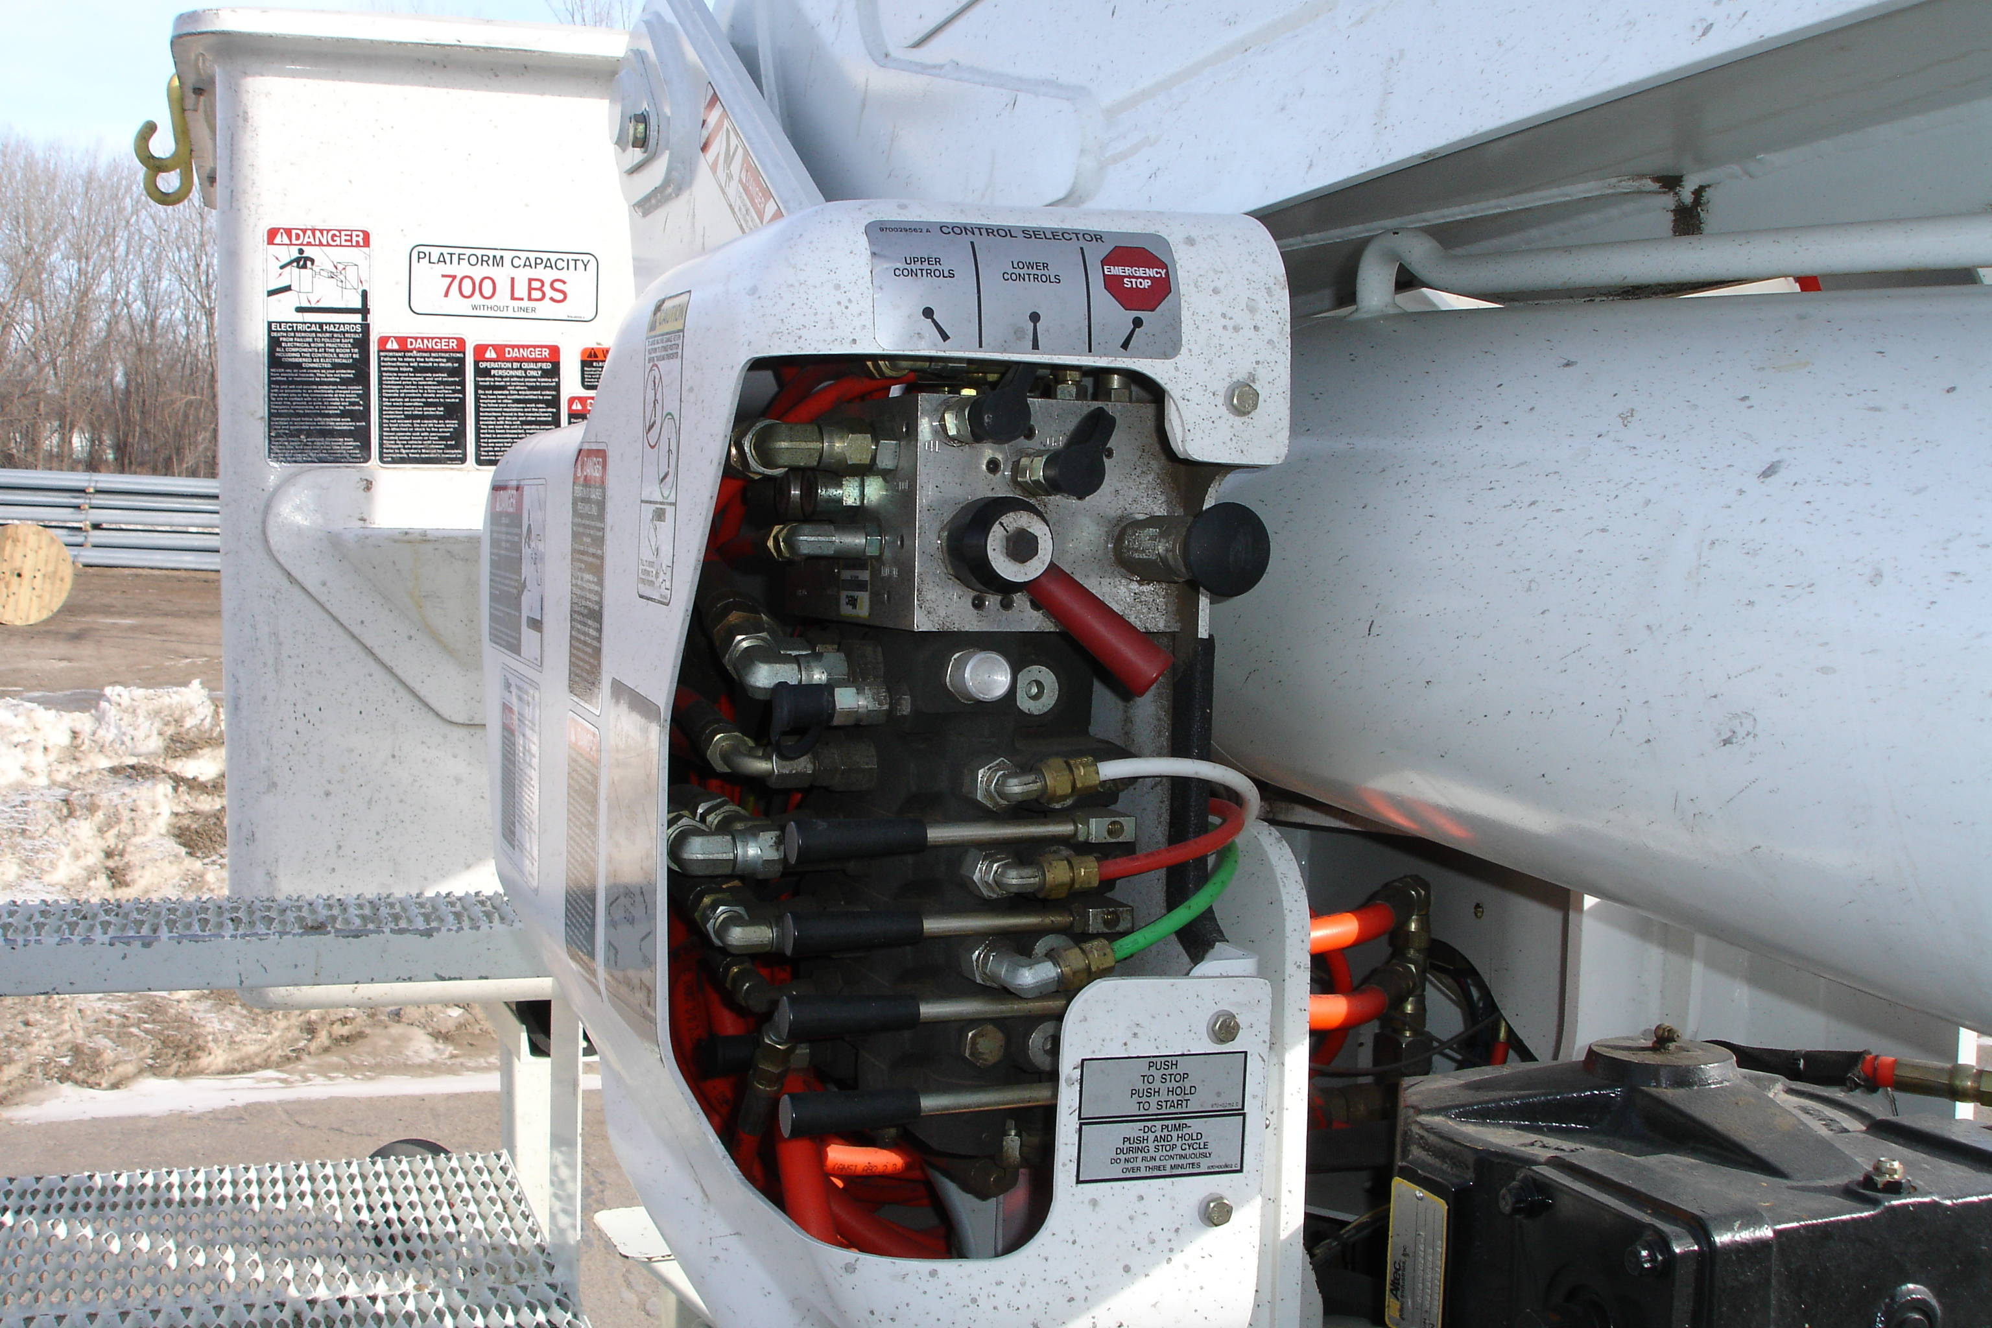
Over Center
Bucket will come to the ground
Bucket will tilt to make injured employ accessible for rescue
Become familiar with where the lower controls are located and how to use them
Notes:
Special Situations
Real life situations are not as ideal as practice sessions
Possible problem situations:
Truck won’t operate
Bucket between phases, cable TV, phone cable, guy in the way
Victim hanging out of bucket
Bucket still energized
Truck is energized
Bucket is on fire
Victim wedged in bucket
Other
Always be alert to the safety of everyone involved

Slide 11
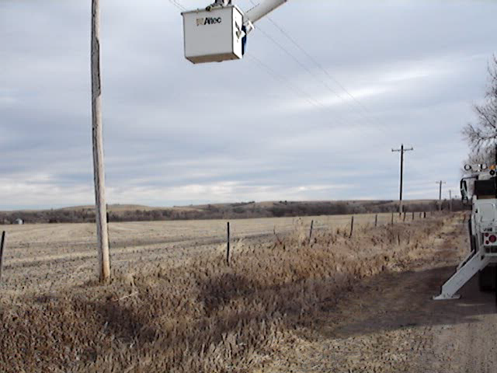
Practice Situational Rescues

Slide 12
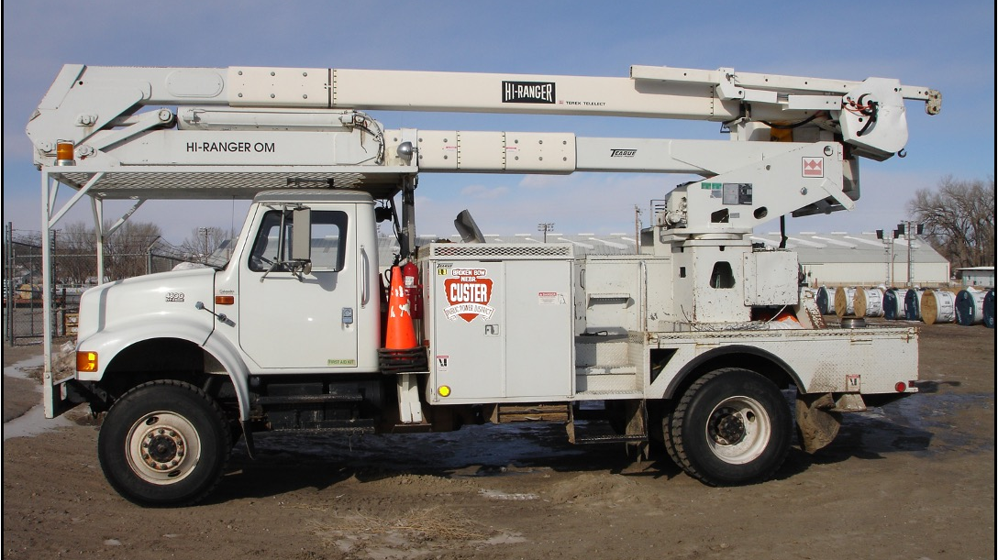
Over Center
Notes:
Discuss how to get victim out of each type of aerial lift in your company
Tilt bucket
Block and tackle
Manual lifting
Consider position of bucket to get the person out of the bucket
Bucket sitting on the ground
Above the cab
Elevated beside the truck

Slide 13
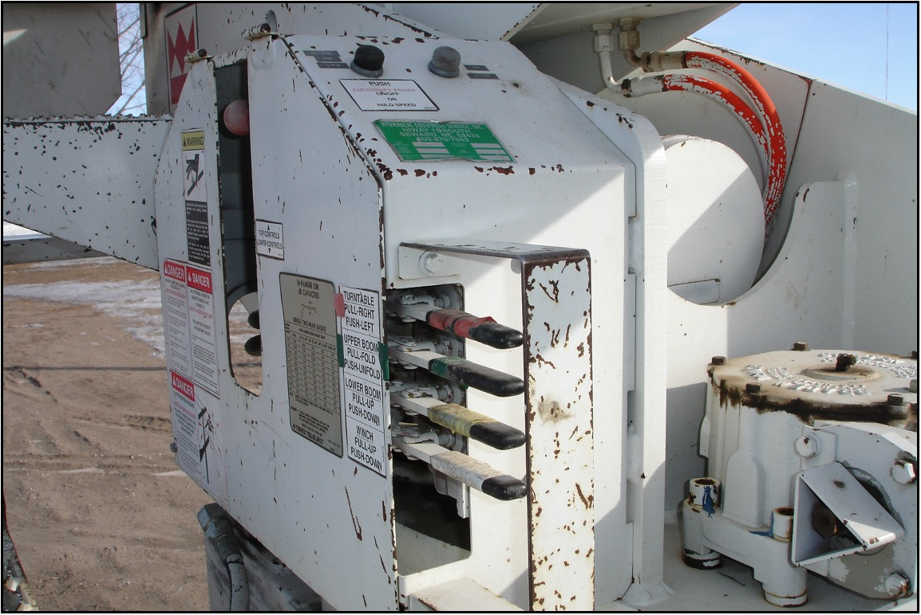
Over Center Lower Controls
Notes:
Practice using overcenter lower controls on various types of trucks

Slide 14
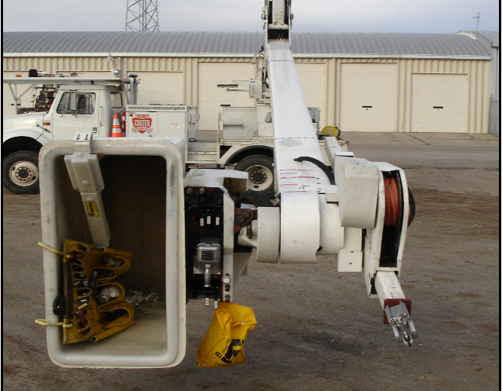
Over Center
If you take the bucket over center, it will come to the ground
Bucket will tilt to make the rescue more accessible
Notes:
Discuss where rescue devices are located on each aerial lift
If located in bin on side of unit:
Will rescue device be accessible when boom is in lowered position
Has rescue device been covered by other items (not accessible)
Is rescue device clearly marked
Is rescue device location clearly marked

Slide 15
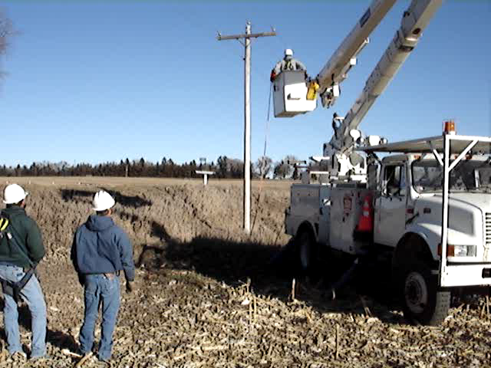
Don’t think “It won’t happen to me.”
Just ask someone who has had an accident what they thought before it happened.

Slide 16
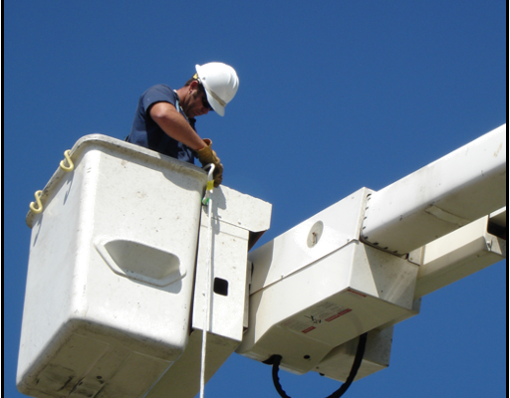
Bucket Descent Device
Use if your truck loses power to descend from the bucket
Notes:
Many different types of devices
A handline with a figure 8 works well and is not very expensive
Don’t forget to remove the lanyard from the attachment

Slide 17
Be careful when exiting

Slide 18
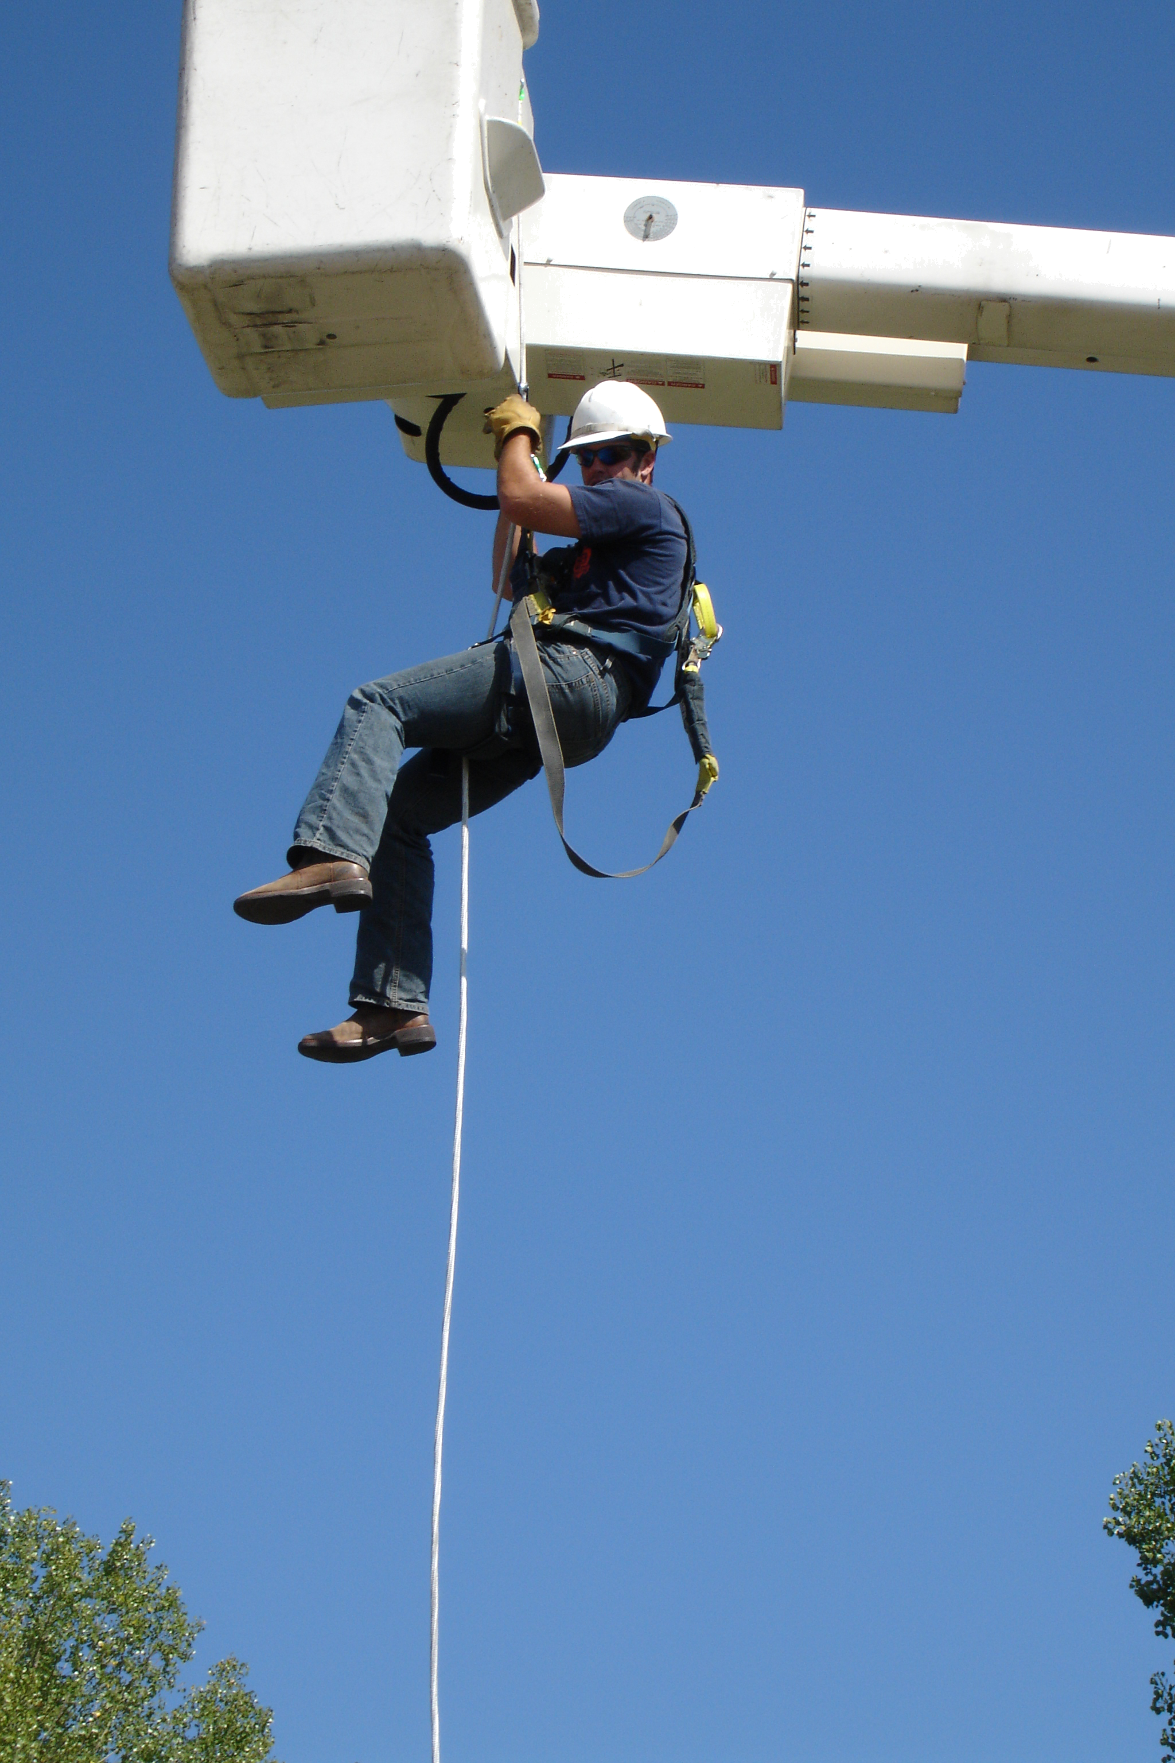
Practice, release slowly
Use gloves to reduce friction heat

Slide 19
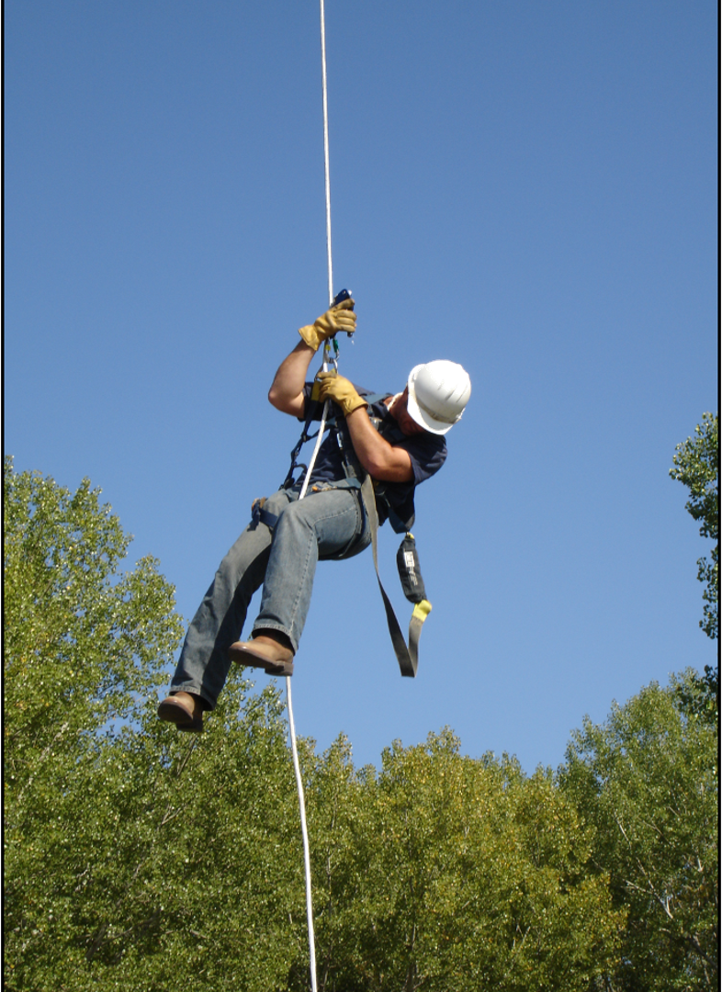
Watch the descent
Make sure there are no obstacles in the way

Slide 20
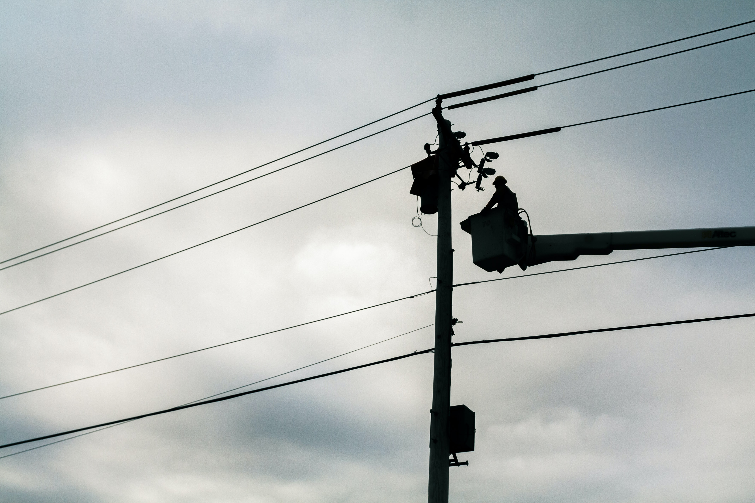
Questions?
Notes:
It is vital for employees to know and be skillful in procedures for an aerial lift rescue.
In an emergency, when one of our fellow workers becomes ill or injured, we must be able to act quickly and correctly.
Practice is one way to ensure that you will be ready and able to respond in an emergency.
Remember that it’s YOUR RESPONSIBILITY to see that your partner can RESCUE YOU if you are injured.

Slide 21
Test Questions (True or False)
Lift controls shall be tested each day prior to use.
Employees shall always stand firmly on the floor of the bucket.
Booms primarily designed for personnel carriers shall have both (upper) and (lower) controls.
An aerial lift truck may be moved when the boom is elevated in a working position with men in the bucket.
All non-over center bucket trucks lower the bucket to the ground.
Notes:
True
True
True
False
False

Slide 22
Test Questions Cont’d (True or False)
It is important to know your location when at the job site.
You should sometimes wear a harness while working in a bucket truck.
You make the May Day call before you start the rescue.
If a victim’s heart stops beating, they will suffer permanent brain damage in 2 to 4 minutes.
You don’t need to know how to operate the lower controls on the bucket if someone else on the crew knows how to operate them.
Notes:
True
False
True
False
False

Slide 23
Thank you
ISPC
info@ispconline.com
430.201.3201

