Slide 1
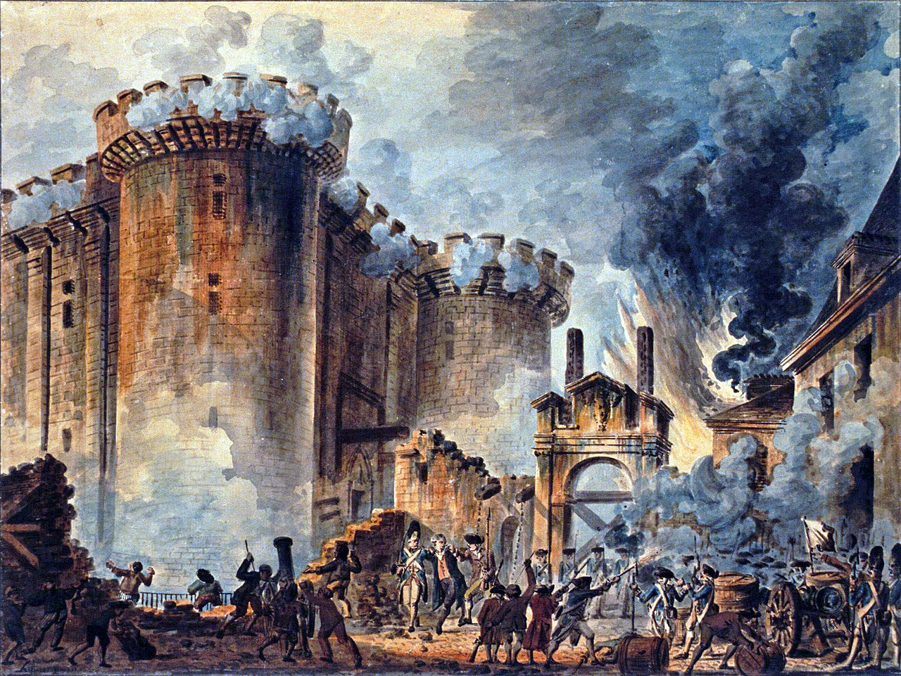
1789
The French Revolution: Part I

Slide 2
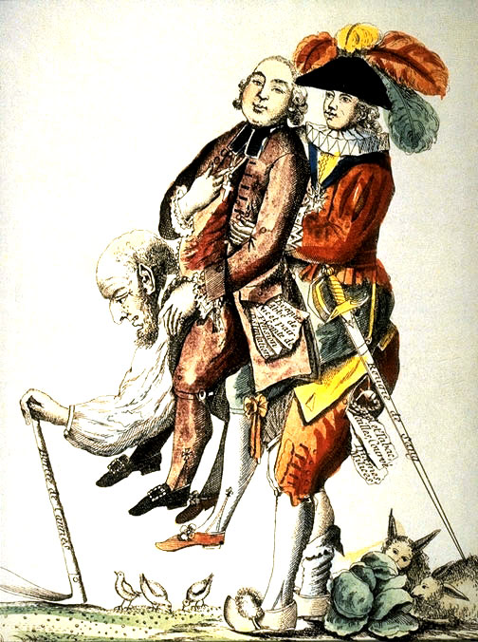
the Old Regime
1
TAX
EXEMPT
3%
2
THREE ESTATES:
First (Clergy)
Second (Nobility)
Third (Everyone Else)
97% of Population
3
Caricature of the Third Estate carrying the First Estate and the Second Estate on its back.

Slide 3
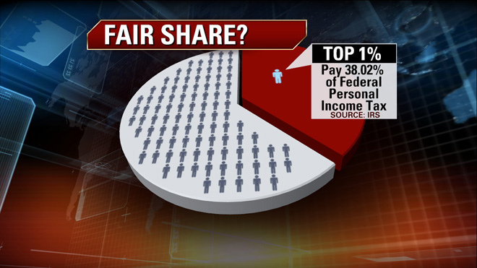
The Tax Burden in America Today
Fox Business: http://www.foxbusiness.com/politics/2012/01/25/truth-about-federal-tax-burden/

Slide 4
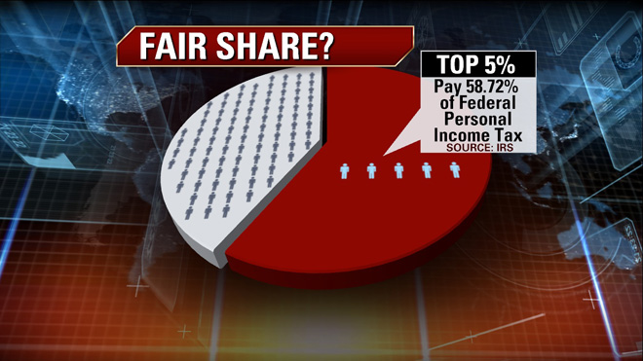
The Tax Burden in America Today
Fox Business: http://www.foxbusiness.com/politics/2012/01/25/truth-about-federal-tax-burden/

Slide 5
exempt
1
2

Slide 6
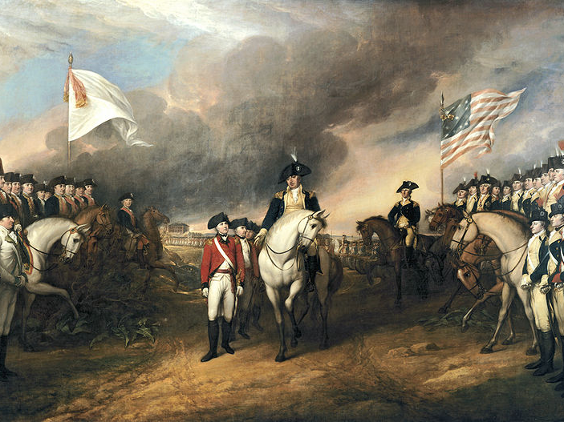
The American Revolution
1775-1783
French military & financial assistance to the U.S. was vital to winning the American Revolutionary War.

Slide 7
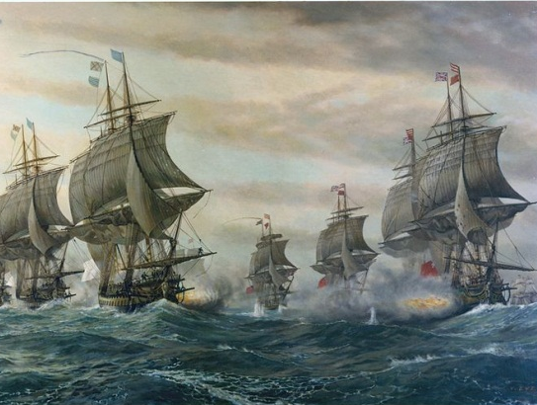
Battle of the Chesapeake

Slide 9
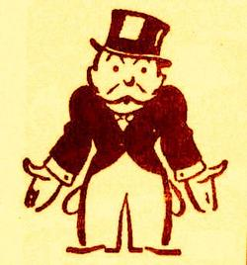
Budget Crisis

Slide 10
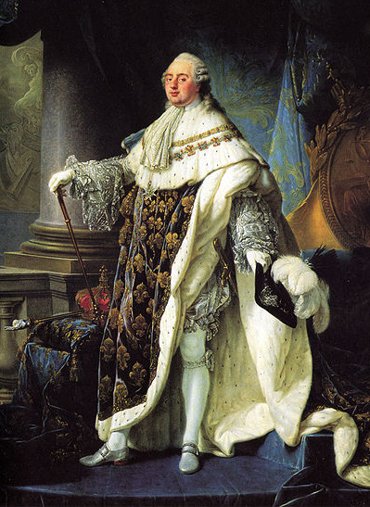
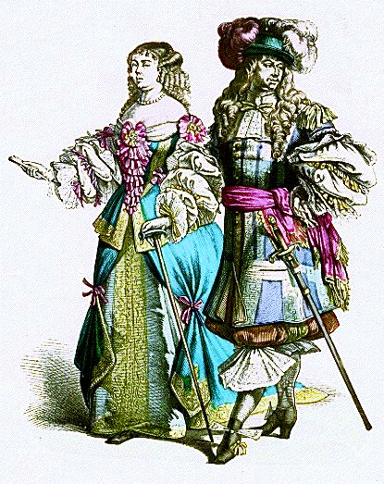
Aristocratic Resurgence
and Royal Weakness
WEAK
RESURGENCE

Slide 11
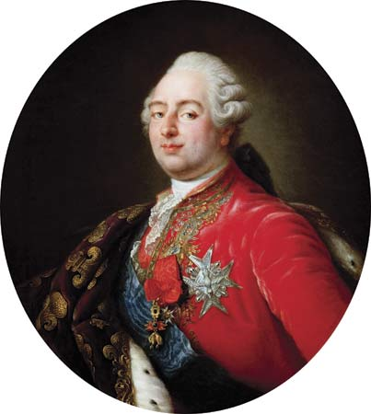
The Assembly of Notables
1787
In 1787, Louis XVI called an “Assembly of Notables,” hoping to get representatives from the nobility and the Church to agree to be taxed.

Slide 12
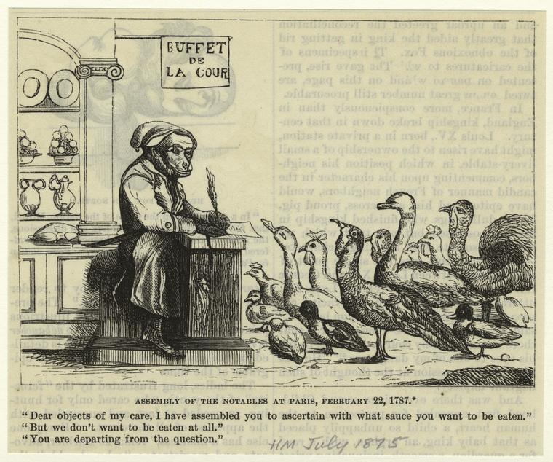
The Assembly of Notables
1787

Slide 13
The Assembly of Notables
1787
FAIL

Slide 14
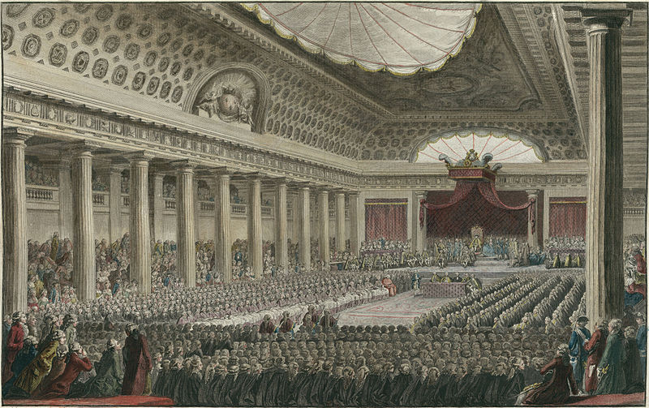
The Estates General
The French king’s advisory body
Not convened since 1614

Slide 15
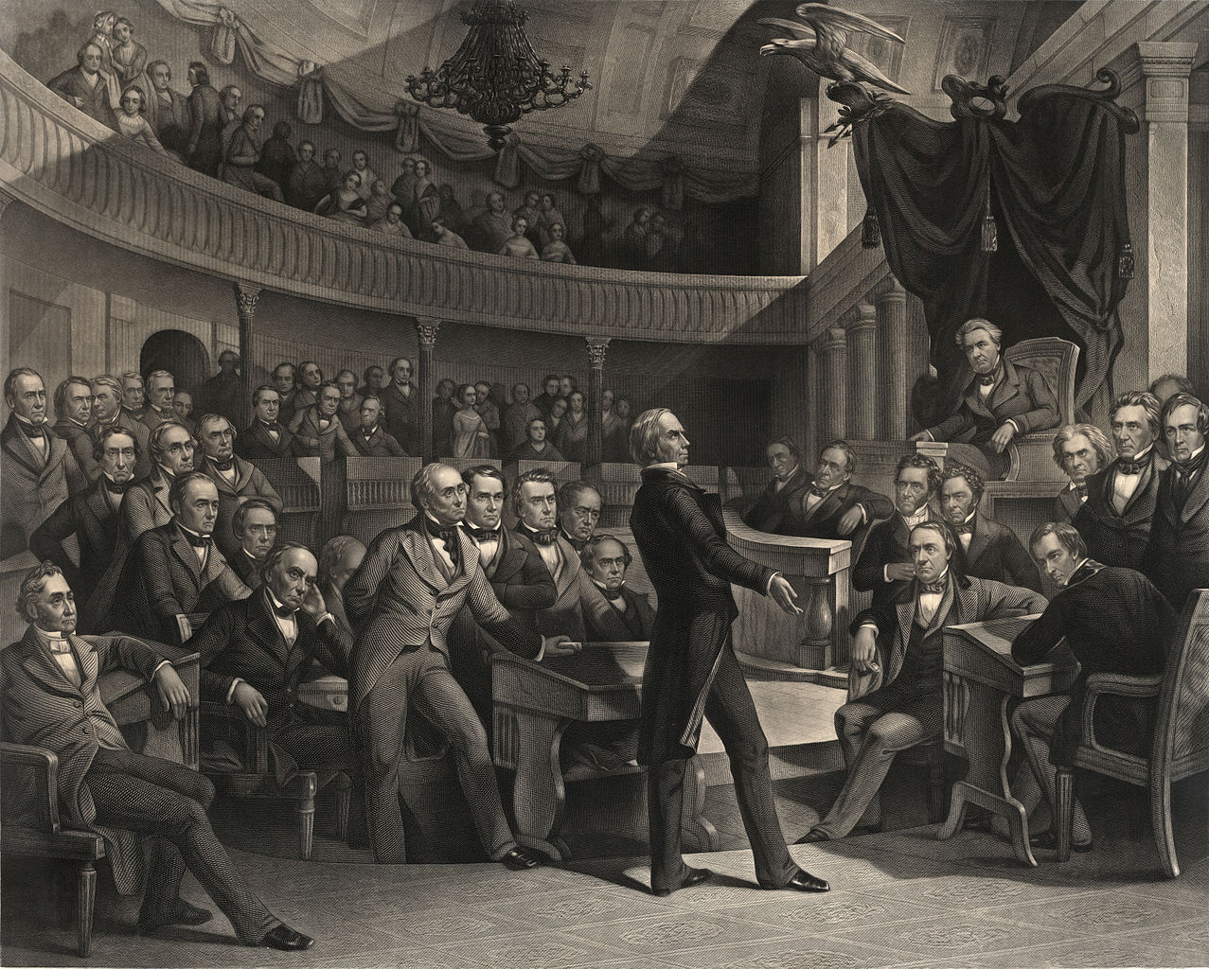
Outdated

Slide 16
Each estate cast one vote as a group.
1
2
3
The Clergy
The Nobility
Everyone Else

Slide 17
BOURGEOISIE

Slide 18
BOURGEOISIE
French Professional Class
(Merchants, Lawyers, etc.)

Slide 19
AGREEMENT = VICTORY
1
2
The Clergy
The Nobility

Slide 20
3% is a majority?
Image Credit: CarbonNYC

Slide 21
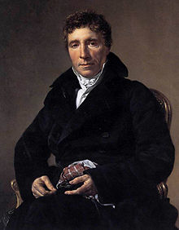
What is The Third Estate?
What is the Third Estate?
Everything.
What has it been until now in the political order?
Nothing.
What does it ask to become?
Something.
?
Sieyes

Slide 22
Reform Proposals
#1: “Doubling” the Third
1
2
3
3
The Clergy
The Nobility
Everyone Else

Slide 23
Reform Proposals
#2: Vote By Head
3
3
3
1
1
1
2
2
2
3
3
3
1
1
1
2
2
2
3
3
3
1
1
1
2
2
2
3
3
3
3
3
3
3
3
3

Slide 24
Reform Proposals
#2: Vote By Head
1
3
3
3
1
1
2
2
1
3
3
3
1
1
2
2
1
3
3
3
1
1
2
2
2
3
3
3
2
3
3
3
In a single assembly, individual nobles and priests could vote with the Third Estate delegates.
2
3
3
3

Slide 25
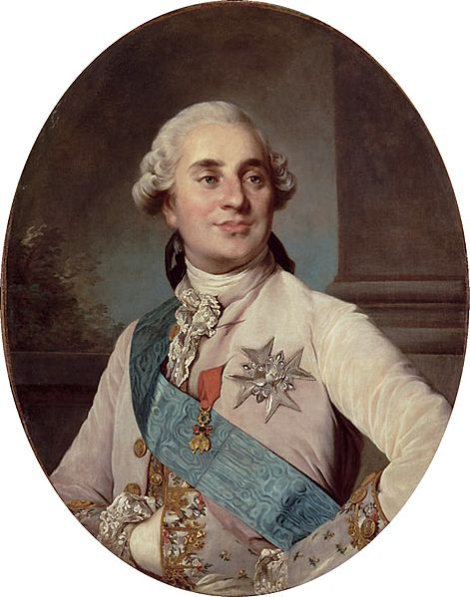
Indecision
“Doubling” the Third
Vote by Head

Slide 26
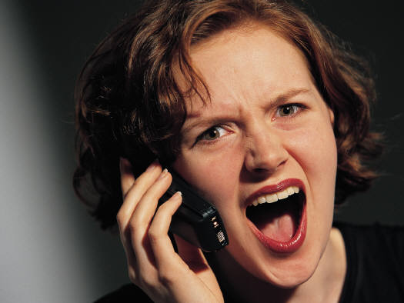
TWICE AS MANY ANGRY DELEGATES

Slide 27
Estates General Convenes
May, 1789

Slide 28
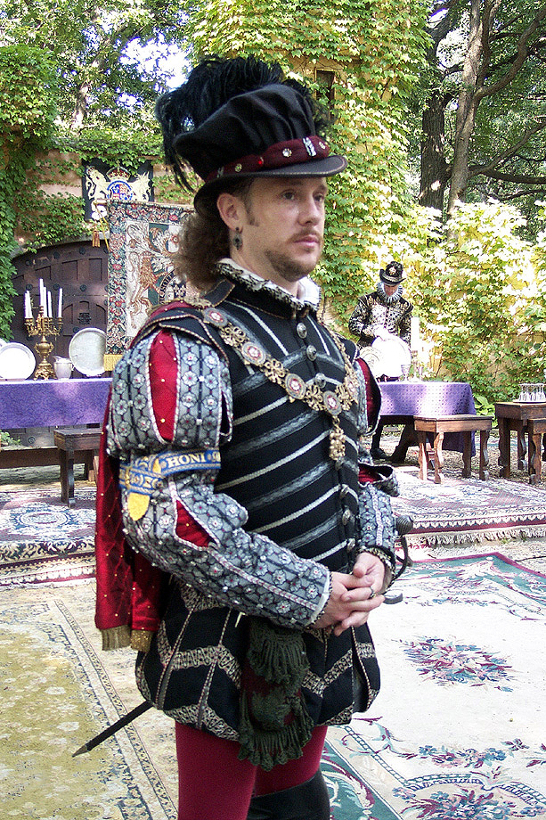
HAT FIASCO
Hats (sumptuary laws)
Louis: Hat off…
Clergy: Hats off….
Nobility: Hats off….
[Uncomfortable Pause]
Third Estate: Hats off.
[Uncomfortable Pause]
Louis: Hat on.
Photo Credit: One lucky guy

Slide 29
The National Assembly
June 17, 1789
3
3
3
1
1
1
2
2
2
3
3
3
1
1
1
2
2
2
3
3
3
1
1
1
2
2
2
3
3
3
3
3
3
3
3
3

Slide 30
The National Assembly
Join us!
1
1
1
2
2
2
1
1
1
2
2
2
1
1
1
2
2
2

Slide 31
The National Assembly
1
1
2
2
2
1
2
2
1
2
2

Slide 32
Three Days Later
Photo Credit: Ravages

Slide 33
The Tennis Court Oath
Photo Credit: Amara U

Slide 34
The Tennis Court Oath
The National Assembly pledged not to adjourn until they had adopted a constitution for France.
Photo Credit: Amara U

Slide 35
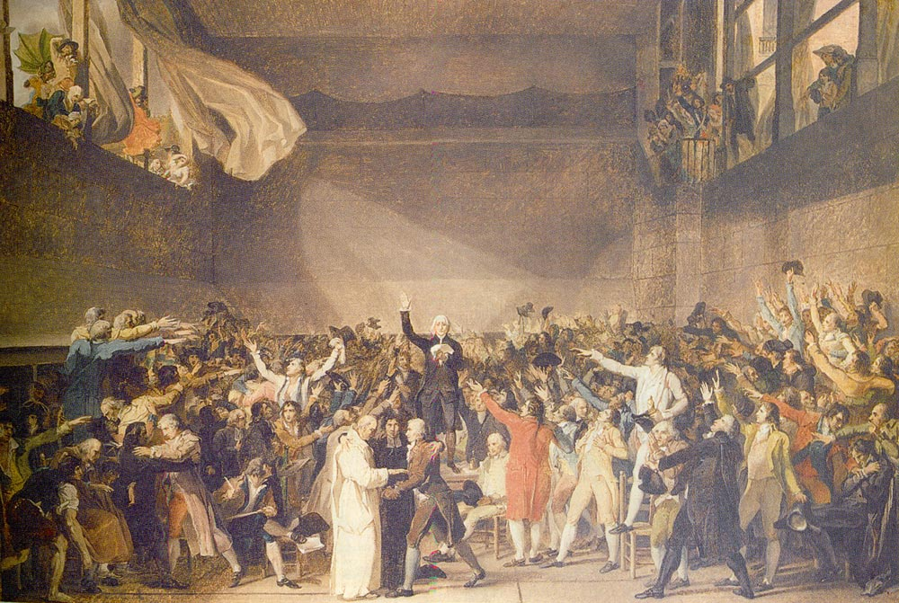
Jacques-Louis David, The Tennis Court Oath

Slide 36
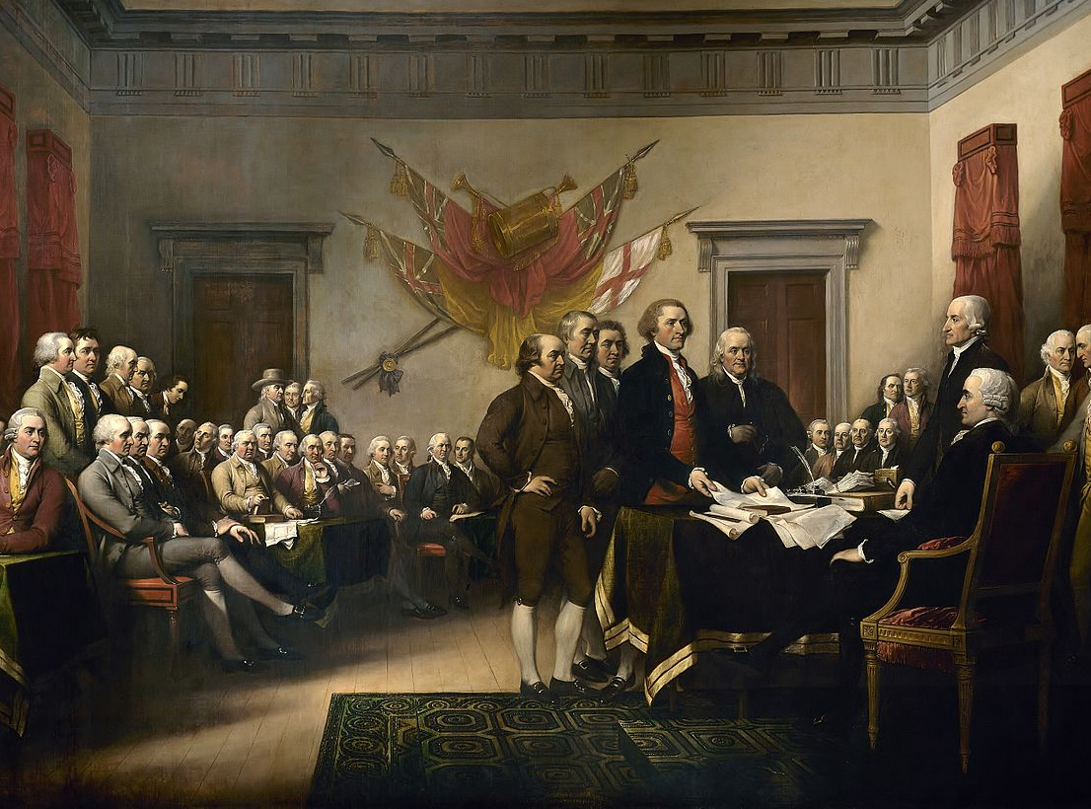
Compare
John Trumbull, The Declaration of Independence, 1819

Slide 37
CAPITULATION
Weird flex, but okay.

Slide 38
CAPITULATION
Louis finally recognized the National Assembly as a lawmaking body and directed the remaining First and Second Estate delegates to join the Assembly...

Slide 39
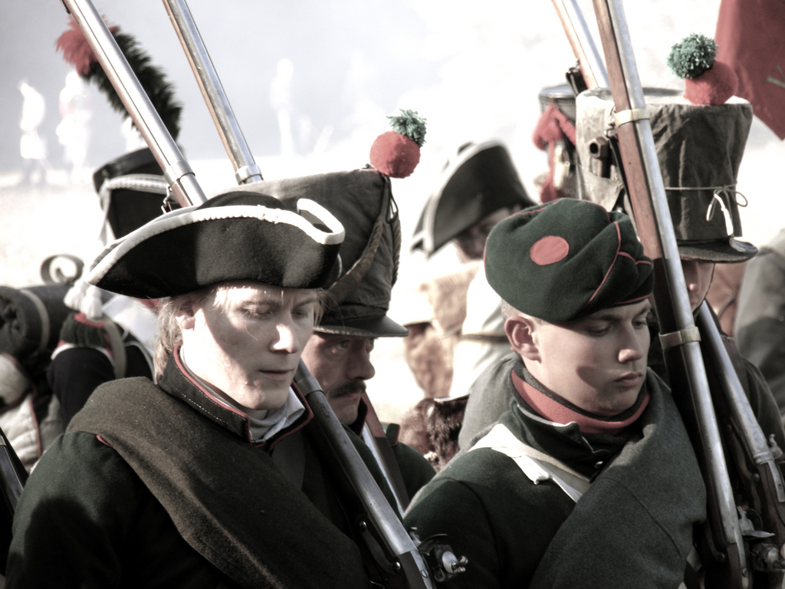
...but he brought troops to Versailles, just in case.
Photo Credit: guillermogg

Slide 40
Meanwhile, in Paris...
Photo Credit: Mark J P

Slide 41
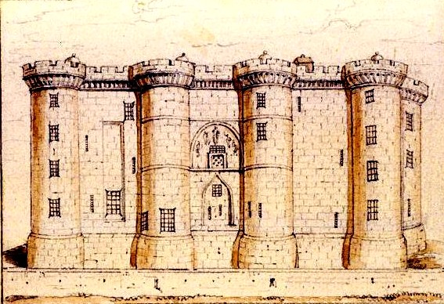
The Bastille

Slide 42
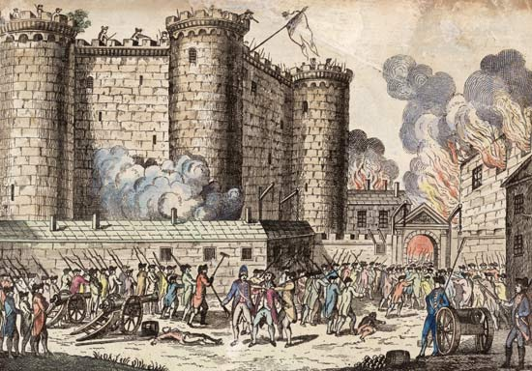
July 14, 1789

Slide 43
And in the Countryside...
Photo Credit: Mark J P

Slide 44
SHORTAGE

Slide 45
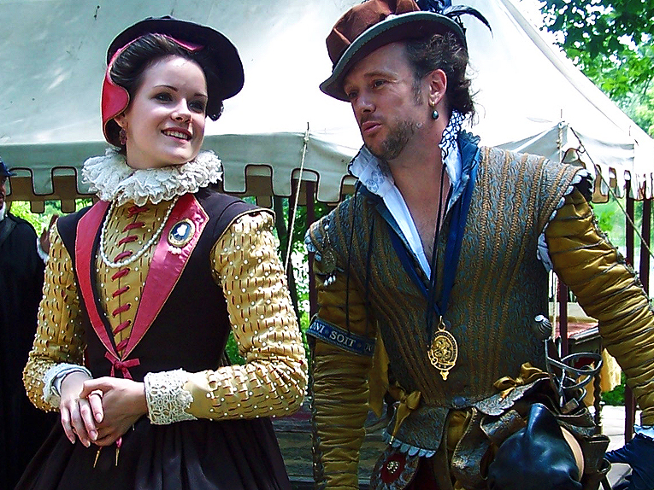
An Aristocratic Plot???
Photo Credit: One lucky guy

Slide 46
Let’s starve some peasants.
Photo Credit: One lucky guy

Slide 47
What a splendid idea!
Photo Credit: One lucky guy

Slide 48
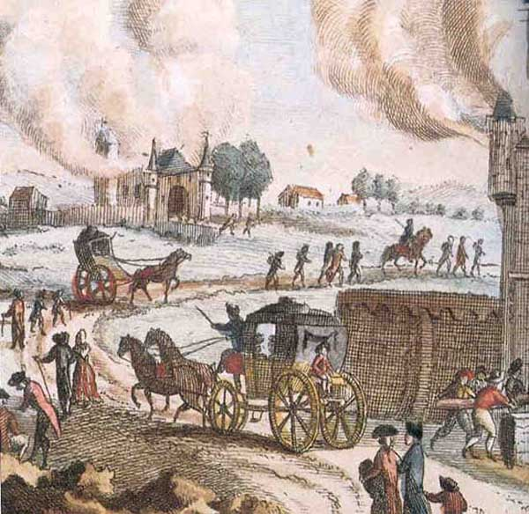
The Great Fear
Summer, 1789
PEASANT REVOLT

Slide 49
OOPS! Did they think we were serious?
Photo Credit: One lucky guy

Slide 50
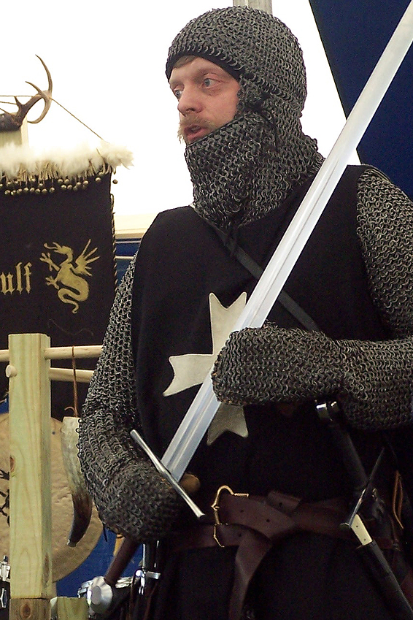
Decrees of August 4th
Abolished the “feudal system”
feudal dues
nobles’ hunting rights
tax exemptions
ABOLISHED
Link to Document
Photo Credit: One lucky guy

Slide 51
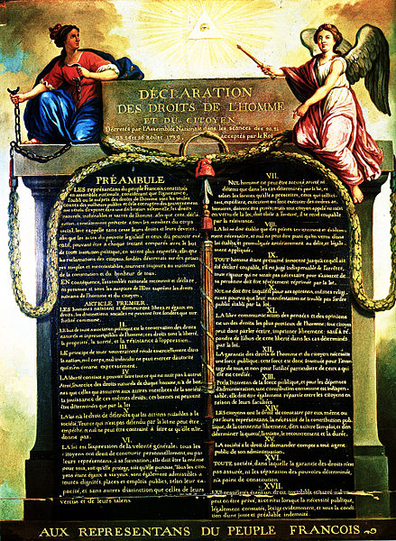
The Rights of Man

Slide 52
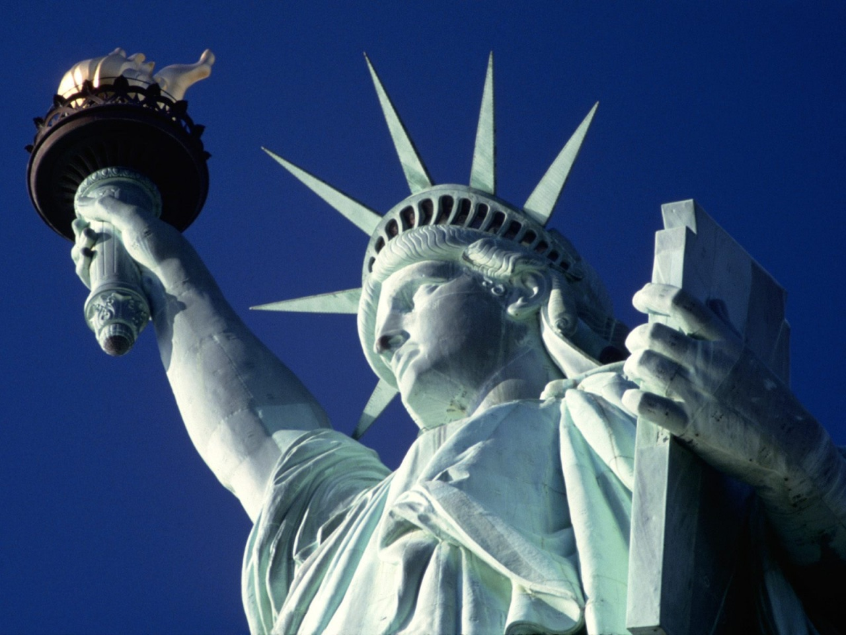
[Classical] Liberalism
Notes:
http://www.hdwallpapers.in/statue_of_liberty_new_york_city-wallpapers.html

Slide 53
[Classical] Liberalism
Limited Government
Economic Liberty
Political Liberty
Notes:
http://www.hdwallpapers.in/statue_of_liberty_new_york_city-wallpapers.html

Slide 54
[Classical] Liberalism
Aristocratic Privilege
State Religion
Absolute Monarchy
Notes:
http://www.hdwallpapers.in/statue_of_liberty_new_york_city-wallpapers.html

Slide 55
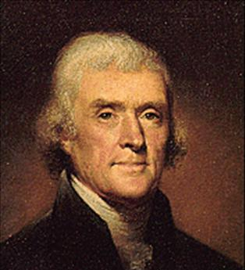
“We hold these truths to be self-evident, that all men are created equal, that they are endowed by their Creator with certain unalienable Rights, that among these are Life, Liberty and the pursuit of Happiness.” -- The Declaration of Independence
Notes:
http://www.hdwallpapers.in/statue_of_liberty_new_york_city-wallpapers.html

Slide 56
The Declaration of the Rights of Man and the Citizen
August 26, 1789
VIEW TEXT

Slide 57
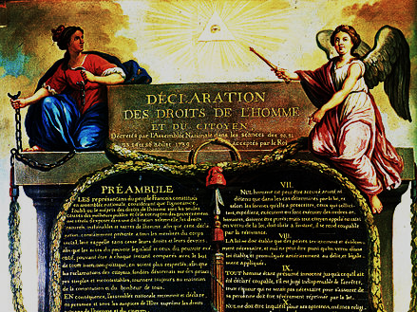
The Representatives of the French people, organized in National Assembly, considering that ignorance, forgetfulness, or contempt of the rights of man are the sole causes of public miseries and the corruption of governments, have resolved to set forth in a solemn declaration the natural, inalienable, and sacred rights of man...

Slide 58
From the SC Department of Education
Indicator 2.2
Release Item for this indicator
Read the quotation below and answer the question that follows.
The representative of the French people…have determined to set forth in a solemn declaration the natural, unreliable, and sacred rights of man…[and reinforce] the happiness of all.
French National Assembly, 1789
FAIL
This was seriously an item released by the South Carolina Department of Education that was included on the annual End of Course (EOC) examination for United States History. I could not make this up!!!

Slide 59
1. Men are born and remain free and equal in rights. Social distinctions may be founded only upon the general good.

Slide 60
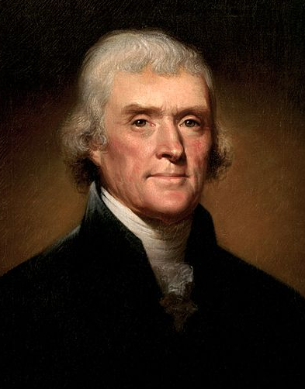
INFLUENCERS
Jefferson
Classical Liberalism

Slide 61
INFLUENCERS
Individual Rights

Slide 62
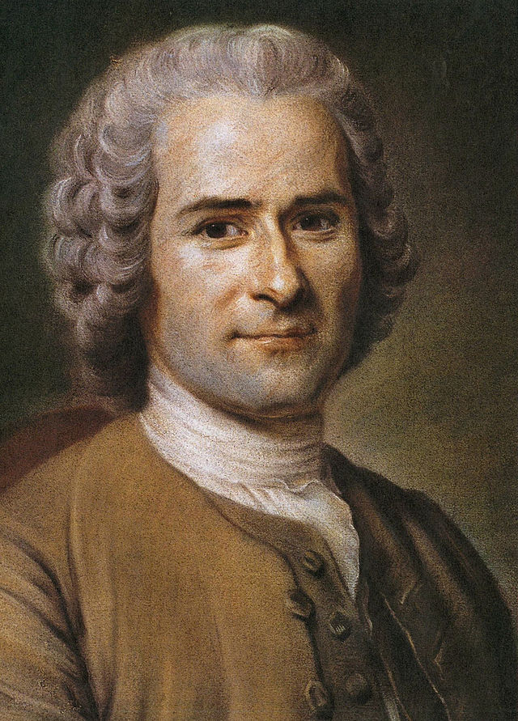
INFLUENCERS
Rousseau
Radical Democracy

Slide 63
INFLUENCERS
The General Will

Slide 64
INFLUENCERS
Proto-Socialist?

Slide 65
A DIALOGUE
Jefferson
Rousseau

Slide 66
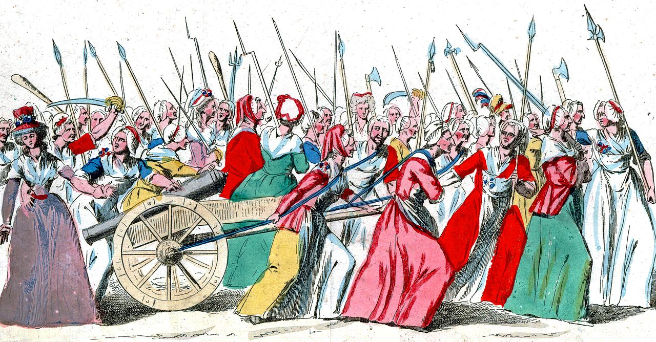
WOMEN’S MARCH ON VERSAILLES
October, 1789

Slide 67
WOMEN’S MARCH ON VERSAILLES
October, 1789
ROYAL FAMILY → PARIS

Slide 68
WOMEN’S MARCH ON VERSAILLES
October, 1789

Slide 69
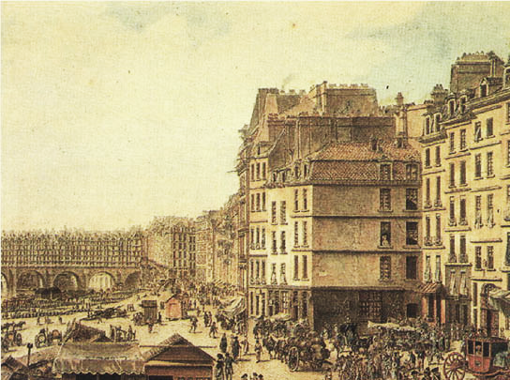
Parisian Revolution
After the Women’s March on Versailles, Paris became the Revolution’s epicenter.

Slide 70
The Civil Constitution of the Clergy
NEXT UP

