Slide 1
Translating Christian Spiritual and Mental Health Languages: Listen for the still, small voice
Tom Okamoto, MD
October 27th, 2018
Depression and the Church

Slide 2
Still Small Voice
Parallel Languages and events
Theology paralleling Mental Health
Not all Thought
Not all Feeling
Spirit drives towards attachment
Spirit drives towards healing and restoration
All healing is Relationship-promoting

Slide 3
Introduction
Citrus orchard
Chickens: being chased, watching
Grandmother as nanny
Japanese speaking
Converted by the Nazarene church
Preparing to do missionary work locally
WWII internment
Church preserved the property
Japanese culture –group vs. individual
Language and speech as minimal
Cultural, genetic (son)
Nonverbal, minimalist communication and aesthetic
Silence as valuable
Communication
Relational
Movement of the spirit
Still, small voice of the holy spirit (1 Kings 19:12)
Language and communications of God
Spiritual
Mental health theory/process

Slide 4
Christian Figures with Depression Symptoms
Martin Luther
CS Lewis
TS Eliot
Dorothea Dix
Abraham Lincoln
Mother Theresa
Henri Nouwen
Thomas Merton
Charles Stanley

Slide 5
Biblical Figures with Depressive symptoms Debbie McDaniels, blog at https://www.crosswalk.com/faith/spiritual-life/7-bible-figures-who-struggled-with-depression.html
•David
o 2 Samuel 12:15-23, 18:33.
o “My guilt has overwhelmed me like a burden too heavy to bear.” Ps. 38:4
o “Why are you downcast, O my soul? Why so disturbed within me? Put your hope in God for I will yet praise him, my Savior and my God.”Ps. 42:11
•Elijah
o “I have had enough Lord, he said. Take my life, I am not better than my ancestors.”1 Kings 19:4
•Jonah
o “Now O Lord, take away my life, for it is better for me to die than to live.” Jonah 4:3
o “…I am angry enough to die.” Jonah 4:9•

Slide 6
Biblical Figures with Depressive symptoms Debbie McDaniels, blog at https://www.crosswalk.com/faith/spiritual-life/7-bible-figures-who-struggled-with-depression.html
Moses
o “But now, please forgive their sin – but if not, then blot me out of the book you have written.” Ex. 32:32
•Jeremiah
o “Cursed be the day I was born…why did I ever come out of the womb to see trouble and sorrow and to end my days in shame?” Jer. 20:14,18
•Job
o “Why did I not perish at birth, and die as I came from the womb?” Job 3:11
o “I have no peace, no quietness, I have no rest, but only turmoil.” Job 3:26
o “I loathe my very life, therefore I will give free rein to my complaint and speak out in the bitterness of my soul.” Job 10:1
o “Terrors overwhelm me…my life ebbs away, days of suffering grip me. Night pierces my bones, my gnawing pains never rest.” Job 30:15-17

Slide 7
Origins and History of Psychiatry-Christian Influences
Johann Christian Reil, MD -PK
(father wanted him to study theology)
1801: “Psychiatry” as Medical Soul Care
Philippe Pinel, MD 1745-1826
“Far from being sinful people who deserve to be punished, the insane are sick people whose unhappy state deserves all of the sympathy that is owed to suffering humanity.”
Karl Bonhoeffer, MD-1828-1907
Oskar Pfister-1873-1956 pastor, friend of Freud, influenced Winnicott
D.W. Winnicott, MD-1896-1971
Benjamin Rush, MD-1746-1813
Dorothea Dix-1802-1887
Tavistock Clinic-1920
Hugh Crichton-Miller, MD-PK
John Rickman, MD-Quaker, influenced Bion
Wilfred Bion,MD
Karl Menninger, MD-1893-1990

Slide 8
Parallel Major Figures in Christianity and Psychoanalysis
C.S. Lewis
Wilfred Bion
Deprivation with parents
Early loss of mother
9yr old separation to British boarding school
World War I trauma
academia, depressive?
Loss of wife to cancer
Deprivation with Parents
Parents Christians in India
8yr old separation to British boarding school-religious bullying
WWI trauma, death of best friend, Quainton (Quaker)
Mood disorder?

Slide 9
Parallel Gatherings/Group Processes for the Holy Spirit?
Friends Church Legacy (Quaker Meetings)
“Communion after the manner of friends”
“Unprogrammed” meetings
“Centering down”
Inner Light
Tavistock Tradition (Bion, others)
three levels of group learning. The first is the heightened recognition that individuals behave irrationally in the face of authority
The next level is the ability to recognise group functioning and see the ways in which conscious efforts toward collaborative work can be hampered by irrational thinking on the part of group members
The third level of learning involves a shift toward new ways of thinking, this requires developing a capacity for both involvement and detachment, similar to what Harry Stack Sullivan called ‘participant-observer

Slide 10
Christian Concepts of Growth and Healing
Christian reference
Mental Health reference
Holy Spirit working in relationships
Spiritual gifts
Spiritual world
Healing through the Spirit
psychoanalytic third/intersubjective third
Character and identity
Latent vs. Manifest process
Libidinal object constancy, depressive phase, transmuting internalization, transcending to “O”

Slide 11
Therapy Language
Mental health
Christian reference
Mindfulness
Cognitive Therapy:
Psychoanalysis-psychodynamic
Intersubjective third
Ineffable, unnamable, unknowable , “O”, deep and formless infinite
“Always already”
“Infinite dread”
Centering Prayer
Phillippians 4:8: Finally, brothers and sisters, whatever is true, whatever is noble, whatever is right, whatever is pure, whatever is lovely, whatever is admirable--if anything is excellent or praiseworthy--think about such things.
For where two or three gather in my name, there am I with them. Matt 18:20
Things too wonderful for me to know
Ineffable, unknowable, unnamable, Yaweh, “I AM”
Fear of the Lord, Awe

Slide 12
Theory Language Theology Language
Attachment Theory: Mr. Rodgers Neighborhood
Neighbor and attachment
Harlow monkeys, anaclitic depression vs. relationship and attachment
Erik Erikson, Bowlby and other attachment psychoanalytic researchers
Object Relations Theory:
Separation-individuation
Transitional space (Winnicott)
Rapproachment (Margaret Mahler)
Love and affirmation
God is Love, He loves us, he adopts us, we are his children, he is our father
Relationship with God
The Fall
Forgiveness:
God is the great reconciler, Christ provides the reconciliation, for the forgiveness of sins, restoration from the fall

Slide 13
Languages of Depression
Biblical
Mental Health
Pride and Surrender
Valley of the Shadow of death
Spiritual darkness
Dark night of the soul
Poor in spirit
Spiritual bondage
Good and Evil
Narcissism and Relationship
Identity and Communion
Boundaries and Enmeshment,codependency
Depression and Joy
Illness and Health
Connection and Separation

Slide 14
Biblical Images of Depression
Valley of the Shadow of death
Spiritual darkness
Dark night of the soul
Poor in spirit
Spiritual bondage

Slide 15
Spiritual Bondage of Depression
Biological
Spiritual
Lack of Motivation
Lack of Energy
Negative Thoughts
Suicidal Ideation
Catastrophic Thoughts
Anxiety
Poor Cognitive Function
Isolation, self-centered, withdrawn
Lack of Joy
Lack of Relationship
Pride (codependency)
Lack of Grace
Lack of Trust
Gratification
Hopelessness
Worldly-Under the Sun

Slide 16
Spiritual Bondage of Depression II
Biological Deceptions
Spiritual Deceptions
Thought-created
Will-created
Character-created
Trauma-created
Event-created
Unchanging
Hopeless
Untreatable
Grace unfelt
Relationship distant
Isolation from God, others
Not chosen
Punishment for Sin
Punishment for Inadequacy
Hopeless
Unchangeable
Unredeemable
Unforgiveable
Evil-controlled

Slide 17
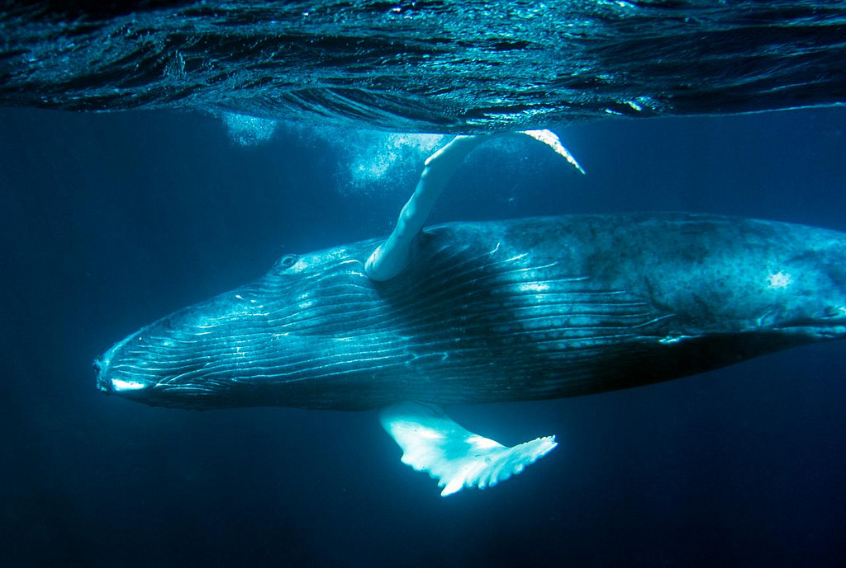
Job 41 Leviathan

Slide 18
Job 41
“Can you pull in Leviathan with a fishhook, or tie down its tongue with a rope?, Can you put a cord through its nose, or pierce its jaw with a hook? W ill it keep begging you for mercy? Will it speak to you with gentle words? Will it make an agreement with you, for you to take it as your slave for life? Can you make a pet of it like a bird or put it on a leash for the young women in your house? Will traders barter for it? Will they divide it up among the merchants? Can you fill its hide with harpoons, or its head with fishing spears? If you lay a hand on it,, you will remember the struggle and never do it again!, Any hope of subduing it is false; the mere sight of it is overpowering. No one is fierce enough to rouse it. Who then? Who is able to stand against me? Who has a claim against me that I must pay? Everything under heaven belongs to me. “I will not fail to speak of Leviathan’s limbs, its strength and its graceful form. Who can strip off its outer coat? Who can penetrate its double coat of armor a ? Who dares open the doors of its mouth, ringed about with fearsome teeth? Its back has rows of shields, tightly sealed together; each is so close to the next, that no air can pass between. They are joined fast to one another; they cling together and cannot be parted. Its snorting throws out flashes of light; its eyes are like the rays of dawn. Flames stream from its mouth; sparks of fire shoot out. Smoke pours from its nostrils, as from a boiling pot over burning reeds. Its breath sets coals ablaze, and flames dart from its mouth. Strength resides in its neck; dismay goes before it. The folds of its flesh are tightly joined; they are firm and immovable. Its chest is hard as rock, hard as a lower millstone. When it rises up, the mighty are terrified; they retreat before its thrashing. The sword that reaches it has no effect, nor does the spear or the dart or the javelin. Iron it treats like straw, and bronze like rotten wood. Arrows do not make it flee; slingstones are like chaff to it. A club seems to it but a piece of straw; it laughs at the rattling of the lance. Its undersides are jagged potsherds, leaving a trail in the mud like a threshing sledge. It makes the depths churn like a boiling caldron, and stirs up the sea like a pot of ointment. It leaves a glistening wake behind it; one would think the deep had white hair. Nothing on earth is its equal—a creature without fear. It looks down on all that are haughty; it is king over all that are proud.”

Slide 19
Job 42: 1-6
Then Job replied to the Lord:
“I know that you can do all things;
no purpose of yours can be thwarted.
You asked, ‘Who is this that obscures my plans without knowledge?’
Surely I spoke of things I did not understand,
things too wonderful for me to know.
“You said, ‘Listen now, and I will speak;
I will question you,
and you shall answer me.’
My ears had heard of you
but now my eyes have seen you.
Therefore I despise myself
and repent in dust and ashes.”

Slide 20
Job 42: 10-17
¹⁰ After Job had prayed for his friends, the Lord restored his fortunes and gave him twice as much as he had before. ¹¹ All his brothers and sisters and everyone who had known him before came and ate with him in his house. They comforted and consoled him over all the trouble the Lord had brought on him, and each one gave him a piece of silver^{[d]} and a gold ring.
¹² The Lord blessed the latter part of Job’s life more than the former part. He had fourteen thousand sheep, six thousand camels, a thousand yoke of oxen and a thousand donkeys. ¹³ And he also had seven sons and three daughters. ¹⁴ The first daughter he named Jemimah, the second Keziah and the third Keren-Happuch. ¹⁵ Nowhere in all the land were there found women as beautiful as Job’s daughters, and their father granted them an inheritance along with their brothers.
¹⁶ After this, Job lived a hundred and forty years; he saw his children and their children to the fourth generation. ¹⁷ And so Job died, an old man and full of years.

Slide 21
Jeremiah 29:11-14 (NIV) Restoration from Exile
For I know the plans I have for you,” declares the Lord, “plans to prosper you and not to harm you, plans to give you hope and a future.
Then you will call on me and come and pray to me, and I will listen to you. You will seek me and find me when you seek me with all your heart.
I will be found by you,” declares the Lord, “and will bring you back from captivity.
I will gather you from all the nations and places where I have banished you,” declares the Lord, “and will bring you back to the place from which I carried you into exile.”

Slide 22
Isaiah 61
The Spirit of the Sovereign Lord is on me, because the Lord has anointed me to proclaim good news to the poor. He has sent me to bind up the brokenhearted, to proclaim freedom for the captives and release from darkness for the prisoners, to proclaim the year of the Lord’s favor and the day of vengeance of our God, to comfort all who mourn, and provide for those who grieve in Zion—to bestow on them a crown of beauty instead of ashes, the oil of joy instead of mourning, and a garment of praise instead of a spirit of despair. They will be called oaks of righteousness, a planting of the Lord for the display of his splendor. They will rebuild the ancient ruins and restore the places long devastated; they will renew the ruined cities that have been devastated for generations. Strangers will shepherd your flocks; foreigners will work your fields and vineyards. And you will be called priests of the Lord, you will be named ministers of our God. You will feed on the wealth of nations, and in their riches you will boast. Instead of your shame you will receive a double portion, and instead of disgrace you will rejoice in your inheritance. And so you will inherit a double portion in your land, and everlasting joy will be yours. “For I, the Lord, love justice; I hate robbery and wrongdoing. In my faithfulness I will reward my people and make an everlasting covenant with them. Their descendants will be known among the nations and their offspring among the peoples. All who see them will acknowledge that they are a people the Lord has blessed.” I delight greatly in the Lord; my soul rejoices in my God. For he has clothed me with garments of salvation and arrayed me in a robe of his righteousness, as a bridegroom adorns his head like a priest, and as a bride adorns herself with her jewels. For as the soil makes the sprout come up and a garden causes seeds to grow, so the Sovereign Lord will make righteousness and praise spring up before all nations.

Slide 23
Still Small Voice
Parallel Languages and events
Theology paralleling Mental Health
Not all Thought
Not all Feeling
Spirit drives towards attachment
Spirit drives towards healing and restoration
All healing is Relationship-promoting

