Slide 1
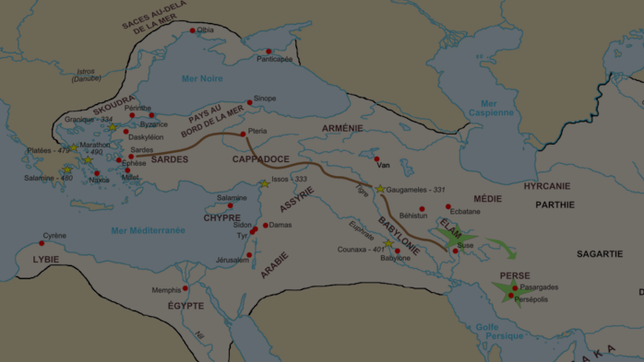
MAP COLLECTION
Persian Empire & Alexander the Great

Slide 2
This map collection was assembled using Google Images for the convenience of other educators who are looking for maps of Persia and Alexander’s conquests. I’ve given credit where possible and make no claim of authorship or originality of any uncredited maps.

Slide 3
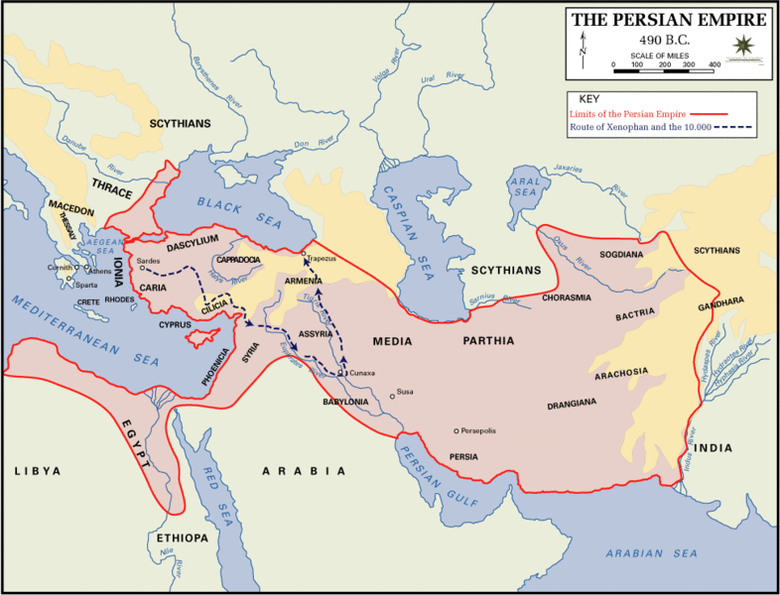

Slide 4
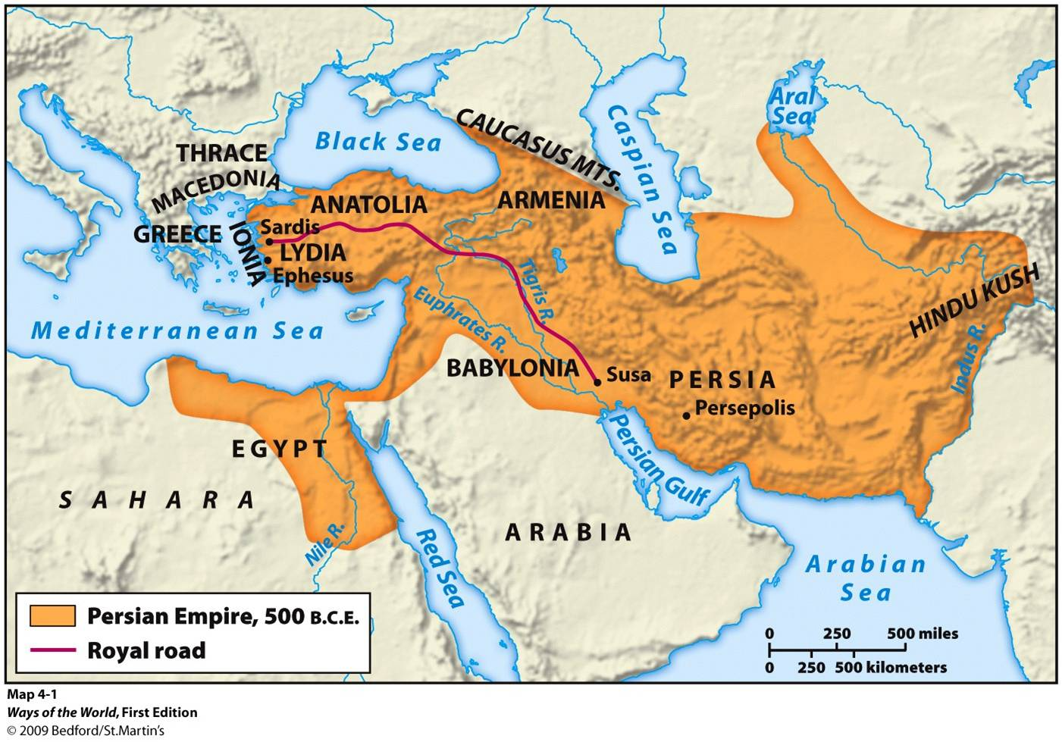

Slide 5
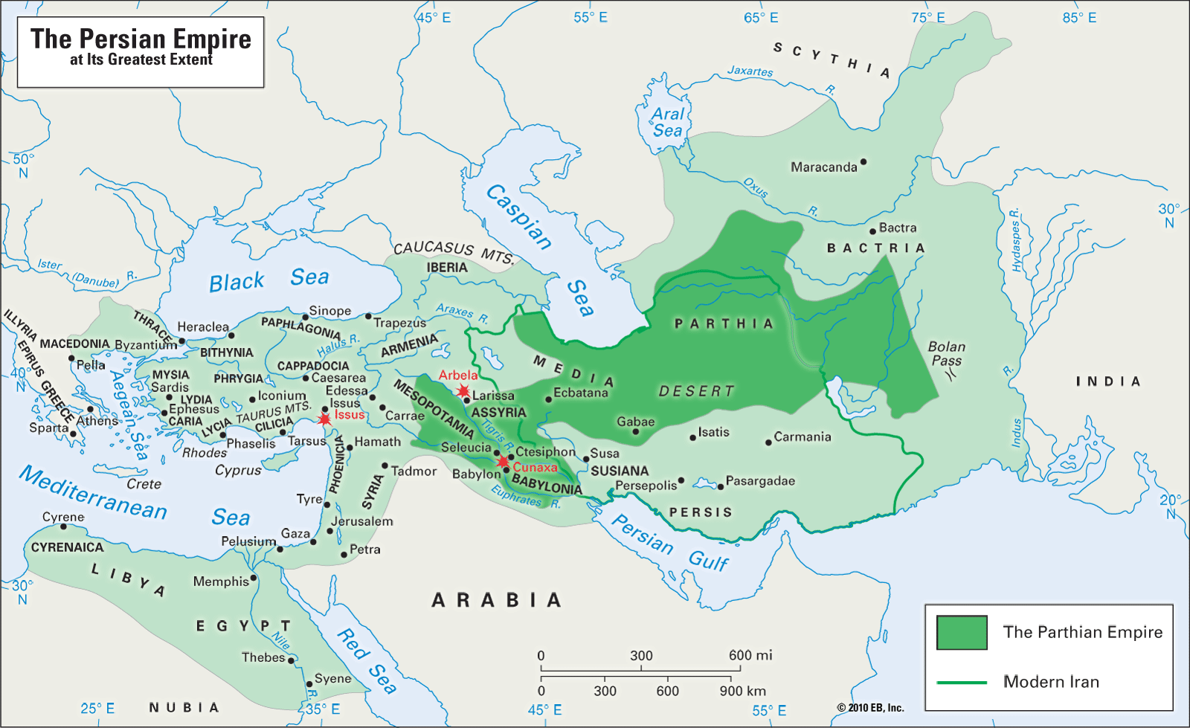

Slide 6
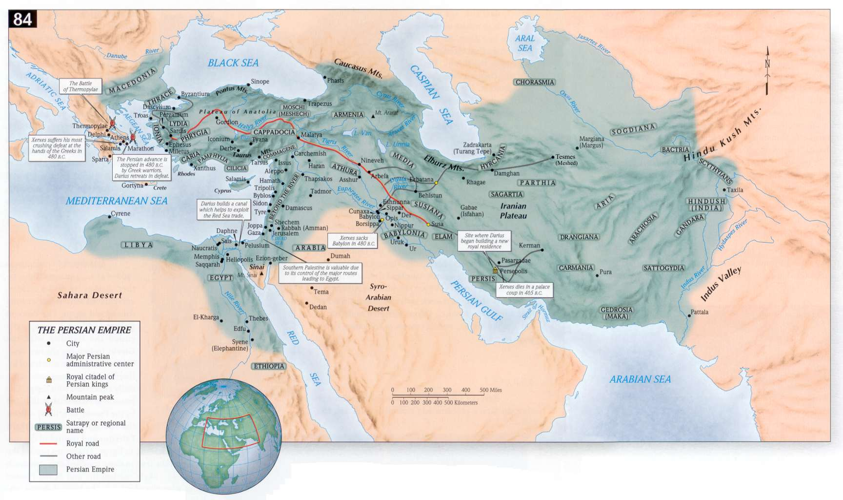

Slide 7
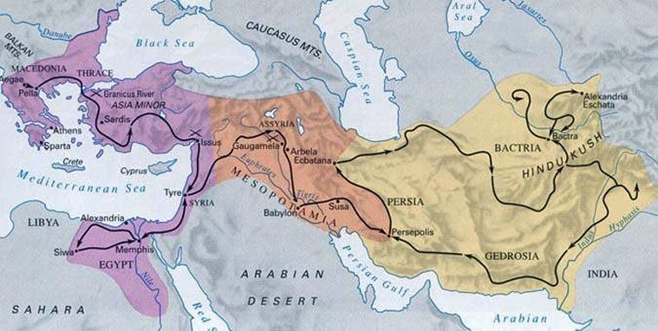

Slide 8
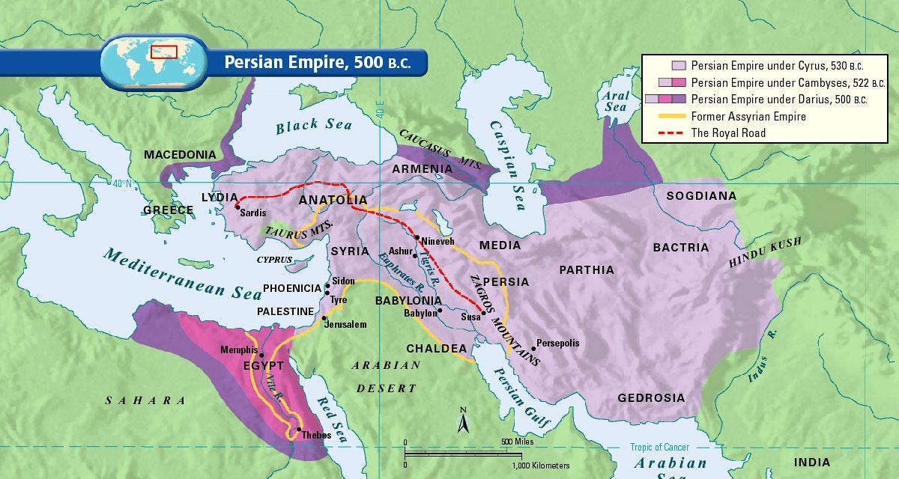

Slide 9
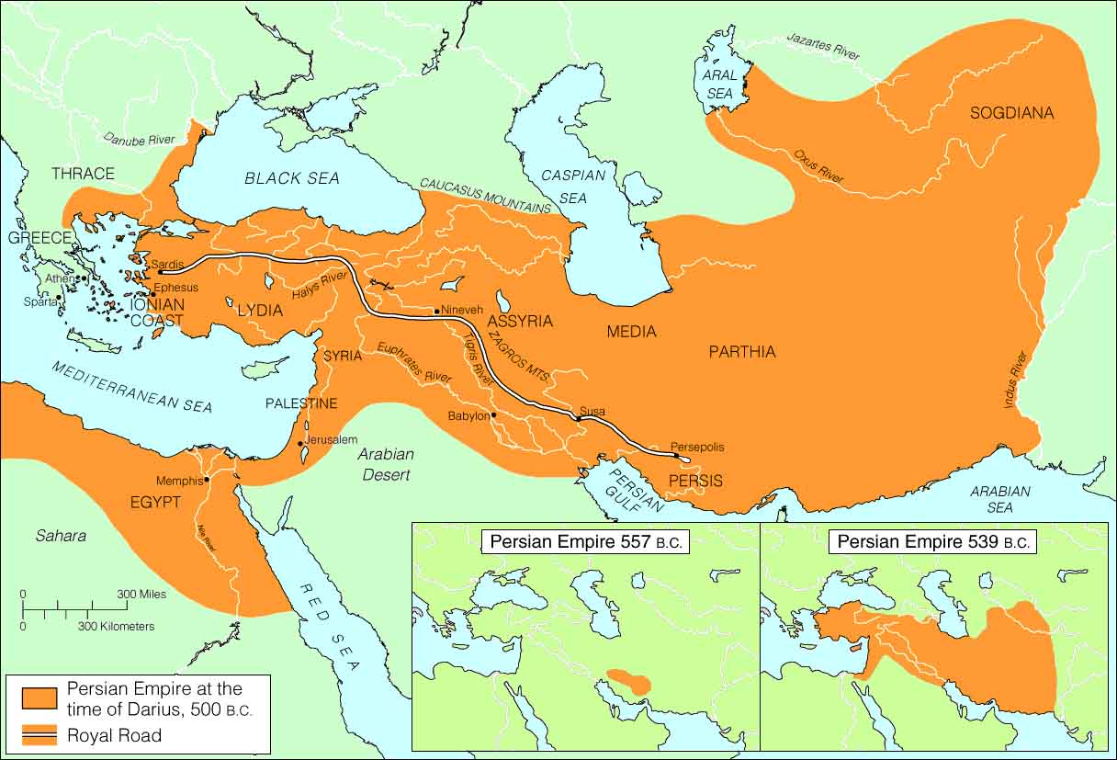

Slide 10
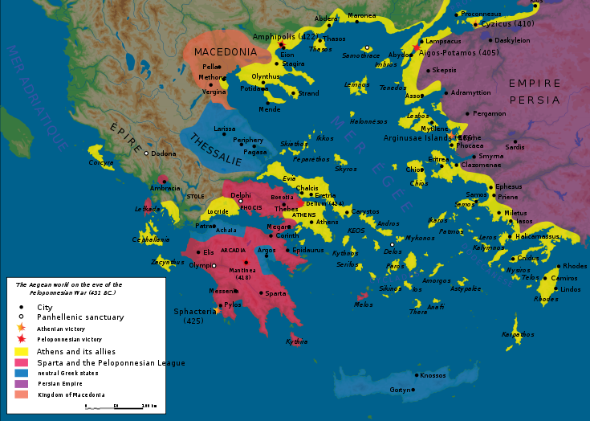

Slide 11
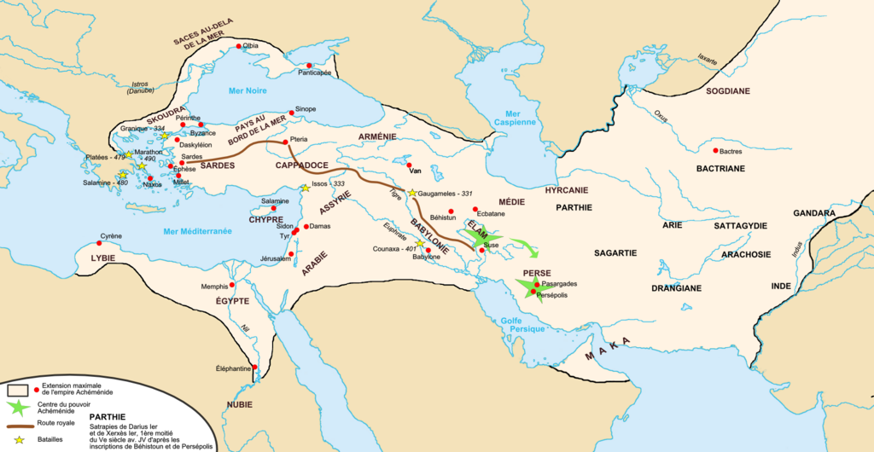
Map Credit: Fabienkhan

Slide 12
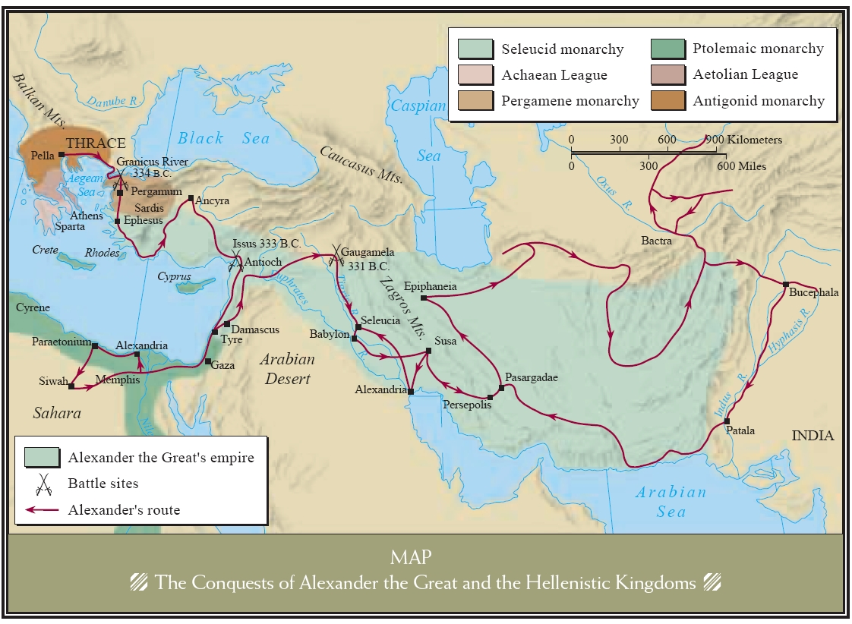

Slide 13
LEARNING. DELIVERED.

