Slide 1
The Apology

Slide 2
THEMES
What is Wisdom?
What is Virtue?

Slide 3
APOLOGY
[uh-pol-uh-jee]
noun, plural -gies.
1. a written or spoken expression of one's regret, remorse, or sorrow for having insulted, failed, injured, or wronged another: He demanded an apology from me for calling him a crook.
2. a defense, excuse, or justification in speech or writing, as for a cause or doctrine.

Slide 4
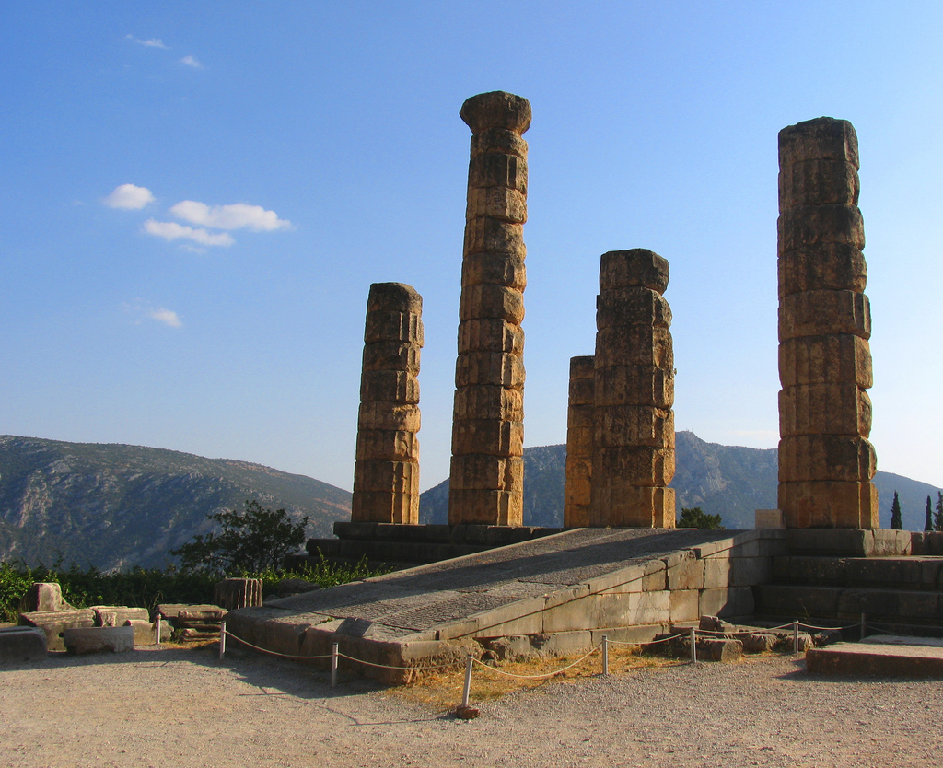
γνῶθι σεαυτόν
Photo by karol m

Slide 5
(Know Thyself)
Photo by karol m

Slide 6
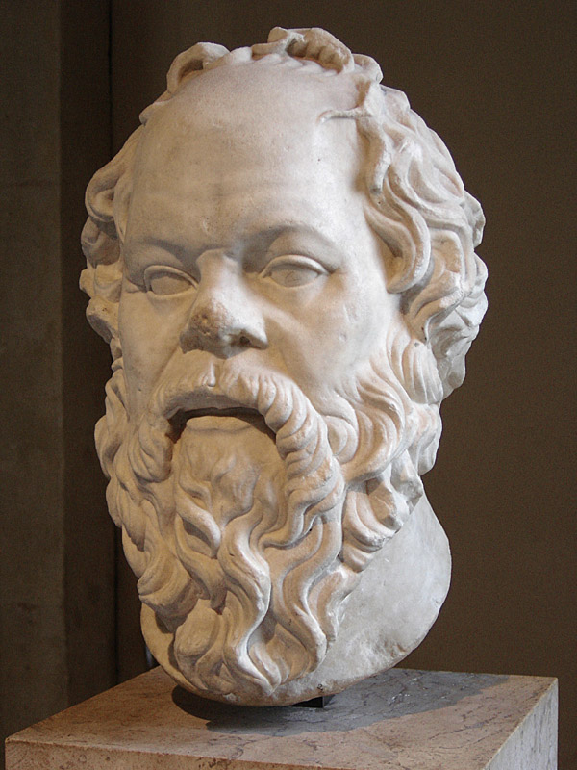
There is No One Wiser
Photo by Eric Gaba

Slide 7
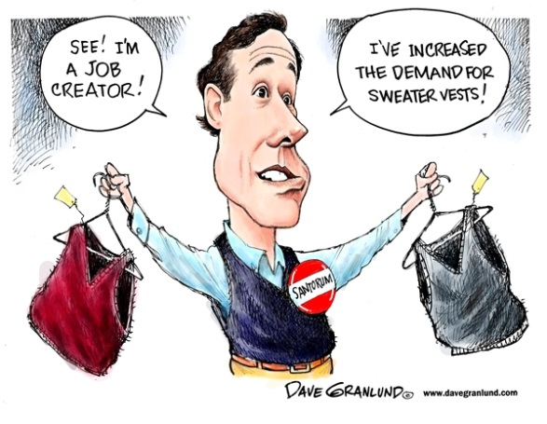
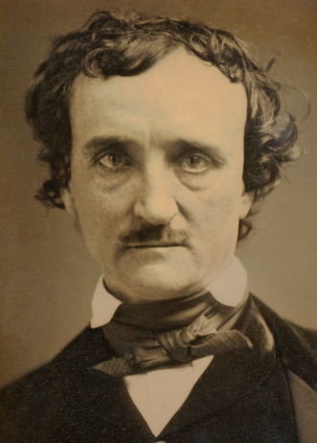
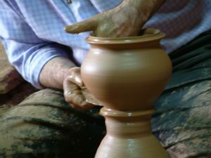
Empiricism
Socrates set out to prove the Oracle wrong by finding someone wiser than he was.
An empiricist seeks evidence of any claim.
Photo taken by Randy Oostdyk
Politicians
Poets
Artisans

Slide 8
What is Wisdom?
Photo by Eric Gaba

Slide 9
“Well, although I do not suppose that either of us knows anything really beautiful and good, I am better off than he is - for he knows nothing, and thinks that he knows. I neither know nor think that I know…”
Photo by Eric Gaba

Slide 10
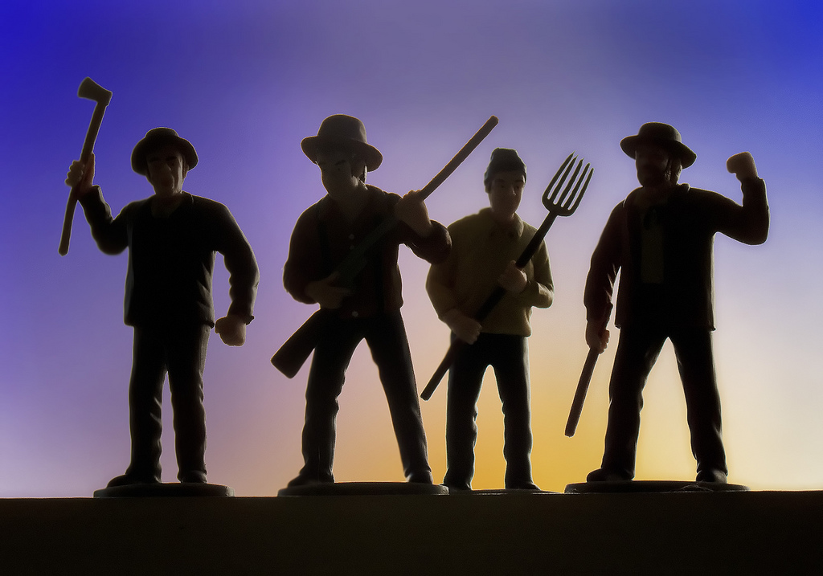
“I went to try to explain to him… and the consequence was he hated me.”
Photo by Robert Couse-Baker

Slide 11
Sophist
R
What evidence does Socrates provide that he is NOT a sophist?
R
R

Slide 12
ATHEISM
Was Socrates an Atheist?

Slide 13
“The unexamined life is not worth living.”
Photo by Eric Gaba

Slide 14
“The greatest good of man is daily to converse about virtue.”
Photo by Eric Gaba

Slide 15
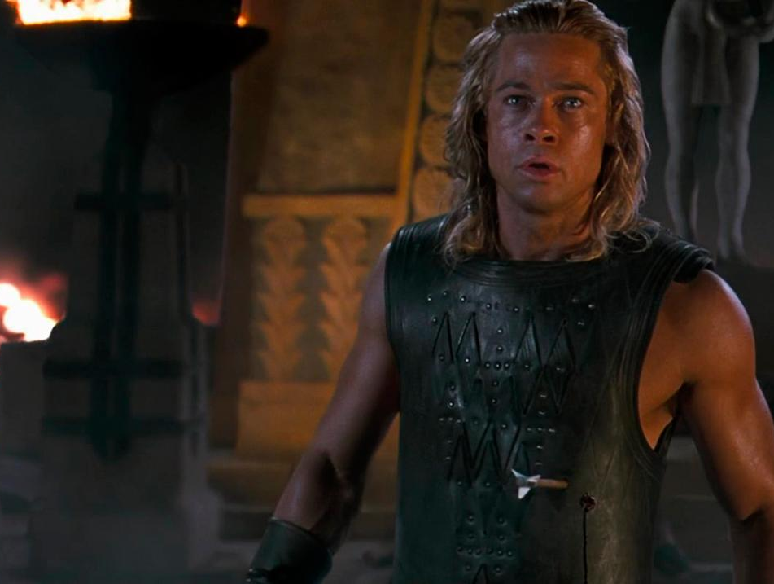
Manliness
“But I had not the boldness or impudence or inclination to address you as you would have liked me to address you, weeping and wailing and lamenting, and saying and doing many things which you have been accustomed to hear from others, and which, as I say, are unworthy of me."
Screenshot from Troy (2004)

Slide 16
“Now I say if death is like this, it is an unspeakable gain.”
Photo by Eric Gaba

Slide 17
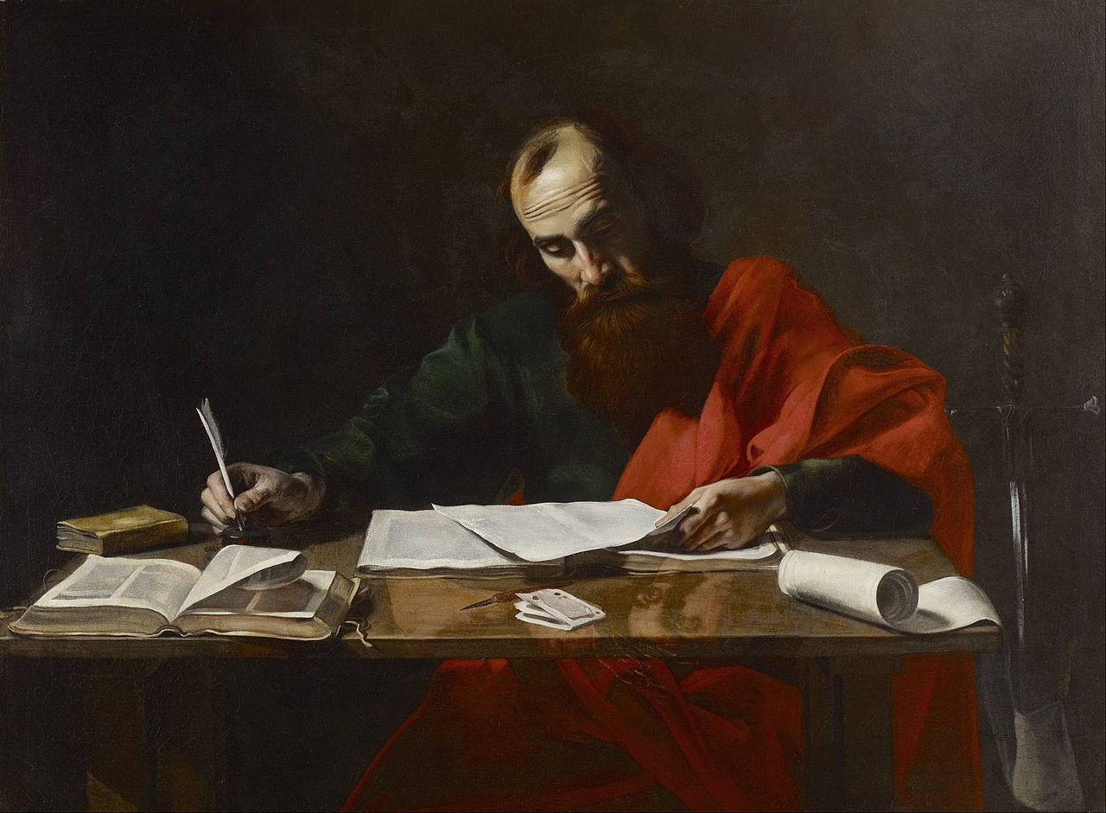
“For to me, to live is Christ and to die is gain.”
–Phil 1: 21

