Slide 1
Creating
Ad’s
for Real Estate
This Document was created by The Orange Stack for Allison James Real Estate Agents. For questions of strategies to get more reach from your Facebook Advertising, please reach out to us at www.TheOrangeStack.com or Call 760-652-9879

Slide 2
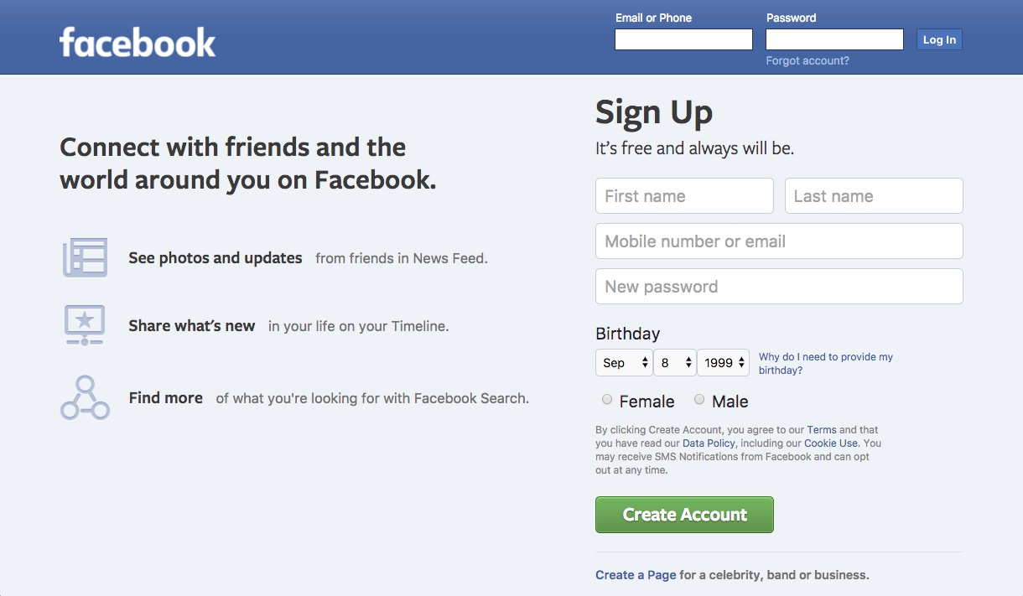
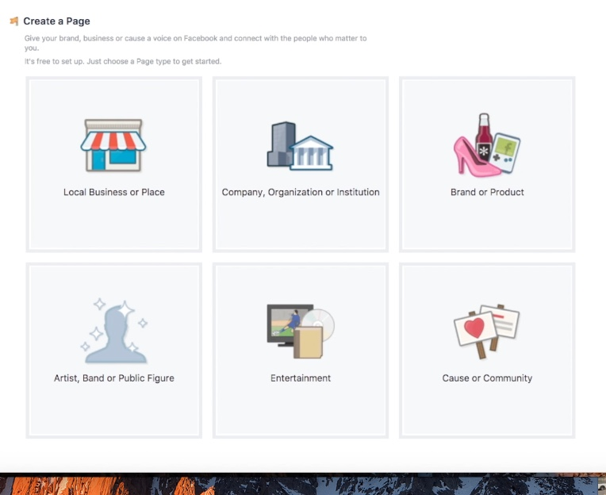
Steps to create a Facebook Page
Go to www.Facebook.com and create an
account if you don’t have one yet
Choose to create a new page.
Pick “Local Business” or “Place” for
Real Estate.

Slide 3
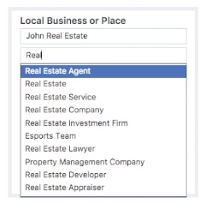
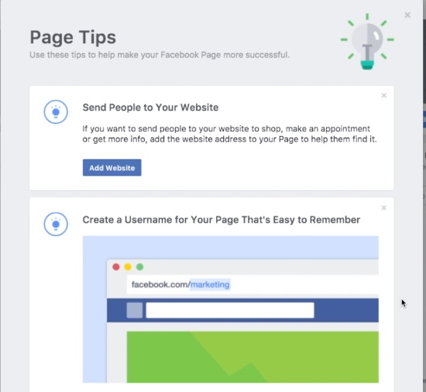
Pick the industry Real Estate
Complete the suggested Page Tips for your page to gain a larger reach on Facebook.

Slide 4
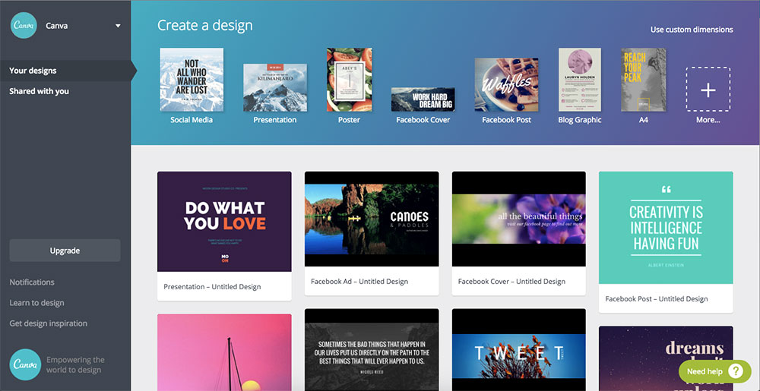
Use sites like www.Canva.com and www.BeFunky.com to help create your Profile and banner Photos.

Slide 5
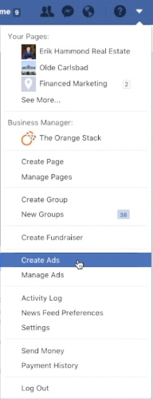
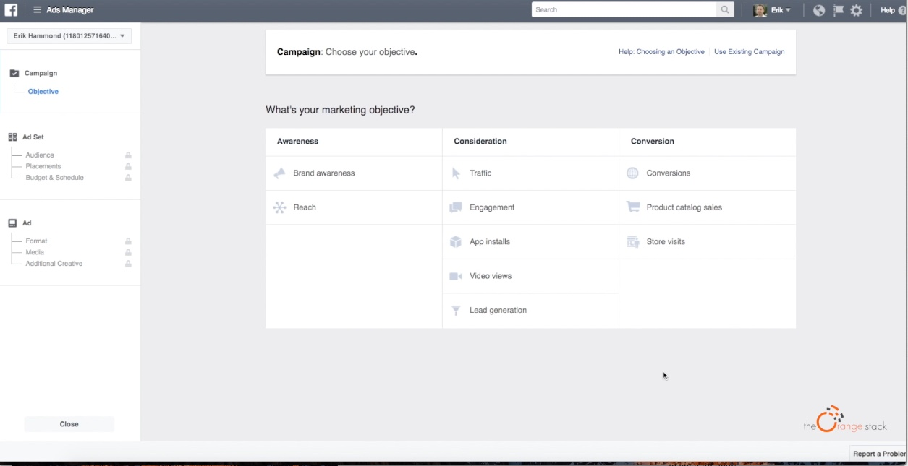
Hit the drop down menu on the right and select - “Create Ad”
In the Ad Manager - decide what type of Ad you want to run. To drive website traffic, click “Traffic.”
To get your video watched, choose “Video Views”

Slide 6
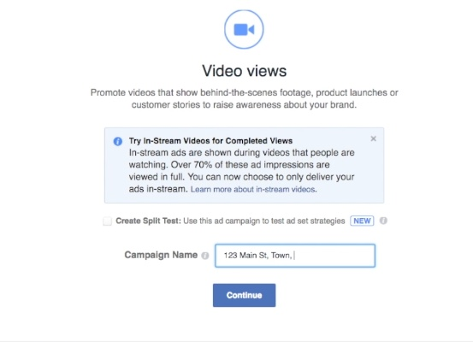
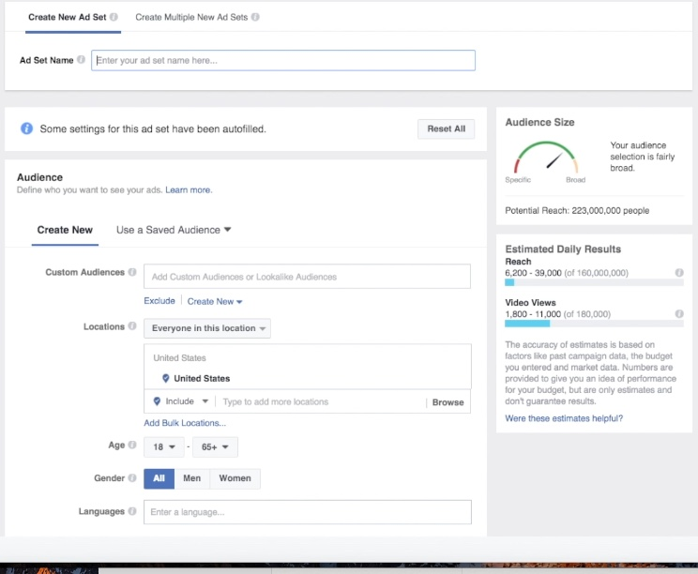
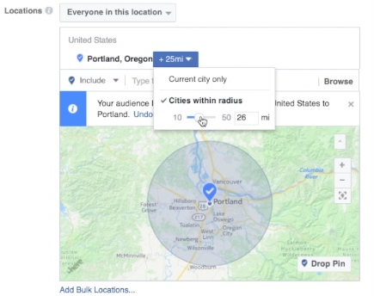
Decide on your Campaign Name.
This helps you stay organized as you run more ads for different properties.
Name your Ad Set (Such as “Open House Traffic”)
Choose your Audience Location, Age, Gender, Language.

Slide 7
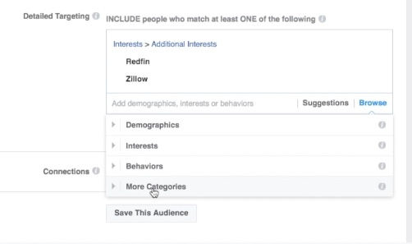
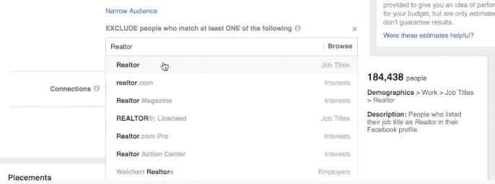
Create your Target Audience:
Who should see your Ad?
Is it near a golf course - Target Golfers
What about a Lake - Boat Owners
Near a great school - Families with Kids
Condo near downtown - Young & Single
Also consider who you don’t want to see your Ad… “Other Agents.”

Slide 8
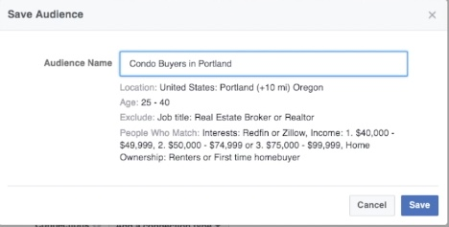
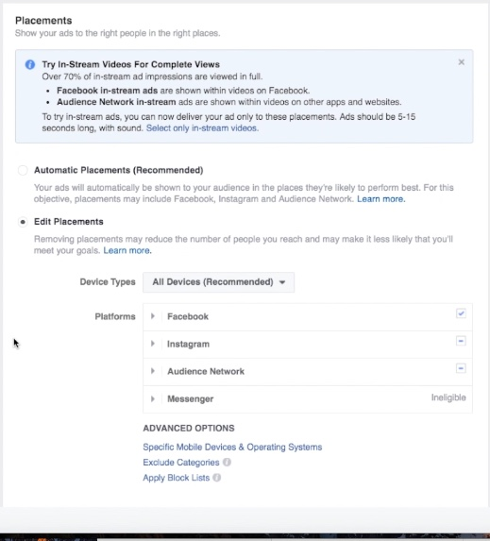
Consider saving your Audience for future use.
If you’re creating an Ad for the Facebook platform, choose only to show it to Facebook users.

Slide 9
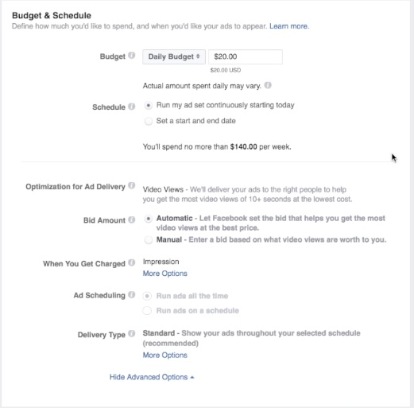
Determine Your Budget
-Daily - ($/Day)
-Lifetime - (Total Amount You Will Spend)
Advanced features that let you determine how much you will spend for your ad to be viewed, when you are charged and when your Ad runs?

Slide 10
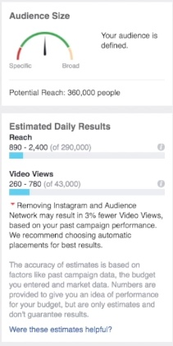
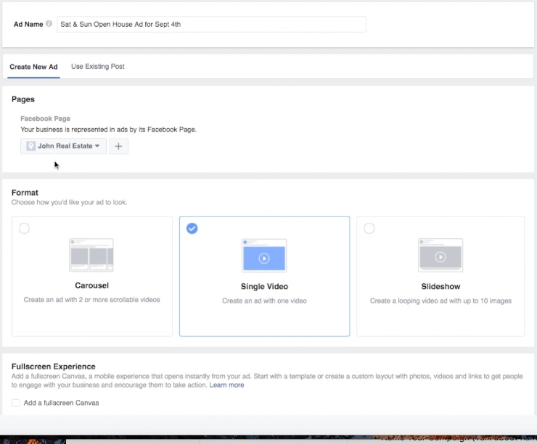
Name Your Ad
The Audience Size shows you how many Facebook users could see your Ad.
Be sure to Advertise on the correct Facebook Page
The Estimated Daily Reach shows how far your budget will go. And how many Video views you could get.
Select the type of media you want to show your audience: Pictures or Video or even a Slideshow.

Slide 11
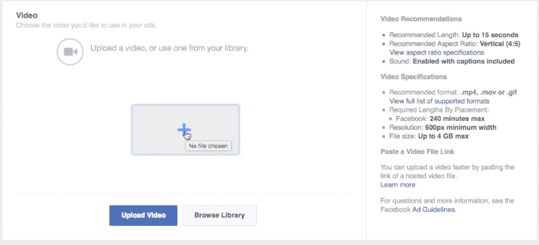
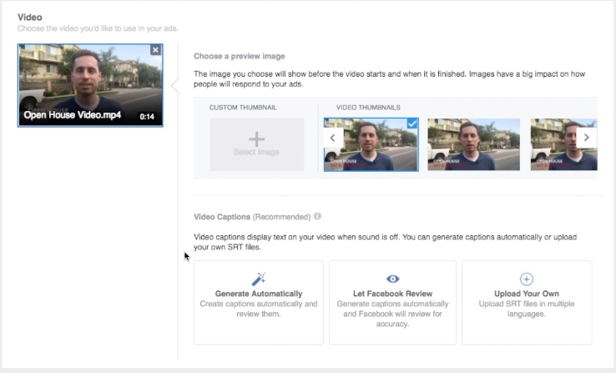
Video Recommendations & Specifications
Choose your video and select a thumbnail when ready. Facebook can even add subtitles.

Slide 12
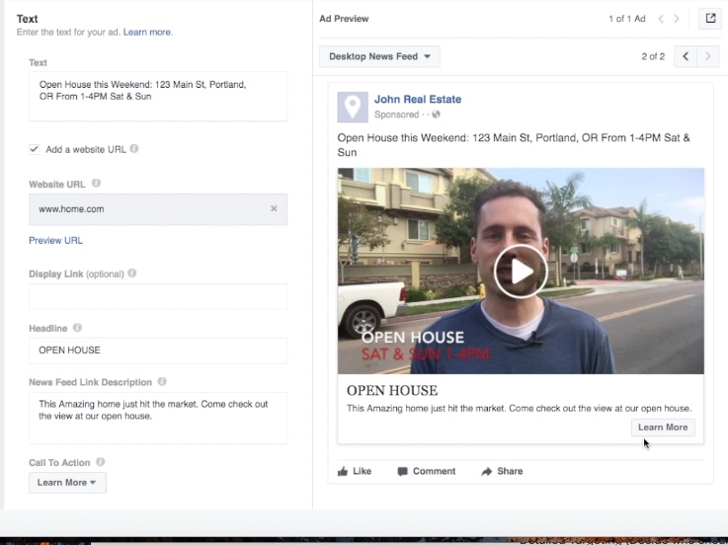
Give your Ad a catchy title
Direct Traffic to a website
Customize the link display
Create a Headline to grab attention
Create the Text to describe why your audience should take action from your Ad.
Pick a Call To Action

Slide 13
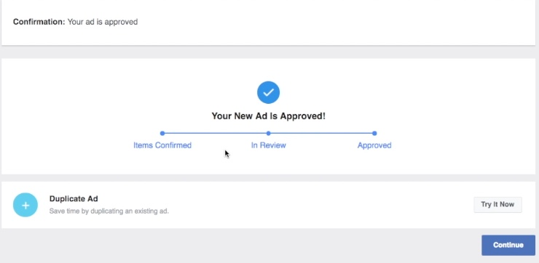
Your Ad has now been Approved and will be shown to new Facebook viewers shortly.

