Slide 1
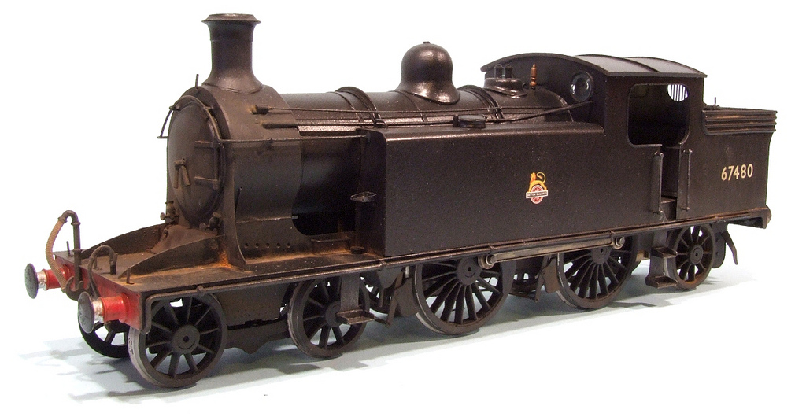
The Second
Industrial Revolution
Photo by Phil Parker

Slide 2
Essential Question
What was the Second Industrial Revolution and what differentiated it from the First Industrial Revolution?

Slide 3
 | 1st Ind. Rev. | 2nd Ind. Rev.
Time Frame
Methods of Production
Mass Production
Power Sources
New Engines
Inventions
Standard of Living for working class
c. 1760-1830
c. 1850-1914
Hand → Machine
Increased Automation
Textiles
Steel (Bessemer Process)
Water, Coal, & Steam*
Petroleum & Electricity
Steam Engine*
Internal Combustion
Spinning Jenny
Water Frame
Spinning Mule
Cotton Gin
Automobiles
Chemicals
Railroads (Prevalent)
Telegraph, Telephone, Radio
AWFUL
Think Tocqueville in Manchester
Still Bad, but Improving
(Sewers, Sanitation, etc.)
Expansion of Middle Class
* Note that these technologies continued to be used during the 2nd IR but new sources of power were introduced, in addition.

Slide 4
 | 1st Ind. Rev. | 2nd Ind. Rev.
Time Frame
Methods of Production
Mass Production
Power Sources
New Engines
Inventions
Standard of Living for working class
* Note that these technologies continued to be used during the 2nd IR but new sources of power were introduced, in addition.

Slide 5
WORLD EXPOSITIONS
1851-Present

Slide 6
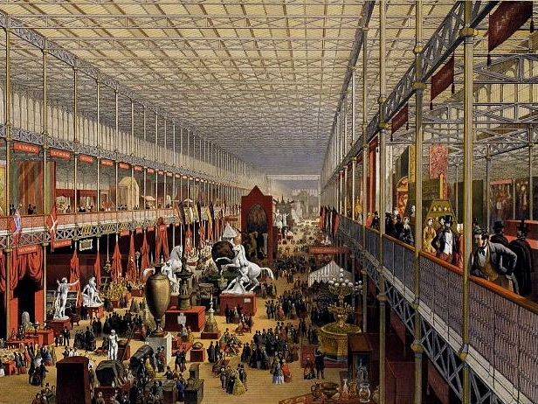
Crystal Palace Exhibition (1851)

Slide 7
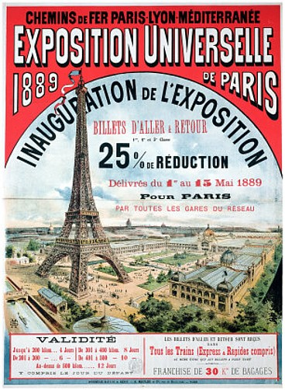
1889

Slide 8
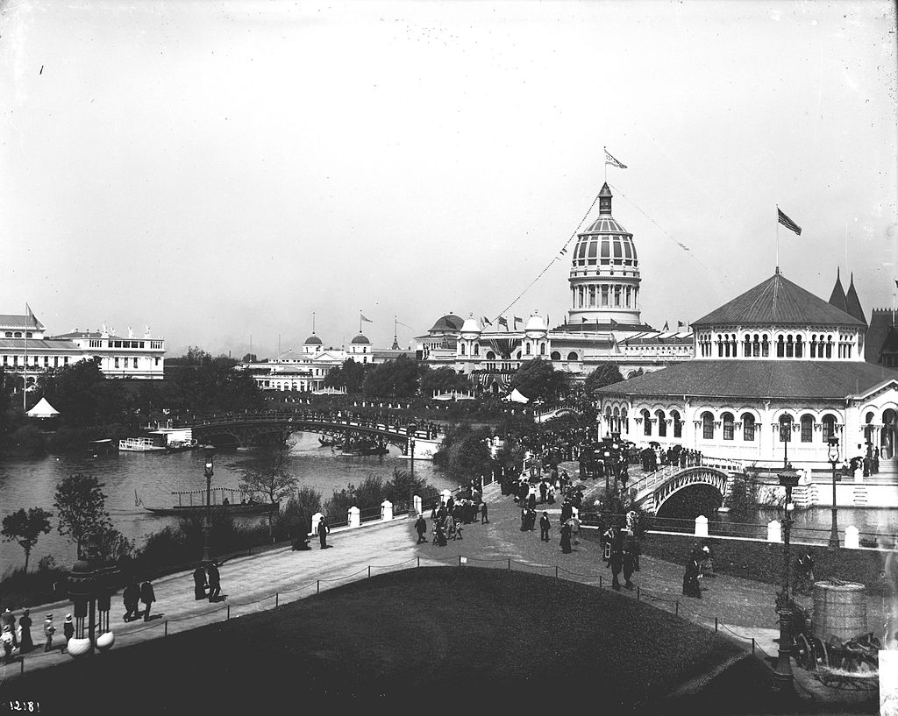
Columbian Exposition (1893)

Slide 9
2005
Photo by Mandy

Slide 10
MILITARY TECHNOLOGIES
Comparing the First and Second Industrial Revolutions

Slide 11
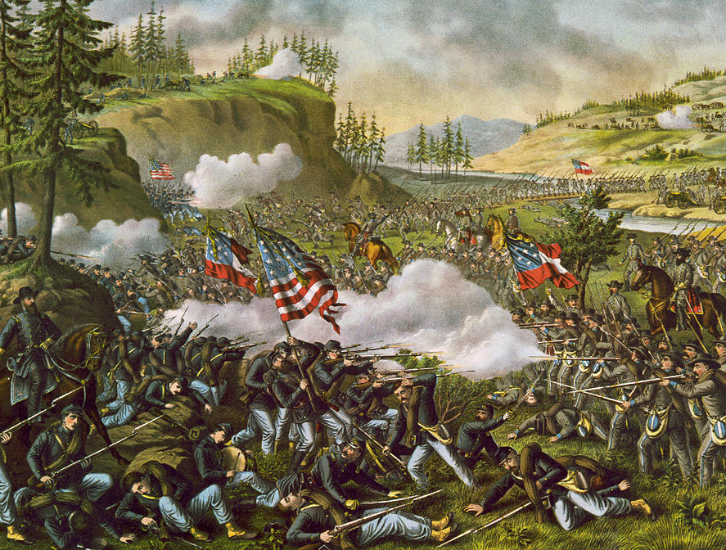
American Civil War

Slide 12
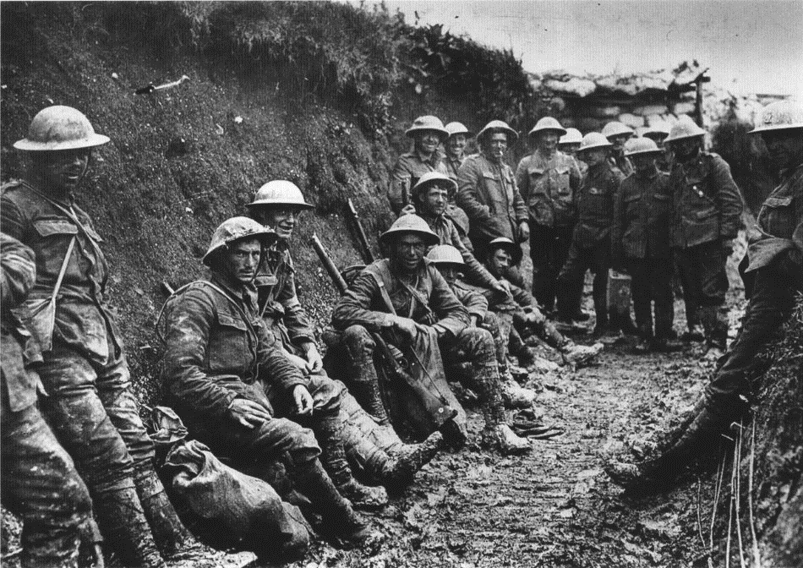
WWI

Slide 13
Spencer
Repeating
Rifle
(American Civil War)
Photo by Thomas Quine

Slide 14
Machine Gun (WWI)
Photo by
Rain0975

Slide 15
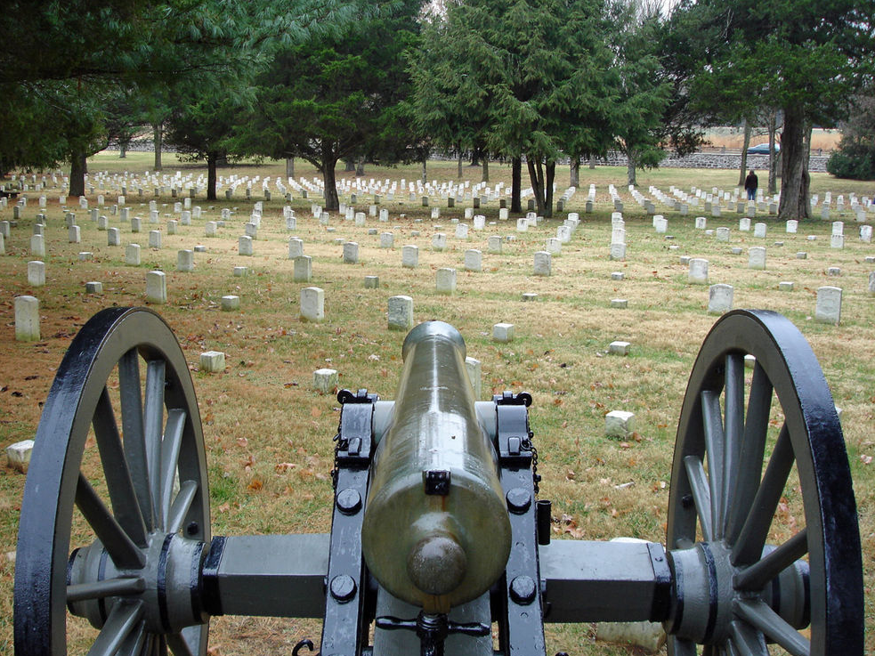
CIVIL WAR CANNON

Slide 16
WWI Artillery Piece

Slide 17
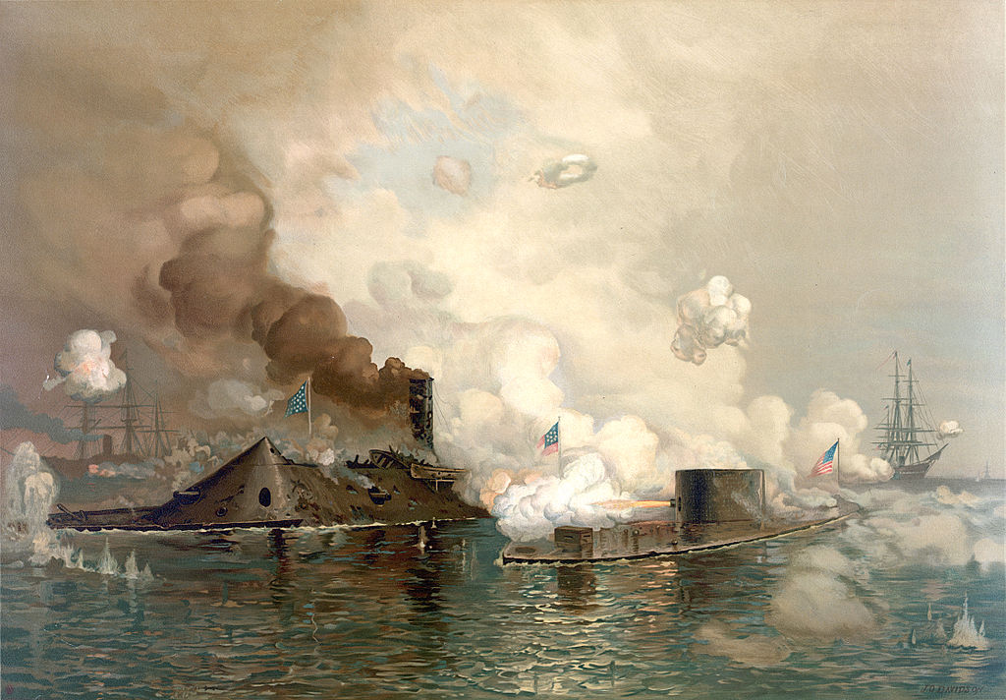
IRONCLADS

Slide 18
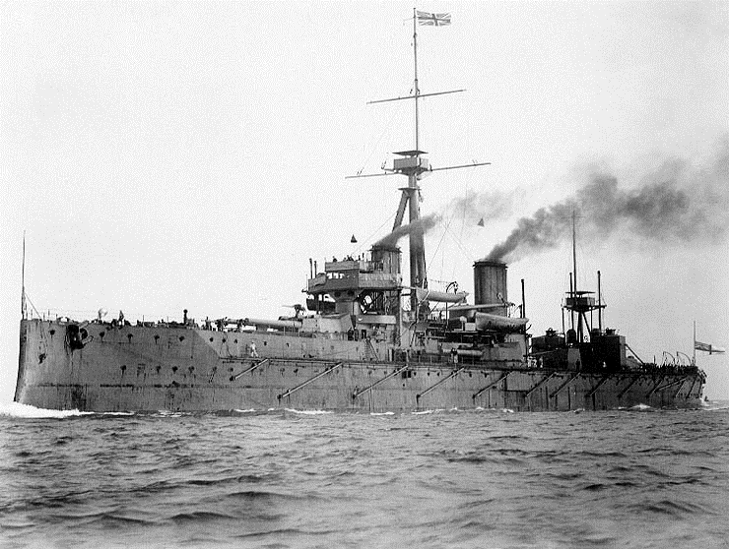
DREADNOUGHT

Slide 19
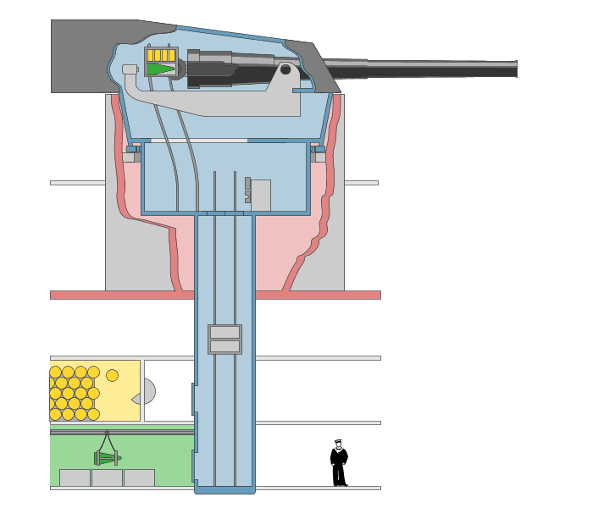
FULLY AUTOMATED
A Revolution in Weaponry
Art Credit: Emoscopes

Slide 21
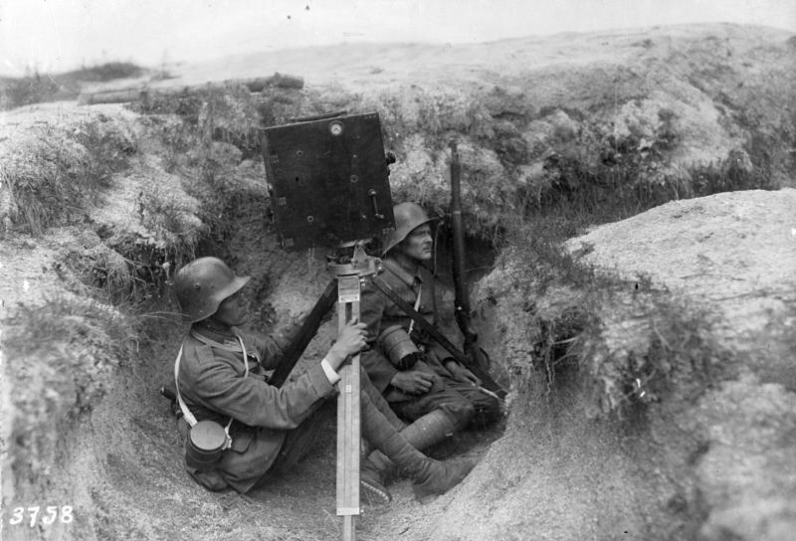
German Federal Archives

Slide 22
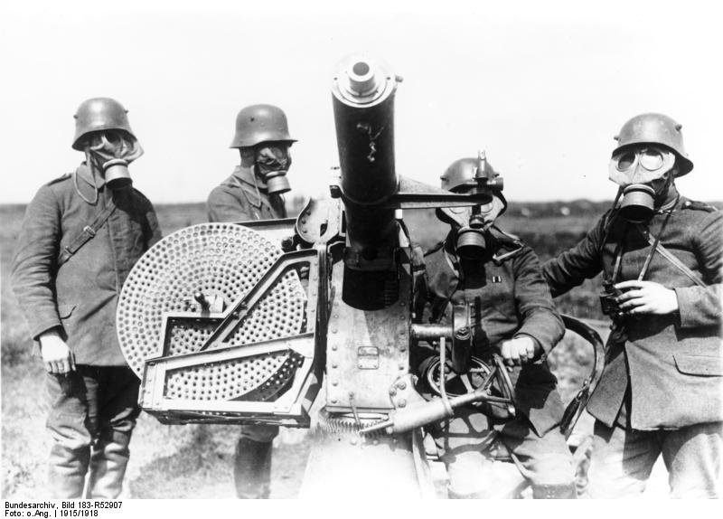
German Federal Archives

Slide 23
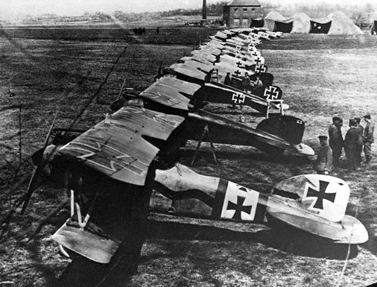

Slide 24
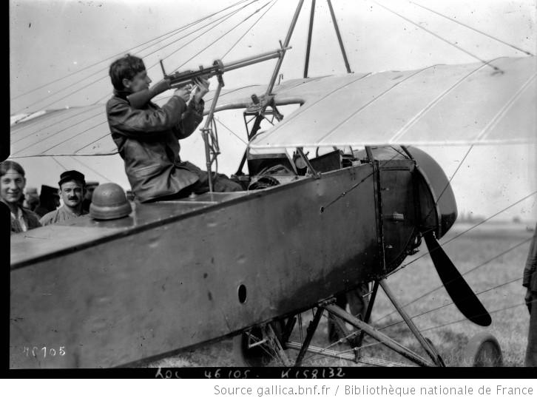

Slide 26
RAILROADS
Photo by Kool Cats Photography

Slide 27
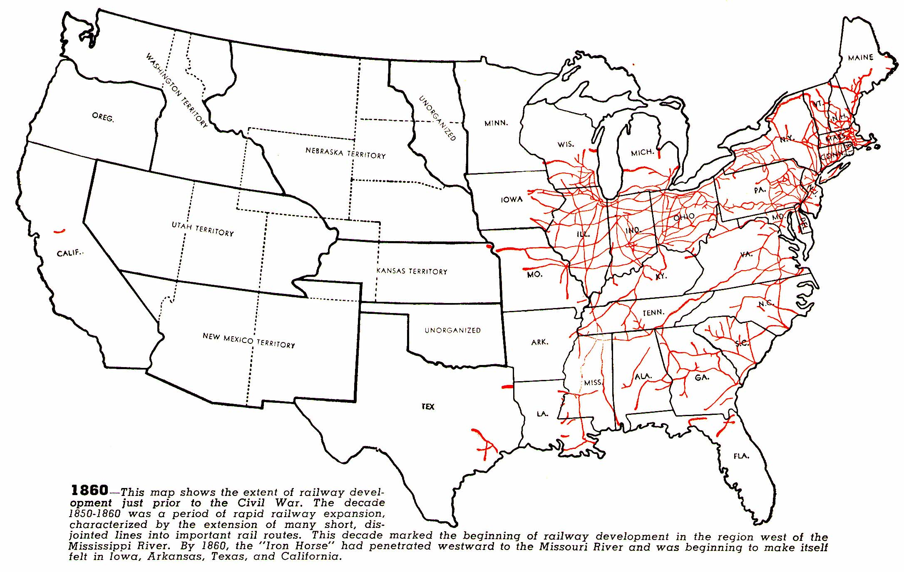
Railroad Tracks (1860)
Copyright Status Unknown – Retrieved from http://www.cprr.org/Museum/RR_Development.html#1L
Reproduced for Educational Use ONLY

Slide 28
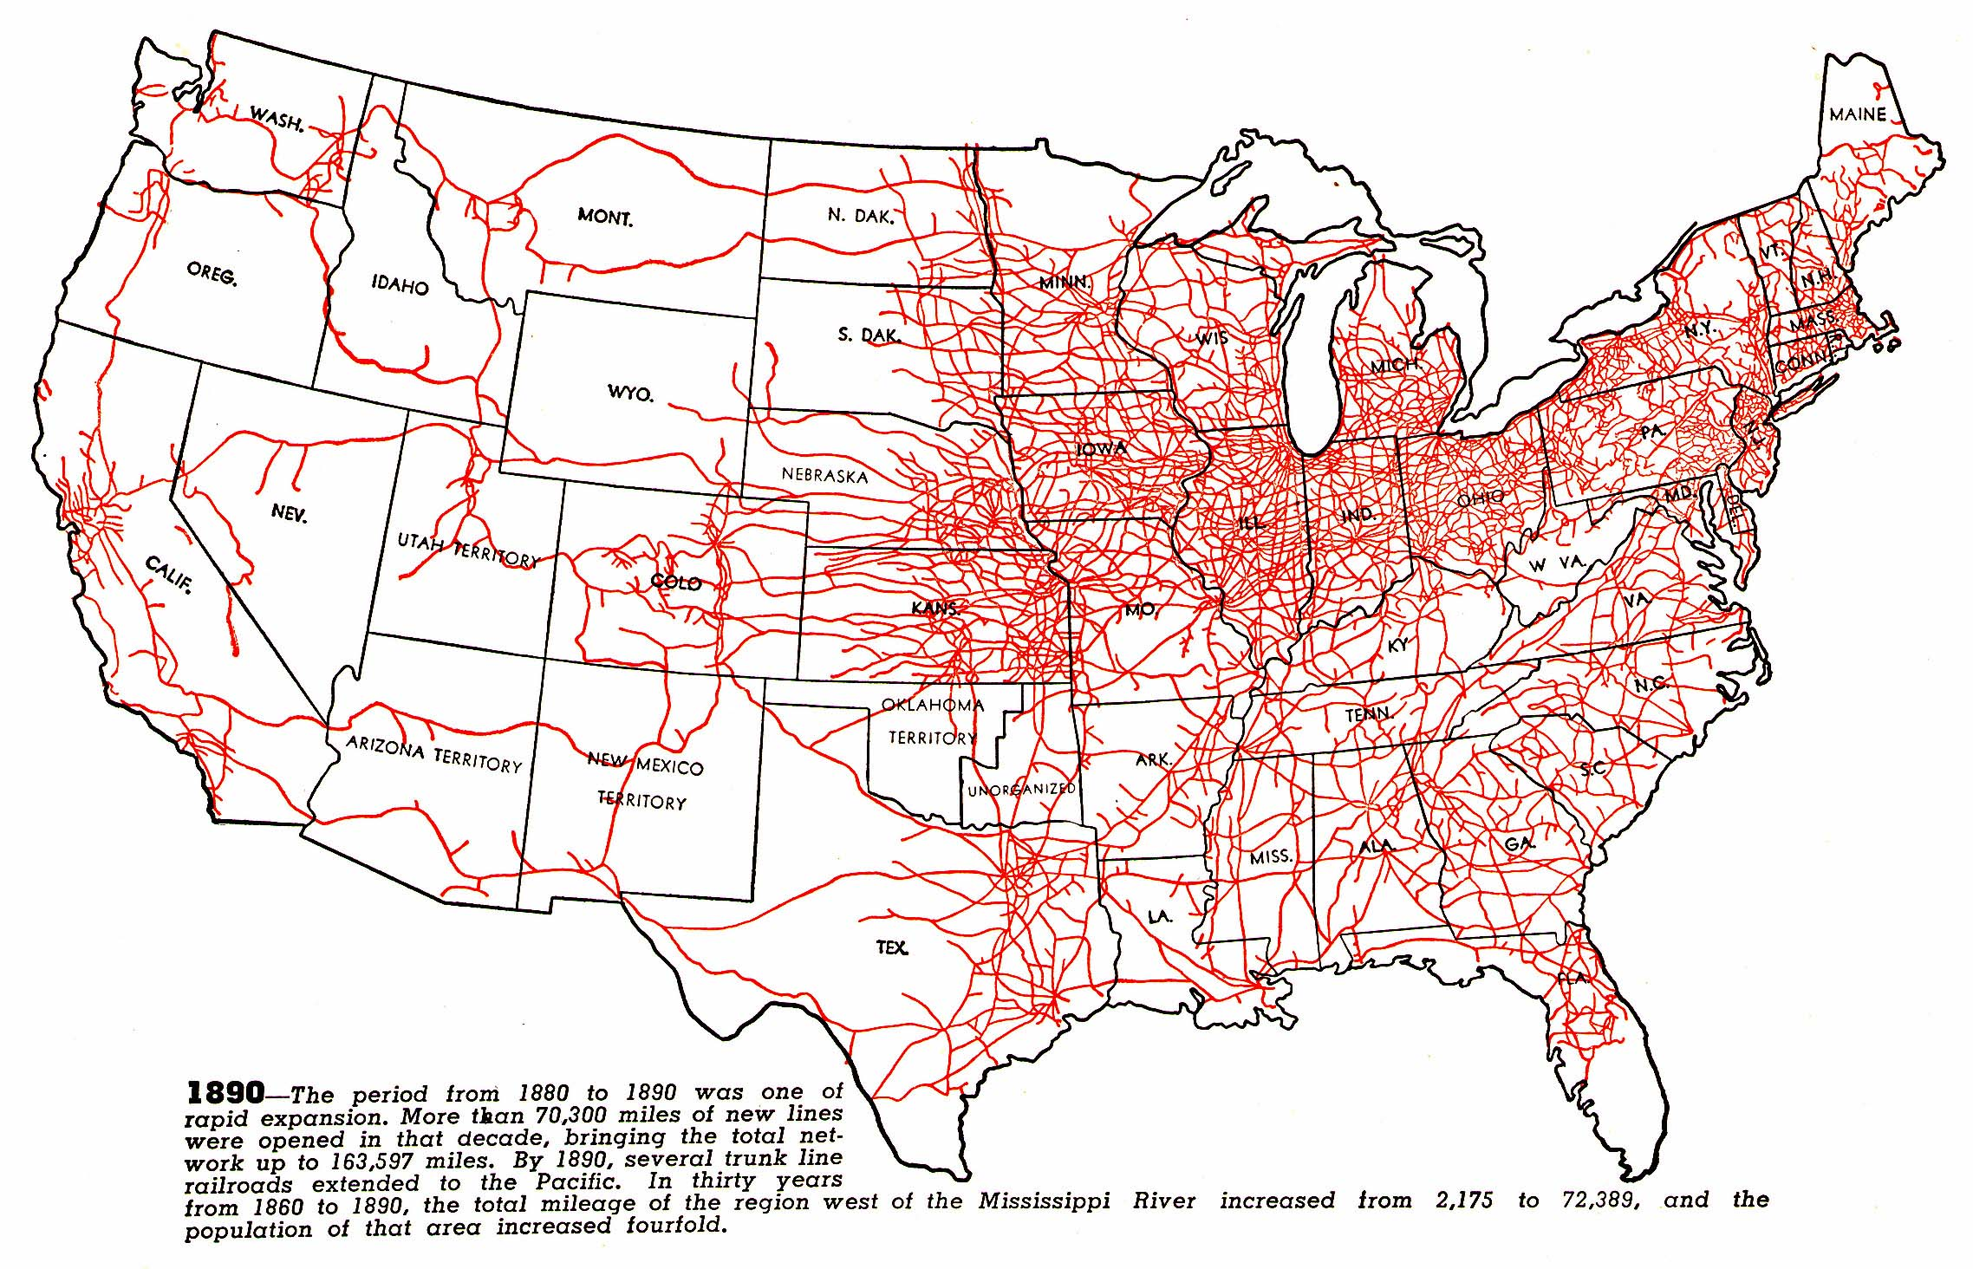
Railroad Tracks (1890)
Copyright Status Unknown – Retrieved from http://www.cprr.org/Museum/RR_Development.html#1L
Reproduced for Educational Use ONLY

