Slide 1
ANCIENT ISRAEL:
DIVISION & DIASPORA
Map Credit: Malus Catulus

Slide 2
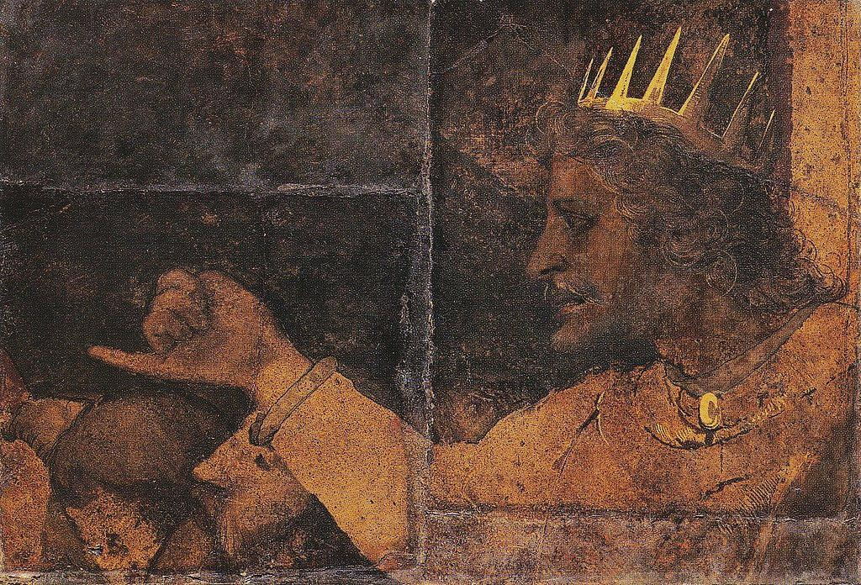
REHOBOAM
King Solomon’s Son
Israelites asked him for relief from high taxes and forced labor.
He refused.

Slide 3
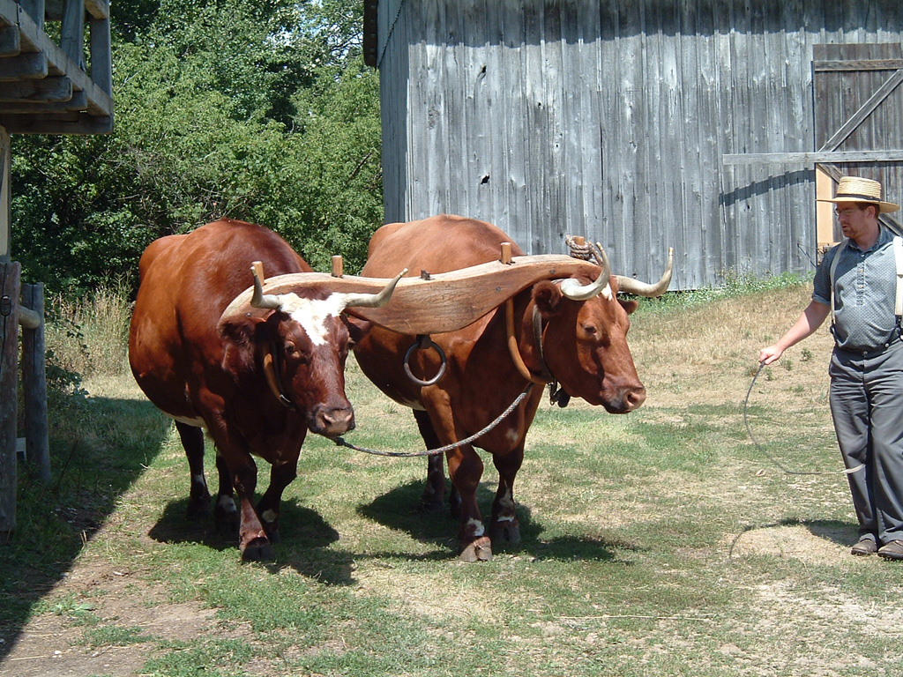
A HEAVY YOKE
Some rights reserved by bcmom

Slide 4
DAD
Some rights reserved by puuikibeach

Slide 5
ME
Some rights reserved by mikebaird

Slide 6
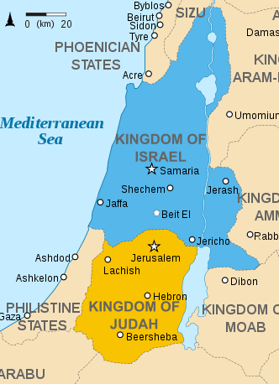
SECESSION
The Northern Tribes of Israel separated from Judah over oppressive taxation and conscription policies.

Slide 7
DIVIDED Kingdom
Jeroboam
King of Israel
Israel and Judah went on to exist as independent kingdoms
Rehoboam
King of Judah

Slide 8
DIVIDED KINGDOM
Starting c. 930 B.C.
 | Israel | Judah
Location
Kings
Conquerors
North
South
Several Dynasties
Davidic Line
Assyrians
c. 722 B.C.
Babylonians
c. 587 B.C.

Slide 9
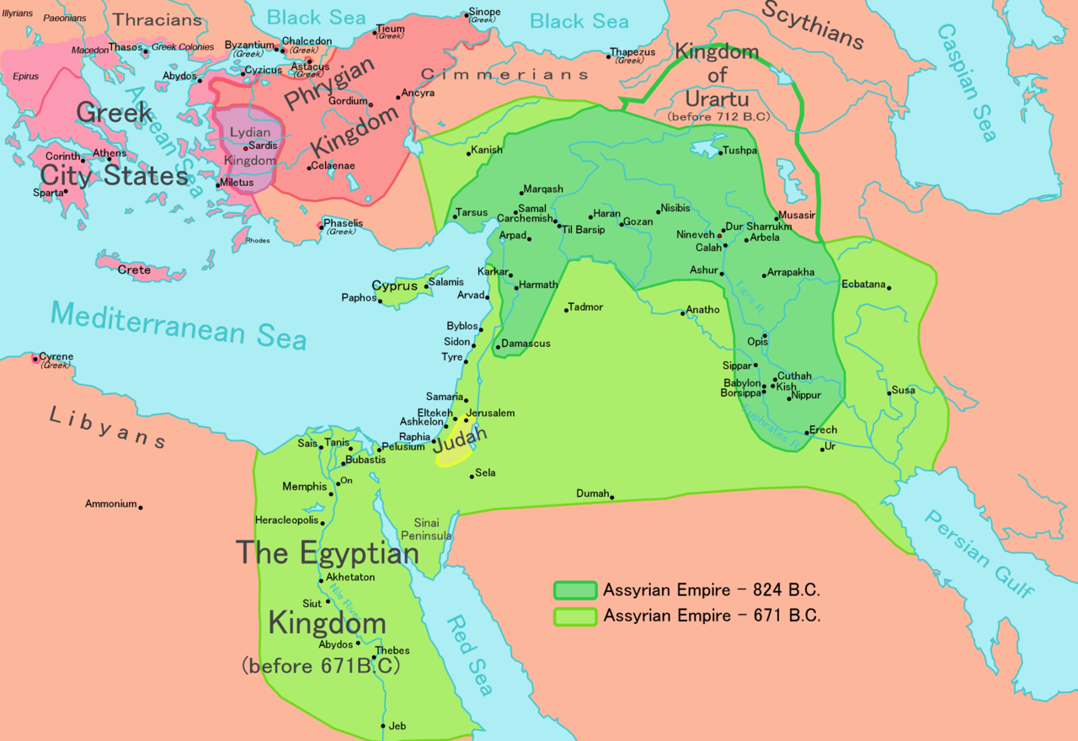
Assyrian Empire
CONQUERED ISRAEL
(Northern Kingdom)
Public Domain Map

Slide 10
Assyrian Empire
Judah:
Vassal State Paid Tribute

Slide 11
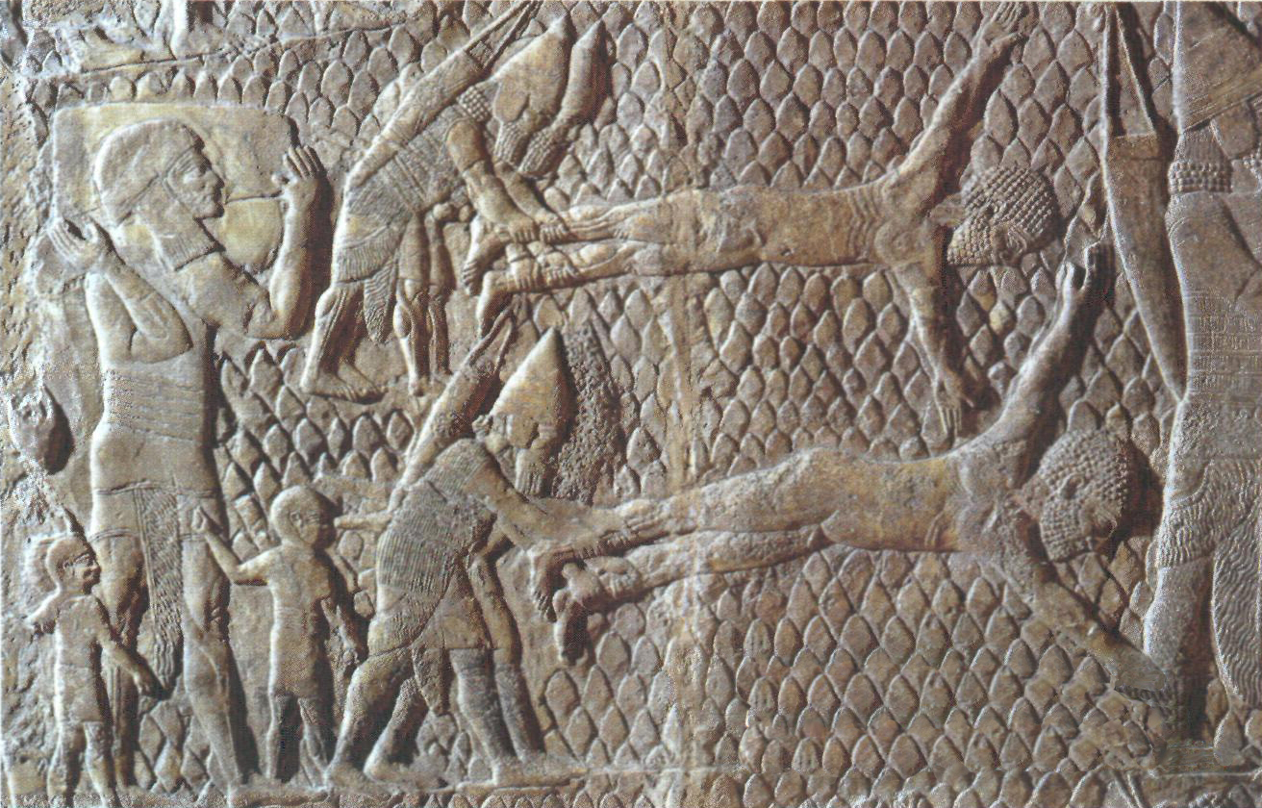
OPPRESSORS
Assyrians depicted flailing prisoners.

Slide 12
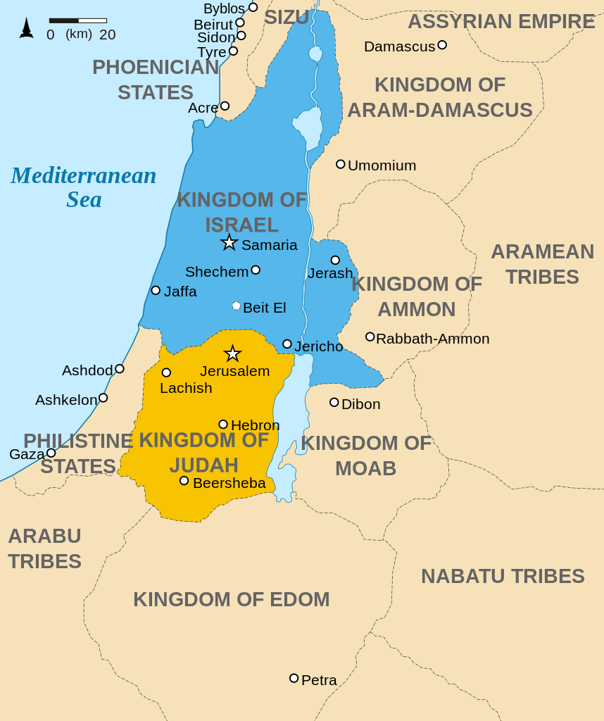
“Lost” Tribes
?
The Northern tribes were so thoroughly scattered by the Assyrians that no one knows for sure what became of them.
Map Credit (Ancient Israel): Malus Catulus

Slide 13
Jews
Judeans
“Jew” comes from the word “Judean,” describing someone specifically from the Tribe of Judah.
Map Credit (Ancient Israel): Malus Catulus

Slide 14
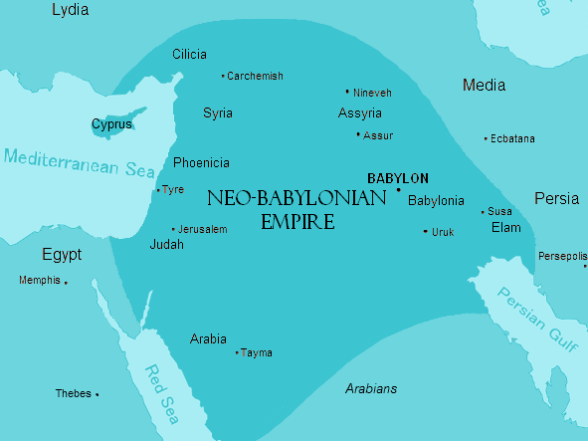
Babylonian Empire
Public Domain Map

Slide 15
DIASPORA
Scattering / Dispersion
Conquerors dispersed conquered peoples in order to prevent rebellions.
Public Domain Map

Slide 16
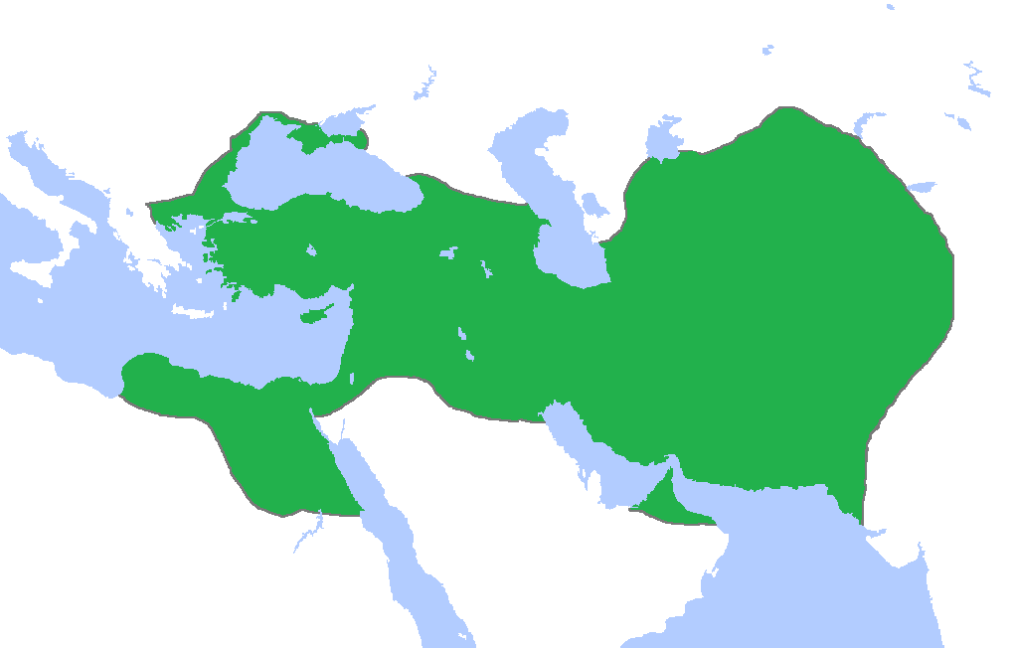
PERSIAN EMPIRE
The Persians conquered the Babylonians in 539 B.C. (less than 50 years after the Babylonians conquered Judah).
Map Credit: HistoryofIran

Slide 17
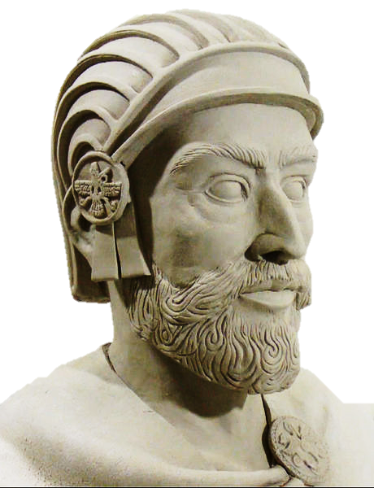
Cyrus the Great
King of Persia
Cyrus allowed the Jews to return to Jerusalem and rebuild their temple.

Slide 18
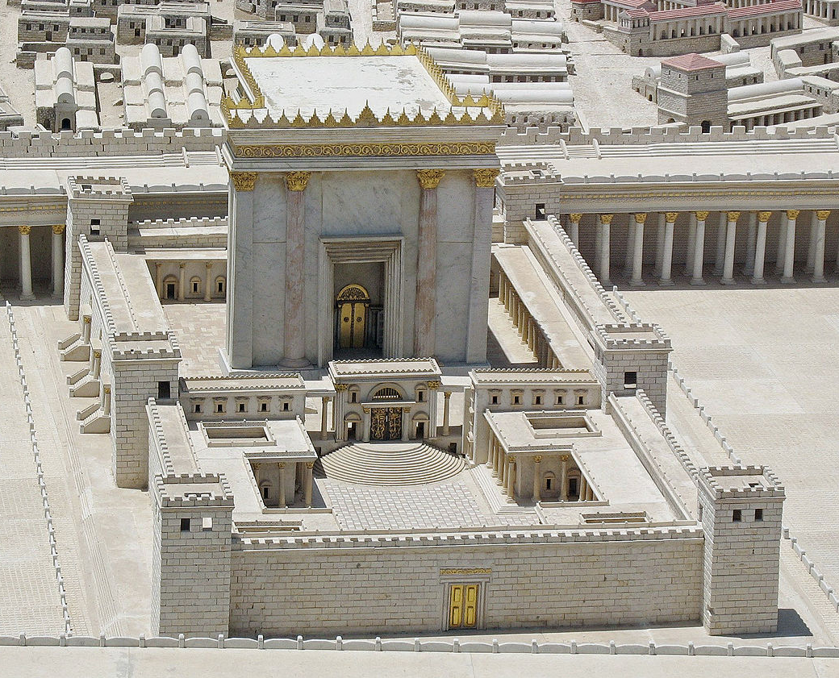
The Second Temple
516 B.C. – 70 A.D.
The Second Temple was the center of Jewish worship until the Romans destroyed it after a Jewish revolt.
Photo of a model of the Second Temple by Ariely

Slide 19
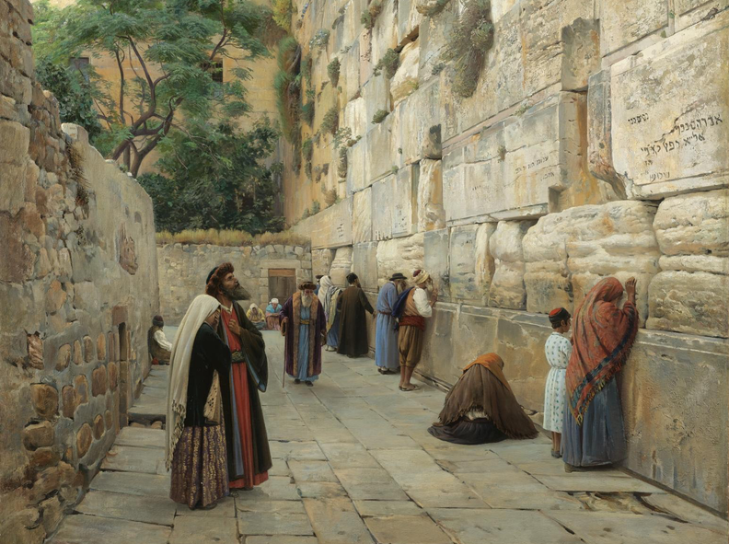
Western (“Wailing”) Wall
The Second Temple’s Western Wall is still a Jewish Holy site.
Gustav Bauernfeind, Wailing Wall (19th Century)

Slide 20
The Restoration of Israel
Messianism (Ancient)
The belief that a Messiah (anointed one), from the Davidic Line, would rule a restored Jewish kingdom in a future “Messianic” age of peace and prosperity. NOTE: Saul, David, and other kings were described as messiahs.

Slide 21
MESSIAH
“The Anointed One”

Slide 22
Iēsus Nazarēnus, Rēx Iūdaeōrum
Photo by Rennett Stowe

Slide 23
Jesus of Nazareth King of the Jews
Photo by Rennett Stowe

Slide 24
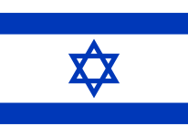
The Restoration of Israel
Messianism (Ancient)
The belief that a Messiah (anointed one), from the Davidic Line, would rule a restored Jewish kingdom in a future “Messianic” age of peace and prosperity. NOTE: Saul, David, and other kings were described as messiahs.
Zionism (Modern)
19th / 20th century movement to restore the Jews to their ancient homeland.
The hopes of the Zionists were realized with the founding of Israel in 1948.

Slide 25
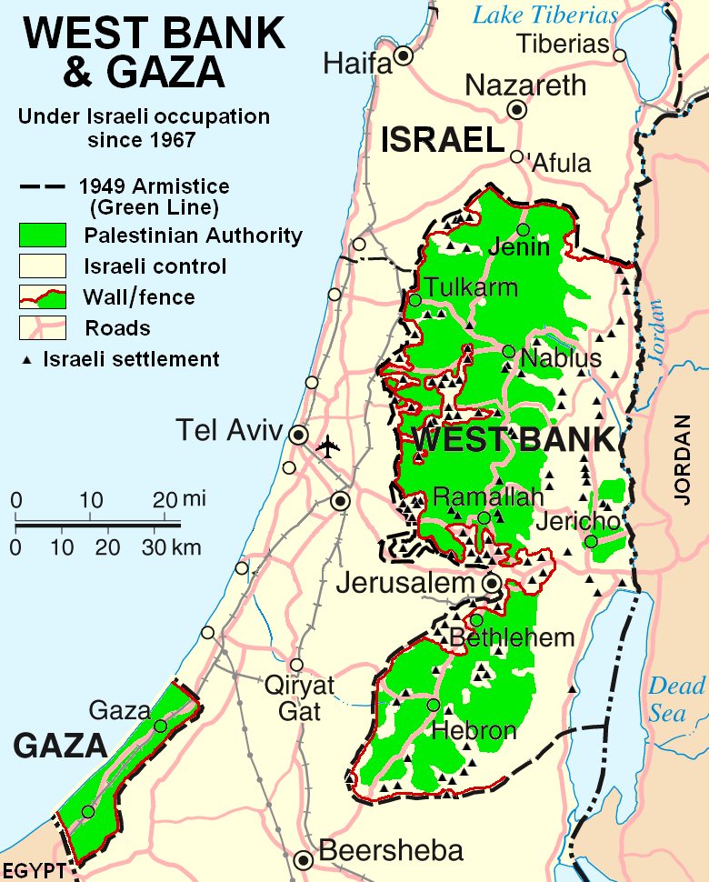
ISRAELI-PALESTINIAN CONFLICT
Modern Day
“Palestinian” is a Latin variant of the ancient Hebrew word, “Philistine.”
Public Domain Map

Slide 26
Ancient Philistia = Modern-Day Gaza Strip
Map Credit (Ancient Israel): Malus Catulus

