Slide 1
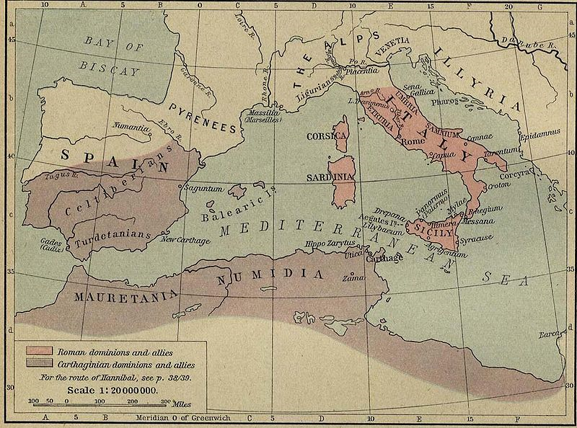
The first punic war
Notes:
Color Palette by: bmagic333 (Conquering Carthage)

Slide 2
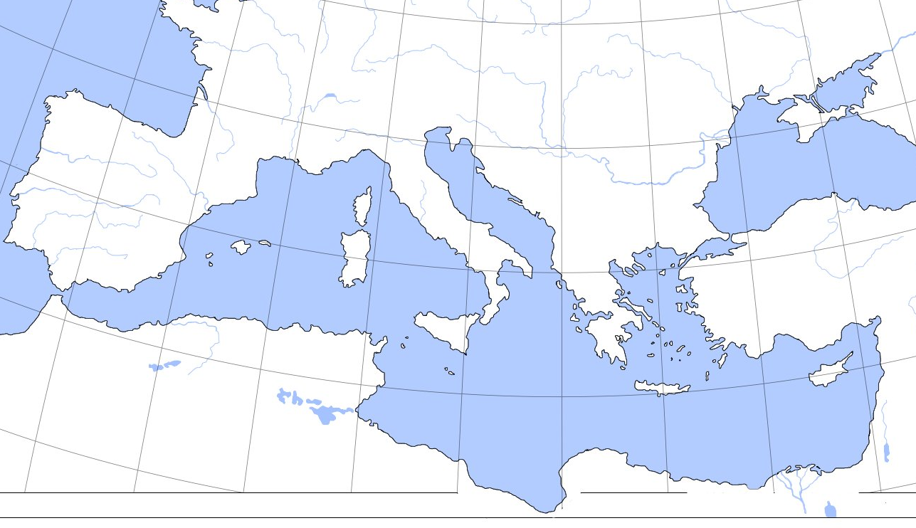
Phoenicians
ROME
Greek, “Dealer in Purple.”
Latin Pronunciation = Punic
Phoenicia
Map Source: http://spraguehs.com/staff/nickel_philip/WHUM/ExamReviews/AncientRome.htm

Slide 3
HOOKED ON PHONICS
VIEW ON YOUTUBE

Slide 4
Phonics
Letters are identified by their sounds.
Photo by kayintveen

Slide 5
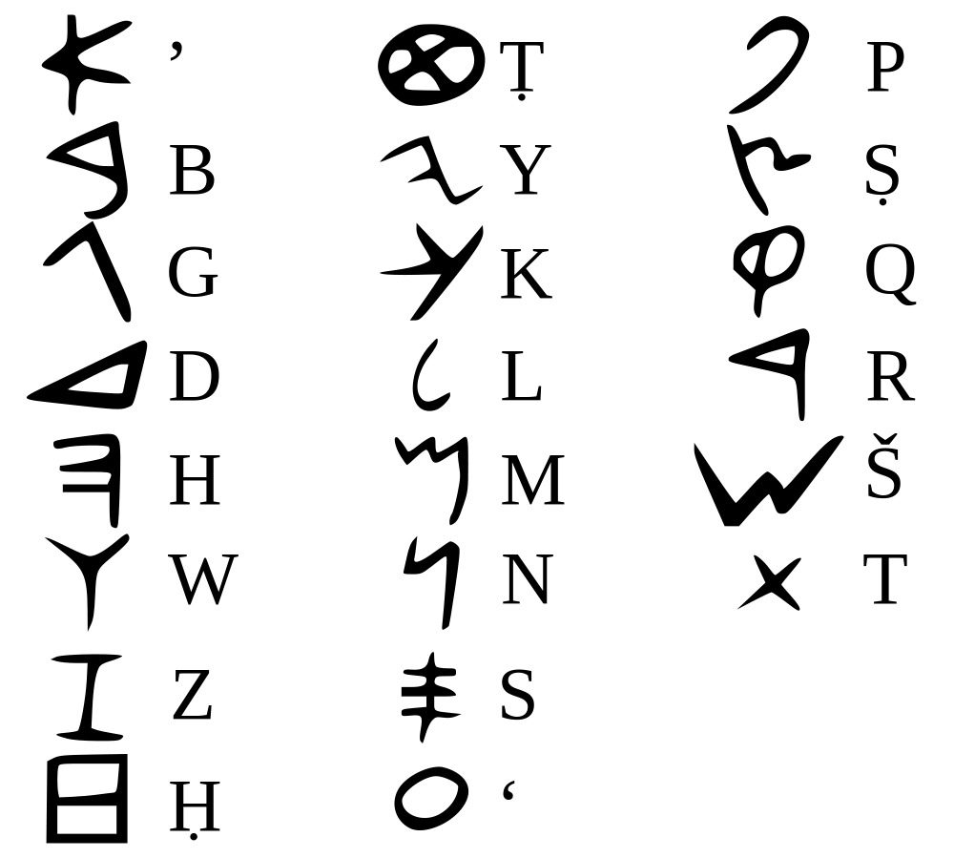
PHONETIC
In a phonetic alphabet, each letter represents a sound.

Slide 6
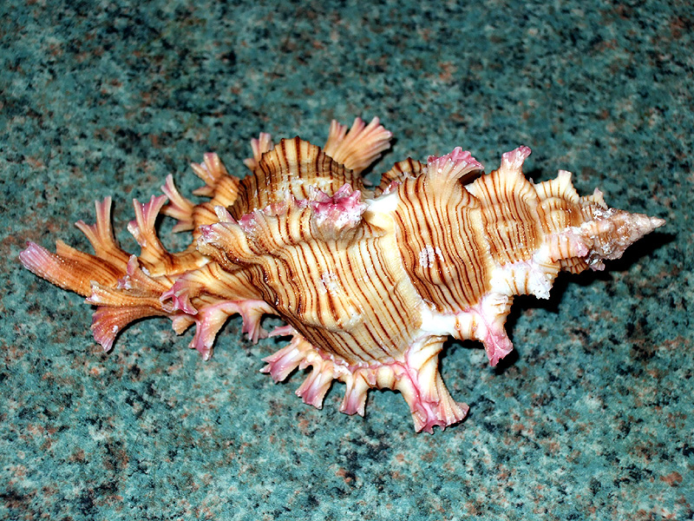
The Murex Snail
by PeterEdin

Slide 7
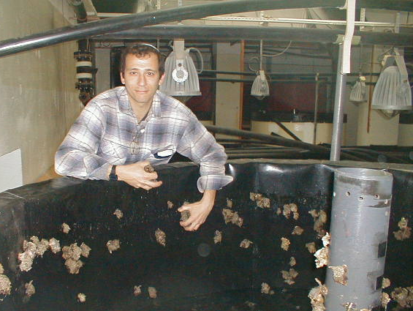
Purple Dye
CLICK for More Photos

Slide 8
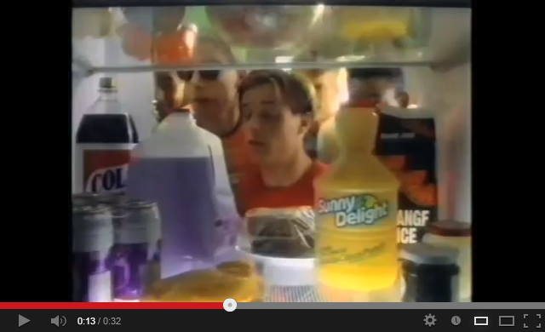
https://www.youtube.com/watch?v=sjgLb0HJ3VE

Slide 9
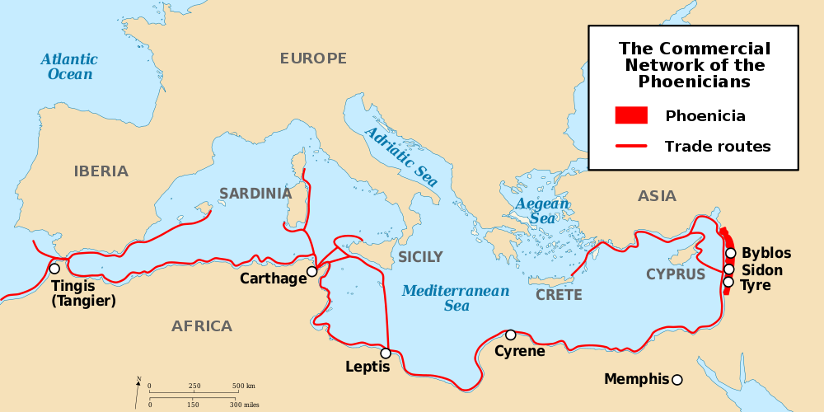
Commercial Network
Map by DooFi
Why didn’t the Phoenicians trade with Rome?

Slide 10
A Jewish Writer Describes the Romans
“[The Romans] have subdued kings far and near, and as many as have heard of their reputation have feared them. Those whom they wish to help come to power, they make kings. Those whom they wish, they bring down. The Romans have been greatly exalted.
“Yet even with all this, not one of them has put on a crown or worn purple as a mark of pride. Instead, they built for themselves a senate chamber.”
-- I Maccabees 8
Source: http://www.biblestudytools.com/ceba/1-maccabees/8.html

Slide 11
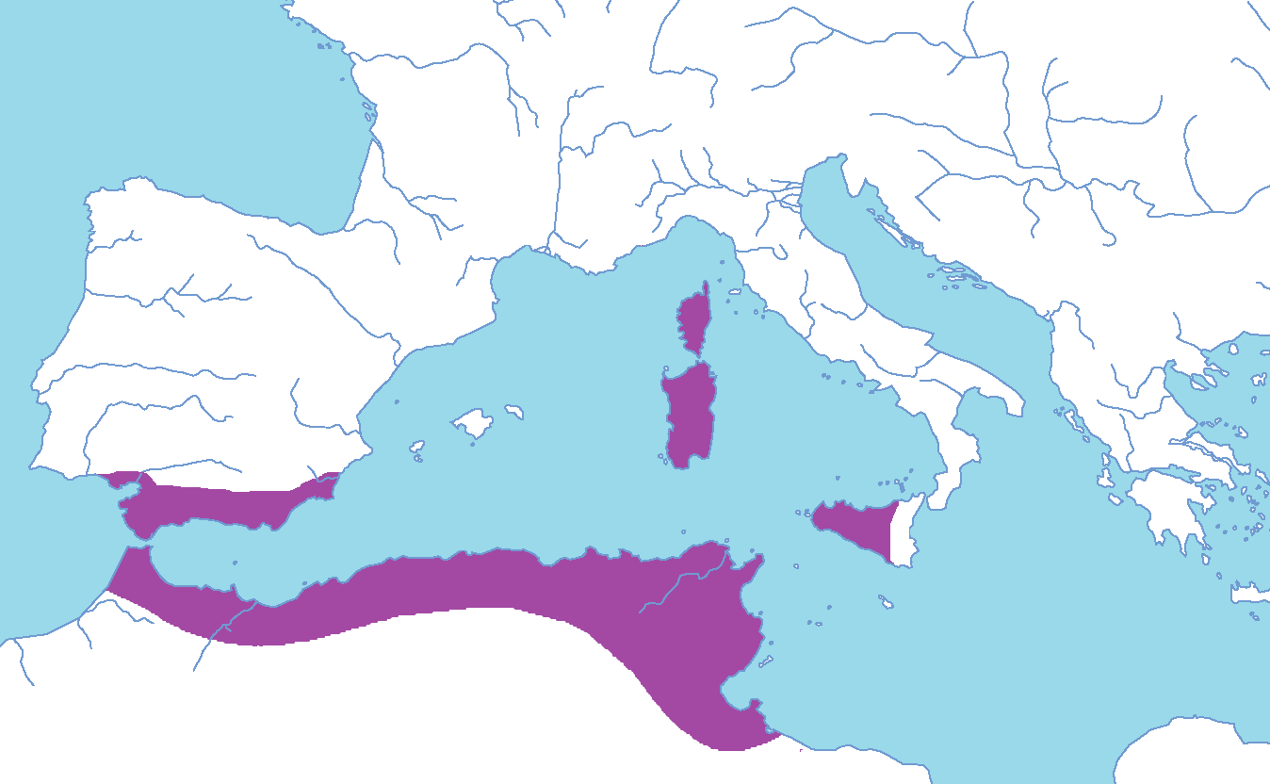
Phoenician Colonies
Carthage: A center for Phoenician commerce
Carthage

Slide 12
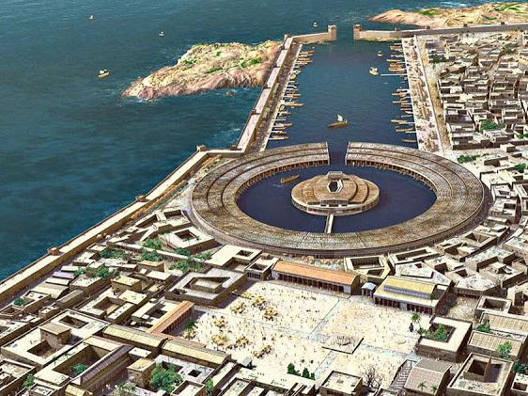
Carthage Naval Power
Picture Source: http://peplums.blogspot.com/2013/01/location-carthage.html

Slide 13
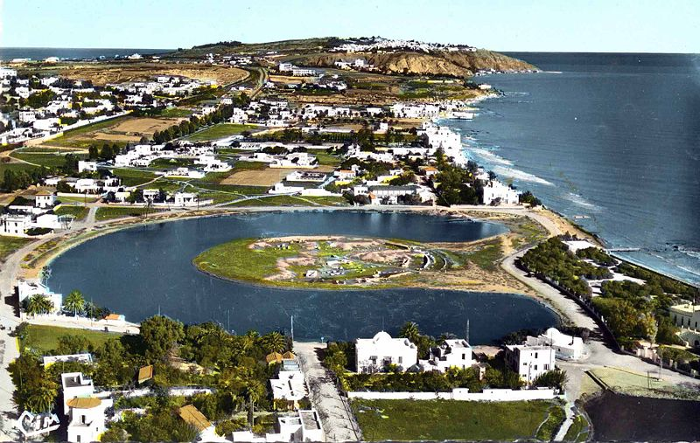
Remains of Carthaginian Naval Base

Slide 14
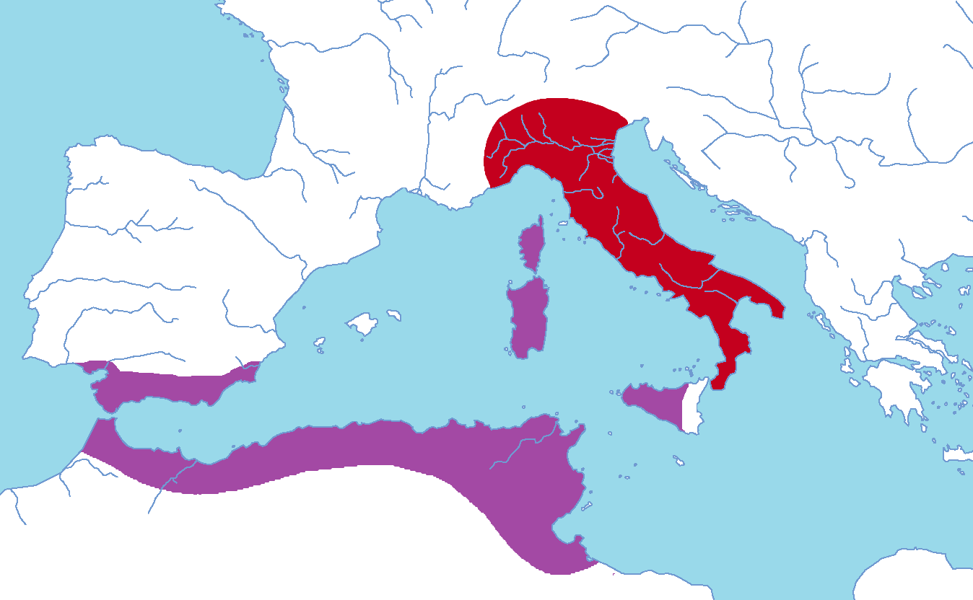
Roman Conquests
Carthage

Slide 15
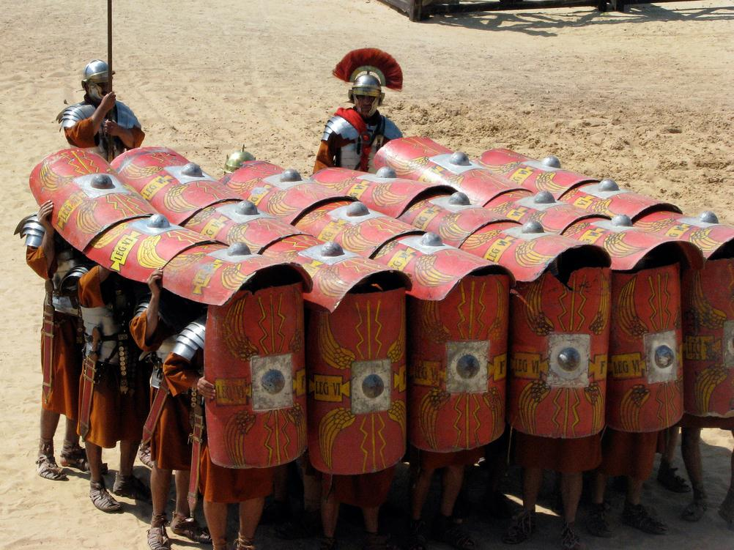
Rome Land Power
LEGIONS
Photo by sentex64

Slide 16
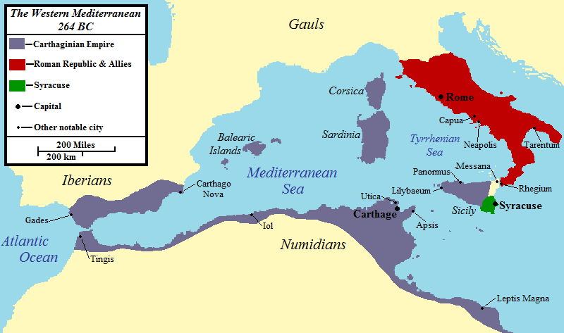
SICILY: The Conflict
Map Credit: Jon Platek

Slide 17
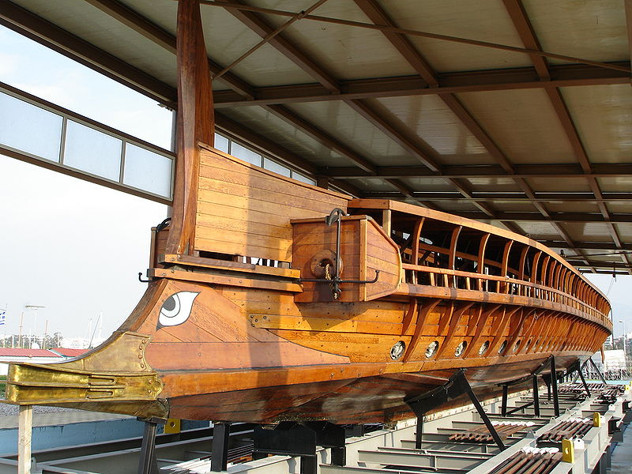
Rome’s Problem:
No Navy
SOLUTION: INGENUITY
Photo Credit: Templar52

Slide 18
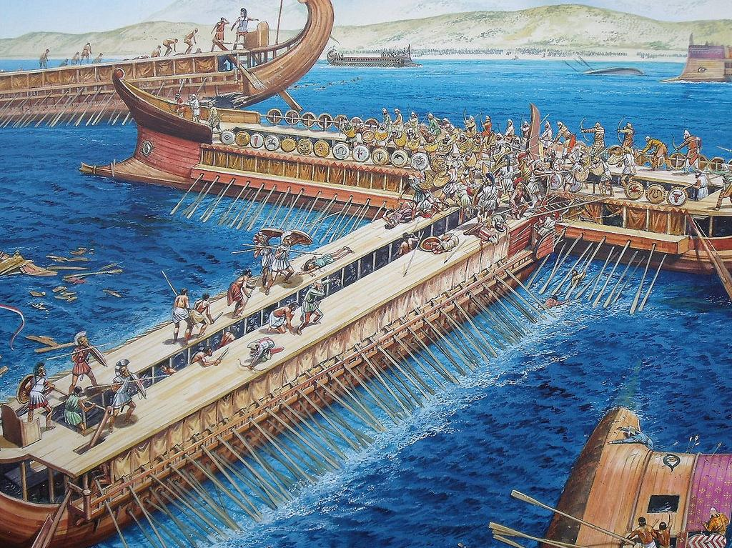
Traditional Strategy: ram THE Enemy Ship
Photo © osprey.publishing
Used with Permission

Slide 19
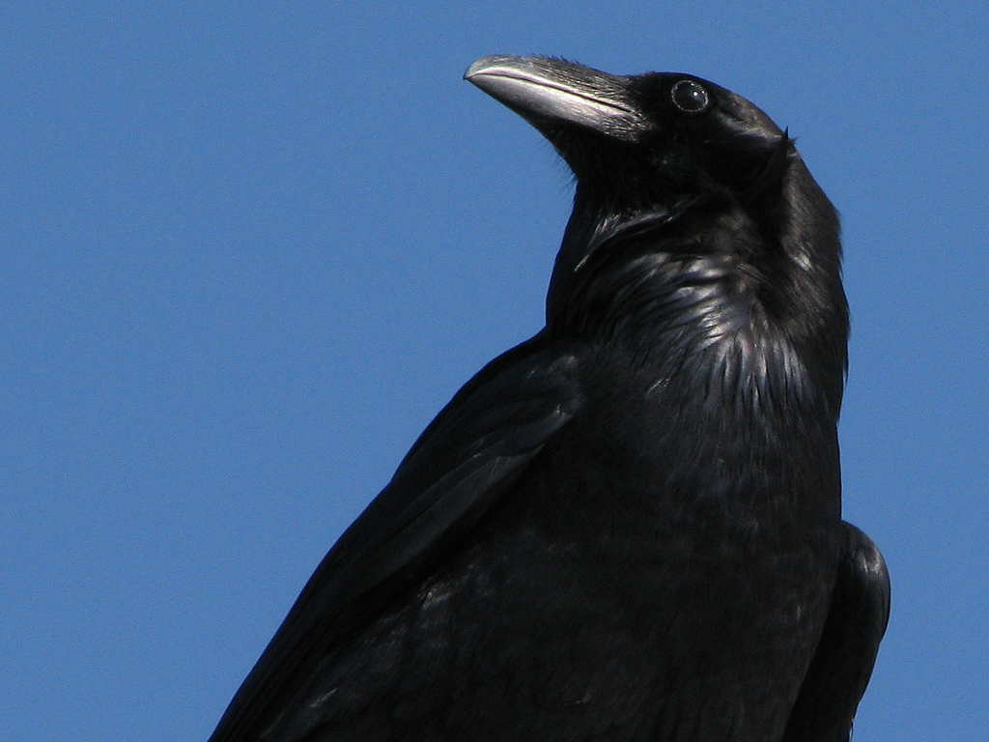
CORVUS
Photo by stonebird

Slide 20
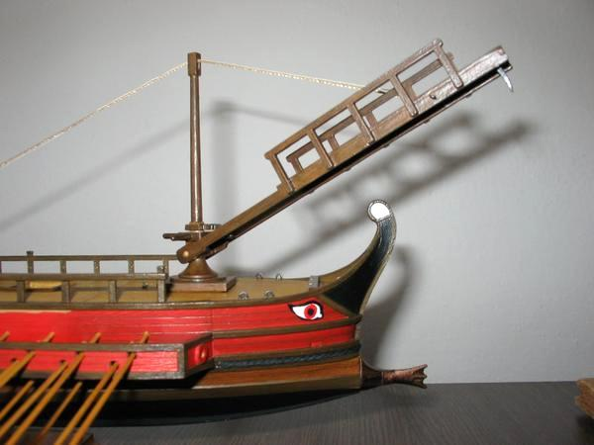
A land battle… at sea!
Photo Source: http://www.livius.org

Slide 21
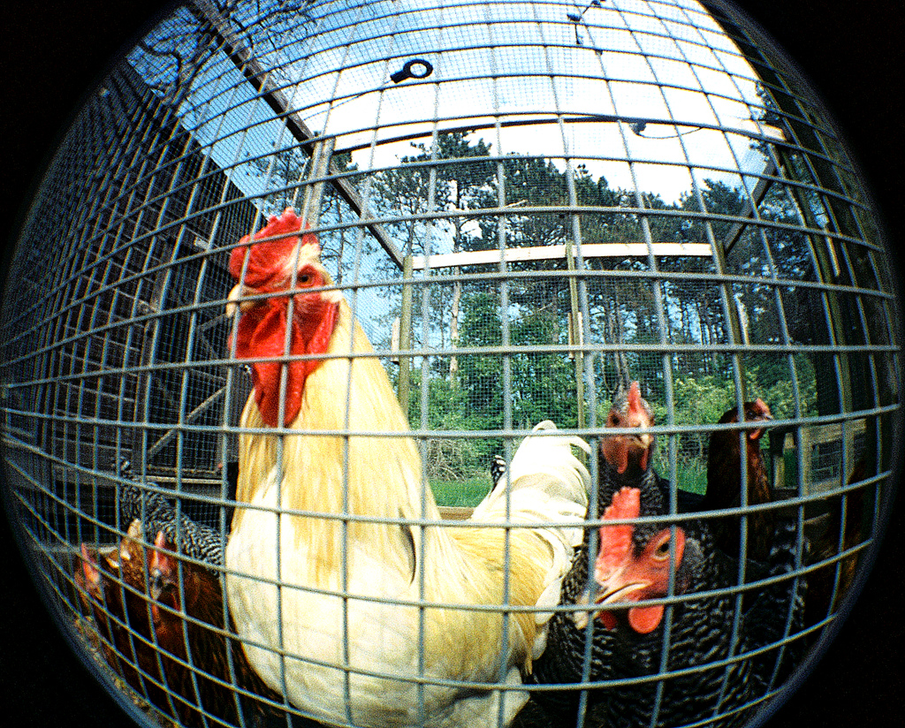
Augury
Photo by sandcastlematt

Slide 22
PERSEVERENCE
In war, the Romans NEVER gave up.

Slide 23
ROME WINS!!!
241 B.C.
TO ROME:
Sicily
Corsica
Sardinia

Slide 24
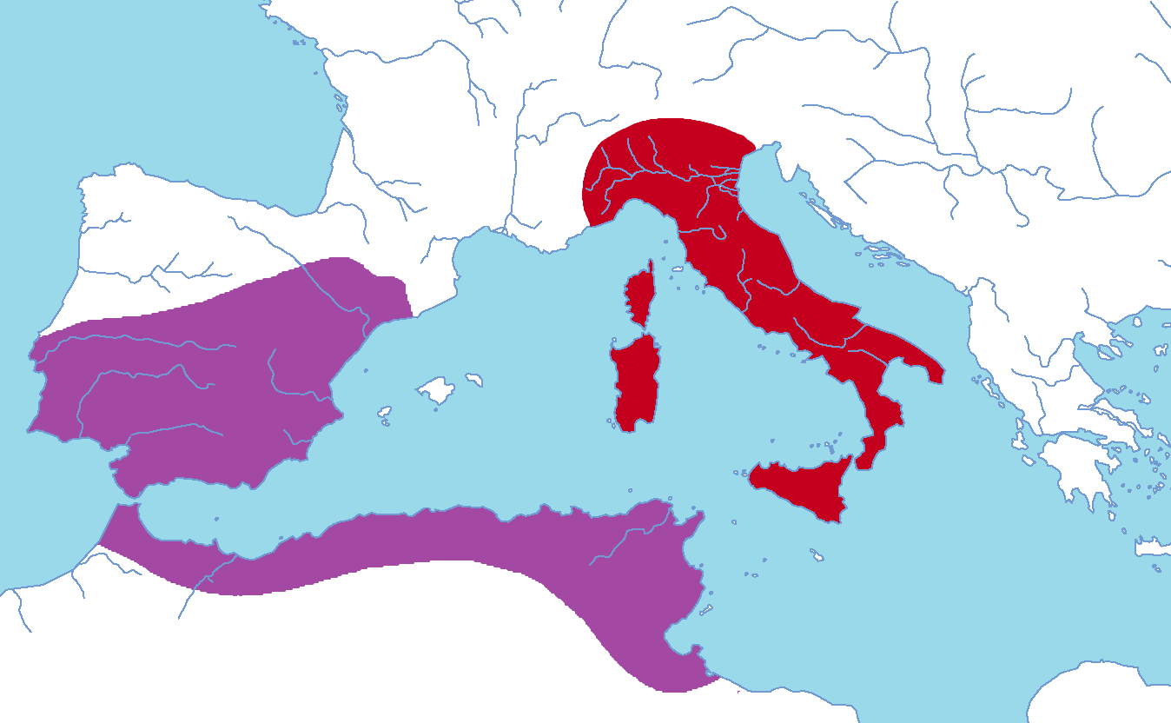
Carthage Rebounds

Slide 25
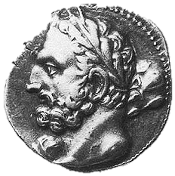
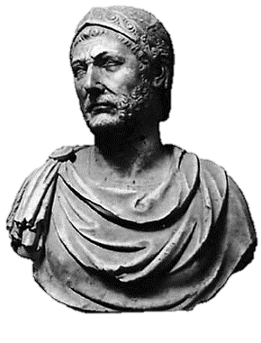
The Barca Family
HAMILCAR
Carthaginian General
First Punic War
HANNIBAL
Hamilcar’s Son
Second Punic War

