Slide 1
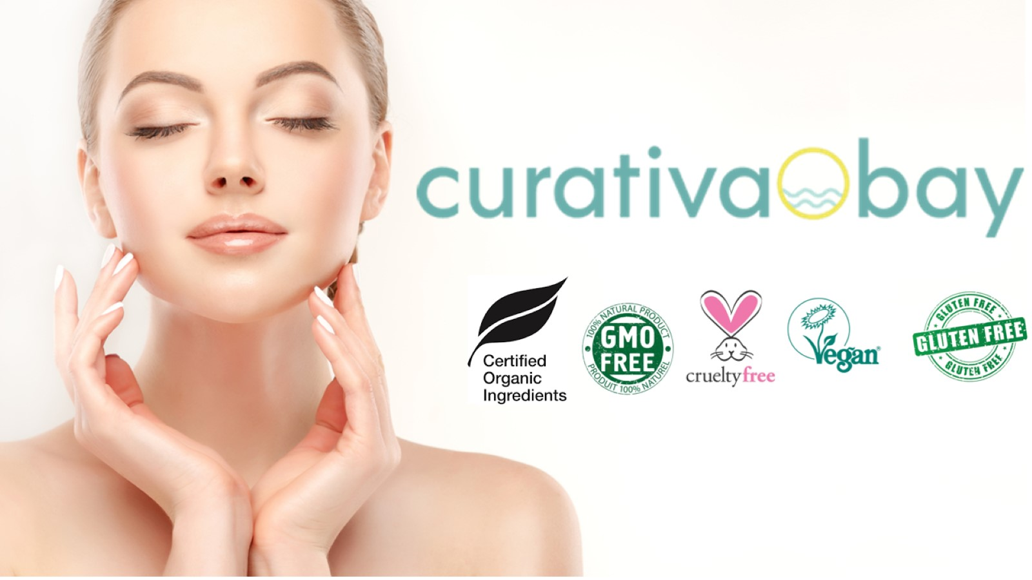

Slide 2
Our Home Come Visit

Slide 3
Curativa Bay Luxury Skin Care The Cure for What Ages You

Slide 5
Innovative Natural Science drives our manufacturing process We have developed products that enhance and improve most skin care concerns such as aging, health, acne/blemishes, dryness, peeling, redness, wrinkles and more. We are also developing a Vegan skin care line that contain no animal products or byproducts, such as beeswax, creating beauty in abundance. Stay Tuned! .

Slide 6
Production Every ingredient is produced is an FDA registered EGMP Facility to Exacting Standards

Slide 7
Our Proprietary Organic HOCL Technology

Slide 8
Proprietary Organic Hypochlorous Skin Mist

Slide 10
Our Products have a 100% 5 star Rating

Slide 11
Luxury, Health & Happiness

Slide 15
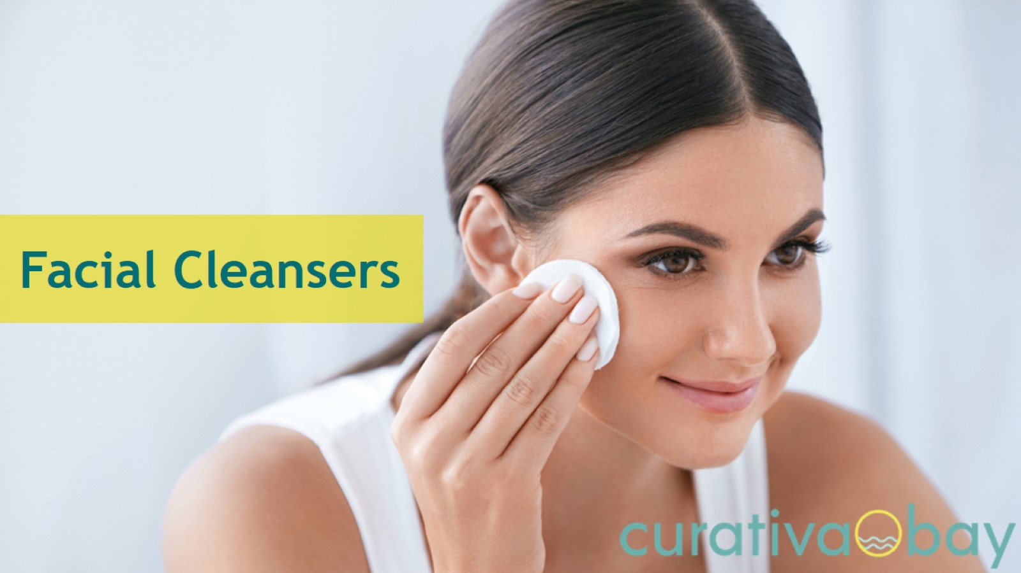

Slide 22
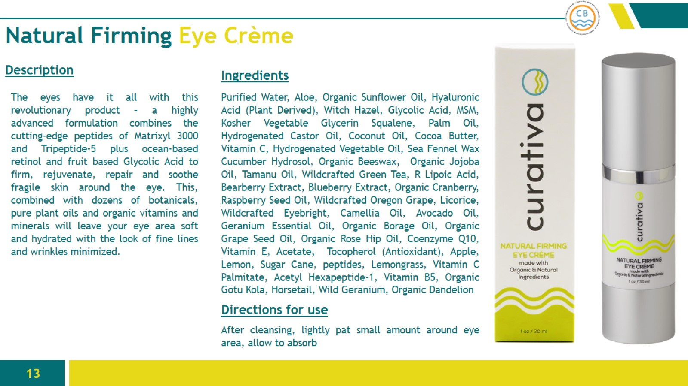

Slide 25
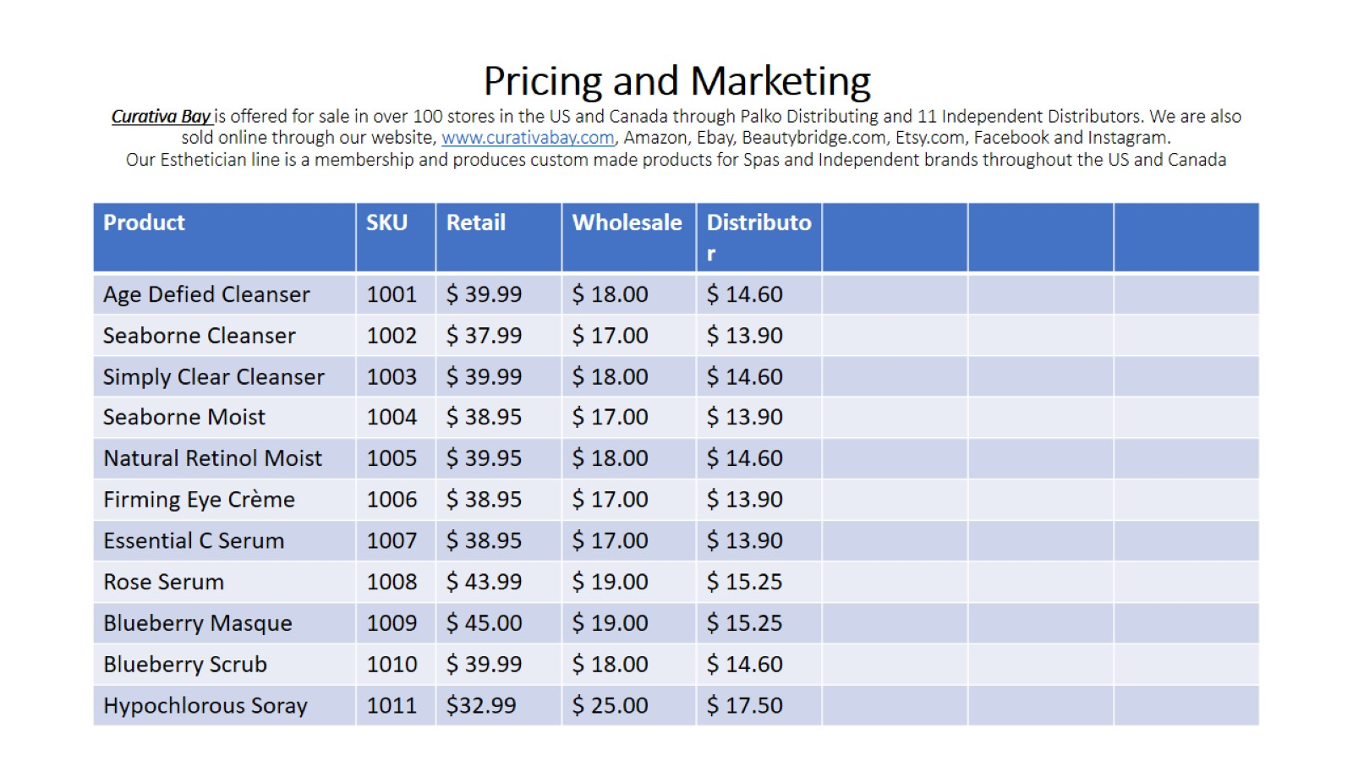
Pricing and Marketing Curativa Bay is offered for sale in over 100 stores in the US and Canada through Palko Distributing and 11 Independent Distributors. We are also sold online through our website, www.curativabay.com, Amazon, Ebay, Beautybridge.com, Etsy.com, Facebook and Instagram. Our Esthetician line is a membership and produces custom made products for Spas and Independent brands throughout the US and Canada

Slide 27
Accolades

