Slide 1
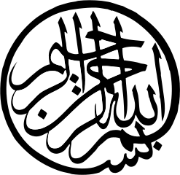
The Rise of Islam

Slide 3
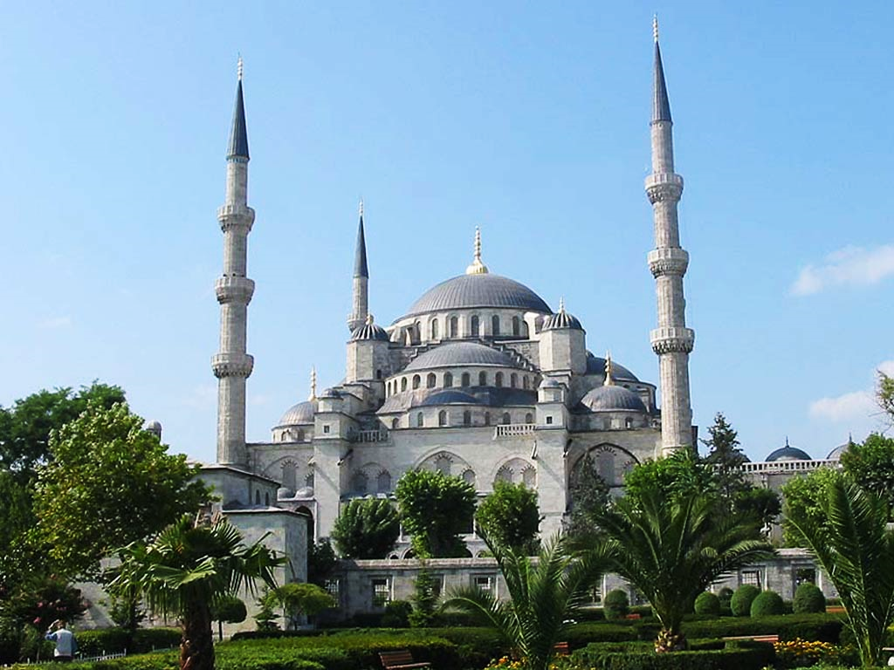
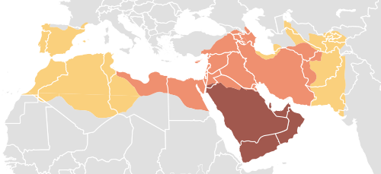
TABLE OF CONTENTS
Part I
Part II
Introduction to Islam
Expansion of Islam

Slide 4
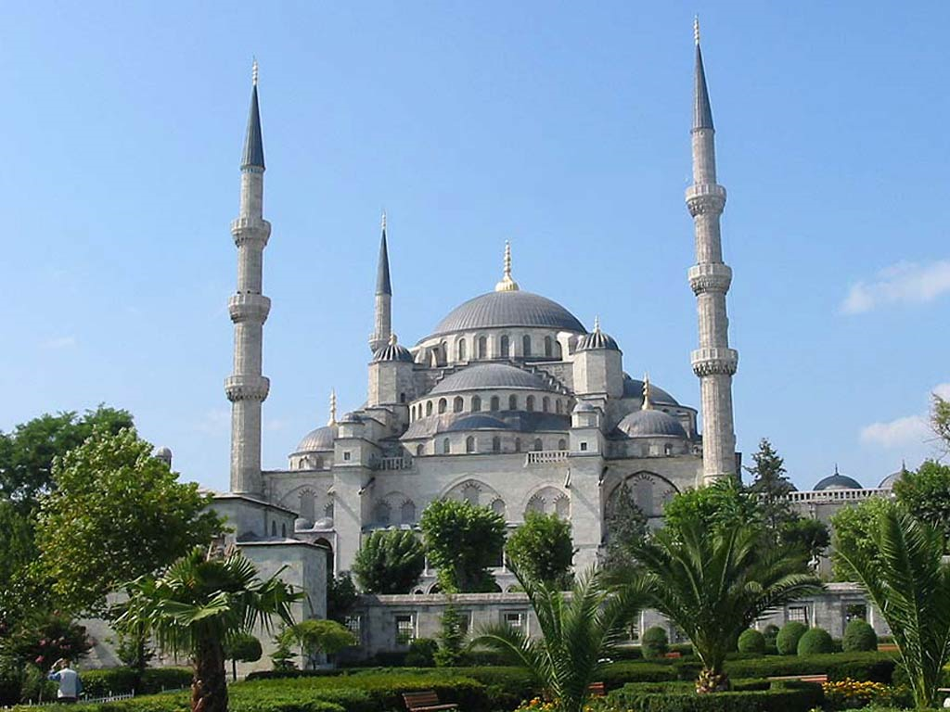
Introduction to Islam

Slide 5
TERMS LIST (A)
Bazaar
Bedouins
Allah
Muhammad
Mecca
Kaaba
Black Stone
Medina
Hijrah
Islam
Muslims
Qur’an
Mosques
Five Pillars
Profession of Faith
Prayer
Mosque Tax
Ramadan
Hajj

Slide 6
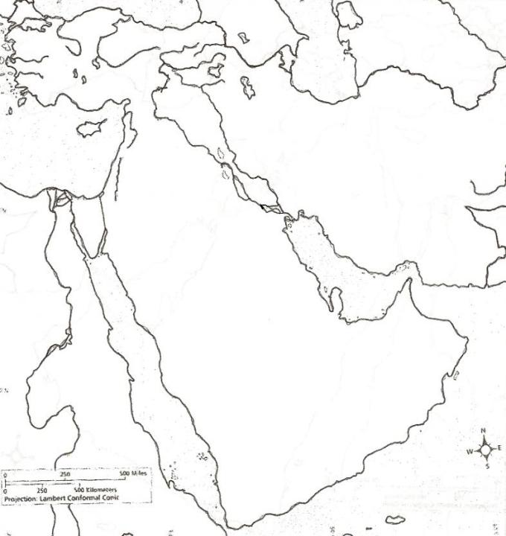
CITIES:
Constantinople
Jerusalem
Mecca
Medina
REGIONS:
Anatolia
Arabian Peninsula
Cyprus
Egypt
Iran
Mesopotamia
WATERS:
Mediterranean Sea
Persian Gulf
Red Sea
Euphrates River
Nile River
Tigris River

Slide 7
Islam
The term Islam means “to submit”
Religion | Islam | “To Submit”
Follower | Muslim | “One Who Submits”

Slide 8
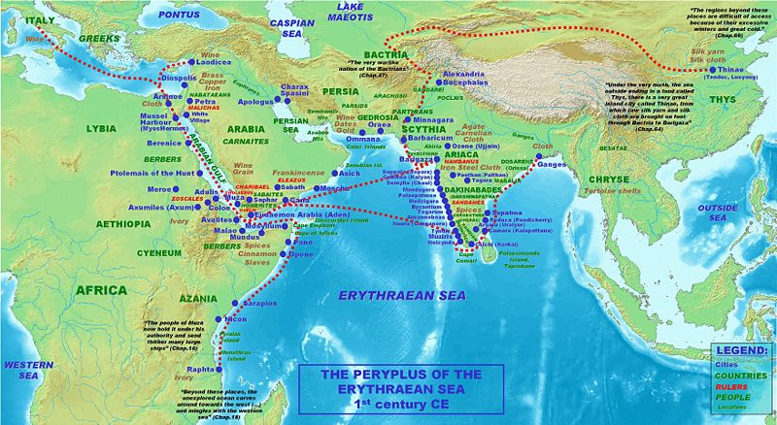
Indian Ocean Trade

Slide 9
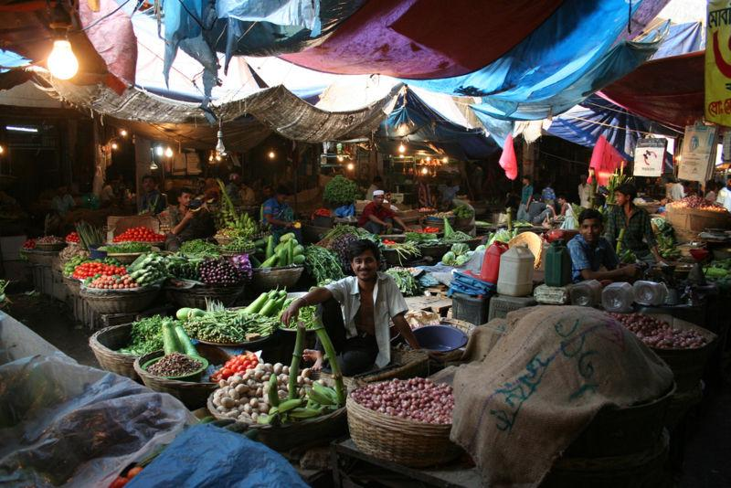
Bazaar

Slide 10
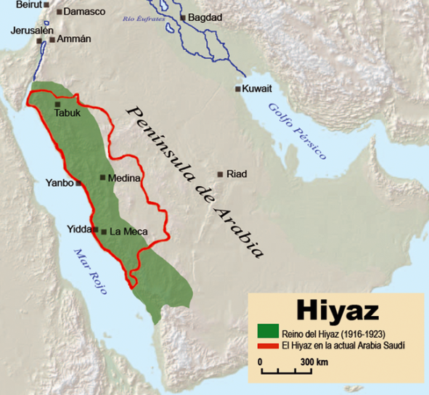
Hejaz
Region of Islam’s holy places
Trade Routes

Slide 11
Bedouin
The term “Bedu” means inhabitant of the desert
It refers to an Arab nomadic pastoralist.
Tribal Loyalty / Kin Relationships:
"I and my brothers against my cousins, I and my brothers and my cousins against the world.“
Bedouin Proverb

Slide 12
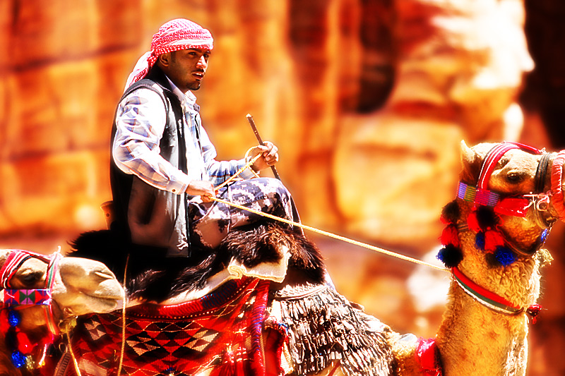

Slide 13
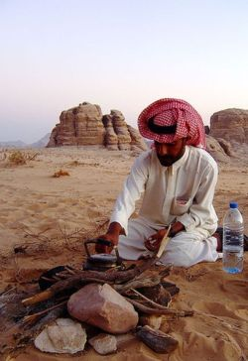

Slide 14
Muhammad
b. 570 A.D. in Mecca
Trading and religious center
Kaaba
Led trade caravans through the Hejaz
Exposed to diverse people and ideas

Slide 15
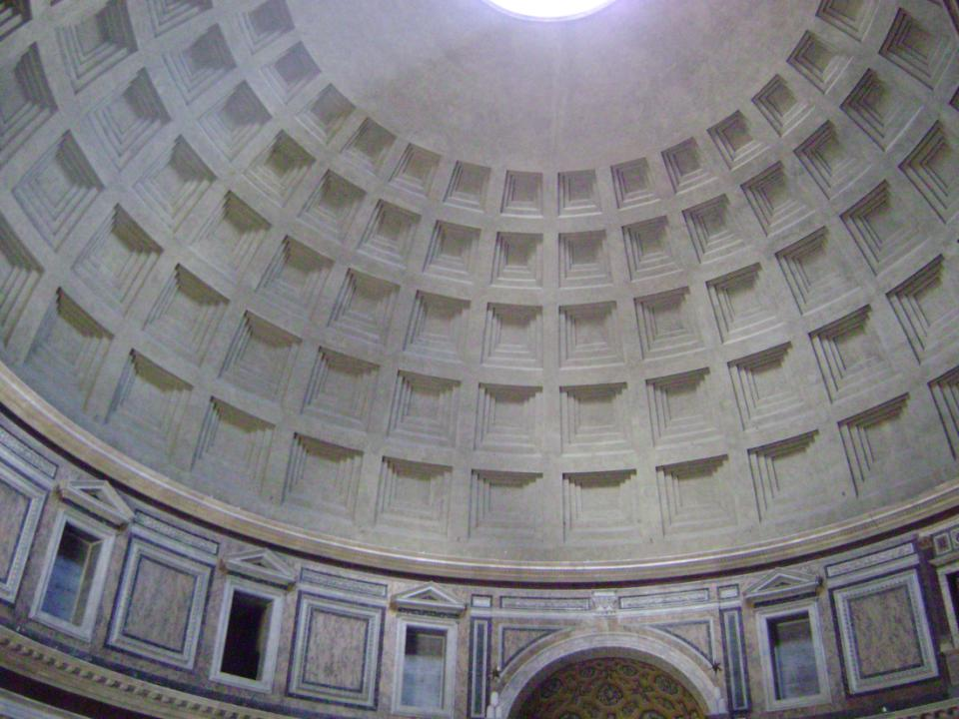

Slide 16
Islam
Allah (God)
Muslim
One who submits
Hijrah
622 A.D.
Flight: Mecca → Medina
Qur’an [Recitations]
Dictated to Muhammad by Gabriel

Slide 17
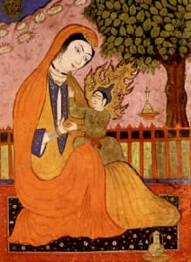
?
?

Slide 18
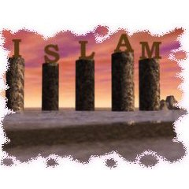
Five Pillars of Islam

Slide 19
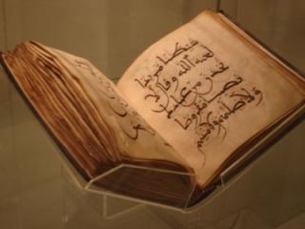
1st Pillar: Profession of Faith (Shahada)
TWOFOLD:
God (Allah) is One
Muhammad is the final prophet
For Muslims, the Qur’an is the
ultimate proof of this declaration.

Slide 20
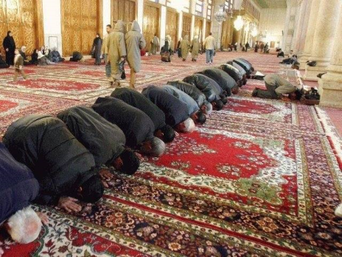
2nd Pillar: Praying (Salat)
Salat is the ritual of prayer
Muslims pray five times a day (dawn, noon, afternoon, sunset, evening) in the direction of Mecca.

Slide 21
Salat

Slide 22
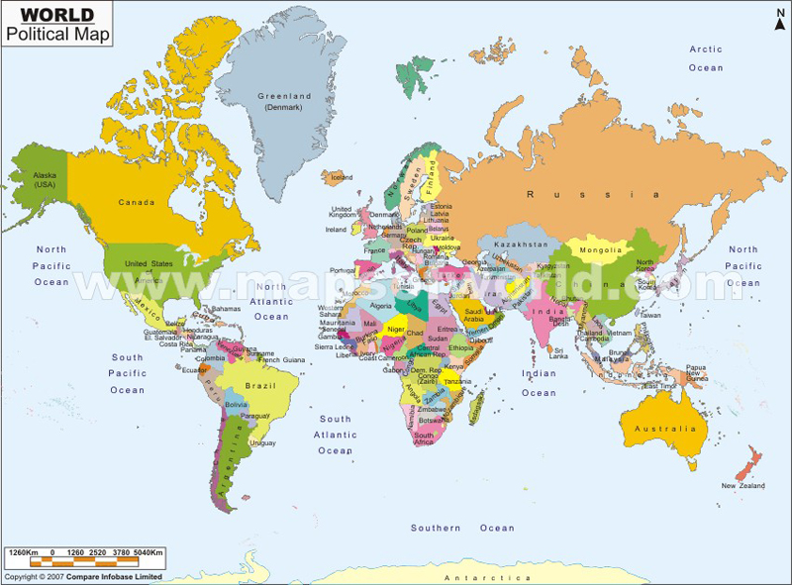

Slide 23
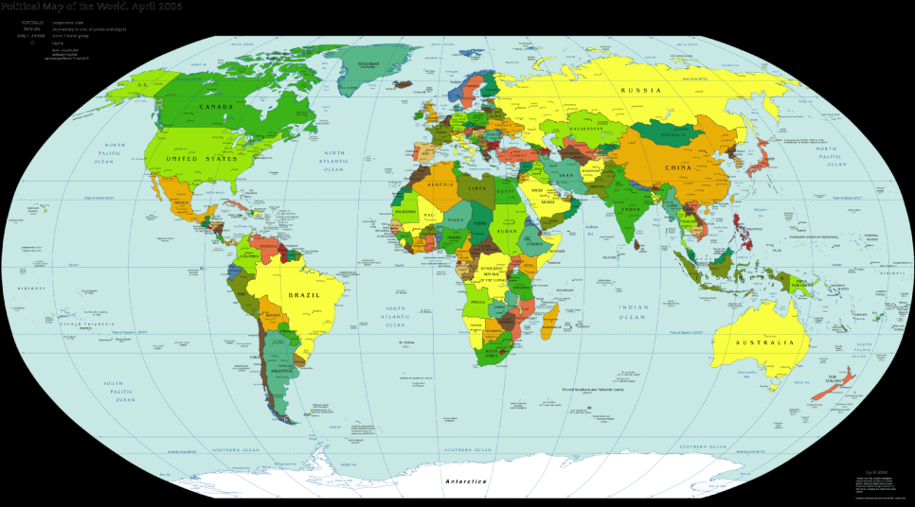

Slide 24
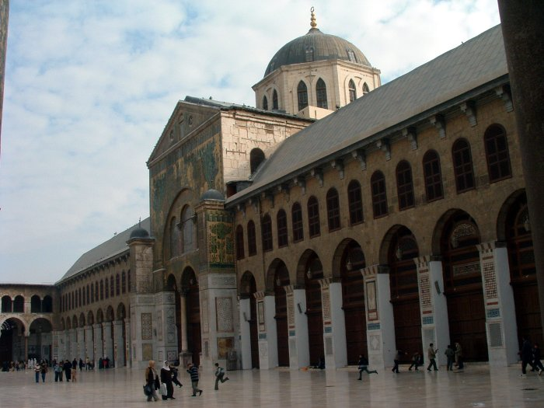
The Umayyad Mosque

Slide 25
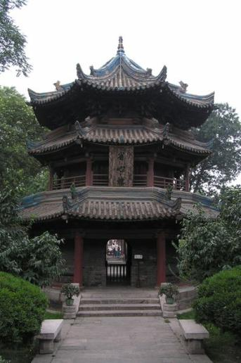
Great Mosque of X’ian

Slide 26
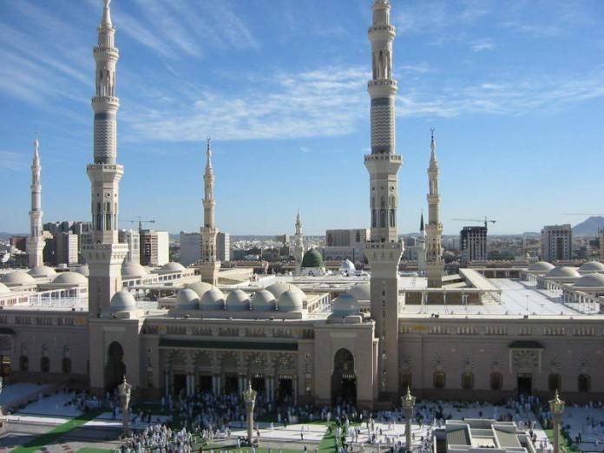
Masjid Nabawi (The Prophet’s Mosque)

Slide 27
3rd Pillar: Zakat (Charity)
Piety and charity are important aspects of Islam. All Muslims are required to be charitable to those who are less fortunate then themselves.

Slide 28
4th Pillar: Ramadan (Fasting)
Ramadan is the ninth month of the Islamic Lunar Calendar.
During this month, Muslims will refrain from all food, drink, tobacco, etc., during daylight hours
Pregnant women, the elderly, and young children do not have to fast.
Ramadan Dates
Easter Dates
Interesting Article:
http://www.islamfortoday.com/ramadan09.htm

Slide 29
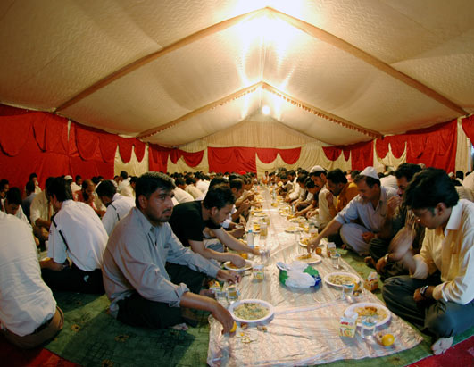

Slide 30
5th Pillar: The Hajj (Pilgrimage to Mecca)
Muslims are required to travel to Mecca at least once during their life time. The Pilgrimage is done during the 12th Lunar Month (Dhul Hijjah).
At Mecca, they will perform a variety of rituals involving the Kaaba and the Black Stone.
The Pilgrimage was performed by Muhammad at the end of his life.

Slide 31
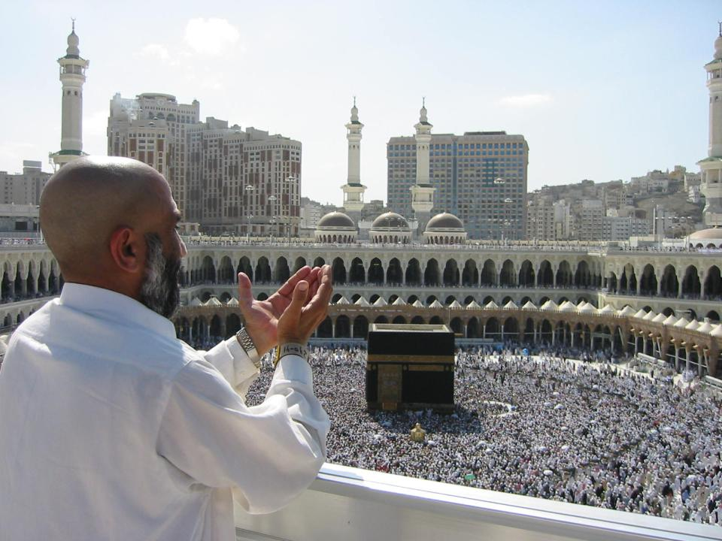

Slide 32
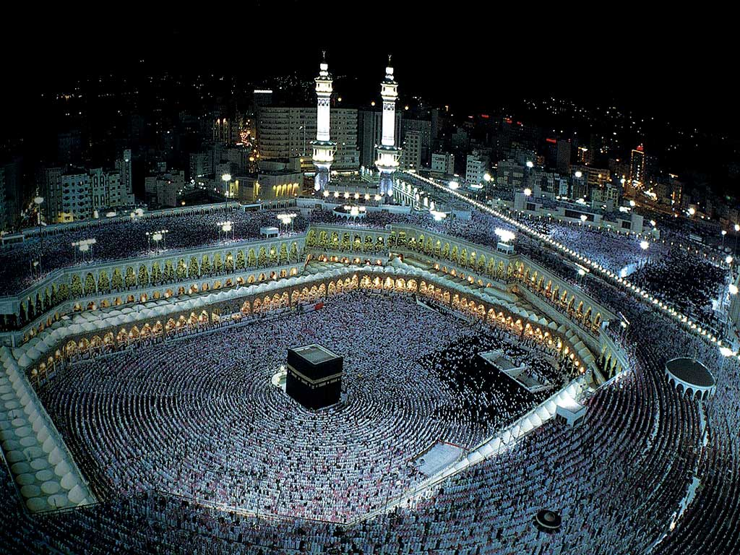

Slide 33
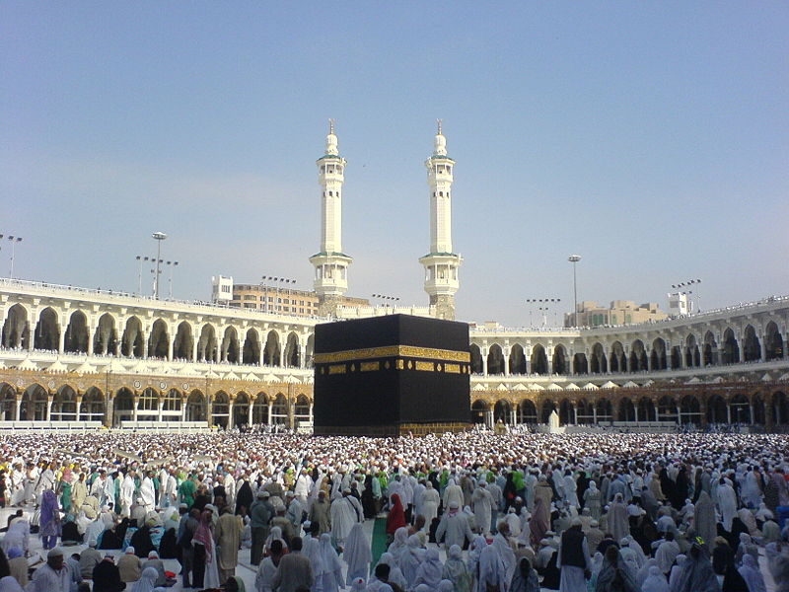

Slide 34
The Black Stone Close-up

Slide 35
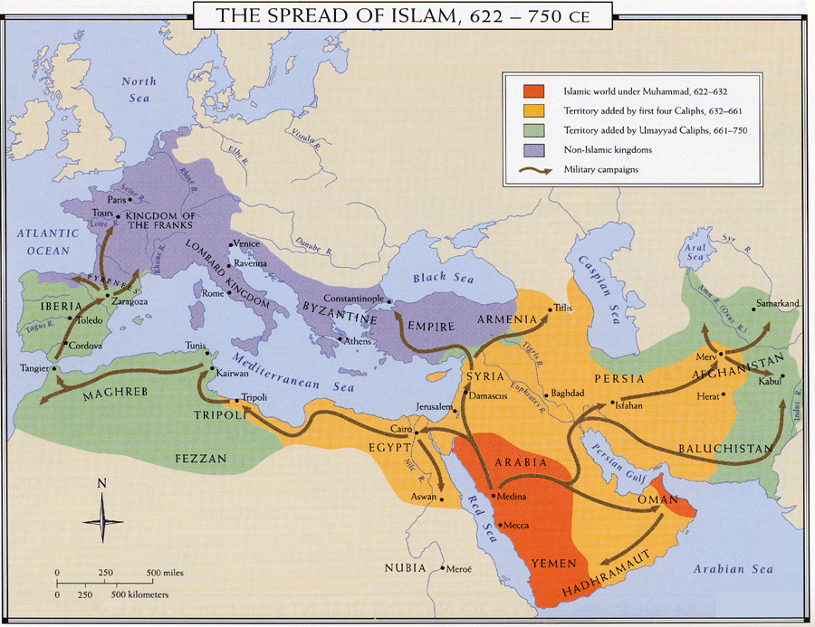
The Expansion of Islam and the limits thereof
SC Standard GS-2
Indicator(s): 2.1, 2.2

Slide 36
TERMS LIST (B)
Jihad
“People of the Book”
Moors
Extent of Islamic Conquests
Franks
Clovis
Merovingian Dynasty
Charles Martel
Battle of Tours
Siege of Constantinople
Theodosian Walls
Greek Fire
Islamic Golden Age

Slide 37
Jihad and Conquest
Jihad
“Strive in the way of Allah”
Could describe spiritual or military struggle
Conquest and Conversion
“People of the Book” not forced to convert
Conquests stretched from Spain in the West to Persia in the East
Moors – Muslim conquerors of Spain

Slide 38
Sieges of Constantinople
(674-678, 717-718)
Tours (732)
Source: http://www.wall-maps.com/Classroom/HISTORY/World/Universal/World-history-universal.htm

Slide 39
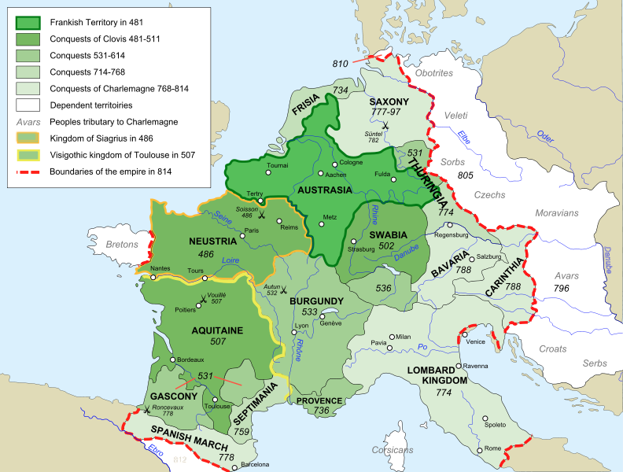
The Franks
Clovis (466-511)
First King of the Franks
Battlefield Conversion to Christianity

Slide 40
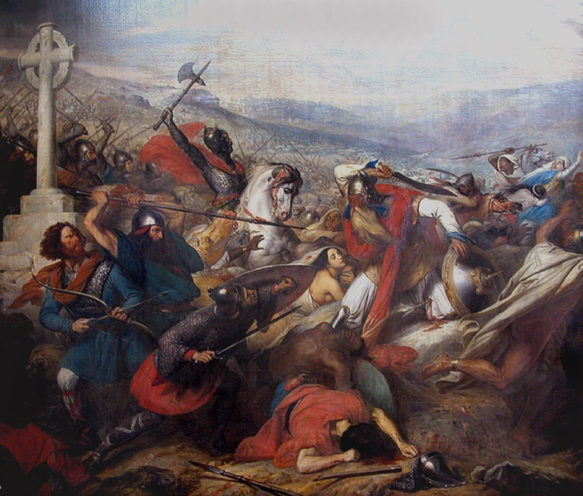
Charles “The Hammer” Martel
Mayor of the Palace
732 - Battle of Tours
Muslim expansion halted
Steuben, Bataille de Poitiers, 1837

Slide 41
Steuben, Bataille de Poitiers [Tours], 1837

Slide 42
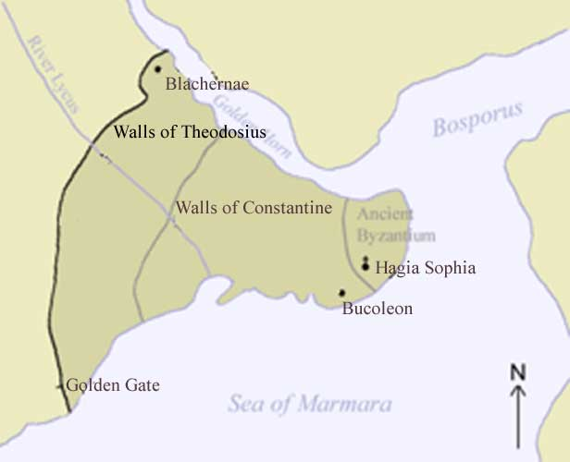
Byzantine-Arab Wars
“All roads lead to Rûm”
-- Arab Saying
WALLS
NAVY

Slide 43
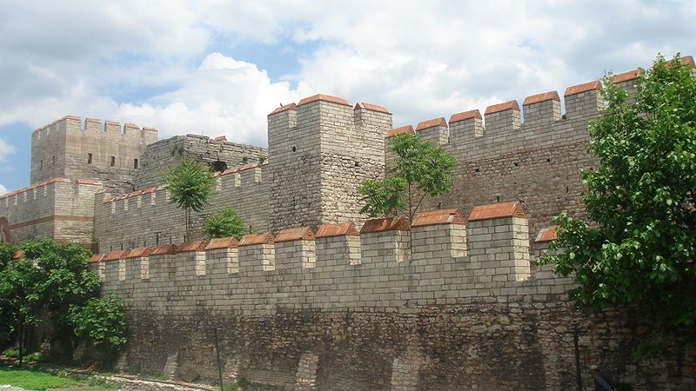
Theodosian Wall (Constantinople)
More: http://www.mlahanas.de/Greeks/Medieval/war/WallsOfConstantinople.html

Slide 44
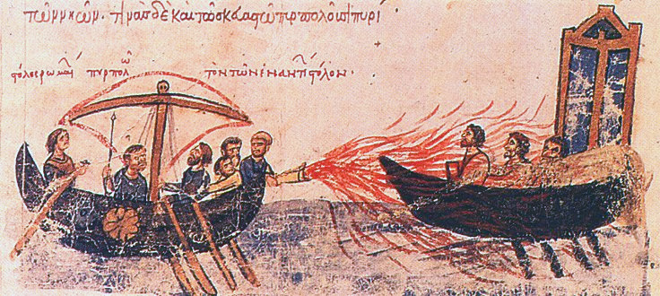
“Greek Fire”

Slide 45
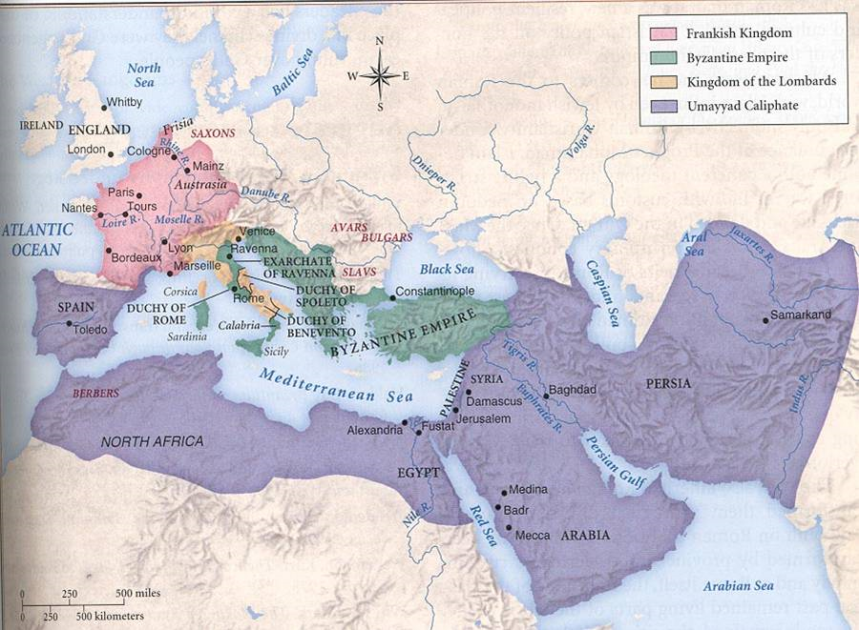
Credit: http://espliego.files.wordpress.com/2008/03/islam-map1ref1.jpg

Slide 46
Islamic Golden Age (c. 700-1200 A.D.)
Literature:
Arabian Nights (10th c.)
Medicine:
Postmortem Autopsies on Humans
Forbidden by Romans
Experimental Surgery
Germ Theory
Disproved Humorism
Chemistry
Distilled Liquors
Perfume
An Arabic manuscript describing the eye, dating back to the 12th century

Slide 47
For more videos and instructional materials, visit

Slide 48
@TomRichey

