Slide 1
cRITO

Slide 2
THEMES
FEAR OF DEATH
REASON VS. EMOTION
DEMOCRACY
SOCIAL CONTRACT
THE RULE OF LAW
CITIZENSHIP
JUSTICE
HONOR

Slide 3
Essential questions
?
Is it ever okay to do EVIL?
What makes a person GOOD?
Is it ever okay to break the LAW?
Should we FEAR death?
What is expected of a CITIZEN?

Slide 4
Journal Prompt
Are you afraid of death? Explain why or why not.

Slide 5
The Unexamined life is not worth living.

Slide 6
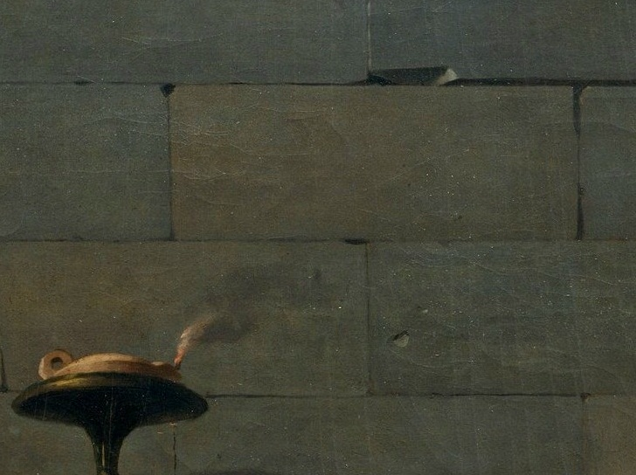
REASON
(LOGOS)
VS.
EMOTION (pathos)
Generic Man by Alex Berkowitz for the Noun Project

Slide 7
What Makes SOMEONE GOOD?
JUSTICE
HONOR
Generic Man by Alex Berkowitz for the Noun Project

Slide 8
principles
THEORY OF FORMS
DON’T bring evil into the world regardless of the circumstances.

Slide 9
Civil Disobedience?

Slide 10
THE MAJORITY
MATERIAL WORLD (Lower Reality) | ABSTRACT FORMS (Higher Reality)
They can hurt you here. | BUT NOT HERE!

Slide 11
THE GENERAL WILL
MATERIAL WORLD (Lower Reality) | ABSTRACT FORMS (Higher Reality)
I cannot act against the General Will. I can only attempt to influence it. | I can believe something contrary to the General Will.

