Slide 1
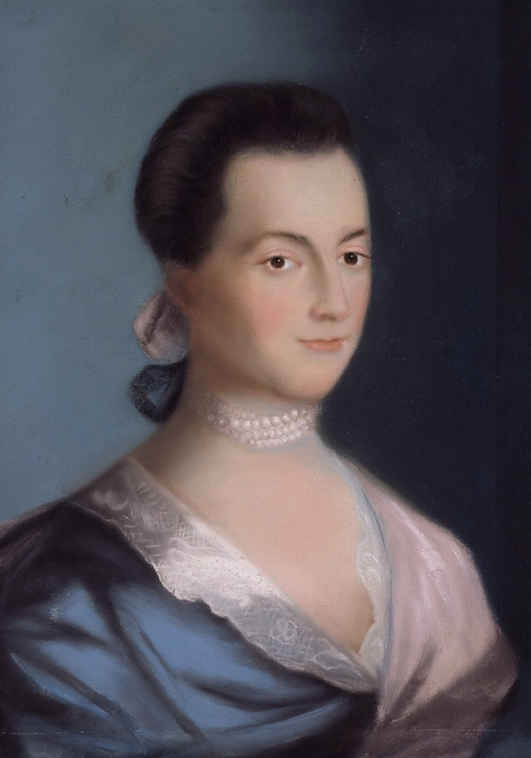
LEGACIES
of the American Revolution

Slide 2
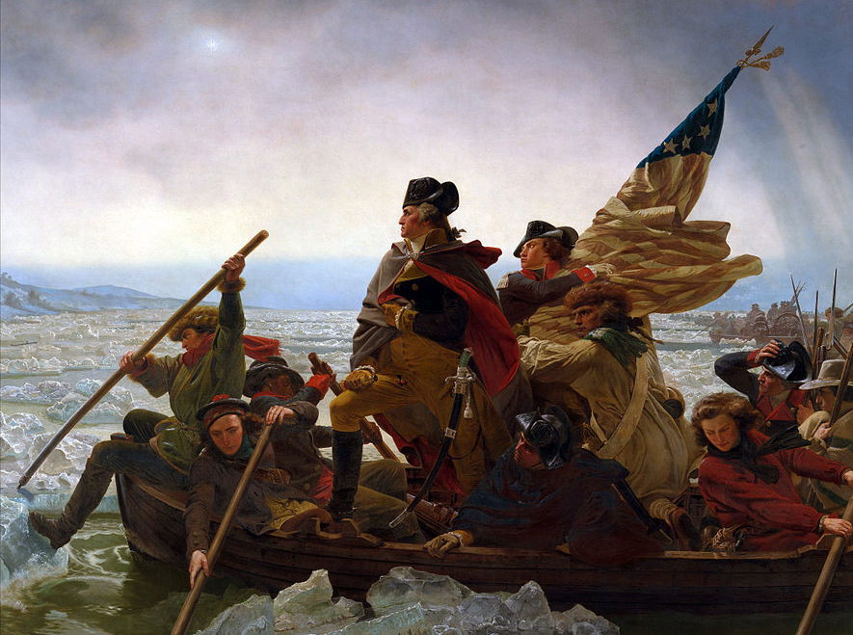
What difference did it make?

Slide 3
Evaluating Revolutions
Political Revolution | Social Revolution
A revolution that produces a change in government | A Revolution that produces a change in society

Slide 4
Evaluating Revolutions
Political Revolution | Social Revolution
A revolution that produces a change in government | A Revolution that produces a change in society

Slide 5
Was the American Revolution simply a political revolution that resulted in a change in government, or did it also result in meaningful changes in American society?

Slide 6
Evaluate the extent to which the American Revolution resulted in changes in American society in the period from 1775 to 1800.

Slide 7
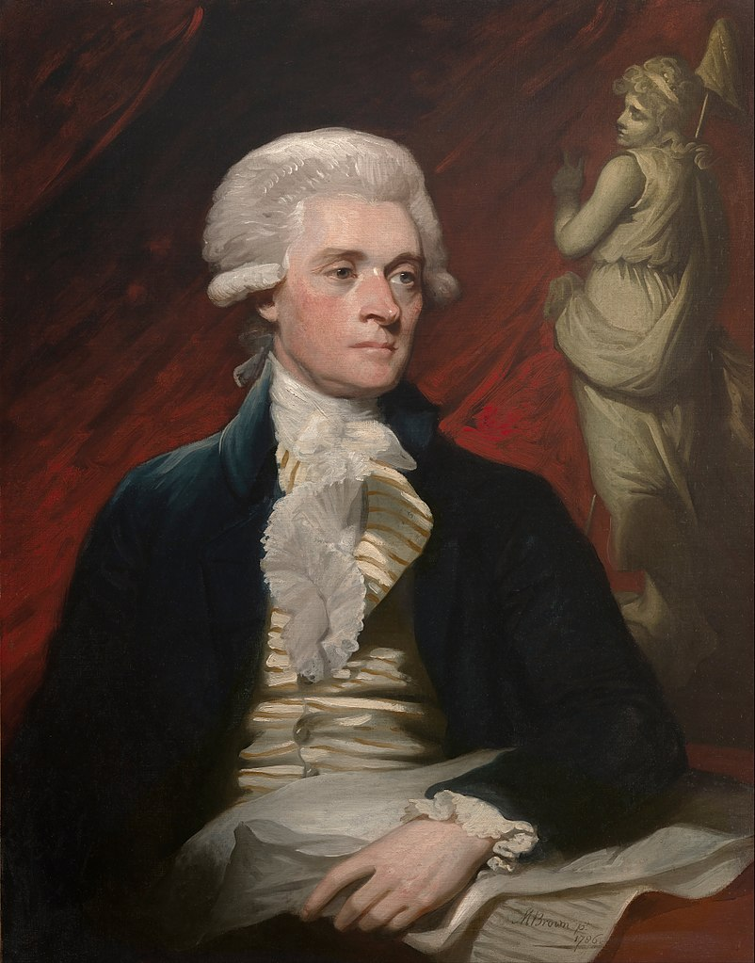
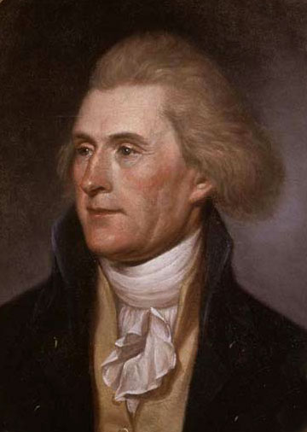
Jefferson in the U.S.
(1791)
Jefferson in Britain
(1786)

Slide 8
[r]epublicanism
Egalitarianism
Emancipation
Religious Freedom
Women’s Rights
Agrarianism
Simplicity

Slide 9
[r]epublicanism
Note the small r.

Slide 10
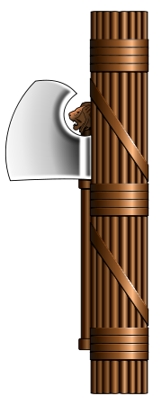
[r]epublicanism
Monarchy
Popular Sovereignty
Representative Government
Egalitarianism (Equality Under the Law)
Limited Government
Individual Rights
Rotation in Office (Term Limits)
Patriotic, Virtuous, & Educated Citizenry
Roman Fasces

Slide 11
Egalitarianism
root word = equal
Monarchy vs. Republic

Slide 12
Monarchy
Republic
Fixed Social Hierarchy
Equality Under the Law

Slide 13
Monarchy
Republic
Fixed Social Hierarchy
Equality Under the Law

Slide 14
Monarchy
Republic
SUBJECTS
(ruled by the monarch)
CITIZENS
(in charge of the gov.)

Slide 15
Monarchy
Republic
SUBJECTS
(ruled by the monarch)
CITIZENS
(in charge of the gov.)

Slide 16
No title of nobility shall be granted by the United States…
United States Constitution
Article I, Section 9, Clause 8

Slide 17
Primogeniture and Titles
Southern states abolished primogeniture laws, which favored firstborn sons after the Revolution.
All state legislatures banned aristocratic titles of nobility.
$
Person by Alex Berkowitz from The Noun Project

Slide 18
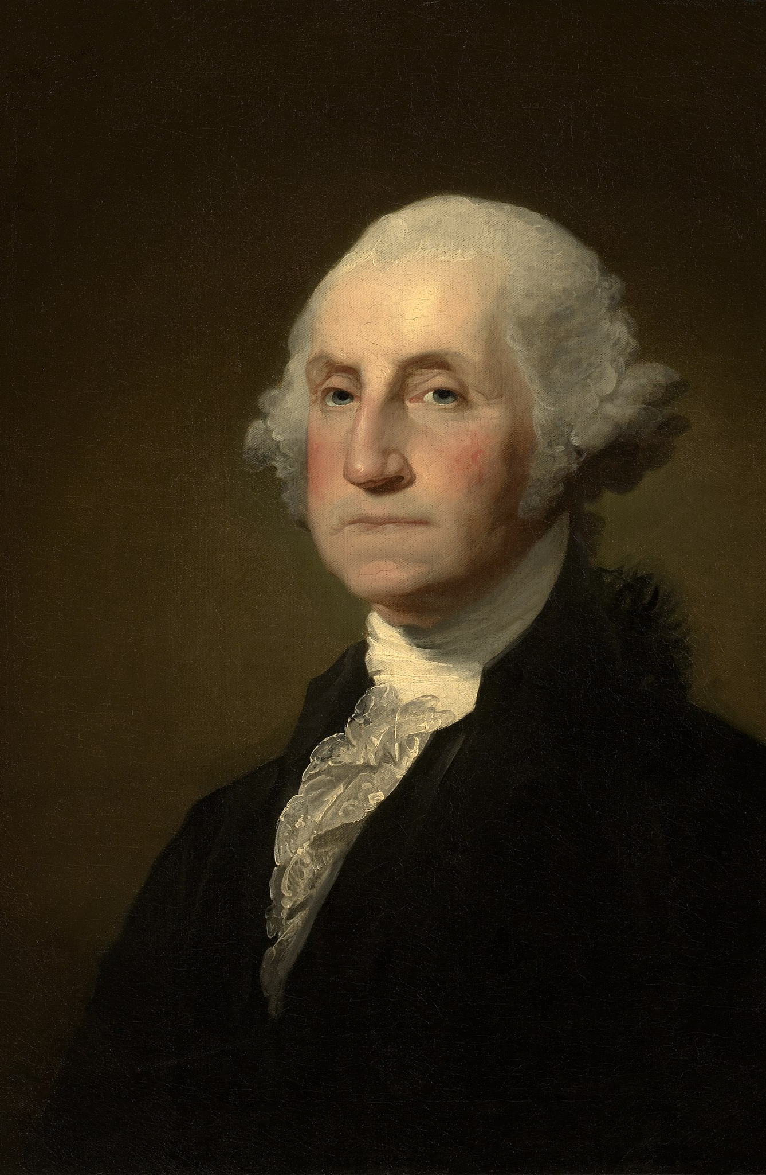
“Mr. President”
Washington’s choice of a title reflects the egalitarianism of a republican society.

Slide 19
Slavery
By 1800, nearly all states north of the Mason-Dixon Line passed laws providing for gradual emancipation of slaves.

Slide 20
Northern Emancipation
 | VT | PA | MA | NH | CT | RI | NY | NJ
Official end of slavery | 1777 | 1780 | 1783 | 1783 | 1784 | 1784 | 1799 | 1804
Actual end of slavery | 1777 | c.1845 | 1783 | c.1845 | 1848 | 1842 | 1827 | 1865
% Black 1790 | 0.3% | 2.4% | 1.4% | 0.6% | 2.3% | 6.3% | 7.6% | 7.7%
% Black 1860 | 0.22% | 1.95% | 0.78% | 0.15% | 1.87% | 2.26% | 1.26% | 3.76%
Source: slavenorth.com

Slide 21
Slavery
Few Northern states allowed free black residents to vote.
Some even banned free black settlement.

Slide 22
Meanwhile…
Slavery became even MORE entrenched in the South.

Slide 23
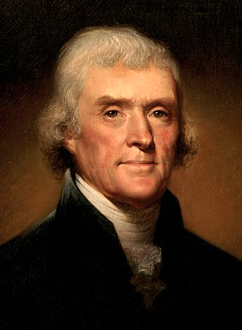
Religious Freedom
Virginia Statute for Religious Freedom (1786)
Anglican Church DISESTABLISHED in Virginia
Jefferson

Slide 24
Before
After
Virginians paid taxes to support the Anglican Church, and there were some legal restrictions on other religious groups.
No mandatory taxes to support any church, and the practice of religion was not regulated by the government, at all.

Slide 25
Before
After
Virginians paid taxes to support the Anglican Church, and there were some legal restrictions on other religious groups.
No mandatory taxes to support any church, and the practice of religion was not regulated by the government, at all.

Slide 26
“No man shall be compelled to frequent or support any religious worship, place, or ministry whatsoever… but that all men shall be free to profess… their opinions in matters of religion…”
Virginia Statute for Religious Freedom (1786)

Slide 27
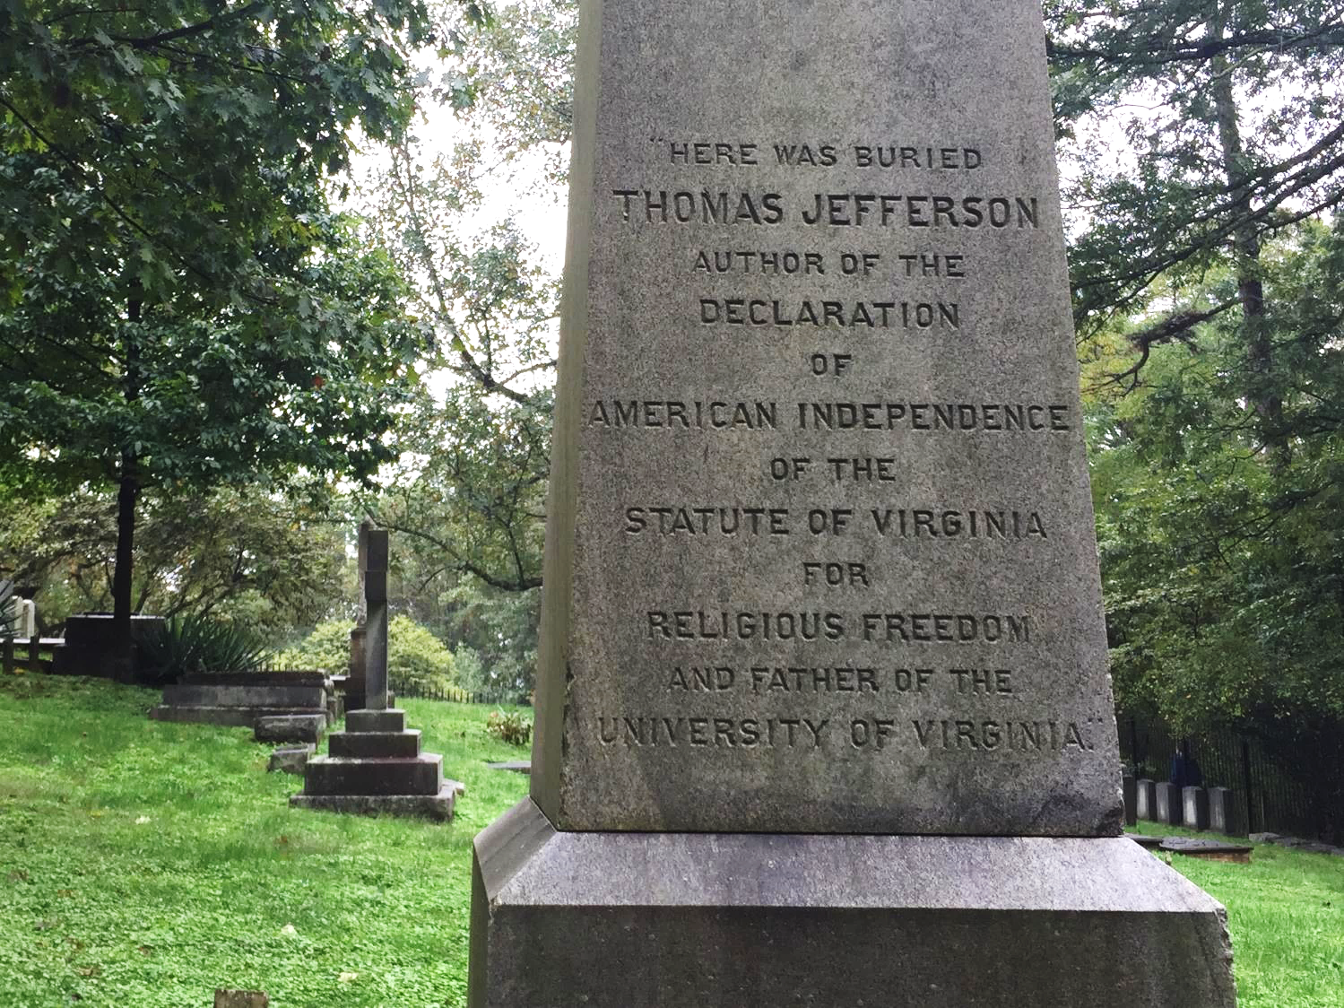
Jefferson’s Epitaph
Notes:
Photo by Tom Richey

Slide 28
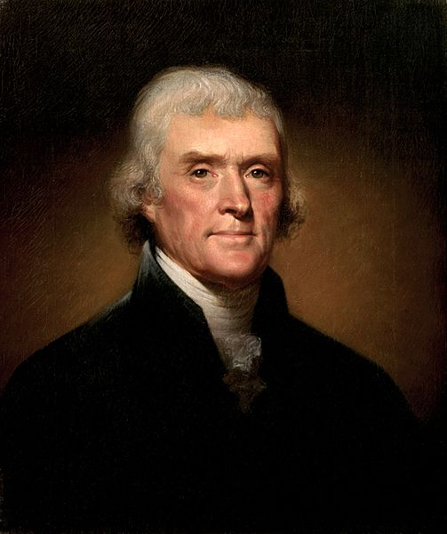
POTUS?

Slide 29
Jefferson was more proud of what he did to make Virginia more free than he was of his personal accomplishments.
Notes:
Photo by Tom Richey

Slide 30
“…no religious test shall ever be required as a qualification to any office or public trust under the United States.”
United States Constitution

Slide 31
Federalism
The states cooperated to win their independence from Britain in the Revolutionary War…

Slide 32
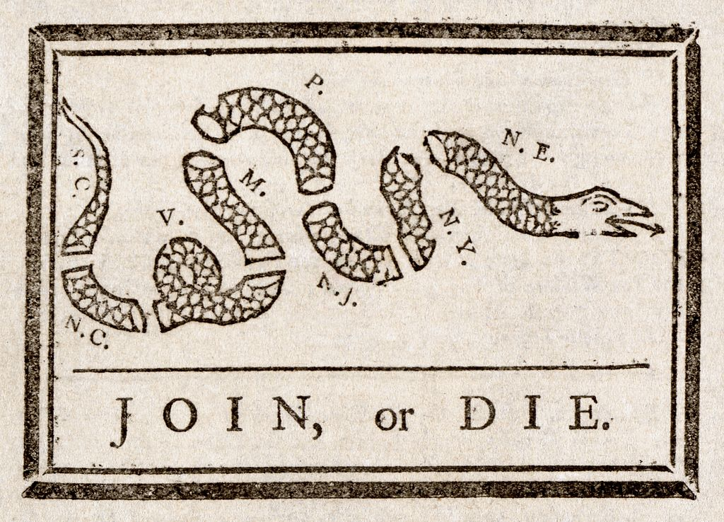
Federalism
The states cooperated to win their independence from Britain in the Revolutionary War…
To a point…

Slide 34
These United Colonies are, and of Right ought to be Free and Independent States…
Declaration of Independence

Slide 35
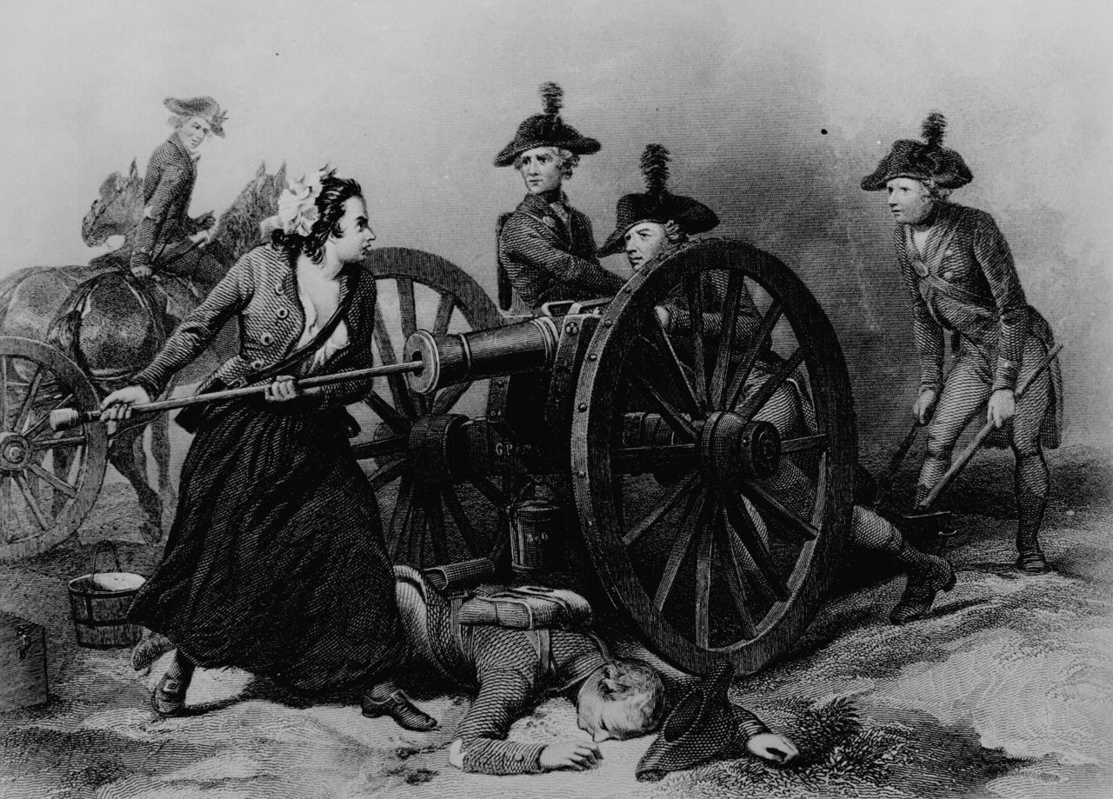
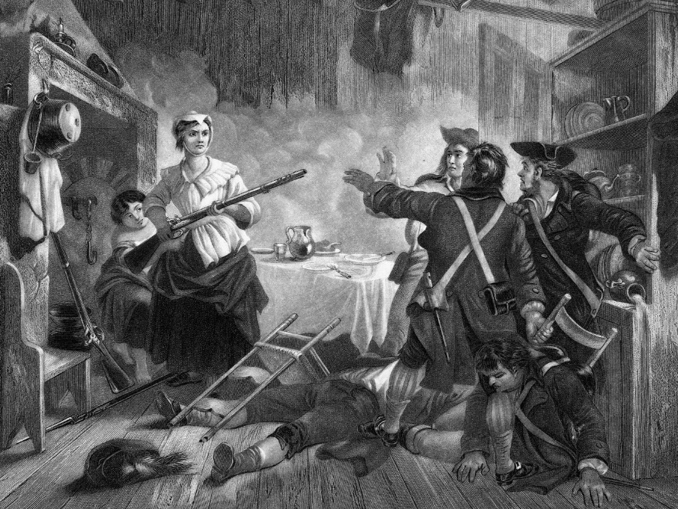
Women and the Revolution

Slide 36
Molly Pitcher
A legend circulated of a woman who took her husband’s place at an artillery piece during the Battle of Monmouth.

Slide 37
Nancy Morgan Hart
Georgia Patriot

Slide 38
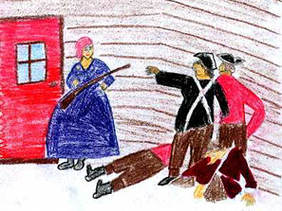
By Christian M.

Slide 39
REMEMBER
the Ladies
Abigail Adams

Slide 40
"I long to hear that you have declared an independency. And, by the way, in the new code of laws which I suppose it will be necessary for you to make, I desire you would remember the ladies and be more generous and favorable to them than your ancestors.
“Do not put such unlimited power into the hands of the husbands. Remember, all men would be tyrants if they could.”
To John Adams (March 1776)

Slide 41
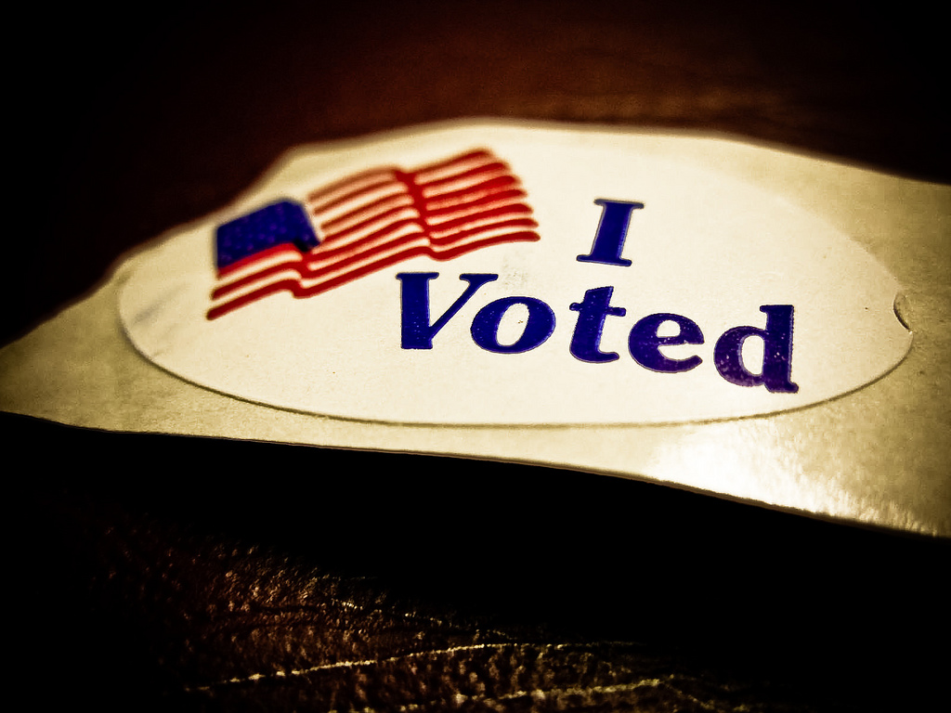
NOT YET
Photo by Vox Efx

Slide 42
Women did not gain the ability to vote (nationwide) until the 19th Amendment was ratified in 1920.
Photo by Vox Efx

Slide 43
Property Ownership
The American Revolution DID NOT result in an increase in property rights for married women. When a woman married, most of her property went into the hands of her husband.

Slide 44
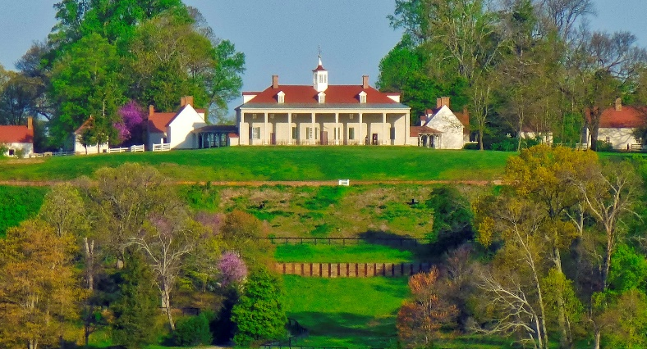
Real Property
Personal Property
A Wife Retained Some Control
A Husband Exercised Complete Control
Photo by F Delventhal

Slide 45
Although George Washington freed his slaves in his will, the slaves who belonged to his wife were never freed.
Public Domain Photo

Slide 46
Real Property
Personal Property
A Wife Retained Some Control
A Husband Exercised Complete Control
Photo by F Delventhal

Slide 47
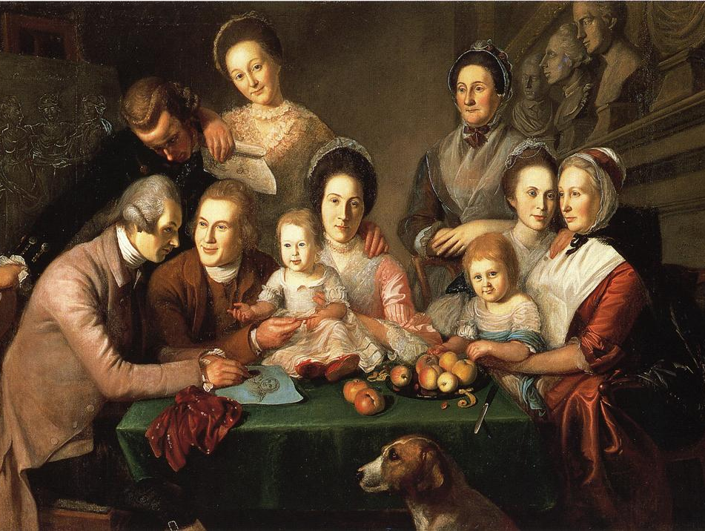
REPUBLICAN MOTHERHOOD
Charles Willson Peale, The Peale Family

Slide 48
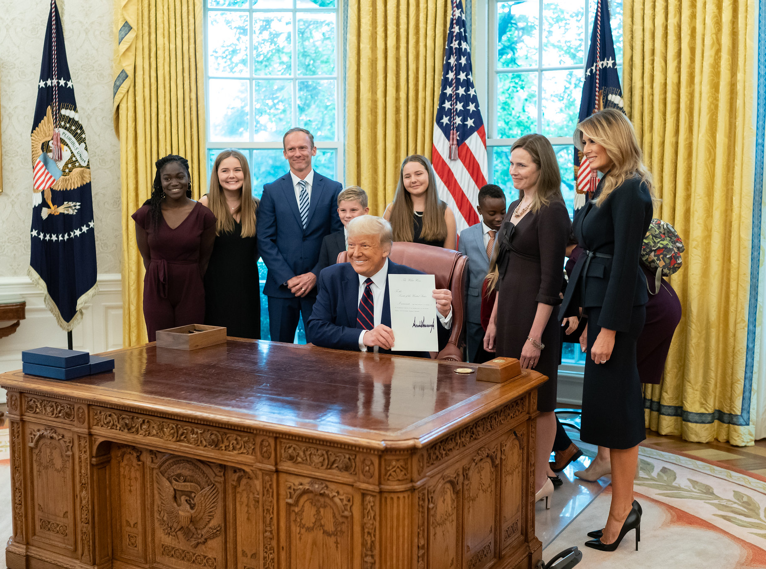
small r!
Public Domain Photo

Slide 49
STRONG FAMILIES = STRONG REPUBLIC
Charles Willson Peale, The Peale Family

Slide 50
"If a nation expects to be ignorant and free… it expects what never was and never will be.”
-- Thomas Jefferson

Slide 51
A Child’s First Teacher
Platt Powell Ryder, The Illustrated Newspaper

Slide 52
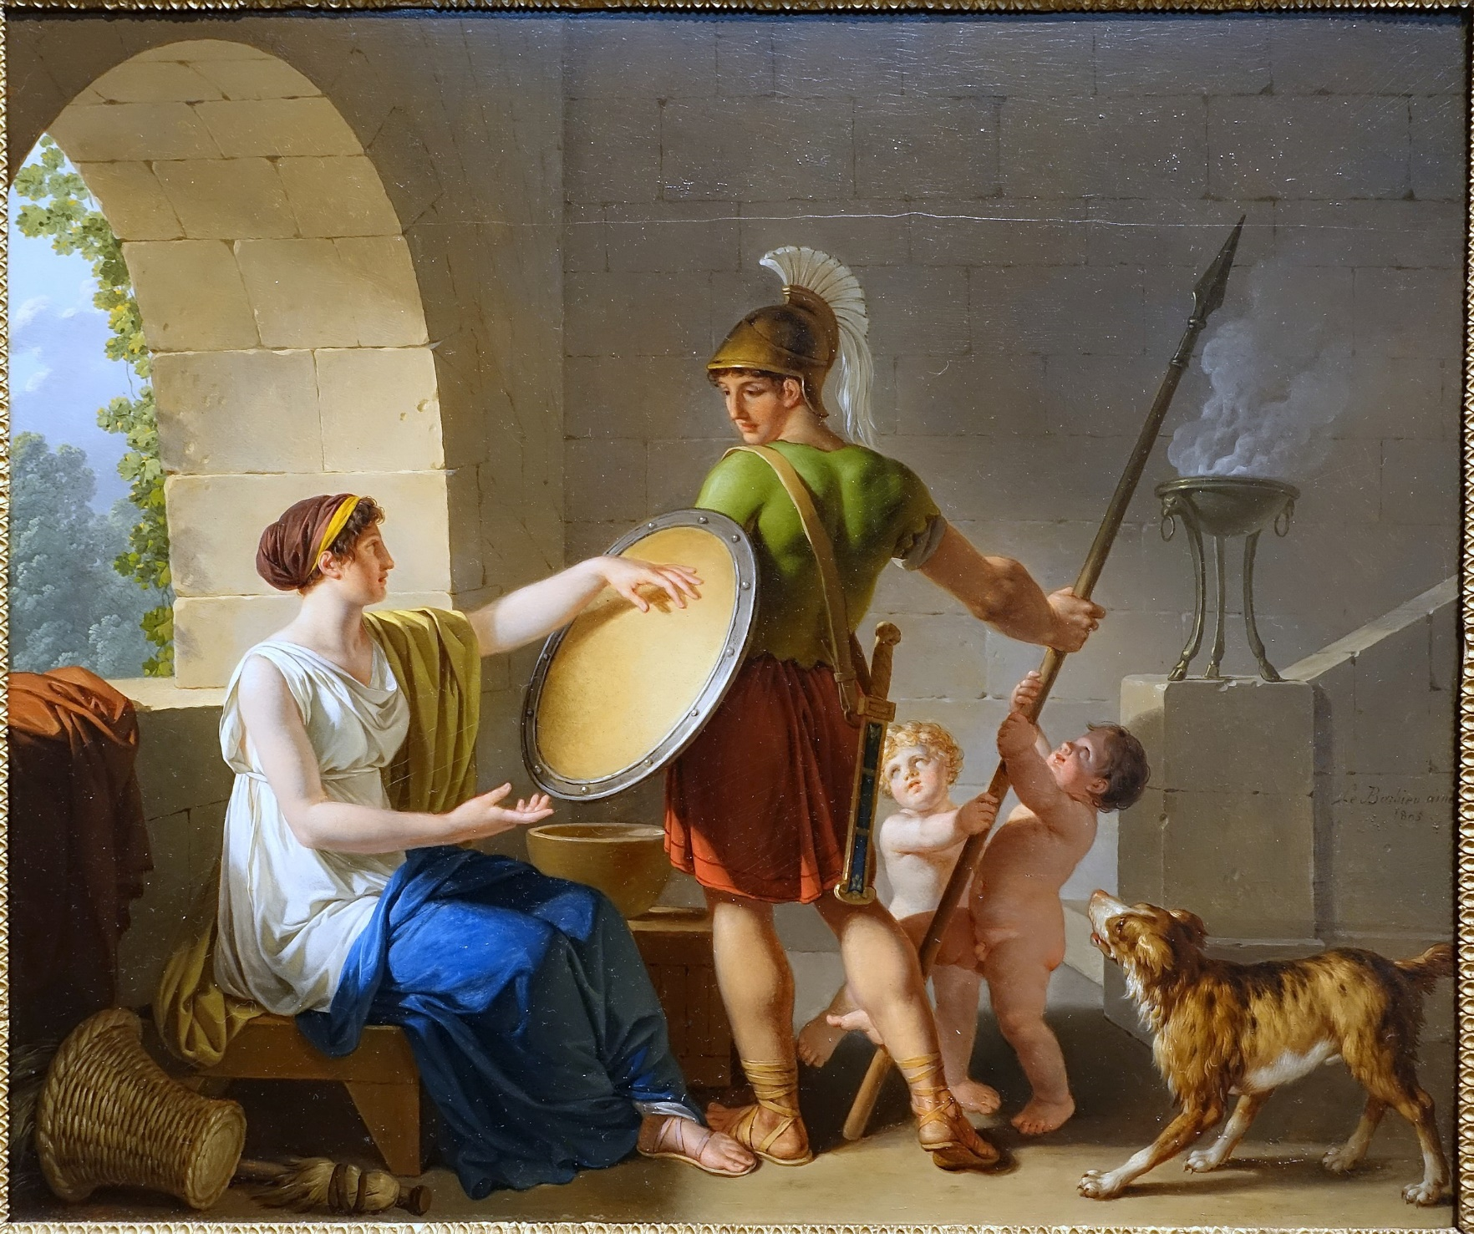
With it or on it!
SPARTA
Jean-Jacques-François Le Barbier , A Spartan Woman Giving a Shield to Her Son (1805)

Slide 53
Greater Emphasis on the Education of Women
Platt Powell Ryder, The Illustrated Newspaper

Slide 54
While Abigail Adams never voted in an election, she was her husband’s most trusted political advisor.
Thomas Jefferson also corresponded with her about political matters.

Slide 55
AGRARIANISM

Slide 56
“Those who labor in the earth are the chosen people of God…”
Thomas Jefferson
Notes on the State of Virginia

Slide 57
[r]epublicanism

Slide 58
SIMPLICITY
Photo by jcookfisher

Slide 59
George Washington [r]epublican Soldier
Photo by Elliott Brown

Slide 60
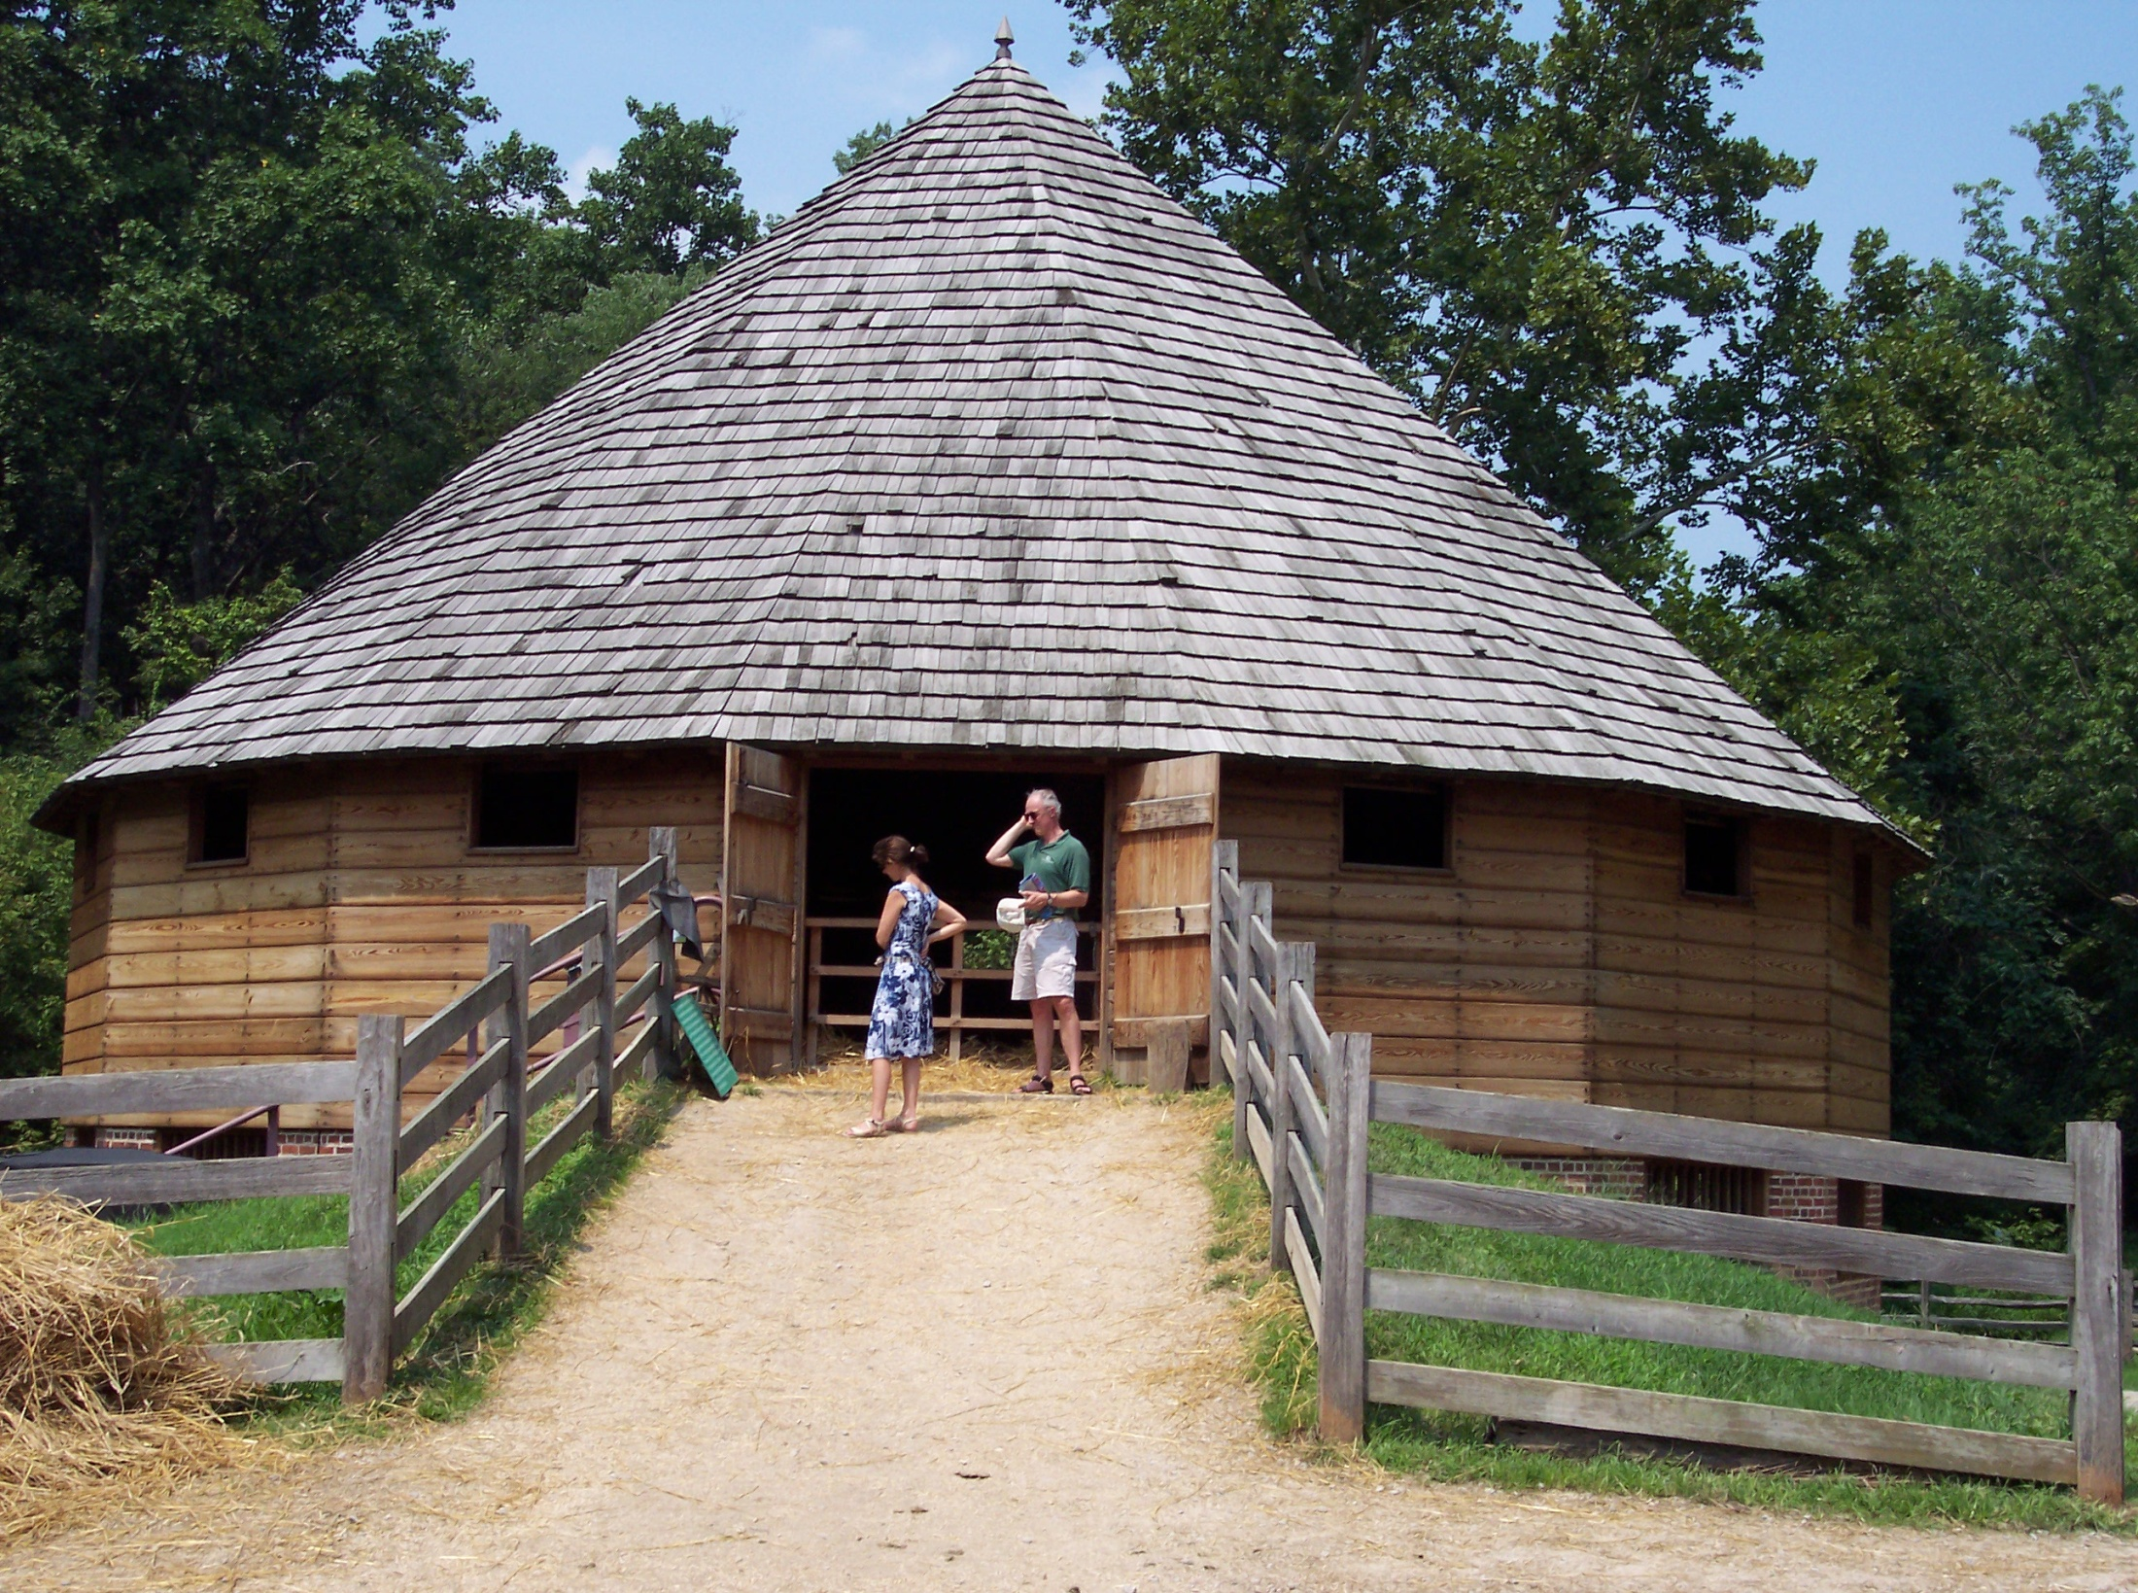
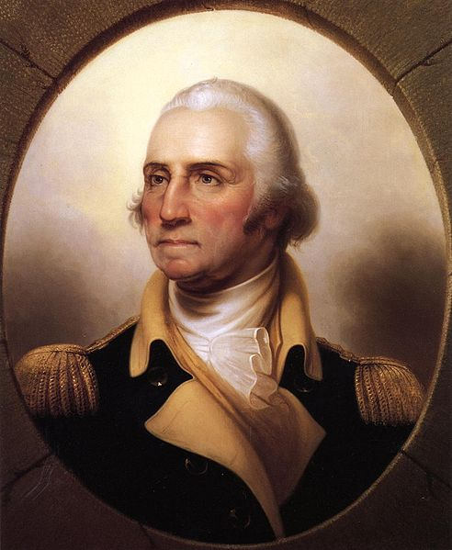
16
George Washington designed a sixteen-sided barn for threshing wheat at his Mount Vernon plantation.

Slide 61
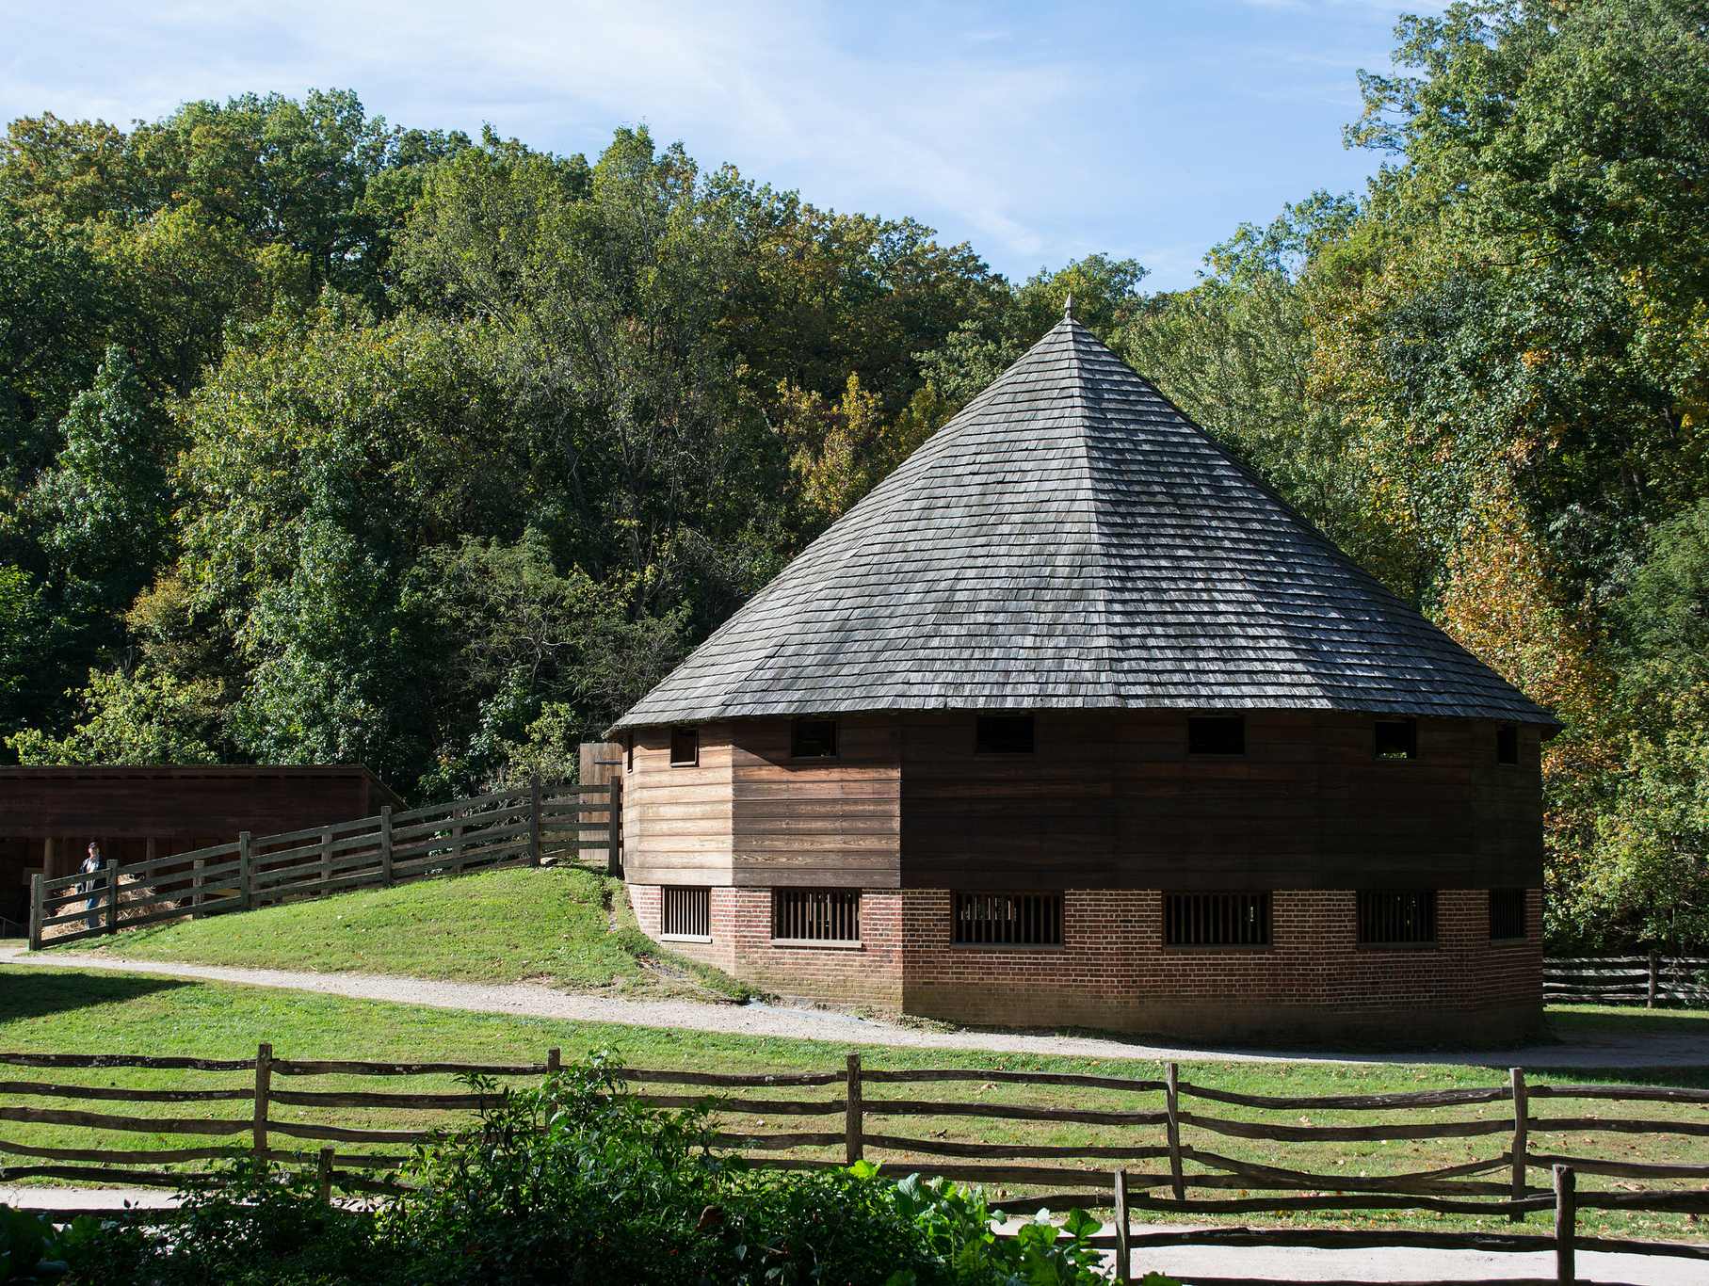
There is not a more beautiful barn in existence anywhere in the world today.
Photo by Tim Evanson

Slide 62
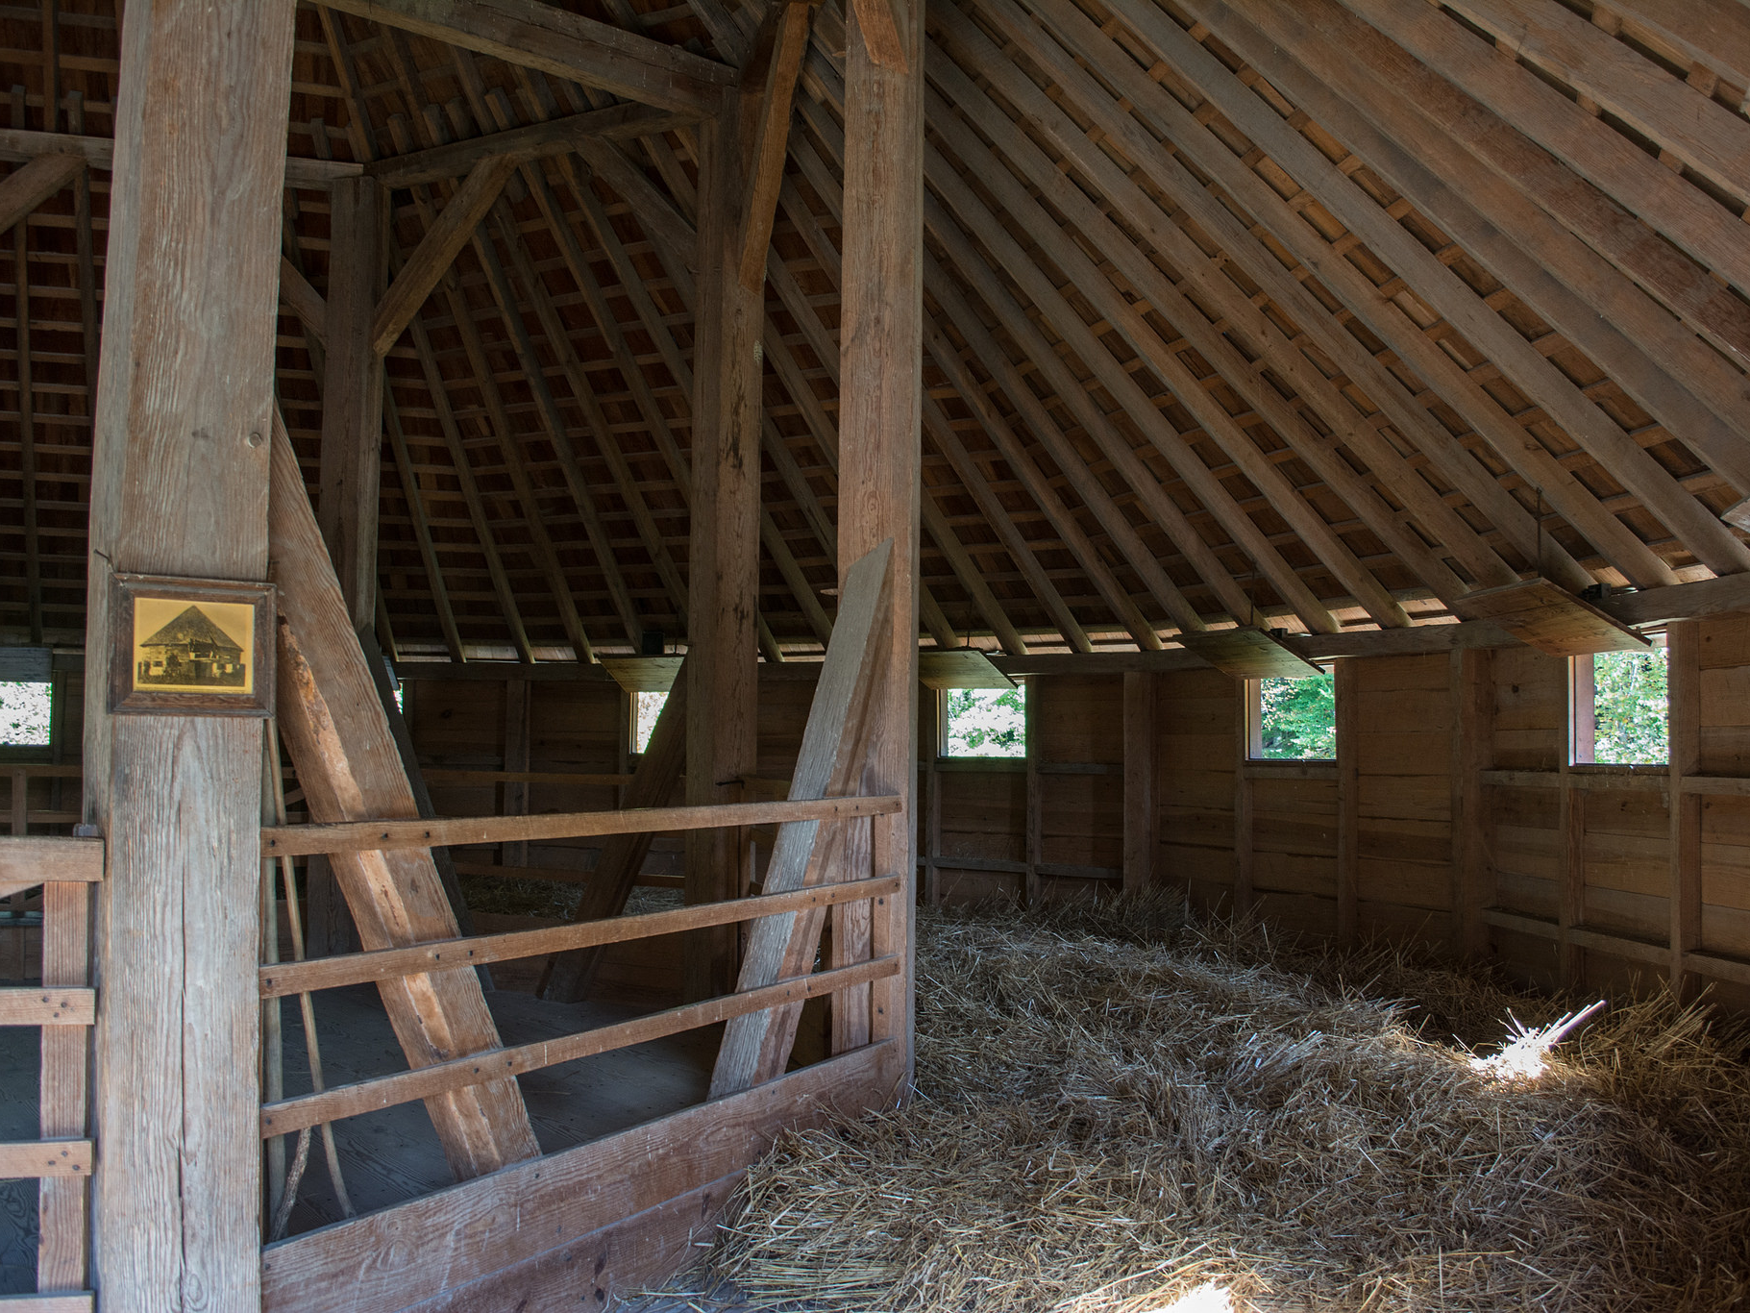
Photo by Tim Evanson

Slide 63
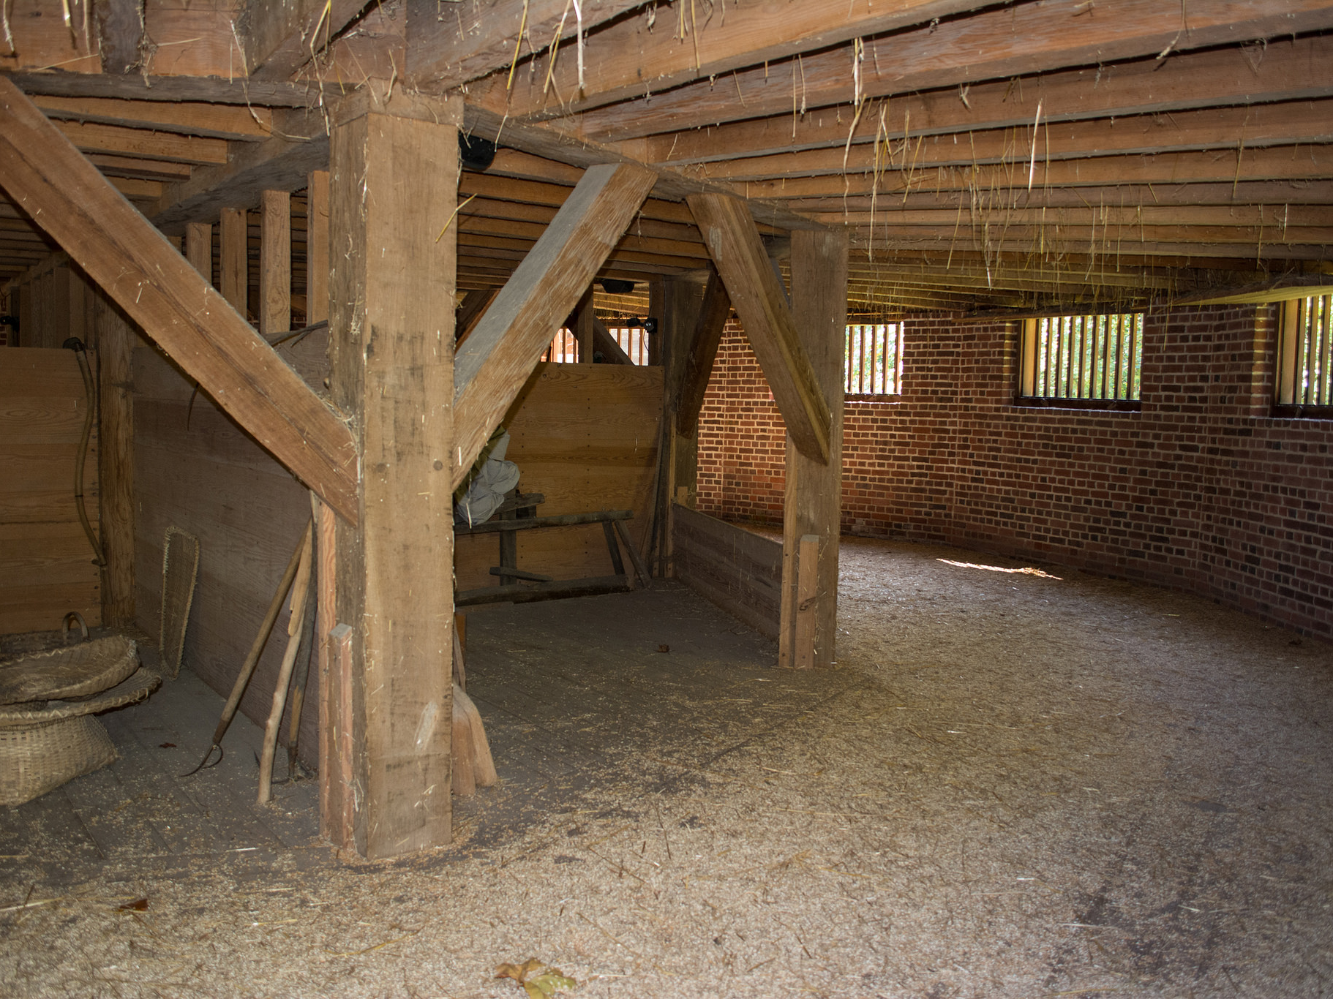
Photo by Tim Evanson

Slide 64
Houdon’s Washington
Houdon’s sculpture of Washington was intended to be a realistic and republican portrayal of the general.
Photo by Wknight94

Slide 65
Houdon’s Washington
[r]epublican simplicity
Photo by Wknight94

Slide 66
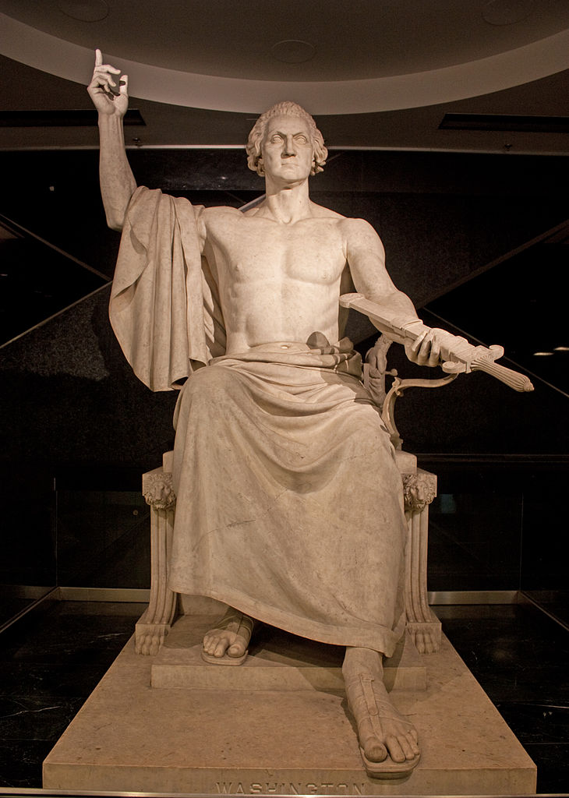
NOT a [r]epublican Portrayal
This 1840 sculpture by Horatio Greenough was not well-received by the American public.
Photo by Wknight94

Slide 67
I’m so much better and richer than you, but I’m not trying to rub it in your face.
Just remember me as a simple farmer and forget that I’m rich.
Photo by Elliott Brown

Slide 68
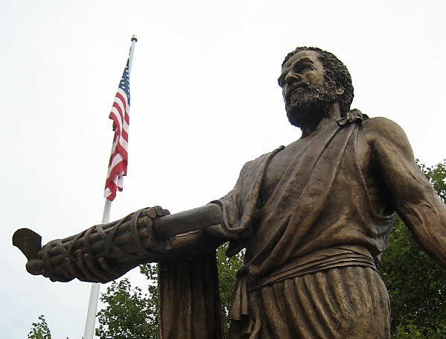
Cincinnatus
Photo by wallyg

Slide 69
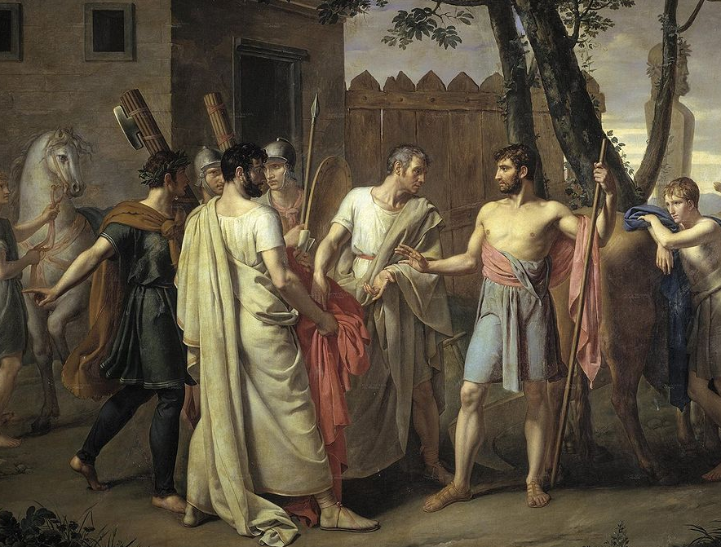
Cincinnatus, an ancient Roman, was made dictator for six months.
He surrendered it after sixteen days.
Cincinnatus leaves the plow for the Roman dictatorship – Juan Antonio Ribera, c. 1806

Slide 70
Rotation in Office

Slide 71
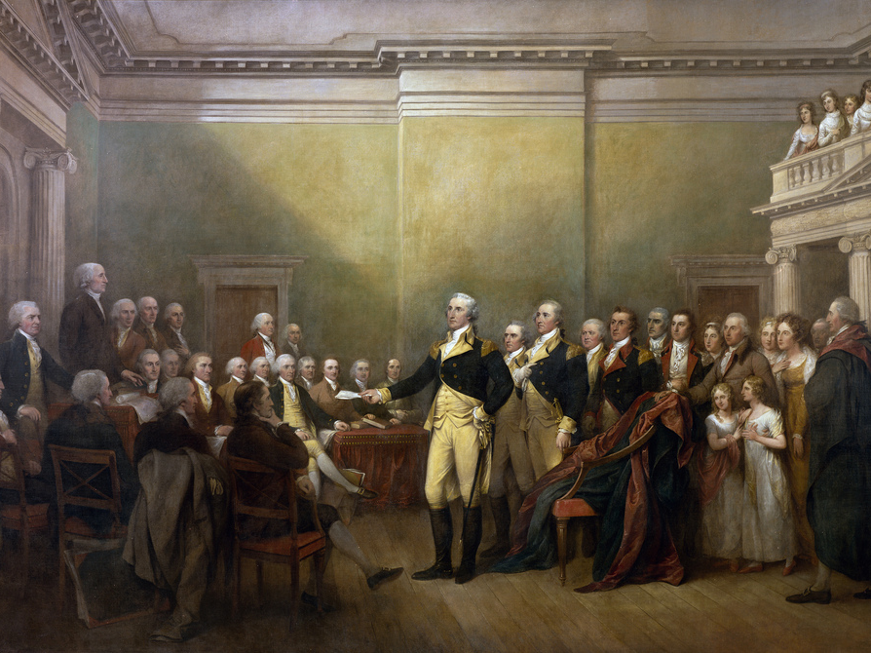
"American Cincinnatus"
“General George Washington Resigning His Commission”
John Trumbull, 1824

Slide 72
Two-Term PRECEDENT for presidents
Washinton voluntarily stepped down after two terms as president, exhibiting the republican tradition of rotation in office.

Slide 73
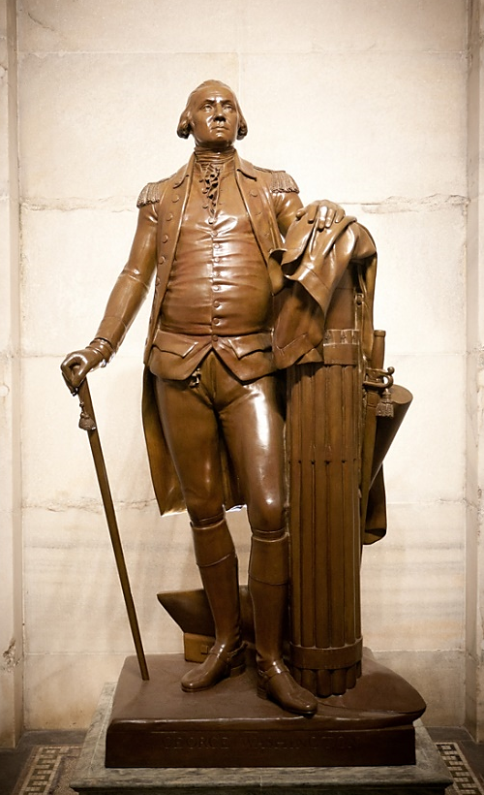
Houdon’s Washington
Statue of Cincinnatus
Cincinnati, OH
Photo by Charlie Williams
Fasces
Fasces
Plow
Plow
Washington, as sculpted by
Jean-Antoine Houdon
Photo by amanderson2

Slide 74
FARMER
Photo by Elliott Brown

Slide 75
SOLDIER
Photo by Elliott Brown

Slide 76
LEGEND
Photo by Elliott Brown

Slide 77
REVIEW

Slide 78
[r]epublicanism
Egalitarianism
Emancipation
Religious Freedom
Women’s Rights
Agrarianism
Simplicity

