Slide 1
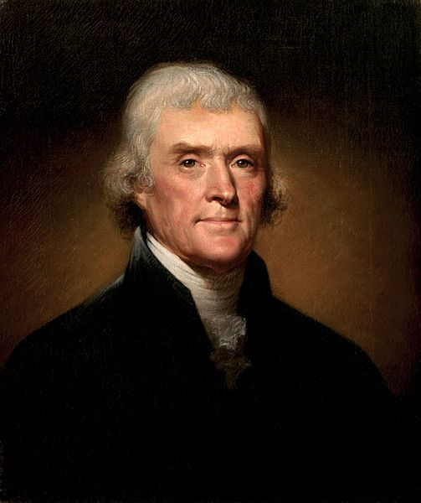

The TRIUMPH of the Jeffersonians

Slide 2

USHC 2.1
Summarize the impact of the westward movement on nationalism and democracy… as the result of major land acquisitions such as the Louisiana Purchase…

Slide 3
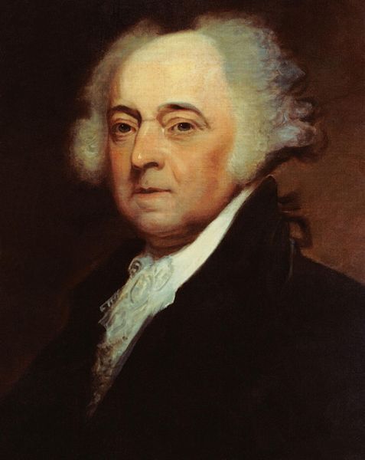
REMATCH
Jefferson vs. Adams

Slide 4
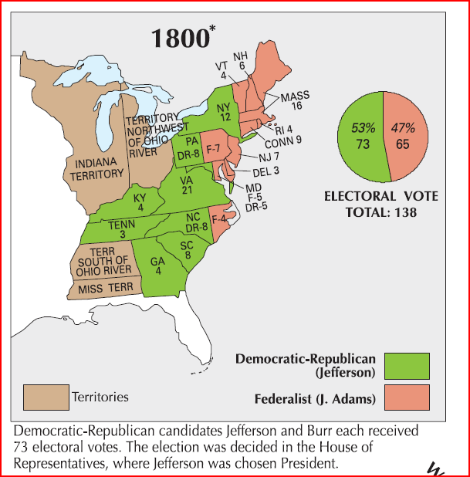

1800
1804
1808
1812
1816
1820

Slide 5
The Electoral College
Candidate | Party | State | Votes
Thomas Jefferson | [Jeffersonian] Republican | VA | 73
Aaron Burr | [Jeffersonian] Republican | NY | 73
John Adams | Federalist | MA | 65
Charles C. Pinckney | Federalist | SC | 64
John Jay | Federalist | NY | 1

Slide 6
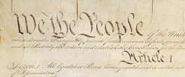
The Twelfth Amendment
DISTINCT BALLOTS
for president and vice president

Slide 7


Slide 8
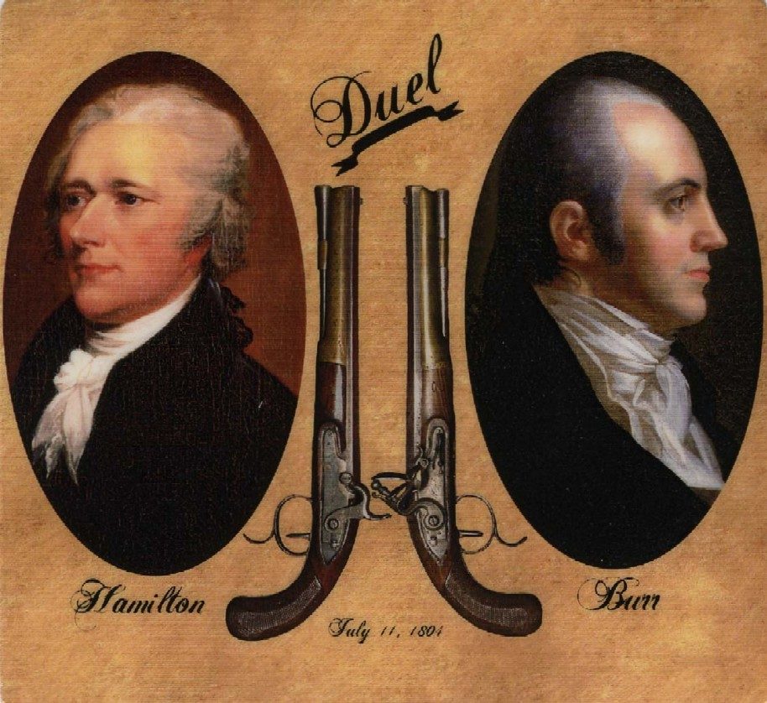


Slide 9
“We are all Republicans, we are all Federalists.”
-- First Inaugural Address

Slide 10
Jeffersonian Principles From Jefferson’s First Inaugural Address
“We are all republicans, | We are all federalists.”
REPublic = Government by REPresentatives | Division of power between state governments and the central government
(Difference is by Degree) | (Difference is by Degree)

Slide 11
Jeffersonian Principles From Jefferson’s First Inaugural Address
“We are all republicans, | We are all federalists.”
DOMESTIC POLICY (Discontinuity) | FOREIGN POLICY (Continuity)
“A wise and frugal Government, which shall restrain men from injuring one another, shall leave them otherwise free to regulate their own pursuits of industry and improvement…” | “…peace, commerce, and honest friendship with all nations, entangling alliances with none.”

Slide 12
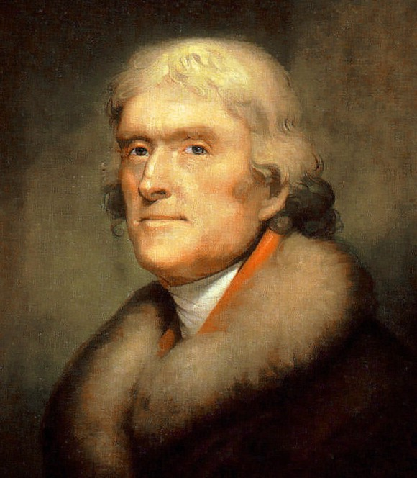

The Louisiana Purchase

Slide 13
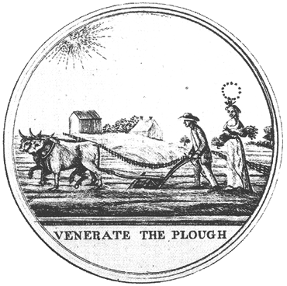

Slide 15
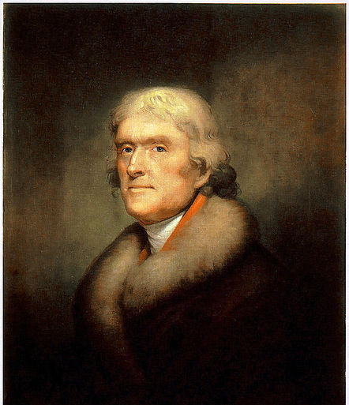

QUESTIONS:
Where, in the Constitution, is the power delegated to the President to add land to the United States?
To what extent did Jefferson compromise his strict constructionist principles by purchasing Louisiana?

Slide 16

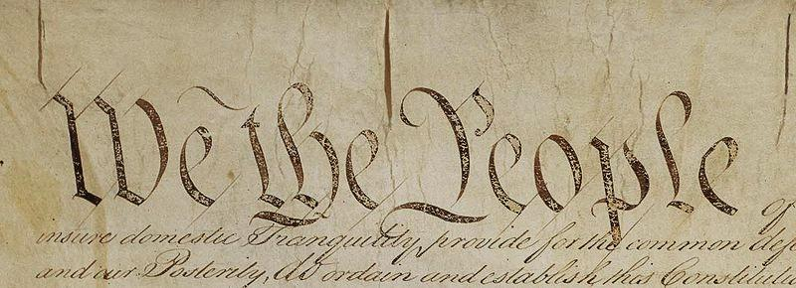
From Article II,
Section 2
[The President] shall have Power, by and with the Advice and Consent of the Senate, to make Treaties, provided two thirds of the Senators present concur...

Slide 17
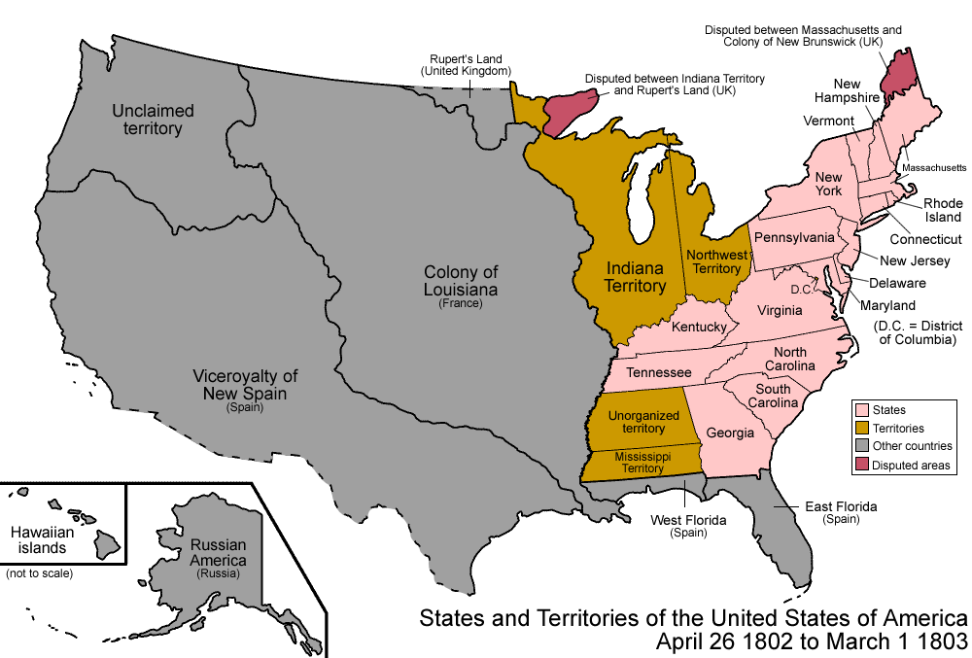
The Louisiana Purchase (1803)

Slide 18
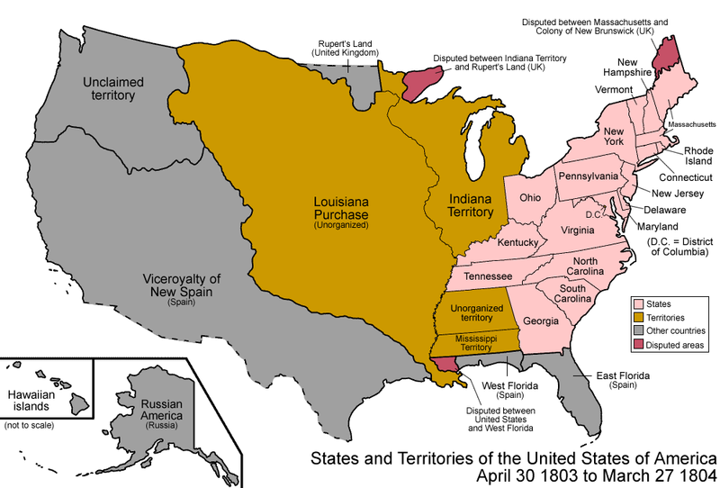
The Louisiana Purchase (1803)

Slide 19
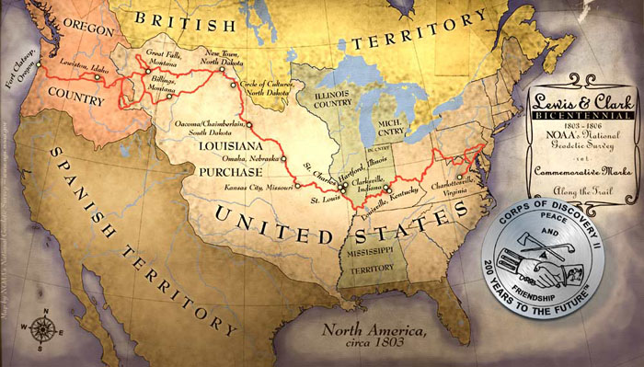

Lewis and Clark Expedition
NORTHWEST PASSAGE?

Slide 20
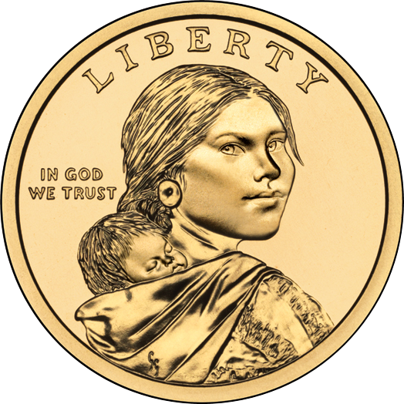

Slide 21







